Slide 1
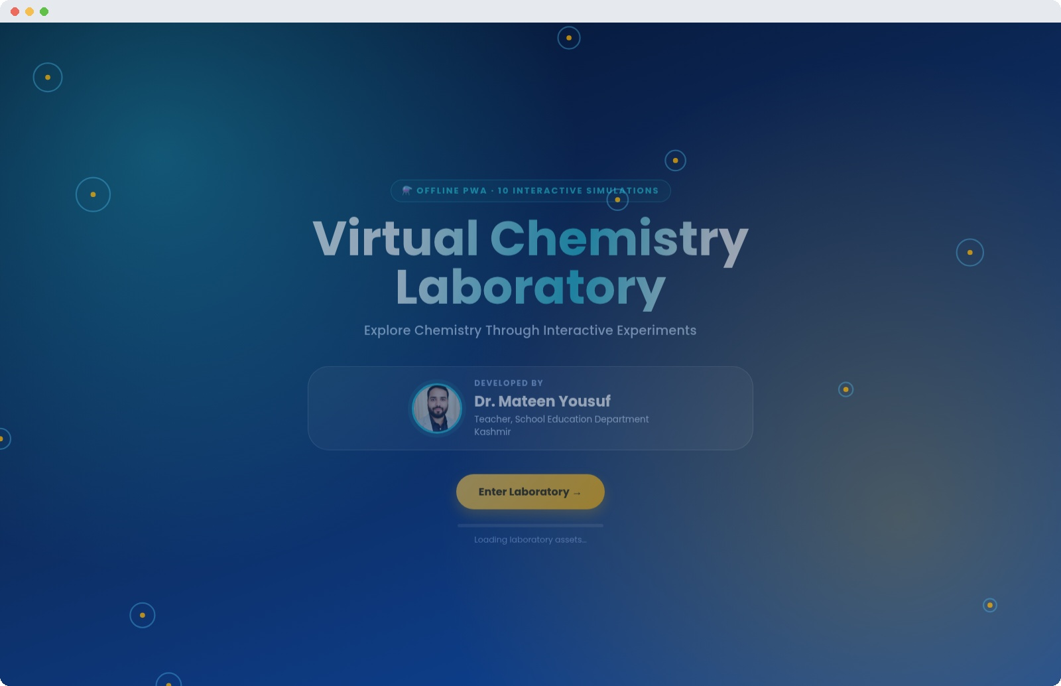

⚗ OFFLINE PWA · 10 INTERACTIVE SIMULATIONS
Virtual Chemistry
Laboratory
Explore Chemistry Through Interactive Experiments
DEVELOPED BY
Dr. Mateen Yousuf
Teacher, School Education Department, Kashmir
A Product Overview & User Guide

Slide 2
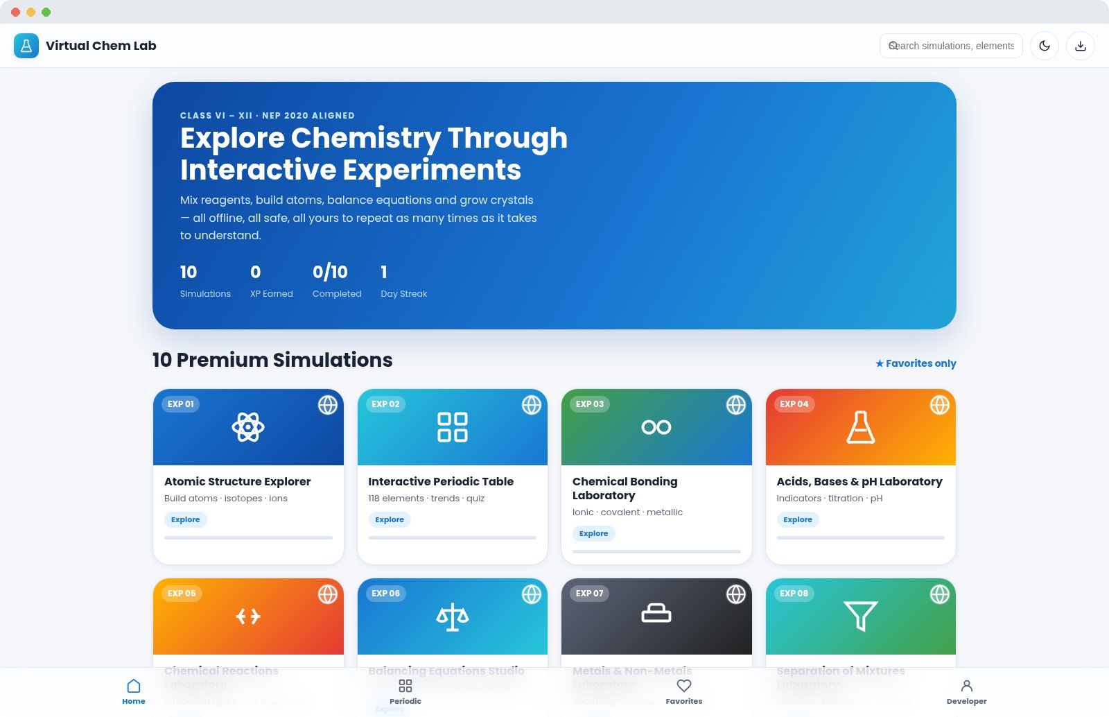
OVERVIEW
What Is the Virtual Chemistry Laboratory?
A fully offline, installable Progressive Web App that turns any classroom, smart board or home device into a working chemistry laboratory. Students don't watch chemistry happen — they run it themselves: build atoms, mix reagents, balance equations and grow understanding through repeated, safe experimentation.
10
100%
118
0
Interactive simulations
Offline after first load
Periodic table elements
Data sent anywhere
Built on HTML5, CSS3 and vanilla JavaScript — no frameworks, no backend, no internet connection required. Every experiment, quiz and reference tool runs entirely in the browser and is installable to a home screen or desktop like a native app.
Virtual Chemistry Laboratory
2

Slide 3

AUDIENCE & PURPOSE
Built for Every Chemistry Classroom
1
Classes VI – XII
2
Teachers & DIET Faculty
Curriculum-aligned experiments across school levels
Ready-made demonstrations, no lab setup required
3
B.Ed. Institutions
4
Science Clubs & Exhibitions
A model for inquiry-based teaching practice
Safe, repeatable, hands-on showcase experiments
Aligned with NEP 2020, competency-based and inquiry-based learning
“This is not a video or animation viewer. Every experiment is fully interactive and responds instantly to student input — designed to be discovered, not memorised.”
Virtual Chemistry Laboratory
3

Slide 4







PLATFORM FEATURES
Everything a Real Lab Offers — Without the Risk
Fully Offline PWA
Deep Interactivity
Gamified Learning
Instant Feedback
Installs to any device; works with zero internet after first load
Sliders, drag targets and live SVG animation in every experiment
XP, streaks, badges and achievements reward genuine exploration
Live observation tables, graphs and quiz explanations
Built-in Reference
Student & Teacher Modes
Adaptive Quizzes
Progress Tracking
Full periodic table, formula handbook and glossary
Extra data and hints unlock for classroom demonstrations
5 explained questions per simulation with instant scoring
Per-simulation completion %, CSV export of observations
Virtual Chemistry Laboratory
4

Slide 5
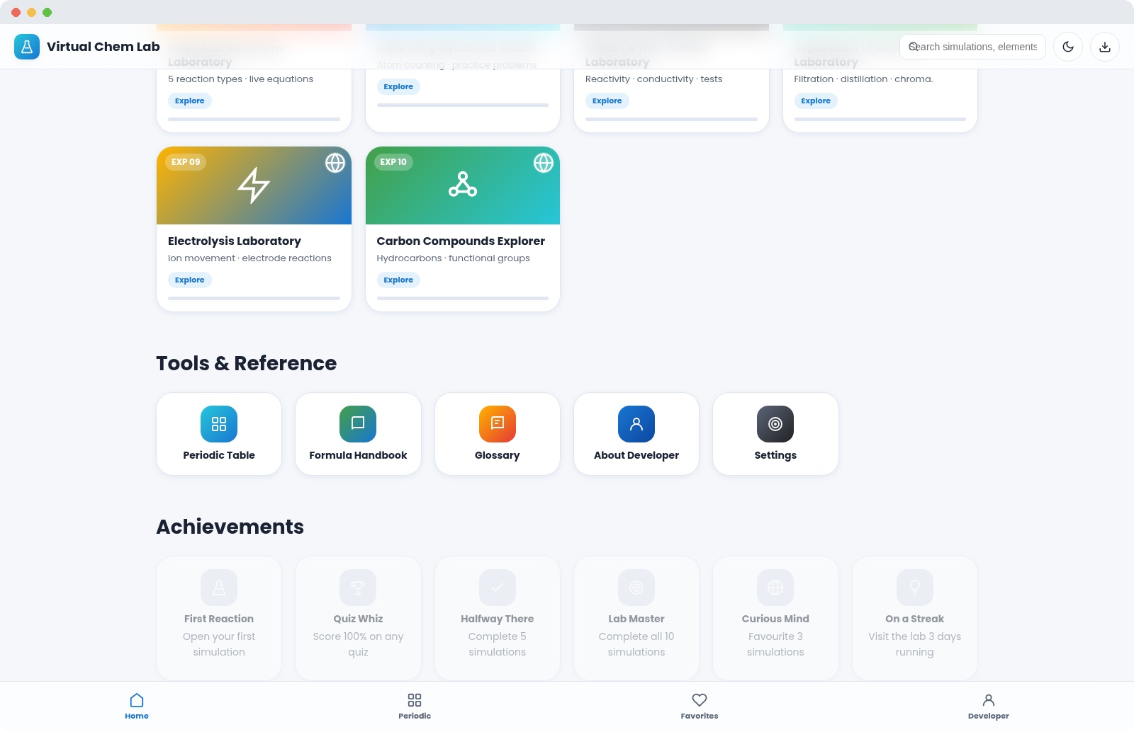
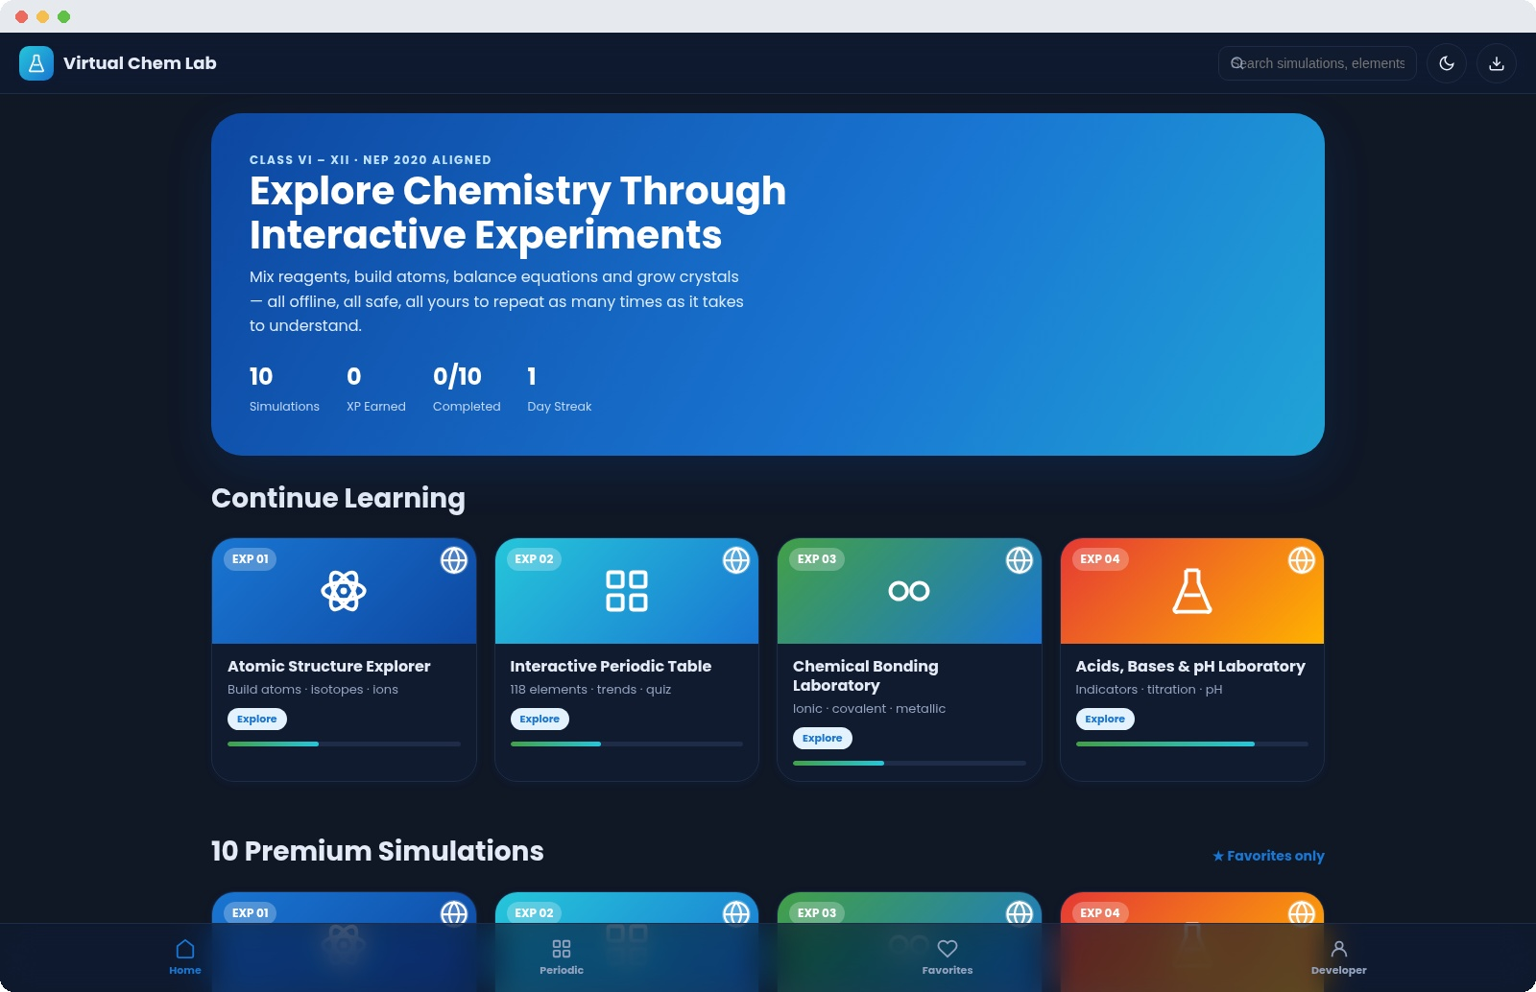
DESIGN SYSTEM
A Premium, Consistent Visual Language
Every screen shares the same glassmorphism cards, rounded corners, soft shadows and scientific colour palette — deep navy, electric blue, cyan, emerald and amber — with full dark-theme support for low-light classrooms and smart boards.
Light theme — tools, reference & achievements
Dark theme — same layout, smart-board friendly
Virtual Chemistry Laboratory
5

Slide 6
HOW TO USE — GETTING STARTED
From Splash Screen to First Experiment
1
Open the App
Launch from a browser or an installed home-screen icon — no login, no internet needed.
2
Enter the Laboratory
The animated splash screen introduces the app and developer, then hands off to the dashboard.
3
Browse or Search
Scroll the 10 simulation cards, use the search bar, or jump back in via Continue Learning.
4
Pick a Simulation
Tap any card to open its dedicated workspace with seven guided tabs.
5
Experiment Freely
Adjust sliders, mix reagents and reactants — the stage responds instantly, every time.
Virtual Chemistry Laboratory
6

Slide 7
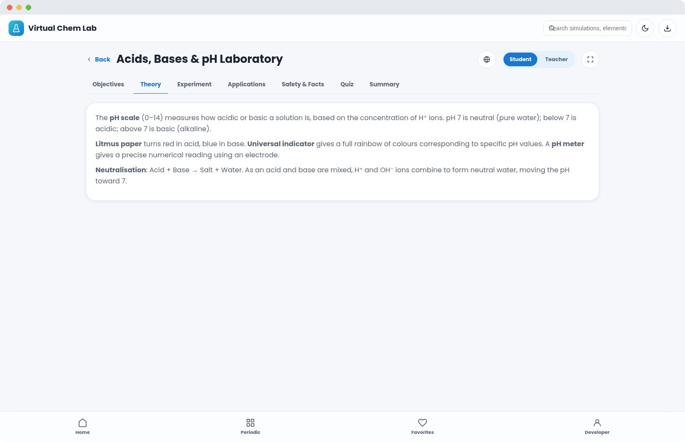
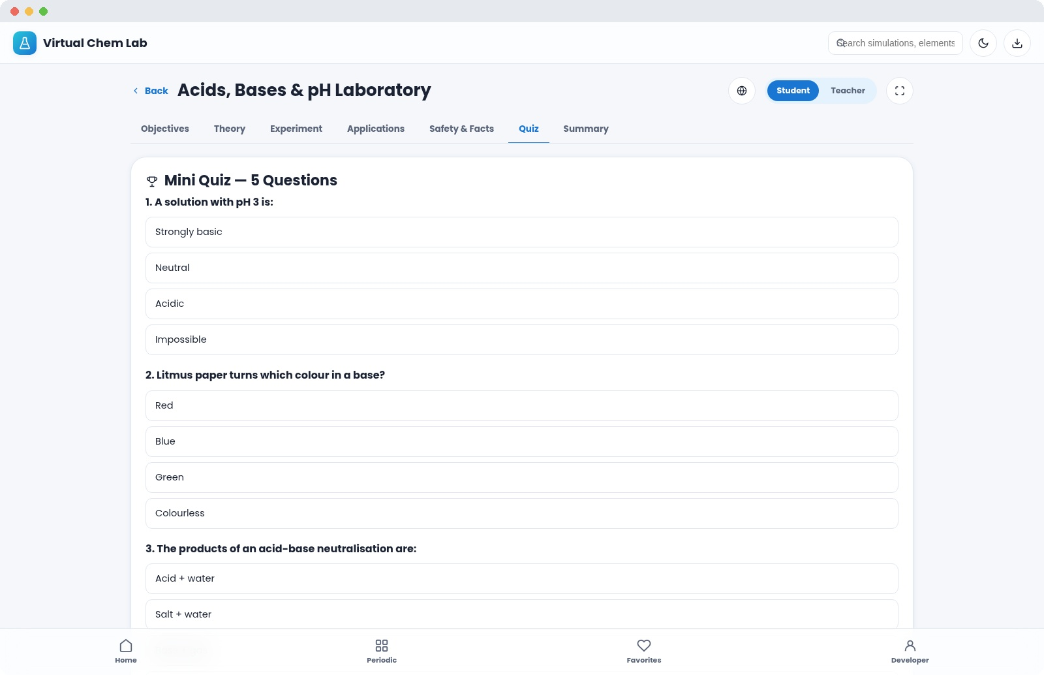
HOW TO USE — INSIDE EVERY SIMULATION
Seven Tabs, One Consistent Workflow
Every one of the 10 simulations follows the exact same structure, so once a student learns one, they can navigate all ten confidently:
1
Objectives
Clear learning goals and a plain-language introduction
2
Theory
The science behind the experiment, explained simply
3
Experiment
The live, interactive stage — the heart of each simulation
4
Applications
Real-world relevance, from industry to everyday life
5
Safety & Facts
Safety guidelines, common mistakes, fun facts
6
Quiz
5 explained questions with instant, honest feedback
7
Summary
A wrap-up plus one-tap 'mark complete' for progress tracking
Virtual Chemistry Laboratory
7

Slide 8
HOW TO USE — FINDING YOUR WAY
Simple Navigation, Always Within Reach
Top Bar
Search box, dark/light toggle and one-tap install button on every screen
Home
Hero banner, Continue Learning, all 10 simulations, tools and achievements
Periodic (bottom nav)
Jumps straight to the full 118-element reference table
Favourites (bottom nav)
Star any simulation to pin it here for quick access
Developer (bottom nav)
About page with vision, credentials and pedagogy notes
Virtual Chemistry Laboratory
8

Slide 9
PART TWO
The 10 Premium Simulations
A guided tour of every experiment — what students do, and what they learn

Slide 10

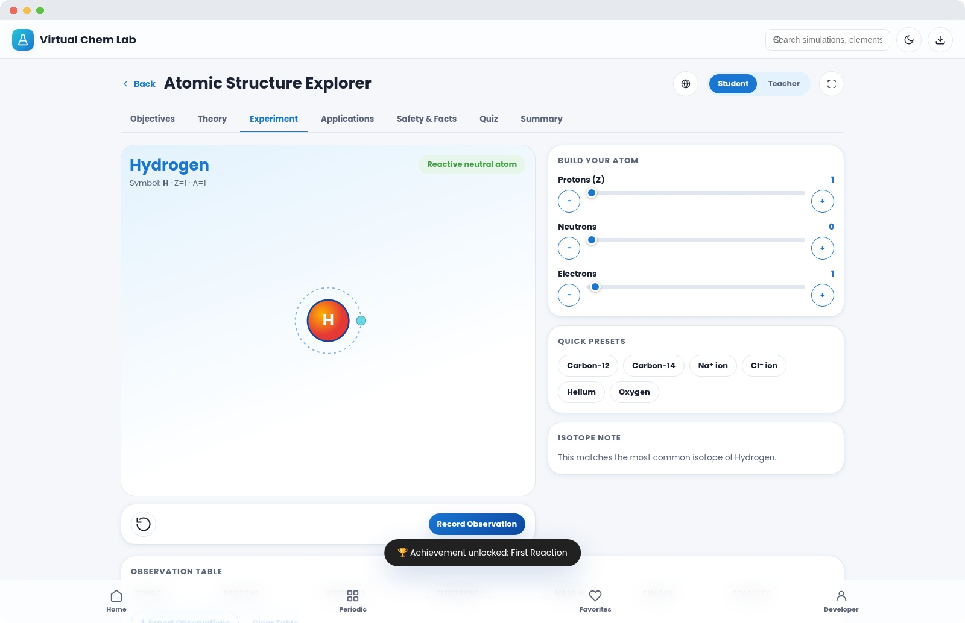
EXPERIMENT 01 / 10
Atomic Structure Explorer
Build any atom from scratch, one particle at a time, and watch stability, isotopes and ions appear instantly.
Add or remove protons, neutrons & electrons with live sliders
Real-time Bohr shell diagram with animated electrons
Instant element identification, isotope & ion detection
Quick presets: Carbon-12 / Carbon-14, Na⁺, Cl⁻, Helium, Oxygen
Virtual Chemistry Laboratory
10

Slide 11

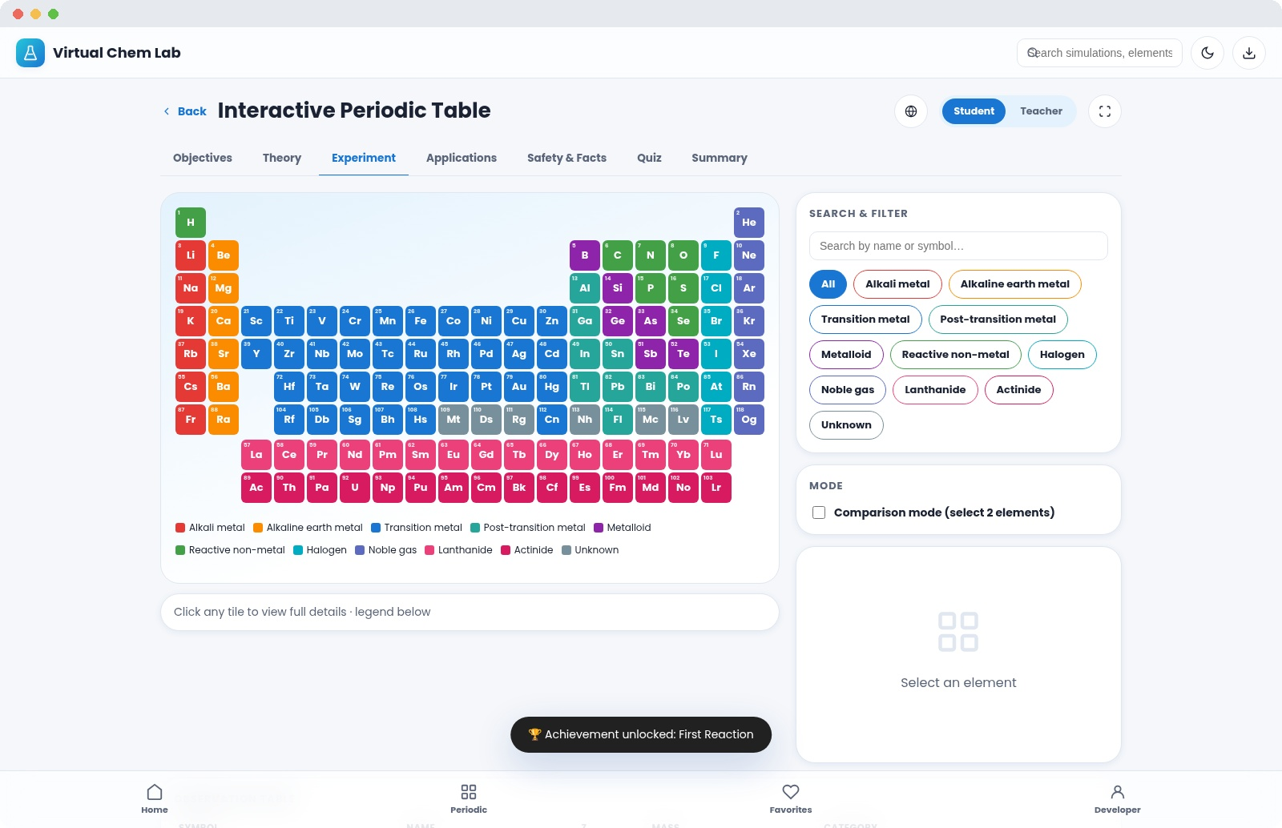
EXPERIMENT 02 / 10
Interactive Periodic Table
All 118 elements, live and clickable, with search, category filters and a side-by-side comparison mode.
Full periodic grid, colour-coded by element category
Search by name or symbol, or filter by family
Click any tile for mass, period, group & shell data
Comparison mode: select two elements to contrast directly
Virtual Chemistry Laboratory
11

Slide 12

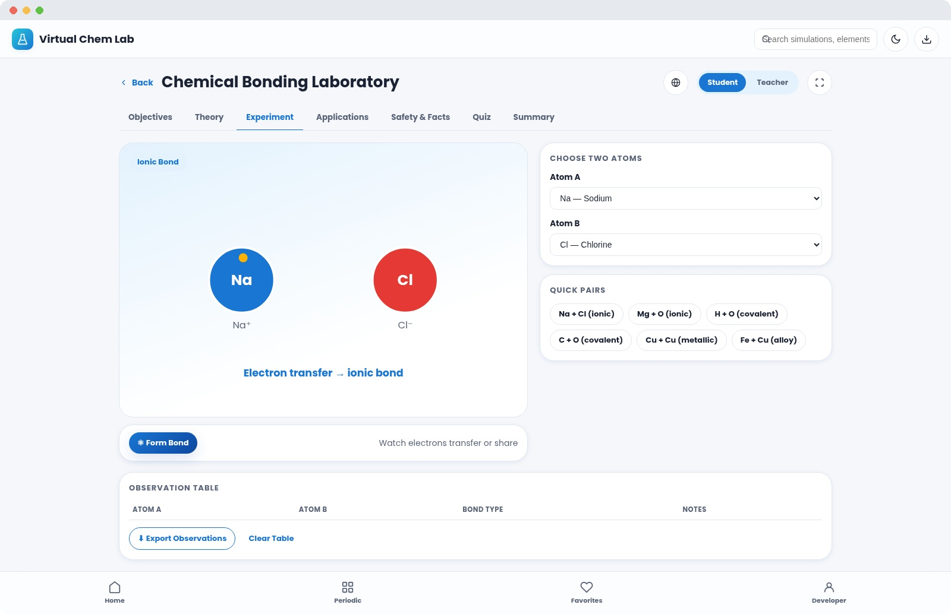
EXPERIMENT 03 / 10
Chemical Bonding Laboratory
Pick any two atoms and watch electrons transfer or share in real time to reveal the bond that forms.
Choose from 13 common metal & non-metal atoms
Live electron-transfer animation for ionic bonds
Shared electron-pair animation for covalent bonds
Delocalised "electron sea" view for metallic bonds & alloys
Virtual Chemistry Laboratory
12

Slide 13

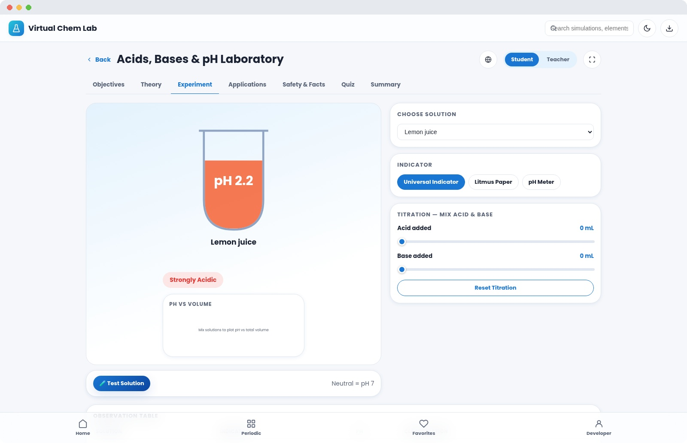
EXPERIMENT 04 / 10
Acids, Bases & pH Laboratory
Test 14 real solutions with three indicator types, then titrate acid into base and watch pH shift live.
Universal indicator, litmus paper & digital pH meter
14 preloaded household and laboratory solutions
Interactive titration sliders with a live pH-vs-volume graph
Instant strongly/weakly acidic, neutral or basic classification
Virtual Chemistry Laboratory
13

Slide 14

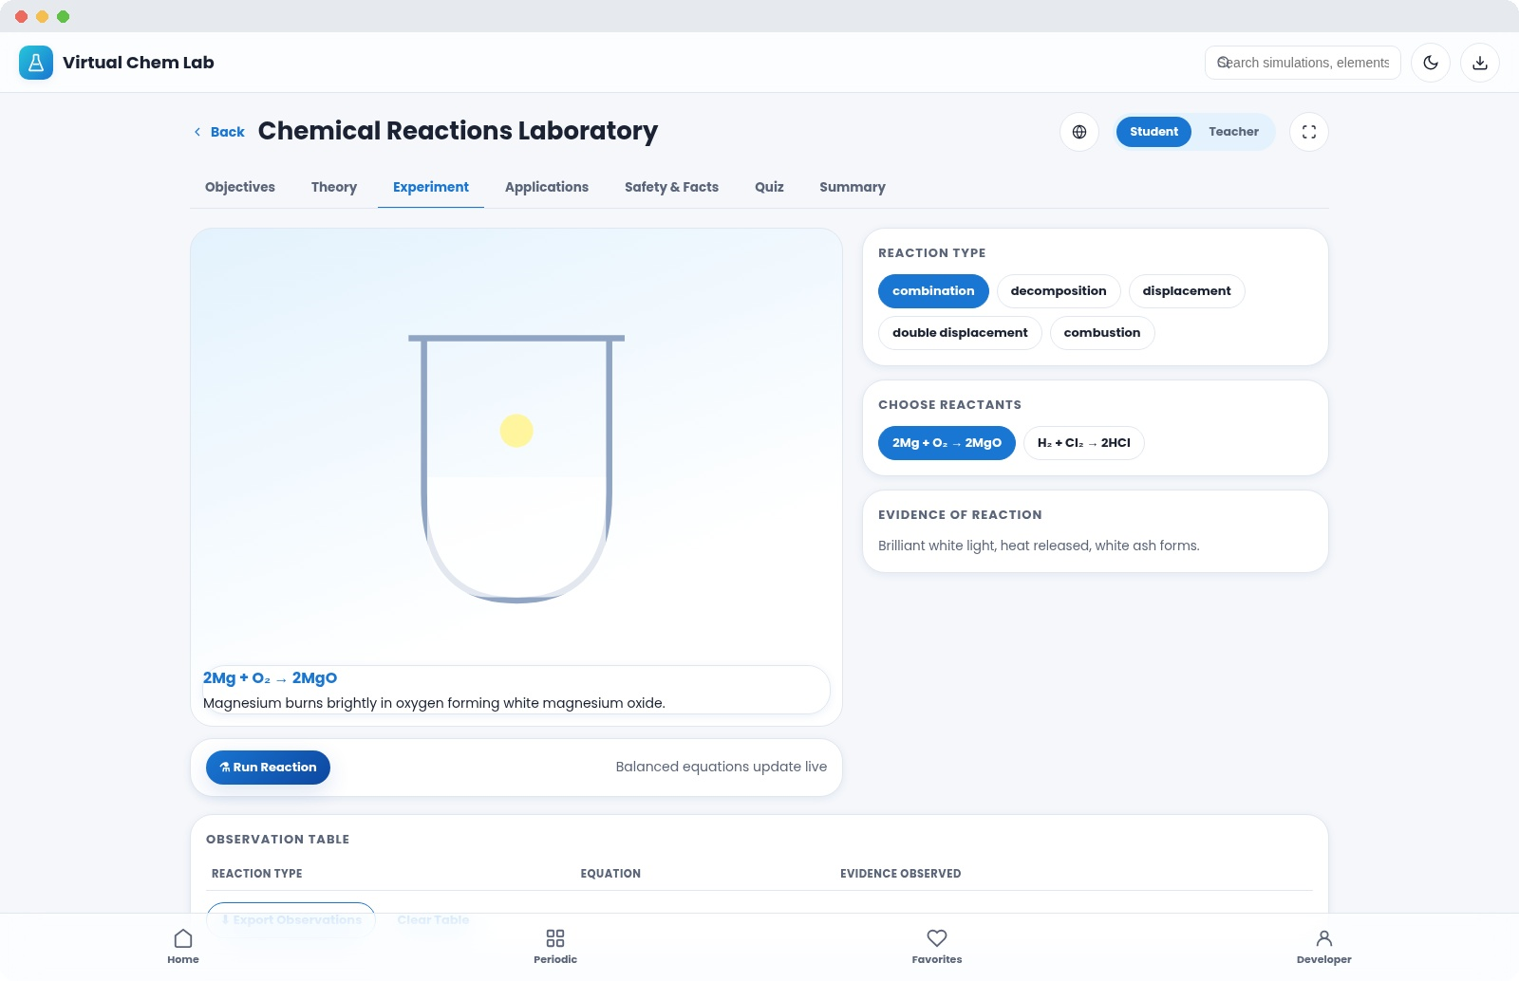
EXPERIMENT 05 / 10
Chemical Reactions Laboratory
Choose a reaction type and reactant pair, then watch the visual evidence unfold in the beaker.
5 reaction types: combination through to combustion
Two real reactant pairs modelled per type
Animated evidence: gas bubbles, flame, precipitate, colour fade
Balanced chemical equations displayed live
Virtual Chemistry Laboratory
14

Slide 15

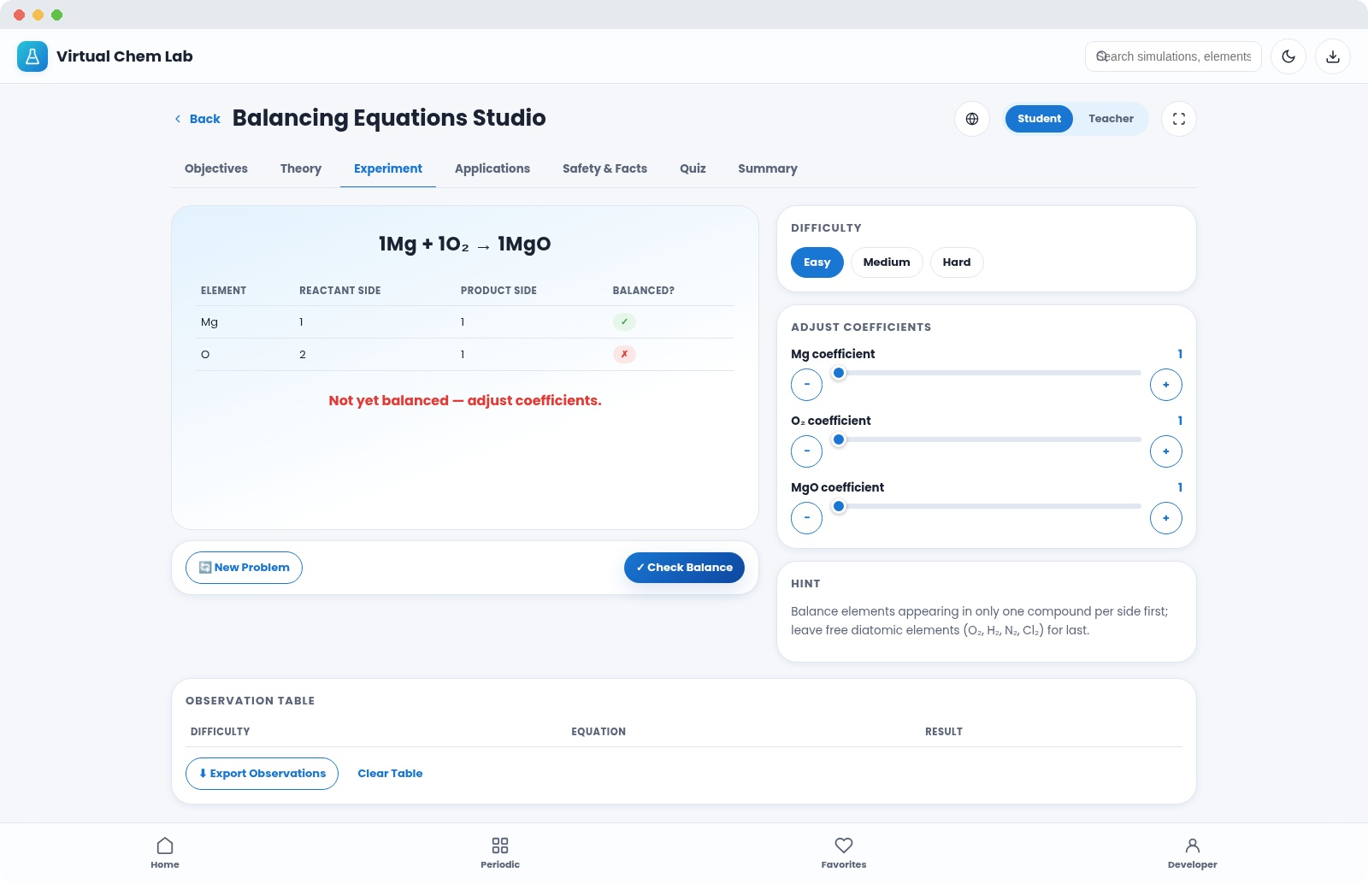
EXPERIMENT 06 / 10
Balancing Equations Studio
Drag coefficients until every atom count matches — with instant validation and three difficulty tiers.
Easy, Medium & Hard auto-generated problem sets
Live per-element atom-count comparison table
Instant "balanced ✓ / not yet ✗" validation
Built-in equation-balancing strategy hints
Virtual Chemistry Laboratory
15

Slide 16

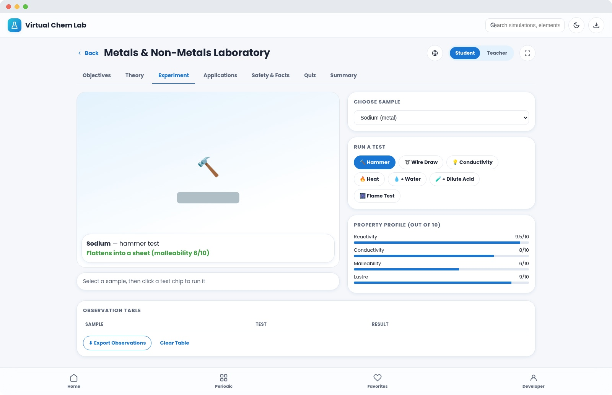
EXPERIMENT 07 / 10
Metals & Non-Metals Laboratory
Run seven virtual tests on nine real samples to build a property profile and rank reactivity.
Hammer, wire-draw, conductivity & heat tests
Reaction with water, dilute acid, and flame test
Live property bars: reactivity, conductivity, lustre, malleability
Compare true metals against non-metals like sulfur & graphite
Virtual Chemistry Laboratory
16

Slide 17

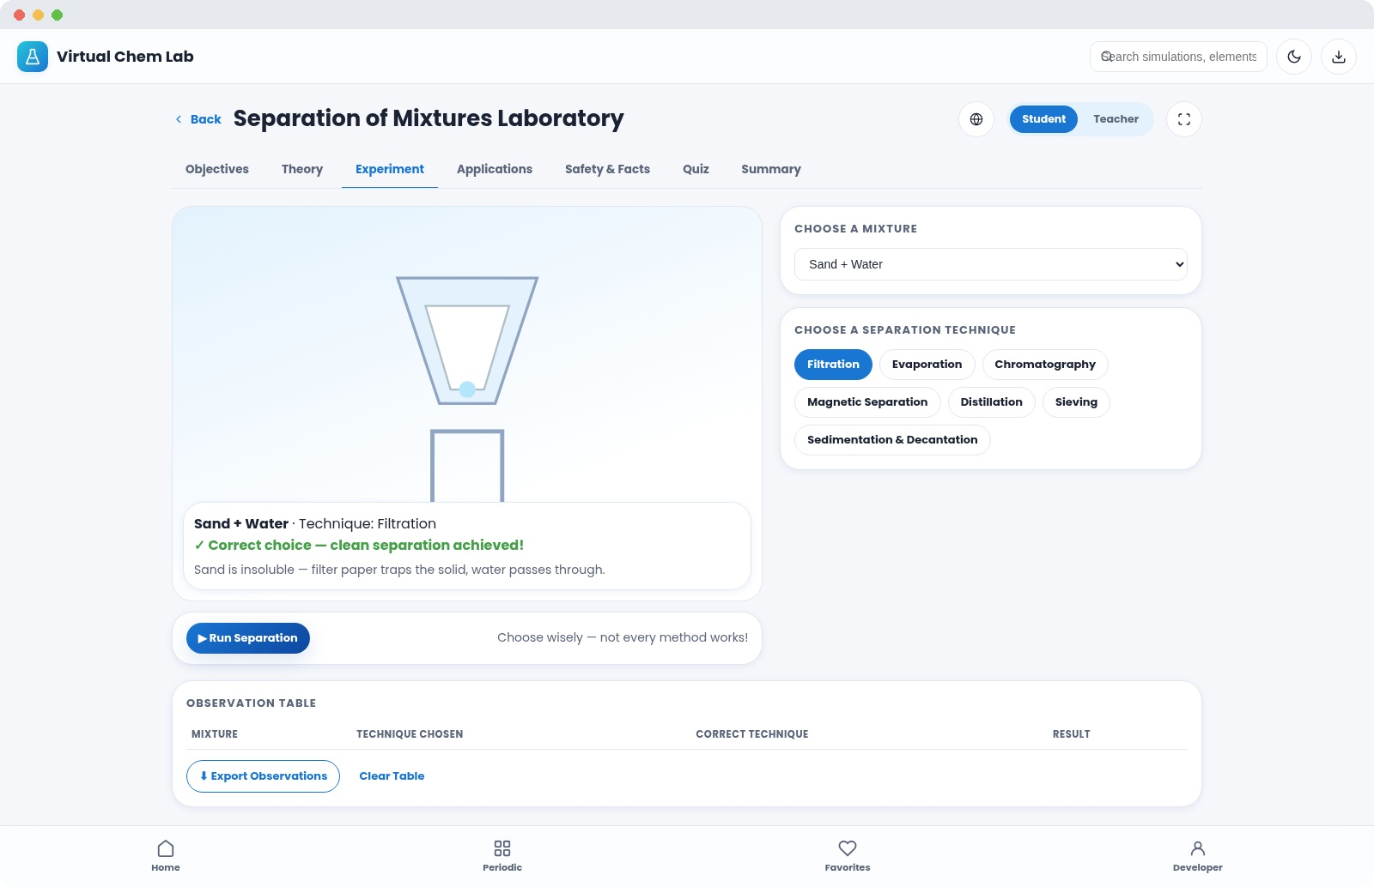
EXPERIMENT 08 / 10
Separation of Mixtures Laboratory
Pick a real mixture, choose your technique, and see whether it actually works — with a clear explanation either way.
7 mixtures: sand-water, ink, muddy water, iodine and more
7 techniques: filtration, evaporation, distillation, chromatography…
Animated apparatus matched to the chosen technique
Instant correct / incorrect feedback with the reasoning behind it
Virtual Chemistry Laboratory
17

Slide 18

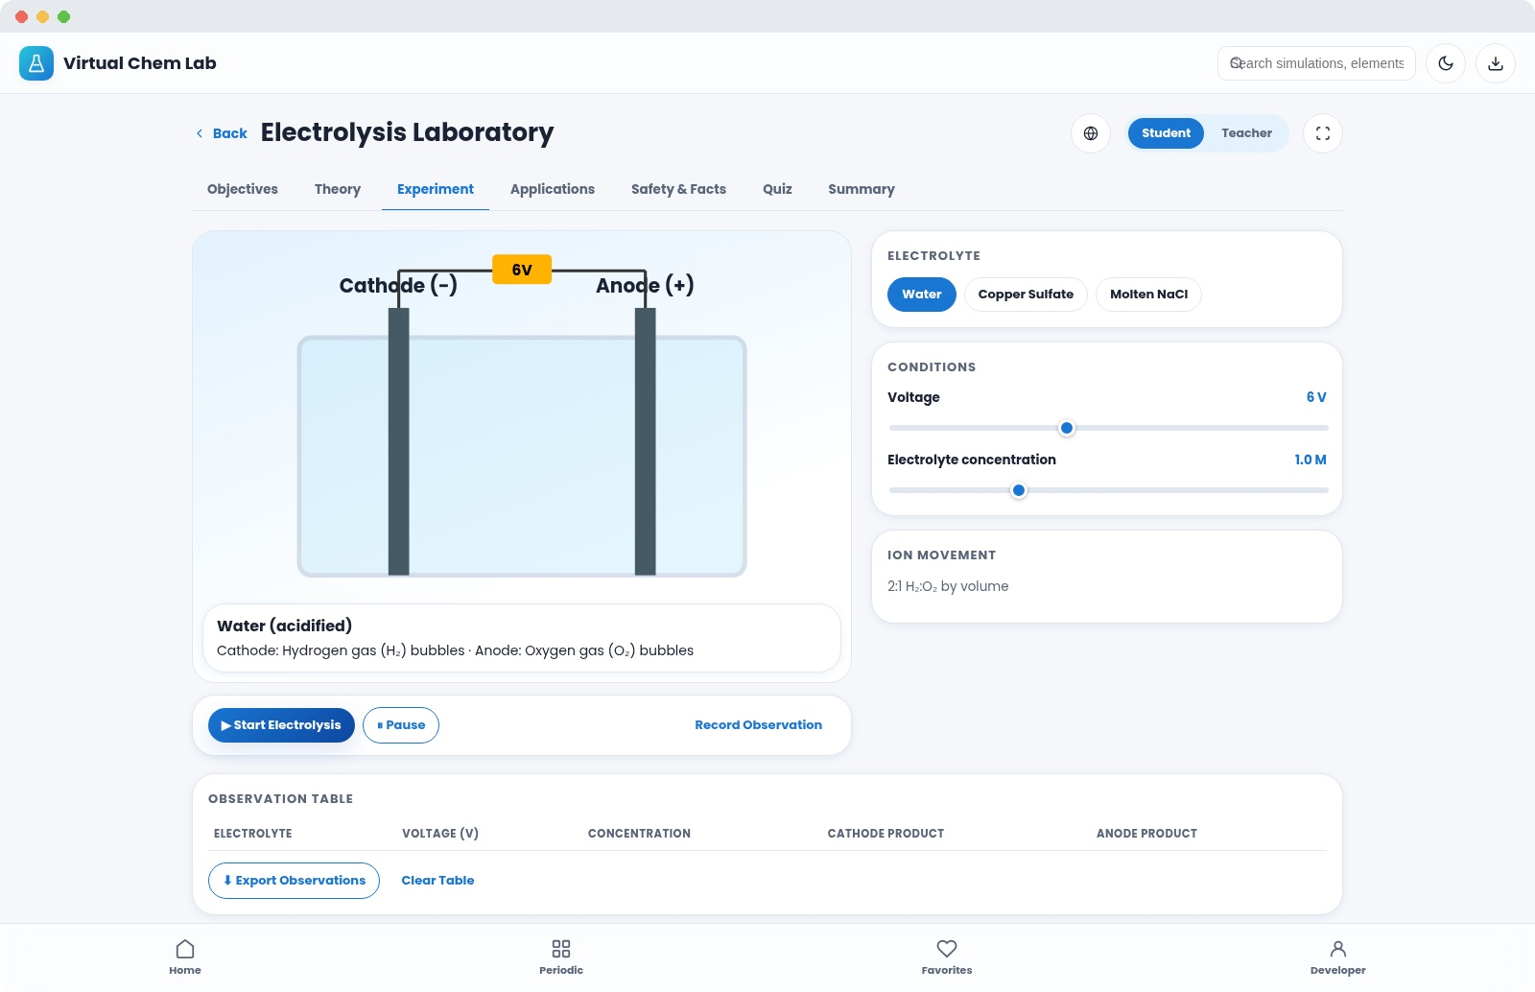
EXPERIMENT 09 / 10
Electrolysis Laboratory
Adjust voltage and concentration and watch ions race to their electrodes in water, copper sulfate or molten salt.
3 electrolytes: water, copper sulfate solution, molten NaCl
Adjustable voltage and electrolyte concentration sliders
Animated ion migration toward cathode & anode
Live cathode / anode product readout for each electrolyte
Virtual Chemistry Laboratory
18

Slide 19

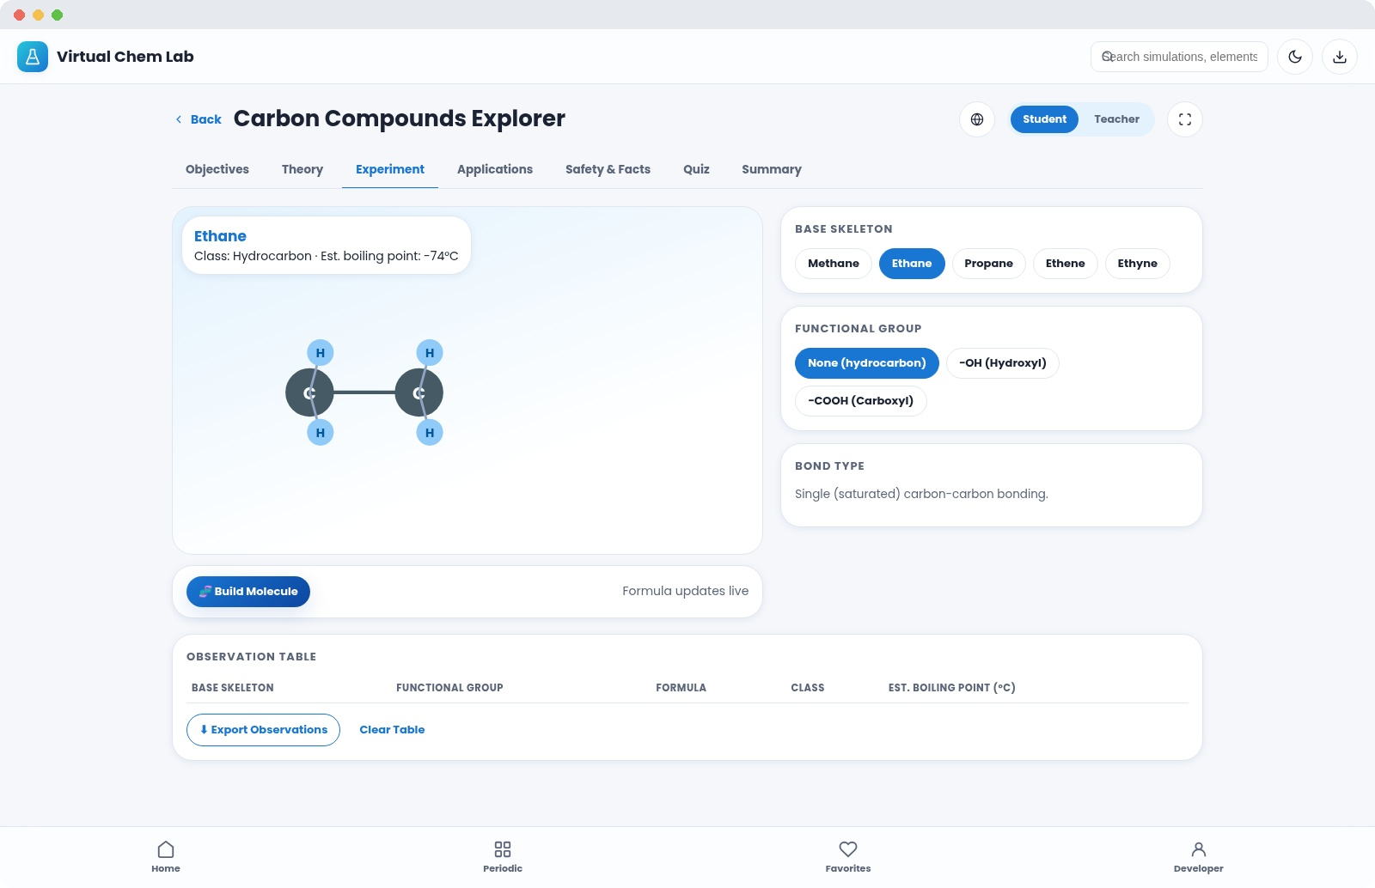
EXPERIMENT 10 / 10
Carbon Compounds Explorer
Build hydrocarbons from methane to ethyne, then attach a functional group and watch the molecule transform.
5 carbon skeletons spanning single, double & triple bonds
Add −OH (alcohol) or −COOH (carboxylic acid) groups live
Auto-generated structural formula and 2D diagram
Estimated boiling-point trend feedback as chains grow
Virtual Chemistry Laboratory
19

Slide 20
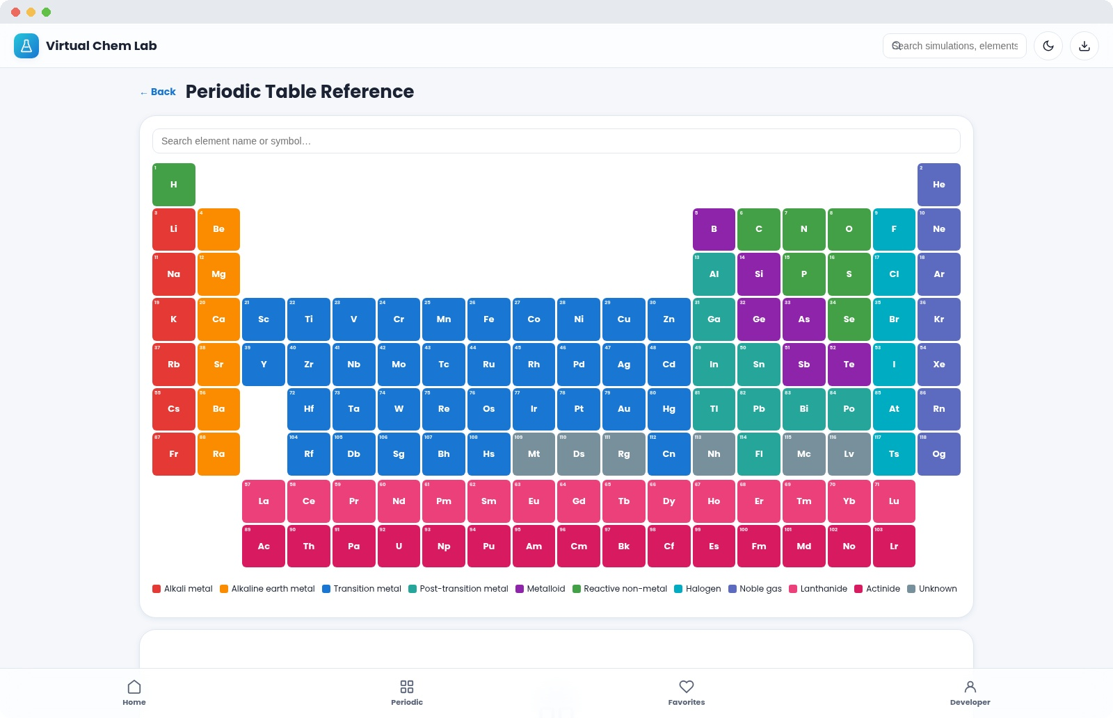
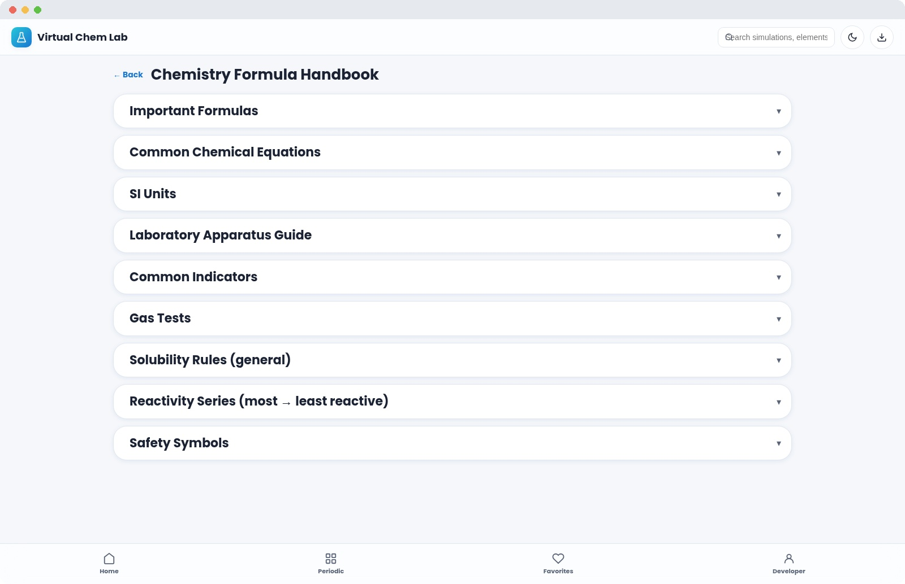
BEYOND THE SIMULATIONS
A Full Reference Library, Built In
Four standalone tools support every simulation — all offline, all searchable, and all just one tap from the home screen.
Periodic Table Reference — full 118-element grid with detail panel
Formula Handbook — equations, SI units, gas tests, safety symbols
Also included: a searchable illustrated Glossary of chemistry terms, and an About Developer page.
Virtual Chemistry Laboratory
20

Slide 21
MOTIVATION & TRACKING
Progress That Motivates, Data That Stays Private
1
2
3
XP & Levels
Achievements
Daily Streaks
Earn points for completing tabs, logging observations and scoring quizzes
6 unlockable badges — from First Reaction to Lab Master
Visit-based streak counter encourages consistent practice
4
5
6
Favourites
Observation Export
100% Local Storage
Star any simulation to pin it to a personal shortlist
Every logged reading can be exported as a CSV file
XP, favourites and progress live only on the student's device
Virtual Chemistry Laboratory
21

Slide 22
Vision for This Project
Make quality, hands-on science education accessible even without a fully equipped physical lab
Align with NEP 2020 through experiential, competency- and inquiry-based learning
Let students explore reactions too hazardous for a real classroom — safely, endlessly
DEVELOPED BY
Dr. Mateen Yousuf
Teacher, School Education Department, Kashmir
Build scientific temper through curiosity, observation and evidence-based reasoning
Virtual Chemistry Laboratory
22

Slide 23
Ready to Enter the Laboratory?
10 simulations · full periodic table · zero internet required
Enter Laboratory →
Virtual Chemistry Laboratory · Dr. Mateen Yousuf · School Education Department, Kashmir

