Slide 1
DeepTCR for Immunotherapy Response Prediction
Relapsed/Refractory B-cell lymphoma • 100-fold Monte Carlo CV Generated 2026-01-05

Slide 2
What’s in this talk
Project goal & dataset
Pipeline (scripts 01–13): preprocessing → training → analysis
Model performance (AUC + bootstrap confidence intervals)
Attention-based interpretability + biological insights
Key findings + next steps
All figures are generated by repository code (PNG exports), not AI-generated images.

Slide 3
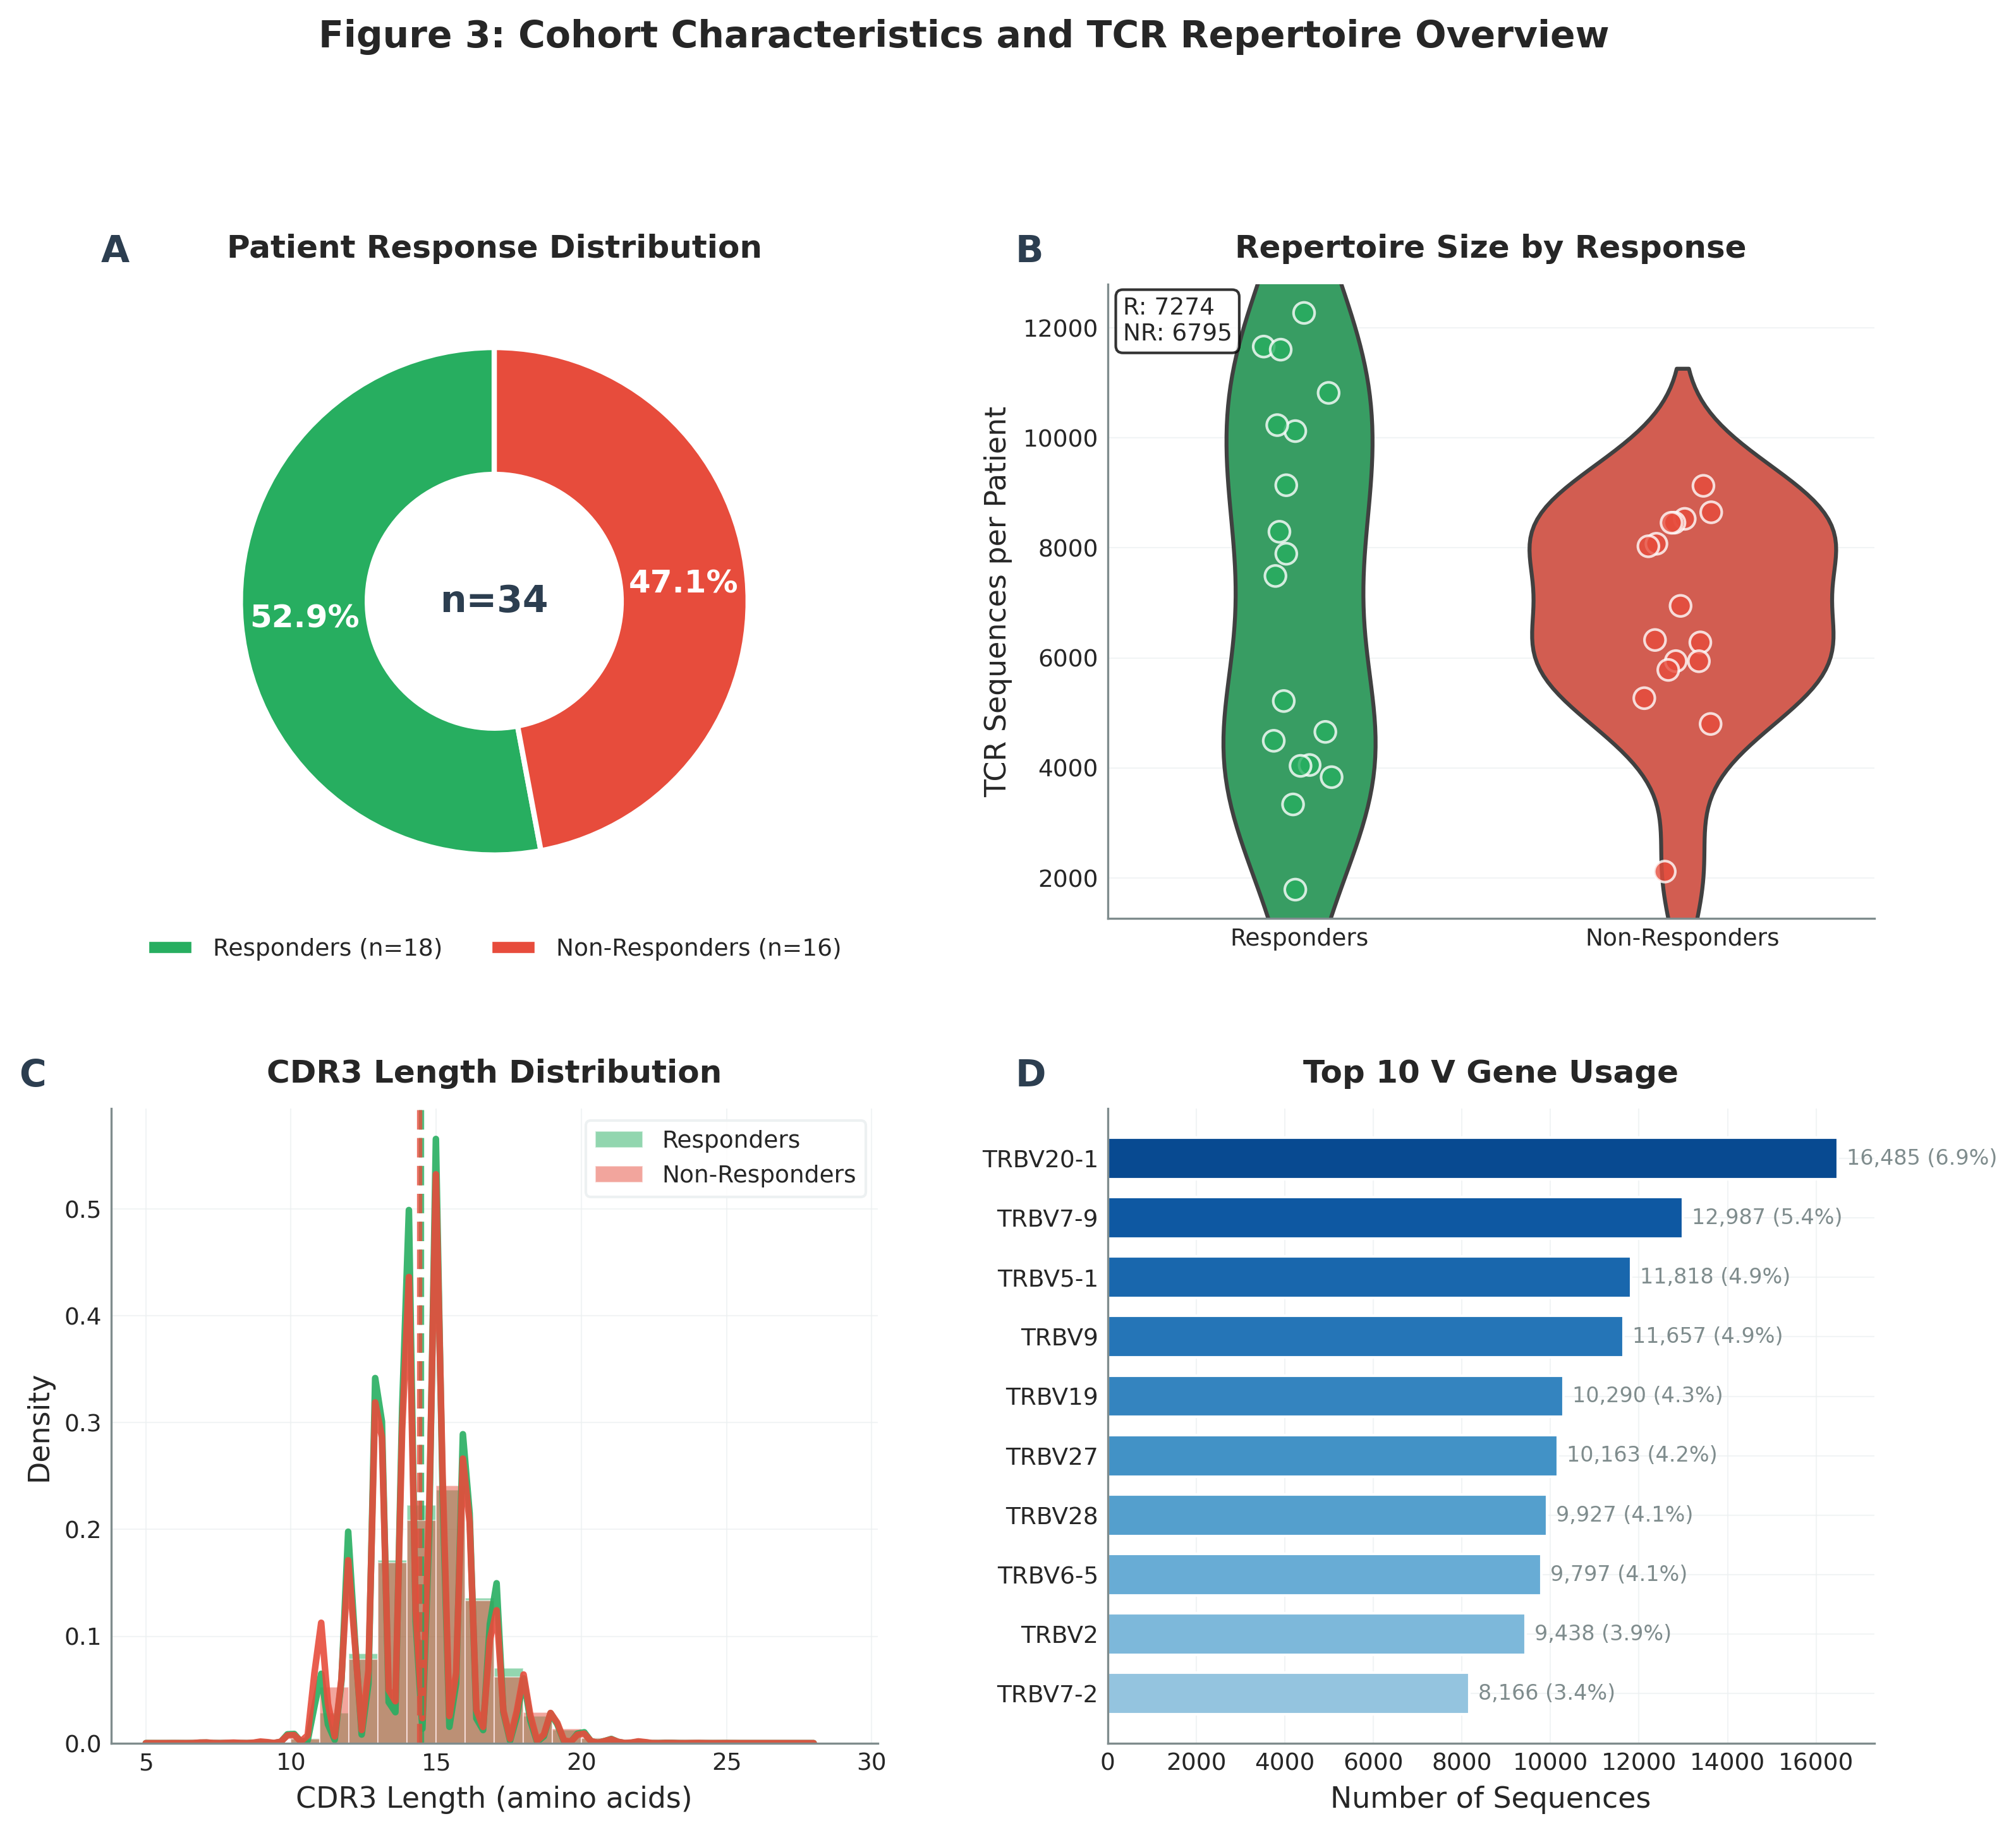
Project Overview
Goal: predict immunotherapy response from TCRβ repertoires using DeepTCR (MIL + attention).
Dataset: 34 patients; 239,634 TCRβ sequences.
Labels: 18 responders vs 16 non-responders.
Approach: 100-fold Monte Carlo cross-validation + post-training interpretation.
Cohort overview generated by analysis scripts.

Slide 4
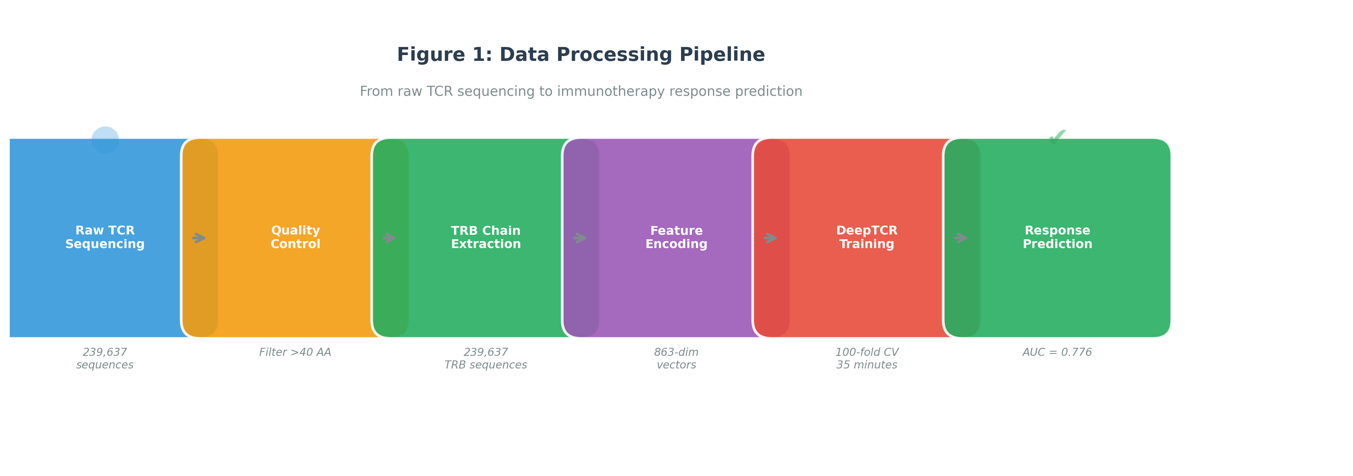
End-to-end pipeline
Data loading → preprocessing/encoding → DeepTCR training → post-training analysis → figures/presentation.

Slide 5
Repository work completed (scripts 01–13)
01: environment verification (Python/CUDA/TensorFlow/DeepTCR).
02: load + clean dataset → `data_processed/deeptcr_trb_ready.csv`.
03: EDA → cohort/sequence figures.
04: one-hot encoding → `X_onehot.npy`, labels, patient IDs.
06: 100-fold Monte Carlo training (patient-level splits).
07–12: AUC + bootstrap, attention extraction/plots, R vs NR stats, gene enrichment, top sequences, AA characteristics.
13: generate this PowerPoint.

Slide 6
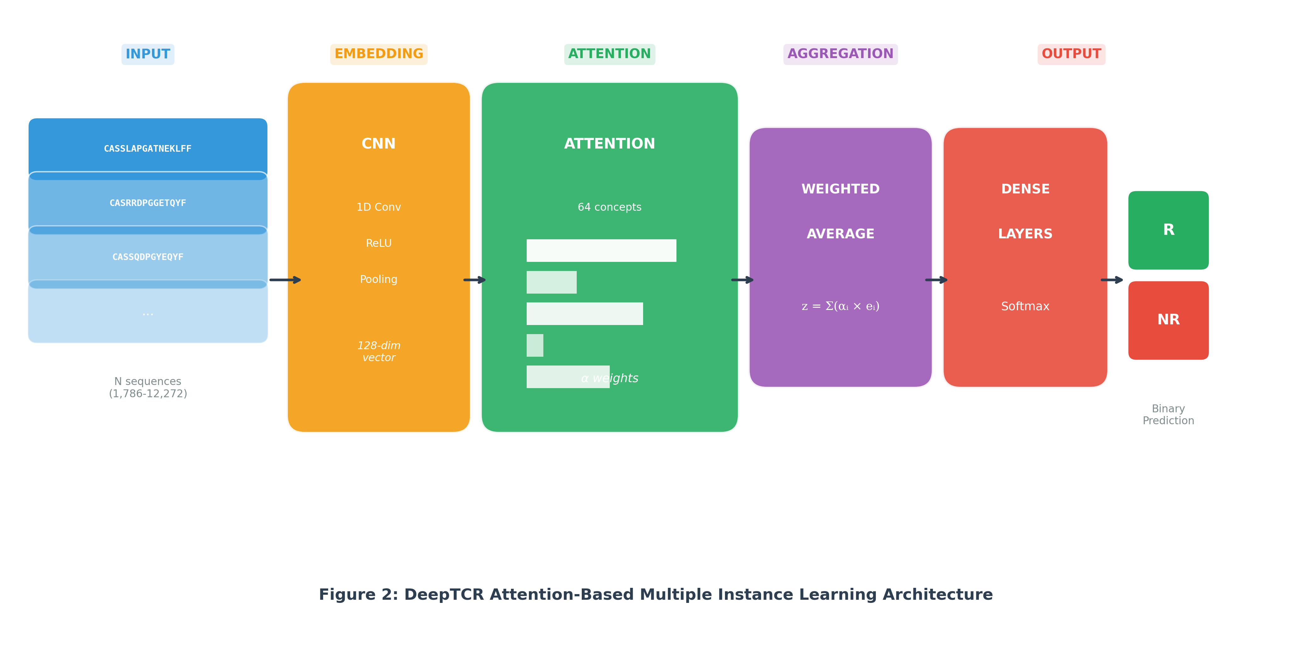
DeepTCR model architecture
Multiple Instance Learning: a patient = bag of TCR sequences.
CNN embedding of CDR3 sequences.
Attention learns which sequences drive the prediction (interpretability).
Output: binary responder vs non-responder.

Slide 7
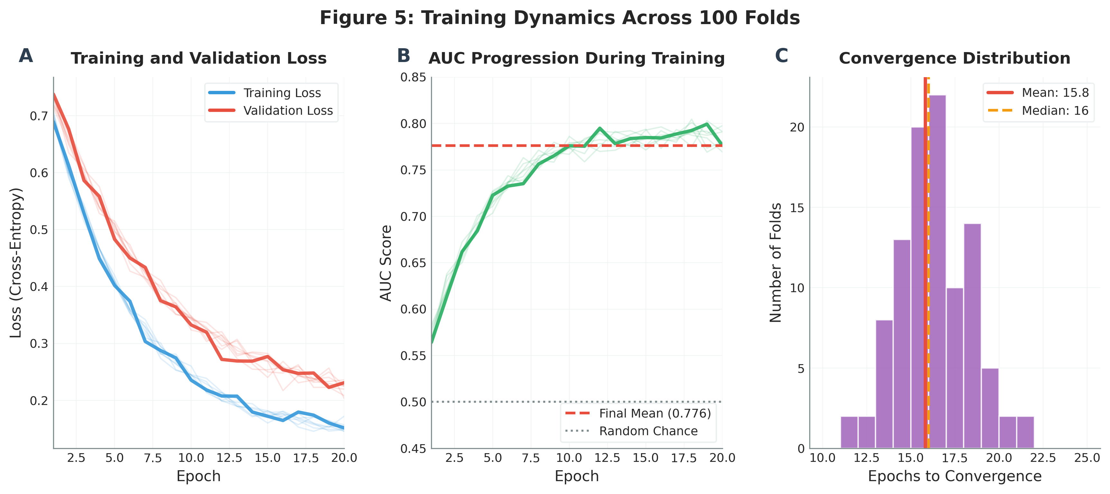
Training setup: 100-fold Monte Carlo CV
100 random patient-level splits (train 75% / test 25%).
Re-estimate performance over many splits to reduce variance from any one partition.
Saved models + logs for reproducibility.
Training dynamics from training logs/exports.

Slide 8
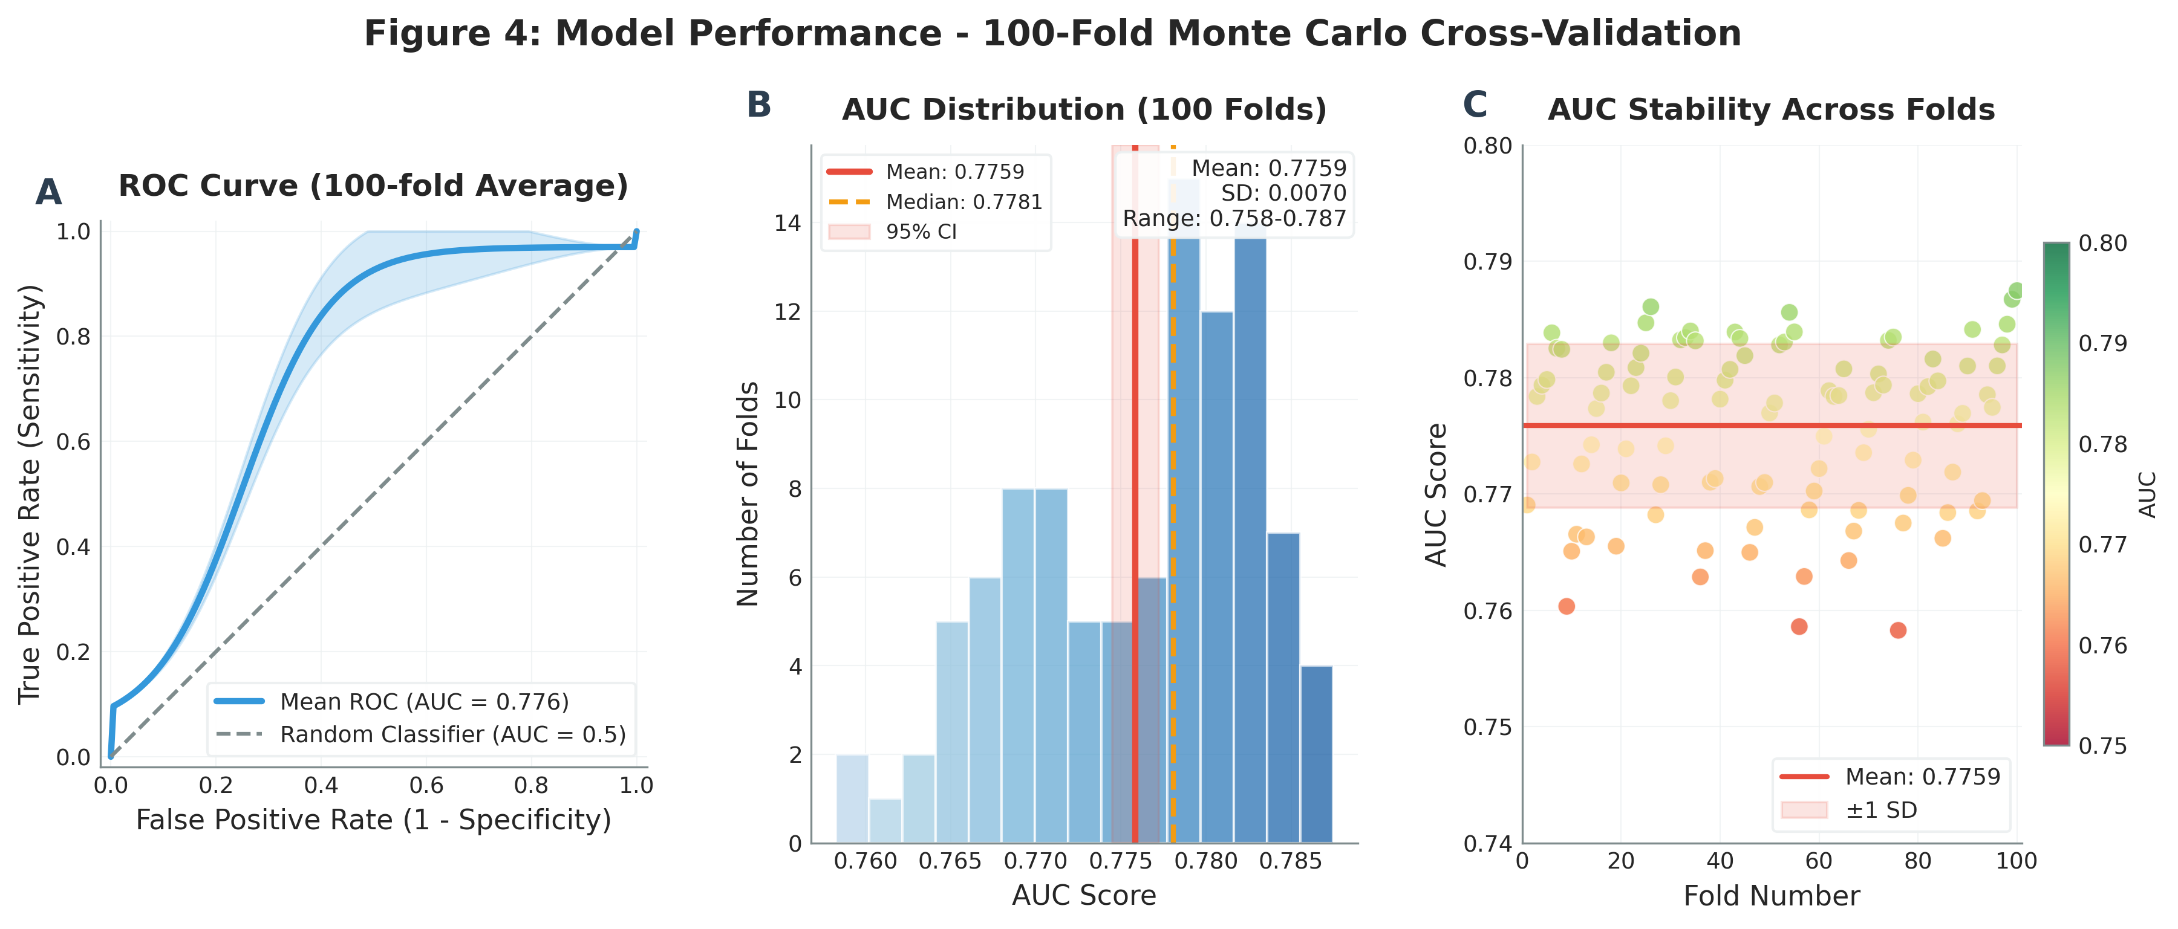
Performance summary (AUC)
Mean AUC = 0.754 ± 0.035 (SD across folds).
95% bootstrap CI = [0.747, 0.761] (n=1000).
AUC range across folds = [0.658, 0.794].

Slide 9
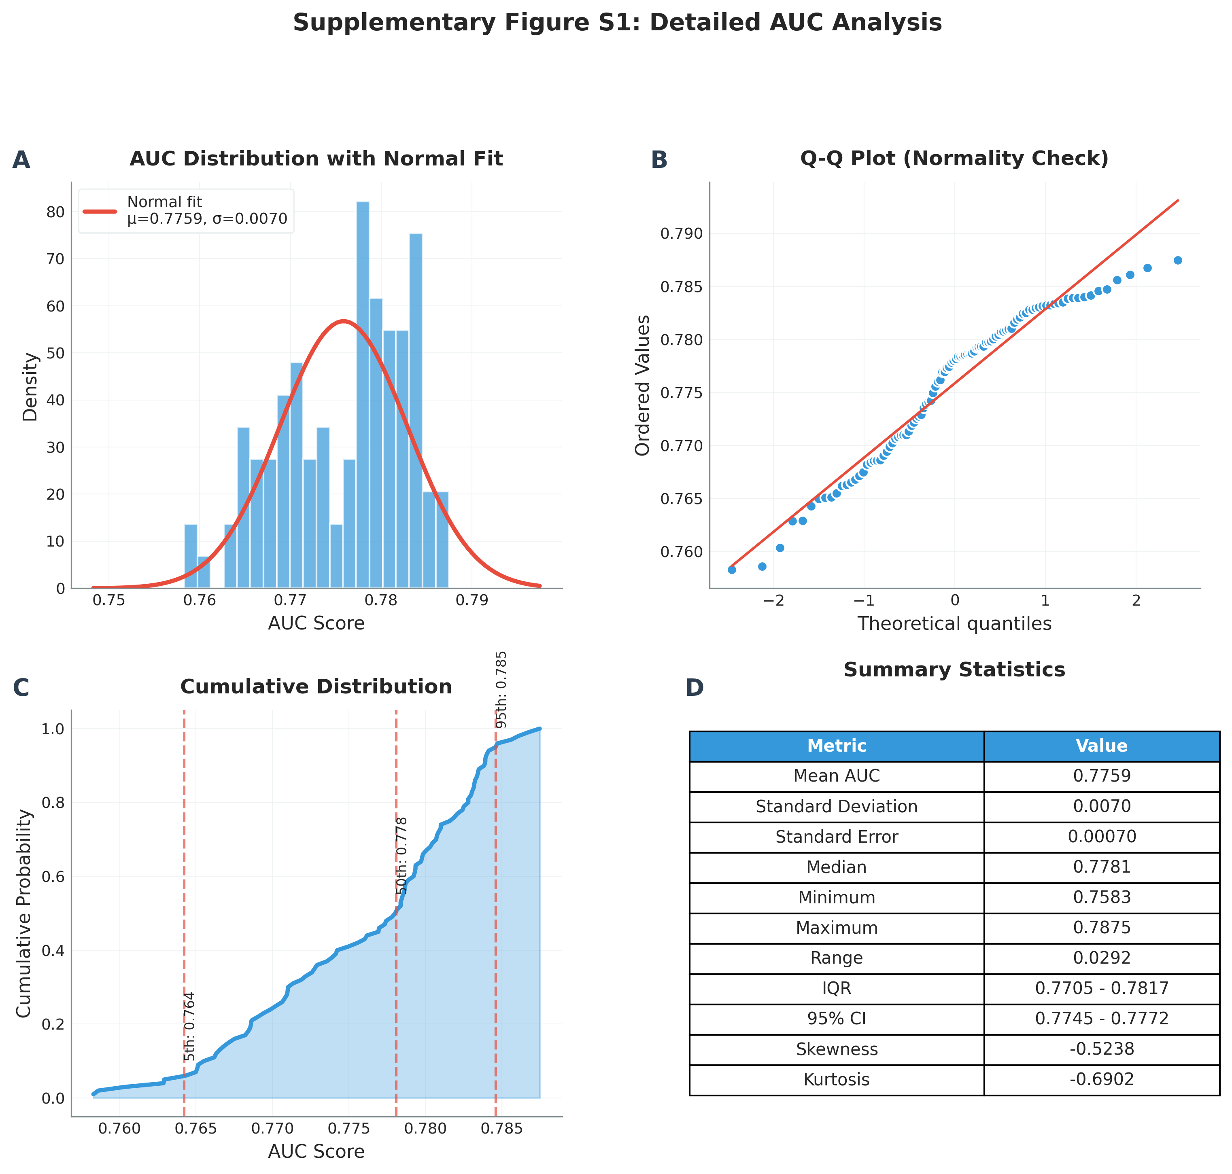
AUC distribution across folds
Fold-wise AUC distribution; generated by post-training analysis scripts.

Slide 10
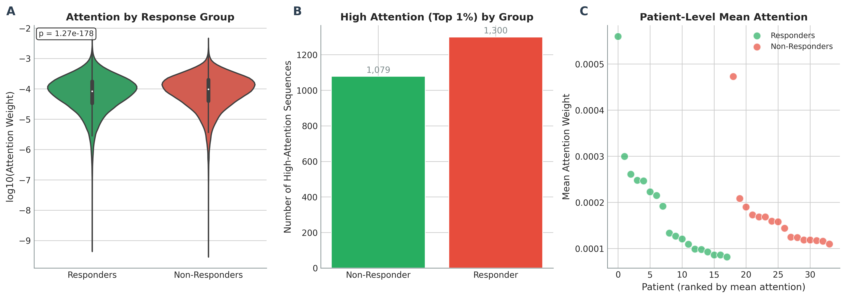
Attention analysis (interpretability)
High-attention sequences: 2,379 (top 1%).
Attention is sparse: a small subset of sequences explains predictions.
Enables biological follow-up: enriched V/J genes and high-attention clonotypes.

Slide 11
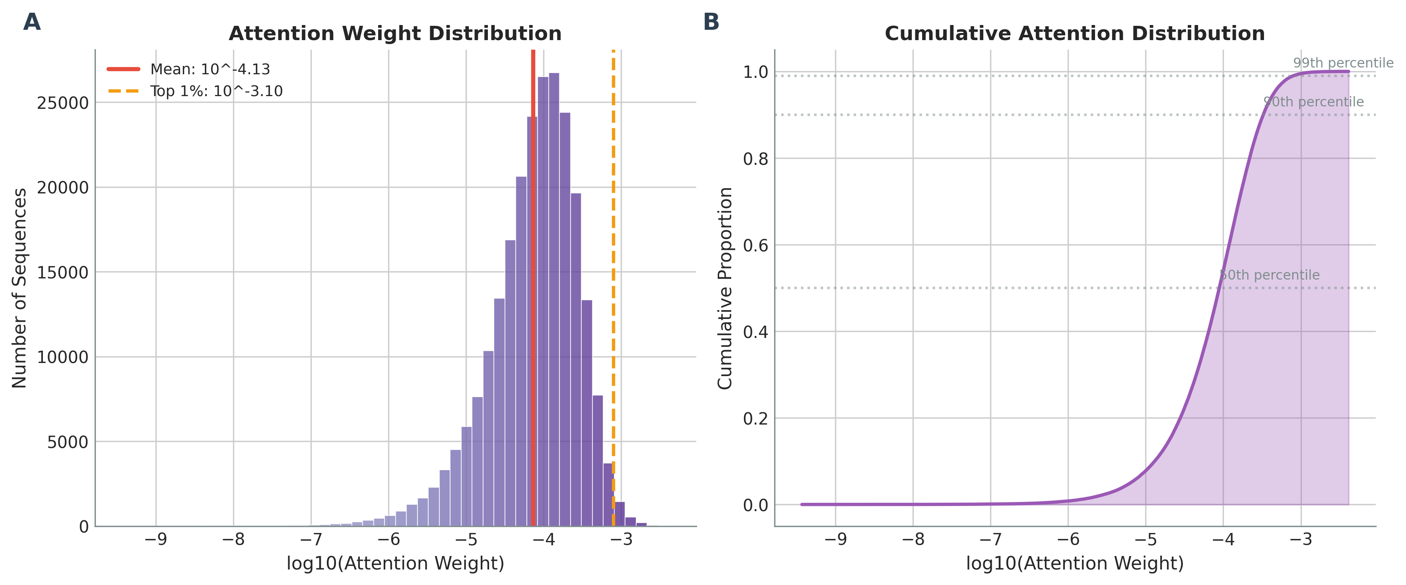
Attention distributions
Left: overall attention distribution. Right: attention by response label.

Slide 12
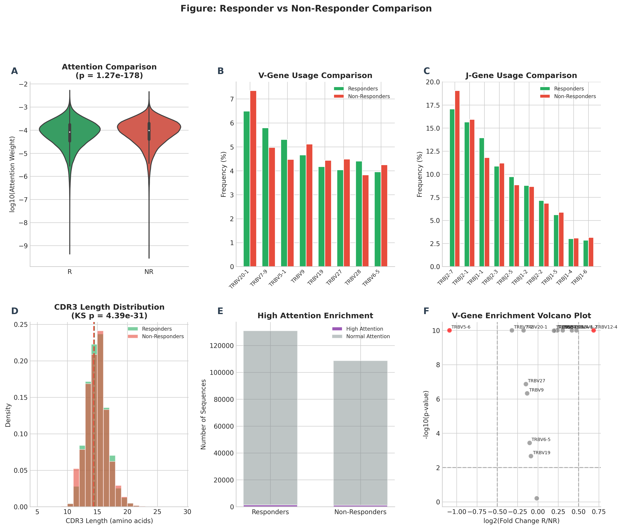
Responder vs non-responder comparison
Statistical tests on attention/sequence properties (see `results/responder_comparison_stats.csv`).
Attention Mann–Whitney p=1.27e-178 (effect size=0.068)
Additional: CDR3 length distribution tests (KS/t-test) included in results.

Slide 13
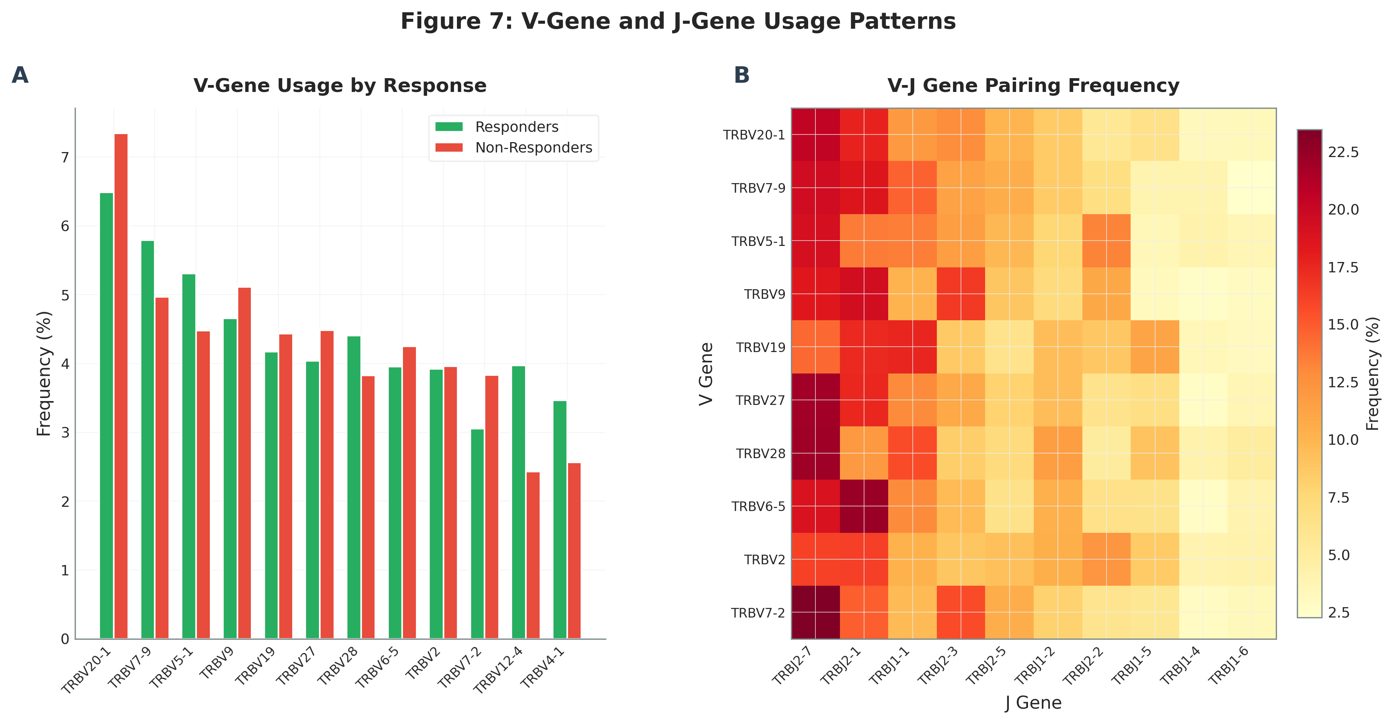
V/J gene usage and enrichment
Top enriched V-gene in high-attention sequences: TRBV5-8 (1.54×).
Top enriched J-gene in high-attention sequences: TRBJ2-2 (1.17×).
Gene usage patterns provide interpretable biological signals.

Slide 14
Top predictive sequences (examples)
Rank | CDR3 | V gene | J gene | Label | Attention
1 | CASRWEEDTEAFF | TRBV7-9 | TRBJ1-1 | Responder | 0.0041
2 | CASSRGGDFYNEQFF | TRBV3-1 | TRBJ2-1 | Responder | 0.0040
3 | CASSLGRTYEQYF | TRBV27 | TRBJ2-7 | Responder | 0.0037
4 | CASSVTSYNEQFF | TRBV9 | TRBJ2-1 | Non-Responder | 0.0036
5 | CASSLGGETQYF | TRBV11-2 | TRBJ2-5 | Responder | 0.0034
Showing top 5 rows.

Slide 15
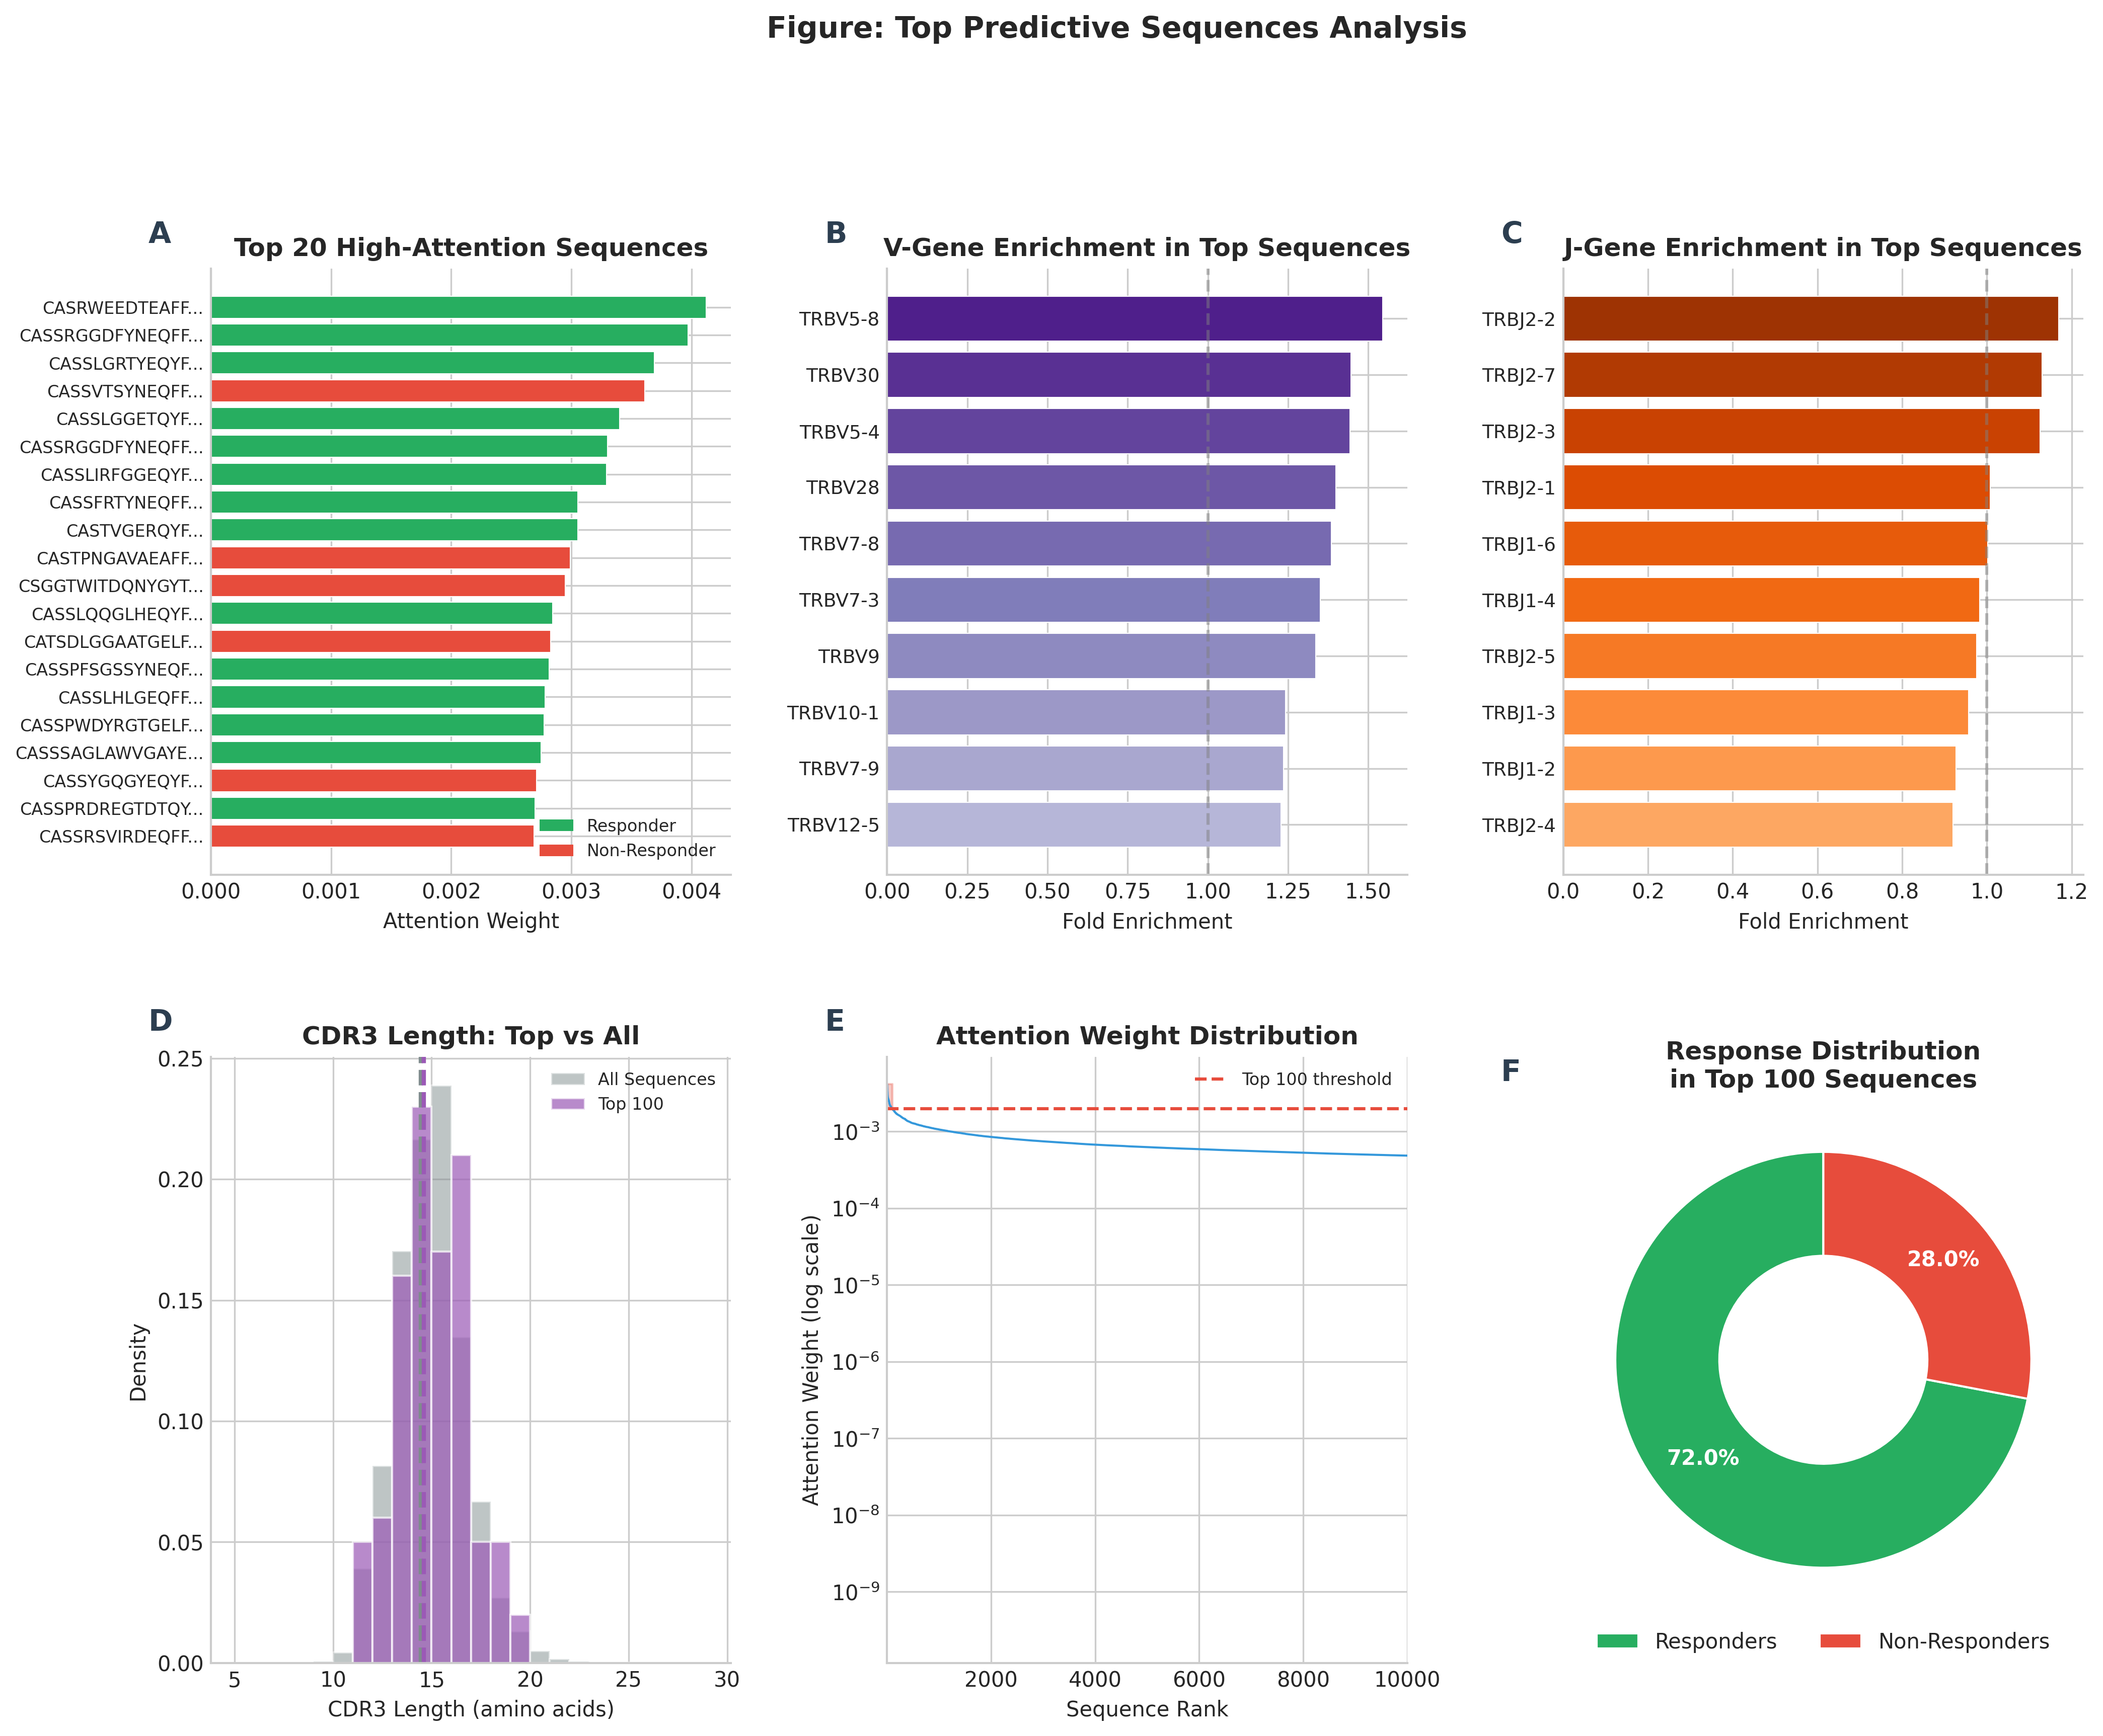
Top sequence patterns (top-100 analysis)
Summary visualization of the top 100 high-attention sequences.

Slide 16
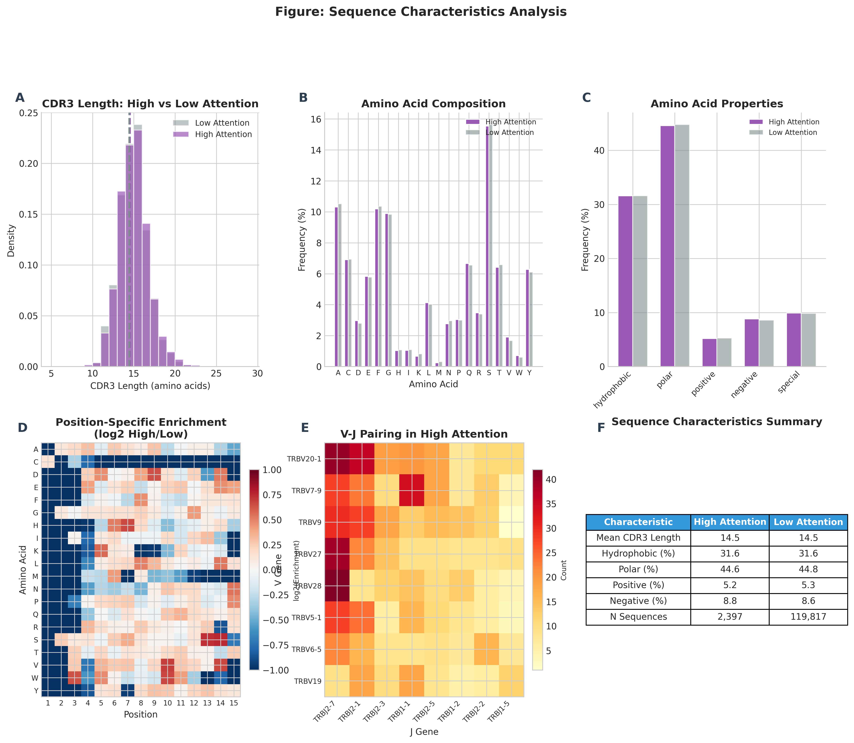
Sequence characteristics
CDR3 length & amino-acid properties (mean length ~14.47).

Slide 17
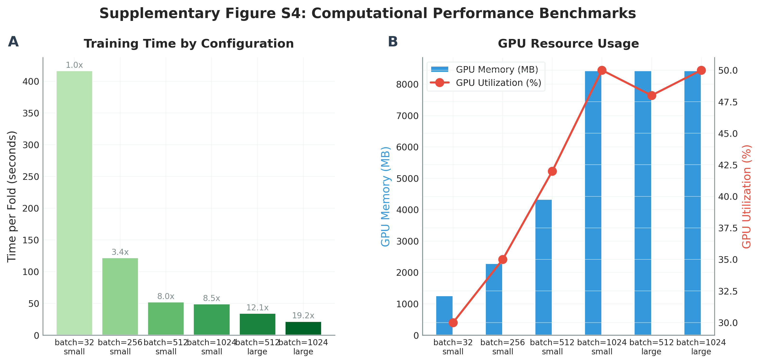
Compute optimization (GPU/H100)
Runtime/memory benchmarking and optimized training settings.

Slide 18
Key takeaways
DeepTCR achieved mean AUC 0.754 with tight bootstrap CI [0.747, 0.761].
Attention provides interpretability: highlights a small subset of predictive sequences.
Enriched V/J gene usage and top clonotypes are candidates for biological validation.
End-to-end pipeline is automated and reproducible (scripts 01–13, logs, figures, paper).

Slide 19
Thank you
Questions?

