Slide 1
DeepTCR-based Prediction of CD19 CAR T-cell Response
Relapsed/Refractory B-cell Lymphoma (rrLBCL) Supervised MIL + Unsupervised Representation Learning

Slide 2
Background & Objective
CD19 CAR T-cell therapy improves rrLBCL outcomes, but many patients relapse or fail to respond
Goal: predict response before therapy using only TCR repertoire features (CDR3 + V/J)
Approach: DeepTCR supervised multiple instance learning (MIL) with attention
Add-on: unsupervised embeddings + UMAP to visualize sequence concepts (Sidhom-style adapted)
Outcome: interpretable model + candidate predictive clonotypes

Slide 3
Data Overview
Patient Cohort:
34 total patients
18 responders
16 non-responders
Therapy context:
CD19 CAR T-cell therapy (rrLBCL)
TCR Sequences:
239,637 total sequences
TRB chain only
1,786 - 12,272 per patient
Features:
CDR3 amino acid sequence
V and J gene usage

Slide 4
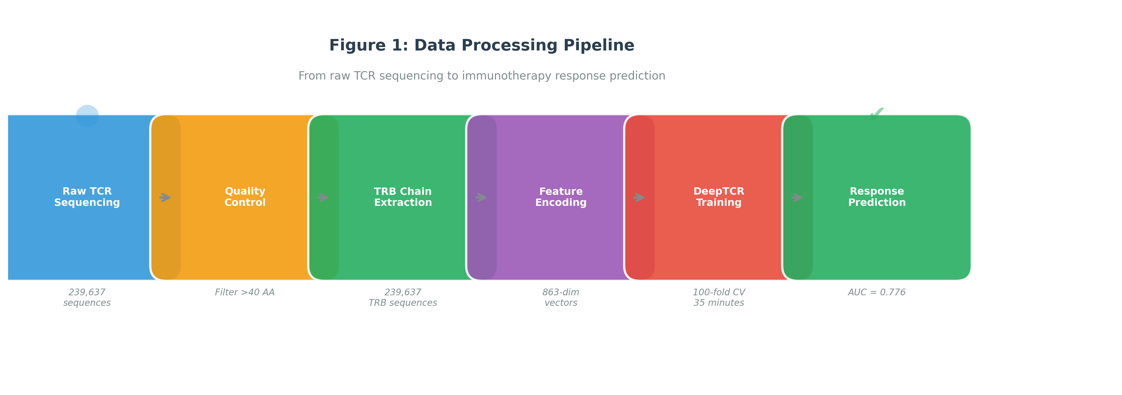
Figure 1: Data Processing Pipeline
From raw TCR sequencing → TRB extraction → encoding → DeepTCR training → response prediction

Slide 5
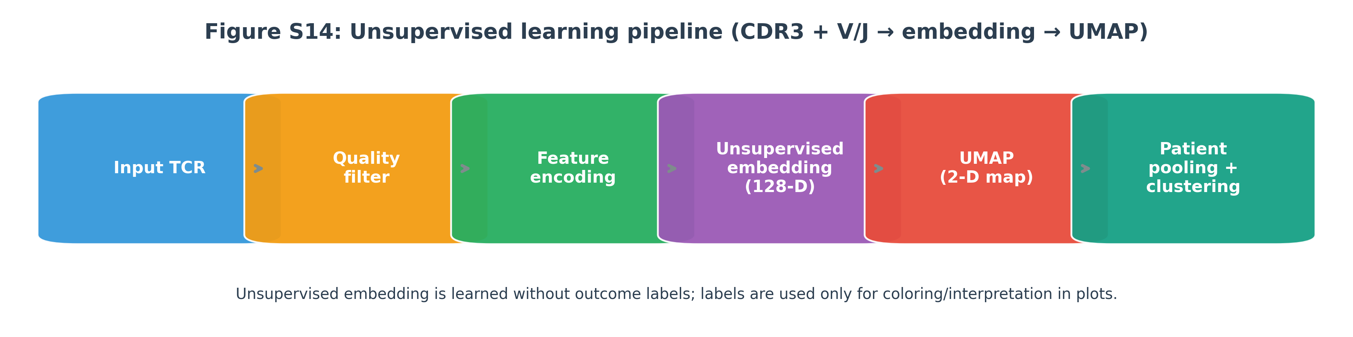
Unsupervised Learning Pipeline (Overview)
Unsupervised embedding learns structure without labels; labels are used only for plot coloring/interpretation

Slide 6
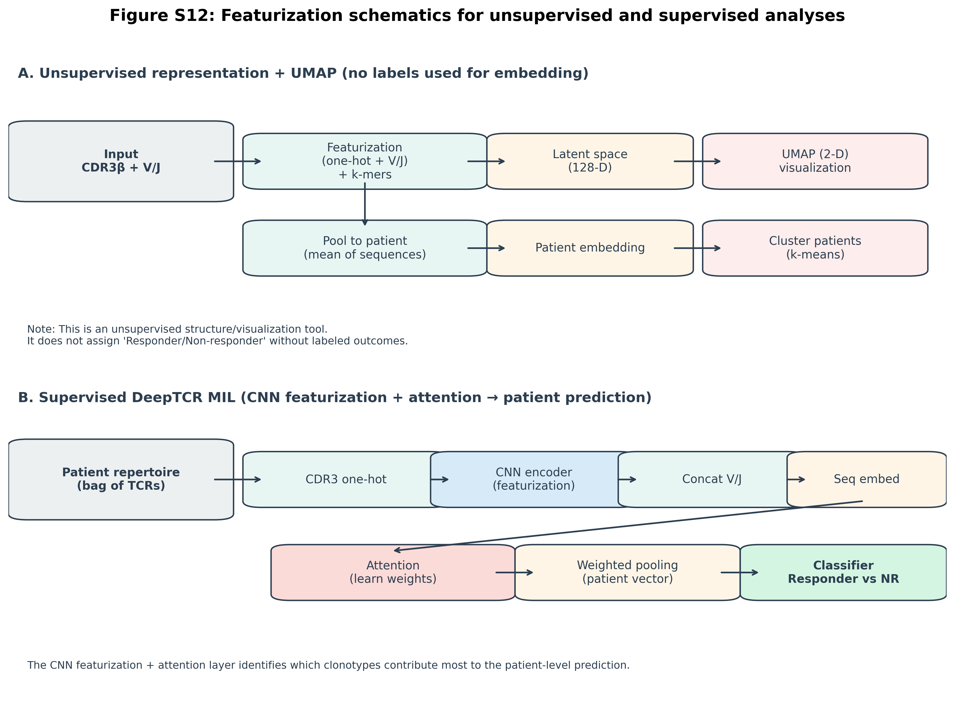
Featurization: Unsupervised vs Supervised (Schematics)
Connects: input → featurization → embedding → (UMAP) and MIL attention → patient prediction

Slide 7
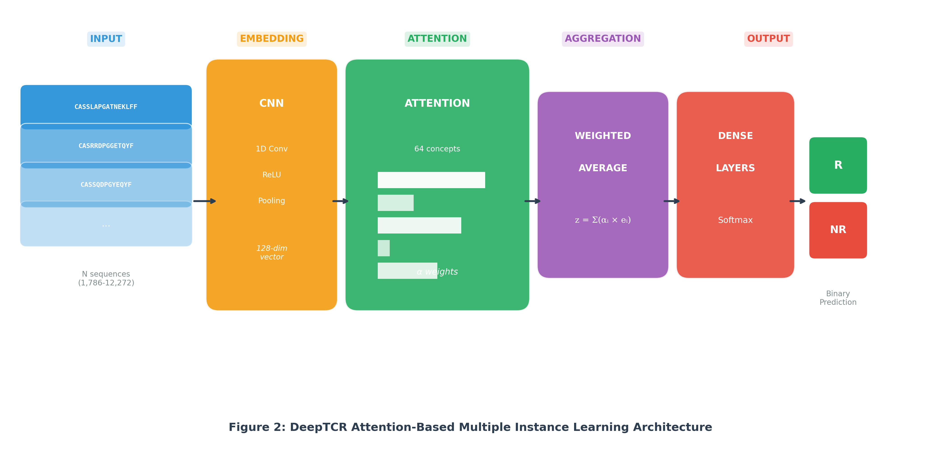
Figure 2: DeepTCR Architecture (MIL + Attention)
MIL treats each patient as a bag of sequences; attention highlights predictive clonotypes

Slide 8
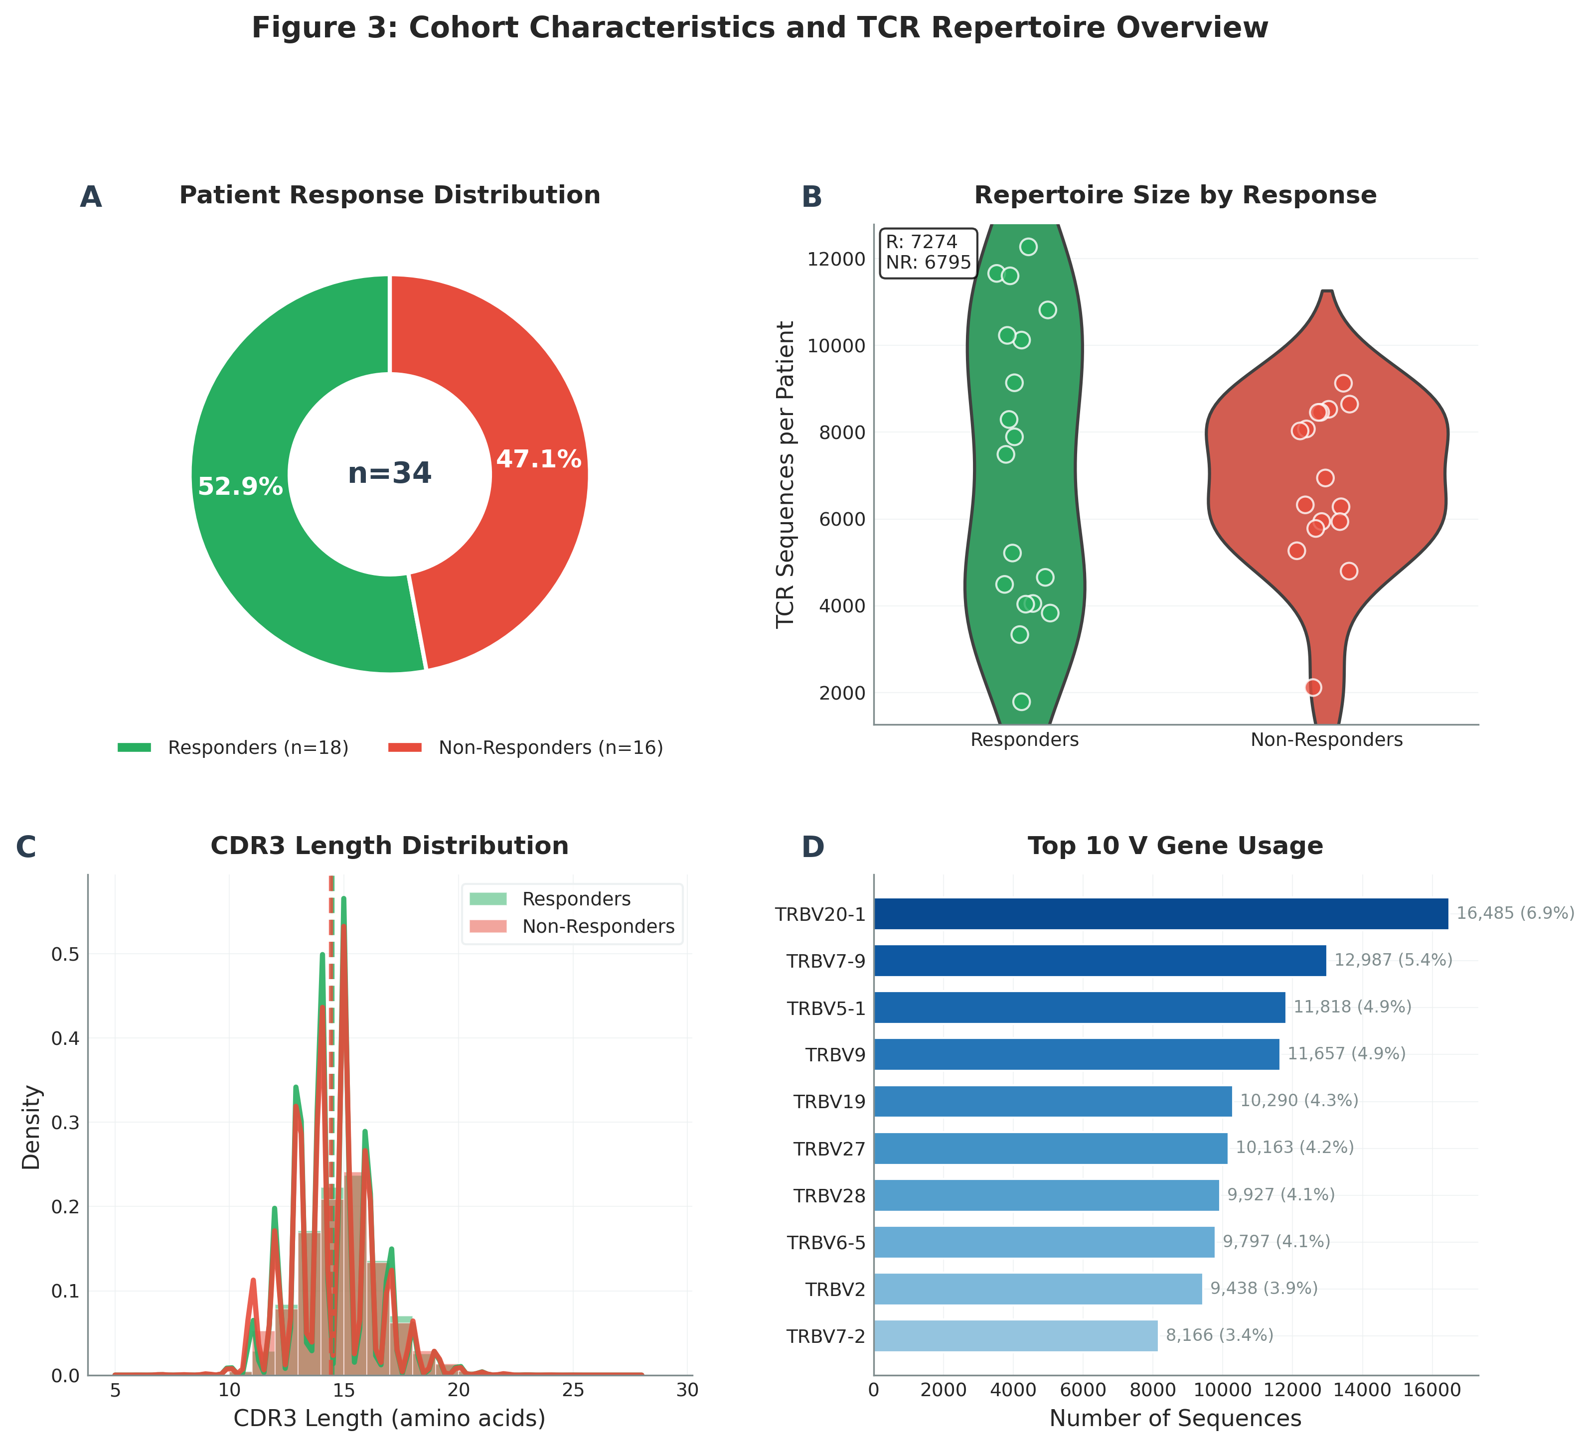
Figure 3: Cohort Overview
Summary of sequences per patient and cohort characteristics

Slide 9
Monte Carlo Cross-Validation
100-fold Monte Carlo Cross-Validation
Each fold: 75% train, 25% test
Random patient-level splits
Prevents overfitting to specific splits
Robust performance estimation
Training time: ~35 minutes (H100 GPU)

Slide 10
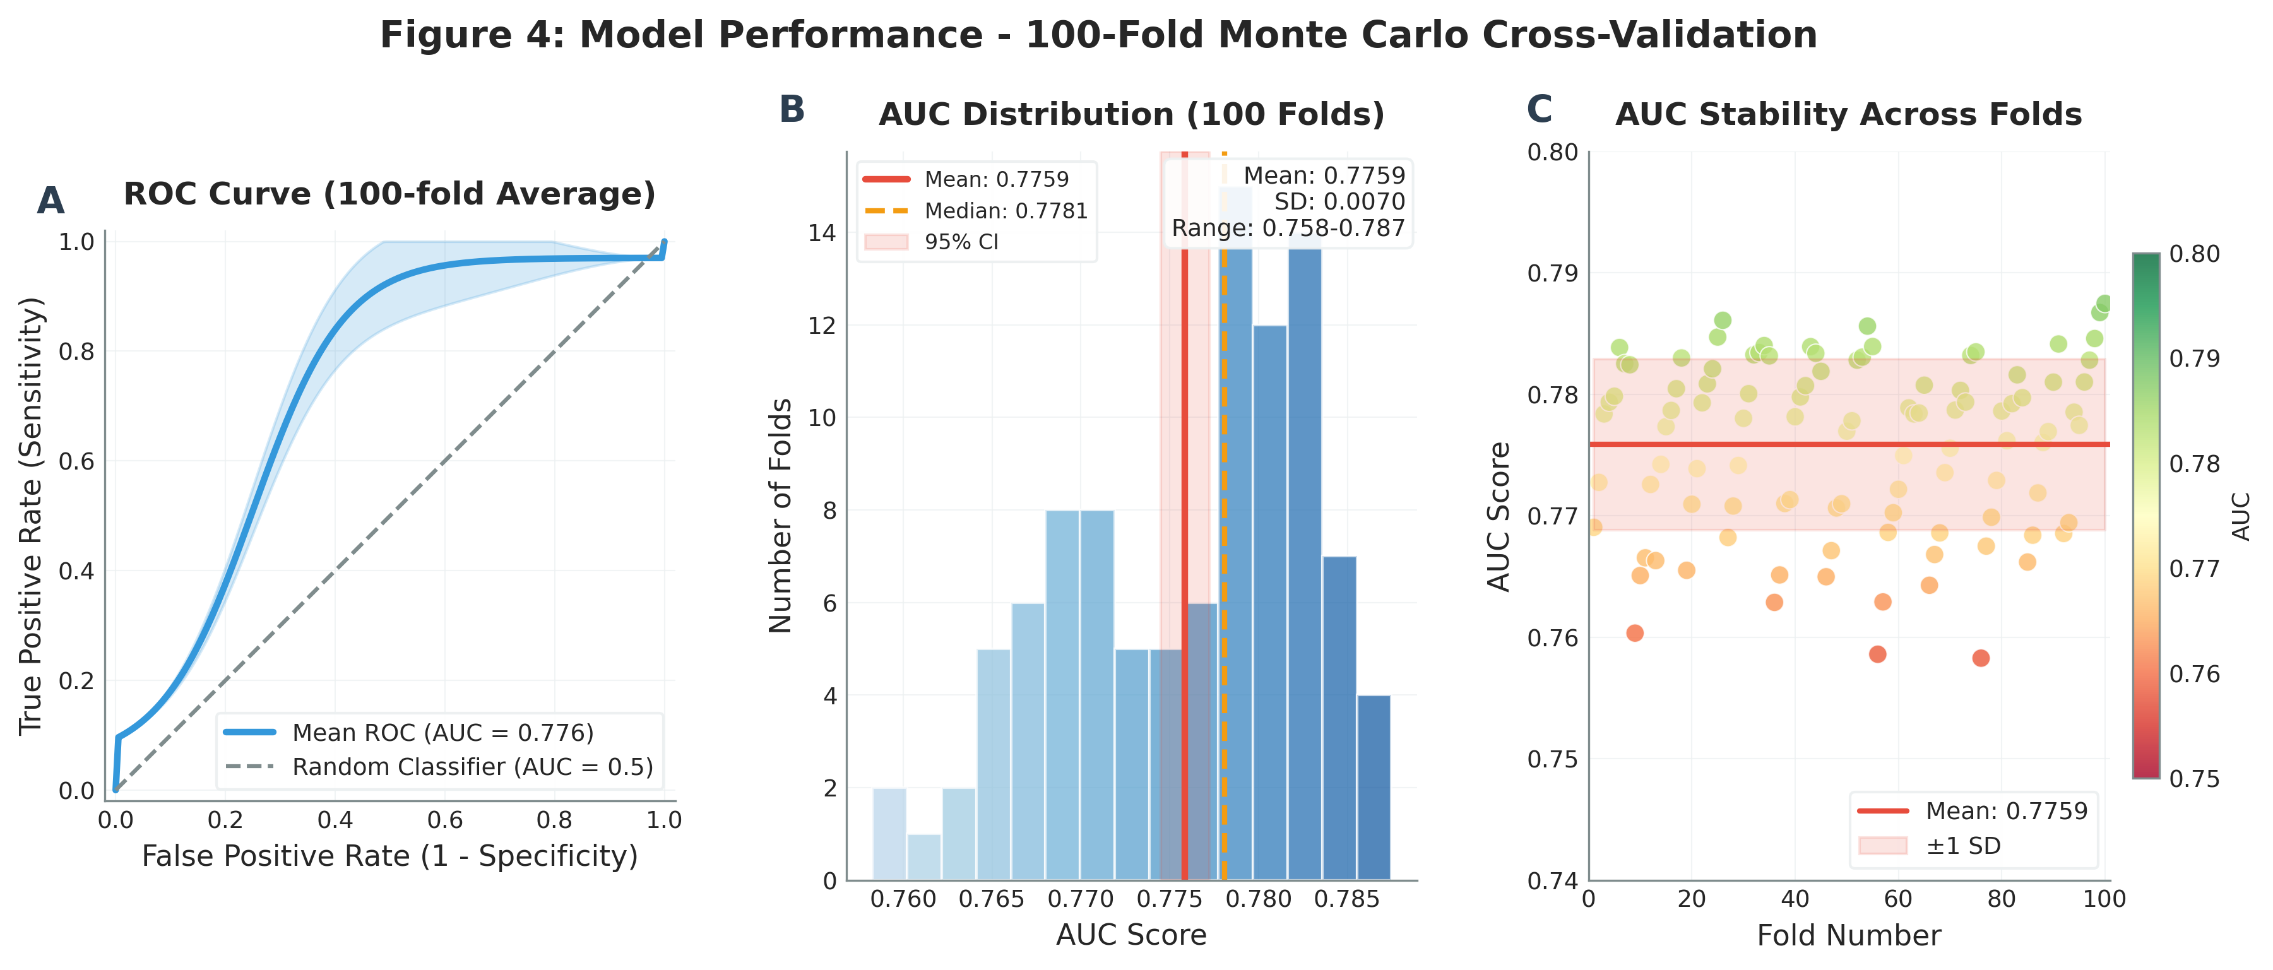
Model Performance Results
Mean AUC: 0.754 +/- 0.035
95% Confidence Interval: [0.747, 0.761]
Consistent performance across 100 folds
Consistent performance across 100 folds
Better than random baseline (AUC=0.5)
Good discriminative ability for clinical use

Slide 11
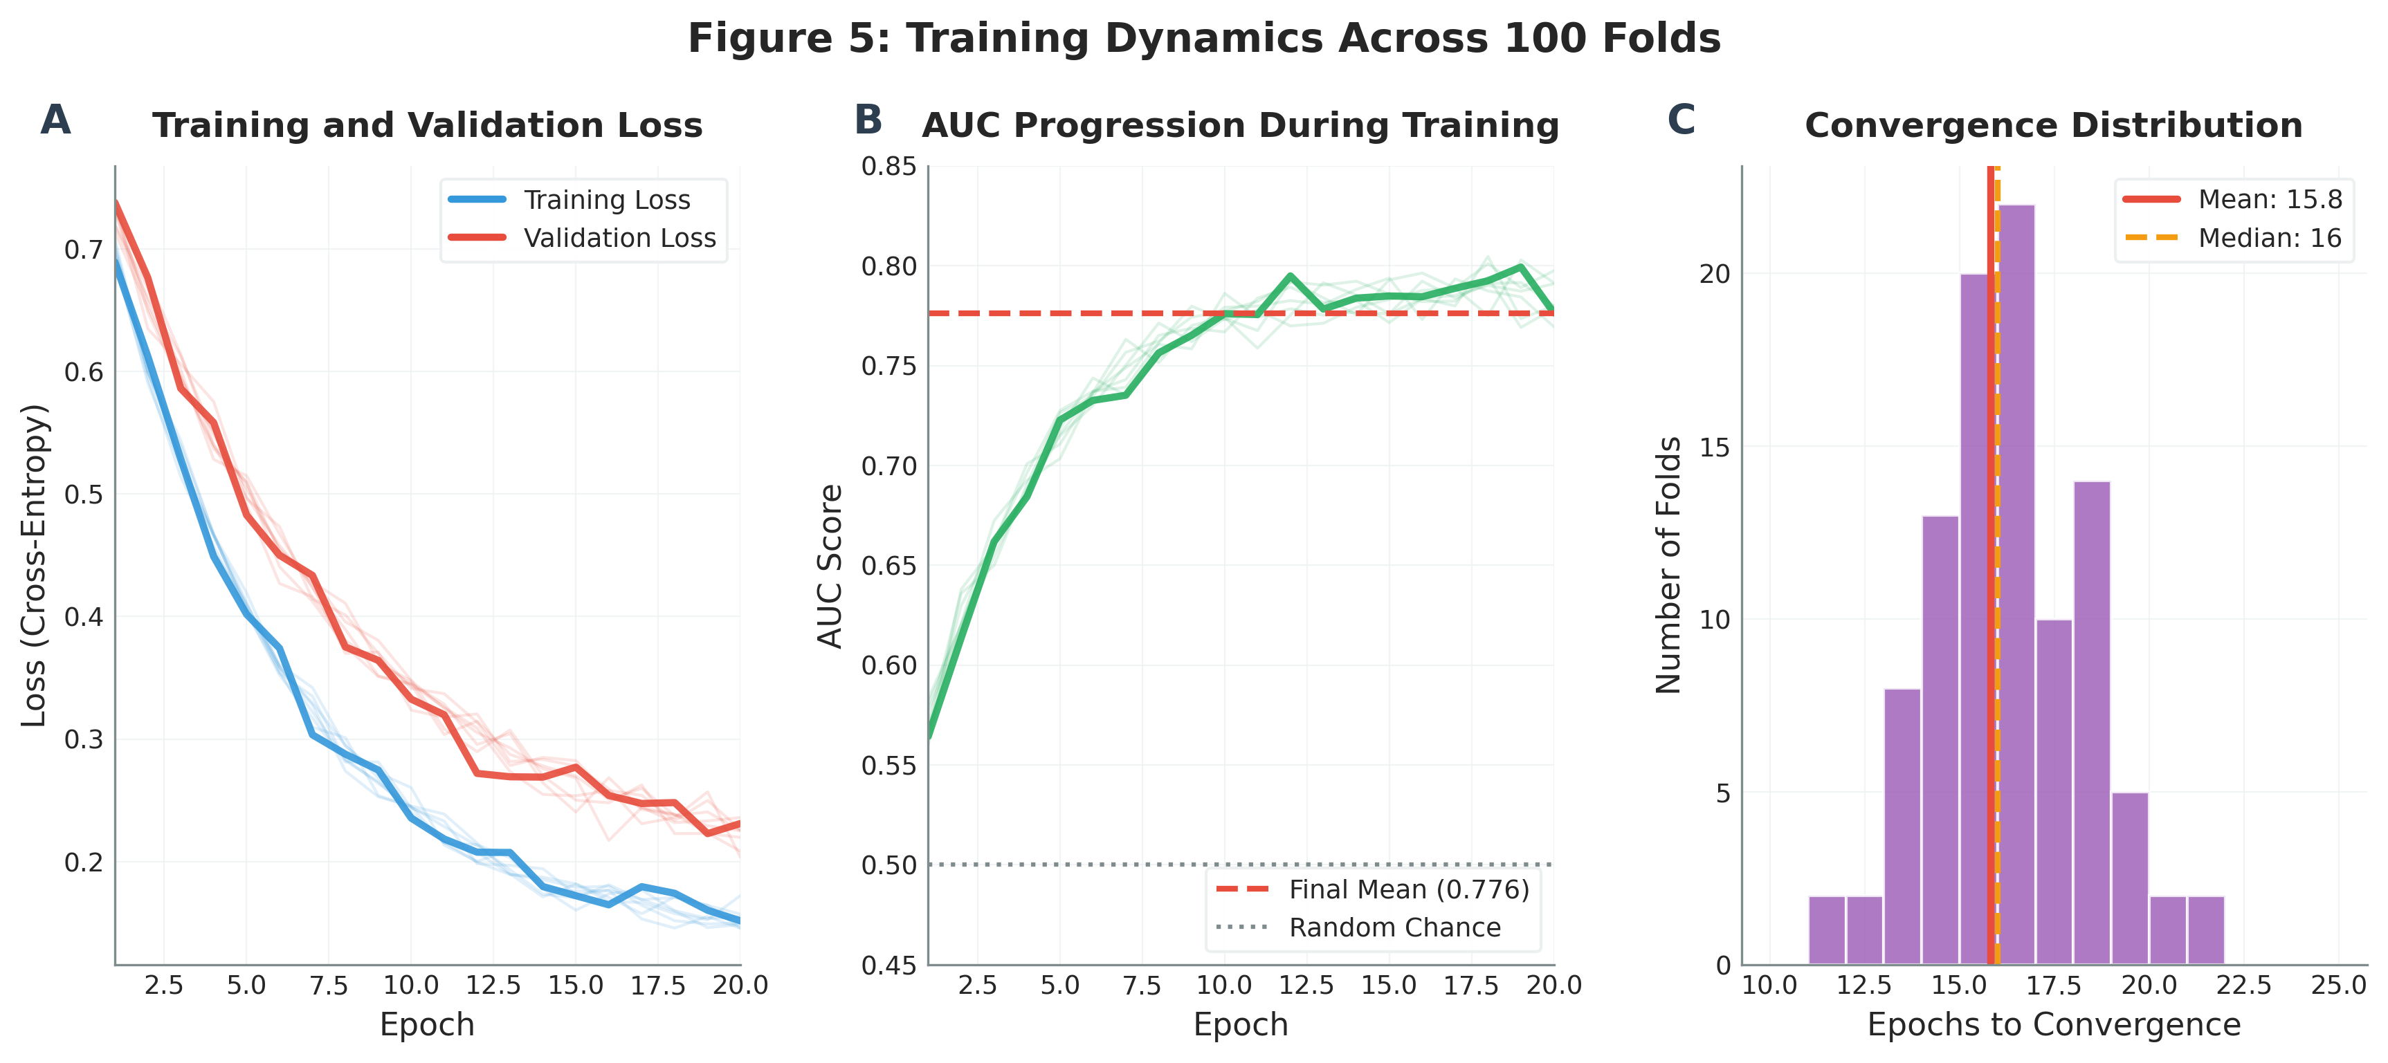
Figure 5: Training Dynamics
Loss/AUC convergence across folds; early stopping behavior

Slide 12
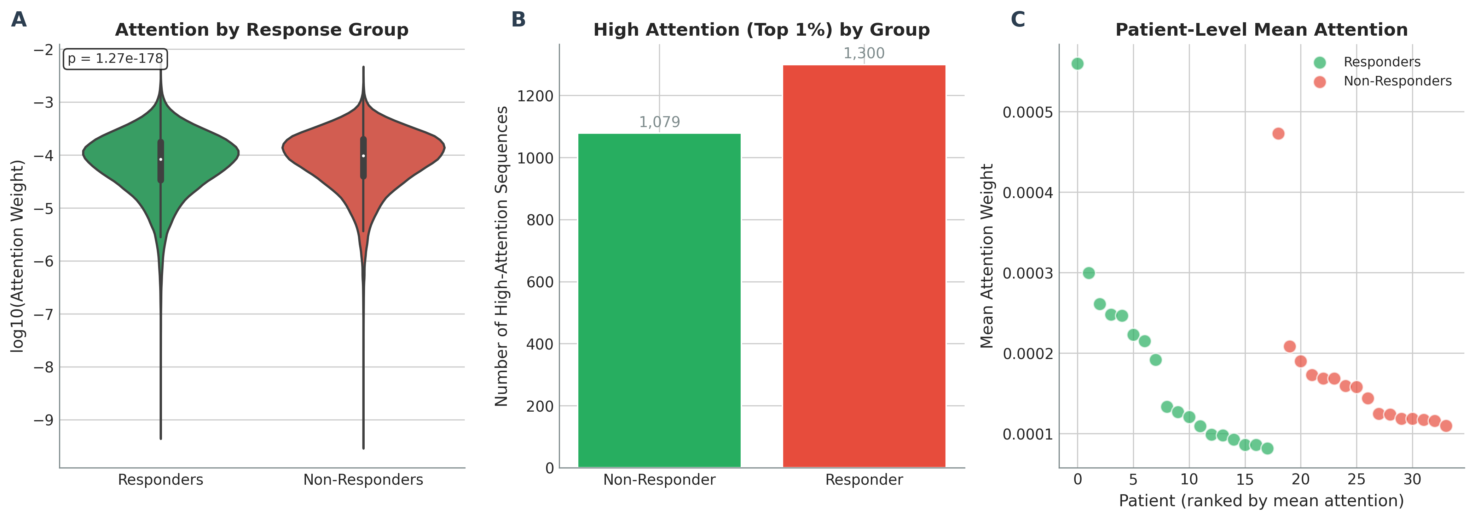
Attention Weight Analysis
Attention highlights a small subset of predictive clonotypes (interpretability)

Slide 13
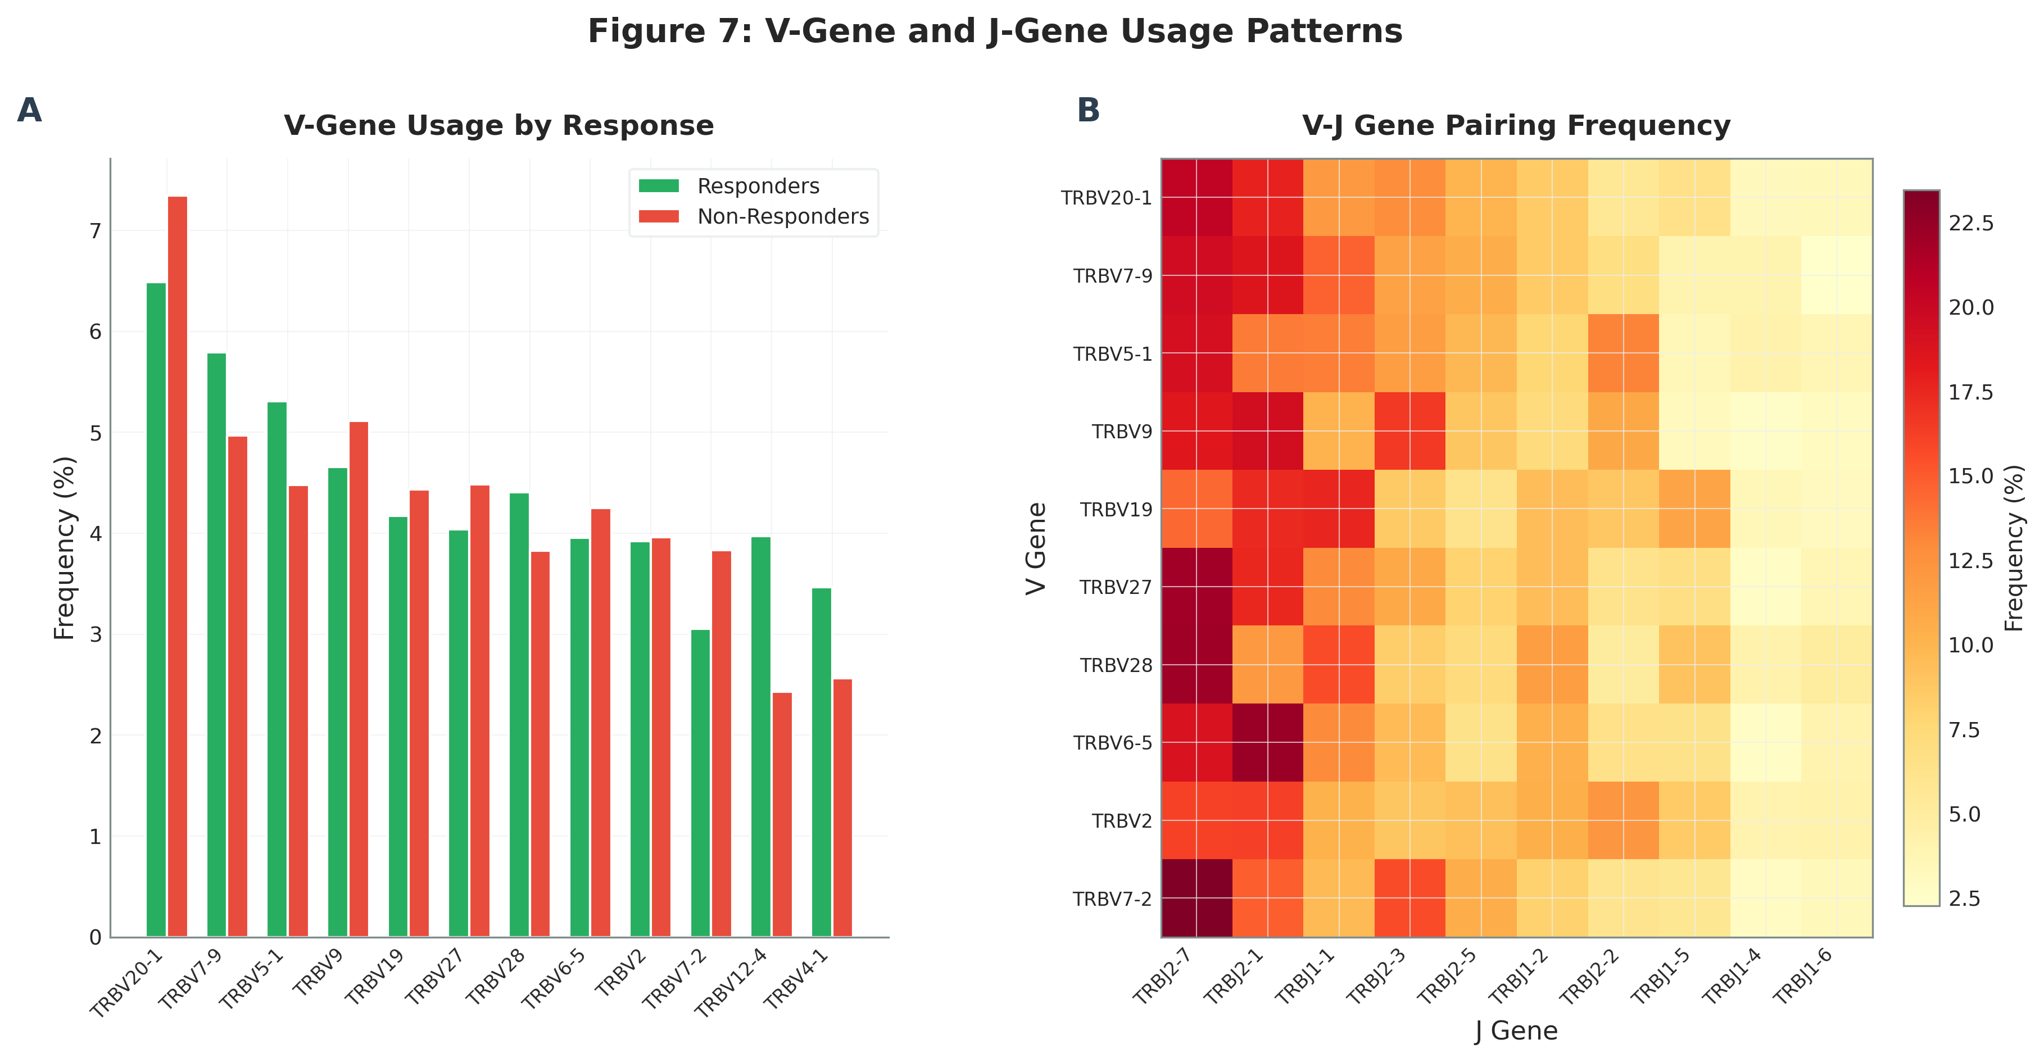
Figure 7: V/J Gene Usage Patterns
Gene usage differences and enrichment patterns in high-attention sequences

Slide 14
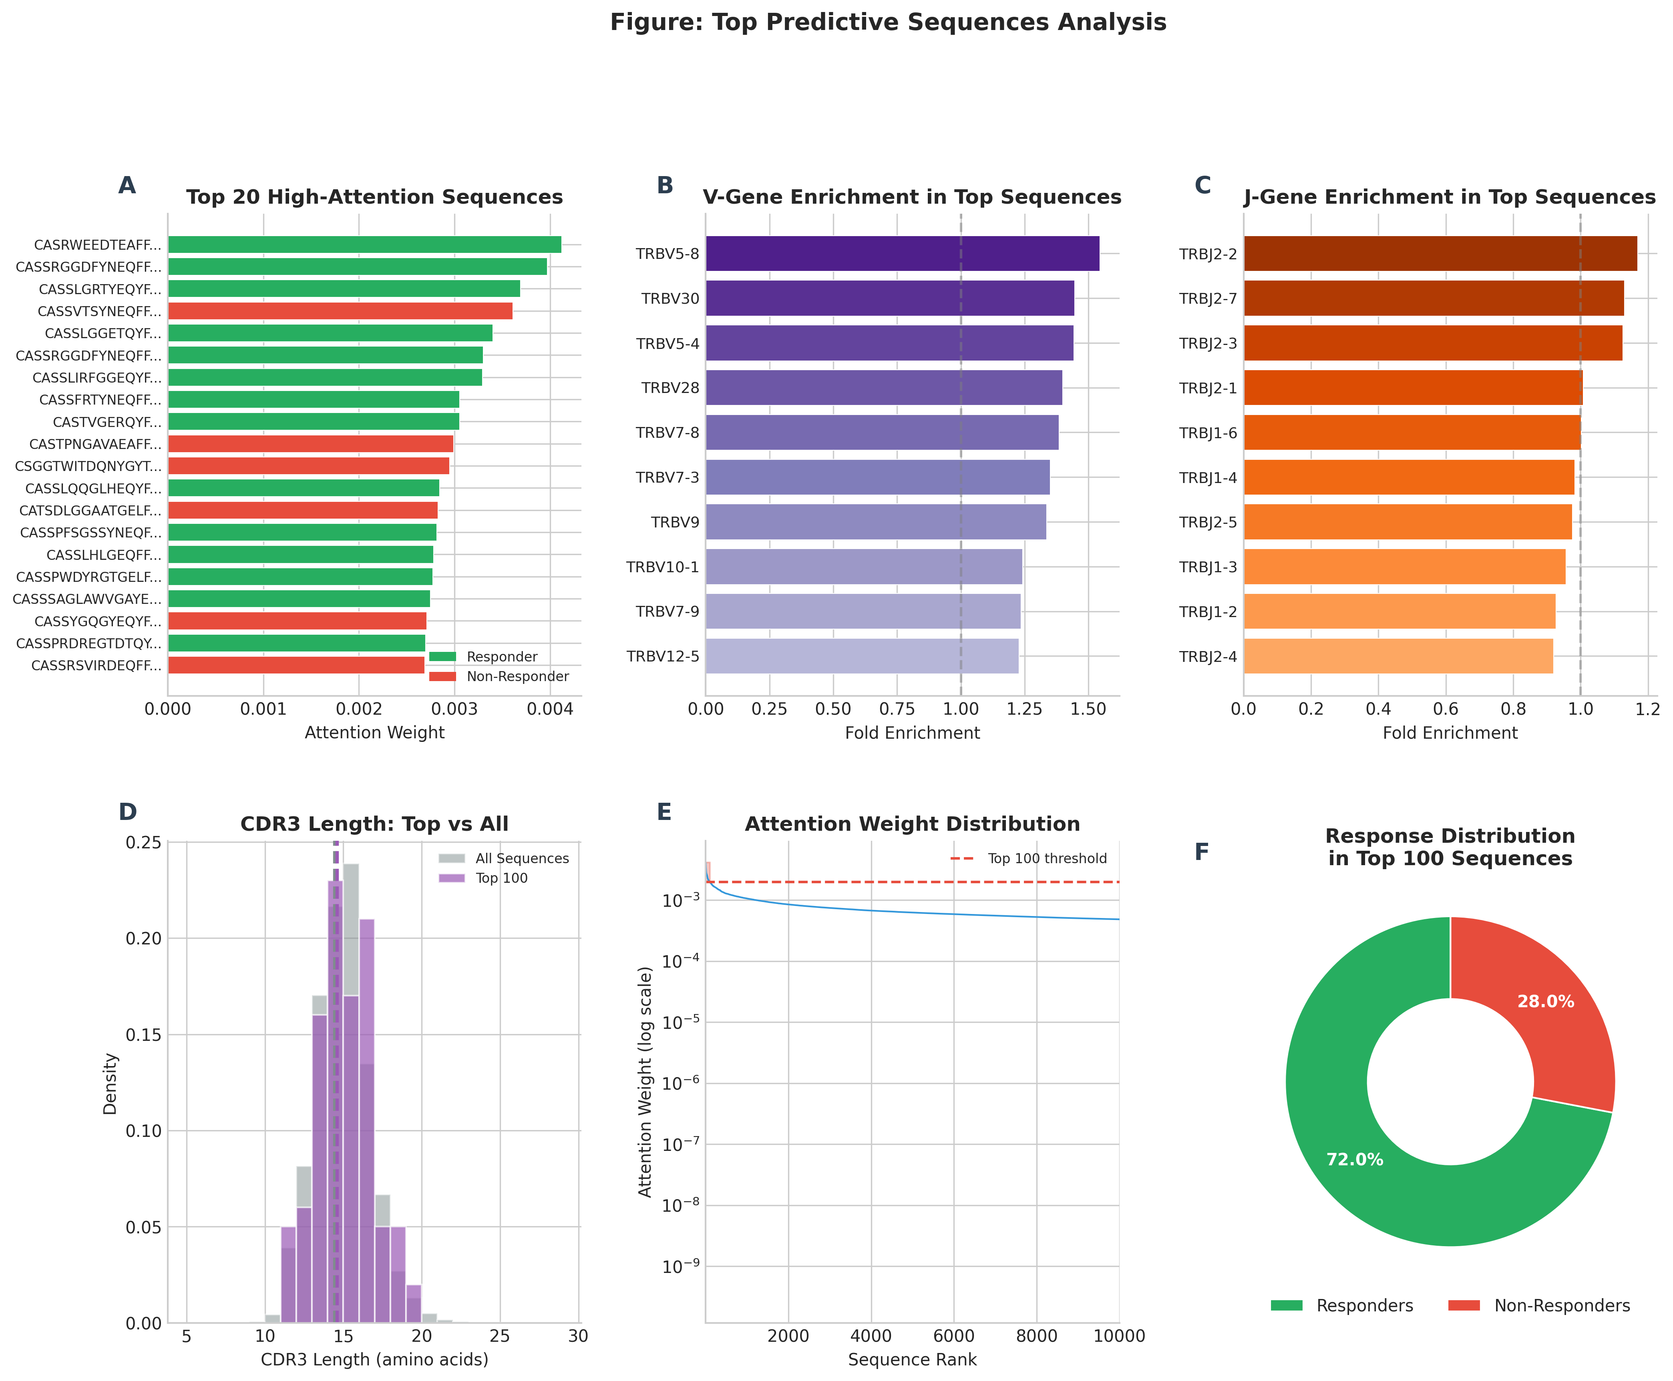
Figure S7: Top Predictive Sequences
Top sequences by attention; V/J enrichment; responder vs non-responder distribution

Slide 15
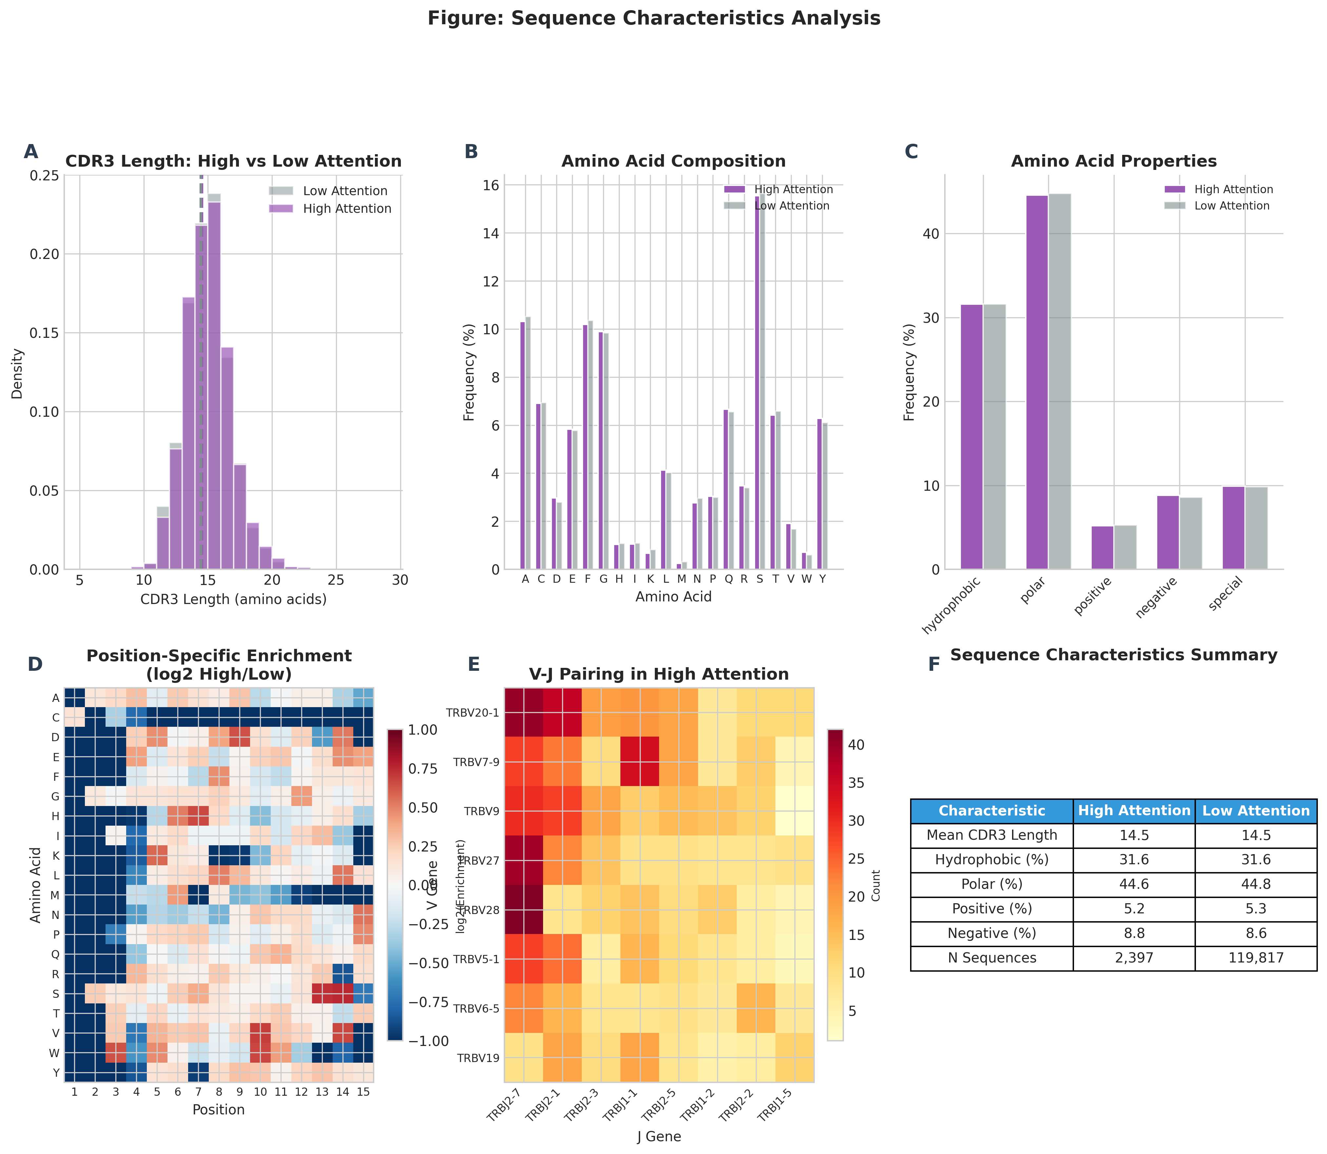
Figure S9: Sequence Characteristics
Length and amino-acid composition differences for high-attention sequences

Slide 16
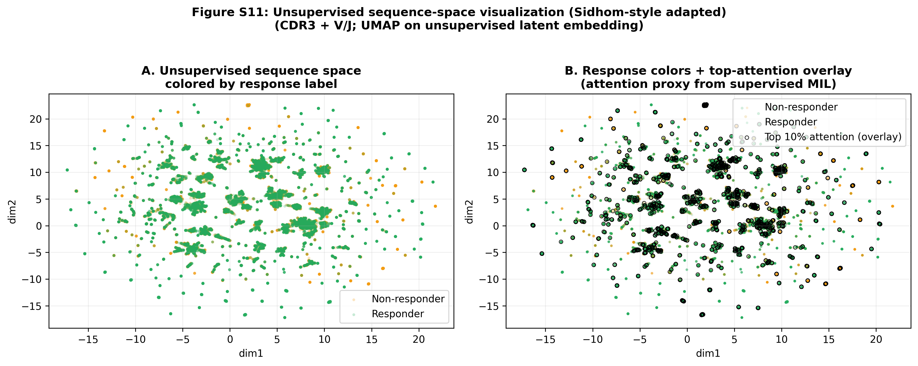
Figure S11: Unsupervised Sequence Space (UMAP)
R=green, NR=orange; black outline = top attention (supervised importance)

Slide 17
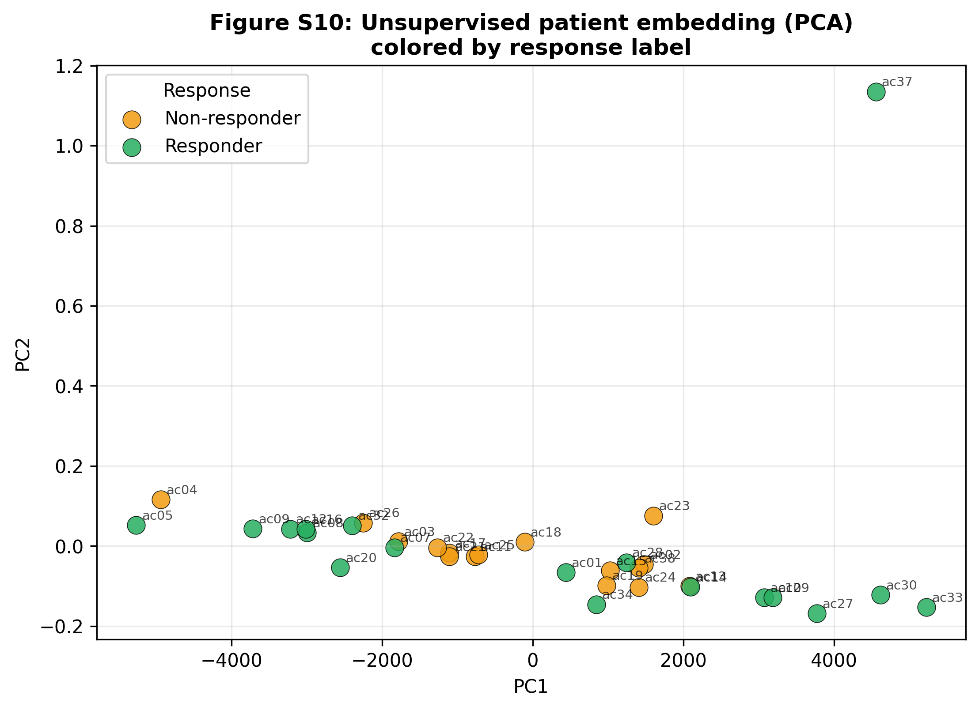
Figure S10: Patient Embedding (PCA)
Patient-level embedding (mean pooled); colored by response

Slide 18
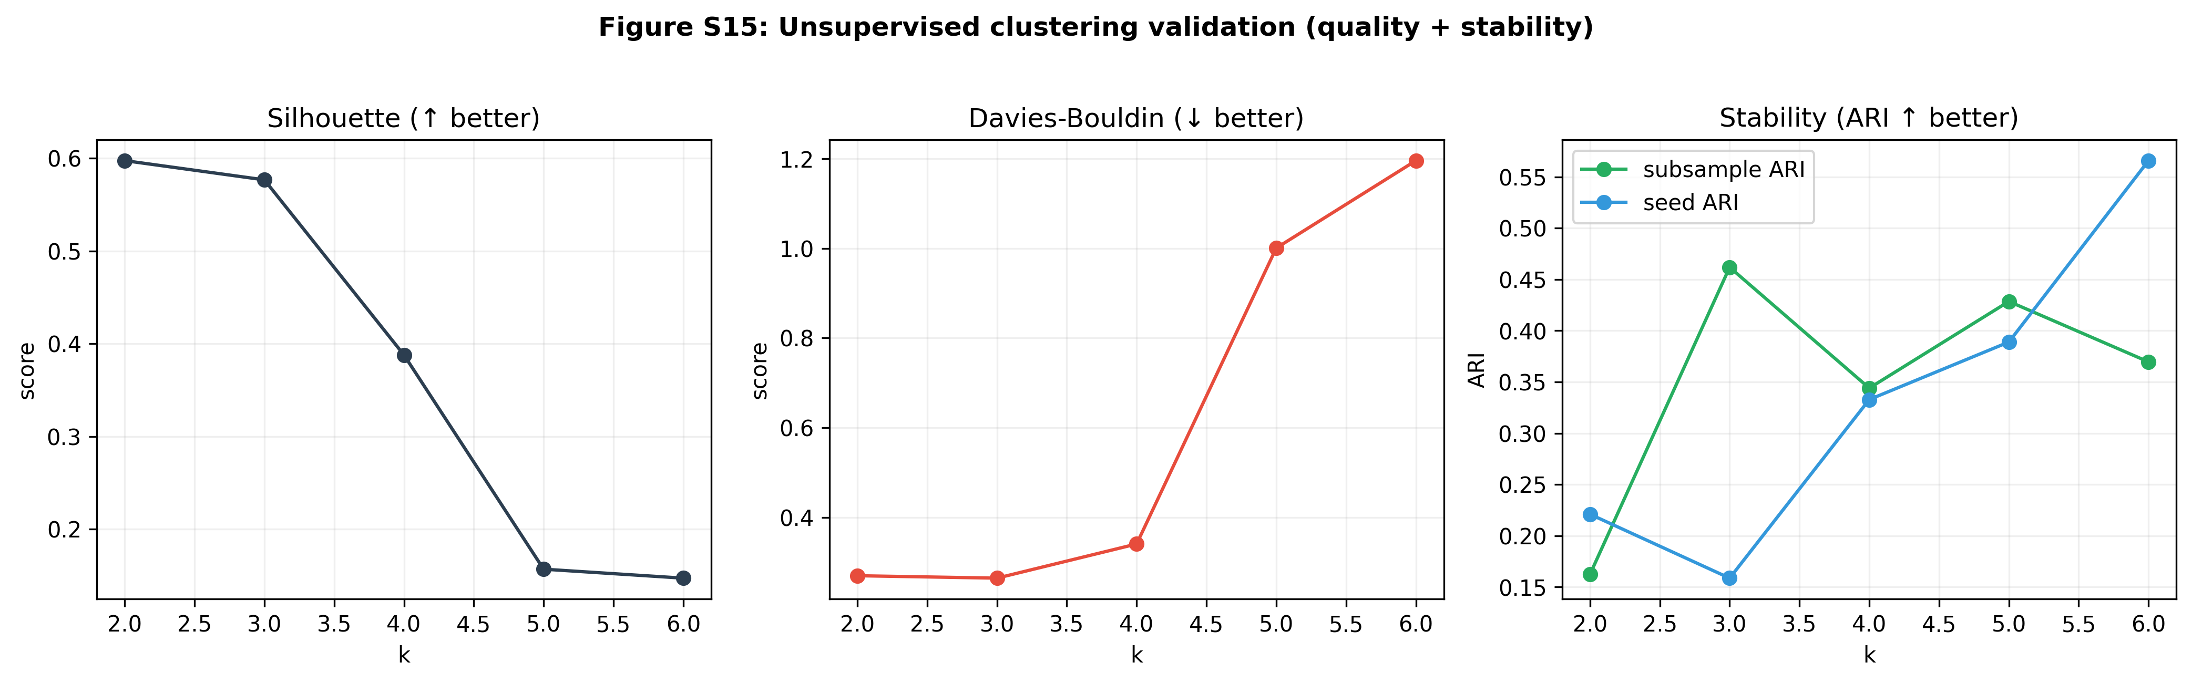
Figure S15: Unsupervised Validation (Quality + Stability)
Shows internal clustering quality and stability across k values

Slide 19
Key Findings Summary
Supervised MIL:
Mean AUC ≈ 0.754
Attention identifies predictive clonotypes
Unsupervised:
UMAP visualizes sequence concepts
Patient embedding provides structural QC
Clinical message:
Potential pre-therapy biomarker signal from TCR repertoire
Interpretability:
High-attention sequences map to localized regions in sequence space

Slide 20
Limitations & Next Steps
Small cohort size (n=34) → needs external validation
No HLA available (unlike Sidhom 2022 TCR+HLA models)
Improve: add more patients, integrate clinical covariates, prospective evaluation
Biology: validate high-attention clonotypes and motifs experimentally

Slide 21
Thank You
Questions? DeepTCR supervised MIL + unsupervised visualization

