Slide 1
Student Housing B.V.
Matei-Cristian Mitran
Ioan-Nicolae Popa
Alexander Bogdanov

Slide 2
Problem
Student Housing B.V. is a housing company in the Netherlands. They tasked us to design a software application to organize and keep track of the daily activities of their tenants.

Slide 3
Solution
We created an app based on the two parties of this “conflict”, the tenants and the administration.
As a tenant, you can file a complaint anonymously, see the announcements, participate in proposed activities, view what tasks have been assigned to them ( with due date ), contribute money to buy essentials and view their account settings ( see how many reports they have, change their password).
As an admin, you can see the complaints filed per every student or to the company itself, add, remove or update announcements and rules, add new tenants or make a tenant the student of the month and assign tasks to a tenant.

Slide 4
Result
With the help of the functionalities implemented by us, the problems in question will be fixed. This application will help the tenants be more organized.

Slide 5
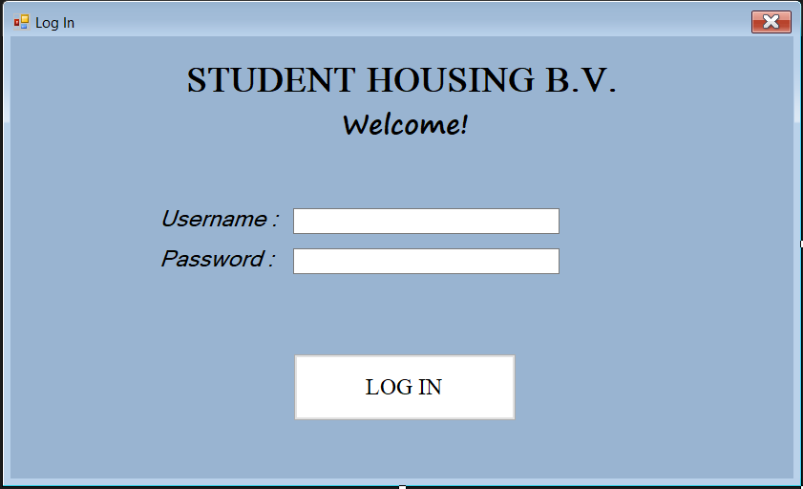
Log-In Screen
Notes:
Here you can log in either as an admin or a tenant.

Slide 6
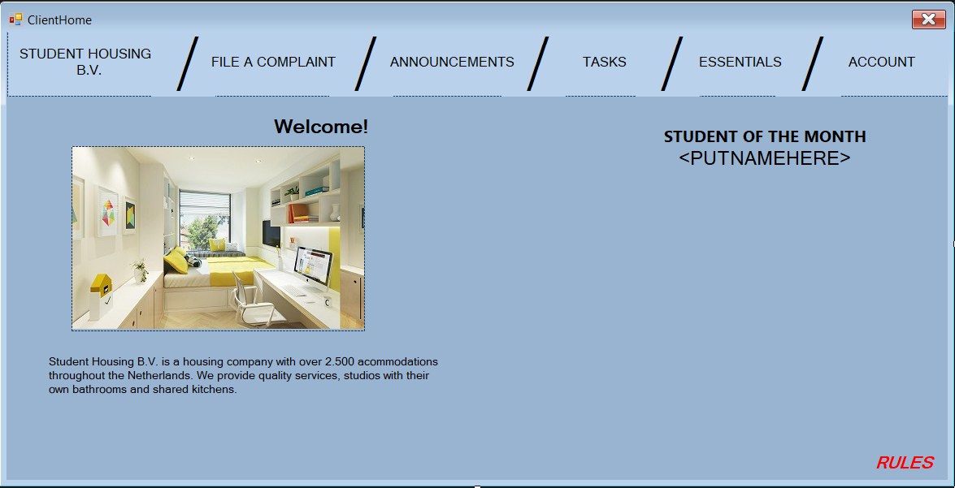
Tenant Home Page
Notes:
Here is the layout of the tenant home page. On the upper side of the form, you have a bar with the buttons that take you to the certain forms. You can also see some info about Student Housing B.V. and a label showing the student of the month. In the lower right corner of the form, there is a button to see the current rules in place.

Slide 7
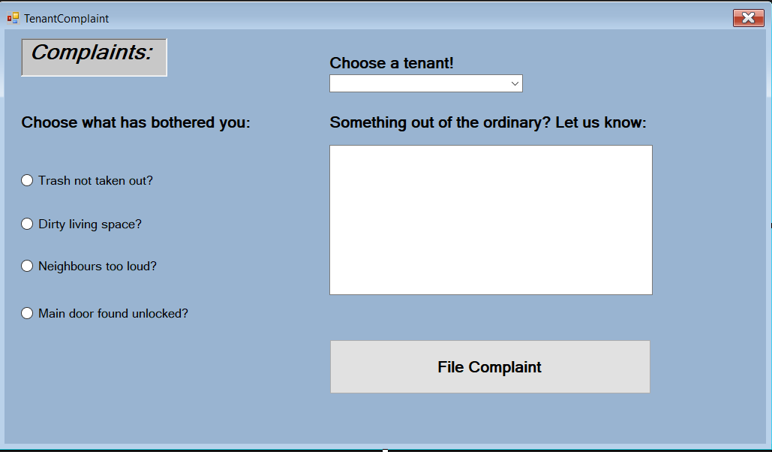
Tenant File A Complaint
Notes:
Here you can choose a tenant and then choose one of the default complaints. If you have a custom complaint, you have to write it in the textbox. After you are done selecting, you can press the
File Complaint button to file it to the system.

Slide 8
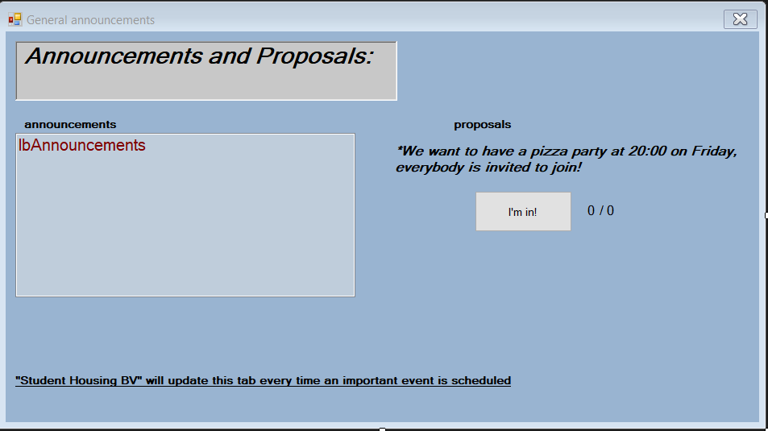
Tenant Announcements and Proposals
Notes:
In this form, on the left side you can see a listbox with all the announcements published by the administrators. On the right side, you can see the proposals and a button to participate. If you press the button, your vote will be counted and when the number of the votes is equal to the number of all the tenants, the proposal will take place.

Slide 9
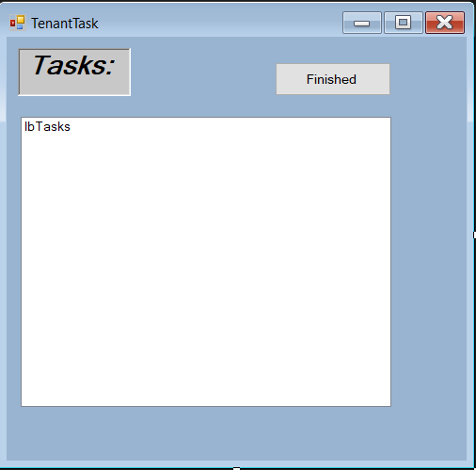
Tenant Tasks
Notes:
In this form, you can see all the tasks assigned to you by the administrators, with their due date and status. If you select a task and press the Finished button, the status of the task changes to “DONE”.
If the due date for the task passed and the status is UNFINISHED, the task is highlighted in red.

Slide 10
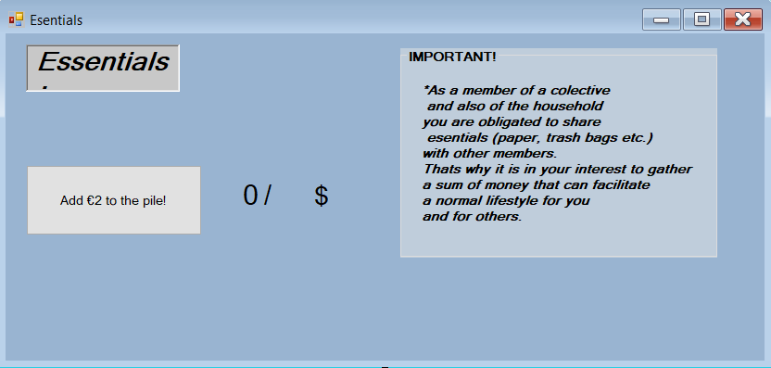
Tenant Essentials
Notes:
In this form, you can contribute with money for the essentials of the tenants by pressing the button. When the certain sum ( the number of the tenants times two ) is gathered, the essentials will be purchased.

Slide 11
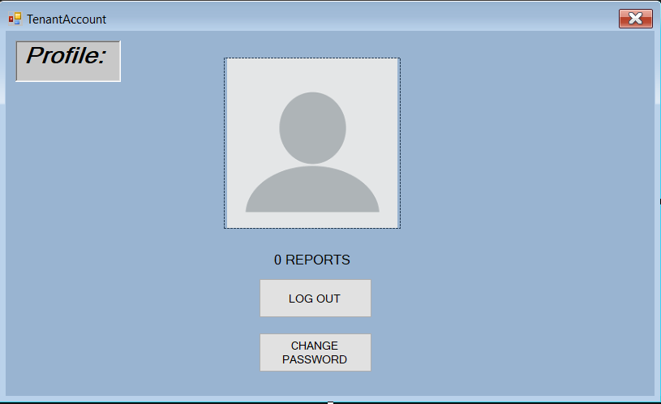
Tenant Account
Notes:
In this form, you can view how many reports you have received, change your password and log out. If you press the log out button, it will take you to the log-in screen. If you press the CHANGE PASSWORD button, it will open a new form.

Slide 12
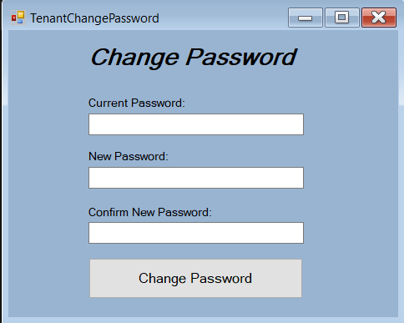
Tenant Change Password
Notes:
In this form, you have to fill in your current password and then a new password, different than the old one and then confirm it. If you press the Change Password button, your password will be updated.

Slide 13
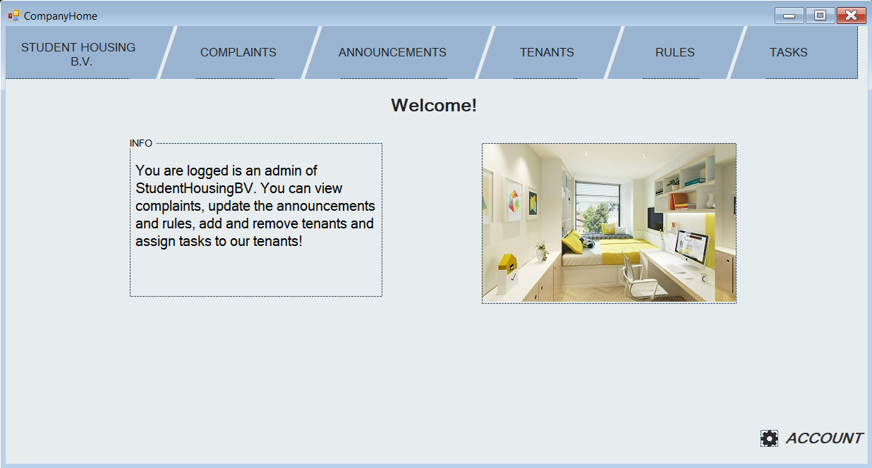
Company Home Page
Notes:
This is the first form the admin sees, like a hub. On the upper side of the form, you can see the buttons that take you to the certain forms. In the lower right corner, you can see the account button, taking you the account settings.

Slide 14
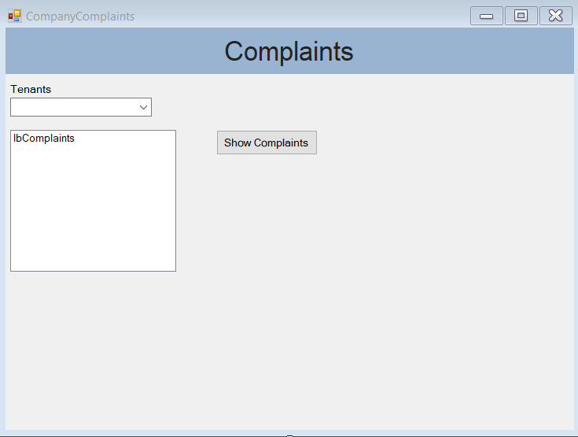
Company Complaints
Notes:
In this form, you can select one of the tenants and then press the button Show Complaints to see their current complaints.

Slide 15
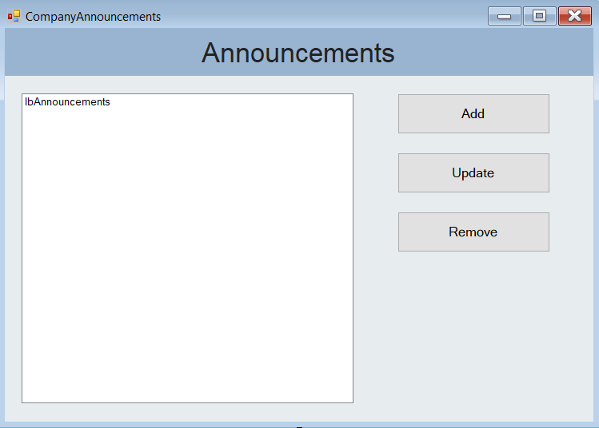
Company Announcements
Notes:
In this form, you can press the button to add an announcement that opens a new form, a button to update an announcement selected from the listbox and a button to remove an announcement selected in the listbox.

Slide 16
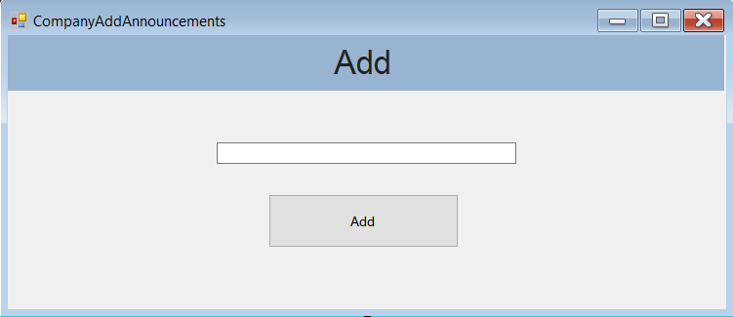
Company Add Announcement
Notes:
In this form, you can fill in an announcement and then press the button to add it.

Slide 17
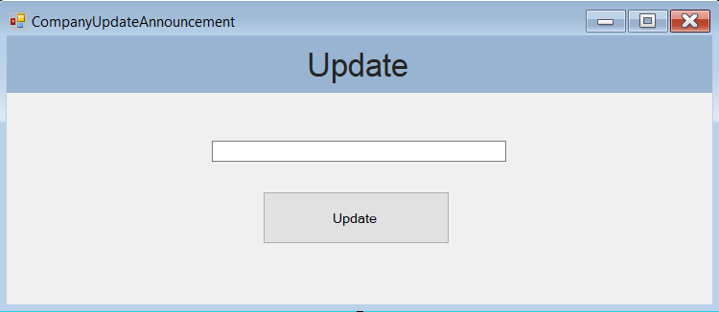
Company Update Announcement
Notes:
When you open this form, the announcement selected is already in the textbox. After you edit it, you can press the update button to update the certain announcement.

Slide 18
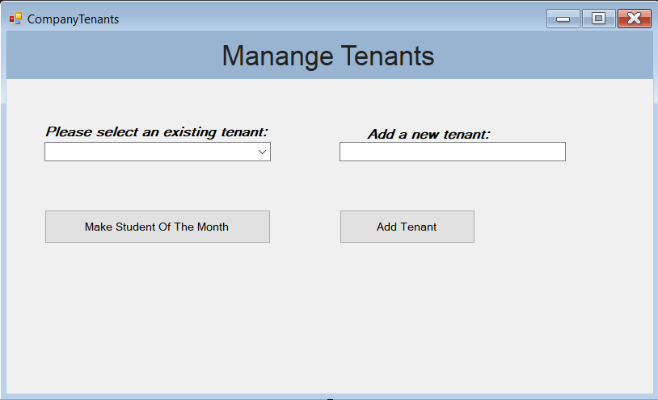
Company Tenants
Notes:
In this form, on the left side, you can select an existing tenant and press the Make Student Of The Month button to make the selected tenant the student of the month. On the right side, you can fill in the textbox a tenant and then press the button to add him/her.

Slide 19
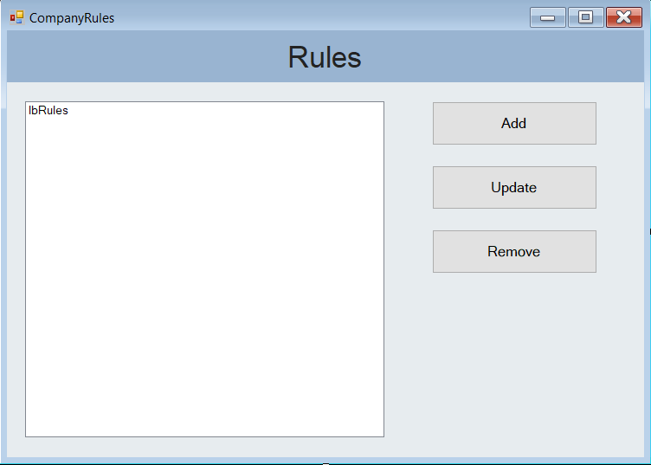
Company Rules
Notes:
In this form, you can press the button to add a rule that opens a new form, a button to update a role selected from the listbox and a button to remove a rule selected in the listbox.

Slide 20
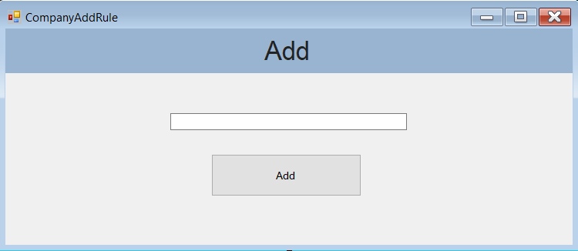
Company Add Rule
Notes:
In this form, you can fill in a rule and then press the button to add it.

Slide 21
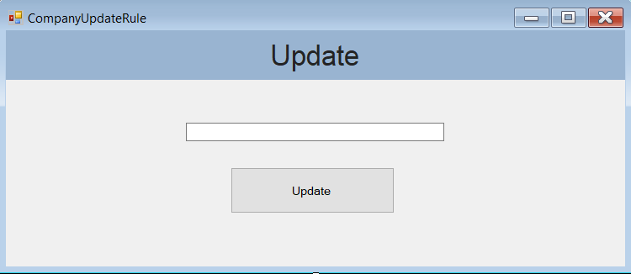
Company Update Rule
Notes:
When you open this form, the rule selected is already in the textbox. After you edit it, you can press the update button to update the certain rule.

Slide 22
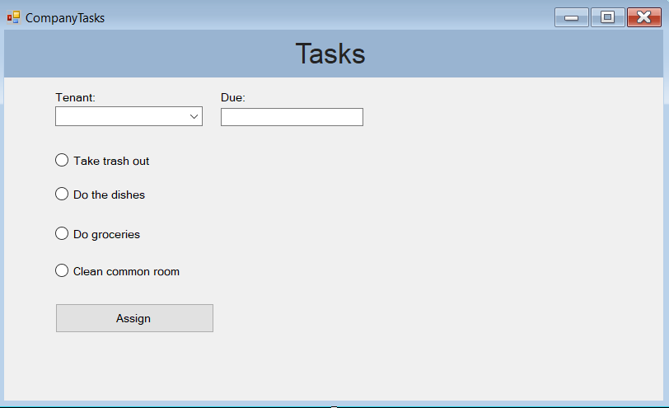
Company Tasks
Notes:
In this form, you can select an existing tenant, enter a due date and select one of the tasks and then assign it by clicking the Assign button.

Slide 23
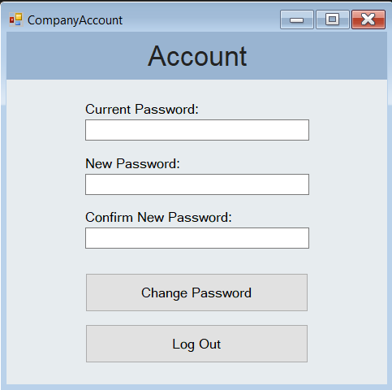
Company Account
Notes:
In this form, you can change the password of the admin account and log out.

Slide 24
Conclusion
In conclusion, the application created by us will help Student Housing B.V. organize and keep track of the tenants, resolving any issues they have had so far.

Slide 25
Demo
5 min

