Slide 1
Software Product line engineering
Matei vASILACHE 3rd year project

Slide 2
The problem we’re facing
Writing code over and over again.
Inefficiency
Could we somehow have reusable bits of code?
Incompatible code

Slide 3
The solution
Classes in OOP are a great example.
Rather than put general software components into a library in the hope that opportunities for reuse will arise, software product lines only call for software artifacts to be created when reuse is predicted in one or more products in a well defined product line.

Slide 4
The definition
Software product lines, or software product line development, refers to software engineering methods, tools and techniques for creating a collection of similar software systems from a shared set of software assets using a common means of production.
A set of software systems that share a common, managed set of features satisfying a need and are developed from a common set of core assets in a prescribed way.

Slide 5
Other important terms 1/2
Software family – the products resulting from the feature model
Feature model – compact representation of all the products of the SPL in terms of features
Feature – prominent or distinctive user-visible aspect, quality, or characteristic. One unit of functionality.
Feature interaction – integration of two features. Modify the behavior of one or both features when selected together.

Slide 6
Other important terms 2/2
Problem space – framework inside of which lies various components that go into creating a resolution for a problem. Creating the feature model.
Solution space – Implementation
Variability – Problem space (enumerative) vs Solution space (parametric)

Slide 7

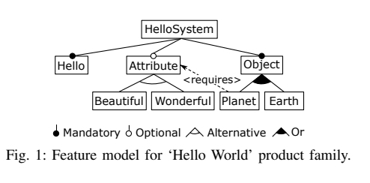
Example
‘HELLO EARTH’
‘HELLO BEAUTIFUL EARTH’
‘HELLO WONDERFUL EARTH’
‘HELLO BEAUTIFUL PLANET’
‘HELLO WONDERFUL PLANET’
Not ‘HELLO PLANET’, due to the ‘PLANET requires ATTRIBUTE’ constraint

Slide 8
Conclusion
Software mass production.
Benefits extend beyond product creation into maintenance and evolution, lowering the overall complexity of product line development, increasing the scalability of product line portfolios.

