Slide 1

Airline Operations
Case Study Analysis
Profitability · Operational Performance · Customer Satisfaction
Based on 500 Flights · 2023 Full Year

Slide 2
Executive Summary
Key performance indicators across 500 flights in 2023
25.2%
22 min
2.99 / 5
Cancellation Rate
Avg Delay
Satisfaction Score
126 of 500 flights
24.8% of flights delayed
50% rated below 3.0
100%
11%
$124k
Profitable Flights
Ancillary vs Ticket
Regional Differences
All 500 flights profitable
~ 15% bellow industry standards
Gap between best and worst earning region

Slide 3
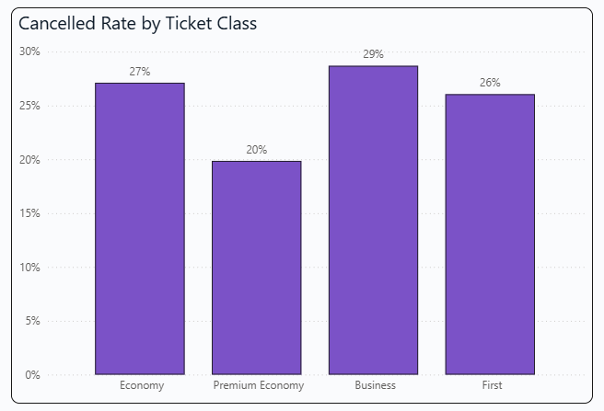
INSIGHT 1
1-in-4 Flights Cancelled
A 25.2% cancellation rate is far above the industry average of 2–4%
126
Total Cancelled Flights
25.2%
Overall Cancellation Rate
2–4%
Industry Benchmark
29%
Business Class (worst)
20%
Prem. Economy (best)
🟢 Implement proactive maintenance scheduling, build crew buffers, and
introduce dynamic re-booking systems. Target sub-5% cancellation rate.

Slide 4
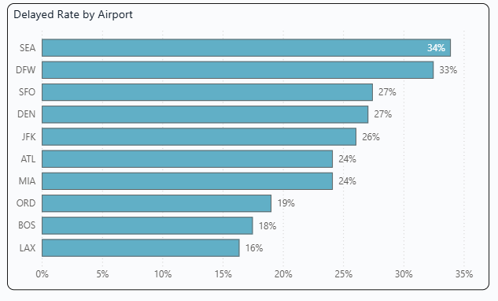
INSIGHT 2
Delays & Operational Reliability
Nearly 1 in 4 operated flights were delayed — and 1 in 6 faced severe delays over 60 minutes
24.8%
Flights Delayed (>0 min)
16.2%
Severe Delays (>60 min)
22 min
Average Delay Duration
2.97
On-time Satisfaction
3.07
🟢 Reduce mechanical delays through preventive programs. Reduce overbooking by
improving capacity algorithm. Establish clear compensation policies to rebuild trust.
Delayed Satisfaction (*)
*Investigate why on-time flights score lower — this
paradox points to a broader service quality issue
beyond just punctuality.

Slide 5
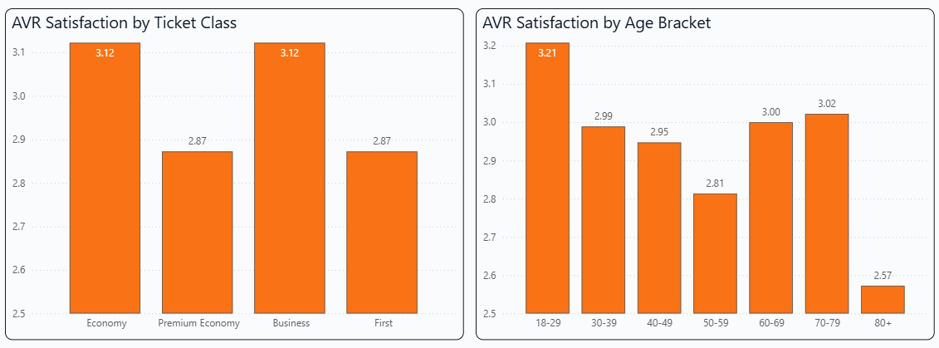
INSIGHT 3
Satisfaction Scores Near Breaking Point
Average satisfaction of 2.99/5 — with 50% of passengers rating below 3.0
First and Premium Economy cabins score the lowest (2.87), which is particularly damaging given these are the higher-value customers.
🟢 Priorities product upgrades in premium cabins, invest in proactive communication during disruptions, and introduce a service recovery
program targeting most impacted age groups.

Slide 6
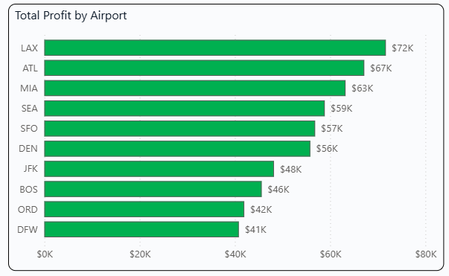
INSIGHT 4
Profitable Flights
Every single flight operated at some profit in 2023
$584.3K
Total Annual Revenue
$1.2K
Avg Revenue / Flight
6%
Fuel Cost/Seat as % of Revenue
$34.1K
Total Fuel Cost
$550.2K
🟢 Look at “what works” at top 3 airports and use those strategies as improvement
bases for less profitable ones. Explore better capacity management to use right-size aircraft to match demand and maximize load factors.
Total Gross Profit

Slide 7
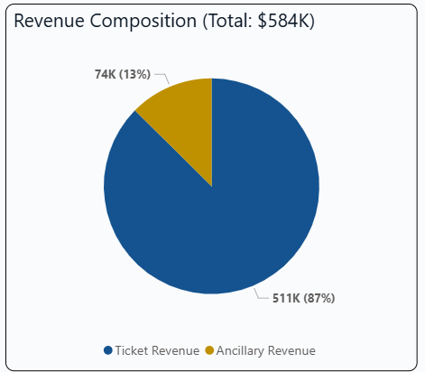
INSIGHT 5
Severely Undeveloped Ancillary Revenue
Ancillary Revenue is about 15% below industry standards
This income stream carries near-zero marginal operational cost and therefore it is a clear area for improvement.
Category | Amount | vs Revenue
Ticket Revenue | $510,686 | 87.4%
Ancillary Revenue | $73,574 | 12.6%
🟢 Build new structured ancillary programs with a goal of increasing the revenue stream to 25% of ticket revenue: - introduce multiple service levels with strategic upsell - create packages (seat + luggage + meal) at premium prices - offer new and improved loyalty rewards - establish partnership with new retailers to sell onboard
- investigate implementing AI-driven recommendation engine
*additional analysis can be done using passenger data to target ancillary offers by demographics

Slide 8
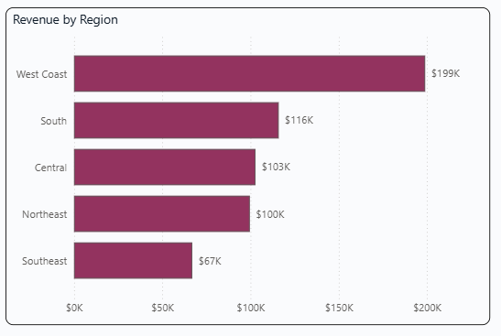
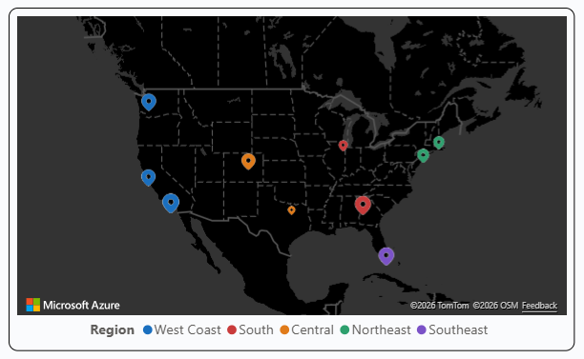
INSIGHTS 6
Region Profitability Variance & Revenue Mix
Significant differences in revenue between regions across the country
Revenue is far from evenly distributed across regions.
🟢 West Coast – focus on introducing premium products in already strong region Southeast – determine whether this is a demand or operational problem – either fix or exit the region and focus elsewhere South, Central, Northeast – similar performance. Focusing on marketing, increased frequency of flights and ancillary revenue programs can push these more towards the West Coast performance level

Slide 9
Summary
The data reveals a business in need for specific changes
🔴 25% cancellation rate and a portion of delayed flights is far above the industry benchmark, destroying customer journey and overall relationships
🟠 Customer satisfaction at 2.99/5 risks permanent customer churn if unaddressed
🟠 With only 12% of ticket revenue, ancillary income is massively underdeveloped area – clearest short-term opportunity
🟢 Gradual optimization of services based on the Region and its current financial performance
Airline Operations Case Study · 2023 Full Year Analysis · 500 Flights

