Slide 1
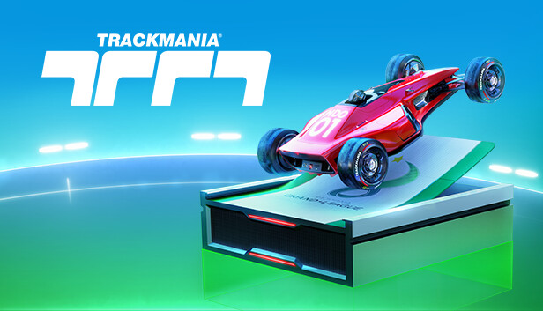
Automania
Rob Verbeek
Matej Buršík
Zubair Hussain

Slide 2
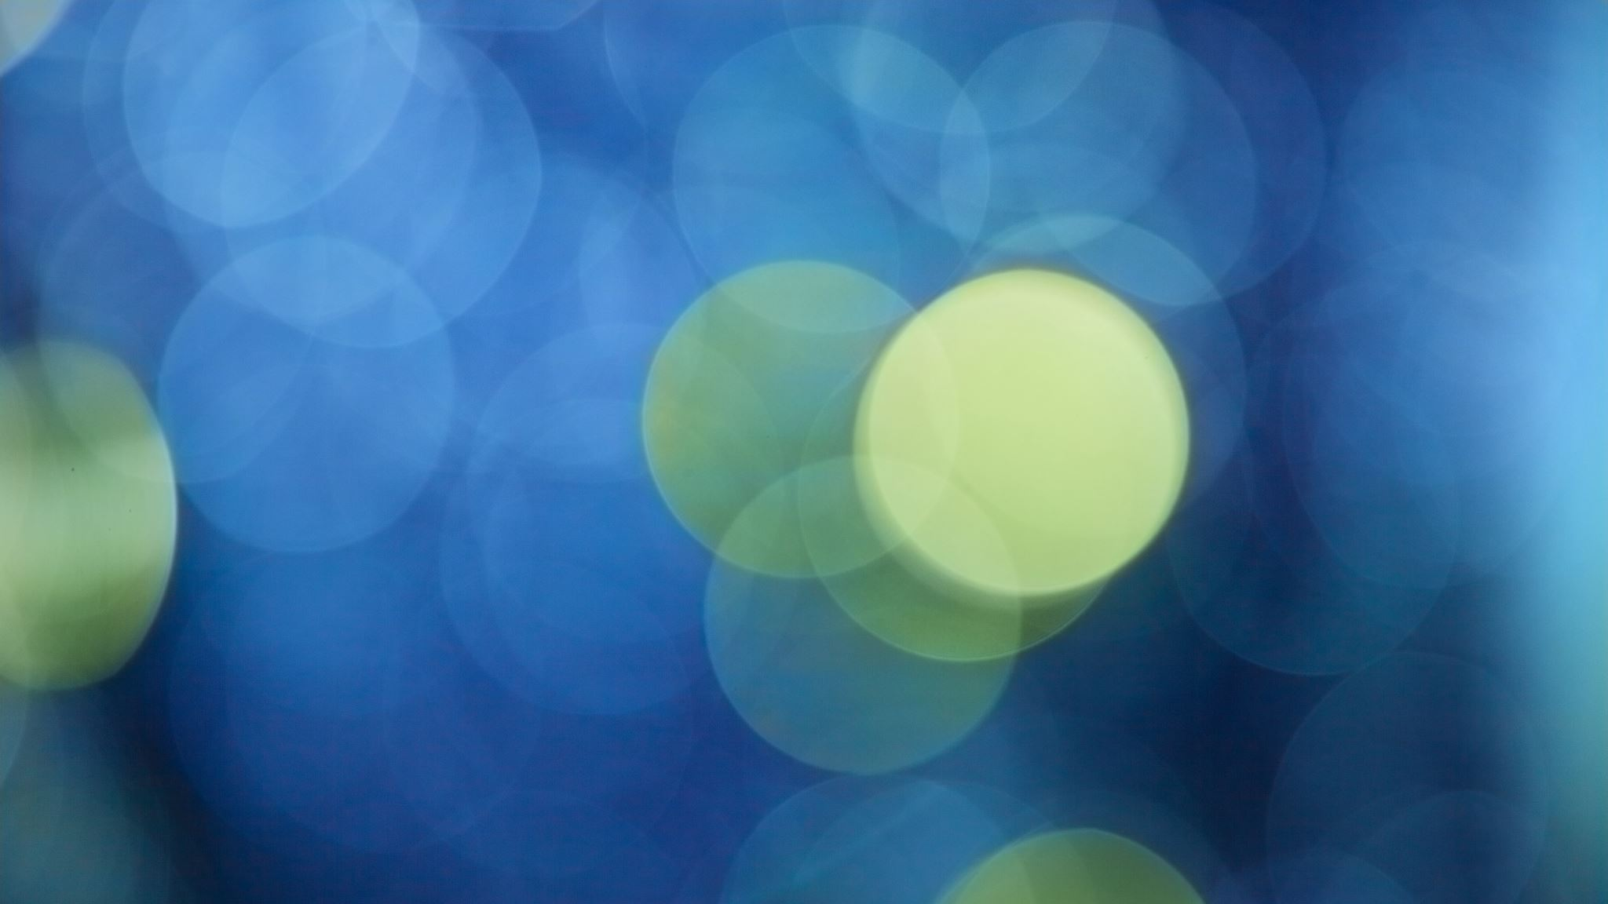
Goal
Develop self-driving car for a videogame
We chose Trackmania
Use computer vision
Ideally has decent driving

Slide 3
Key steps
Data collection
Data pre-processing
Model selection
Model testing
Fine-tuning
Integration with trackmania

Slide 4

Extras
Bounding boxes with YOLO
Sequential decision making with LSTM

Slide 5

Data collection
Record gameplay and inputs
Save inputs in a csv
Different folders per dataset
Dataset: turn_1
frame, left, right, forward, backward
frame_170.jpg, 0 ,1 ,1 , 0
All: 5459 Forward: 942 - 17.25% Backward: 93 - 1.71% Right: 2663 - 48.79% Left: 1761 - 32.25%

Slide 6
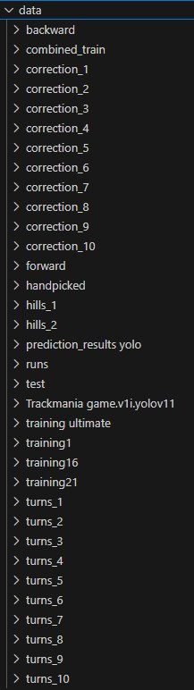
Data cleaning
Manual cleaning
Utilizing scripts
Combined approach

Slide 7

Combining Datasets
Lots of folders with images
Lots of different csv files
Solution: Combine them into a single dataframe

Slide 8
Model selection
We chose Resnet
Has good image recognition
Avoids vanishing gradients
Still struggles with trackmania objects

Slide 9

Improving training time
3000 images, 10 epochs
Long training times 30 minutes +
FP16 to reduce training time
Loss in quality but not in model

Slide 10
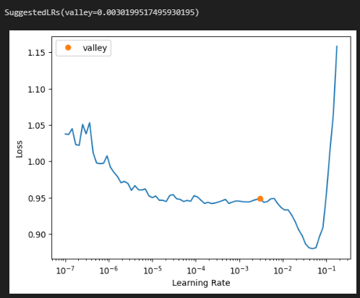
Learning rate finder
Learning rate determines how much the model changes
FastAI lr_find to find the optimal learning rate
Optimal learning rate to decrease loss

Slide 11
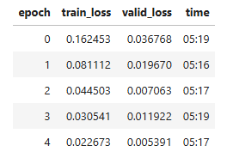
One-fit cycles
Adjust the learning rate throughout cycles
Start low, peak, then decay
Helps avoid local minima

Slide 12

Failed techniques
Custom learner (pretrained body + custom head)
Dropout to avoid neuron superstars
Discriminative learning spiked loss

Slide 13
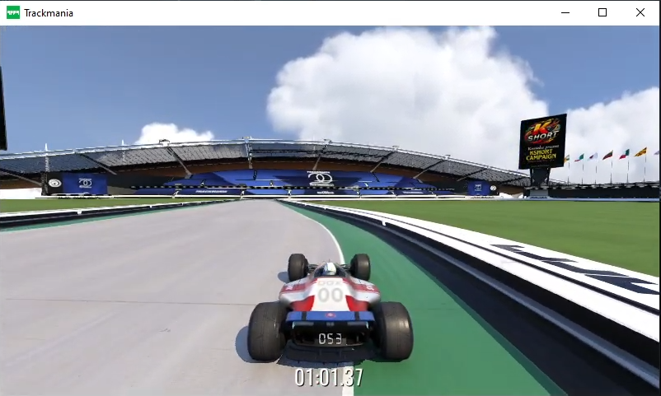
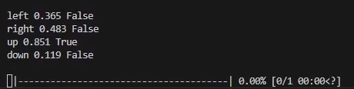
Integration with trackmania
Take a screenshot (real-time)
Make a prediction
Process the result of the prediction

Slide 14
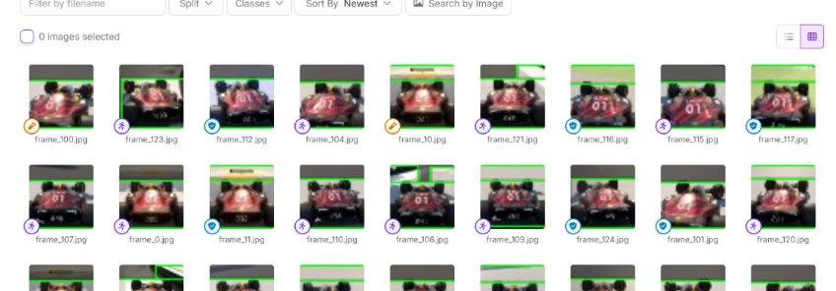
YOLO
YOLO for Object Detection
Custom Dataset

Slide 15
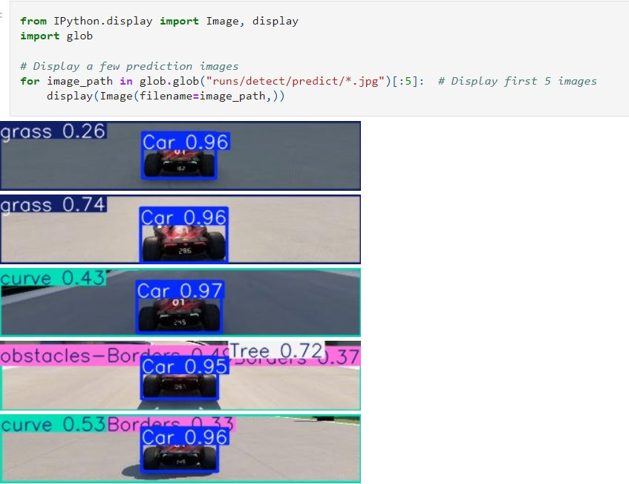

Slide 16
LSTM
CNN Feature Extraction
Integration of YOLO Features
LSTM Layer
Output Layer

Slide 17
Automania demo
https://www.youtube.com/watch?v=nge85Ai3Lfw https://www.youtube.com/watch?v=N5Ct5qnqUcU

