Slide 1

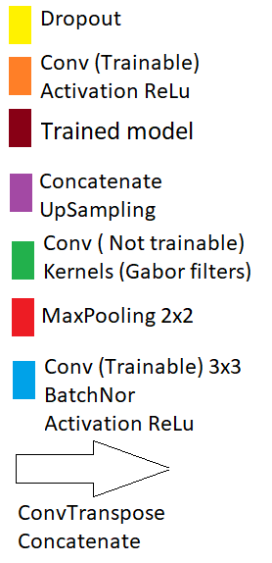
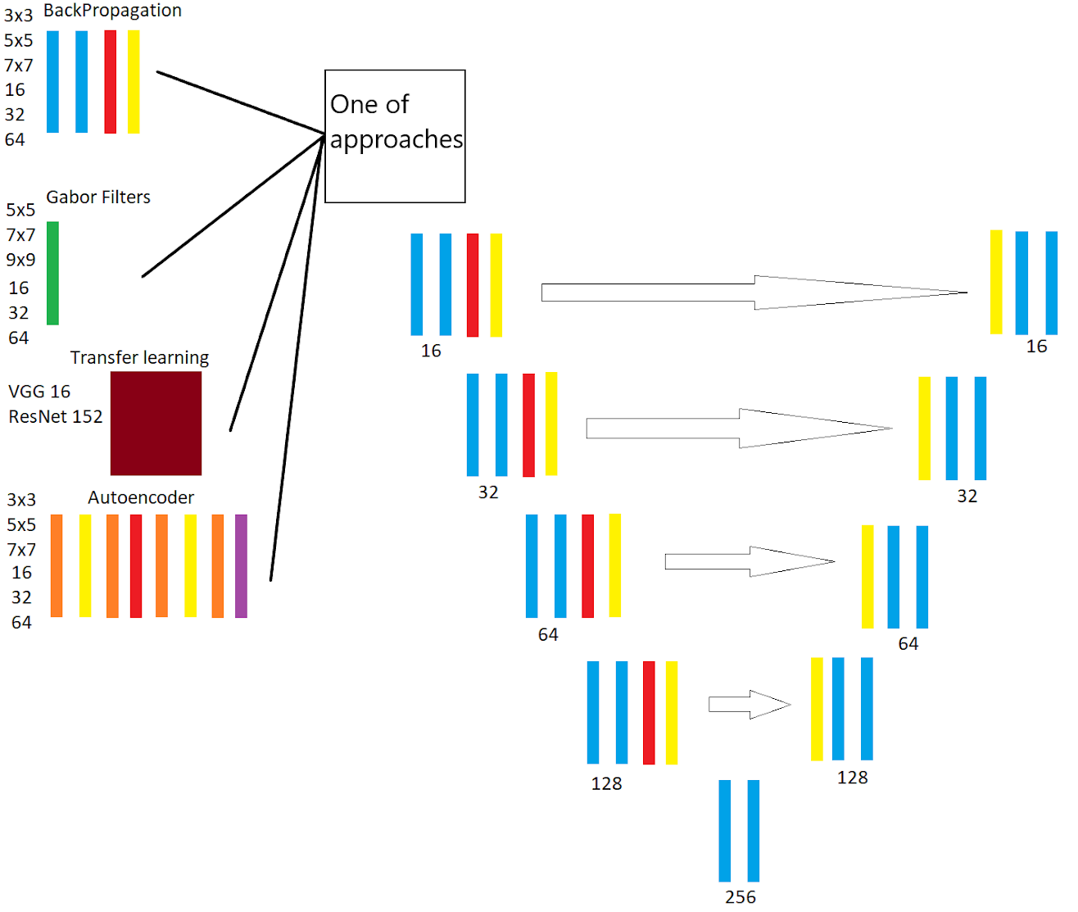



Processing of medical data by artificial intelligence for medical diagnosis support
FIIT STU
Matej Horniak, supervisor: Vanda Benešová
Dataset PatchCamelyon16
Images shape 96x96x3
Training part 262 144 images
Test part 32 768 images
Valid part 32 768 images
Best results and tested variations
Backpropagation: 3x3, 5x5, 7x7 kernel size
Autoencoder: 3x3, 5x5, 7x7 kernel size
Gabor filters: 5x5, 7x7, 9x9 kernel size
Transfer learning: ResNet, VGG16
Conclusion and future work
The best approach is classic backpropagation The worst approach is transfer learning by ResNet Future work will be compared to individual approaches on textured surfaces (DAGM dataset)
Approaches | Kernel size | Accuracy
Backpropagation | 5x5 | 0.83279
Autoencoder | 5x5 | 0.70458
Gabor filters | 5x5 | 0.77017
Transfer learning | ResNet

