Slide 1

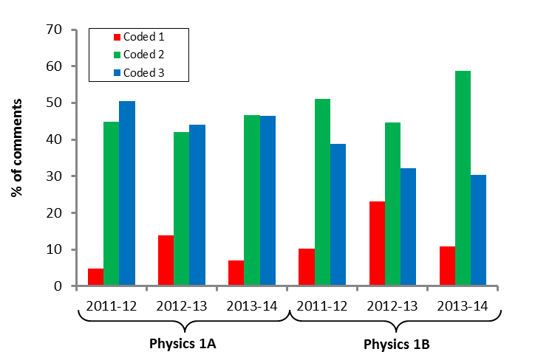
Poster title: An investigation into…
Your name
Supervisor: Prof XXX YYY
Introduction
A summary of the background and context of your project together with the aims and motivation of your work.
Make sure the body text is readable from around a metre away. Remember to cite your references.¹
Results
The key results from your project and a discussion of what they mean.
In this layout the results are placed centre stage. Use figures and/or graphs to show key findings.
Make sure all labels etc. are visible. The poster should be eye catching, but easy to read; try to avoid ‘busy’ backgrounds and colour schemes which distract from the content.
Conclusions
Discussion, conclusions and suggestions for future work.
A reader should be able to skim top the three boxes – Intro, Results, Conclusions - and get a good sense of what you did, why it was worth doing and what you achieved.
Figure 1: Distribution of comment codes.
References
¹ Pollitt, A. (2012). The method of Adaptive Comparative Judgement. Assessment in Education: Principles, Policy & Practice, 19(3), 281–300
Methods
A summary of the methods you used.
This may not be of interest to everyone, so in this layout this section is tucked away at the bottom left hand side, although the poster still follows a logical flow.
Figure 1: Figures should have brief captions.
Acknowledgements
Thanks to…
Notes:
Copyright Colin Purrington (http://colinpurrington.com/tips/academic/posterdesign).

