Slide 1


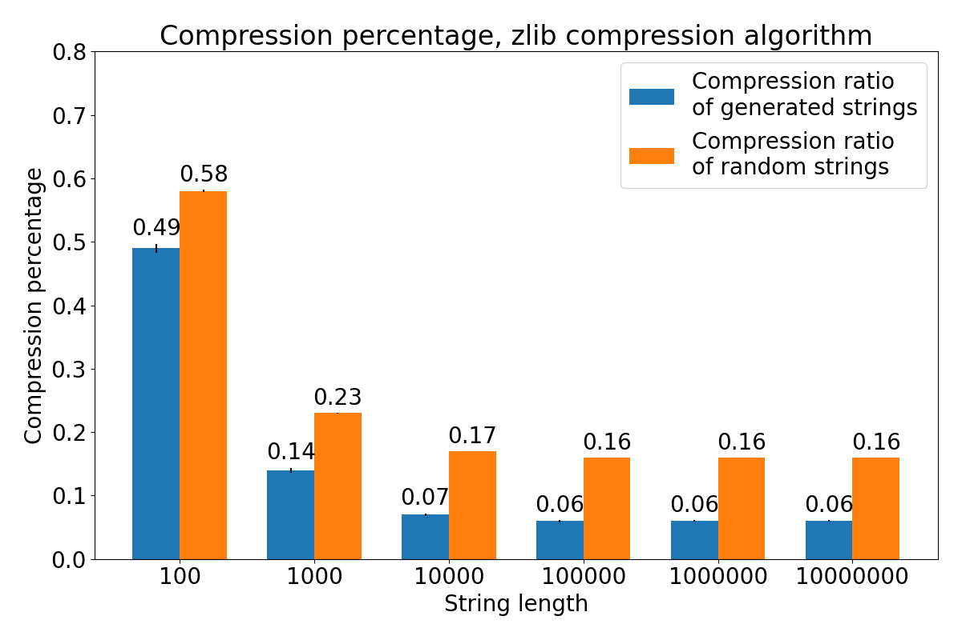
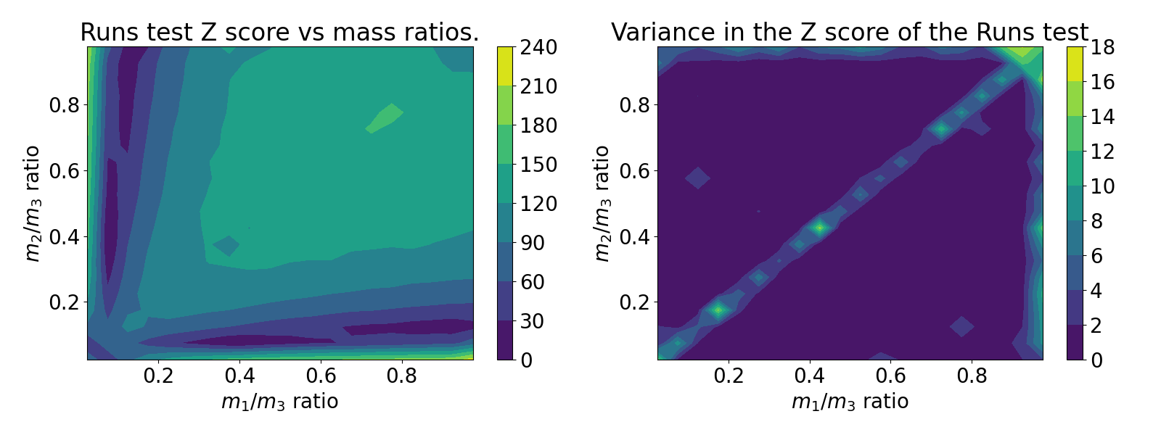
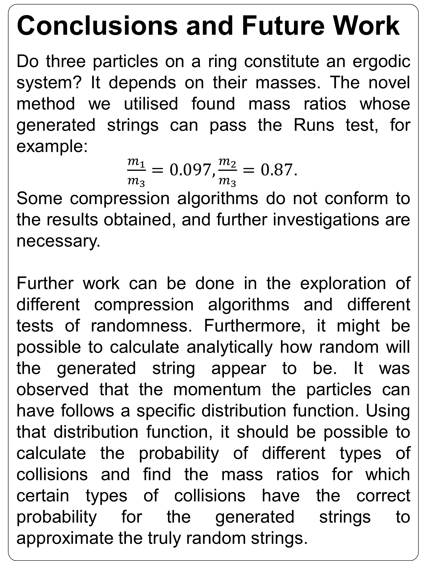
Ergodicity of Three Hard Spheres on a Ring
Matej Vedak
Supervisor: Prof G. J. Ackland
Introduction
The ergodic hypothesis says that all accessible microstates are equiprobable over a long period. Knowing that a system is ergodic allows us to utilise the methods of statistical physics on the system. However, it is far from clear that a deterministic system will explore all of its microstates [1]. To this end, a system of three particles on a ring is studied. A novel method of ergodicity exploration is used.
Ergodicity example¹:
Regular dice – outcomes can be anything from 1 to 6.
Non-ergodic system example:
Weighted or magnetic dice that only produces the number 6. Microstates 1-5 are not accessible.
Results
Collision generated strings are, in general, less random than actual random generated strings. The compression ratio decreases with increasing string length – compression algorithms work better on longer data sequences. Entropy comparison didn’t turn out to be very useful, as string entropy quickly rose to 1 bit entropy (maximum).
Exploring differing mass ratios, it was found that there are areas with a high chance of randomness. As long as one of the masses is sufficiently small, the collision generated strings can pass the Wald-Wolfowitz runs test.
Conclusions and Future Work
Do three particles on a ring constitute an ergodic system? It depends on their masses. The novel method we utilised found mass ratios whose generated strings can pass the Runs test, for example:
$\frac{m_{1}}{m_{3}}=0.097, \frac{m_{2}}{m_{3}}=0.87$.
Some compression algorithms do not conform to the results obtained, and further investigations are necessary.
Further work can be done in the exploration of different compression algorithms and different tests of randomness. Furthermore, it might be possible to calculate analytically how random will the generated string appear to be. It was observed that the momentum the particles can have follows a specific distribution function. Using that distribution function, it should be possible to calculate the probability of different types of collisions and find the mass ratios for which certain types of collisions have the correct probability for the generated strings to approximate the truly random strings.
Figure 1: Distribution of comment codes.
Figure 1: zlib algorithm compression percentage for differing string lengths.
¹The example given does not tell the whole story of ergodicity and is not a formal example; it does suffice for this purpose of a „popular” explanation
Methods
When two particles collide in a three-particle system on a ring, only two things can happen afterwards: either one particle collides with the third one, or the other one does. This binary outcome is utilised to produce binary strings whose entropy, compressiveness and randomness are tested and compared to actual random strings. To test randomness, the Wald-Wolfowitz runs test was used [2], whose Z score indicates randomness.
References
[1] Peter Vranas. „Epsilon-Ergodicity and the Success of Equilibrium Statistical Mechanics”. In: Philosophy of Science 65.4 (1998), pp. 688-708. DOI: 10.1086/392667.
[2] NIST agency of U.S. Department of Commerce. Runs Test for Detecting Non-randomness. 2003. DOI: https://doi.org/10.18434/M32189. URL: https://www.itl.nist.gov/div898/handbook/eda/section3/eda35d.htm.
Figure 2: Wald-Wolfowitz runs test Z score (the lower the better) for differing mass ratios of the 3 particles. There are areas of low Z scores for which the generated strings would pass this test of randomness.
Notes:
Copyright Colin Purrington (http://colinpurrington.com/tips/academic/posterdesign).

