Slide 1
1
Bending of Starlight - Introduction
angle θ
sun
Deflection angle calculated through Newtonian methods
and relativity methods off by a factor of two.
(0.87 vs 1.75 arcseconds)
Goal: Model this phenomenon numerically using
General Relativity procedures and compare results to Newtonian model of gravity.
Experimentally confirmed by Sir Arthur Eddington in 1919, which essentially “proved” Einstein’s theory of relativity.

Slide 2
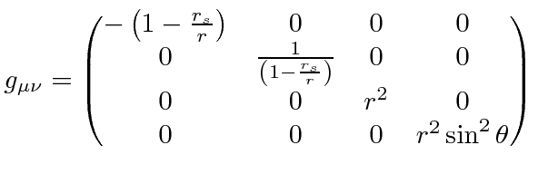
2
GR Stuff
The metric provides notions of distances in 4-dimensional space. The metric I dealt with was the Schwarzschild metric,
as it is very simple and works great for static, spherically symmetric things (like the sun!)
The line element is what quantifies “distances” precisely. An example is that ds^2 = dx^2+dy^2 in the xy-plane, so that our metric would just be the identity matrix.

Slide 3
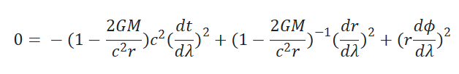


3
Photon Trajectory Derivation
Choose ds = 0 since photon trajectory. Let dθ = 0, θ=π/2
It’s nice to work with conserved quantities,
particularly E and L:

Slide 4

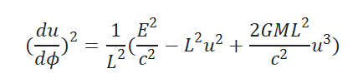
4
Photon Trajectory Derivation
Multiplying through and solving for dr/dλ:
In physics fashion, let u = 1/r:

Slide 5


5
Photon Trajectory Derivation
Chain rule, differentiate by ϕ:
Finally, our photon geodesic:

Slide 6

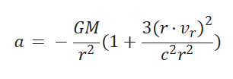
6
1PN Approximation
Essentially applies a correction factor to Newtonian gravity to account for relativistic effects.
GR acceleration term correction
Newtonian gravity

Slide 7
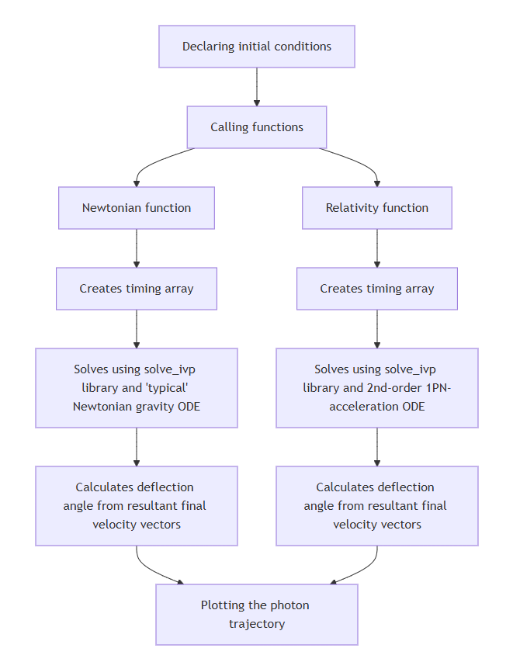
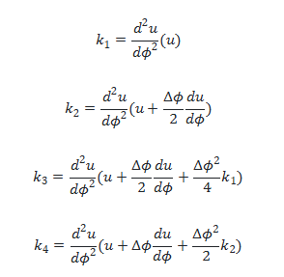
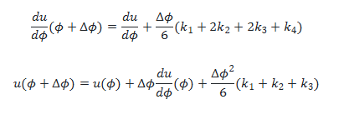
7
Algorithms
Explored implementing following RK4 algorithm
with upcoming step values determined by
What I ended up doing instead

Slide 8
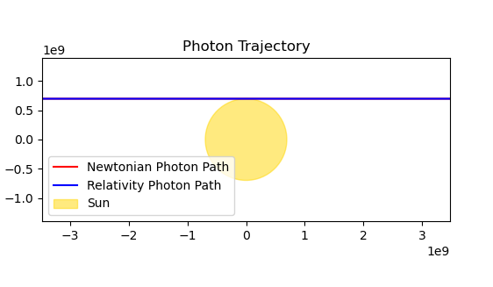
8
Results
Results align with analytic solutions
Results align with experimental data
Results must be good
Finally got correct deflection angle,
as analytically calculated by Einstein and
as measured by Eddington in 1919.
Alternative Methods
Could use geodesic equation towards plotting photon trajectories instead.
Implement RK4 maybe next time?

