Slide 1
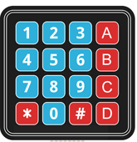
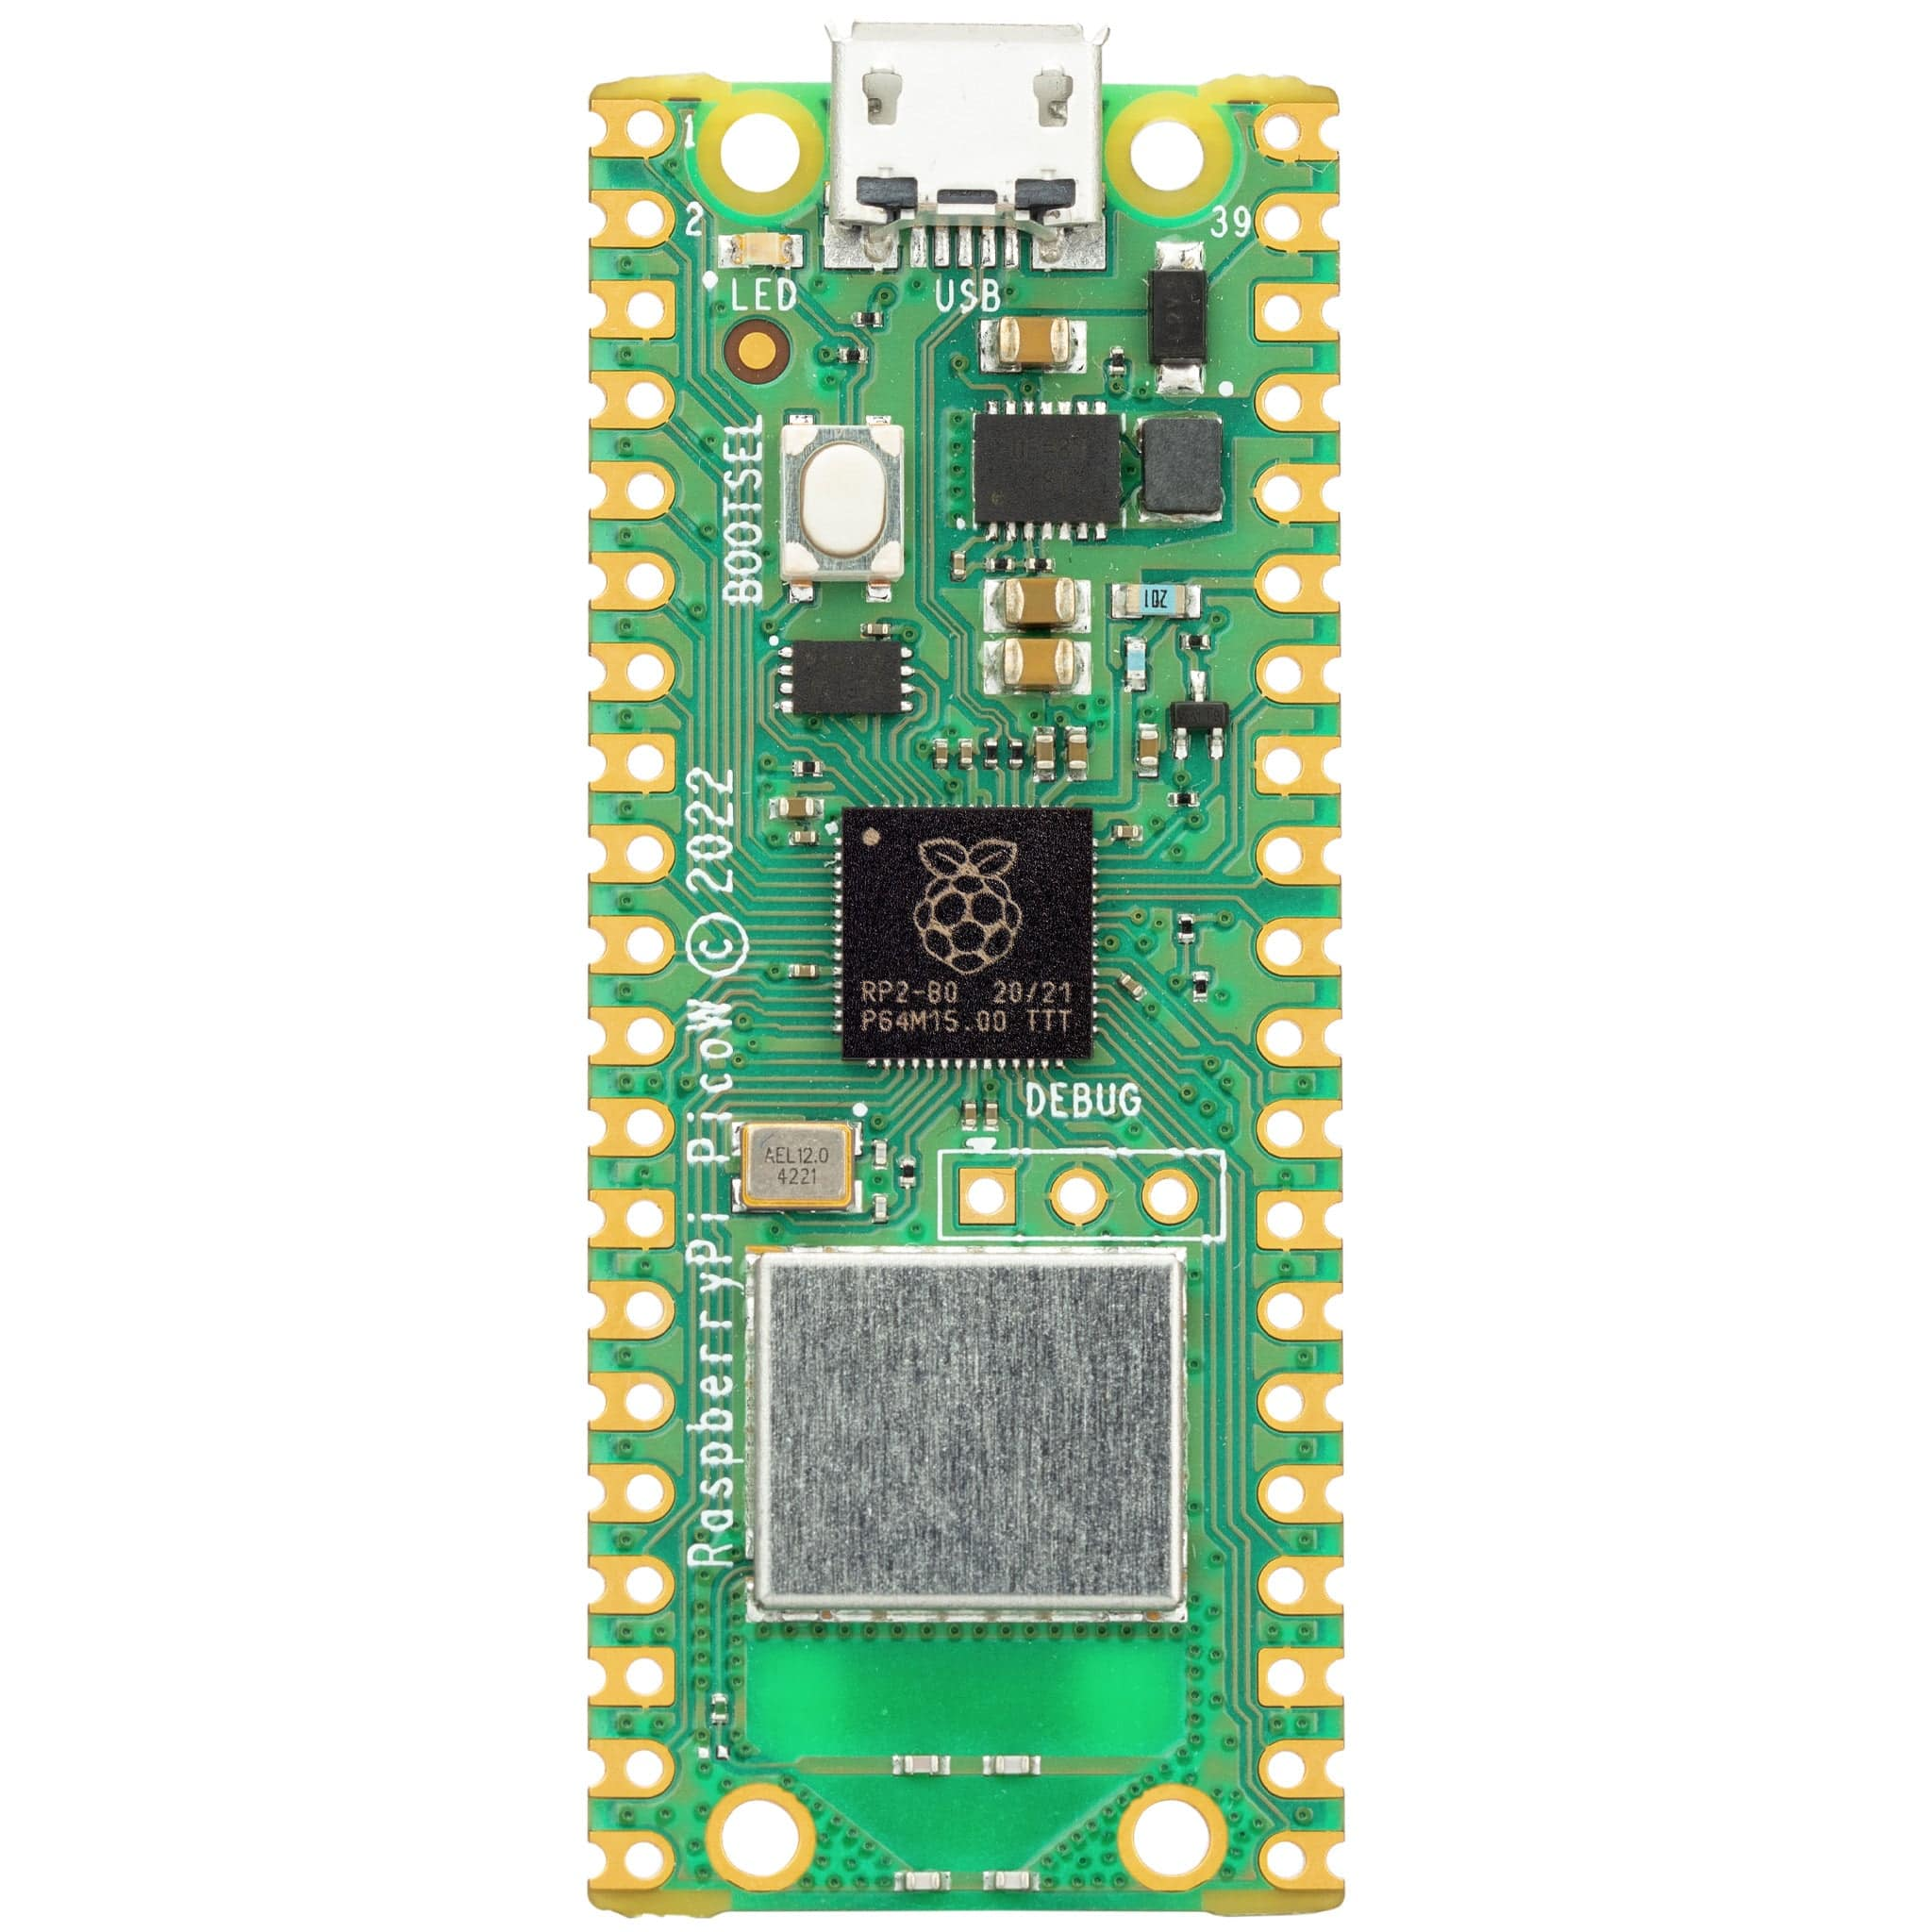












$$+15v$$
LM7805
10K
$$V_{CC}=5v$$
1K
$$13$$
DAC 0808
$$14$$
$$15$$
5K
$$2$$
5
6
7
8
9
10
11
12
5K
-
+
$$4$$
LF 351
Entradas
Salidas
$$Salida$$
PICO_W
$$16$$
5K
3.3V
$$3$$
$$0.1 uF$$
$$(104)$$
330
330
330
330
$$V_{CC}=−15v$$
1K

