Slide 1



Tablero_IDEO
View in Power BI
Last data refresh:
6/3/2026 15:58:59 UTC
Downloaded at:
9/3/2026 16:12:11 UTC

Slide 2
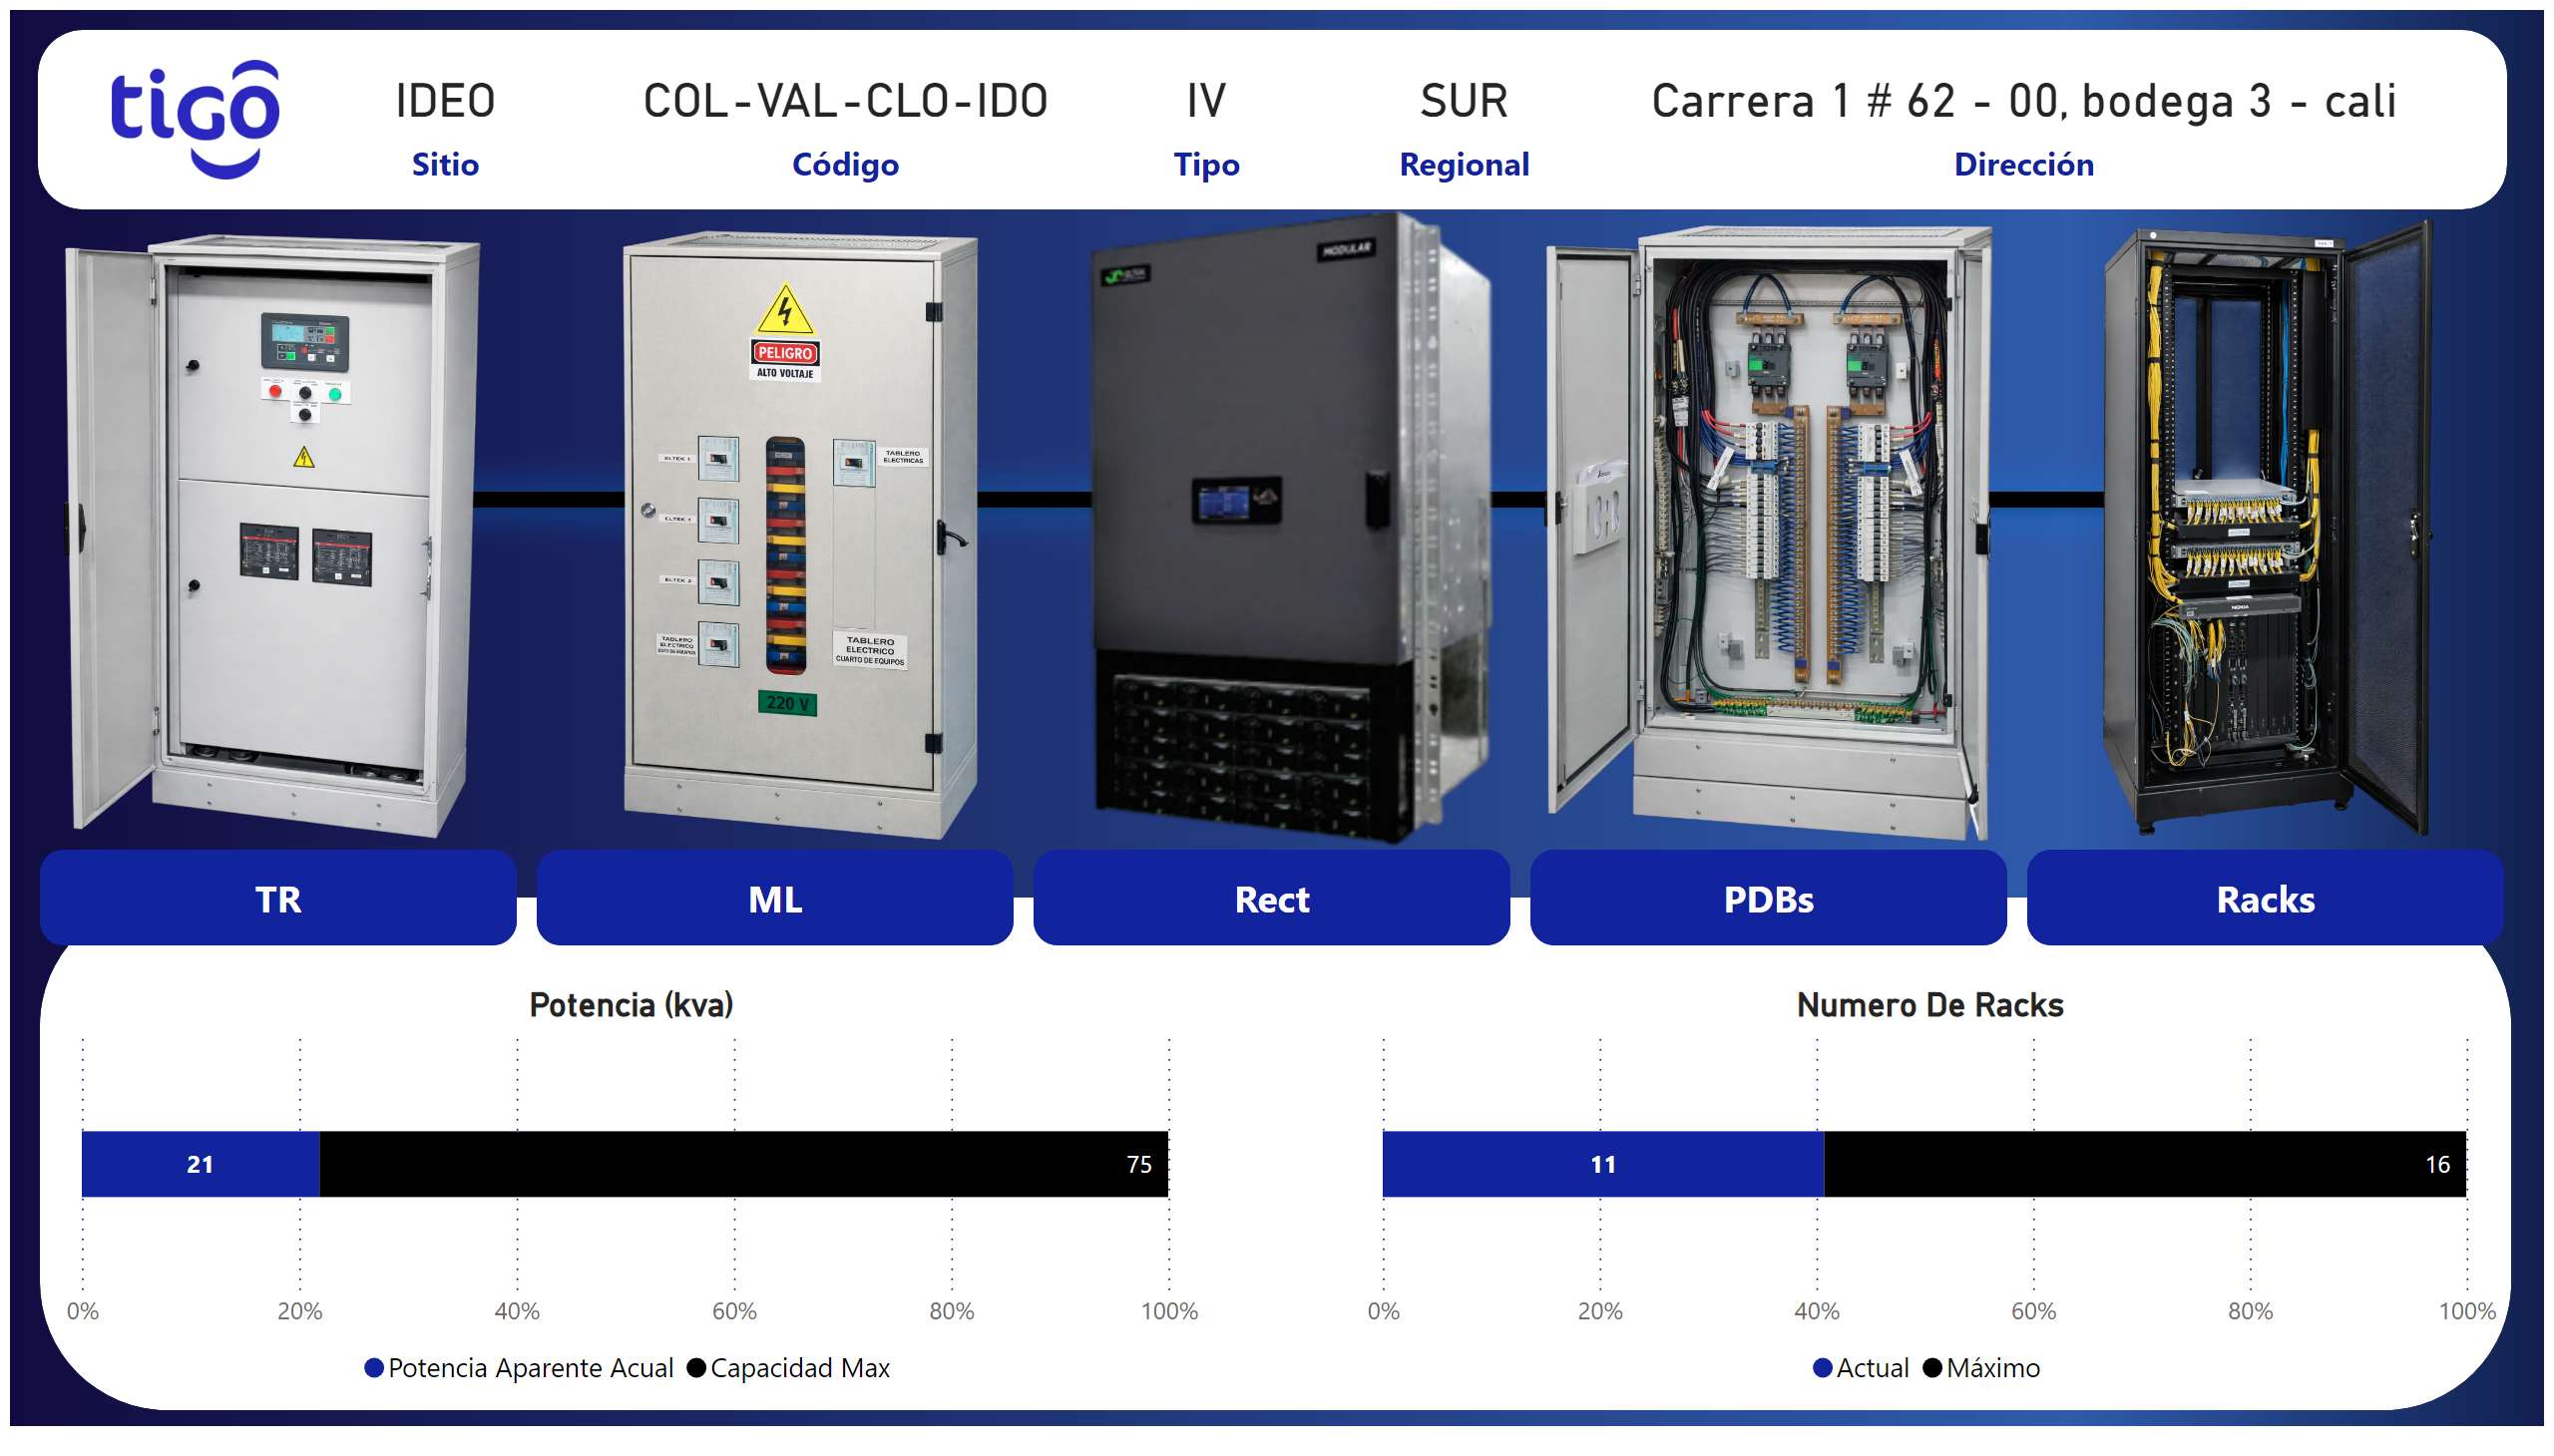
Inicio
Notes:
image
No alt text provided
shape
No alt text provided
image
No alt text provided
card
No alt text provided
card
No alt text provided
card
No alt text provided
card
No alt text provided
card
No alt text provided
yy
No alt text provided
image
No alt text provided
image
No alt text provided
image
No alt text provided
image
No alt text provided
shape
No alt text provided
Potencia (kva)
No alt text provided
shape
No alt text provided
Numero De Racks
No alt text provided
pageNavigator
No alt text provided

Slide 3
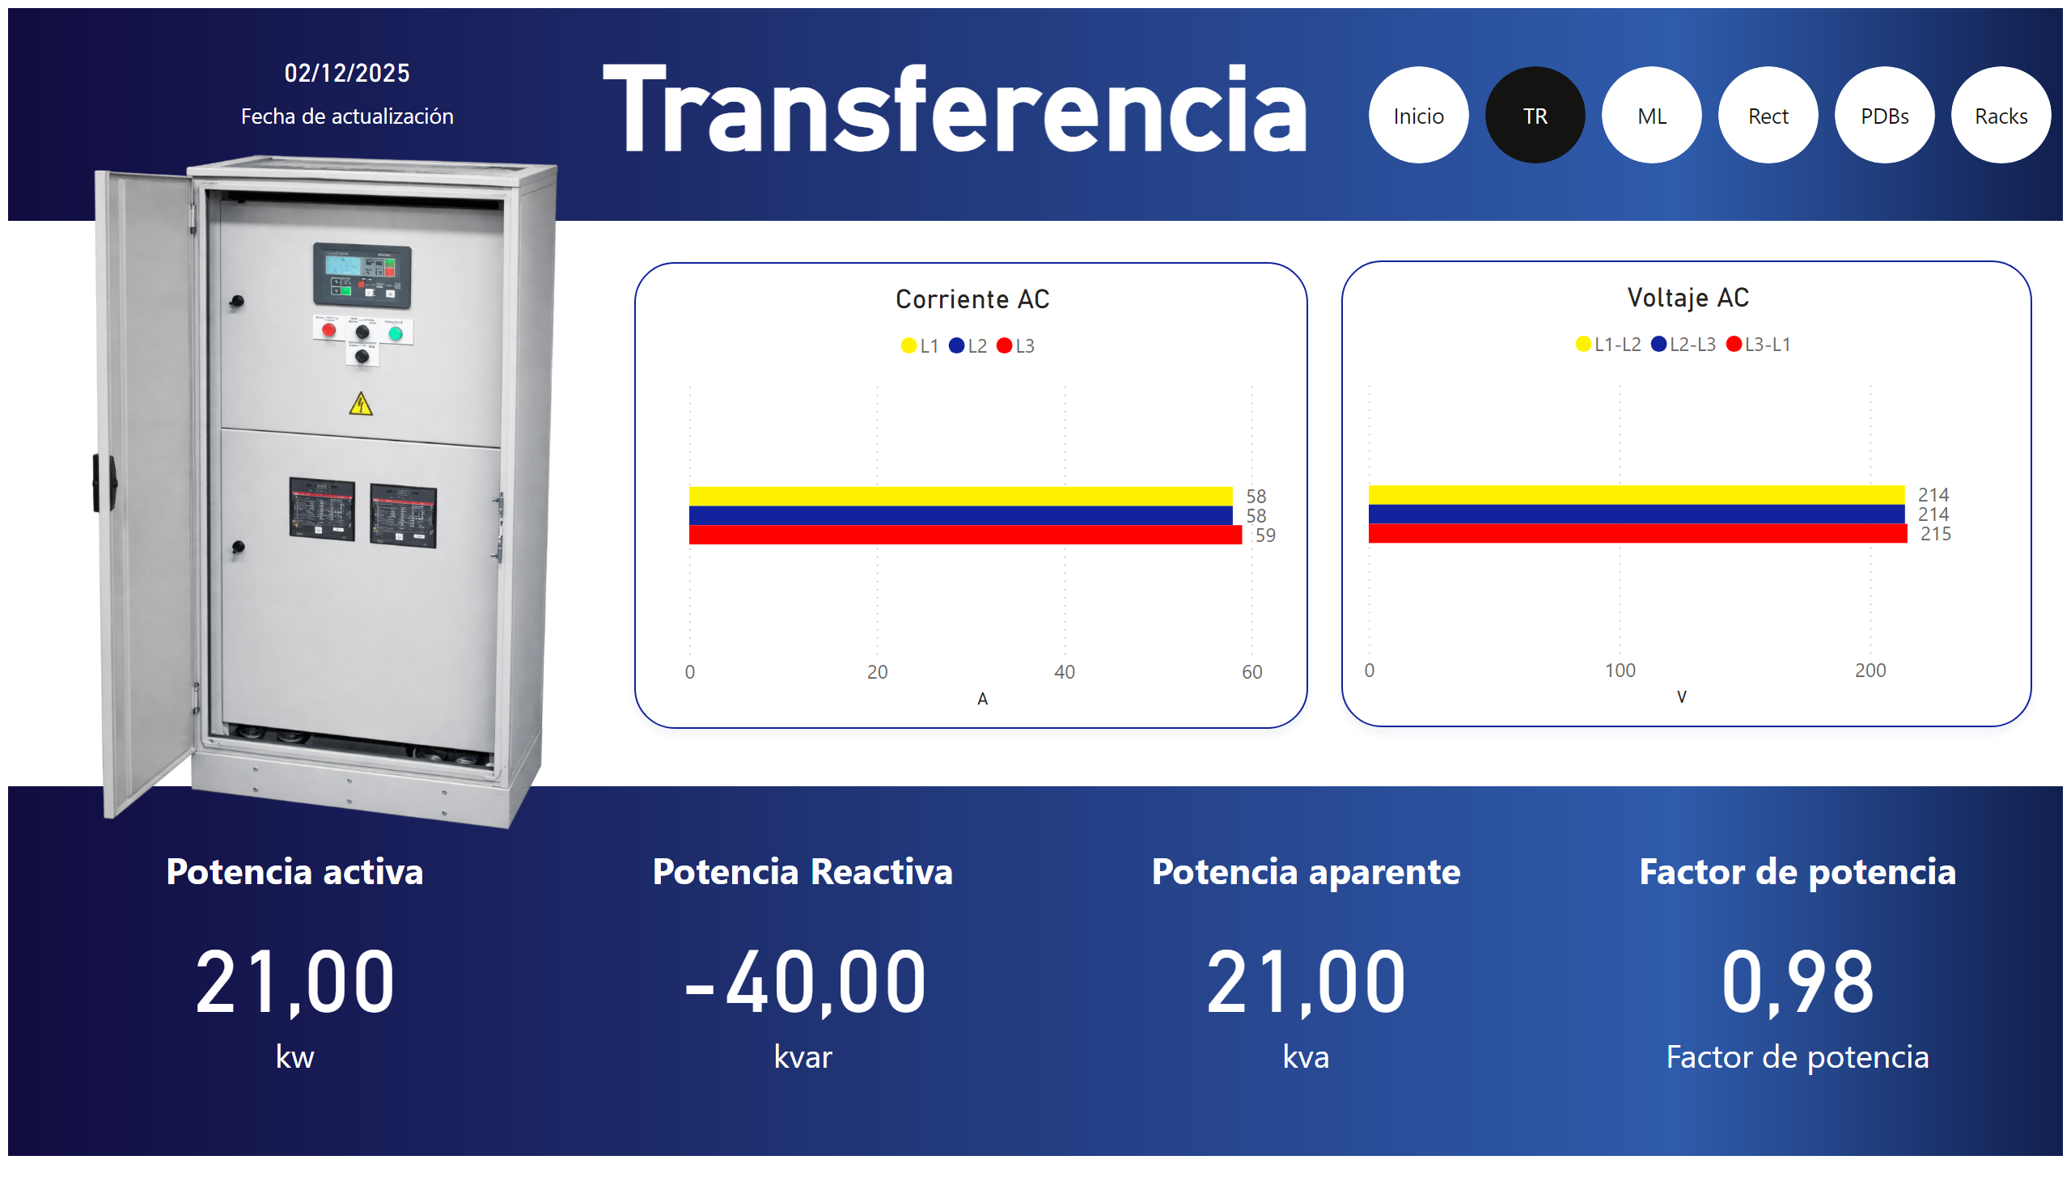
TR
Notes:
Corriente AC
No alt text provided
Voltaje AC
No alt text provided
Factor de potencia
No alt text provided
Potencia Reactiva
No alt text provided
Potencia aparente
No alt text provided
Potencia activa
No alt text provided
image
No alt text provided
image
No alt text provided
textbox
No alt text provided
image
No alt text provided
Potencia aparente
No alt text provided
pageNavigator
No alt text provided

Slide 4
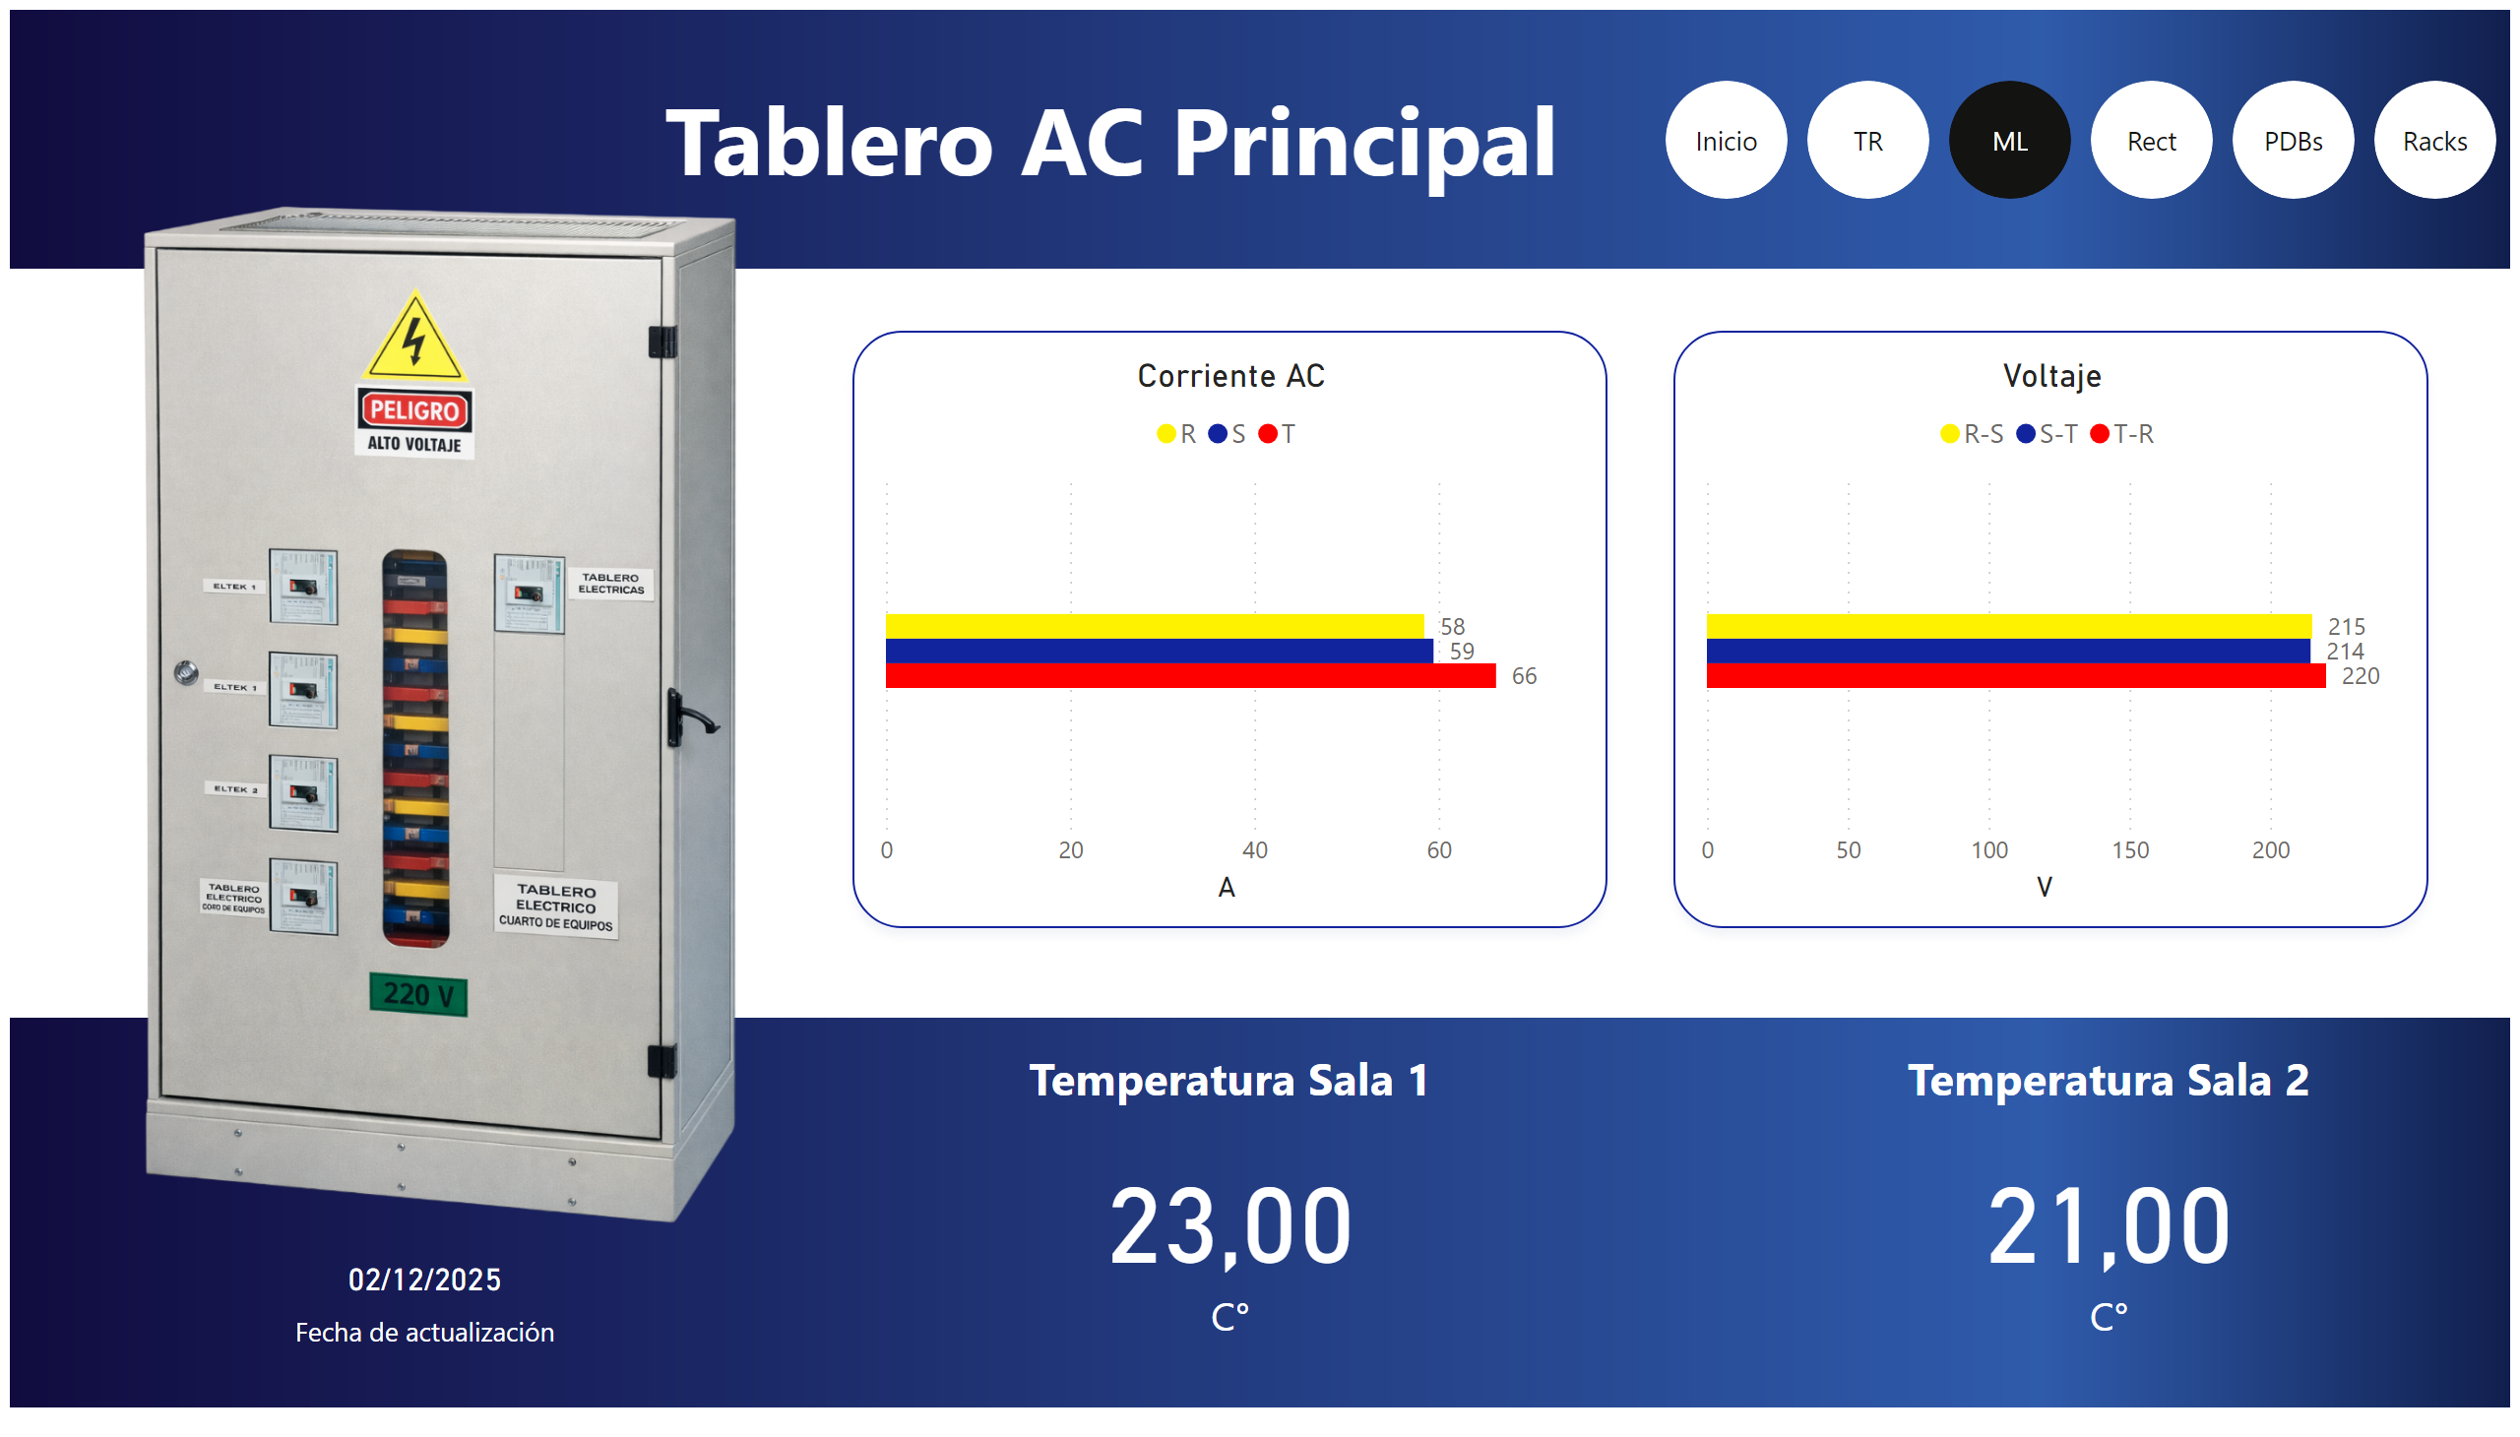
ML
Notes:
Corriente AC
No alt text provided
Voltaje
No alt text provided
Temperatura Sala 1
No alt text provided
Temperatura Sala 2
No alt text provided
image
No alt text provided
textbox
No alt text provided
image
No alt text provided
image
No alt text provided
Potencia aparente
No alt text provided
pageNavigator
No alt text provided

Slide 5
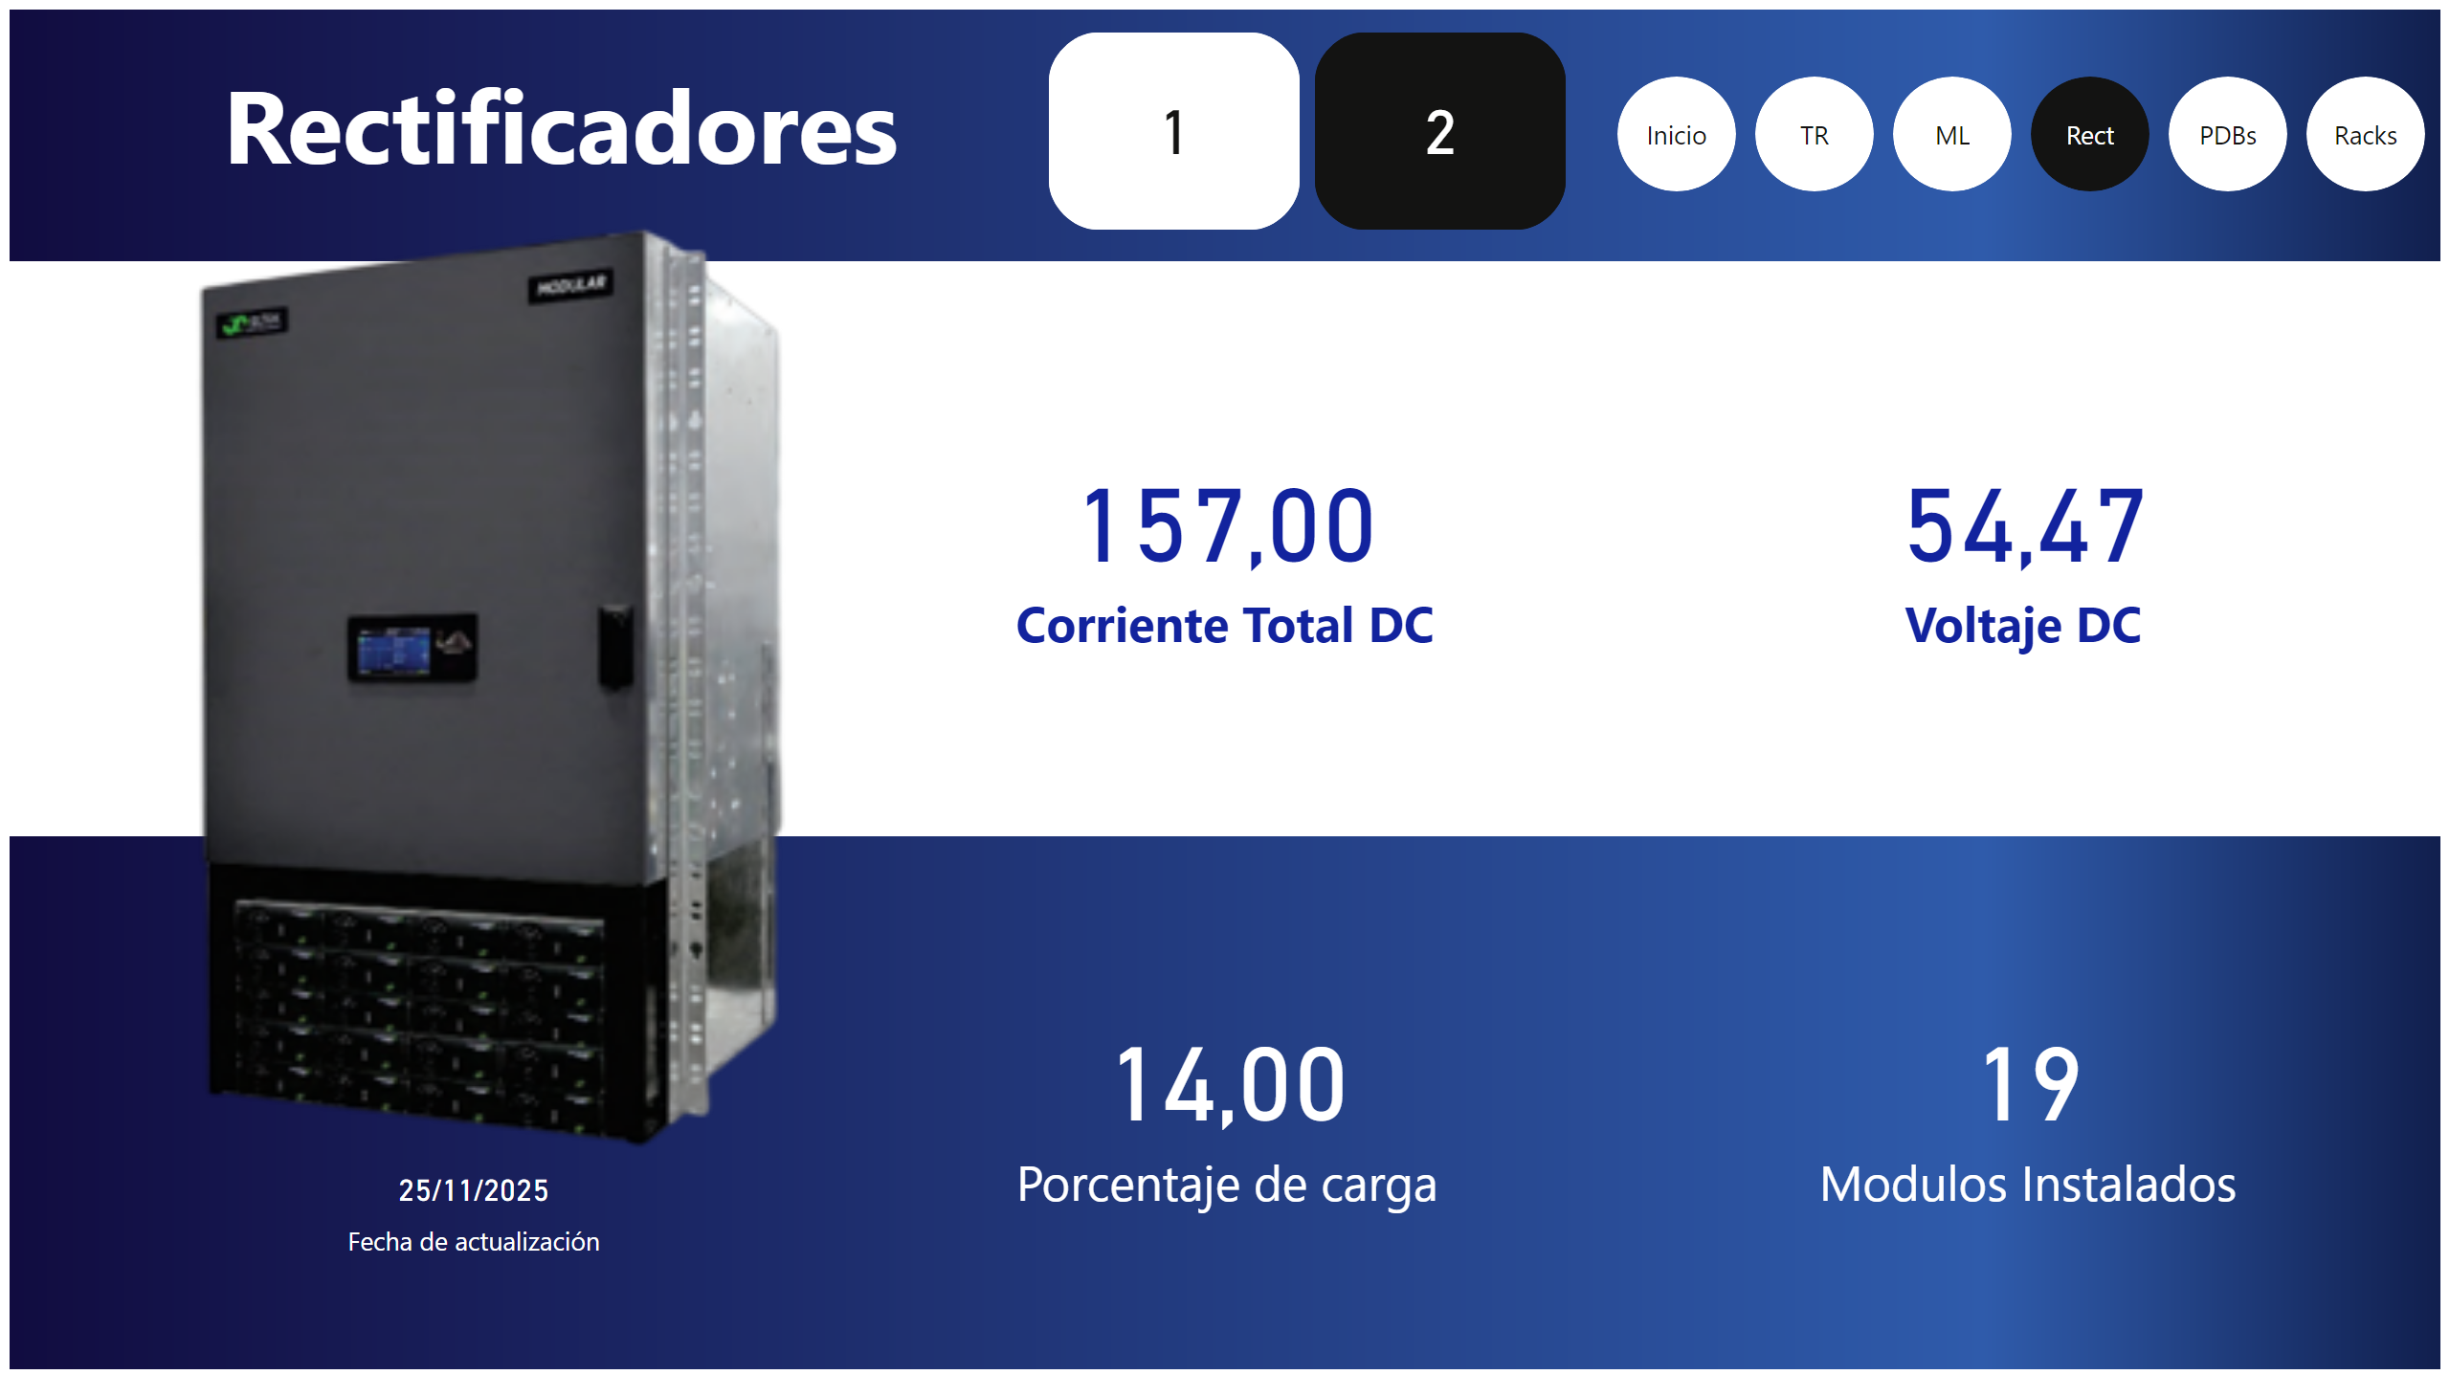
Rect
Notes:
Rectificador
No alt text provided
card
No alt text provided
card
No alt text provided
card
No alt text provided
card
No alt text provided
image
No alt text provided
image
No alt text provided
image
No alt text provided
textbox
No alt text provided
Potencia aparente
No alt text provided
pageNavigator
No alt text provided

Slide 6
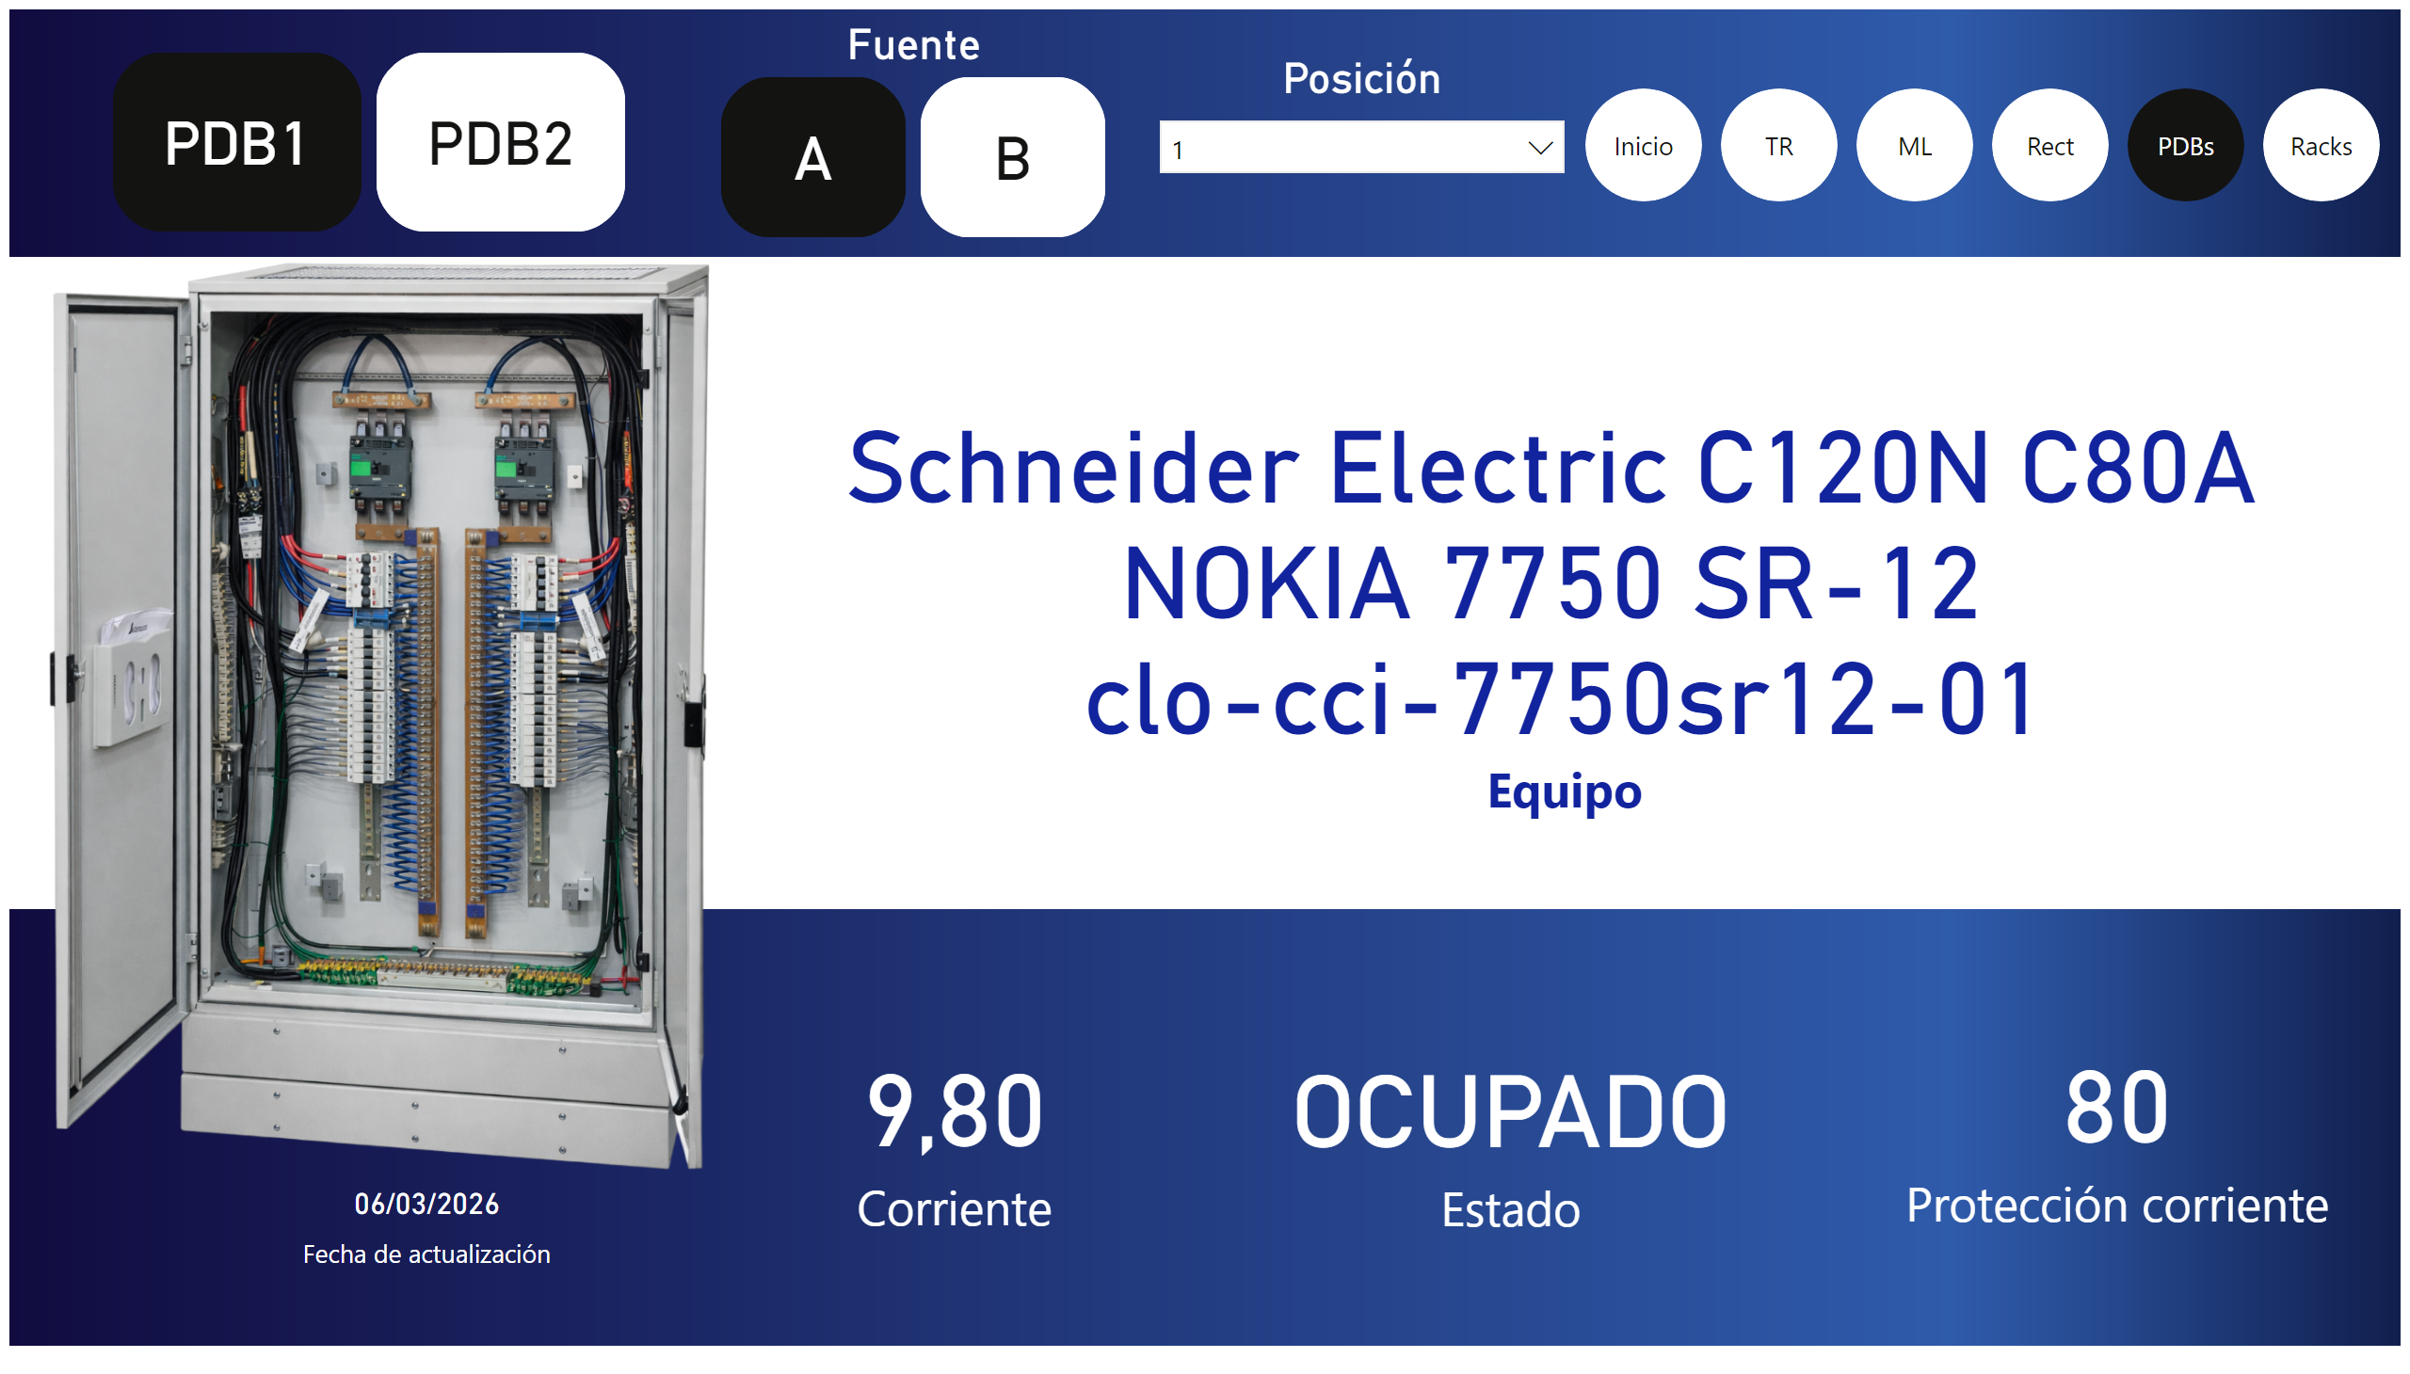
PDBs
Notes:
card
No alt text provided
card
No alt text provided
advancedSlicerVisual
No alt text provided
Fuente
No alt text provided
Posición
No alt text provided
card
No alt text provided
card
No alt text provided
image
No alt text provided
image
No alt text provided
image
No alt text provided
Potencia aparente
No alt text provided
pageNavigator
No alt text provided

Slide 7
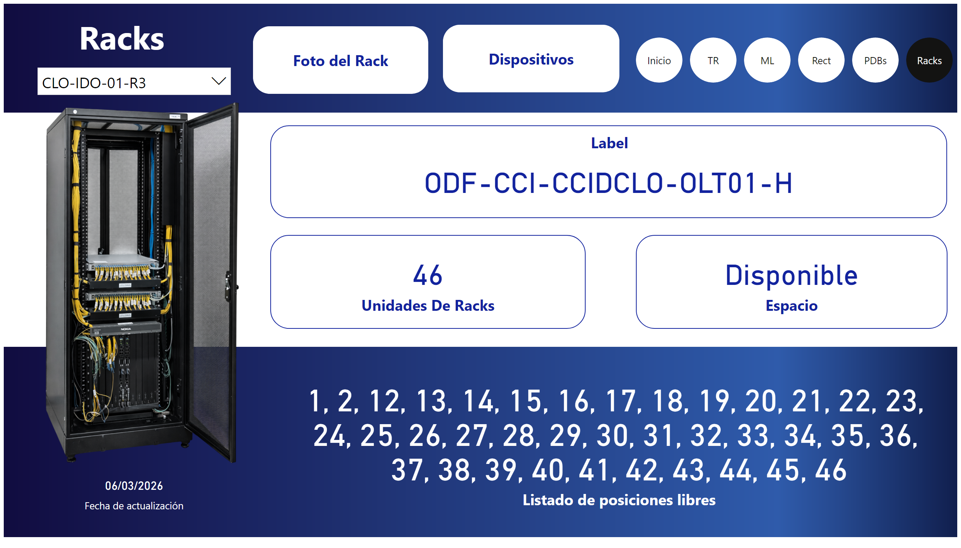
Racks
Notes:
slicer
No alt text provided
Label
No alt text provided
Listado Posición Libre
No alt text provided
card
No alt text provided
card
No alt text provided
actionButton
No alt text provided
actionButton
No alt text provided
image
No alt text provided
image
No alt text provided
image
No alt text provided
textbox
No alt text provided
Potencia aparente
No alt text provided
pageNavigator
No alt text provided

