Slide 1


Semantic Textual Similarity Project
Introduction to Human Language Technology
Master in Artificial Intelligence
Benet Manzanares & Ramon Mateo
2021/2022
Notes:
Ramon

Slide 2
Index
Preprocessing
Similarity
Base similarities
Regression
Results
Conclusions
References
Notes:
Ramon

Slide 3
Preprocessing
RegEx: Replace and remove not alphanumeric characters
Formal contractions (‘nt, ‘m, ‘re, ‘ll, ‘ve):
Example:
I’m → I am
doesn’t → does not
Tokenization
Stop words removing
Gold Standard normalization: [0,5] → [0,1]
Notes:
Ramon

Slide 4
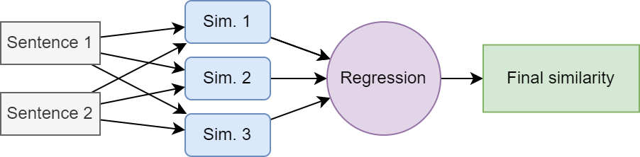
2. Similarity
Base similarities
Notes:
Ramon

Slide 5
2.1. Base similarities
Similarity based on sets → Jaccard similarity (customized)
Sentences are transformed into sets of:
Words
Lemmas
Synsets
N-grams
N-lemmas
Lexical and positional features are considered
Notes:
Ramon

Slide 6
2.1. Base similarities - Words, Lemmas & Synsets
Words are extracted using:
NLTK tokenizer
spaCy tokenizer
Lemmas are extracted using:
NLTK PoS + WordNet Lemmatizer
spaCy PoS + Lemmatizer
Synsets are extracted using:
WordNet
Notes:
Ramon

Slide 7
2.1. Base similarities - Lexical
NLTK words: Use NLTK words
Spacy words: Use Spacy words
NLTK Lemmas: Use NLTK Lemmas
Spacy Lemmas: Use Spacy Lemmas
Synsets NLTK: Using NLTK synsets
Synsets spaCy: Using Spacy synsets
Words + Synonyms: Apply words and after apply function for find synonyms and replace it.
Notes:
Ramon

Slide 8
2.1. Base similarities - Match synonyms
Find synonyms and replacing by a general word.
Example:
Cats are jolly & Cats are pretty
Jolly & Pretty synonyms
Result: Cats are pretty & Cats are pretty
Notes:
Ramon

Slide 9
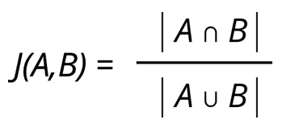
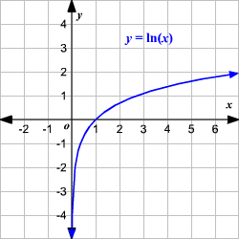
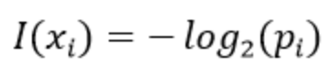
2.1. Base similarities - Custom set similarity
By default, we use Jaccard similarity:
Nevertheless, if sets are formed by lemmas Information Theory is employed:
Set length (| S |) is substituted by set Information content
It is based on lemmas probabilities at train set
If a lemma is not present at train set, maximum information content is assigned
e
Notes:
Benet

Slide 10
2.1. Base similarities - Lexical and Positional
N-grams
In this case, a set of N consecutive characters
Computed using a sliding window of size N and stride 1
Economical approach for considering chunks (e.g., “The New Yorker”) while not exclusively depending on them
Considers morphological similarities (e.g., “Thanks for calling America Expansion” and “Thanks for calling American Express”)
N-lemmas
A set of N consecutive lemmas
Computed using a sliding window of size N and stride 1
Economical approach for considering chunks while not exclusively depending on them
Helps with specific expressions (e.g, “Do not open the door”)
N is more intuitive to decide
Notes:
Benet

Slide 11
2.1. Base similarities - Used measures
NLTK words
spaCy words (without preprocessing)
Word synonyms
NLTK lemmas
spaCy lemmas
Lemmas synonyms
Synsets
2-grams
3-grams
4-grams
5-grams
6-grams
7-grams
2-lemmas
Notes:
Ramon

Slide 12
2.2. Regression
Using the Base similarities as input and Gold Standard as labels, we train two models using the training set:
Linear regression
Multi-Layer Perceptron Regression
The outputs are passed through a hyperbolic tangent (tanh). Similarly to the logarithmic function applied at the UKP system.
Notes:
Benet

Slide 13
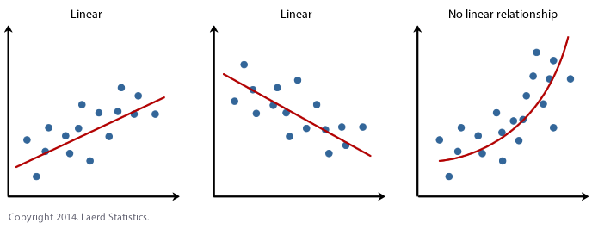
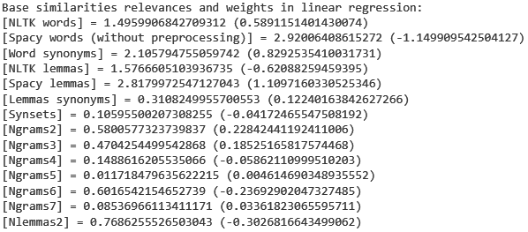
2.2. Regression - Linear
We use the model from Sklearn.
Only able to correctly solve linear problems.
Nevertheless, it is easy to know which inputs are more relevant for the model. In our case, using normalized weights magnitudes:
← Negative values imply correlations
Notes:
Benet

Slide 14
2.2. Regression - Multi-Layer Perceptron (MLP)
Manages non-linear problems.
Benefits from Gold Standard normalization.
We use the Sklearn implementation with:
Three hidden layers with 200, 100, 50 neurons, respectively.
Rectified Linear Unit (ReLU) activation function.
Adam optimizer.
Maximum of 1000 epochs.
A fixed random state (42) for better/fair comparisons.
Notes:
Benet

Slide 15
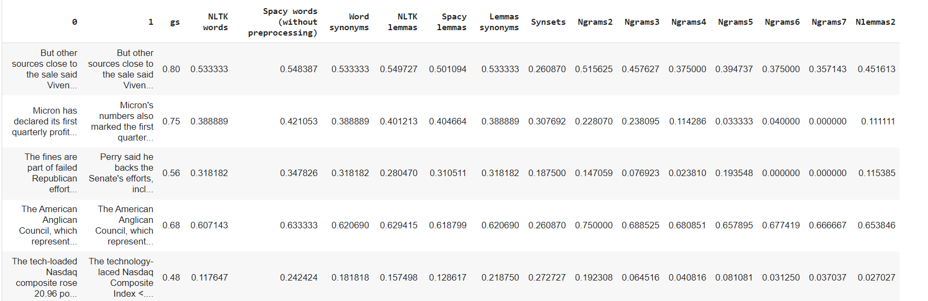
3. Results - Base similarities
Notes:
Benet

Slide 16
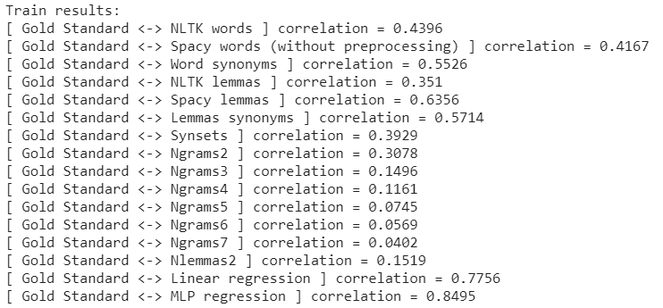
3. Results - Train set
Notes:
Benet (relacionada amb la següent)

Slide 17
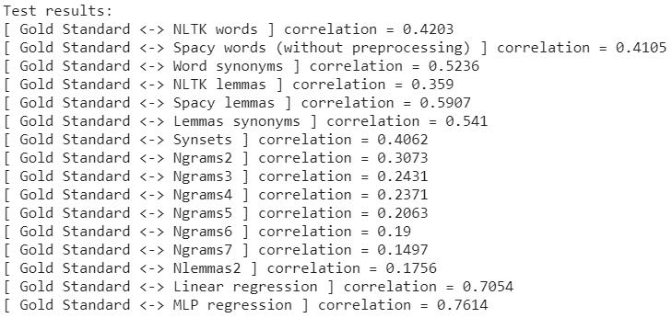
3. Results - Test set
Notes:
Benet

Slide 18
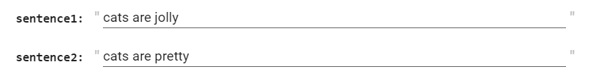
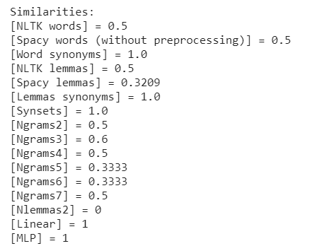
3. Results - Example with new sentences
Notes:
Ramon

Slide 19
4. Conclusions
We noted:
The importance of combining difference features
The capabilities of MLPs for regression
How greedy is the definition of parameters
How even basic similarity measures can be useful for matching similarity (at least for these datasets)
Notes:
Benet

Slide 20
5. References
UKP: Computing Semantic Textual Similarity by Combining Multiple Content Similarity Measures
The Free Dictionary: Forming contractions
Information Theory

Slide 21
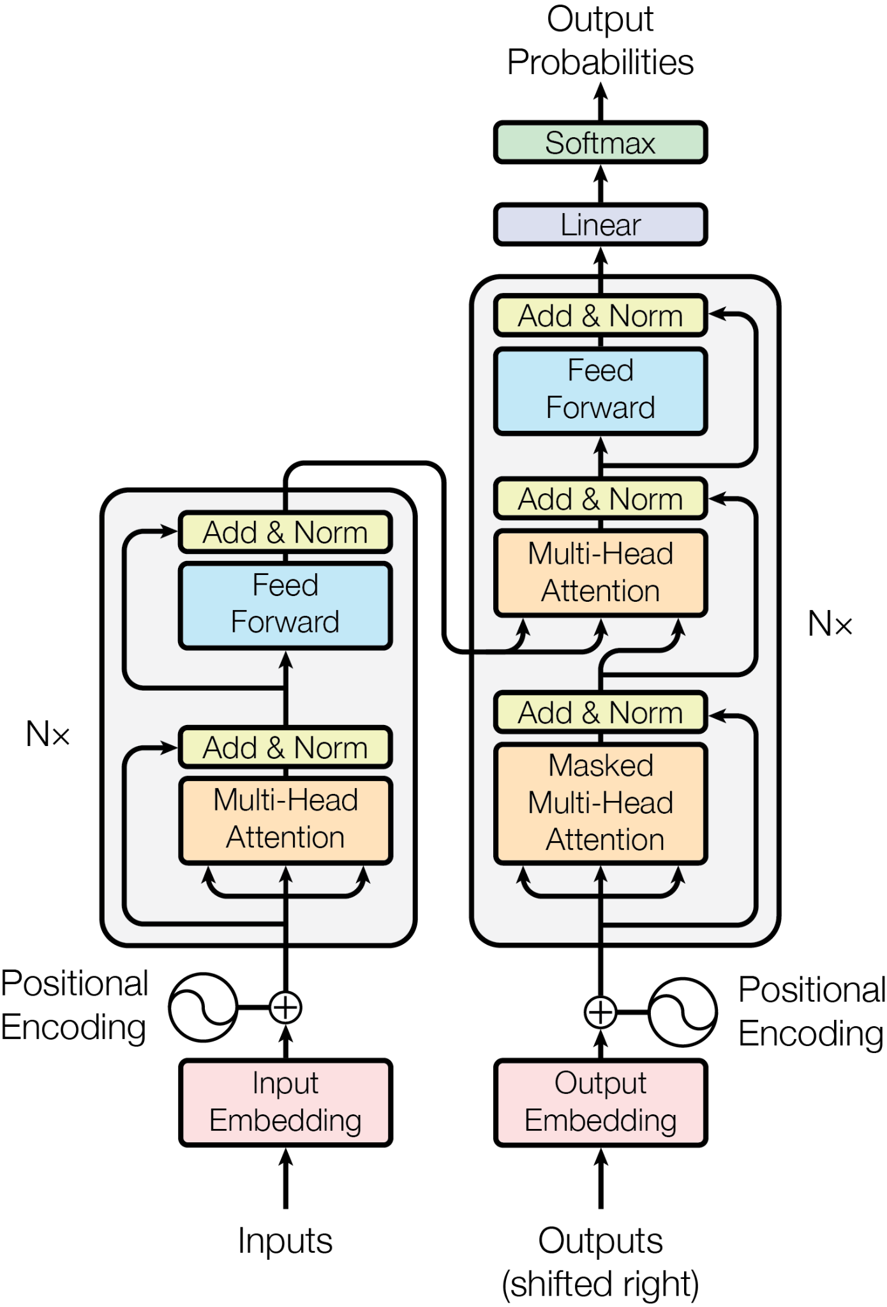
Thanks for your attention...
...which is all you need 😉🤗

