Slide 1
Graphical User Interfaces (GUIs)
CS 2316
Fall 2016

Slide 2
Before we had GUIs:
>
Notes:
Everything was run through the command line/terminal!

Slide 3
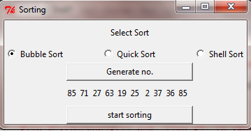
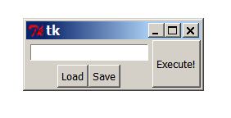
GUI: Graphical User Interface
A way for people to interact with computer programs
Uses windows, icons and menus
Can be manipulated by a mouse and keyboard
Notes:
So far in this course we’ve written programs that the user must interact with in the command line.
Today we’ll learn how to make a GUI for users to interact with your program.

Slide 4
GUIs: Step by Step
Design the GUI
Create all the buttons, labels, entries, etc. (widgets)
And specify where they go in a window
Write functions/methods to do what needs to be done
Connect the widgets to the functions/methods
Start the main loop

Slide 5
Tkinter
We will use the Tkinter GUI toolkit to create Python GUIs
tkinter: the module containing all the code
To import the tkinter library:
from tkinter import *
https://docs.python.org/3/library/tk.html
Notes:
Tkinter is the de facto Python standard GUI library, it comes with your installation of Python and doesn’t need to be installed separately

Slide 6
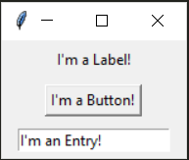
Some simple tkinter widgets
Label
Just displays text, not clickable
Button
Can be linked to a function/method; that function/method is called on click
Entry
Can allow the user to enter text
Can also be used to display text
Has 3 possible states: normal, readonly, disabled
Notes:
There are many GUI widgets but here are 3 common ones

Slide 7
Basic tkinter GUI
win = Tk()
win.title("My GUI")
l = Label(win, text="Hello, world")
b = Button(win, text="Click me!")
l.pack()
b.pack()
win.mainloop()
Notes:
This code creates a basic GUI with a Label and a Button and places them in a window using the Pack layout manager.
The button has no “command” so it has no function when clicked.

Slide 8
Linking the button to a function
def clicked():
print("Button clicked!")
win = Tk()
win.title("My GUI")
l = Label(win, text="Hello, world")
b = Button(win, text="Click me!", command=clicked)
l.pack()
b.pack()
win.mainloop()
Notes:
Now the clicked function will be called every time the button is clicked
If we defined the clicked function below the GUI code, the line creating the Button would throw a NameError
We can avoid this problem by writing a class for our GUI

Slide 9
Encapsulating a GUI into an Object
class MyGUI:
def __init__(self, win):
l = Label(win, text="Hello, world!")
b = Button(win, text="Click me!", command=self.clicked)
l.pack()
b.pack()
def clicked(self):
print(“Button clicked!”)
Notes:
The __init__ method takes in a Tk window, creates GUI widgets, and packs them
Command is now self.clicked because clicked is a method in the class

Slide 10
Encapsulating a GUI into an Object
def main(args):
win = Tk()
win.title("My GUI")
MyGUI(win)
win.mainloop()
if __name__ == '__main__':
import sys
main(sys.argv)
Notes:
In the main method, we create a Tk window, give it a title, and pass it as the win argument of a new GUI object

Slide 11
GUI layout managers
Pack
Positions widgets relative to each other
Simple to use
Limited layout possibilities compared to grid
Grid
Allows you to place widgets in rows and columns
More complicated than pack but good for GUIs where a particular arrangement is desired
Don’t use grid and pack in the same container!

Slide 12
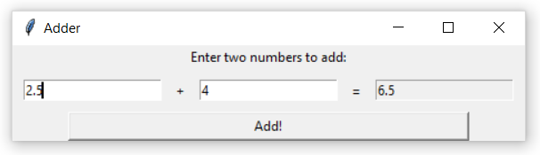
Exercise: Adder
Create a GUI with two NORMAL entries and one READONLY entry
There should a button that, when clicked, adds the numbers entered in the first two entries and displays the sum in the third entry
If the calculation can’t be performed due to invalid input, display a message box with an error message.

Slide 13
Next time...
Frames
Radiobuttons, StringVars and IntVars
Multiple windows!
Making the GUI pretty

Slide 14
Frames
Container that can be placed within a window
Holds other widgets
Each frame has its own grid layout, independent of the main window
You can use a different layout manager for each container

Slide 15
Example: Frames (use within GUI class)
f1 = Frame(win, height=100, width=100, bd=1, relief=SUNKEN)
f2 = Frame(win, height=100, width=100, bd=1, relief=SUNKEN)
f1.grid(row=0, column=0, sticky=EW)
f2.grid(row=0, column=1, sticky=EW)
# self.l1 will be used for another method later
self.l1 = Label(f1, text="One", height=5, width=5)
self.l1.grid(row=0, column=0)
Label(f1, text="Two", height=5, width=5).grid(row=0, column=1)
Label(f2, text="Three", height=5, width=5).pack(side=LEFT)
Label(f2, text="Four", height=5, width=5).pack(side=LEFT)
Notes:
bd=1 sets the border width to 1 so the border is visible, relief=SUNKEN gives the frame’s border a sunken appearance

Slide 16
Radiobuttons
Allows the user to choose from one or more options
Can be linked to other Radiobuttons with StringVars and IntVars
If configured correctly, only one Radiobuttons from a group can be selected at at time

Slide 17
StringVars and IntVars
Two variable classes included in Tkinter
Have .set() method to set their value
e.g. my_string_var.set(“Hello”)
StringVars have string value, IntVars have integer value
Have .get() method to get their value
e.g. val = my_string_var.get()
Can be passed in as “variable” argument when creating a Radiobutton, or “textvariable” argument when creating an Entry

Slide 18
Exercise
Revisit our Adder example from the last class
Instead of using Entry.insert and Entry.delete, use a StringVar to change the text of the result Entry
See what happens if you don’t set the Entry state to “normal” before changing the text!

Slide 19
Adding Radiobuttons to our Frame example
self.color = StringVar()
rb1 = Radiobutton(win, text="Red", variable=self.color, value="red")
rb2 = Radiobutton(win, text="Blue", variable=self.color, value="blue")
rb3 = Radiobutton(win, text="Green", variable=self.color, value="green")
self.color.set("unknown") # deselects all radiobuttons linked to self.color
rb1.grid(row=1, column=0)
rb2.grid(row=2, column=0)
rb3.grid(row=3, column=0)
Button(win, text="Change Color", command=self.change_color).grid(row=1, column=1)

Slide 20
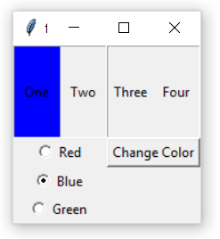
Adding Radiobuttons to our Frame example
def change_color(self):
new_color = self.color.get()
if new_color == "unknown":
pass
else:
self.l1.config(bg=new_color)

Slide 21
Additional Exercise
Add another set of Radiobuttons to the GUI
Separate from those linked to self.change_color
There should be four Radiobuttons, each linked to one of the labels
Create an IntVar to use as the variable for these Radiobuttons
The user’s selection should determine which Label will change color when the button is clicked.

Slide 22
Root Window vs. Toplevels
The root window is your main window (Tk)
A GUI application should have only one root window
Any additional windows should be Toplevels
Hide windows with .withdraw()
Show windows with .deiconify()
Delete windows with .destroy() (they will be gone forever!)
If you destroy the root window, all Toplevels will also be destroyed

Slide 23
Adding multiple windows to our example:
# in __init__ method, add line: self.root = win
def new_window(self):
self.root.withdraw()
self.new = Toplevel()
Label(self.new, width=30, height=10, text="I'm a new window!").pack()
Button(self.new, text="Close window", command=self.close_new).pack()
def close_new(self):
self.new.destroy() # destroy new window
self.root.deiconify() # show root window

Slide 24
Changing the GUI appearance
GUI windows and widgets have many optional parameters to change their appearance
bg: background color
fg: foreground color (for Labels, this is the font color)
bd: border width
border: border type (RAISED, SUNKEN, etc)
For color codes: http://htmlcolorcodes.com/
For more options, check the documentation or online tutorials

