Slide 1
What did I do?
Generate a random graph with n vertices
Run the approximate solution on the generated graph
Repeat step the previous step 5 more times
Run the exact solution
Wait
Wait
Wait
Wait
Compile the results in a text file
Repeat steps 1-9, 4 more times, increasing n by 2 each iteration and appending to the text file created in step 9
Visualize the results in a box and whisker plot

Slide 2
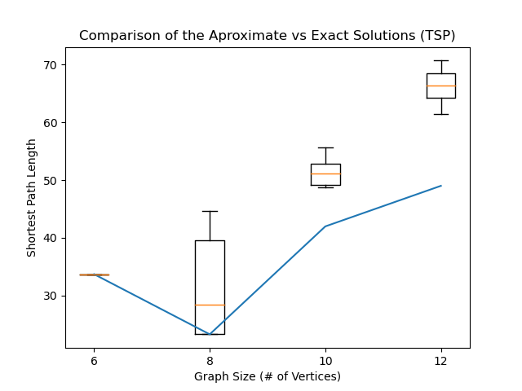
Results
Takeaways
The residual increases alongside the number of vertices
The approximation is very accurate in small graphs
Questions Raised
Does output variance increase with the number of vertices?
How can we tighten the accuracy of the approximate solution?

Slide 3
Why NP Hard?
Finding the Shortest Path
Proving the Shortest Path
Estimating the Shortest Path
O(N!)
O(N!)
O(N³)
For every possible combination of vertices check if the distance is shorter than the previous
Iterations = Permutation(V,V)
Proving that we have found the shortest path requires searching for a shorter path
Essentially just as effective as running the algorithm again
Randomly generate tours and explore internal permutations.
Dominated by iterating over the tour in a nested for-loop (n*n*n).

