Slide 1
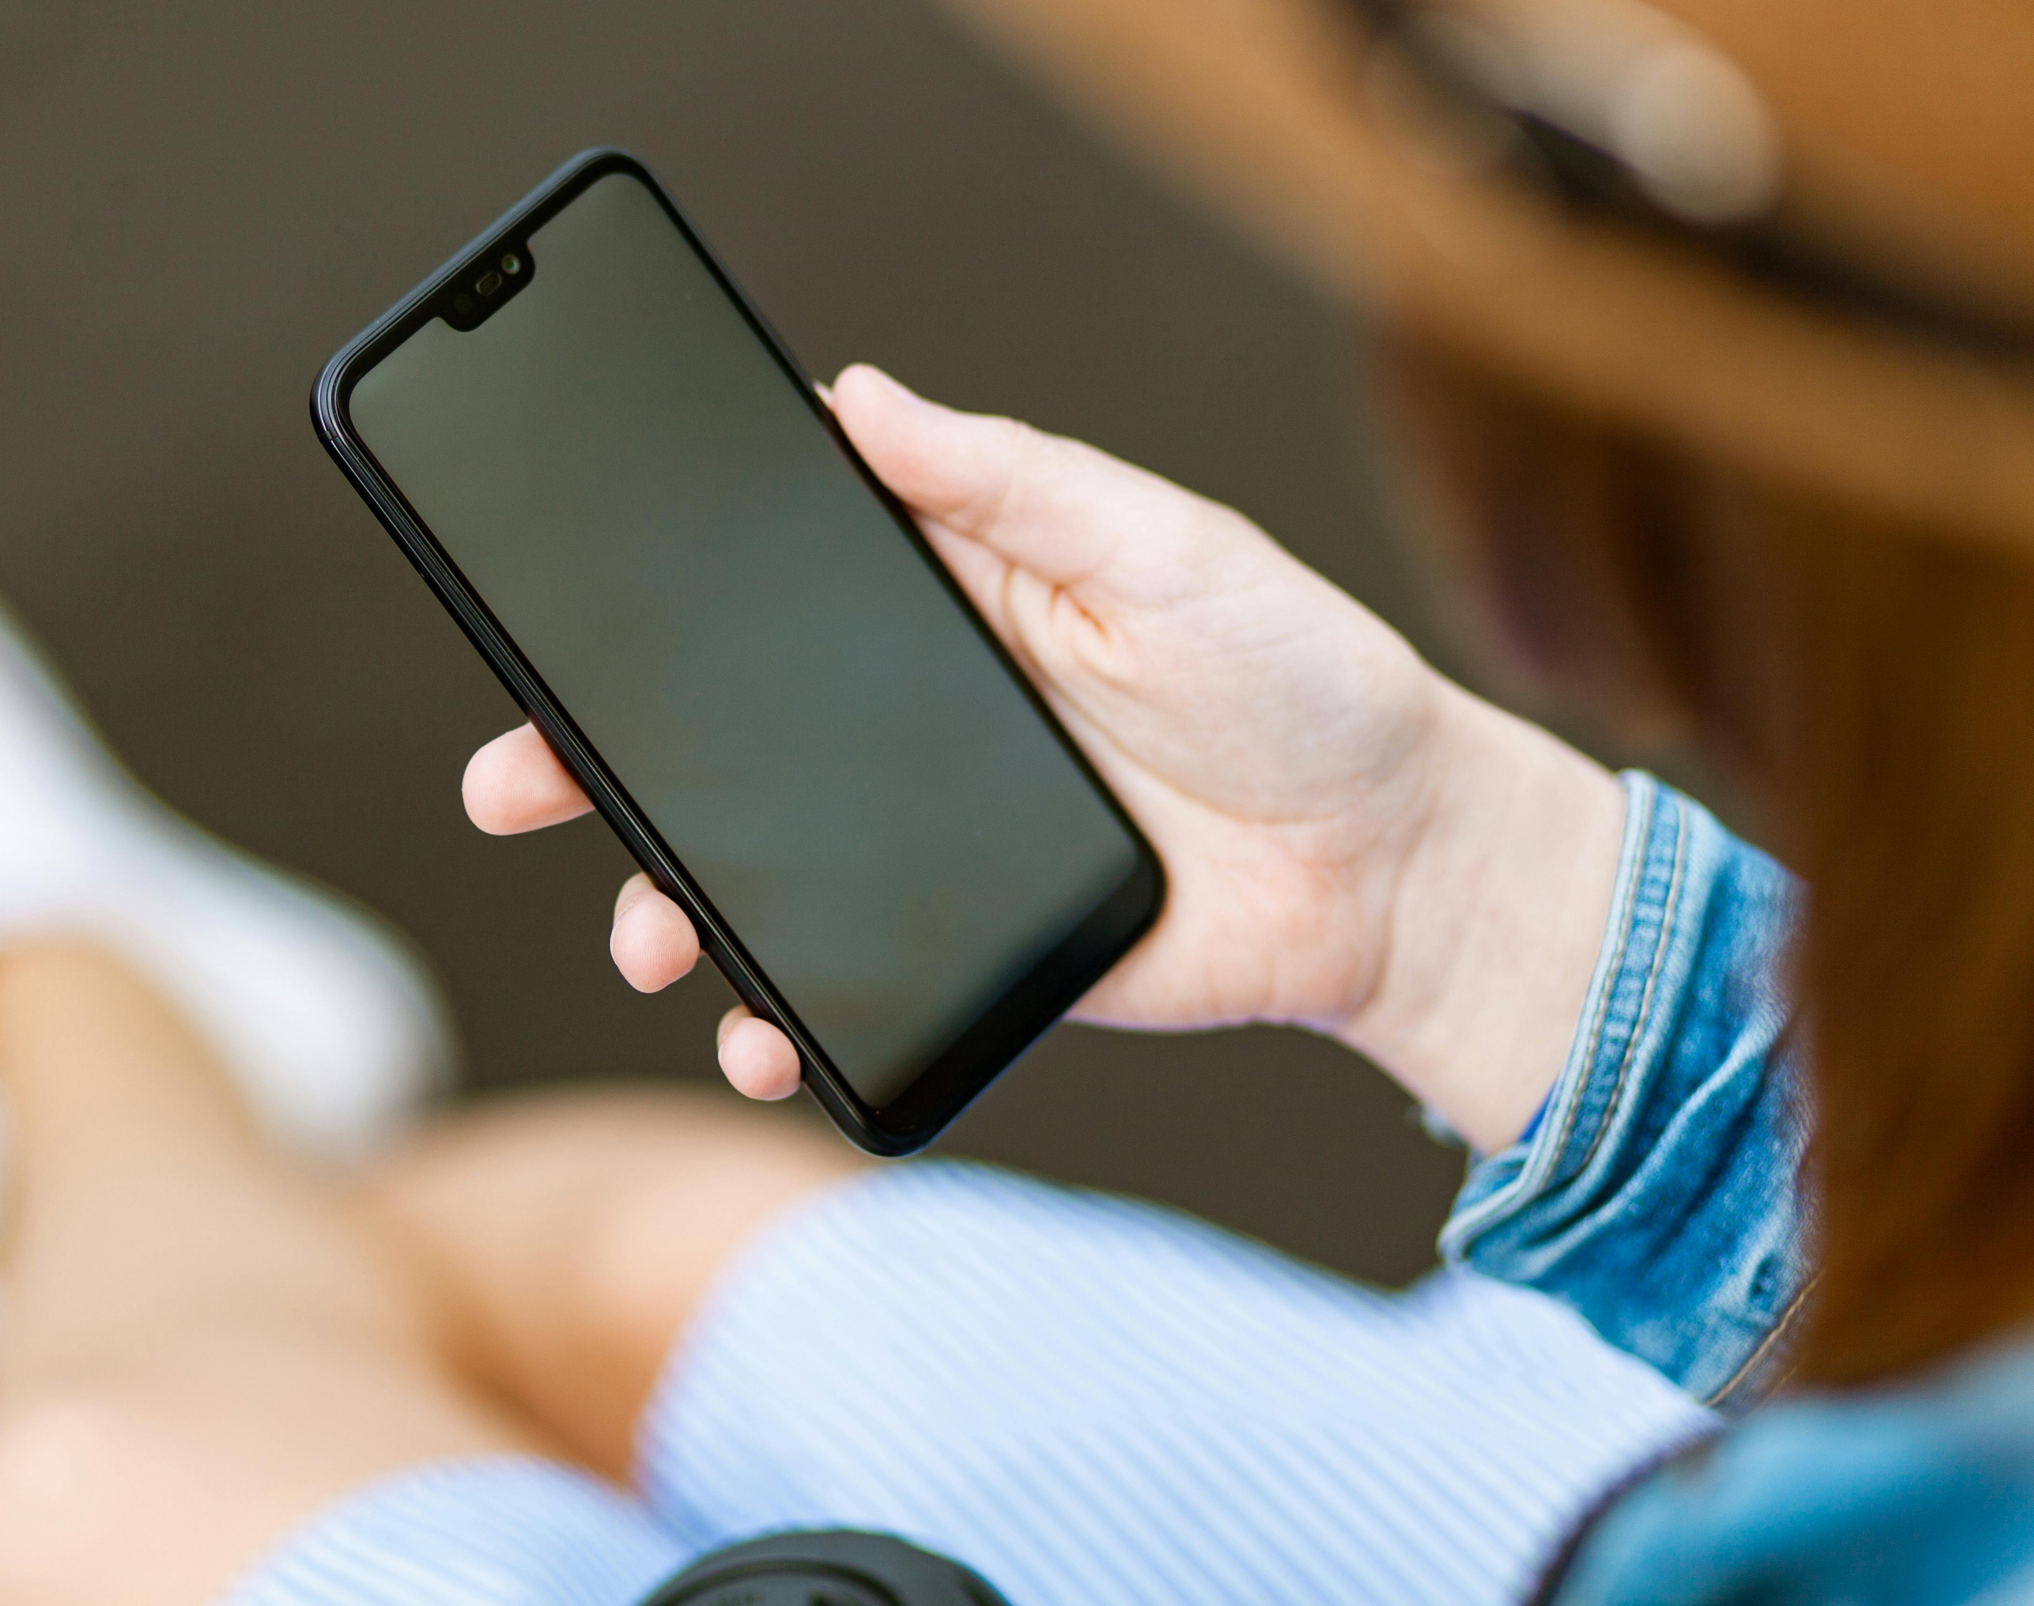
Smartphone-Based Human Activity Recognition Using Inertial
Sensors
Tomas Pastore Godoy, Mateo Saettone, and Ethan Thompson
CIS4930 – Wireless and Mobile Computing
April 22nd, 2026

Slide 2
Overview
Context and Background
Dataset Overview
System Overview
Experimental Results
Limitations and Future Work

Slide 3
Context and Background
Our idea: make an activity tracking/sensing app that detects user movement
Activity recognition has real applications in health monitoring, fitness tracking, and elderly care
Smartphones are already widely available, so a purely software-based solution requires no extra hardware
Practical problem with meaningful impact

Slide 4

Why Mobile?
Phone carrying is the norm for most adults, many fitness devices have some form of mobile connection already
Smart watches and fitness bands (Fitbit)
Alternatives present issues such as infrastructure costs and privacy concerns
Less likely to hallucinate movement

Slide 5
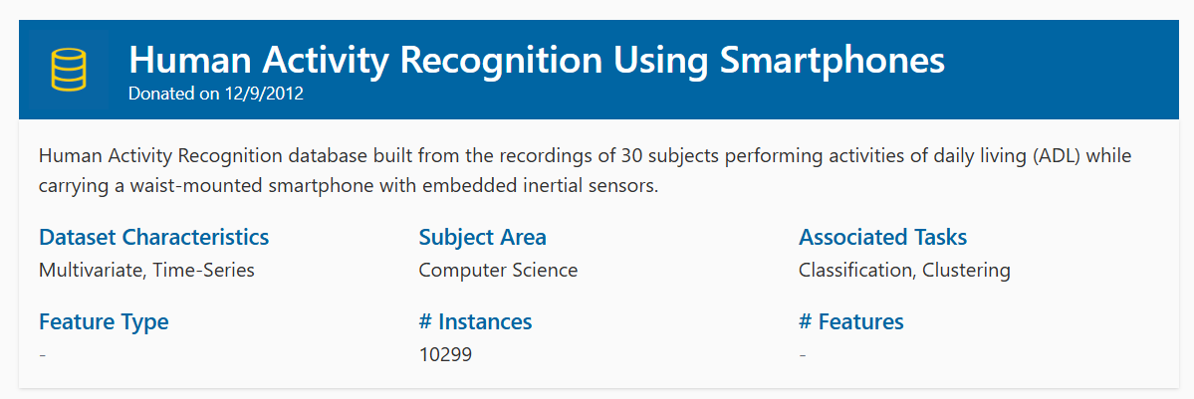
Dataset Overview
Consists of data collected from 30 volunteers aged 19 - 48
Each participants performed the following activities:
Walking
Walking up and down stairs
Sitting
Standing
Laying down
Data obtained via accelerometer and gyroscope of Samsung Galaxy S II worn on waist
70/30 split between training data and test data

Slide 6
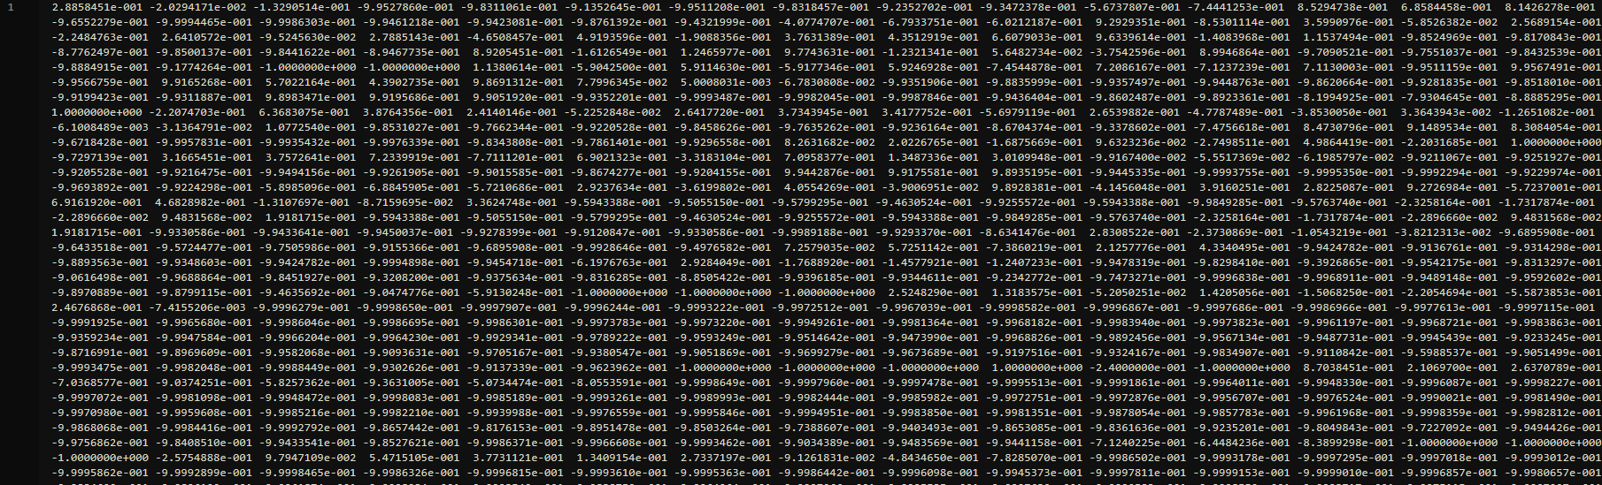
Dataset Overview
Includes time information for body acceleration, gravity acceleration, and gyro information for X, Y, and Z axes
Magnitude of each is also calculated
Sensors: 3-axis accel + 3-axis gyro at 50 Hz
Windows: 2.56 s, 50% overlap → 128 samples/window
Comes in two flavors: raw inertial signals and a 561-feature engineered table
Train/test data is split up into dataset, activity labels, subject number, and inertial signals for gyro and acceleration data

Slide 7
Our System
Model 1: Random Forest
Model 2: 1D CNN

Slide 8
Training Pipeline
Raw data from UCI dataset (acceleration and gyro)
Preprocessing (window, filtering, normalization, splitting)
Feature extraction (time and frequency, raw data window for CNN model)
Model training
Exporting results (model.json + TF.js, ONNX Web)

Slide 9
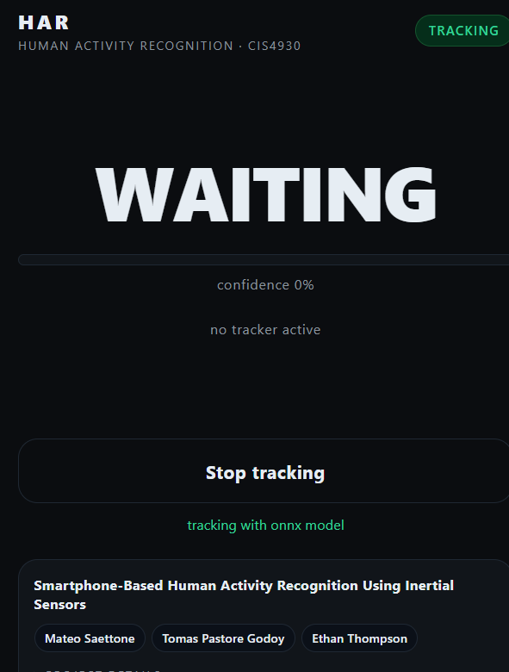
Final Product
Final project is publicly available as a web app
https://har-demo-cis4930.vercel.app/
Uses our trained model to predict the current movement of the user based on model classes by tracking motion and acceleration of user's phone
Detects all types of movement with fair accuracy

Slide 10
Limitations and Future Work
Despite being generally accurate, final model has issues with low confidence in result

Slide 11
Conclusion
Placeholder

