Slide 1

The MTA’s Capital Programs and Customer Experience
To what extent does the MTA’s data recollection influence their Capital Investment Allocation, as a means to improve customer experience?

Slide 2
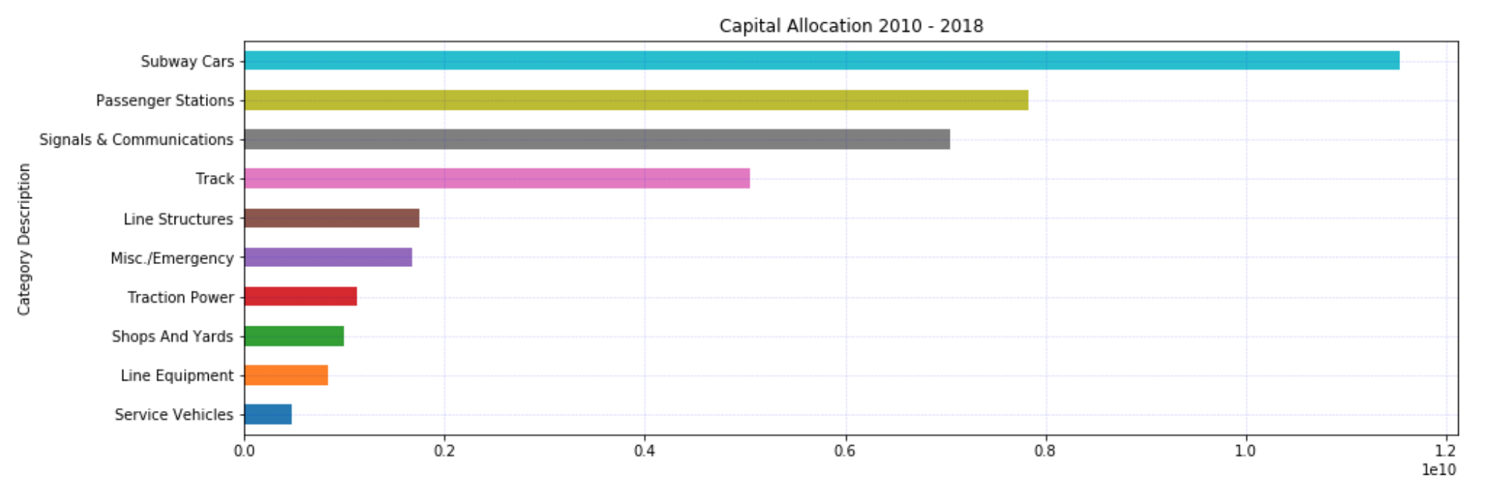

Slide 3
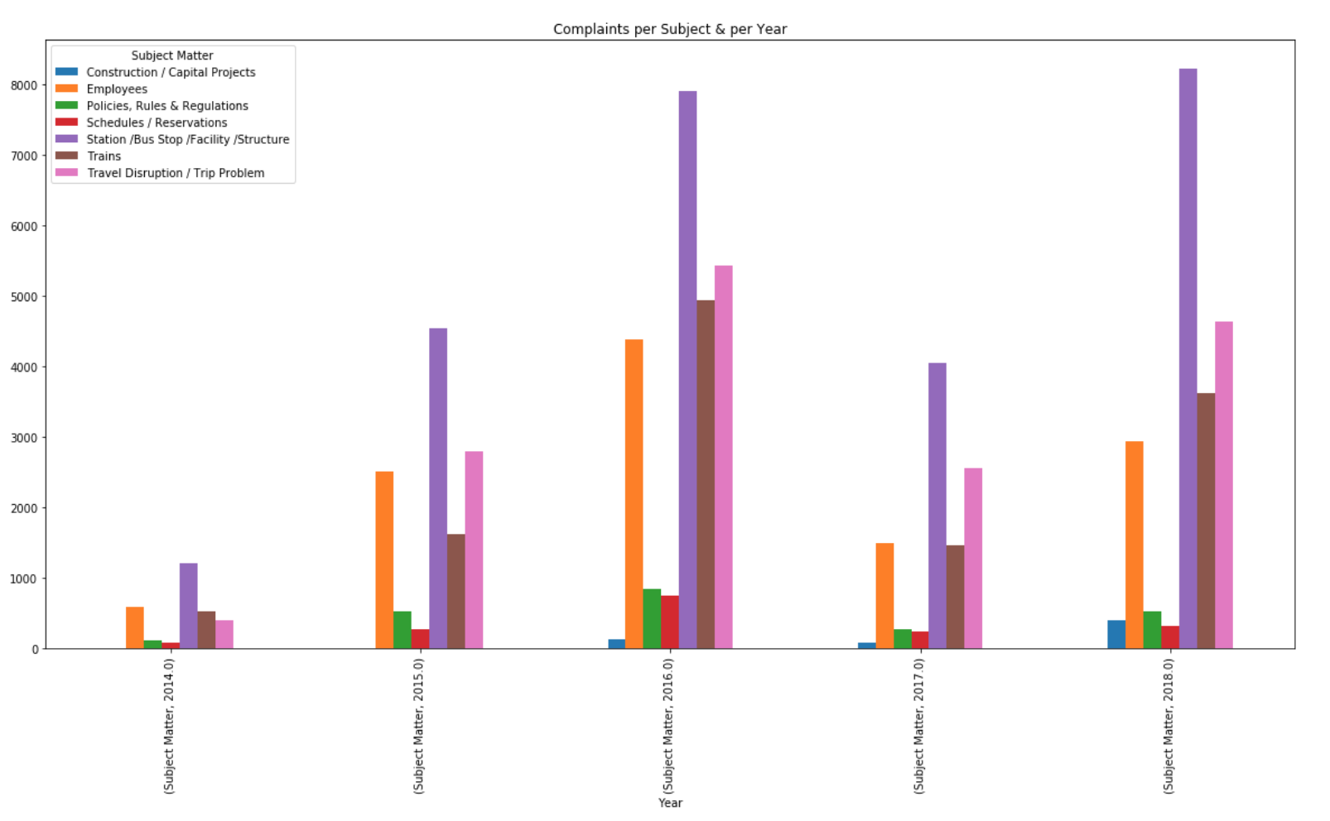

Slide 4
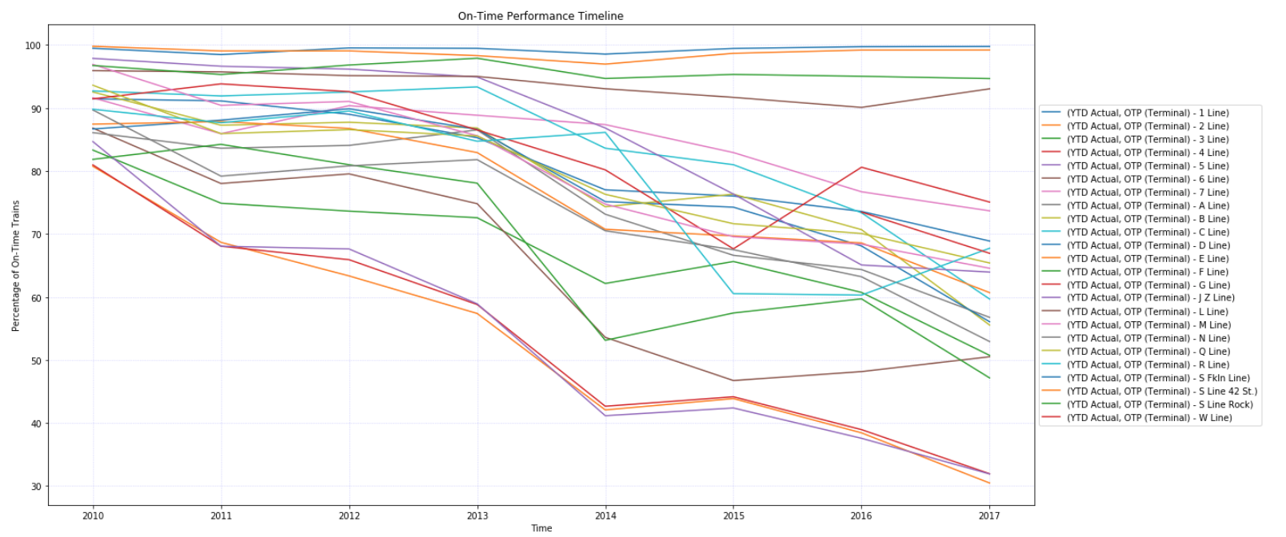

Slide 5
