Slide 1
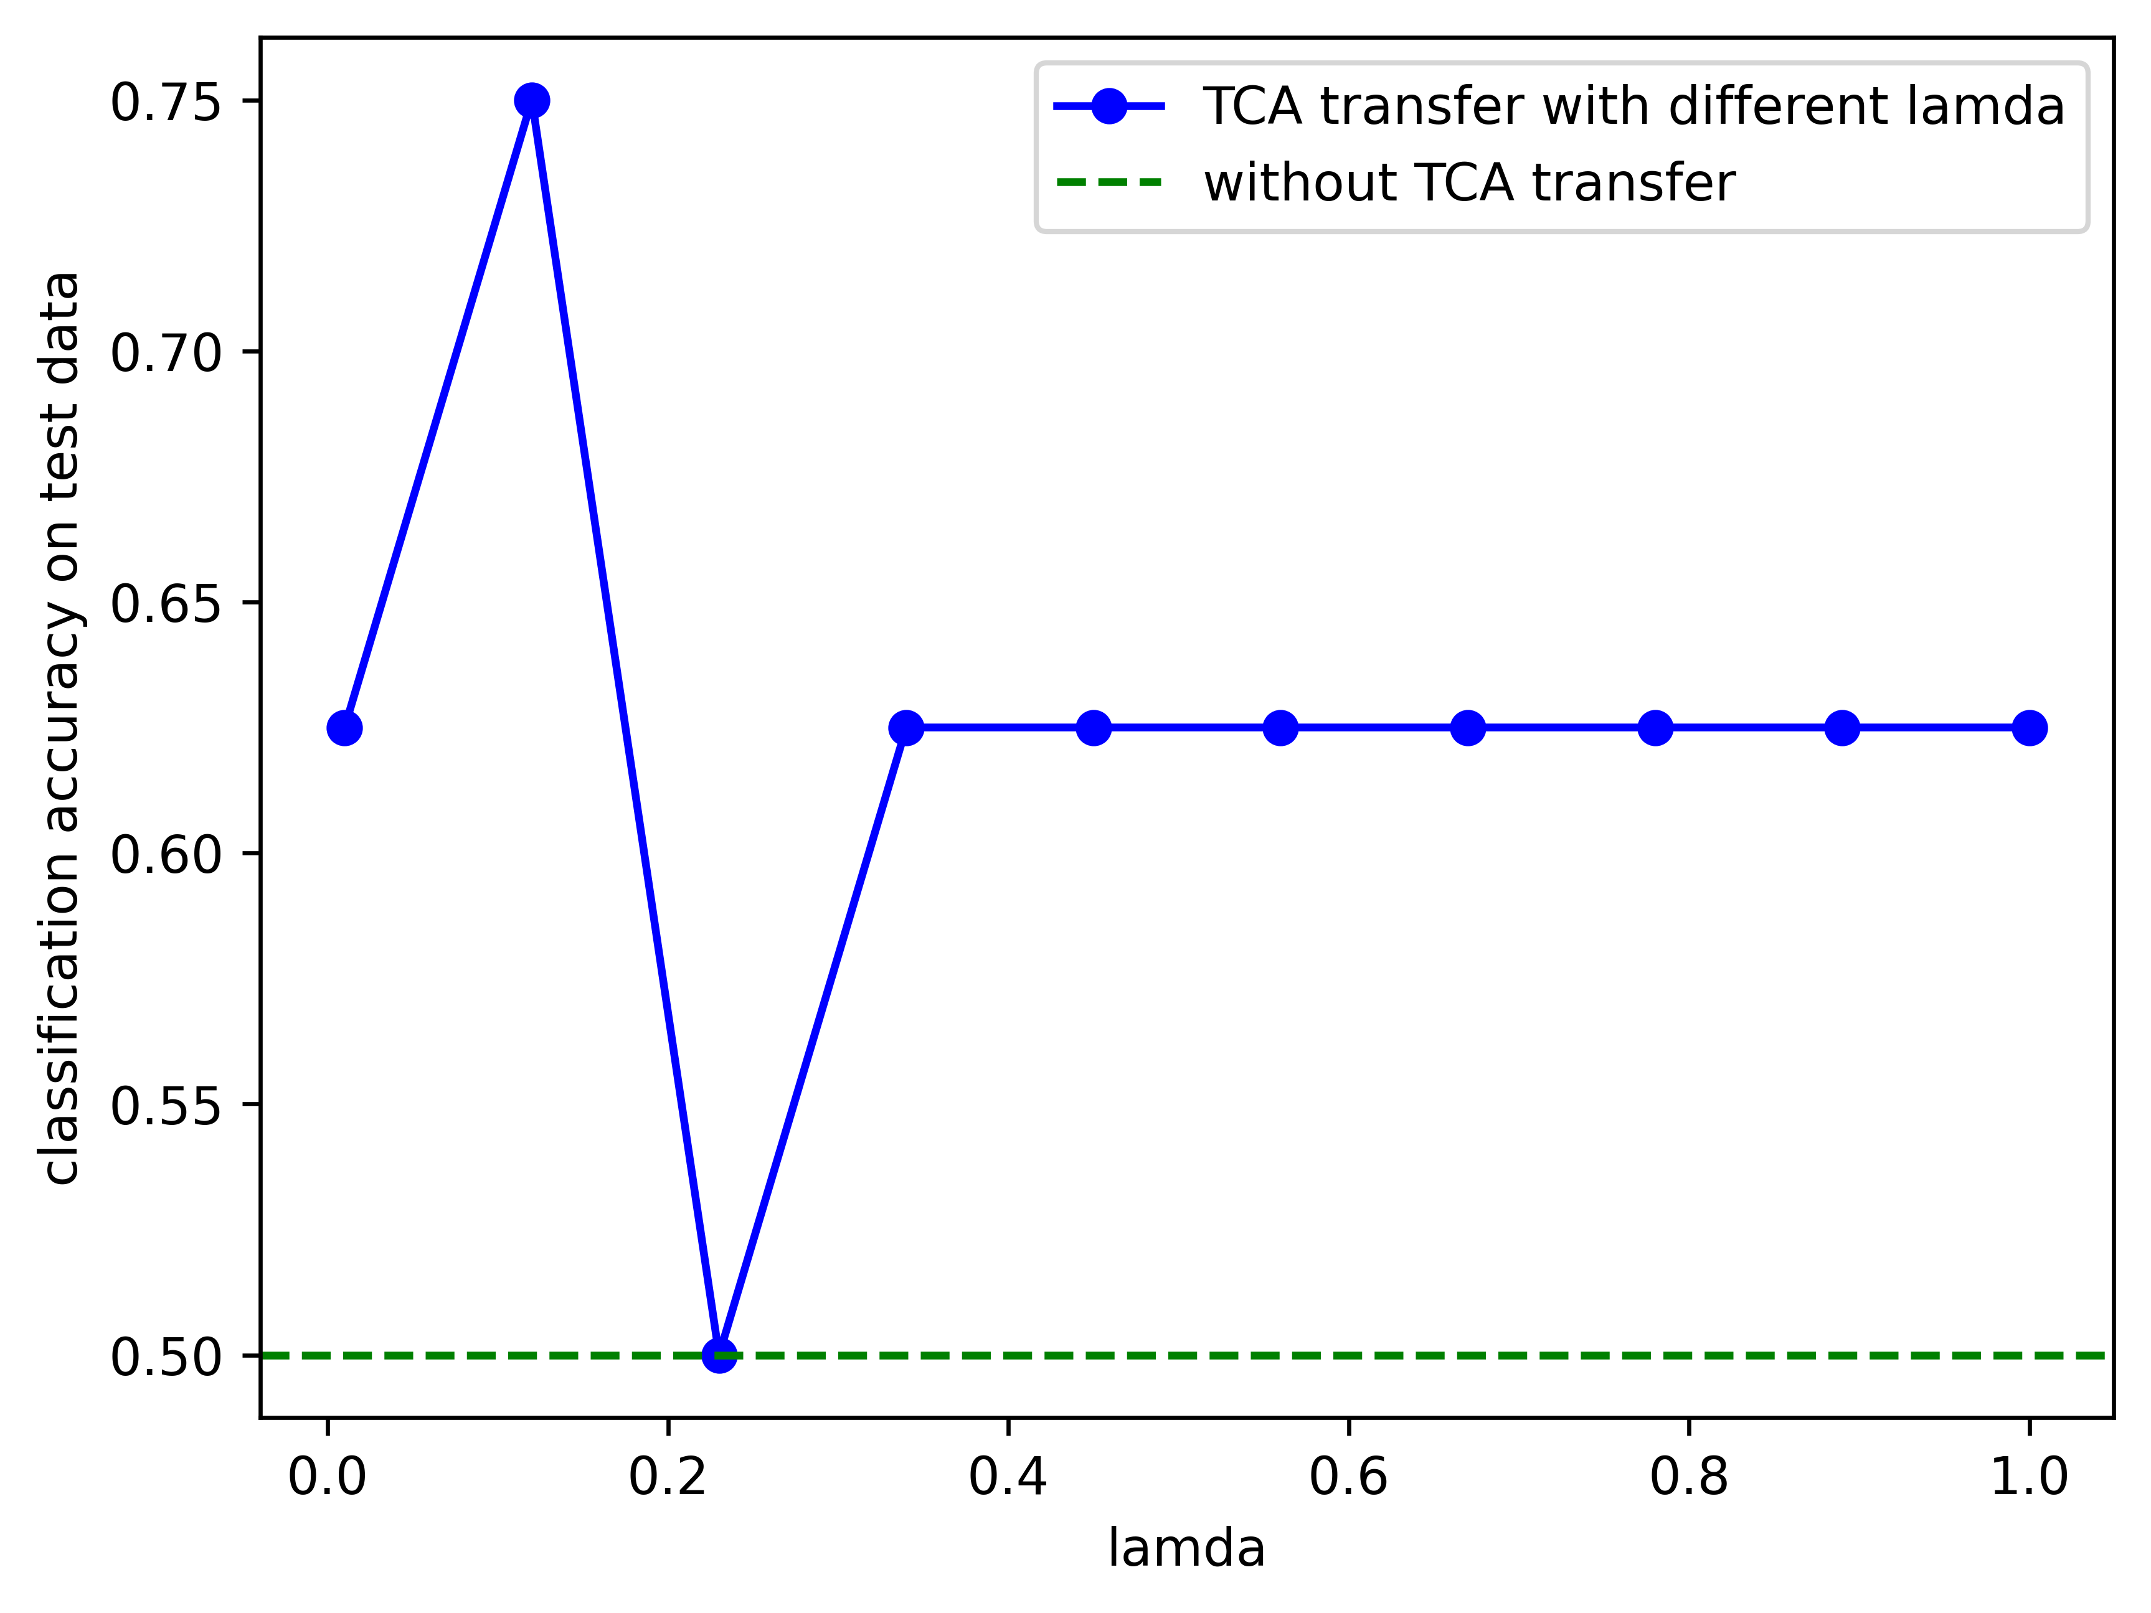
0.75
0.625
0.625
0.5
$$μ$$

