Slide 1
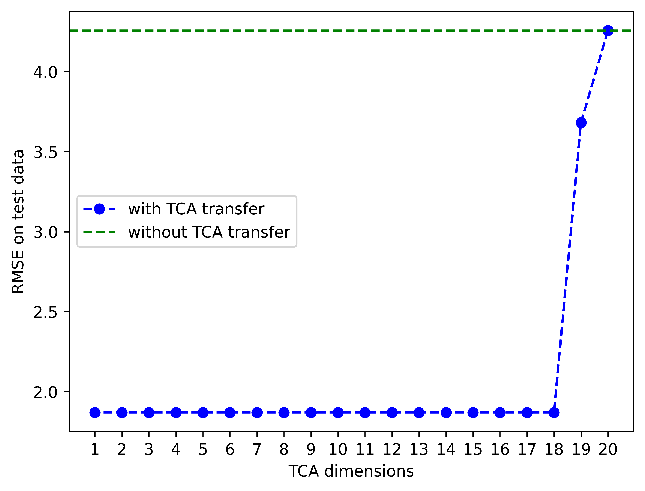
4.2573
3.6818
1.8707

