Slide 1
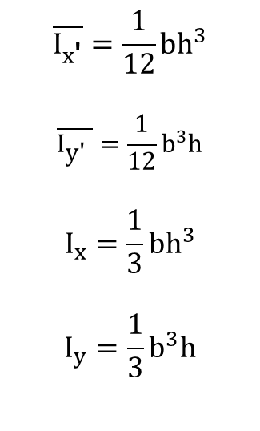
$$\overline{I_{x\text{′}}}=\frac{1}{12}bh^{3}$$
$$\overline{I_{\text{y}\text{′} }}=\frac{1}{12}b^{3}h$$
$$I_{x}=\frac{1}{3}bh^{3}$$
$$I_{y}=\frac{1}{3}b^{3}h$$
y
y'
h
C
x'
x
O
b

Slide 2
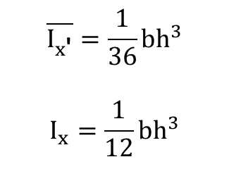

$$\overline{I_{x\text{′}}}=\frac{1}{36}bh^{3}$$
$$I_{x}=\frac{1}{12}bh^{3}$$
h
C
C
x'
$$\frac{h}{3}$$
x
b

Slide 3
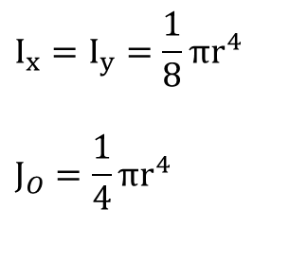
$$I_{x}=I_{y}=\frac{1}{8}πr^{4}$$
$$J_{O}=\frac{1}{4}πr^{4}$$
y
C
x
O
r

Slide 4
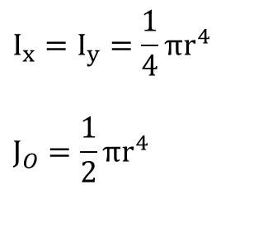
$$I_{x}=I_{y}=\frac{1}{4}πr^{4}$$
$$J_{O}=\frac{1}{2}πr^{4}$$
y
r
O
x

Slide 5
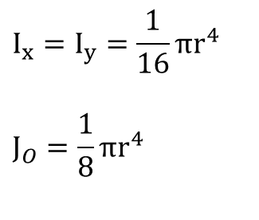
$$I_{x}=I_{y}=\frac{1}{16}πr^{4}$$
$$J_{O}=\frac{1}{8}πr^{4}$$
y
C
x
O
r

Slide 6

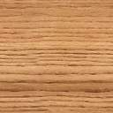


Slide 7
$$\overline{I_{x\text{′}}}=\frac{1}{12}bh^{3}$$
$$\overline{I_{\text{y}\text{′} }}=\frac{1}{12}b^{3}h$$
$$I_{x}=\frac{1}{3}bh^{3}$$
$$I_{y}=\frac{1}{3}b^{3}h$$
y
dA
dy
h
y
x
O
b

Slide 8
$$\overline{I_{x\text{′}}}=\frac{1}{12}bh^{3}$$
$$\overline{I_{\text{y}\text{′} }}=\frac{1}{12}b^{3}h$$
$$I_{x}=\frac{1}{3}bh^{3}$$
$$I_{y}=\frac{1}{3}b^{3}h$$
y
dA
dy
y
C
h
x'
x
O
b

Slide 9
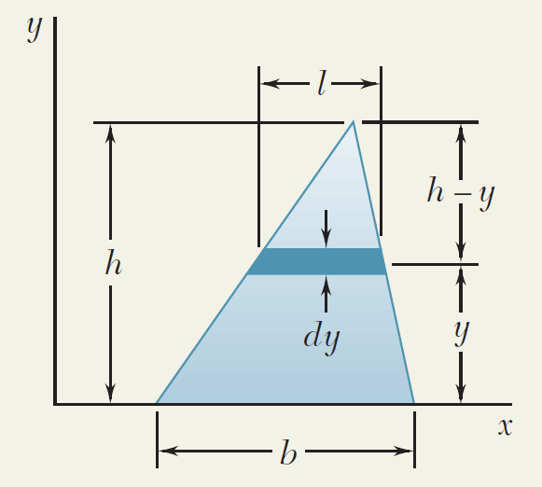

Slide 10
y
du
r
u
x
O

Slide 11
dA
y’
B
B’
y
C
d
A
A’

Slide 12
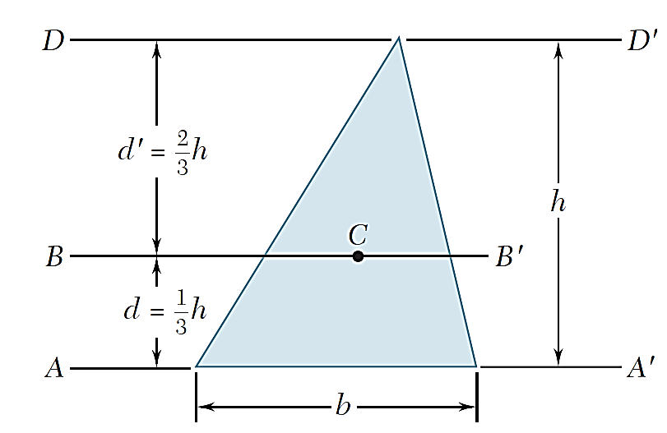

Slide 13
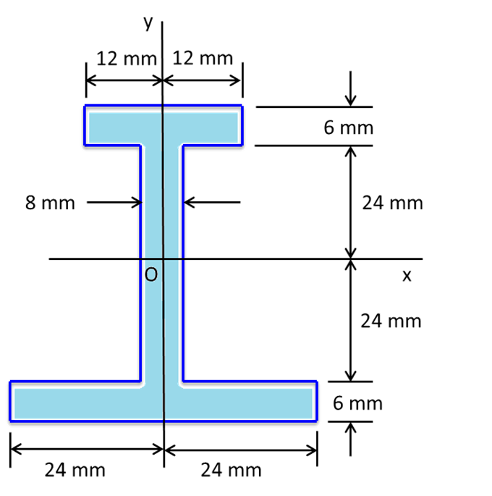
20 cm
12 cm
12 cm
20 cm

Slide 14
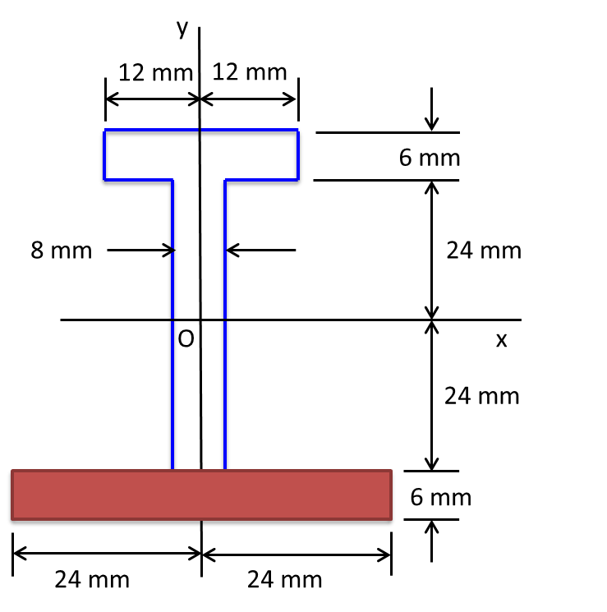
y
12 mm
12 mm
6 mm
8 mm
24 mm
O
x
24 mm
6 mm
24 mm
24 mm

Slide 15
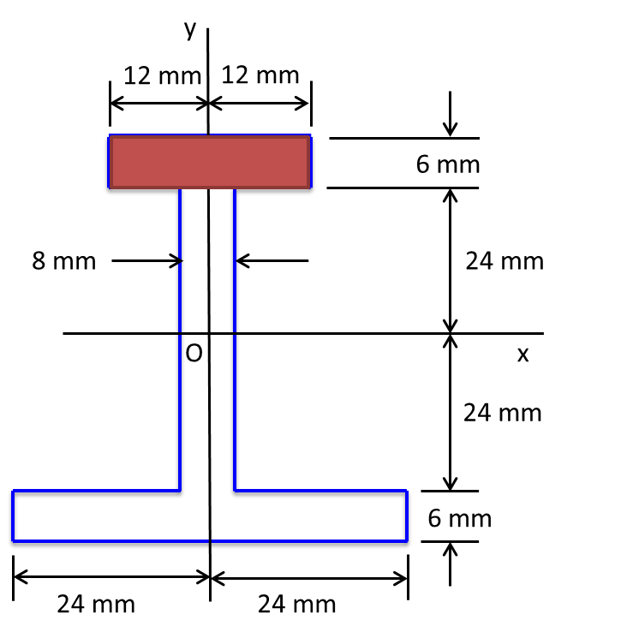
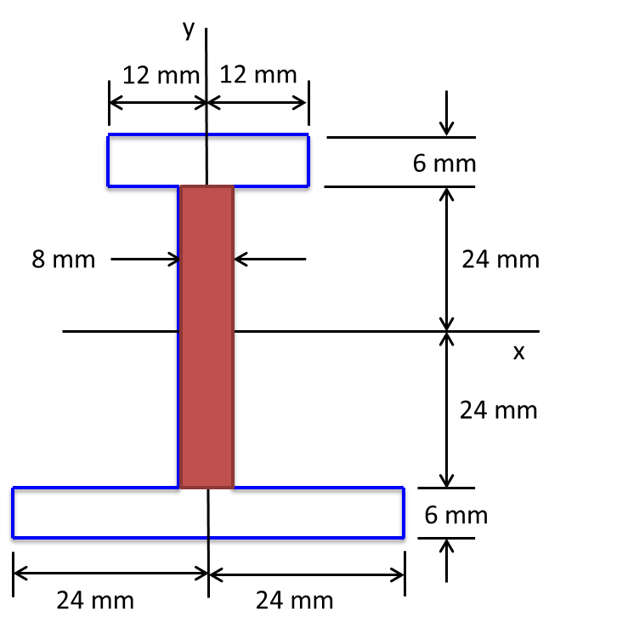

Slide 16
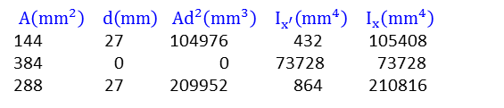
$$A\left({mm}^{2}\right) d\left(mm\right) Ad^{2}\left({mm}^{3}\right) I_{x^{′}}\left({mm}^{4}\right){ I}_{x}\left({mm}^{4}\right)$$
144 27 104976 432 105408
0 0 73728 73728
288 27 209952 864 210816

