Slide 2
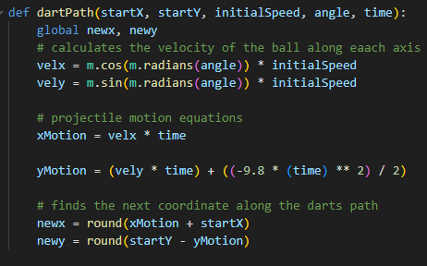
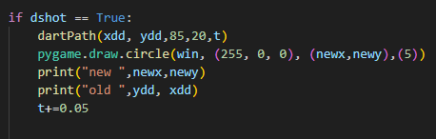
Projectile Motion
The dartPath() function is used to calculate the coordinates of the dart at each time increment. It takes in 5 variables; the initial coordinates (starting position), the time (variable parameter, is incremented in each frame), the angle, and the initial speed. The latter two parameters are used to calculate the x and y velocities by using the angle to get both the x and y components and then multiplying those by the initial speed to get their respective velocities. The calculated velocities can then be used in the projectile motion equations to get the coordinates of the dart. These are then returned and used to draw a circle which simulates a thrown dart at each frame.

