Slide 1
Clustering Techniques and Applications to Image Segmentation
Liang Shan
shan@cs.unc.edu

Slide 2
Roadmap
Unsupervised learning
Clustering categories
Clustering algorithms
K-means
Fuzzy c-means
Kernel-based
Graph-based
Q&A

Slide 3
Unsupervised learning
Definition 1
Supervised: human effort involved
Unsupervised: no human effort
Definition 2
Supervised: learning conditional distribution P(Y|X), X: features, Y: classes
Unsupervised: learning distribution P(X), X: features
Back
Slide credit: Min Zhang

Slide 4
Clustering
What is clustering?

Slide 5
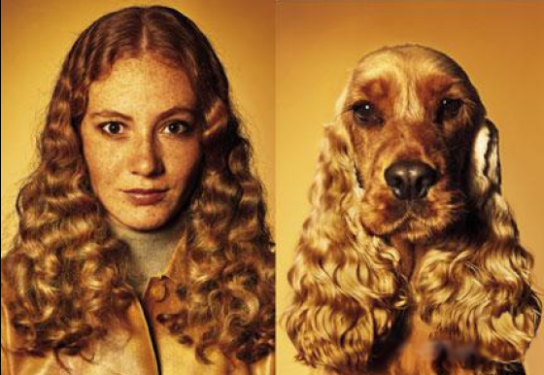
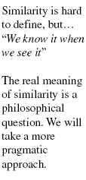
Clustering
Definition
Assignment of a set of observations into subsets so that observations in the same subset are similar in some sense

Slide 6
Clustering
Hard vs. Soft
Hard: same object can only belong to single cluster
Soft: same object can belong to different clusters
Slide credit: Min Zhang

Slide 7
Clustering
Hard vs. Soft
Hard: same object can only belong to single cluster
Soft: same object can belong to different clusters
E.g. Gaussian mixture model
Slide credit: Min Zhang

Slide 8
Clustering
Flat vs. Hierarchical
Flat: clusters are flat
Hierarchical: clusters form a tree
Agglomerative
Divisive

Slide 9
Hierarchical clustering
Agglomerative (Bottom-up)
Compute all pair-wise pattern-pattern similarity coefficients
Place each of n patterns into a class of its own
Merge the two most similar clusters into one
Replace the two clusters into the new cluster
Re-compute inter-cluster similarity scores w.r.t. the new cluster
Repeat the above step until there are k clusters left (k can be 1)
Slide credit: Min Zhang

Slide 10
Hierarchical clustering
Agglomerative (Bottom up)

Slide 11
Hierarchical clustering
Agglomerative (Bottom up)
1st iteration
1

Slide 12
Hierarchical clustering
Agglomerative (Bottom up)
2nd iteration
1
2

Slide 13
Hierarchical clustering
Agglomerative (Bottom up)
3rd iteration
3
1
2

Slide 14
Hierarchical clustering
Agglomerative (Bottom up)
4th iteration
3
1
2
4

Slide 15
Hierarchical clustering
Agglomerative (Bottom up)
5th iteration
3
1
2
5
4

Slide 16
Hierarchical clustering
Agglomerative (Bottom up)
Finally k clusters left
3
9
6
1
2
5
8
4
7

Slide 17
Hierarchical clustering
Divisive (Top-down)
Start at the top with all patterns in one cluster
The cluster is split using a flat clustering algorithm
This procedure is applied recursively until each pattern is in its own singleton cluster

Slide 18
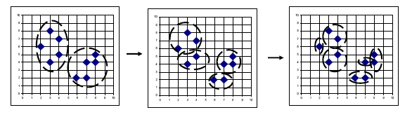
Hierarchical clustering
Divisive (Top-down)
Slide credit: Min Zhang

Slide 19
Bottom-up vs. Top-down
Which one is more complex?
Which one is more efficient?
Which one is more accurate?

Slide 20
Bottom-up vs. Top-down
Which one is more complex?
Top-down
Because a flat clustering is needed as a “subroutine”
Which one is more efficient?
Which one is more accurate?

Slide 21
Bottom-up vs. Top-down
Which one is more complex?
Which one is more efficient?
Which one is more accurate?

Slide 22
Bottom-up vs. Top-down
Which one is more complex?
Which one is more efficient?
Top-down
For a fixed number of top levels, using an efficient flat algorithm like K-means, divisive algorithms are linear in the number of patterns and clusters
Agglomerative algorithms are least quadratic
Which one is more accurate?

Slide 23
Bottom-up vs. Top-down
Which one is more complex?
Which one is more efficient?
Which one is more accurate?

Slide 24
Bottom-up vs. Top-down
Which one is more complex?
Which one is more efficient?
Which one is more accurate?
Top-down
Bottom-up methods make clustering decisions based on local patterns without initially taking into account the global distribution. These early decisions cannot be undone.
Top-down clustering benefits from complete information about the global distribution when making top-level partitioning decisions.
Back

Slide 25
K-means
Data set:
Clusters:
Codebook :
Partition matrix:
Minimizes functional:
Iterative algorithm:
Initialize the codebook V with vectors randomly picked from X
Assign each pattern to the nearest cluster
Recalculate partition matrix
Repeat the above two steps until convergence

Slide 26
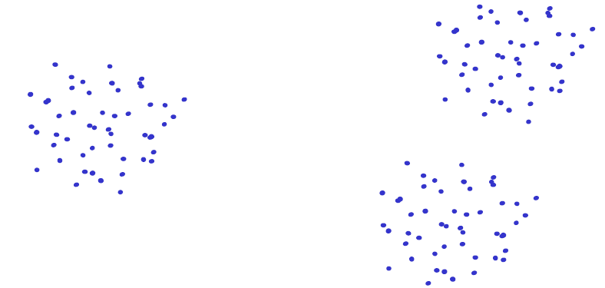
K-means
Disadvantages
Dependent on initialization

Slide 27
K-means
Disadvantages
Dependent on initialization

Slide 28
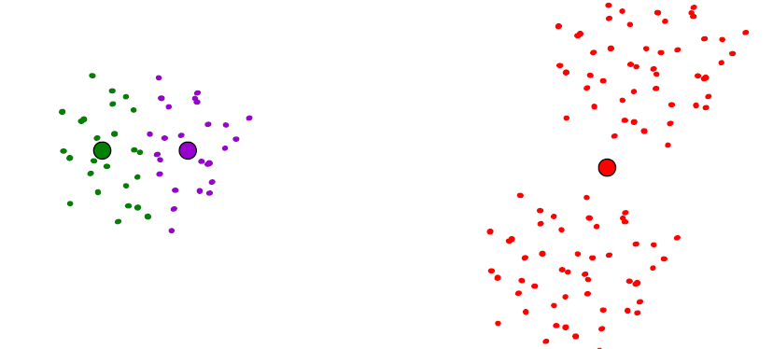
K-means
Disadvantages
Dependent on initialization

Slide 29
K-means
Disadvantages
Dependent on initialization
Select random seeds with at least D_{min}
Or, run the algorithm many times

Slide 30
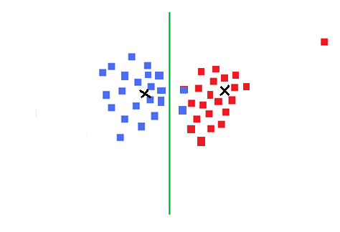
K-means
Disadvantages
Dependent on initialization
Sensitive to outliers

Slide 31
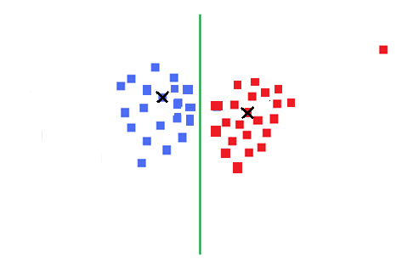
K-means
Disadvantages
Dependent on initialization
Sensitive to outliers
Use K-medoids
Notes:
Add definition of median

Slide 32
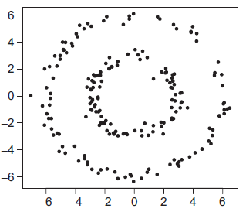
K-means
Disadvantages
Dependent on initialization
Sensitive to outliers (K-medoids)
Can deal only with clusters with spherical symmetrical point distribution
Kernel trick

Slide 33
K-means
Disadvantages
Dependent on initialization
Sensitive to outliers (K-medoids)
Can deal only with clusters with spherical symmetrical point distribution
Deciding K

Slide 34
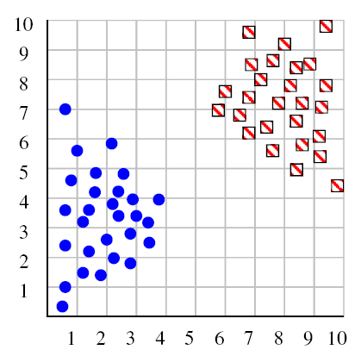
Deciding K
Try a couple of K
Image: Henry Lin

Slide 35
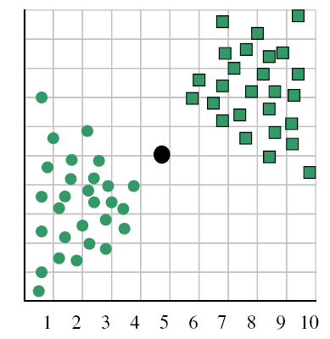
Deciding K
When k = 1, the objective function is 873.0
Image: Henry Lin

Slide 36
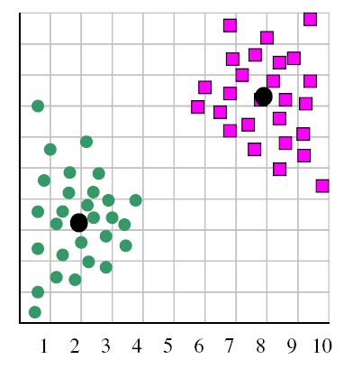
Deciding K
When k = 2, the objective function is 173.1
Image: Henry Lin

Slide 37
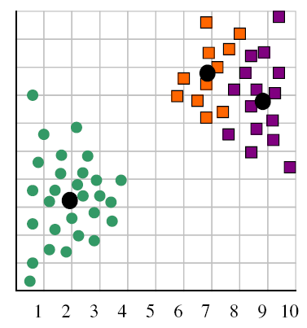
Deciding K
When k = 3, the objective function is 133.6
Image: Henry Lin

Slide 38
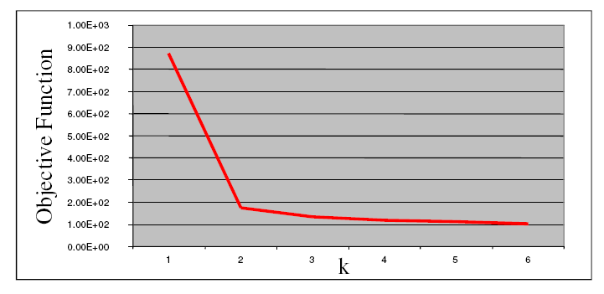
Deciding K
We can plot objective function values for k=1 to 6
The abrupt change at k=2 is highly suggestive of two clusters
“knee finding” or “elbow finding”
Note that the results are not always as clear cut as in this toy example
Back
Image: Henry Lin

Slide 39
Fuzzy C-means
Data set:
Clusters:
Codebook :
Partition matrix:
K-means:
Soft clustering
Minimize functional
fuzzy partition matrix
fuzzification parameter, usually set to 2

Slide 40
Fuzzy C-means
Minimize
subject to

Slide 41
Fuzzy C-means
Minimize
subject to
How to solve this constrained optimization problem?

Slide 42
Fuzzy C-means
Minimize
subject to
How to solve this constrained optimization problem?
Introduce Lagrangian multipliers
Notes:
Show equations here

Slide 43
Fuzzy c-means
Introduce Lagrangian multipliers
Iterative optimization
Fix V, optimize w.r.t. U
Fix U, optimize w.r.t. V

Slide 44
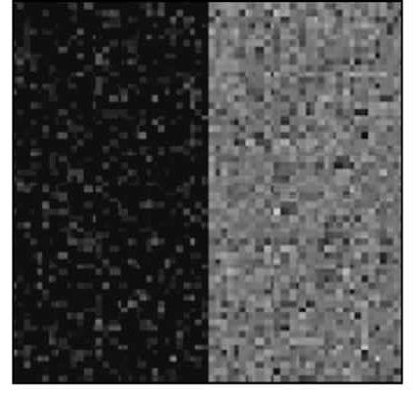
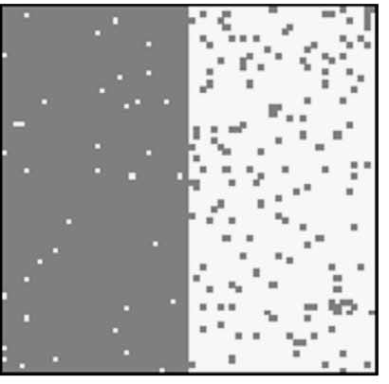
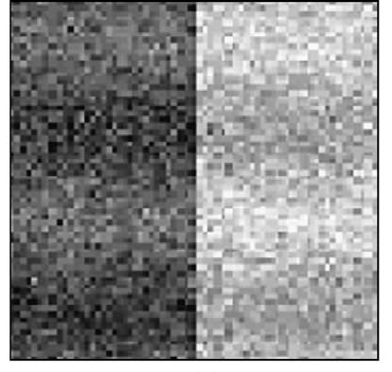
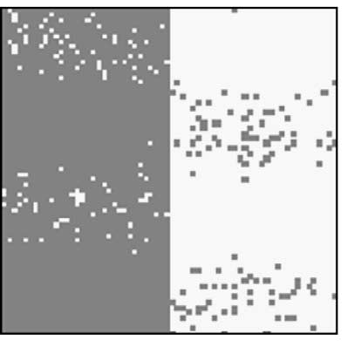
Application to image segmentation
Original images
Segmentations
Homogenous intensity corrupted by 5% Gaussian noise
Accuracy = 96.02%
Sinusoidal inhomogenous intensity corrupted by 5% Gaussian noise
Accuracy = 94.41%
Back
Image: Dao-Qiang Zhang, Song-Can Chen

Slide 45
Kernel substitution trick
Kernel K-means
Kernel fuzzy c-means

Slide 46
Kernel substitution trick
Kernel fuzzy c-means
Confine ourselves to Gaussian RBF kernel
Introduce a penalty term containing neighborhood information
Equation: Dao-Qiang Zhang, Song-Can Chen

Slide 47
Spatially constrained KFCM
: the set of neighbors that exist in a window around
: the cardinality of
controls the effect of the penalty term
The penalty term is minimized when
Membership value for x_{j} is large and also large at neighboring pixels
Vice versa
0.9 | 0.9 | 0.9
0.9 | 0.9 | 0.9
0.9 | 0.9 | 0.9
0.1 | 0.1 | 0.1
0.1 | 0.9 | 0.1
0.1 | 0.1 | 0.1
Equation: Dao-Qiang Zhang, Song-Can Chen

Slide 48
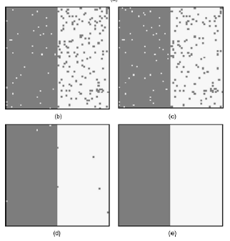
FCM applied to segmentation
FCM
Accuracy = 96.02%
KFCM
Accuracy = 96.51%
Original images
Homogenous intensity corrupted by 5% Gaussian noise
SFCM
Accuracy = 99.34%
SKFCM
Accuracy = 100.00%
Image: Dao-Qiang Zhang, Song-Can Chen

Slide 49
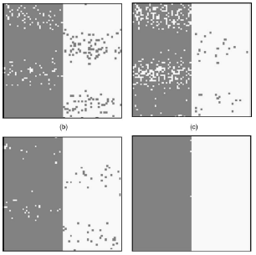
FCM applied to segmentation
FCM
Accuracy = 94.41%
KFCM
Accuracy = 91.11%
Original images
Sinusoidal inhomogenous intensity corrupted by 5% Gaussian noise
SFCM
Accuracy = 98.41%
SKFCM
Accuracy = 99.88%
Image: Dao-Qiang Zhang, Song-Can Chen

Slide 50
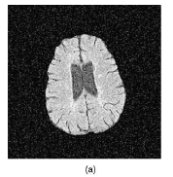
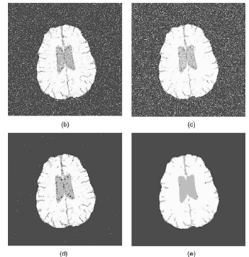

FCM applied to segmentation
FCM result
KFCM result
Original MR image corrupted by 5% Gaussian noise
SFCM result
SKFCM result
Back
Image: Dao-Qiang Zhang, Song-Can Chen

Slide 51
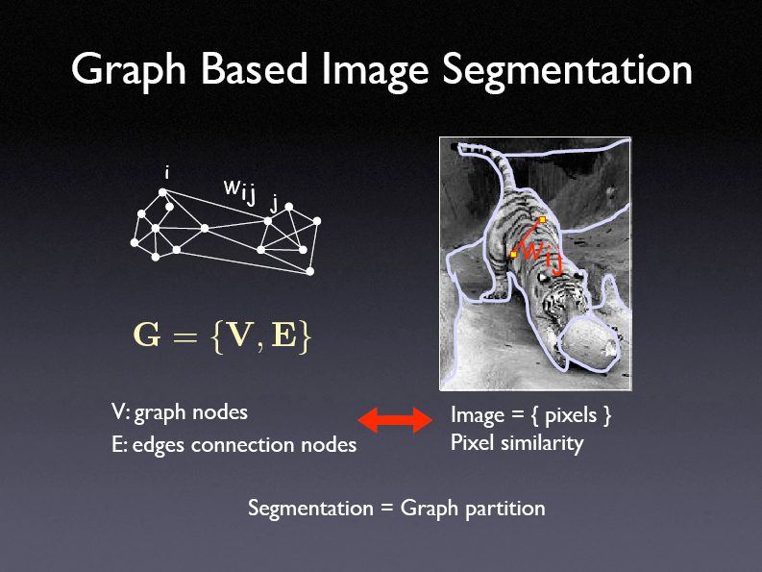
Graph Theory-Based
Use graph theory to solve clustering problem
Graph terminology
Adjacency matrix
Degree
Volume
Cuts
Slide credit: Jianbo Shi

Slide 52
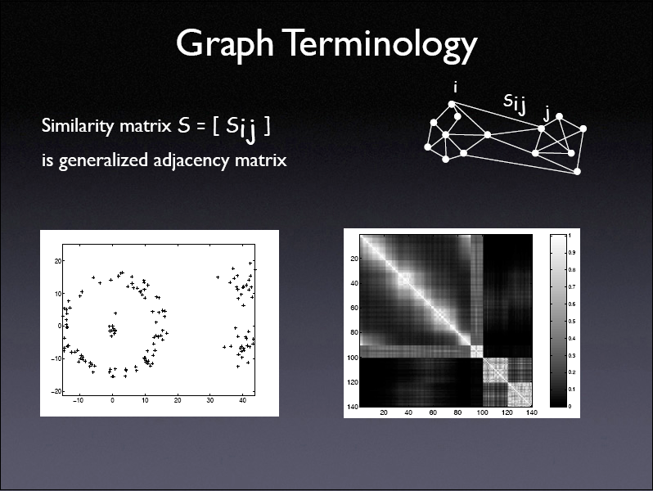
Slide credit: Jianbo Shi

Slide 53
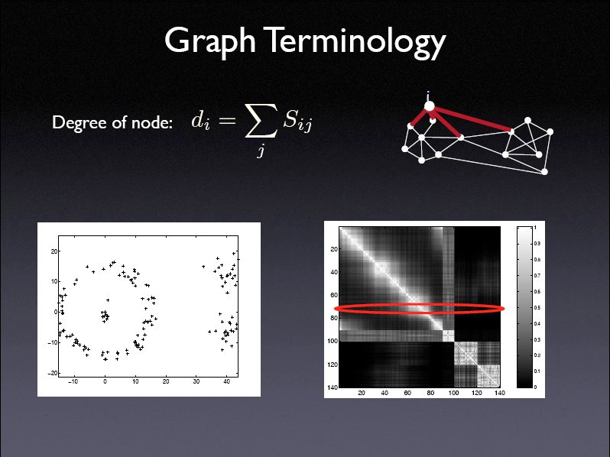
Slide credit: Jianbo Shi

Slide 54
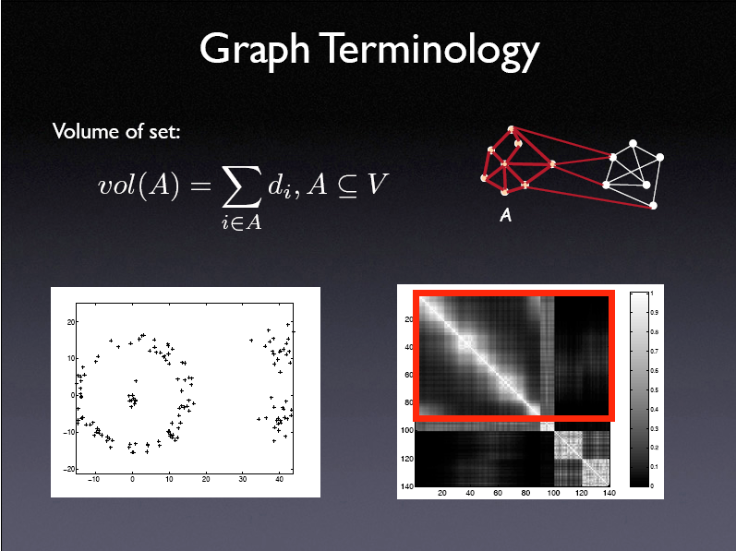
Slide credit: Jianbo Shi

Slide 55
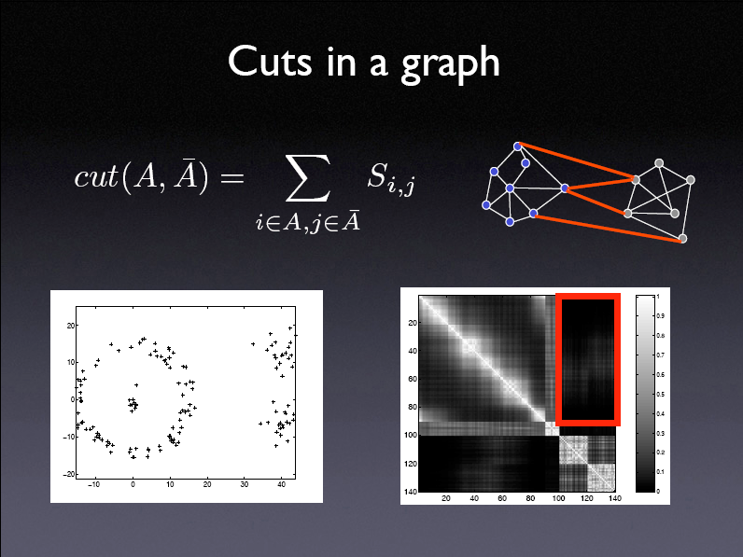
Slide credit: Jianbo Shi

Slide 56
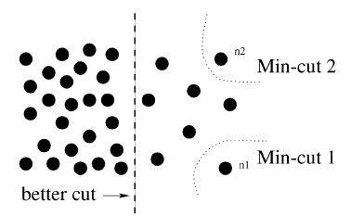
Problem with min. cuts
Minimum cut criteria favors cutting small sets of isolated nodes in the graph
Not surprising since the cut increases with the number of edges going across the two partitioned parts
Image: Jianbo Shi and Jitendra Malik

Slide 57
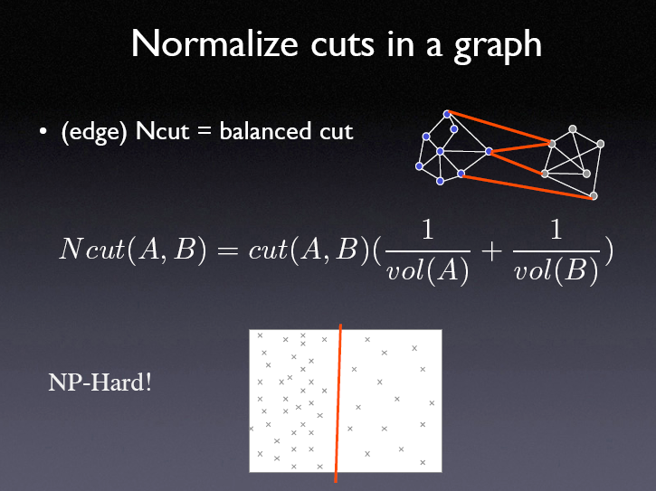
Slide credit: Jianbo Shi

Slide 58
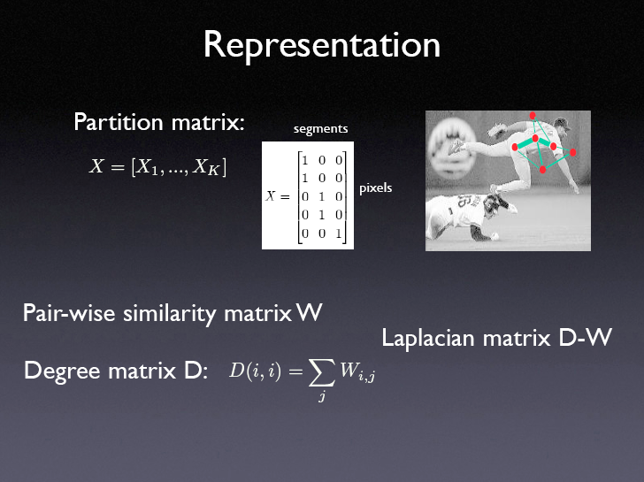
Slide credit: Jianbo Shi

Slide 59
Algorithm
Given an image, set up a weighted graph and set the weight on the edge connecting two nodes to be a measure of the similarity between the two nodes
Solve for the eigenvectors with the second smallest eigenvalue
Use the second smallest eigenvector to bipartition the graph
Decide if the current partition should be subdivided and recursively repartition the segmented parts if necessary

Slide 60
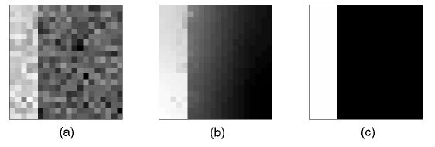
Example
(a) A noisy “step” image
(b) eigenvector of the second smallest eigenvalue
(c) resulting partition
Image: Jianbo Shi and Jitendra Malik

Slide 61
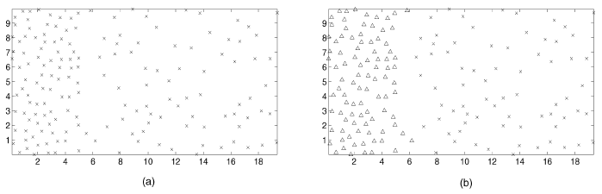
Example
(a) Point set generated by two Poisson processes
(b) Partition of the point set

Slide 62
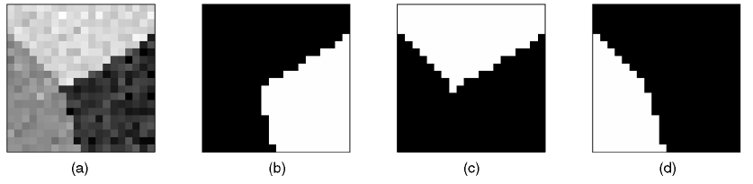
Example
(a) Three image patches form a junction
(b)-(d) Top three components of the partition
Image: Jianbo Shi and Jitendra Malik

Slide 63
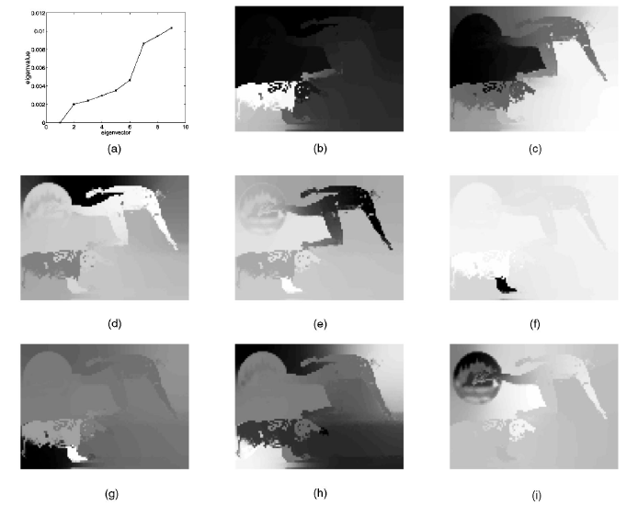
Image: Jianbo Shi and Jitendra Malik

Slide 64
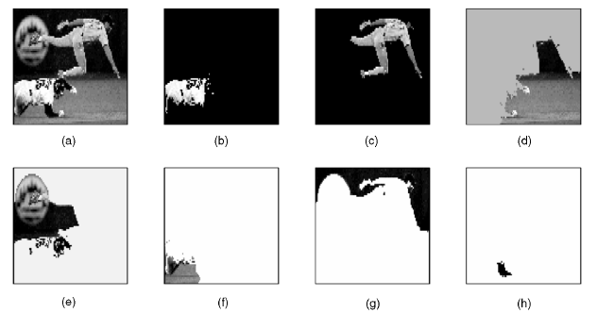
Example
Components of the partition with Ncut value less than 0.04
Image: Jianbo Shi and Jitendra Malik

Slide 65
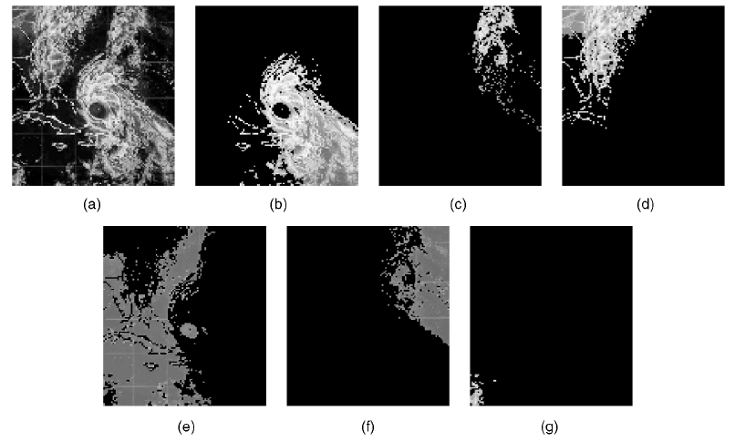
Example
Back
Image: Jianbo Shi and Jitendra Malik

