Slide 1
US Software Comps – Oct 2025
Auto-generated from comps CSV

Slide 2
Key Takeaways
Median EV/EBITDA ≈ 19.0x; P/E ≈ 32.8x
Prefer medians & IQR (25–75th) over means due to outliers
Growth/margins cluster in Software/Semis within this sample

Slide 3
Comparable Companies Table
Company | Ticker | Sector | EV (USD bn) | EBITDA (USD bn) | EV_EBITDA | PE | Rev_Growth_% | EBITDA_Margin_%
Apple Inc. | AAPL | Tech Hardware | 2800.0 | 135.0 | 20.7x | 32.1x | 7.8% | 33.2%
Microsoft Corp. | MSFT | Software | 3100.0 | 150.0 | 20.7x | 35.0x | 14.3% | 48.0%
NVIDIA Corp. | NVDA | Semiconductors | 2500.0 | 120.0 | 20.8x | 45.2x | 90.5% | 57.0%
Alphabet Inc. | GOOGL | Internet | 1900.0 | 110.0 | 17.3x | 28.7x | 9.1% | 33.5%
Amazon.com Inc. | AMZN | E-commerce/Cloud | 1900.0 | 100.0 | 19.0x | 62.4x | 12.7% | 16.0%
Meta Platforms | META | Social Media | 1200.0 | 65.0 | 18.5x | 27.4x | 15.8% | 42.0%
Oracle Corp. | ORCL | Software | 475.0 | 25.0 | 19.0x | 31.8x | 9.0% | 41.0%
Adobe Inc. | ADBE | Software | 240.0 | 12.0 | 20.0x | 38.2x | 10.9% | 45.0%
Salesforce Inc. | CRM | Software | 250.0 | 14.0 | 17.9x | 33.5x | 11.4% | 30.0%
Intel Corp. | INTC | Semiconductors | 200.0 | 15.0 | 13.3x | 22.0x | -3.5% | 24.0%

Slide 4
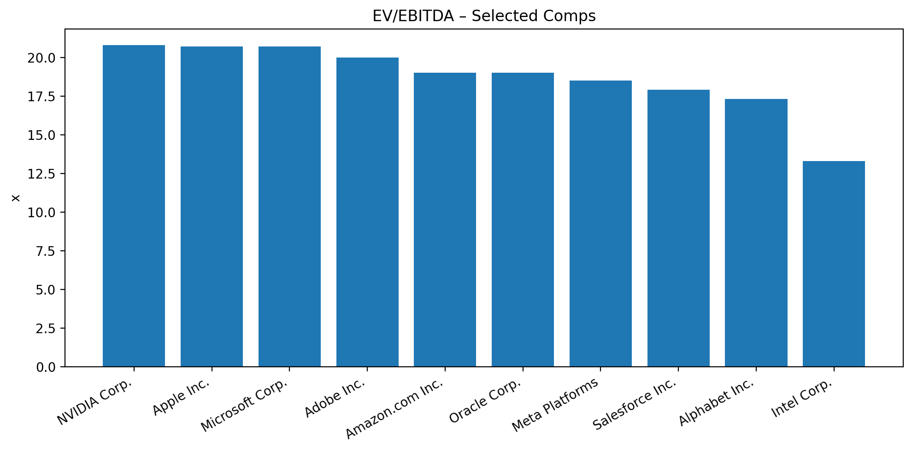
EV/EBITDA – Distribution

Slide 5
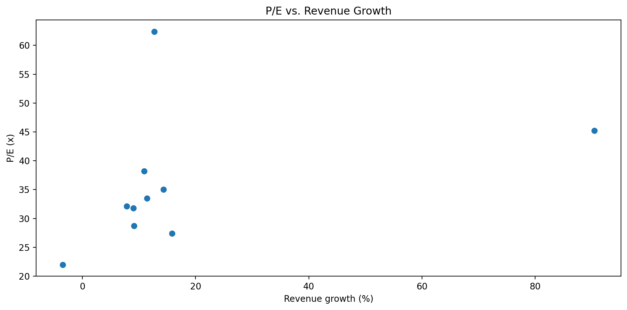
P/E vs Revenue Growth
Illustrative only; ensure sector comparability.

Slide 6
Valuation Summary (EV/EBITDA & P/E)
Metric | Median (x) | 25th (x) | 75th (x)
EV/EBITDA | 19.0 | 18.0 | 20.5
P/E | 32.8 | 29.5 | 37.4

Slide 7
Methodology & Sources
Universe: 10 listed software comps; currency: USD; base: TTM.
Valuation: EV/EBITDA & P/E; medians and interquartile range (25–75th).
Outliers reviewed; results illustrative. Sources: public filings & aggregators.

