Slide 1
Forecasting rental prices in Krakow
Mateusz Jałocha

Slide 2



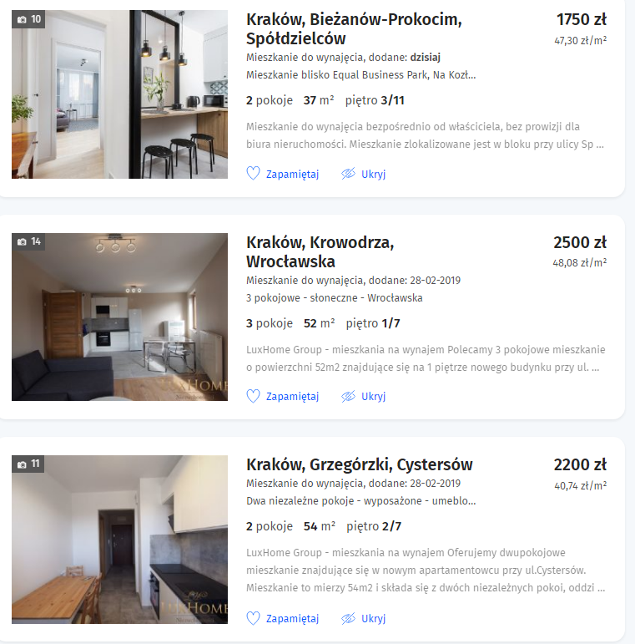
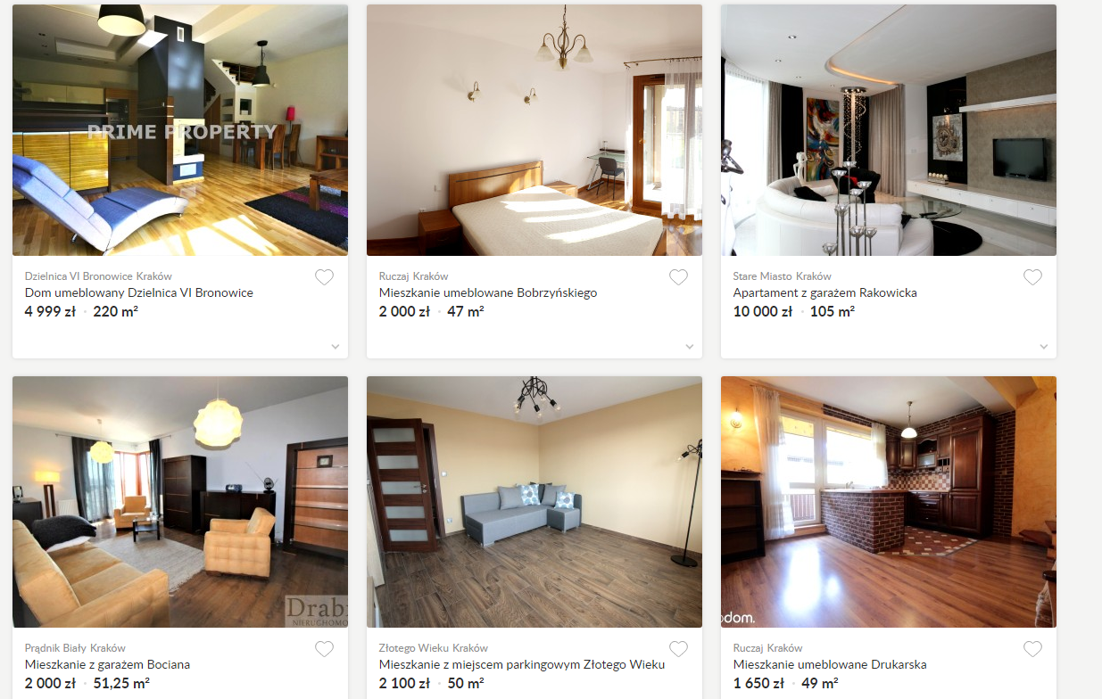


Where does the data come from?
2

Slide 3
Basic variables
The variables from the Internet services that have been taken into account, include:
Price per meter – less or equal to 60 PLN
Surface – less or equal to 80 m^2
Number of rooms – two or three
Longitude
Latitude

Slide 4
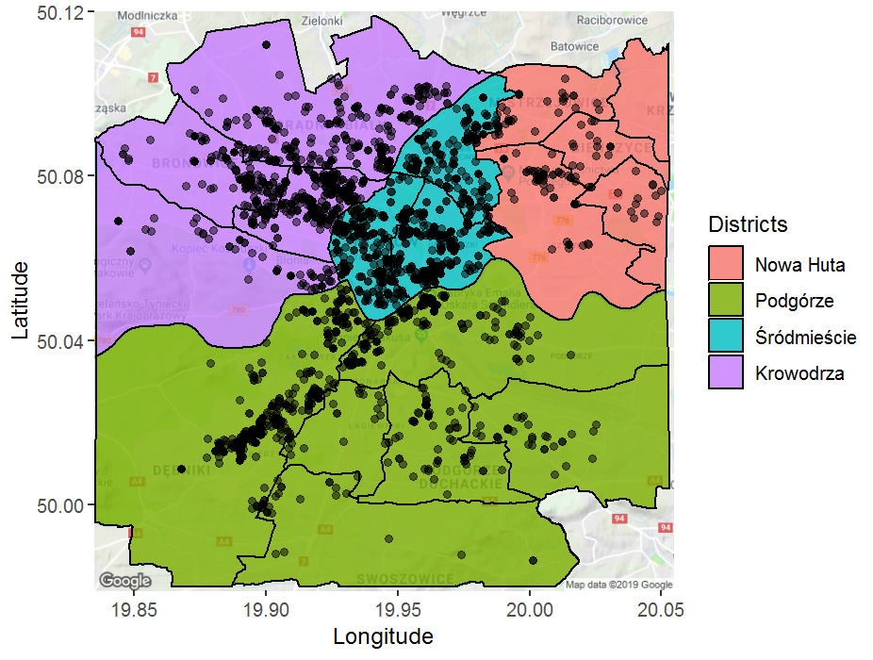
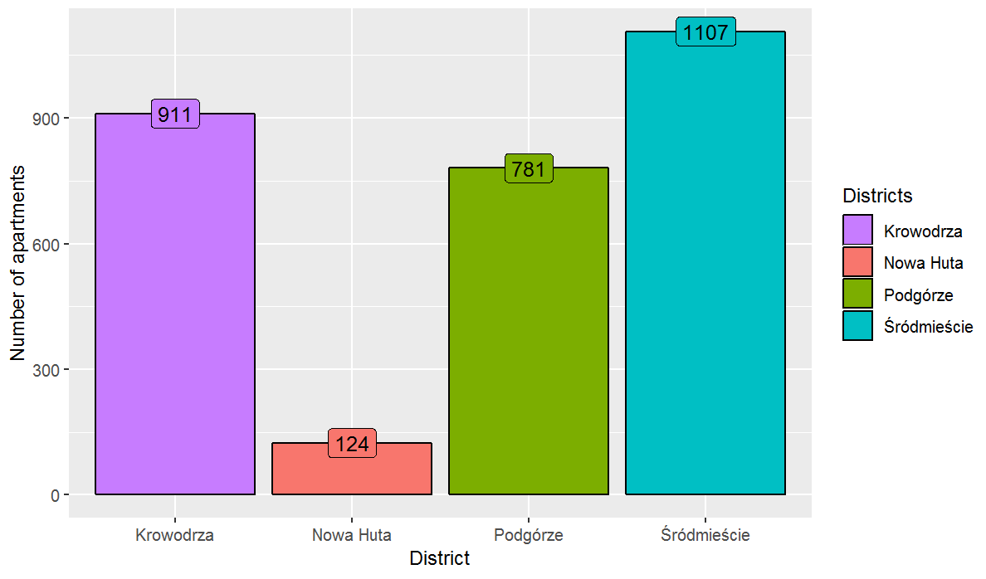
How do the scrapped data look like?

Slide 5
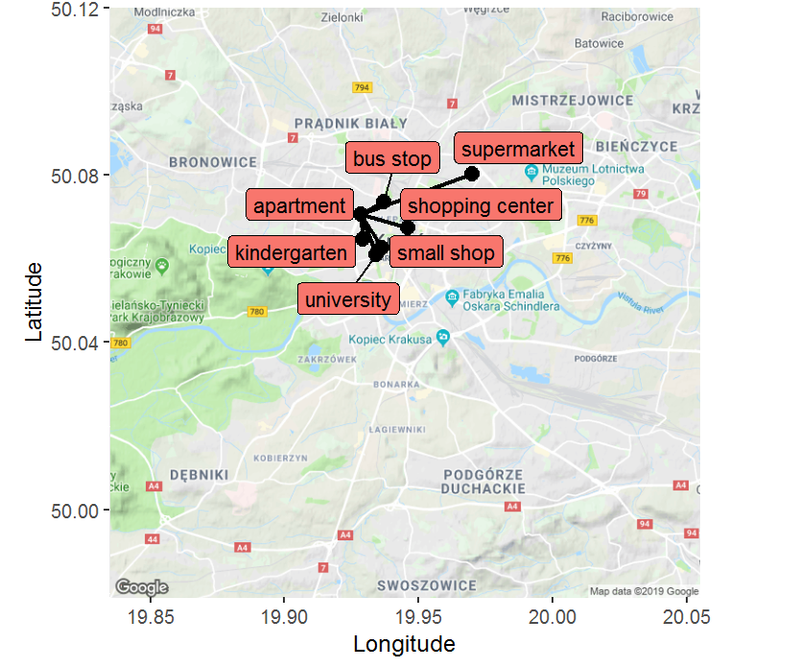

New variables
 | Distance | Average distance
University
Shopping center
Kindergarten
Small shop
Bus stop
Supermarket
City center
Park
$1− \frac{number of students at university}{number of students in Cracow}$

Slide 6
Methods used to create models
Bagging
Random Forest
02
04
01
03
05
Multiple regression
Gradient Boosting Machine (GBM)
XGBoost

Slide 7
Selected variables for models
 | Śródmieście | Krowodrza | Podgórze | Nowa Huta | One model
Dist. university
Avg. dist. universities
Dist. shopping mall
Avg. dist. shopping malls
Dist. kindergarten
Avg. dist. kindergartens
Dist. supermarket
Dist. park
Avg. dist. bus stops

Slide 8
Results
Root Mean Square Error - RMSE
Methods | One model - train | One model - test | Districts models – train | Districts models - test
Multiple regression | 7,59 | 7,73 | 7,35 | 7,65
Bagging | 7,70 | 7,61 | 6,00 | 7,24
Random Forest | 3,84 | 7,04 | 3,90 | 6,74
GBM | 5,29 | 7,15 | 5,50 | 6,96
XGBoost | 4,50 | 6,99 | 4,36 | 6,68
*These values are expressed in PLN
Mean Absolute Percentage Error - MAPE
Method | One model - train | One model - test | Districts models – train | Districts models - test
Random Forest | 6,84 % | 13,40 % | 6,9 % | 12,27 %

Slide 9
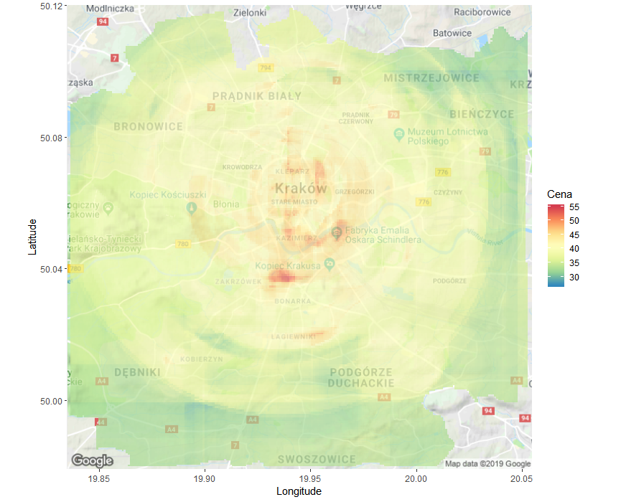
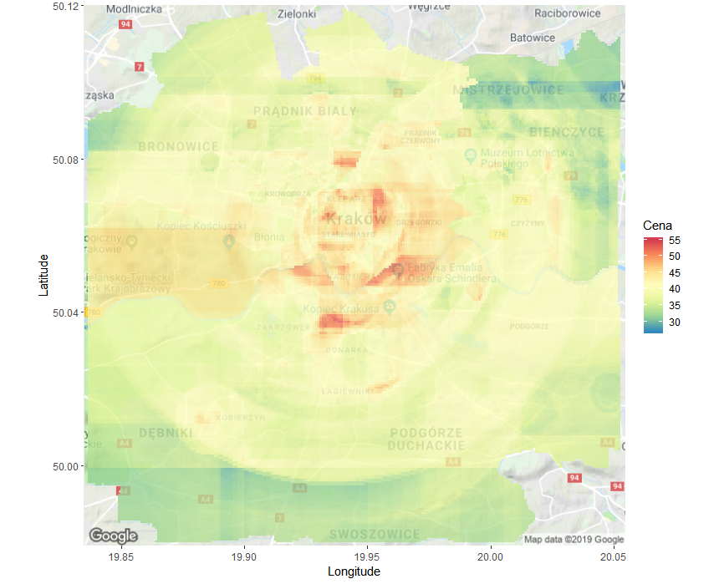
Comparison
Price
Price

Slide 10
Bibliography
Biecek P., Analiza danych z programem R. Modele liniowe z efektami stałymi, losowymi i mieszanymi, PWN, Warszawa, 2011
Brittany A., Using Machine Learning to predict home prices, „towardsdatascience.com”, 07.01.2019, [dostęp: 30.03.2019]
Chen T., Guestrin C., XGBoost: A Scalable Tree Boosting System, „Proceedings of the 22nd ACM SIGKDD International Conference on knowledge discovery and data mining”, 2016, vol. 1, s. 785-794.
Ridgeway G., Generalized Boosted Models: A Guide to the GBM Package, „Compute” 2007, vol. 1, s. 1-12.
Szeliga M., Data Science i uczenie maszynowe, PWN, Warszawa, 2017
Walesiak M., Gatnar E., Statystyczna analiza danych z wykorzystaniem programu R, PWN, Warszawa, 2012
Wickham H., Grolemund G., Język R. Kompletny zestaw narzędzi dla analityków danych, Helion, Gliwice, 2018

Slide 11
Libraries
Web scrapping:
library(XML)
library(rvest)
library(rlang)
library(stringr)
library(RCurl)
Coordinates of objects:
library(tidyverse)
library(osmdata)
library(sf)
library(ggmap)
library(dplyr)
library(dbplyr)
library(geosphere)
library(googleway)
library(gmapsdistance)
Machine learning:
library(randomForest)
library(pracma)
library(ipred)
library(gbm)
library(e1071)
library(Matrix)
library(data.table)
library(xgboost)
library(MLmetrics)
library(caret)
library(wesanderson)
library(ggnewscale)
library(metR)
library(magrittr)

Slide 12
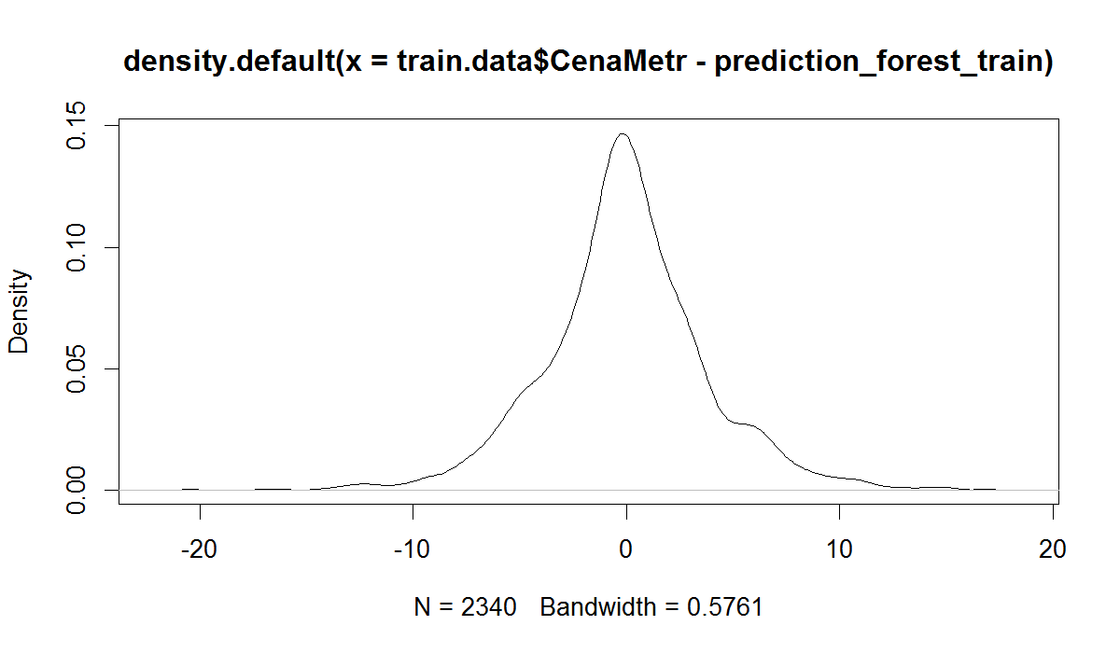
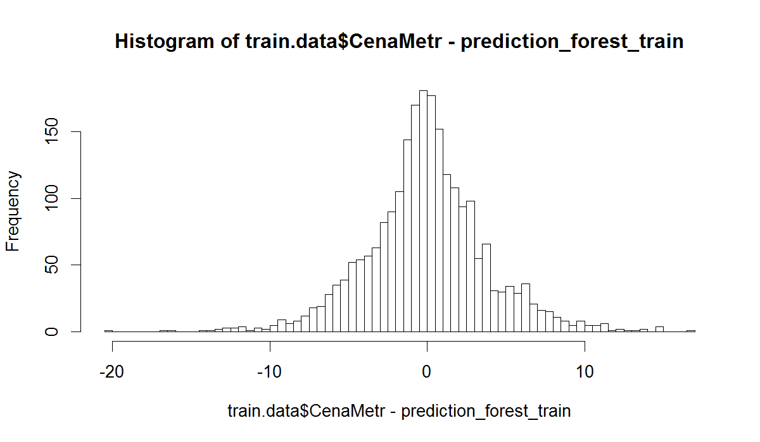
One model - train
Sd = 3,85
Mean = -0,04

Slide 13
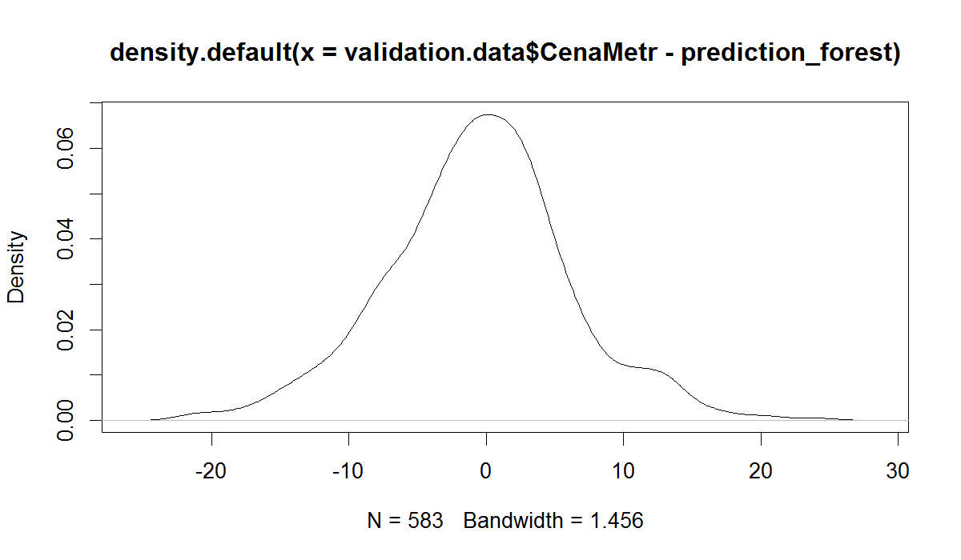
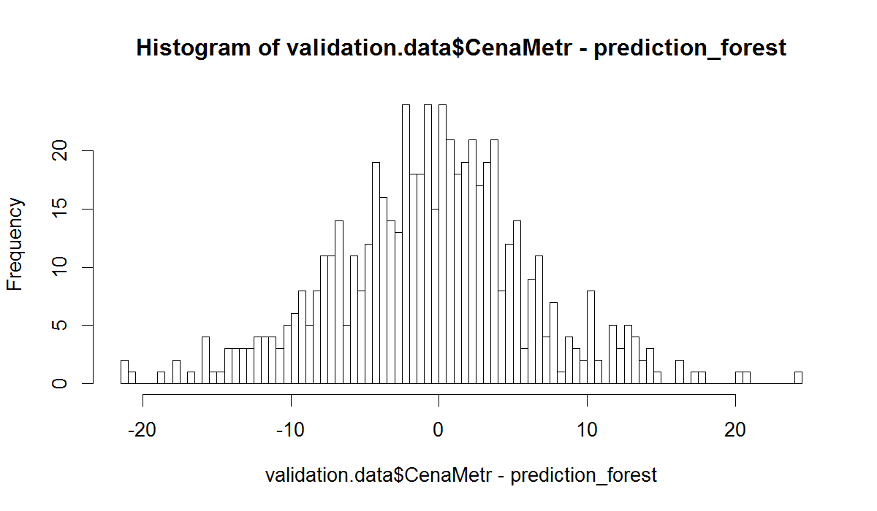
One model - test
Sd = 6,72
Mean = -0,56

Slide 14
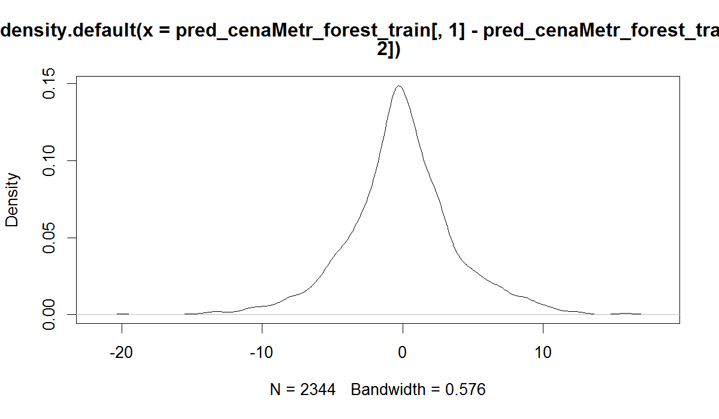
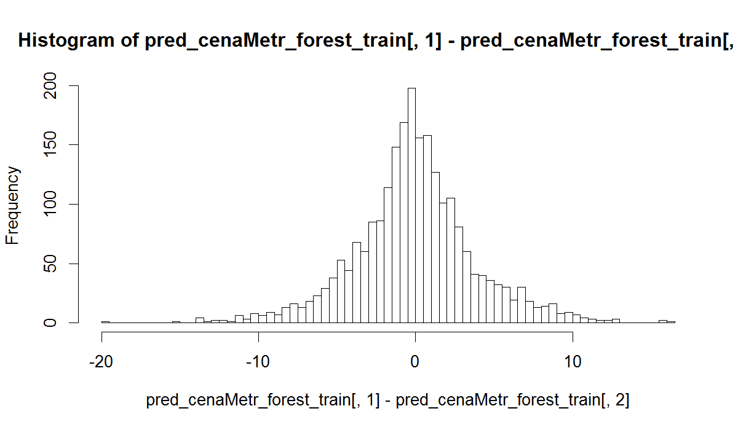
Districts models - train
Sd = 3,87
Mean = -0,06

Slide 15
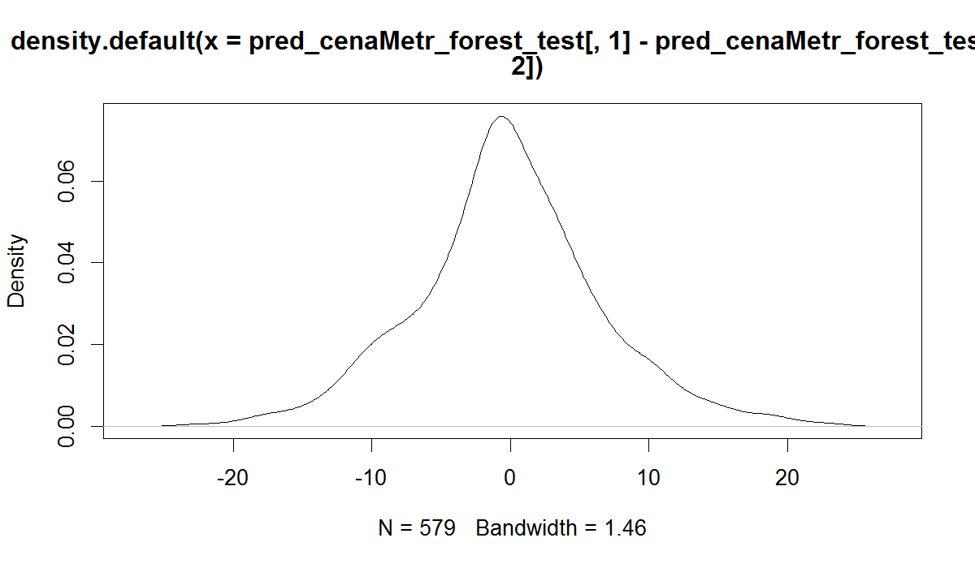
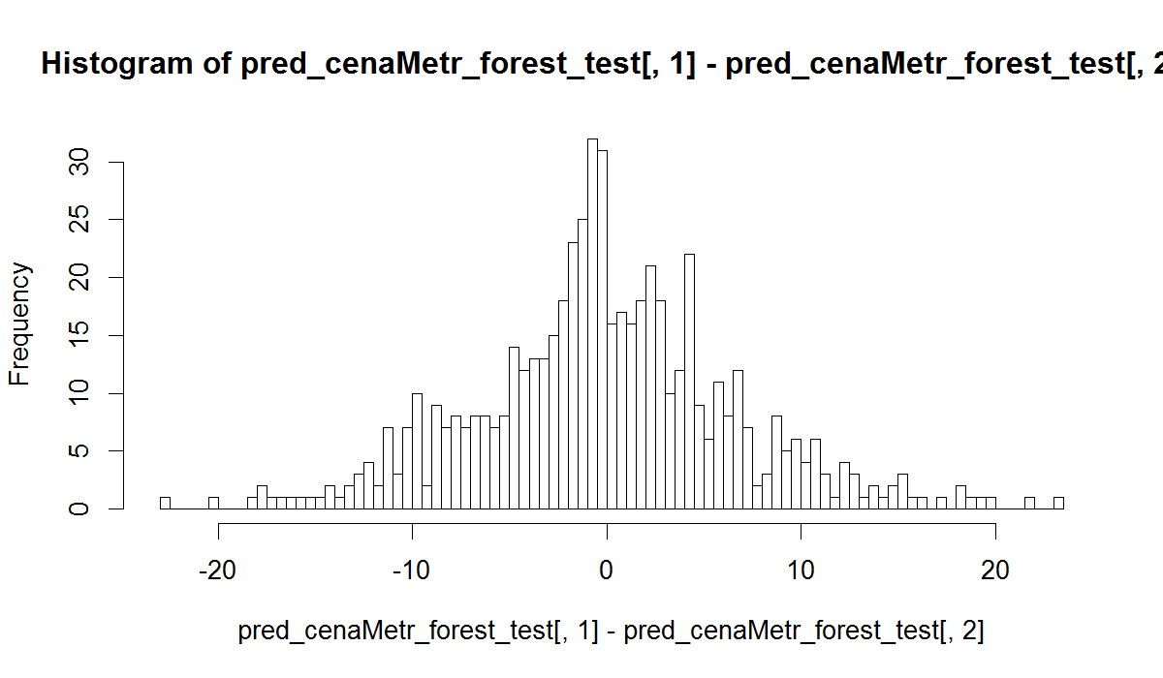
Districts models - test
Sd = 6,75
Mean = -0,12

