Slide 1
Formula 1 Analysis
Nomthunzi Moyo and Mateusz Majak

Slide 2
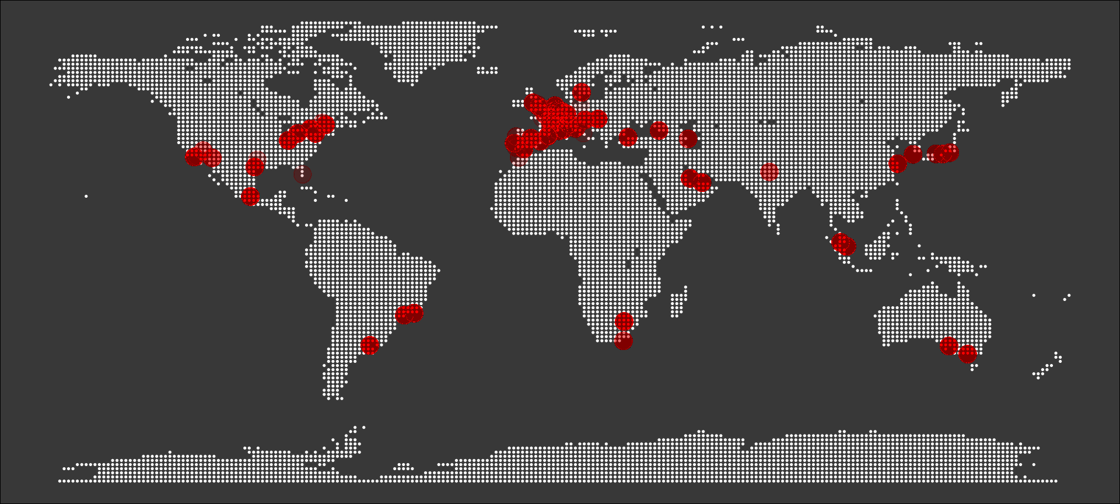
Map of circuits
Notes:
Formula 1 is known world over and is not only popular for motorsport lovers but all other people too. It is a massive research and development powerhouse. Some research has shown that technologies developed within F1 team factories find their way into other industries, making human lives simpler, safer and more efficient.
Over the past 70 years F1 has been done in 6 continents and this map of circuits shows a densely populated number of races being in Europe

Slide 3
Data Description
Data set from Kaggle
F1 race season statistics from 1950 to 2020
Problem statement : Challenge in comparing complex F1 data
Aim of the project: Use R visualisation plots to analyse F1 data
Notes:
The dataset used in this project consists of information about F1 races statistics from 1950 until the latest 2020 season.
It was shared by Vopani on the Kaggle platform and consists of 13 csv files:
* circuits* constructor_results* constructor_standings* constructors* driver_standings* drivers* lap_times* pit_stops* qualifying* races* results* seasons* status
It is a real challenge to compare drivers, cars and teams, considering very complex structure of the cars and the numerous changing factors on the track.
In this project we wish to answer a few interesting questions using some R visualization techniques

Slide 4
How has the competition and level of F1 changed over the years?
Notes:
This question will be evaluated using the following two slides

Slide 5
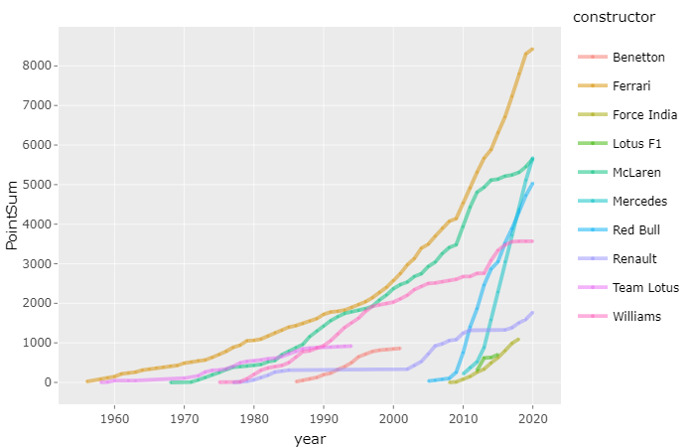
Top 10 Constructors
Notes:
In each decade there are variations.
This plot shows the accumulated sum of points for top 10 contractors over the years
The accumulated number for the Mercedes increased the fastest regardless of the Mercedes being introduced in later years.
The Ferrari has the highet number of accumulated points

Slide 6
Is the competion being won in qualifying?

Slide 7
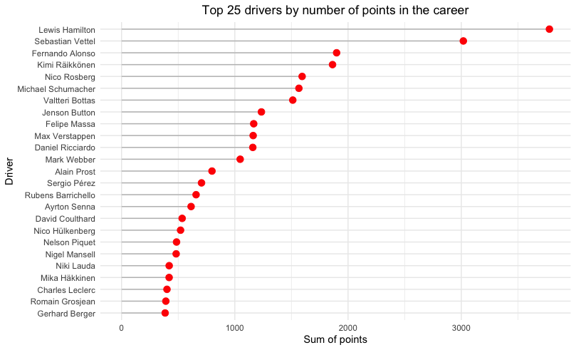
Accumalation of Points in Qualifying
Notes:
The graph shows a total of

Slide 8
Difference in the cars decrease over the years?
Notes:
Do the differences between the cars decrease over the years?
To answer this question we have used a plot that shows the differences in the number of cars in the past years

Slide 9
The worst races

Slide 10
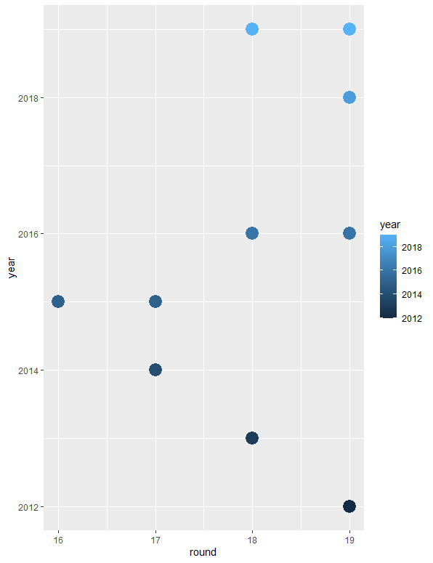
Longest Races Scatter Plot
Notes:
This scatter plot shows the years with races with the highest racing times
It is important to analyse the pattern of the longest racing times in order to make logical sense as to why this has occurred.
This knowledge will help the teams and individual drivers to work on their time in order to remain competitive and relevant

Slide 12
Which F1 circuits provide a more even fight?

