Slide 1
Formula 1 analysis
Nomthunzi Moyo and Mateusz Majak

Slide 2
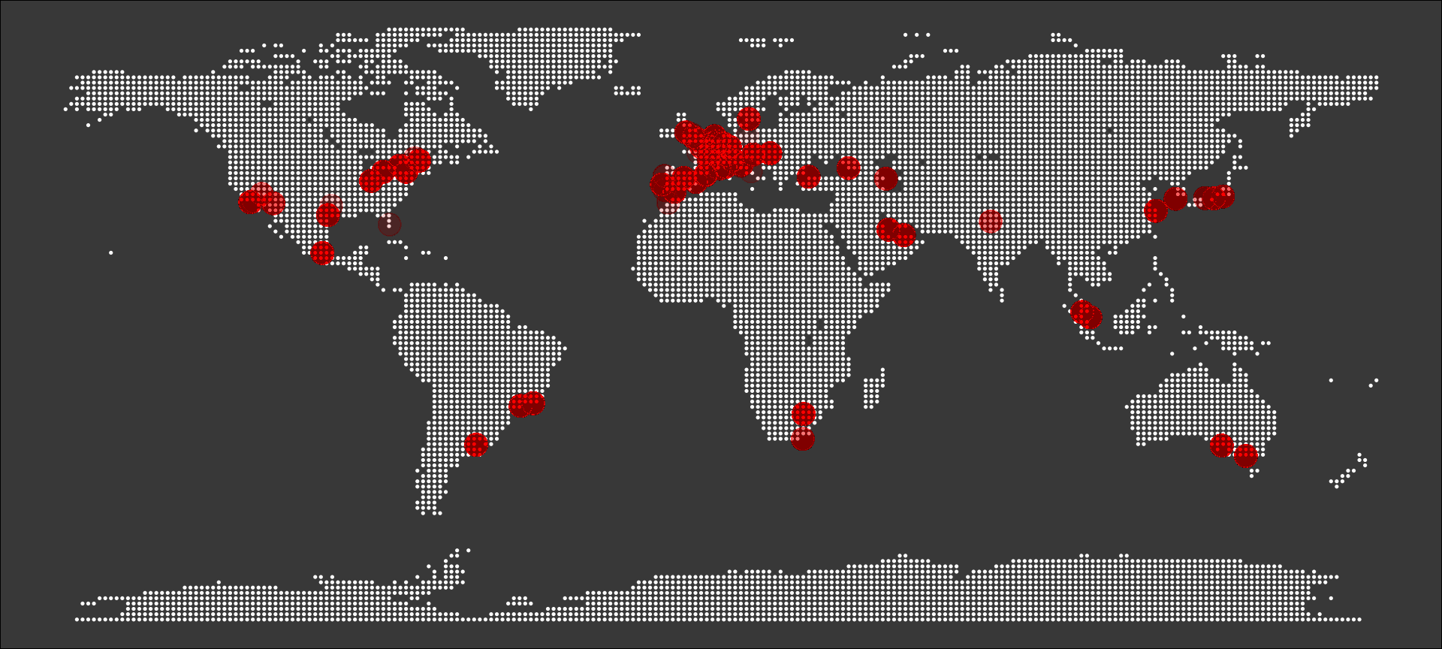
Map of circuits

