Slide 1
Formula 1 Analysis
Nomthunzi Moyo and Mateusz Majak

Slide 2
Data Description
Data set from Kaggle platform
F1 seasons statistics from 1950 to 2020
Problem statement : Challenge in comparing complex F1 data
Aim of the project: Use visualisation techniques to analyse F1 data
Data structure…
Notes:
The dataset used in this project consists of information about F1 races statistics from 1950 until the latest 2020 season.
It was shared by Vopani on the Kaggle platform and consists of 13 csv files:
* circuits* constructor_results* constructor_standings* constructors* driver_standings* drivers* lap_times* pit_stops* qualifying* races* results* seasons* status

Slide 3
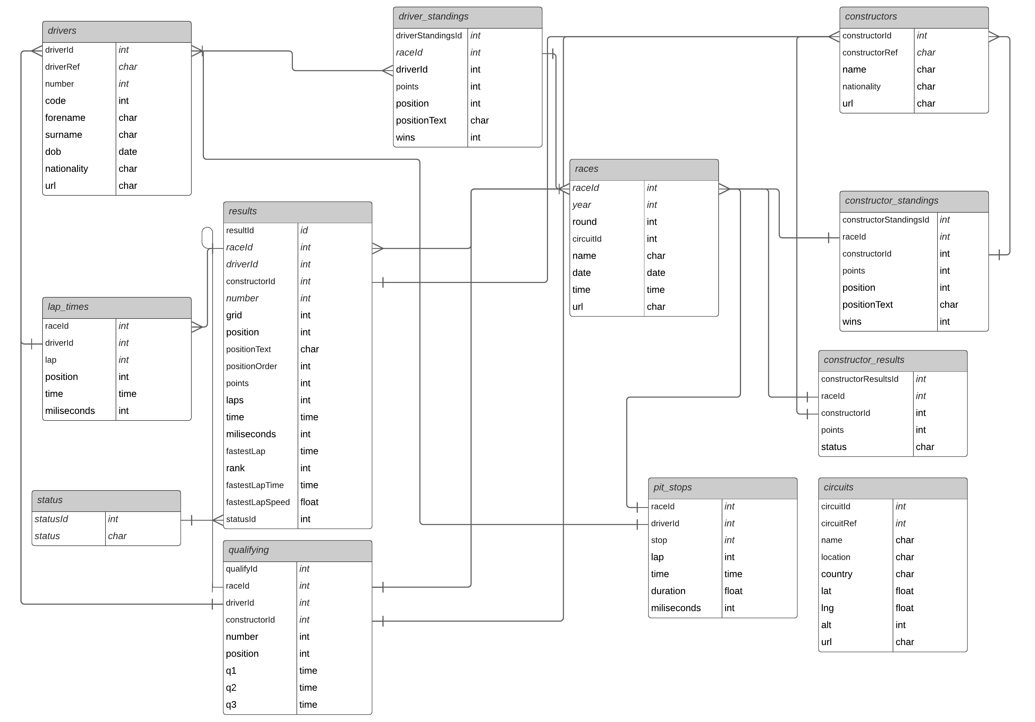
Notes:
The dataset used in this project consists of information about F1 races statistics from 1950 until the latest 2020 season.
It was shared by Vopani on the Kaggle platform and consists of 13 csv files:
* circuits* constructor_results* constructor_standings* constructors* driver_standings* drivers* lap_times* pit_stops* qualifying* races* results* seasons* status

Slide 4
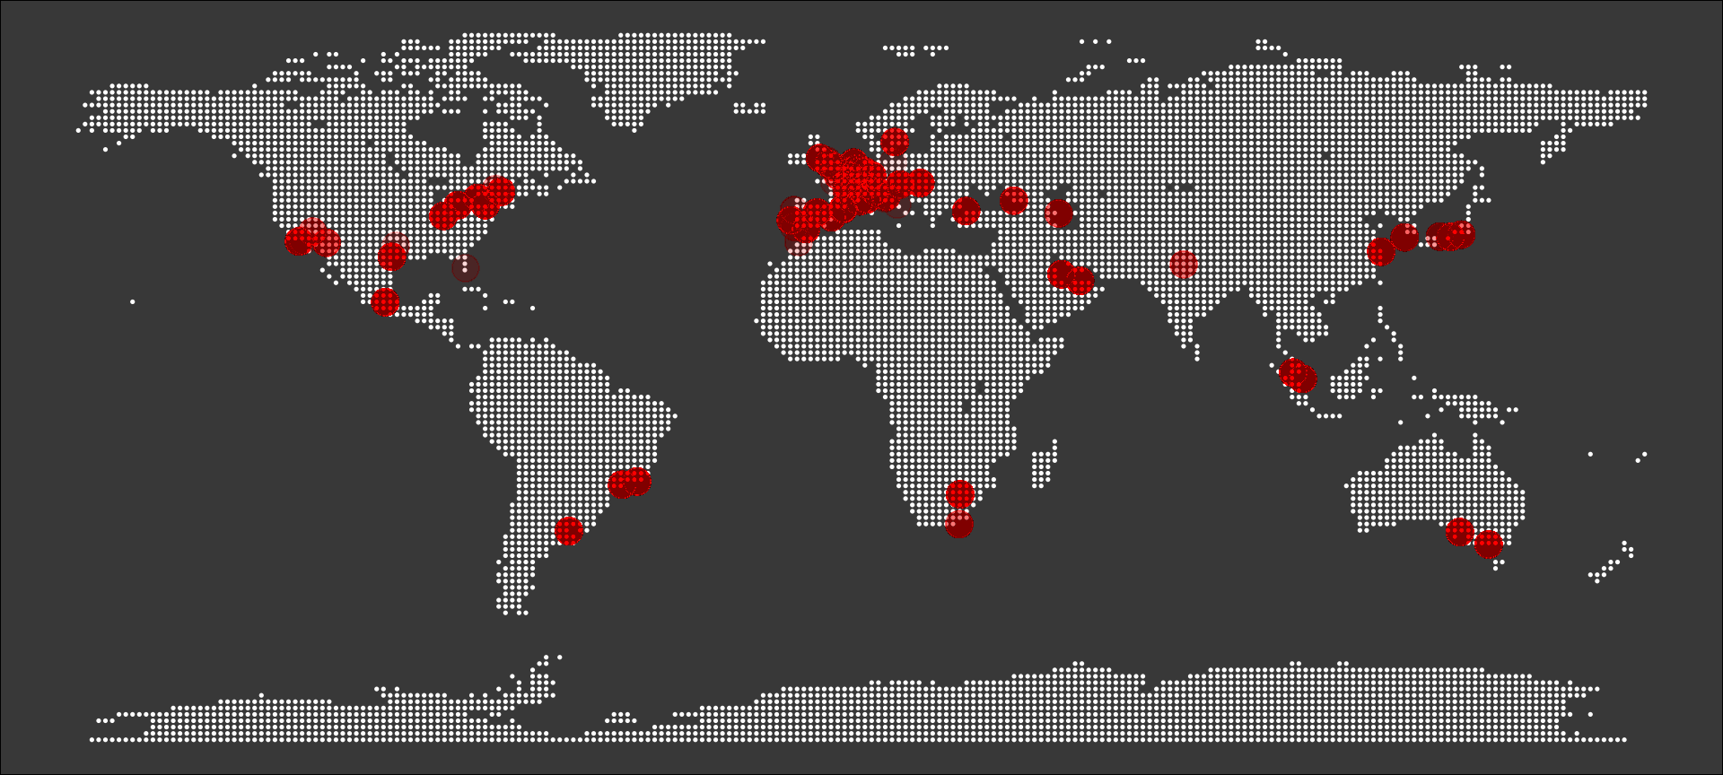
F1 circuits around the World

Slide 5
How has the competition changed over the years?

Slide 6
Notes:
Here we can see how close were the top 10 teams to each other from the beginning of the formula 1 history
This plot shows the accumulated sum of points for top 10 constractors over the years
4 from the top 10 teams were born after 2000, so it looks quite impressive they could reach this level so quickly and maybe shows the new quality of team management

Slide 7
Best drivers based on number of points

Slide 8
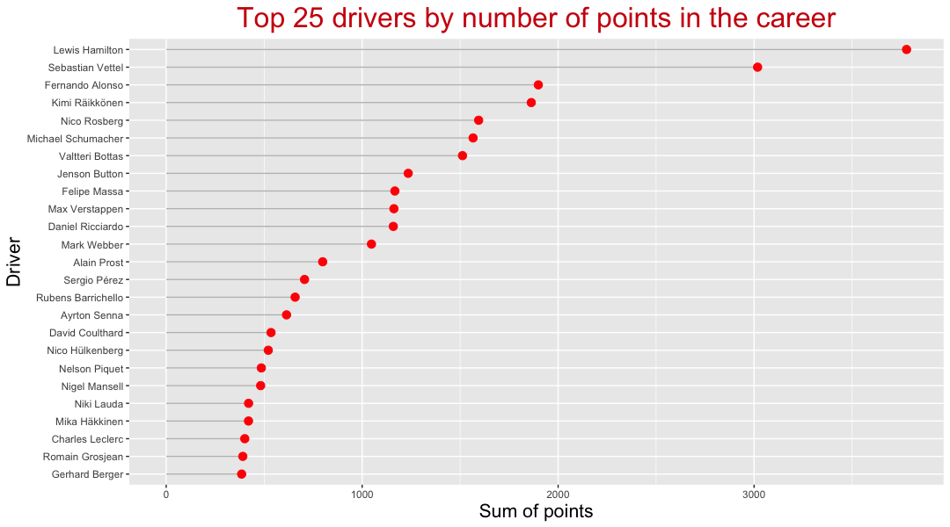
Notes:
Here we can see the top 25 drivers in the F1 history based of number of points and the dominance of the last 2 decades champions – Seb Vettel and Lewis Hamilton

Slide 9
Is the race being won already in qualifying?

Slide 10
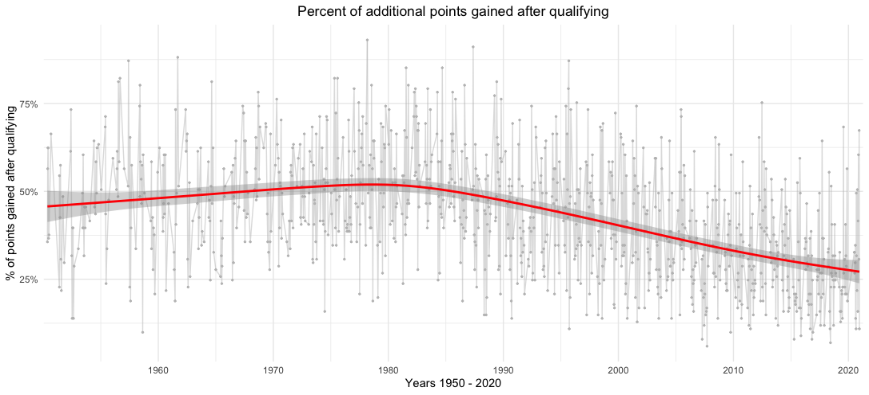
Notes:
This plot shows a percent of points gained during the race (in comparison to qualify) as number of gained points divided by number of total possible points to gain from 1st to 10th position, which is 101 points. In fact, the point system has been changed over years, but we use the current system to be able to compare every single year from the history.
We can see the decrease of newly gained points after qualifying, so it means that today a lot of race results are dependent on qualifying results.

Slide 11
Thank you :)
Notes:
That was the small impressions of journey we want to provide for the user of the report

