Slide 1
Formula 1 Analysis
Nomthunzi Moyo and Mateusz Majak

Slide 2
Data Description
Data set from Kaggle platform
F1 seasons statistics from 1950 to 2020
Problem statement : Challenge in comparing complex F1 data
Aim of the project: Use visualisation techniques to analyse F1 data
Data structure…
Notes:
The dataset used in this project consists of information about F1 races statistics from 1950 until the latest 2020 season.
It was shared by Vopani on the Kaggle platform and consists of 13 csv files:
* circuits* constructor_results* constructor_standings* constructors* driver_standings* drivers* lap_times* pit_stops* qualifying* races* results* seasons* status
It is a real challenge to compare drivers, cars and teams, considering very complex structure of the cars and the numerous changing factors on the track.
In this project we wish to answer a few interesting questions using some R visualization techniques

Slide 3
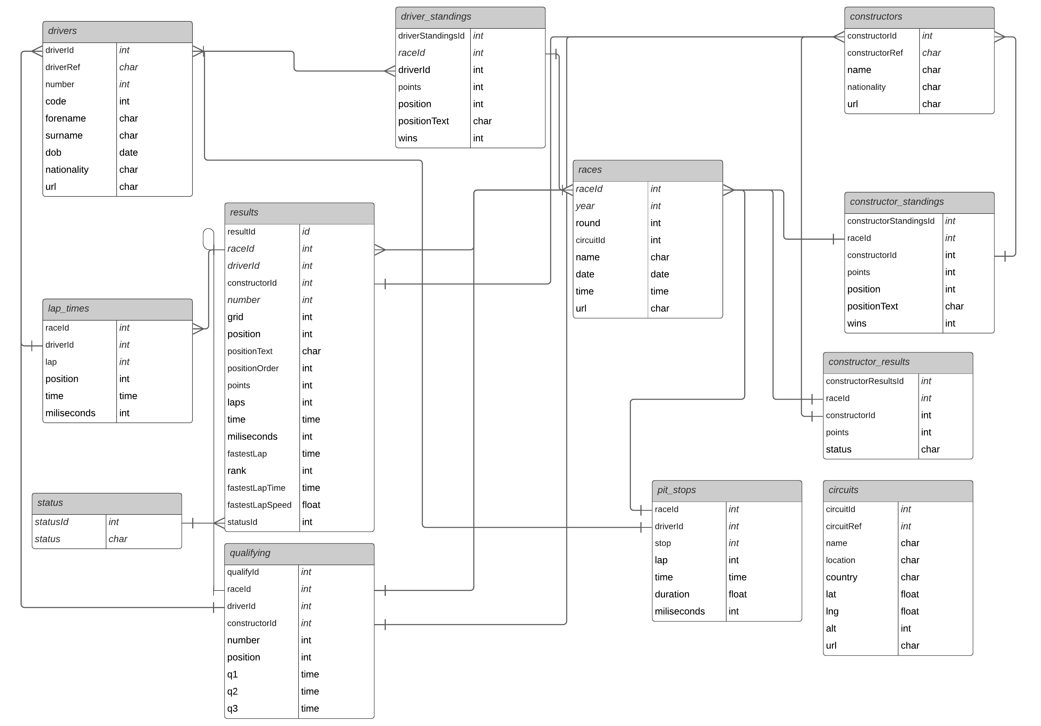
Notes:
The dataset used in this project consists of information about F1 races statistics from 1950 until the latest 2020 season.
It was shared by Vopani on the Kaggle platform and consists of 13 csv files:
* circuits* constructor_results* constructor_standings* constructors* driver_standings* drivers* lap_times* pit_stops* qualifying* races* results* seasons* status
It is a real challenge to compare drivers, cars and teams, considering very complex structure of the cars and the numerous changing factors on the track.
In this project we wish to answer a few interesting questions using some R visualization techniques

Slide 4
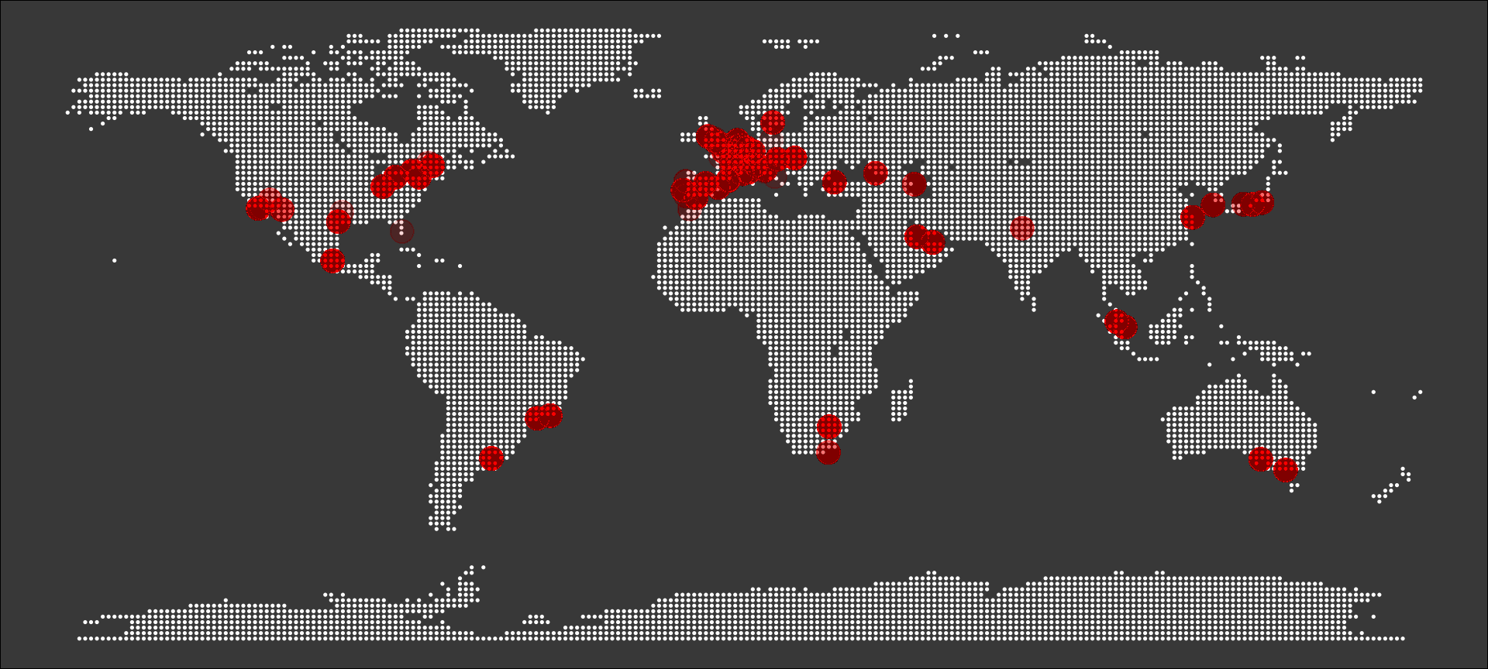
F1 circuits around the World
Notes:
Formula 1 is known world over and is not only popular for motorsport lovers but all other people too. It is a massive research and development powerhouse. Some research has shown that technologies developed within F1 team factories find their way into other industries, making human lives simpler, safer and more efficient.
Over the past 70 years F1 has been done in 6 continents and this map of circuits shows a densely populated number of races being in Europe

Slide 5
How has the competition changed over the years?
Notes:
This question will be evaluated using the following two slides

Slide 6
Notes:
In each decade there are variations.
This plot shows the accumulated sum of points for top 10 constractors over the years
The accumulated number for the Mercedes increased the fastest regardless of the Mercedes being introduced in later years.
The Ferrari has the highest number of accumulated points

Slide 7
Best drivers based on number of points
Notes:
This question will be evaluated using the following two slides

Slide 8
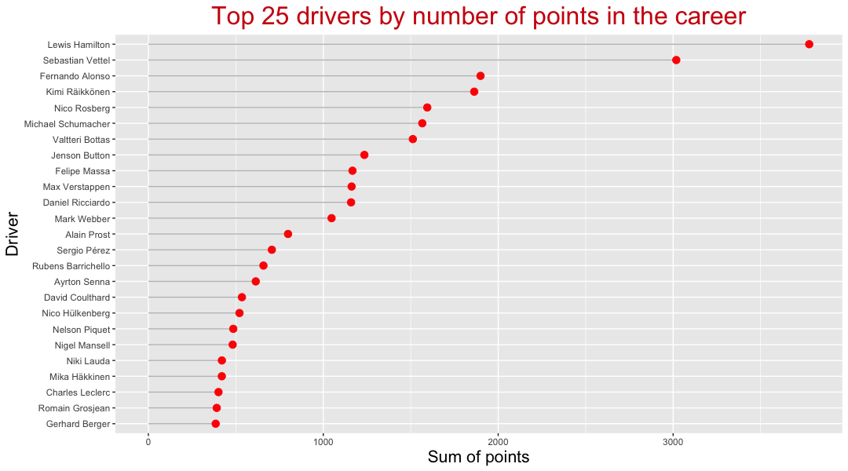

Slide 9
Is the race being won already in qualifying?

Slide 10
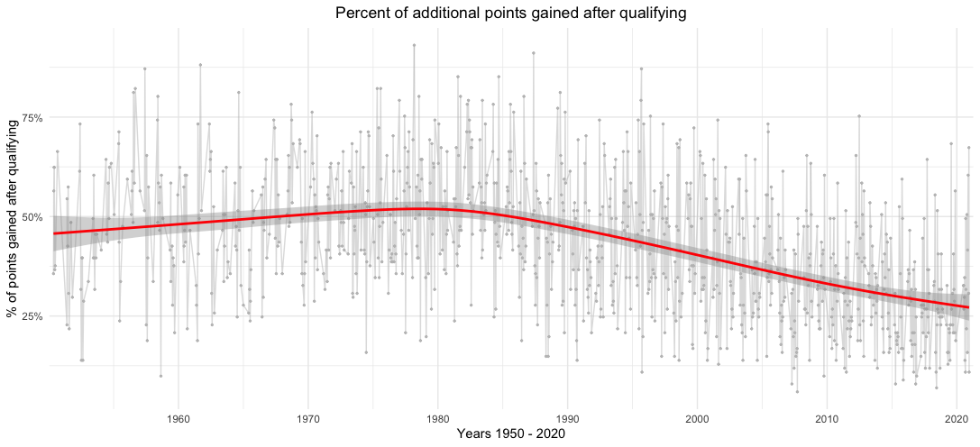
Notes:
Is F1 currently being won in qualifying?
This plot shows a percent of points gained during the race (in comparison to qualify) as number of gained points divided by number of total possible points to gain from 1st to 10th position, which is 101 points. In fact, the point system has been changed over years, but we use the current system to be able to compare every single year from the history.

Slide 11
Thank you :)

