Slide 1
1
Data Science Course Overview
Notes:
1

Slide 2
Who Am I?
1
Serhiy Protsenko Doctor of Science, Professor from Sumy state university, ua. Primary Expertise: Physics of solid state, applied physics, material science, experimental technics Secondary Expertise: Labview, data science, python
Notes:
1

Slide 3
Content Philosophy
1
Application-based approach
Understand key principles
Balance depth with breadth
Course project
Notes:
1

Slide 4

Communication
1
Communicate early and often
We will communicate via Telegram Messenger
https://telegram.org/
Public channel: @DSLublin2019 t.me/DSLublin2019
Chat group: link is in channel @DSLublin2019
We will use GitHub
https://github.com/SerhiyProtsenko/LublinDataScienceWorkshop
Notes:
1

Slide 5
Set-up Your Environment
1
Prerequisites:
Hardware:
Laptop or PC :)
2+ Cores, 4+ Gb of RAM (ideally 8+ Gb)
Free disc space 3+ Gb
Software:
Recent build of Anaconda for Python https://www.anaconda.com/download/
Notes:
1

Slide 6
Set-up Your Environment
1
Installations:
Download (detail is in channel telegram or GitHub) and install latest Anaconda build for Python 3.6+
Profit! You are ready to create/view Jupyter .ipynb notebooks
Notes:
1

Slide 7
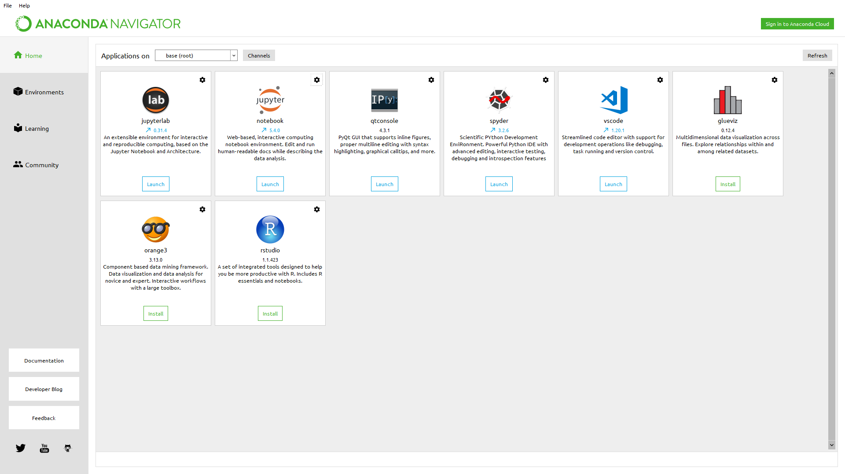
Anaconda navigator
1
Notes:
1

Slide 8
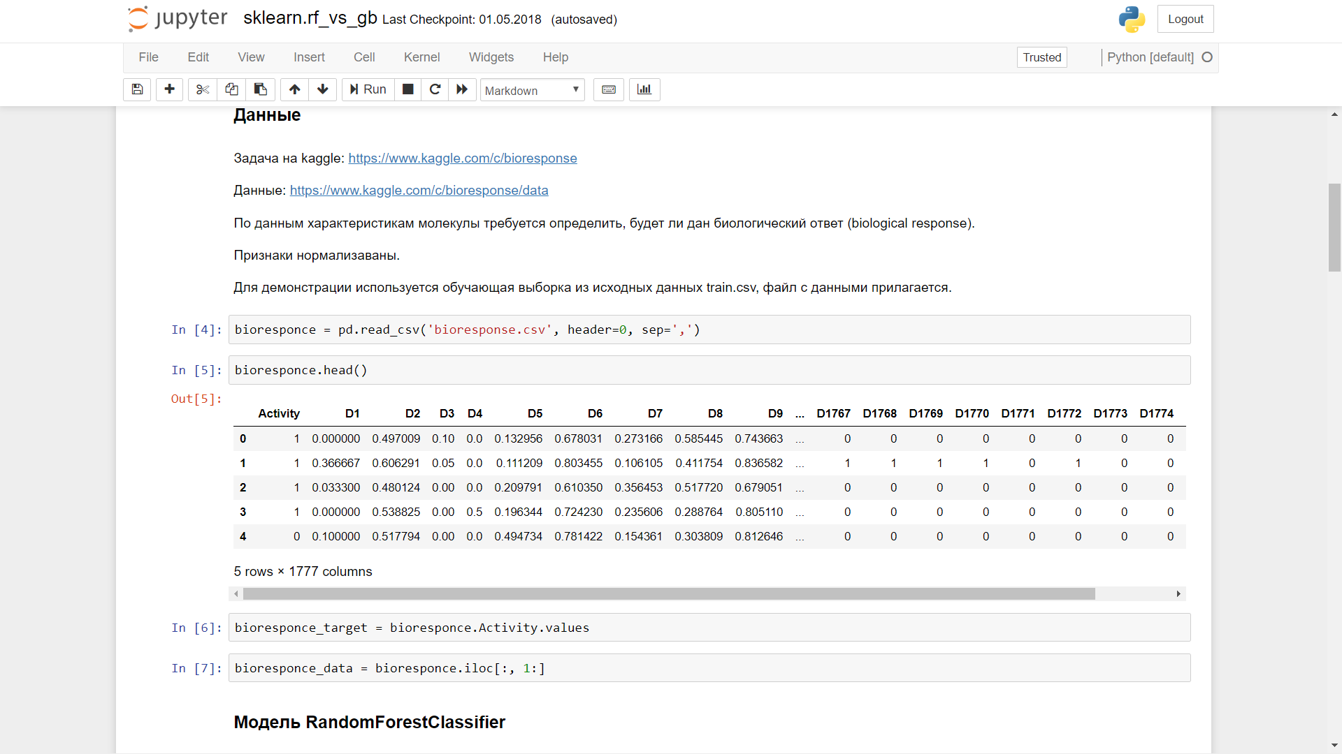
Jupiter notebook
1
Notes:
1

Slide 9
How to Succeed
1
Effort not prior knowledge
Communicate what you’ve learned
Help your classmates
Be patient with yourself
Notes:
<number>

Slide 10
Typical Class
1
Lecture
Code walk-throughs
Code exercises
Discussion of homework and readings
Exam
Notes:
<number>

