Slide 3
Questions
What is the mean measure in the cases?
What is the mean measure in the controls?
Are the unknown samples cases or controls?

Slide 5
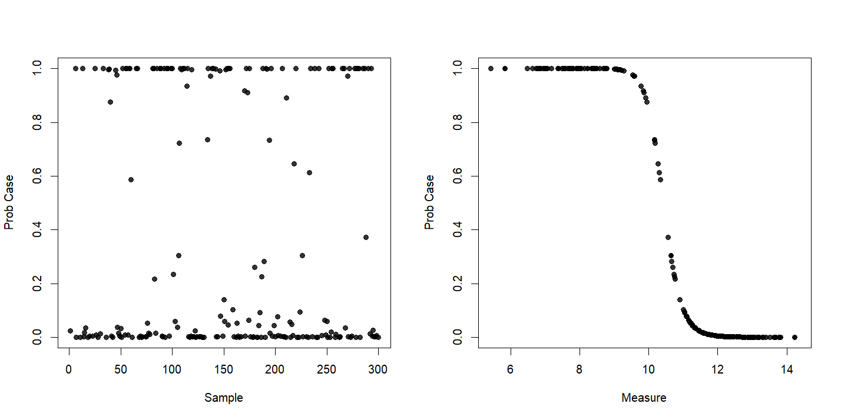

Slide 6
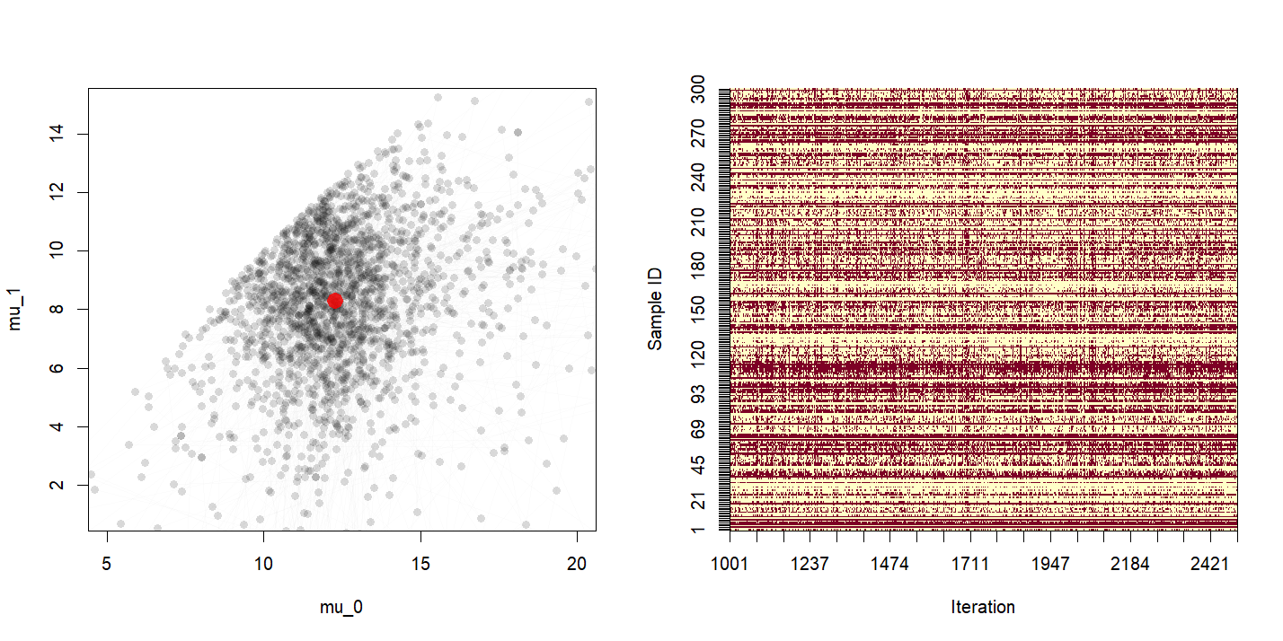

Slide 7
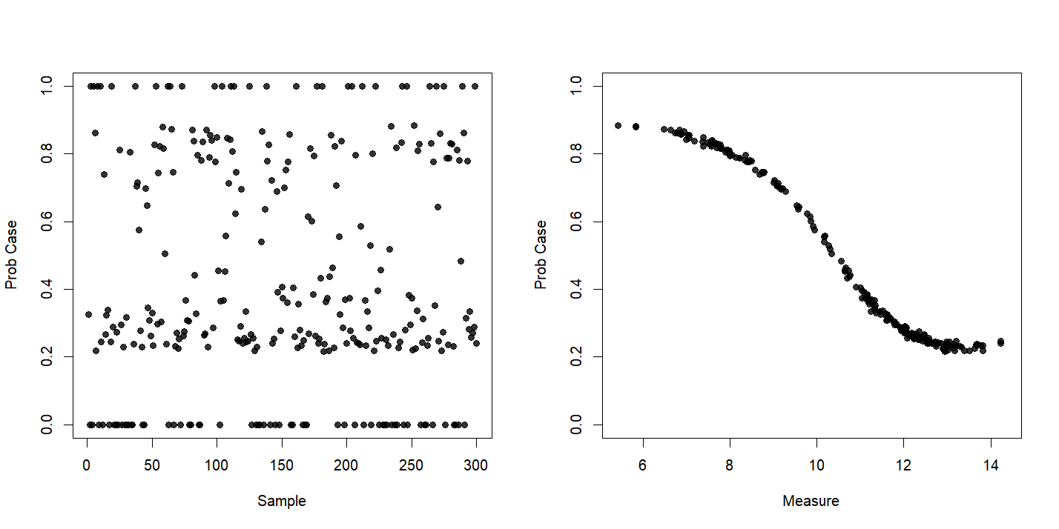

Slide 10
