Slide 1
Northwind sales

Slide 2
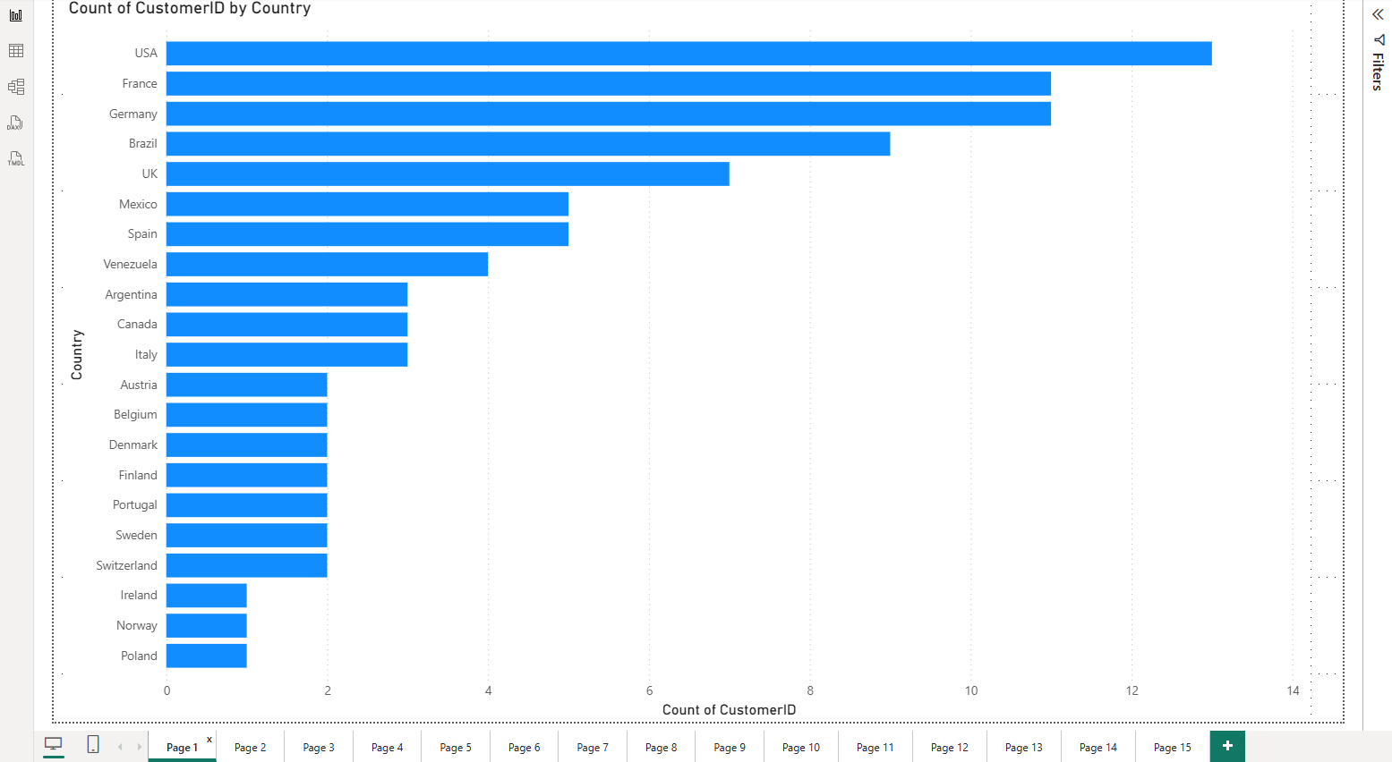
How does customer distribution vary across different countries or cities?

Slide 3
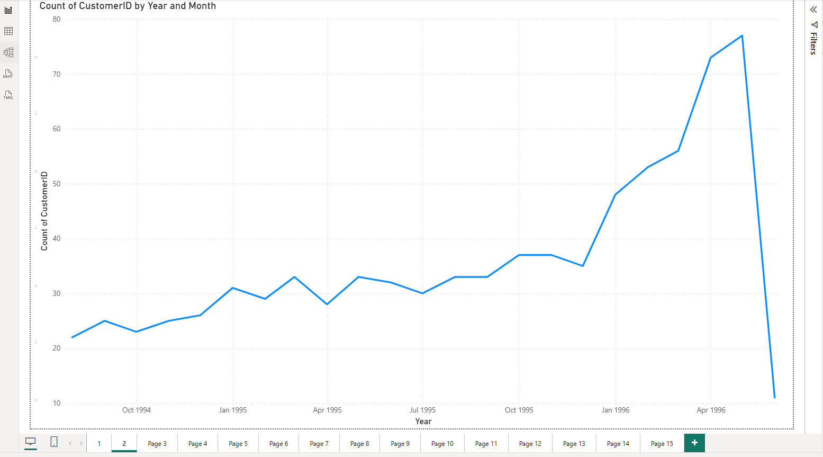
What is the trend in customer orders over time?

Slide 4
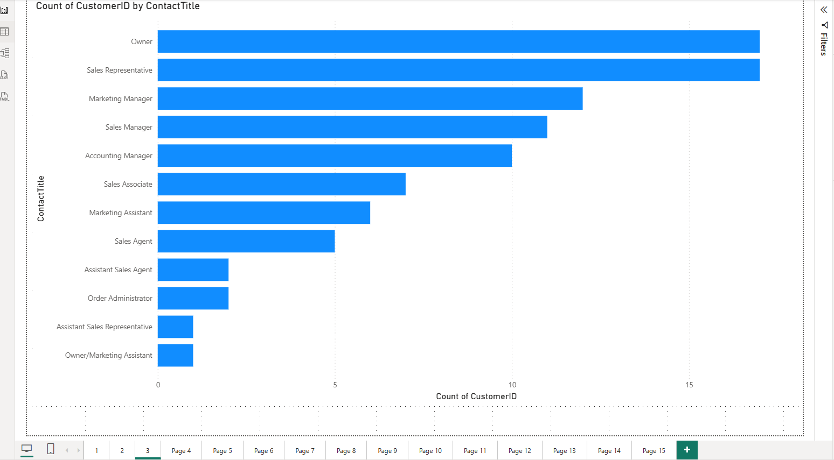
What is the distribution of customers by Contact Title or Region

Slide 5
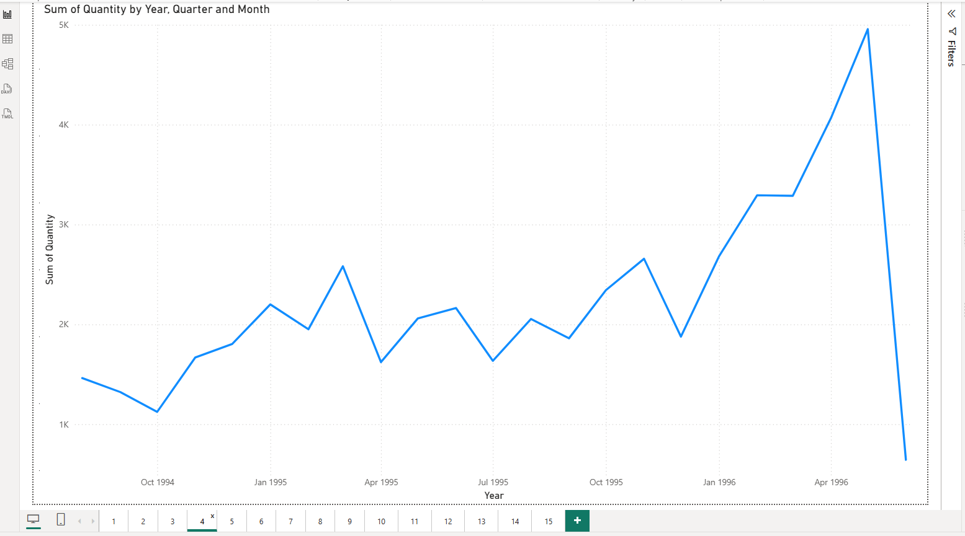
How does order volume change over time

Slide 6
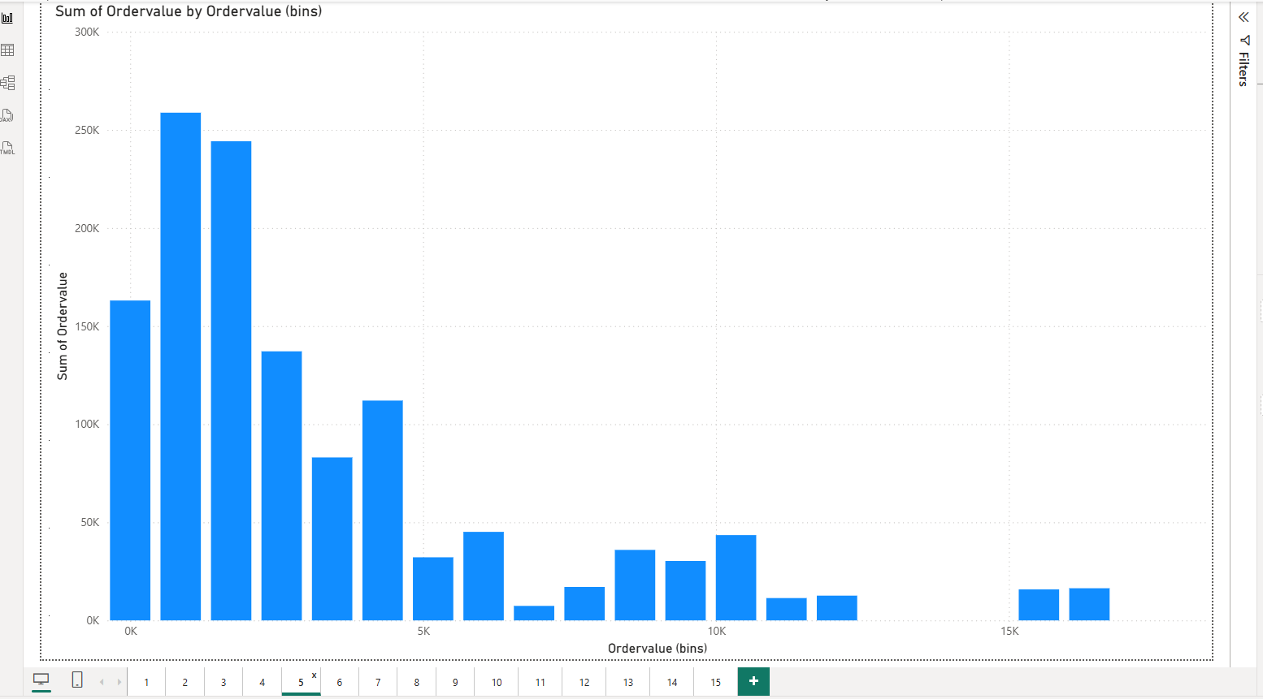
What is the distribution of order values

Slide 7
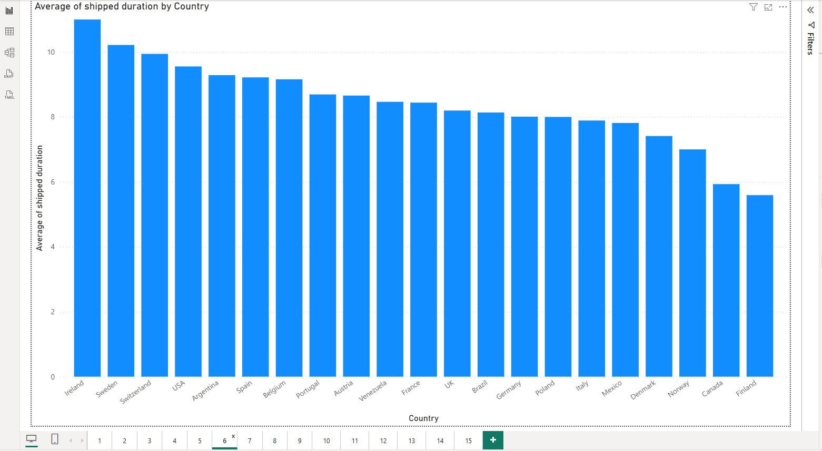
What is the average order shipping duration

Slide 8
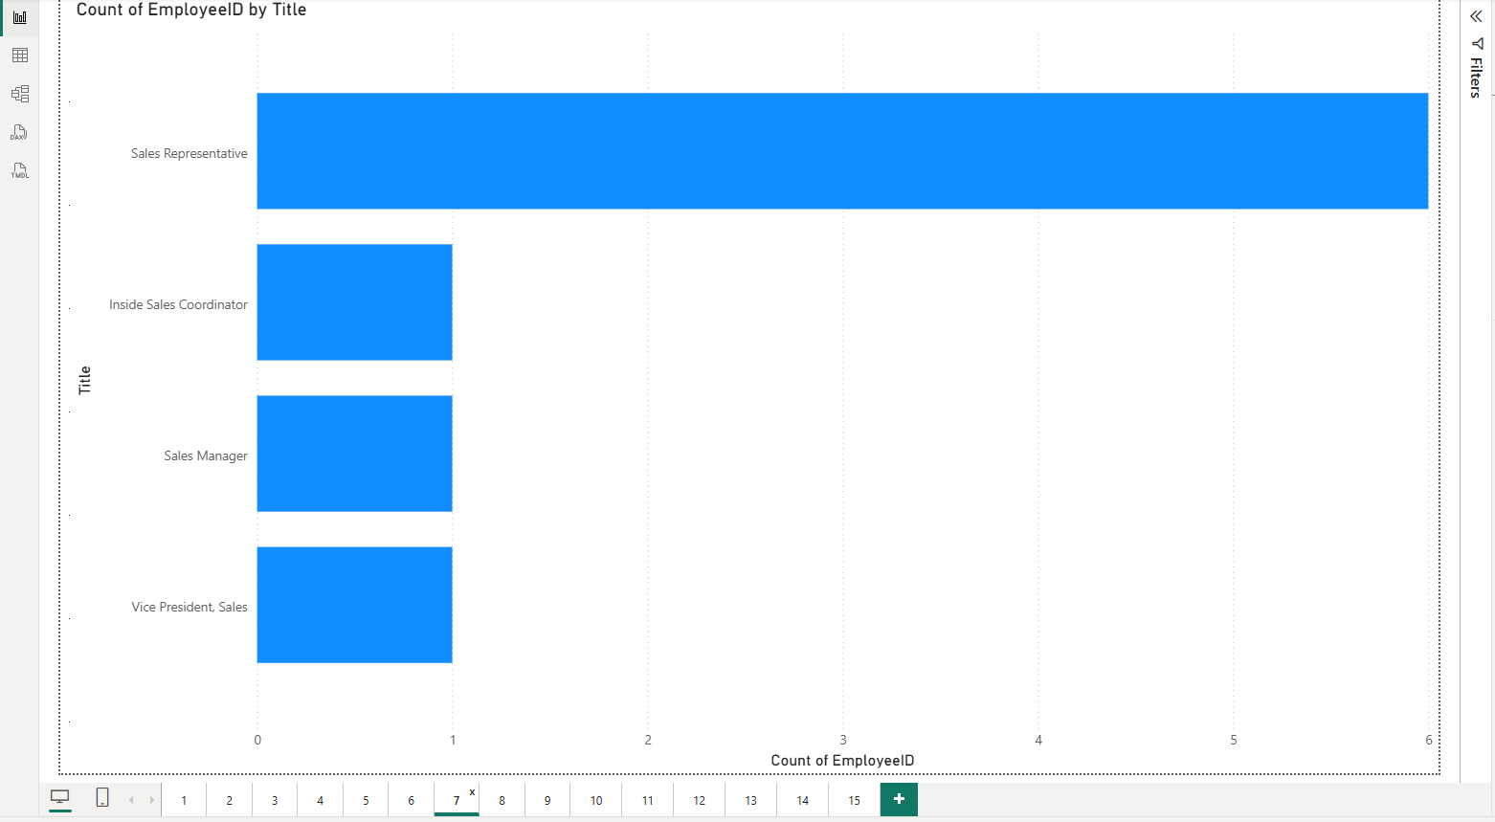
What is the count of employees by job title or region

Slide 9
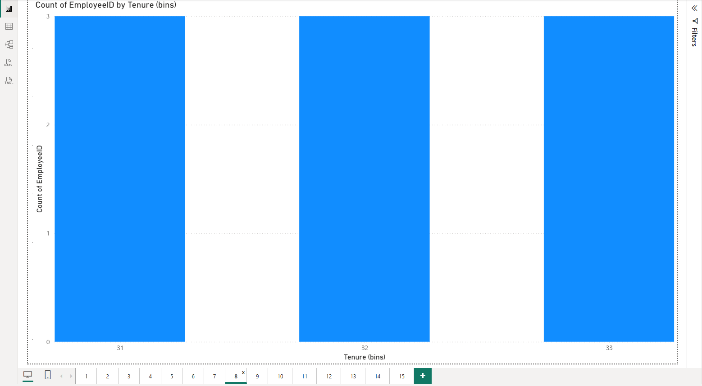
What is the distribution of employee tenure

Slide 10
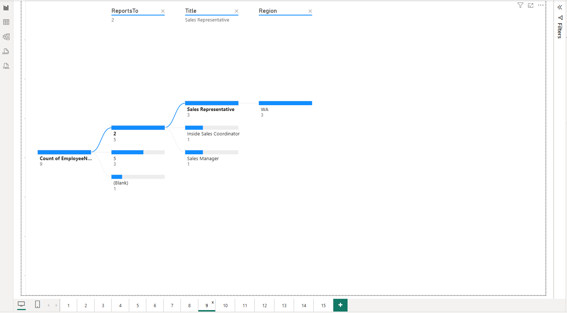
What is the reporting structure among employees

Slide 11
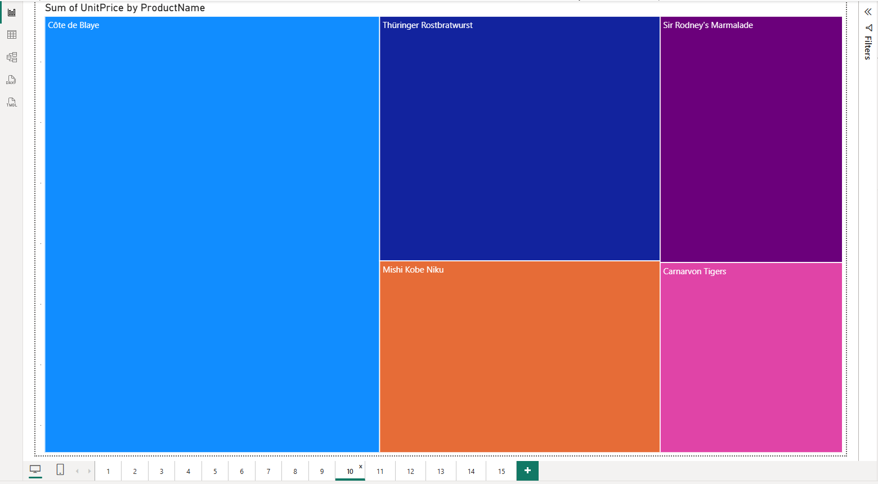
Which products have the highest sales volume

Slide 12
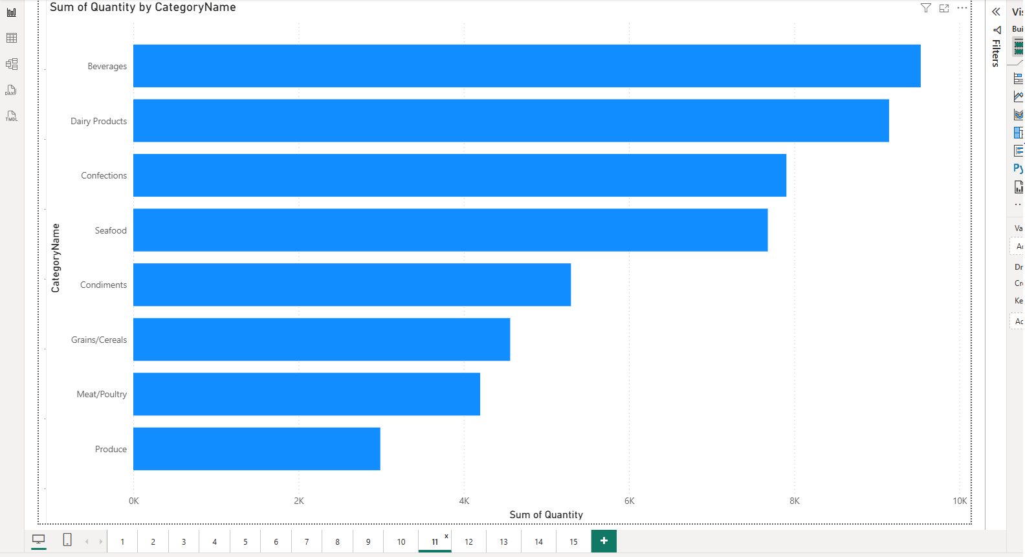
How does the sales volume vary across different product categories

Slide 13
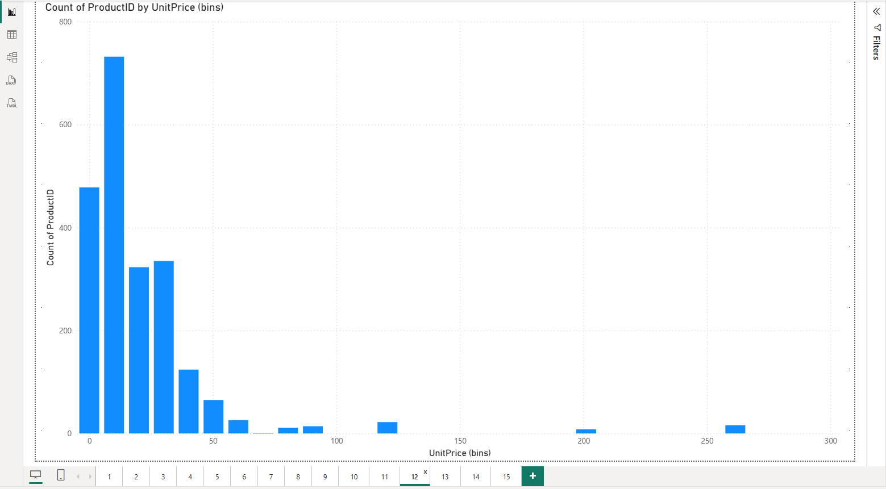
Can we visualize the pricing distribution of products

Slide 14
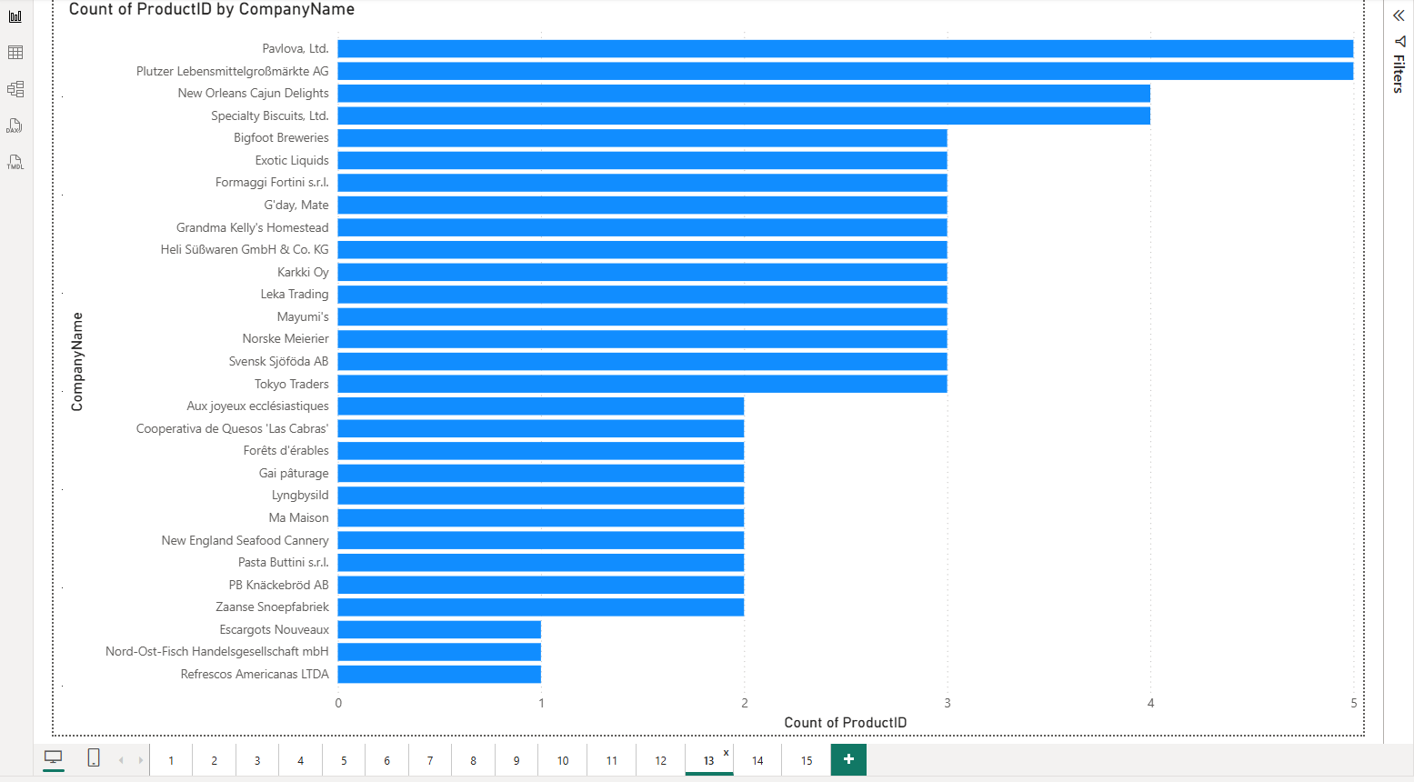
How many products are supplied by each supplier

Slide 15
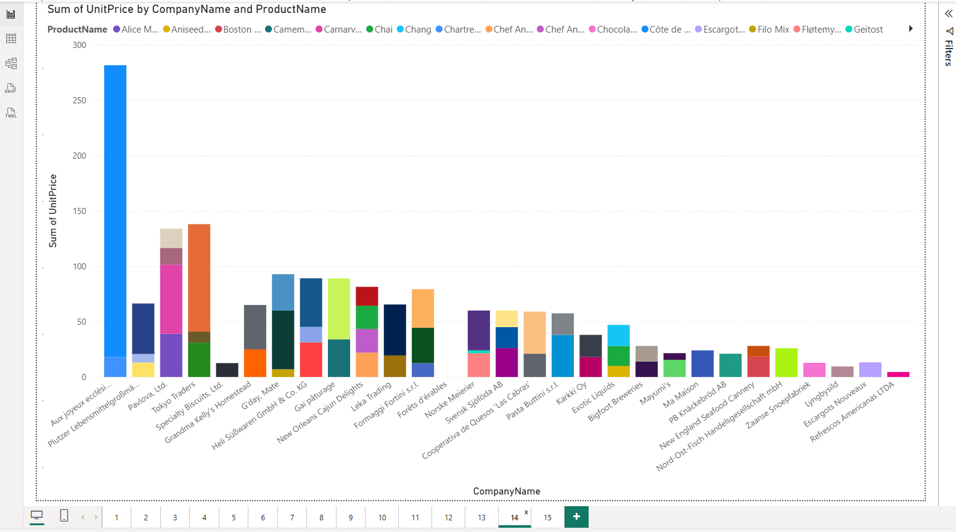
How does product pricing vary across different suppliers

Slide 16
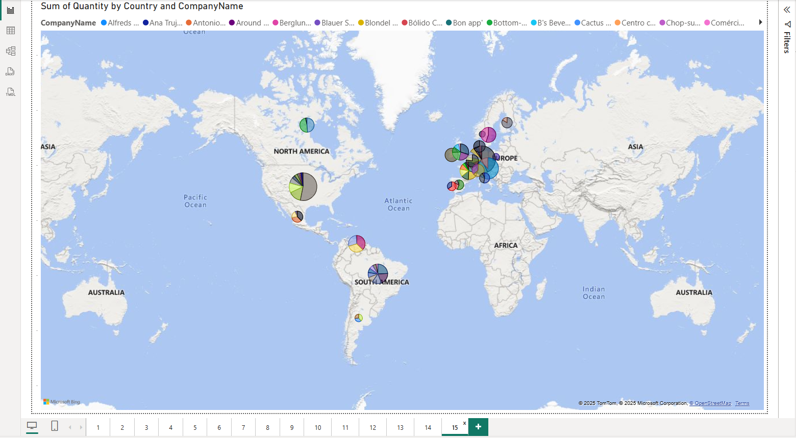
What is the geographical distribution of suppliers

