Slide 1

Creating a Championship Winning NBA Team

Slide 2

Purpose of the project
Sports manger
Duty
Financial difficulties

Slide 3


Overview
Team of 13 to 15 players
The chosen players must combine to produce a higher performance(stats) than the previous champions
Minimizing the cost

Slide 4

Assumption
There is no difference between the 5 positions
Eg there could be a team of 13 shooting guards
We assume the team is realistic: ie. There will not contain 13 rookies, on rookie contracts (We will have a minimum 90 million dollar Expenditure)

Slide 5
Specific Questions
How is the total cost affected by the change in penalty cost parameter? (will explain penalty cost later)
If we allow the “3 points shots made” (3PM) constraint to be below the threshold of the requirement, what would happen to the team’s combination? How sensitive is it?
What happens when we take the square of the penalty cost function? And what does the result mean?

Slide 6
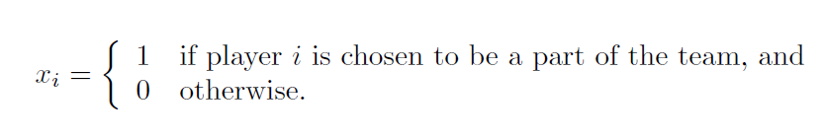
Basic Model
Similar to a bin packing (covering) model.
Each player has his own skillset and salary
Integer Linear Program (ILP)
n = Number of players in the league
m = total # of constraints
x = binary variable (decision variable )

Slide 7
Basic Model Cont.
is the cost for player i
is the d standard/requirement
is the d stats for player i

Slide 8


Basic Model Cont.
A constraint on how many players we can have on a team
A function that represents the total cost of hiring such team

Slide 9
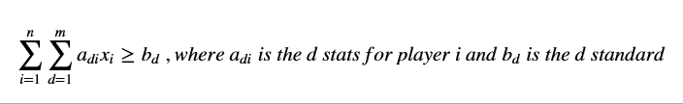
Basic Model Cont.
Also, all of our constraints are written in the form of

Slide 10
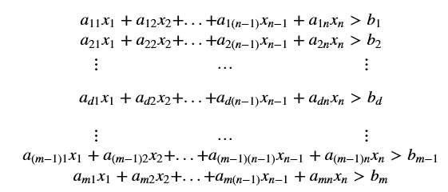
Basic Model Cont.

Slide 11

Basic Model Cont.
the penalty cost parameter is given as
The unit for this parameter is in millions of dollars.
It enables the ILP to accept a different set of players that do not meet the certain constraint requirement

Slide 12
Basic Model Cont.
The difference between the constraint requirement and the sum of players selected equals the unit penalized.
The difference is given as
Where b_k donates as requirement k, and a_ki donates as the k skillset for player i, for k in m
Penalty cost function

Slide 13

Basic Model Cont.
Therefore our objective function is

Slide 14
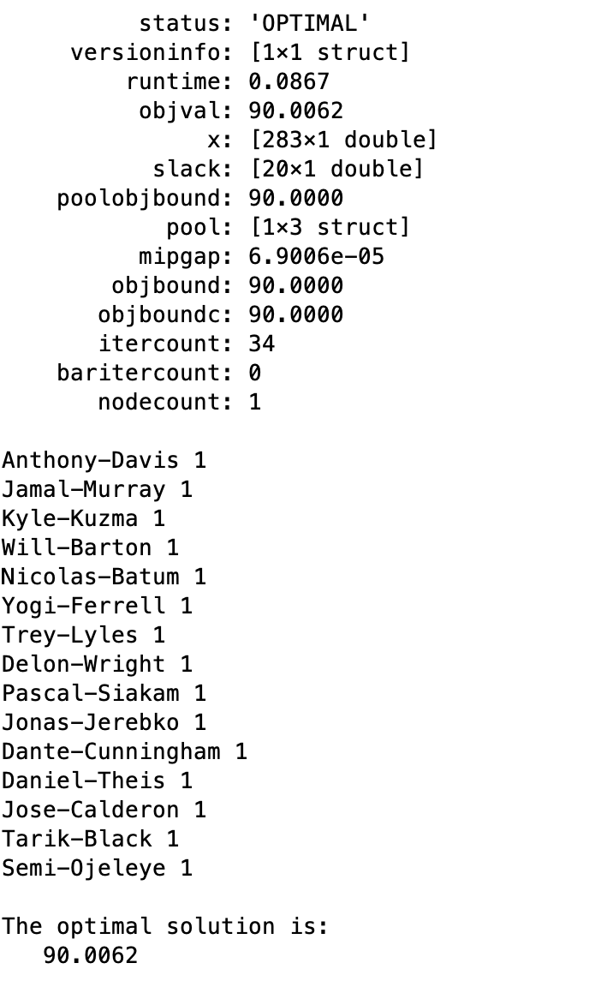
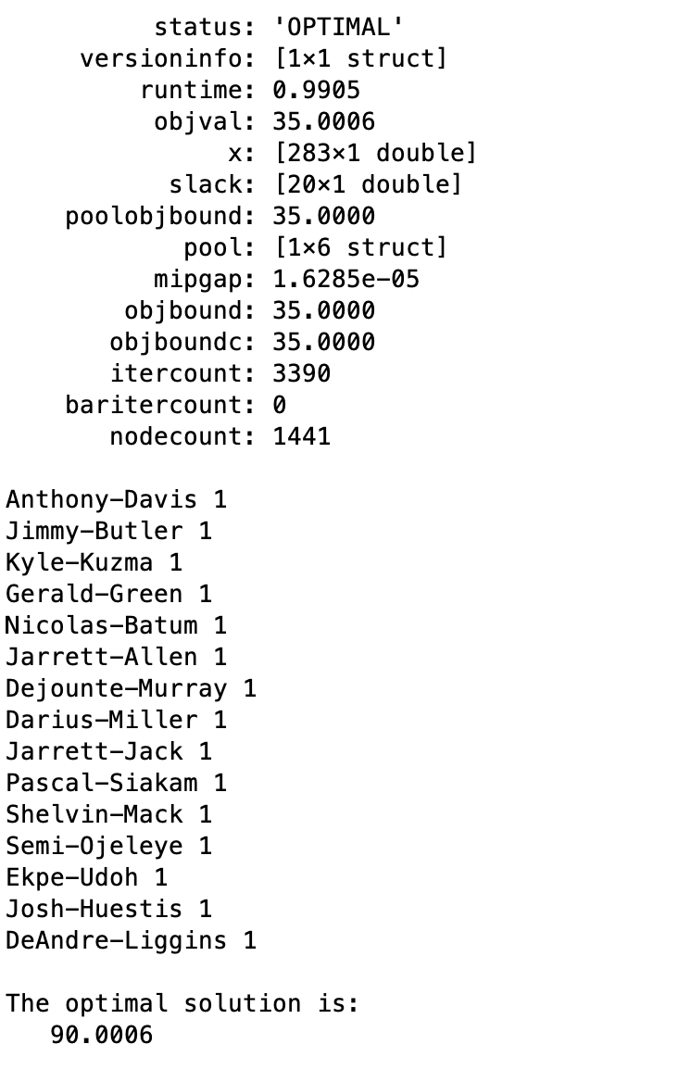
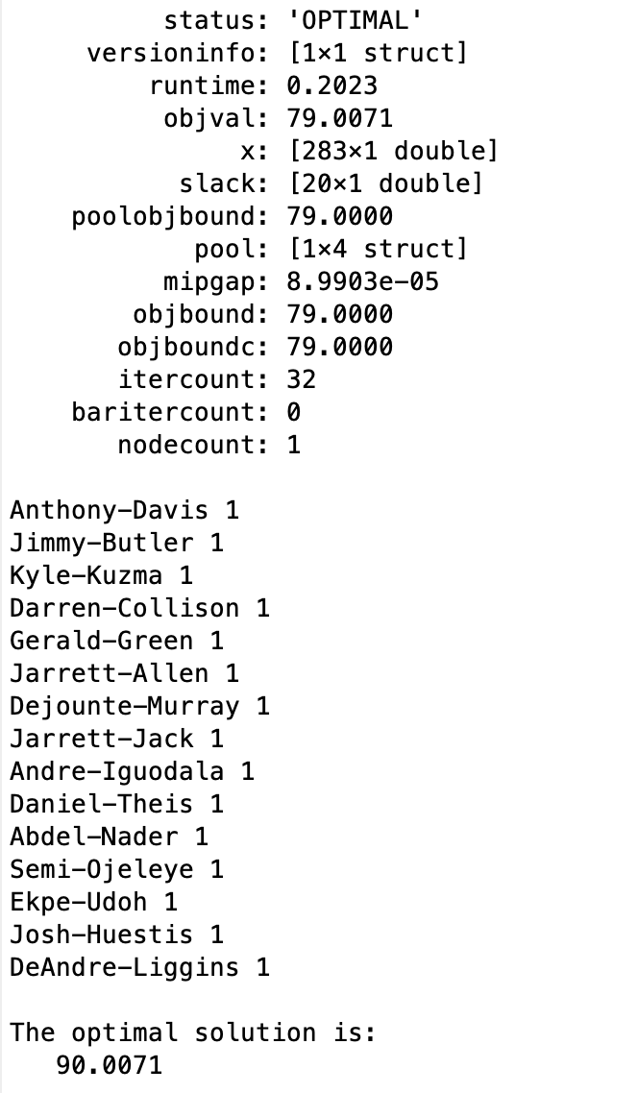
Observation So Far:

Slide 15
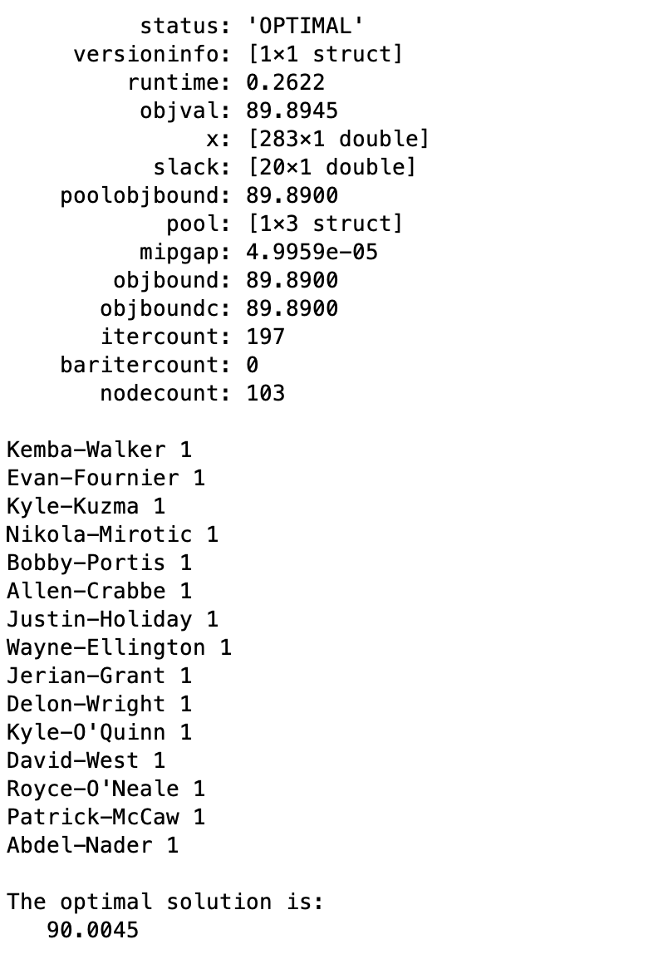
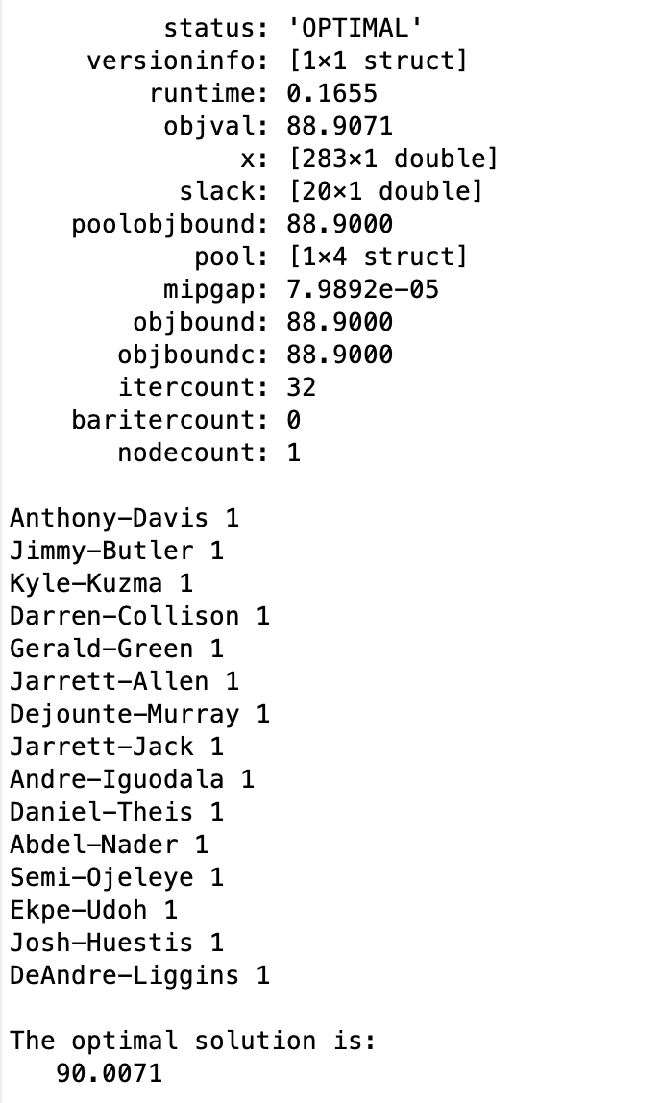
Observation So Far

Slide 16

Advanced Model
The same concept as Basic Model
The only different is squaring the difference between the constraint selected and the standard
Given as
Objective function

Slide 17
Advanced Model Cont.
In this model, we no longer describe the program as ILP.
It is now a quadratic program that utilizes integer and linear programming
We are taking the square of the difference because it achieves a more realistic model. (same logic as residual, or/and error term)

Slide 18
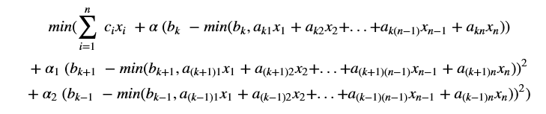
Complex Model
The same concept as advanced model
The only difference is instead of having only one alpha, we add 2 more
Objective function

Slide 19
Data
Mainly from the NBA website
Includes statistics and salary of each players
Uses excel to do the cleaning the filtering first
Filters out players who played less than 41 games yearly ??, and whose average playtime is less than 9 minutes per game.
Uses 2017 – 2018 season info

Slide 20
Thank you

