Slide 1
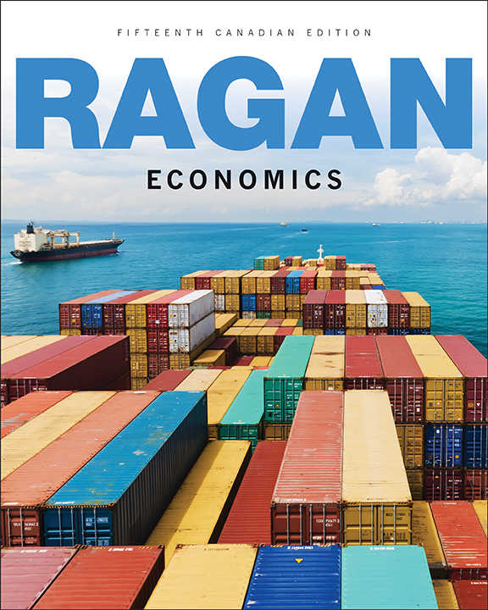
Chapter 22:
Adding Government and Trade to the
Simple Macro Model
Copyright © 2017 Pearson Canada Inc.

Slide 2
Chapter Outline/Learning Objectives
Section
Learning Objectives
After studying this chapter, you will be able to
22.1
Introducing
1.
understand how government purchases and tax
Government
revenues relate to national income.
22.2
Introducing
2.
understand how exports and imports relate to national
Foreign Trade
income.
22.3
Equilibrium
3.
distinguish between the marginal propensity to
National Income
consume and the marginal propensity to spend.
22.4
Changes in
4.
explain why the introduction of government and foreign
Equilibrium
trade in the macro model reduces the value of the
National Income
simple multiplier.
5.
explain how government can use fiscal policy to
influence the level of national income.
22.5
Demand
-
Determined
6.
understand why output is demand determined in our
Output
simple macro model.
Copyright © 2017 Pearson Canada Inc.
Chapter 22, Slide <number>

Slide 3
22.1 Introducing Government
Fiscal policy is the use of the government’s tax and spending policies to achieve government objectives.
Government Purchases
Desired government purchases, G, are part of aggregate desired expenditures.
We make the assumption that the level of government purchases is autonomous with respect to the level of national income.
Copyright © 2017 Pearson Canada Inc.
Chapter 22, Slide <number>

Slide 4
Net Tax Revenues
Net tax revenue is total tax revenue minus transfer payments, denoted T.
T = tY
where t is the net tax rate—the increase in net tax revenue generated when national income rises by one dollar.
Copyright © 2017 Pearson Canada Inc.
Chapter 22, Slide <number>

Slide 5
The Budget Balance
The budget balance is the difference between total government revenue and total government expenditure. It equals net tax revenue minus government purchases, T – G.
When net revenues exceed purchases, the government has a budget surplus.
When purchases exceed net revenues, the government has a budget deficit.
When the two amounts are equal, the government has a balanced budget.
Copyright © 2017 Pearson Canada Inc.
Chapter 22, Slide <number>

Slide 6
Provincial and Municipal Governments
When measuring the overall contribution of government to desired aggregate expenditure, all levels of government must be included.
To summarize:
All levels of government add directly to desired aggregate expenditure through their purchases of goods and services, G.
Governments collect tax revenue and make transfer payments. Net tax revenues are denoted T and are positively related to national income.
T will enter the AE function indirectly, through its effect on disposable income (Y_{D}) and consumption.
Copyright © 2017 Pearson Canada Inc.
Chapter 22, Slide <number>

Slide 7
22.2 Introducing Foreign Trade
Net Exports
Exports depend on spending decisions made by foreign households and firms that purchase Canadian products.
Typically, exports will not change as a result of changes in Canadian national income.
So we treat exports as autonomous expenditure.
Copyright © 2017 Pearson Canada Inc.
Chapter 22, Slide <number>

Slide 8
Net Exports
Imports depend on the spending decisions of Canadian households and firms.
The marginal propensity to import (m) is the increase in import expenditures induced by a $1 increase in national income.
IM = mY
Net exports is given by
NX = X – mY
Exports are autonomous with respect to Y but imports are positively related to Y, so net exports are negatively related to national income.
Copyright © 2017 Pearson Canada Inc.
Chapter 22, Slide <number>

Slide 9
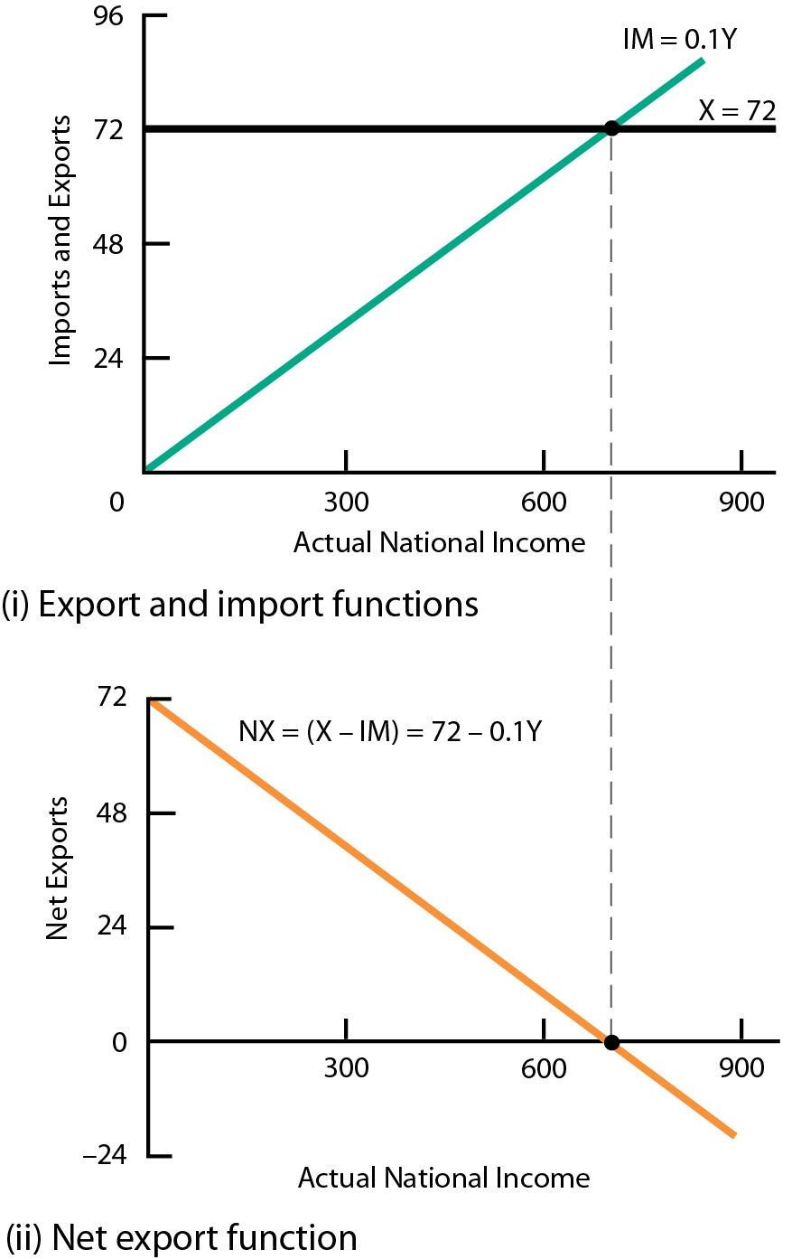
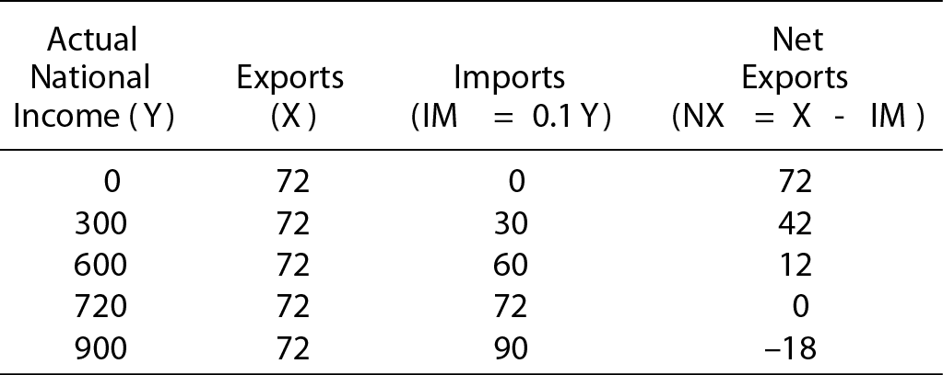
Fig. 22-1 The Net Export Function
The slope of the import function in part (i) is equal to the marginal propensity to import.
The slope of the net export function in part (ii) is the negative of the marginal propensity to import.
Copyright © 2017 Pearson Canada Inc.
Chapter 22, Slide <number>

Slide 10
Shifts in the Net Export Function
Changes in Foreign Income
An increase in foreign income, other things being equal, increases the quantity of Canadian goods demanded by foreign countries.
The X curve shifts upward and the NX function also shifts upward, parallel to its original position.
Copyright © 2017 Pearson Canada Inc.
Chapter 22, Slide <number>

Slide 11
Shifts in the Net Export Function
Changes in International Relative Prices
A rise in Canadian prices relative to those in other countries decreases Canadian exports.
The X curve will shift downward.
Canadians will see imports from foreign countries become cheaper relative to the prices of Canadian-made goods.
The marginal propensity to import will rise, and the IM curve will rotate up.
Copyright © 2017 Pearson Canada Inc.
Chapter 22, Slide <number>

Slide 12
Shifts in the Net Export Function
A rise in Canadian prices relative to those in other countries reduces Canadian net exports at any level of national income.
A fall in Canadian prices increases net exports at any level of national income.
The most important cause of a change in international relative prices is a change in the exchange rate.
A depreciation of the Canadian dollar means that foreigners must pay less of their money to buy one Canadian dollar, and Canadian residents must pay more Canadian dollars to buy a unit of any foreign currency.
Copyright © 2017 Pearson Canada Inc.
Chapter 22, Slide <number>

Slide 13
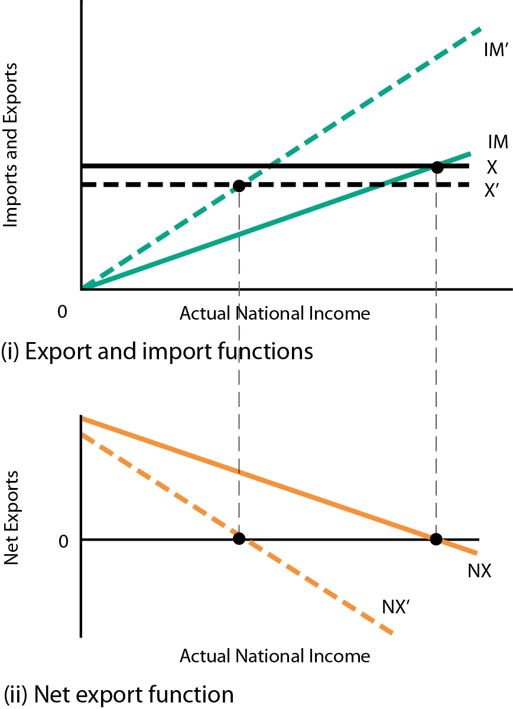
Fig. 22-2 The Net Export Function and a Change in International Relative Prices
A rise in Canadian prices relative to foreign prices lowers exports from X to X’ and raises the import function from IM to IM’.
This shifts the net export function downward from NX to NX’.
Copyright © 2017 Pearson Canada Inc.
Chapter 22, Slide <number>

Slide 14
22.3 Equilibrium National Income
Desired Consumption and National Income
Y_{D} = Y - T.
If T = (0.1)Y, then Y_{D} = (0.9)Y.
C = 30 + (0.8)Y_{D}
C = 30 + (0.8)(0.9)Y
C = 30 + (0.72)Y
The marginal propensity to consume out of national income (0.72) is less than the marginal propensity to consume out of disposable income (0.8).
Copyright © 2017 Pearson Canada Inc.
Chapter 22, Slide <number>

Slide 15
The AE Function
The AE function is given by
AE = C + I + G + X – IM.
Recall that the slope of the AE function is the marginal propensity to spend out of national income—z.
In this model,
z = MPC(1 – t) – m
Copyright © 2017 Pearson Canada Inc.
Chapter 22, Slide <number>

Slide 16
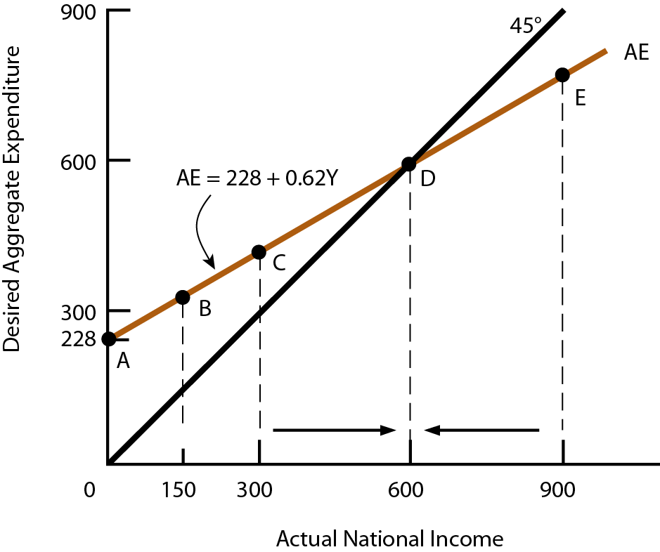
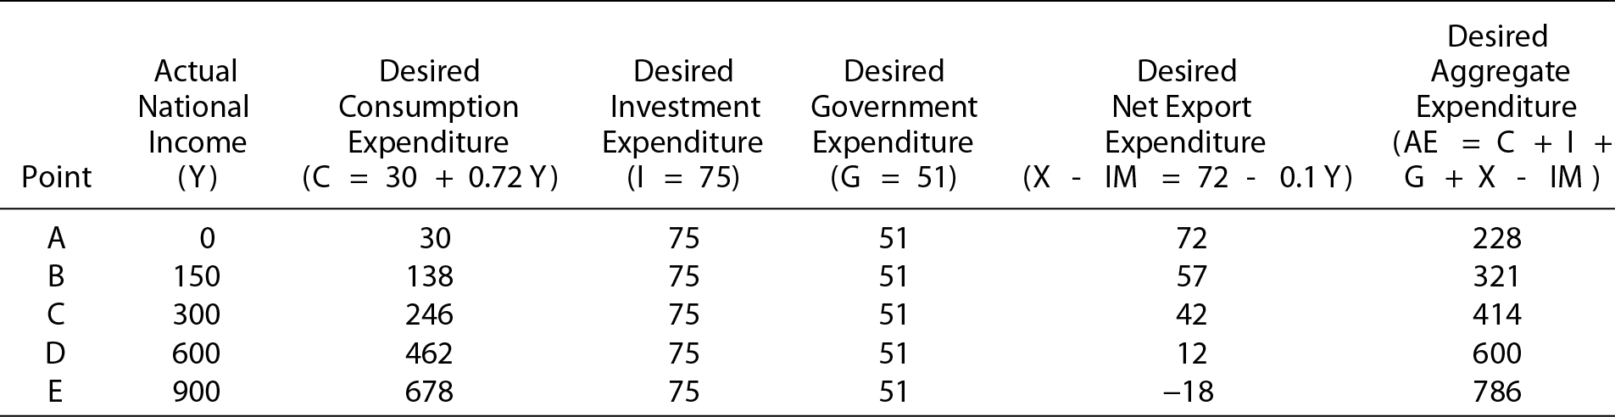
Fig. 22-3 The Aggregate Expenditure Function
The slope of the AE function is the marginal propensity to spend on domestic output. The equilibrium level of national income is $600 billion.
Copyright © 2014 Pearson Canada Inc.
Chapter 22, Slide <number>

Slide 17
Equilibrium National Income
Suppose national income is less than its equilibrium amount.
Some of the desired expenditure must either be frustrated or take the form of purchases of inventories of goods that were produced in the past.
As firms see their inventories being depleted, they will increase production, which increases the level of national income.
The opposite sequence of events occurs when national income is greater than its equilibrium amount.
Only when national income is equal to desired aggregate expenditure is there no pressure for output to change.
Copyright © 2017 Pearson Canada Inc.
Chapter 22, Slide <number>

Slide 18
22.4 Changes in Equilibrium National Income
The Multiplier with Taxes and Imports
The presence of imports and taxes reduces the marginal propensity to spend out of national income and reduces the value of the simple multiplier.
The simple multiplier equals 1/(1 – z), where z = MPC(1 – t) – m.
In Canada, if MPC = 0.8, t = 0.25, and m = 0.35, how large is Canada’s simple multiplier?
Copyright © 2017 Pearson Canada Inc.
Chapter 22, Slide <number>

Slide 19
Net Exports
As with other elements of desired aggregate expenditure, if the net export function shifts upward, the AE function will also shift upward and equilibrium national income will rise.
If the net export function shifts downward, so too will the AE function and equilibrium national income will fall.
Exports are autonomous with respect to domestic national income.
If exports increase by $1 billion, then equilibrium national income will increase by $1 billion times the simple multiplier.
Copyright © 2017 Pearson Canada Inc.
Chapter 22, Slide <number>

Slide 20
Fiscal Policy
Any policy designed to reduce the economy’s cyclical fluctuations and thereby stabilize national income is stabilization policy.
In our model, there are two fiscal policy tools available to government policymakers—the net tax rate (t) and government purchases (G).
A reduction in the net tax rate or an increase in government purchases shifts the AE curve upward, setting in motion the multiplier process that tends to increase equilibrium national income.
Copyright © 2017 Pearson Canada Inc.
Chapter 22, Slide <number>

Slide 21
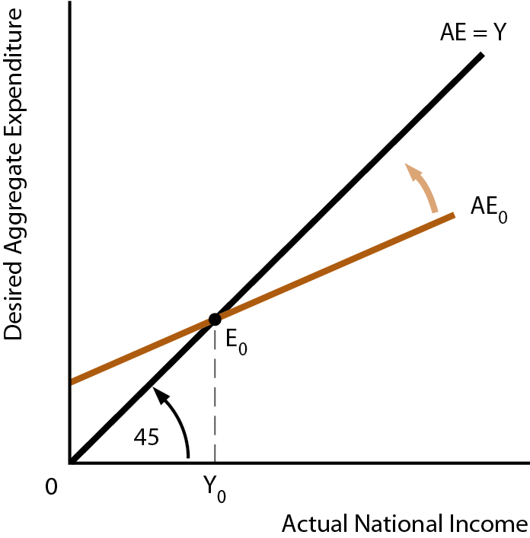
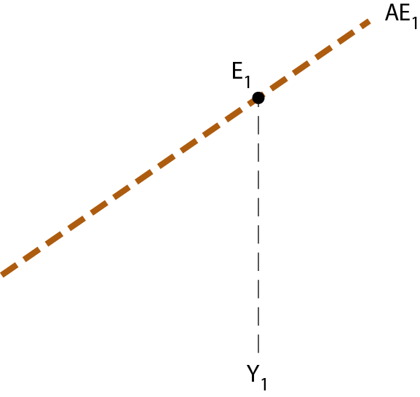
Fig. 22-4 The Effect of Changing the Net Tax Rate
A reduction in the net tax rate rotates the AE curve from AE₀ to AE₁.
The new curve has a steeper slope because the lower net tax rate withdraws a smaller amount of national income from the desired consumption flow.
Equilibrium income increases.
Copyright © 2017 Pearson Canada Inc.
Chapter 22, Slide <number>

Slide 22
22.5 Demand-Determined Output
Equilibrium National Income
The equilibrium level of national income is the level at which desired aggregate expenditures equals actual national income (AE = Y).
If actual national income exceeds desired expenditure, firms will eventually reduce production, causing national income to fall.
If actual national income is less than desired expenditure, firms will eventually increase production, causing national income to rise.
Copyright © 2017 Pearson Canada Inc.
Chapter 22, Slide <number>

Slide 23
The Simple Multiplier
The simple multiplier measures the change in equilibrium national income that results from a change in the autonomous part of desired aggregate expenditure.
The simple multiplier is equal to 1/(1 – z), where z is the marginal propensity to spend out of national income.
In a closed economy with no government, z = MPC.
In an open economy with government, z = MPC(1 – t) – m.
Copyright © 2017 Pearson Canada Inc.
Chapter 22, Slide <number>

Slide 24
Demand-Determined Output
The model that we have examined is constructed for a given price level—that is, the price level is assumed to be constant.
In this model, national income is demand determined.
In the following chapters, we expand the model by making the price level an endogenous variable.
We do this by considering the supply side of the economy.
Copyright © 2017 Pearson Canada Inc.
Chapter 22, Slide <number>

