Slide 1

Entrepreneurial Finance
Cash Breakeven
Contribution Analysis
Sales Forecasting
Cash Budgeting
Cash Burn
New Venture Financing
New Venture Valuation
Strategies for Growth/Exit

Slide 2
Learning Objectives
After studying this topic you should understand:
how to create a realistic and justifiable top-down and bottom-up sales forecast
how to create and use a cash budget, and determine the amount of financing needed
how to measure a venture’s cash build and burn rate and what it means
the different stages a new venture goes through and the sources of funding available at each stage
the different approaches to valuing a new venture and how to come up with a valuation and ‘ask’
(the different strategies for growing a business through the various stages, and the different strategies for harvest and exit)

Slide 3
Startup Financial Metrics Text page 176
For all startups:
Sales Forecast, Headcount, Expenses (fixed and variable), Breakeven cash flow
+ Unique metrics…
Gross margin, Inventory turns, Occupancy, Qualified leads (acquistion, retention, revenue, viral coefficient)
Creation and capture of value:
Customer acquisition costs (CAC) vs. Lifetime customer value (LCV)
Revenues per salesperson and time to revenue
Contribution margin
Monthly burn rate

Slide 4
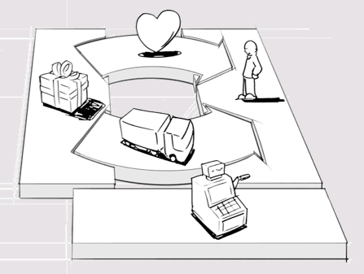
So # 1 on the list… Can you capture the value you’ve created? Can you sell enough to breakeven and achieve financial performance?

Slide 5
Forecasting Demand/Sales Revenue
No formula – projections based on research and logic = educated guess you can defend
Market potential ≠ Sales forecast
AND Forecast depends on plan - scalability
Top-down forecasting (Breakdown)
Market potential not just #households
with lawns / likely to mow lawn / care about benefits
Still doesn’t equal sales forecast
consider the geographic market operating in and seasonality
ready to buy? (lawn mowers/yr/capita – target buy in same proportion?, need new one?, time to adopt / switching costs?)

Slide 6
Forecasting Demand (cont’d)
Bottom-up forecasting (Buildup)
What you can do given capacity and marketing plan
# stores that sell mowers / # that will carry / # each must sell to meet target – make sense?
Compare to breakeven – what you have to do
Sensitivity analysis and contingency plan
Assumptions to base sensitivity on
Breakeven
Largest/smallest/average competitor
Similar product launch
Capacity
Milestones – points that increase valuation of business and/or trigger need for capital
Contingency plan
“it is important to consider the potential changes to the forecasts with the highest probability of occurrence and to factor in how the impact of these changes will be dealt with” text page 194

Slide 7
Forecasting Demand visually
Top-Down
150 million cars
1% install satellite radio
Install 10 systems per day
10 installation facilities
10 x 10 x 240 days = 24,000
% listen to radio
% care about benefits
% would pay price
% adoption rate
1.5 million
Capacity, plan/strategy
Bottom-up

Slide 8
“It’s important for entrepreneurs to keep in mind that all of the numbers they come up with in their forecasts will be challenged and they must be prepared to defend them. It’s difficult to do if the estimate was simply pulled out of the air… There is a 100 percent chance that the numbers... Will be wrong text page 189 (SO) narrative assumptions about the numbers for demand, revenues, expenses, and startup costs must be developed… one of the biggest problems that many entrepreneurs have when trying to present a case for the financial feasibility of their business models is that they can’t justify the numbers they have put into their projections” text page 179

Slide 9
Cash Budgeting
Tool to forecast and manage cash flows
Beginning Cash Balance
+ Receipts
Total Cash Available
- Disbursements
Cash Excess / (Deficiency)
Minimum Cash Balance Desired
Financing Req’d / Surplus or Repayment
Ending Cash Balance
*
*
* Worksheet based on historical measures of amounts and timing of cash flows / what is typical in industry

Slide 10
Example
you need to prepare a cash budget for the months of June, July and August
minimum cash balance requirement = $6,000
beginning cash balance in June = min. cash balance
assume that sales are forecasted at $10,000, $20,000, $30,000, $15,000, $25,000, and $20,000 from April to September respectively
assume also that you expect to collect 30% in month of sale, 60% in month following sale, and 10% in the 2nd month after sale
assume that purchases are 75% of the next month’s sales
assume also that you pay for 20% of purchases in the month of purchase, and 80% in the month following

Slide 11
Worksheet
April May June July Aug. Sept.
Net Sales 10,000 20,000 30,000 15,000 25,000 20,000
Collections:
30% month of sale
60% month follow
10% 2nd month
Total Receipts
Net Purchases
75% next mth. sales
Payments:
20% month of purch.
80% month follow
Total Disbursements for Purch.
22,000 24,500 19,500
20,250 12,750 18,000

Slide 12
Cash Budget
June, July, August, 19XX
Beg. Cash Balance
Add: Receipts
Total Cash Available
Less: Disb. for Purch.
Selling & Admin.
Interest
Dividends
Capital Expenditures
Taxes
Total Disbursements
Cash Excess / (Deficiency)
Min. Cash Balance Desired
Financing Required
Surplus Cash
Ending Cash Balance
June
July
August

Slide 13
Keys:
3 possibilities (besides excess = balance req’d)
1. Deficiency
finance deficiency + minimum
ending balance = minimum req’d
2. Excess > Minimum
surplus available to repay borrowing
if do… ending balance = minimum req’d
if don’t… ending balance = total excess
3. Excess < Minimum
finance to = minimum req’d
end balance = minimum req’d

Slide 14
Example
you need to prepare a cash budget for the months of June, July and August
minimum cash balance requirement = $6,000
beginning cash balance in June = min. cash balance
assume that sales are forecasted at $10,000, $20,000, $30,000, $15,000, $25,000, and $20,000 from April to September respectively
assume also that you expect to collect 30% in month of sale, 60% in month following sale, and 10% in the 2nd month after sale
assume that purchases are 75% of the next month’s sales
assume also that you pay for 20% of purchases in the month of purchase, and 80% in the month following
Forecast other monthly expenses depending on your plans

Slide 15
How Much Cash Do you Need?
The cash budget determines the net cash inflows and outflows, assuming no startup capital
The total cumulative financing required until you are cash flow positive + startup costs and a safety margin (contingency factor) is your ASK Text page 190-193
Safety margin / contingency factor often based on sales and collection cycle

Slide 16
Cash Burn Rates & Liquidity
Cash Burn Rate
How quickly a venture ‘burns through’/uses cash
“The rate at which a new company uses up capital to finance overhead before generating positive cash flow from operations.”Investopedia
Determine weeks of cash remaining
Cash Build Rate
How quickly a venture builds cash through collections on sales
Liquidity
The ability of the venture to maintain a build rate high enough to meet its obligations as they come due

Slide 17
Measuring Burn and Build Rates
Cash Burn = the cash a venture expends on its operating and financing expenses and its investments in assets
Cash Burn
= Cash Operating Expenses + Interest + Taxes
+ Increase in Inventories
– Changes in Payables and Accruals
+ Capital Expenditures

Slide 18
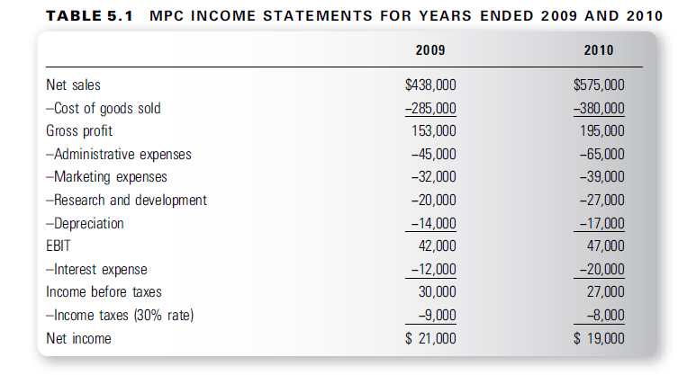
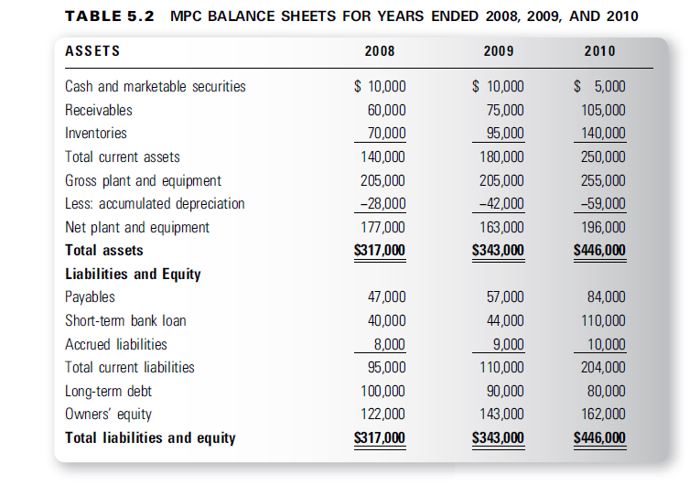
Cash Burn Rate =

Slide 19
Cash Build = what the venture receives on its sales
Cash Build = Net Sales – Increase in Receivables
Cash Build Rate
=

Slide 20
Cash Build = what the venture receives on its sales
Cash Build
= Net Sales – Increase in Receivables
=
Net Cash Burn – when cash burn exceeds cash build
=
Monthly Burn Rate
Monthly cash burn rate =
– Monthly cash build rate =
= Monthly net cash burn rate =
Given that the company has $5,000 in cash at the end of 2010, it has < 1 month until it runs out of cash
If you invested $15,000, how long would it be before more external financing is needed?

Slide 21
How Do I Calculate Burn/Build Rate without Statements?
The cash budget shows total cumulative cash needs
This indicates your burn (or build) rate

Slide 22
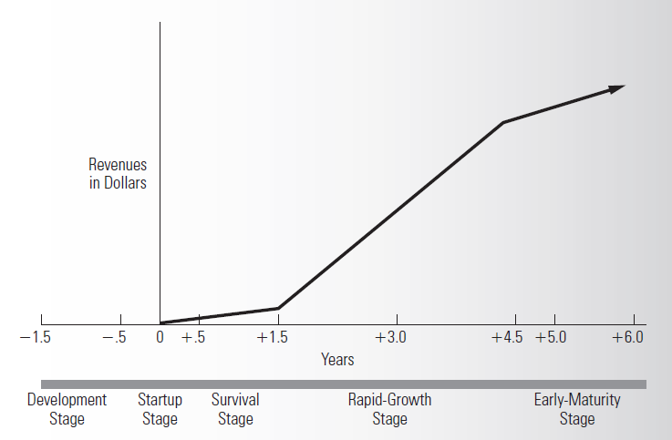
Financing through the Venture Life Cycle
Early stage ventures
Seasoned firms

Slide 23
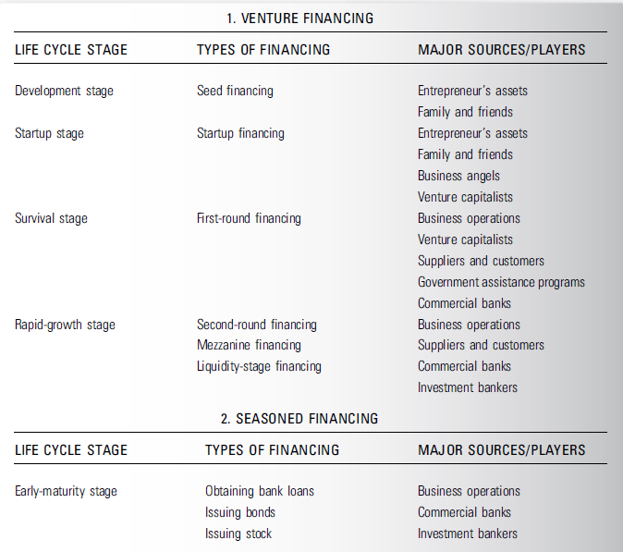
Financing through the Venture Life Cycle

Slide 24
Venture Valuation
Approaches to valuation
Income approach
Based on assumption that value of business = sum of the present values of any expected future benefits – income stream and/or liquidity event
Market approach
Value is determined based on comparisons to similar companies for which values are known
‘Market multiple’
Cost approach
Value determined as measure of net cost of assets, original amount invested or ‘cost-to-duplicate’

Slide 25
Income approach methods
Discounted cash flow
Determine ‘free’ cash flows
= operating cash flow – capital expenditures
Use cash surpluses from cash budget
+ potential liquidity event
Discount for risk and time value of money
Investors will use a relatively high discount rate for risk involved
Early development 50-70%
Market studies, testing prototypes, ltd. manuf 40-60%
Viable product and established market 35-50%
Risk adjusted net present value
Probability of occurrence
Venture capital method
https://www.youtube.com/watch?v=mqnZaswHI1g

Slide 26
BUT…
No hard and fast rules for valuing early stage companies
Too many unknowns
Valuation professionals need 3 things to value any asset
An income stream
A growth rate
A discount rate
In early stage companies at least 2 of the 3 is subject to substantial uncertainty

Slide 27
Considerations in applying the income approach:
Because the development of projections depends on specific outcomes and milestones, one scenario of cash flow is inadequate
The risk of failure is likely higher than the present value discount rate
Venture capitalists consider portfolios of investments
If losses are forecast in the first few years, it is likely that they will occur and even greater ones
Valuations are driven by subjective factors
Management team, value proposition, intellectual property, time to market, path to profitability, capital needs and burn rate, industry volatility, and deal structure

Slide 28
In real life, result of a mutually accepted valuation between the company and its investors, which incorporates
entrepreneur’s determination of the acceptable amount of ownership that may be given in return for the capital and/or expertise
investor’s assessment of risks and rewards
Most external capital is raised through the issuance of preferred stock with provisions to provide protection for the investor
Royalty arrangements becoming more common
Good for investor and entrepreneur – why?

Slide 29

“Impossible to answer…
Each dragon approaches differently – one could say $4mm and another $400,000
People underestimate the risk - 90% won’t do well – therefore need big upside = lower valuations
Entrepreneurs only look at it from their perspective – what they need and what they are willing to give up vs investor’s – reasonable rate of return
Tremendous amount of guess-work – not a science – comes down to experience of investor”

