Slide 1
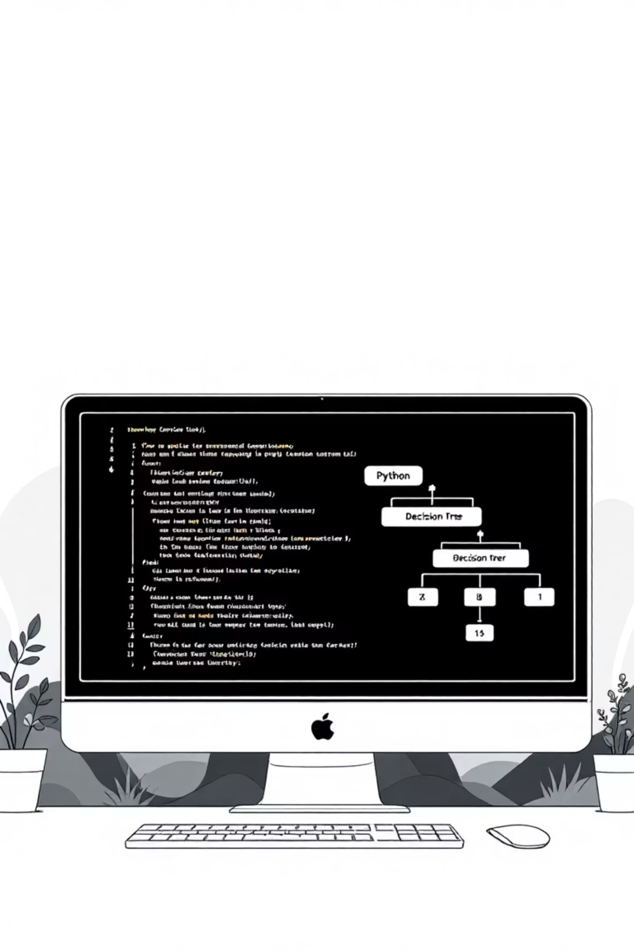
Constraints and Conditional Statements in Python – Complete Guide
A comprehensive guide to understanding how constraints work as rules in programming and how conditional statements enforce them to create safe, correct, and predictable programs.

Slide 2
Constraints First!
What are Constraints?
Constraints are rules or limits that tell us what values are acceptable in a system.
Real Life
Math
Programming
"You must be at least 16 to ride this roller coaster."
"x must be between 1 and 100."
"Password must be at least 8 characters."
They describe the boundaries within which everything works correctly.

Slide 3
Why are Constraints Important?
Constraints help keep our programs:
Safe
Correct
Fair and Predictable
They don't allow wrong inputs
Answers follow the rules
Everyone plays by the same rules
Without constraints:
An age of -5 years doesn't make sense.
A score of 200 in a game with max 100 would break fairness.
An empty password would not keep accounts safe.
Just like classroom rules keep order, constraints keep programs running smoothly.

Slide 4

How Do We Enforce Constraints?
This is where Conditional Statements step in. They are like gatekeepers who check:
"Does this input follow the rules?"
"If yes, what should we do? If no, what's the correct response?"
Example:
age = int(input("Enter your age: "))if age < 0: print("Age cannot be negative.") # Enforcing constraintelif age < 18: print("You are not eligible to vote yet.")else: print("You can vote!")
Here:
Constraint: age >= 0
Conditional Statement: if age < 0 checks and blocks invalid input
Flow: Program continues only when the value follows the rules
👉 In short: Constraints are the rules. Conditional statements are the tools to enforce them.

Slide 5
Conditional Statements – The Enforcers
Computers are patient helpers waiting for instructions. Conditional statements are their "decision goggles" that enforce your constraints by asking questions and choosing the correct path.
Single if (Optional Action)
Ask ONE question; maybe run ONE block.
Real life: "Is it raining?" If yes → grab umbrella; otherwise continue.
Example: Helmet Safety
going_to_ride_bike = True # Change to False to testif going_to_ride_bike: print("Put on helmet")print("Ready to go")
If condition is False the inside block is skipped.

Slide 6
More Quick Examples
Input Version
raining = Trueif raining: print("Take umbrella")print("Leave house")battery_low = Falseif battery_low: print("Plug in charger")print("Continue using device")
answer = input("Did you finish your homework? (yes/no): ")if answer == "yes": print("Great job! Free time now.")print("Homework check complete.")
Try editing the prompt for other habits.
Practice – Single If
Ask: "Did you sleep well?" If yes print "Energy high!".
Ask: "Hungry?" If yes print a snack idea.
Ask: "Water bottle full?" If no (answer != "yes") print "Fill it".
Ask: "Backpack packed?" If no print "Pack it now".

Slide 7
if / else (Exactly One of Two Paths)
One question. ALWAYS take exactly one branch.
Pattern:
if condition: # then branchelse: # else branch
Example: Traffic Light
color = input("Light color (red/green): ")if color == "green": print("Go")else: print("Stop")
More Examples
done = input("Chores finished? (yes/no): ")if done == "yes": print("Snack time!")else: print("Do chores first")
cold = input("Is it cold? (yes/no): ")if cold == "yes": print("Wear jacket")else: print("No jacket needed")
Practice – If / Else
Battery low? yes -> Charge now / else -> Keep using.
Friend online? yes -> Start chat / else -> Wait.
Shoes on? no -> Put on shoes / else -> Ready.

Slide 8
if / elif / else (Choose ONE of Many)
Top-to-bottom scan. First True branch runs; rest are skipped. Optional final else for "none matched".
Shape:
if cond1: ...elif cond2: ...elif cond3: ...else: ... # (only if nothing above matched)
Example: Weather Outfit
weather = input("Weather (sunny/cloudy/rainy): ")if weather == "sunny": print("Wear sunglasses")elif weather == "cloudy": print("Take a light jacket")elif weather == "rainy": print("Grab an umbrella")else: print("Check the forecast")

Slide 9
match (Structural / Exact Pattern Match) – Python 3.10+
Modern alternative for checking ONE value against many patterns. Cleaner than large if/elif chains when comparing the same subject.
Shape:
match value: case pattern1: ... case pattern2: ... case _: ... # fallback
_ is a wildcard (anything else). You can group with | and add guards if ... for ranges.
Example: Day Greeting
day = "mon" # try: mon / tue / wed / fri / sat / sunmatch day: case "mon": print("Monday boost: You got this!") case "tue": print("Tuesday: Keep rolling") case "wed": print("Mid-week high five") case "fri": print("Friday: Almost weekend!") case "sat" | "sun": print("Weekend mode: Relax") case _: print("Use a short day code (mon/tue/wed/fri/sat/sun)")

Slide 10
Quick Decision Pattern Cheat Sheet
Need
Use
Enforce or check a constraint
if or if / else
Maybe do something
single if
Exactly one of two
if / else
One of many (first true)
if / elif / else
One of many (same subject)
match
Real-Life Rule
Python Constraint
Finish homework before play
if homework_done: print("Play time!")else: print("Finish homework first")
© 2025 MathCodeLab Team. All Rights Reserved.

