Slide 1
PD30 flipbook — talk skeleton (Acts 0–VI)
One slide per flipbook slide ID in _DISPOSABLE_paper_flipbook_PD30.md
Subset of figure inventory — not the full catalog
Regenerate: python scripts/build_flipbook_figure_deck.py

Slide 2
— Act 0 —

Slide 3
0.2 · What is not the claim?
Act 0 · Binding three-separations table
Open document: 3-Master_Plan/BINDING_Selection_is_its_own_step.md
3-Master_Plan/BINDING_Selection_is_its_own_step.md
Markdown — not a PNG; read binding doc.
TEXT

Slide 4
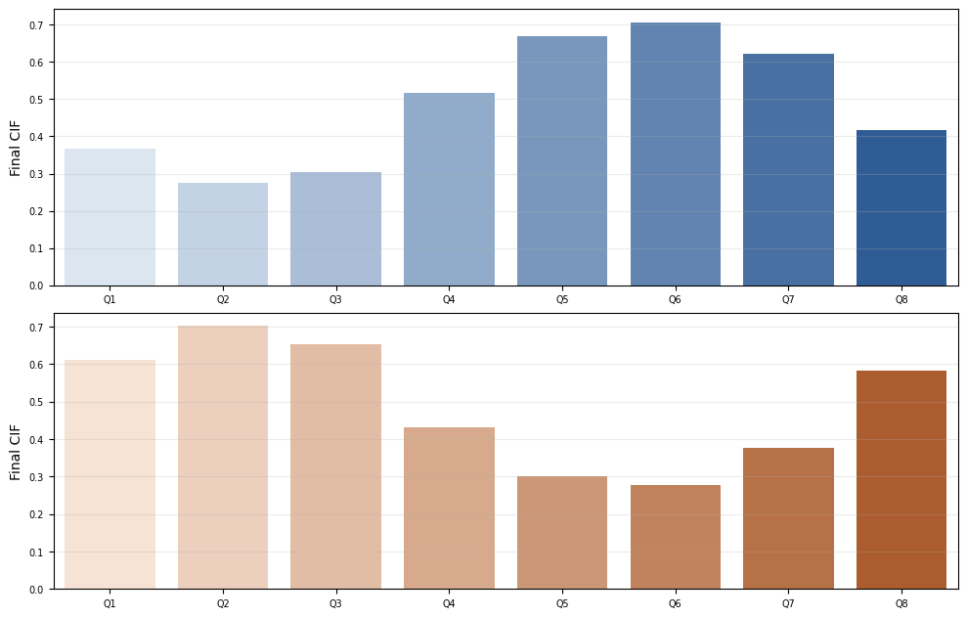
0.3 · What is the hero?
Act 0 · Army CIF / pool-quality porch (G1)
3-Master_Plan/re_entry/HEROs_and_PASSes/army_sandbox/ARMY_G1_pool_minus_mean_fwd_cif_b8.png
G1: regenerate from talent/520 Cell 11 — z_pool_minus_mean_snr_fwd 8-bin promotion CIF. · auto-discovered
OK

Slide 5
0.4 · Why basketball in the repo?
Act 0 · Access narrative
Text-only slide — no figure file
Text slide — no figure.
TEXT

Slide 6
— Act I —

Slide 7
1.1 · Who is in the pond?
Act I · Army cohort / HRC talent pipeline
Open document: talent/documents/520_PIPELINE_COX_OVERVIEW.md
talent/documents/520_PIPELINE_COX_OVERVIEW.md
Notebook: talent/talent_pipeline/520_pipeline_cox_working.ipynb
TEXT

Slide 8
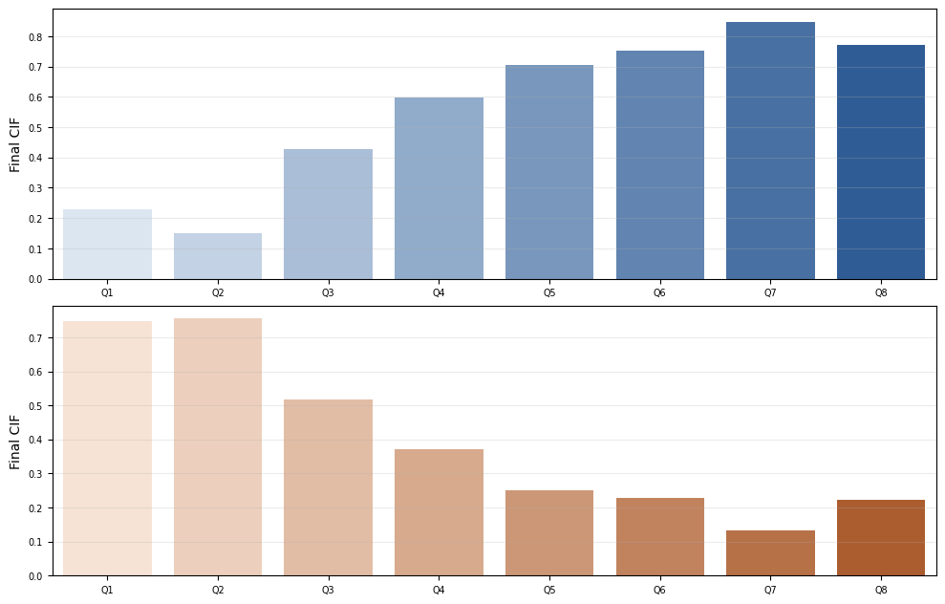
1.2 · Talent alone?
Act I · Own TB ratio — monotone promotion CIF
3-Master_Plan/re_entry/HEROs_and_PASSes/army_sandbox/ARMY_own_tb_ratio_fwd_cif_b8.png
G1 sibling: Cell 11 z_tb_ratio_fwd_snr 8-bin bars (not in git). · auto-discovered
OK

Slide 9
1.3 · The hero shape?
Act I · Strong inverted-U vs pool LOO (G1)
3-Master_Plan/re_entry/HEROs_and_PASSes/army_sandbox/ARMY_G1_pool_minus_mean_fwd_cif_b8.png
G1 lead figure — Q1–Q8 promotion CIF on z_pool_minus_mean_snr_fwd. · auto-discovered
OK

Slide 10
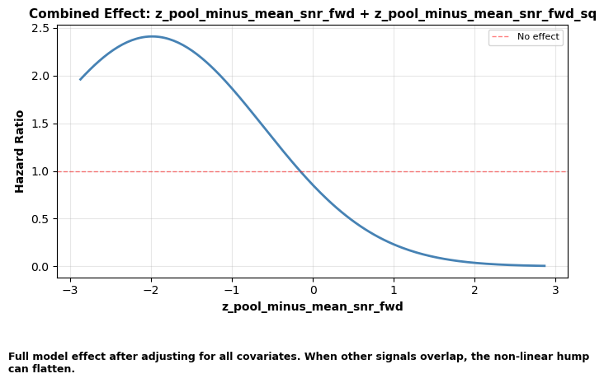
1.4 · Formal check?
Act I · Cox quadratic + partial effects
3-Master_Plan/re_entry/HEROs_and_PASSes/army_sandbox/ARMY_partial_effects_pool_minus_mean.png
Cell 12 / 12.6A exports not in git. · auto-discovered
OK

Slide 11
— Act II —

Slide 12
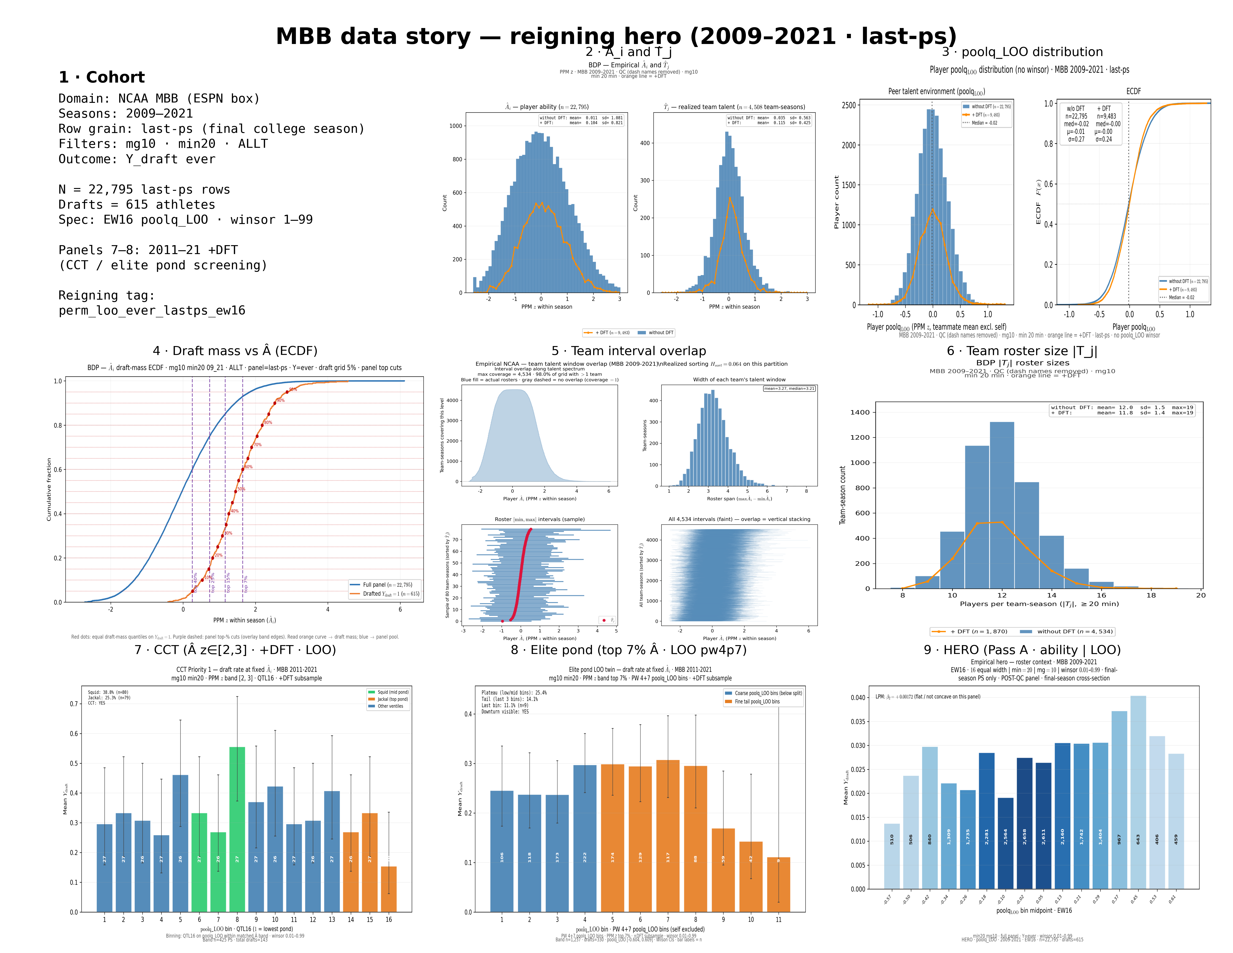
2.1 · Who is in the pond?
Act II · MBB cohort (panel 1 text in 3×3)
3-Master_Plan/re_entry/HEROs_and_PASSes/sports_sandbox/data_story/MBB_DATA_STORY_reigning_3x3.png
Panel 1 = text tile top-left of this mosaic.
OK

Slide 13
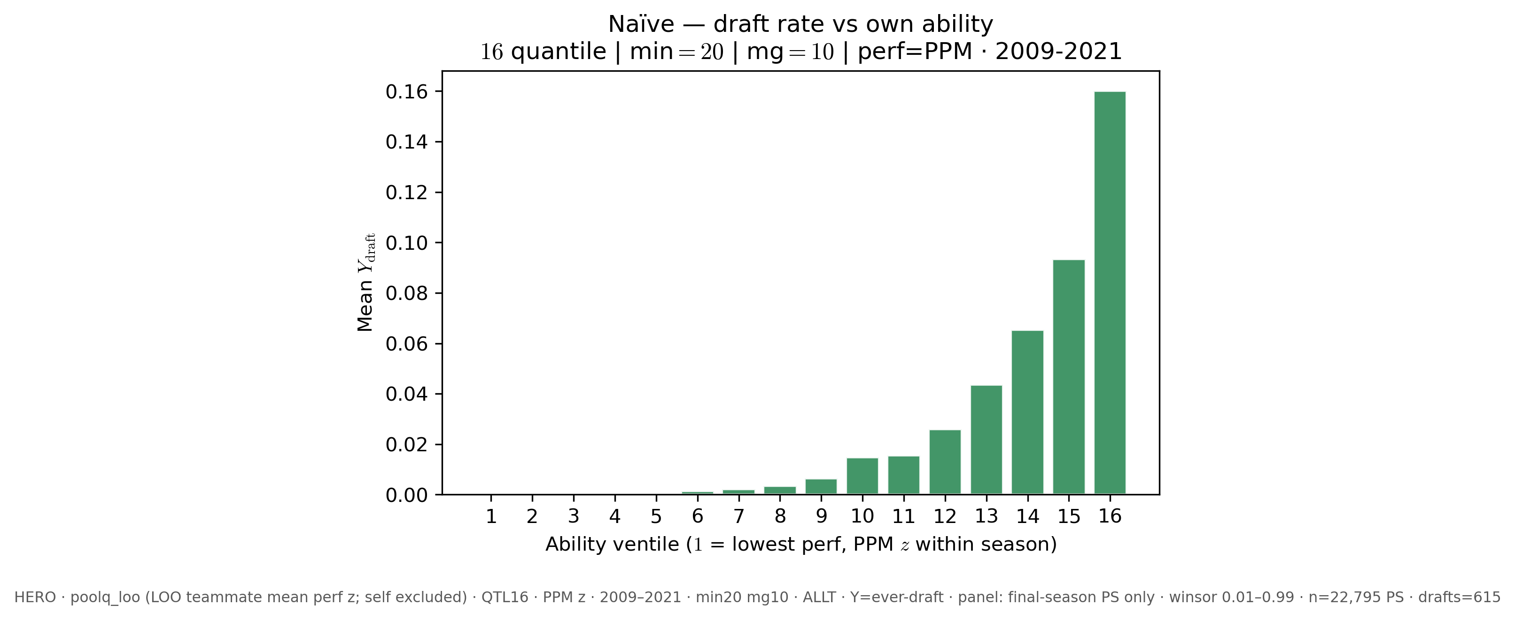
2.2 · Talent alone? (naïve)
Act II · Draft rate vs own ability ventiles
3-Master_Plan/re_entry/HEROs_and_PASSes/pass_a/PASS_A_naive_ability_q16_allt_min20_mg10_9_21_last_ps.png
Pairs with 2.3 hero; regen: pass_a_empirical_bundle.py --panel-rows last-ps --season-min 2009 --season-max 2021 --naive-panel
OK

Slide 14
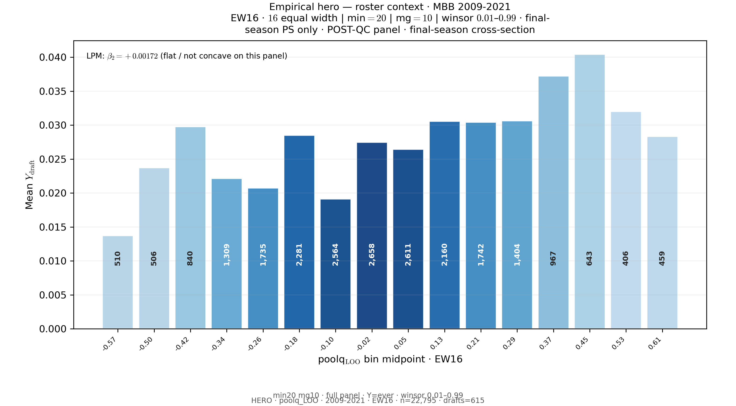
2.3 · Same axis, same family?
Act II · Reigning HERO EW16 (panel 9)
3-Master_Plan/re_entry/HEROs_and_PASSes/sports_sandbox/hero/HERO_ew16_allt_min20_mg10_09_21_last_ps_perm_loo_ever_lastps_ew16.png
OK

Slide 15
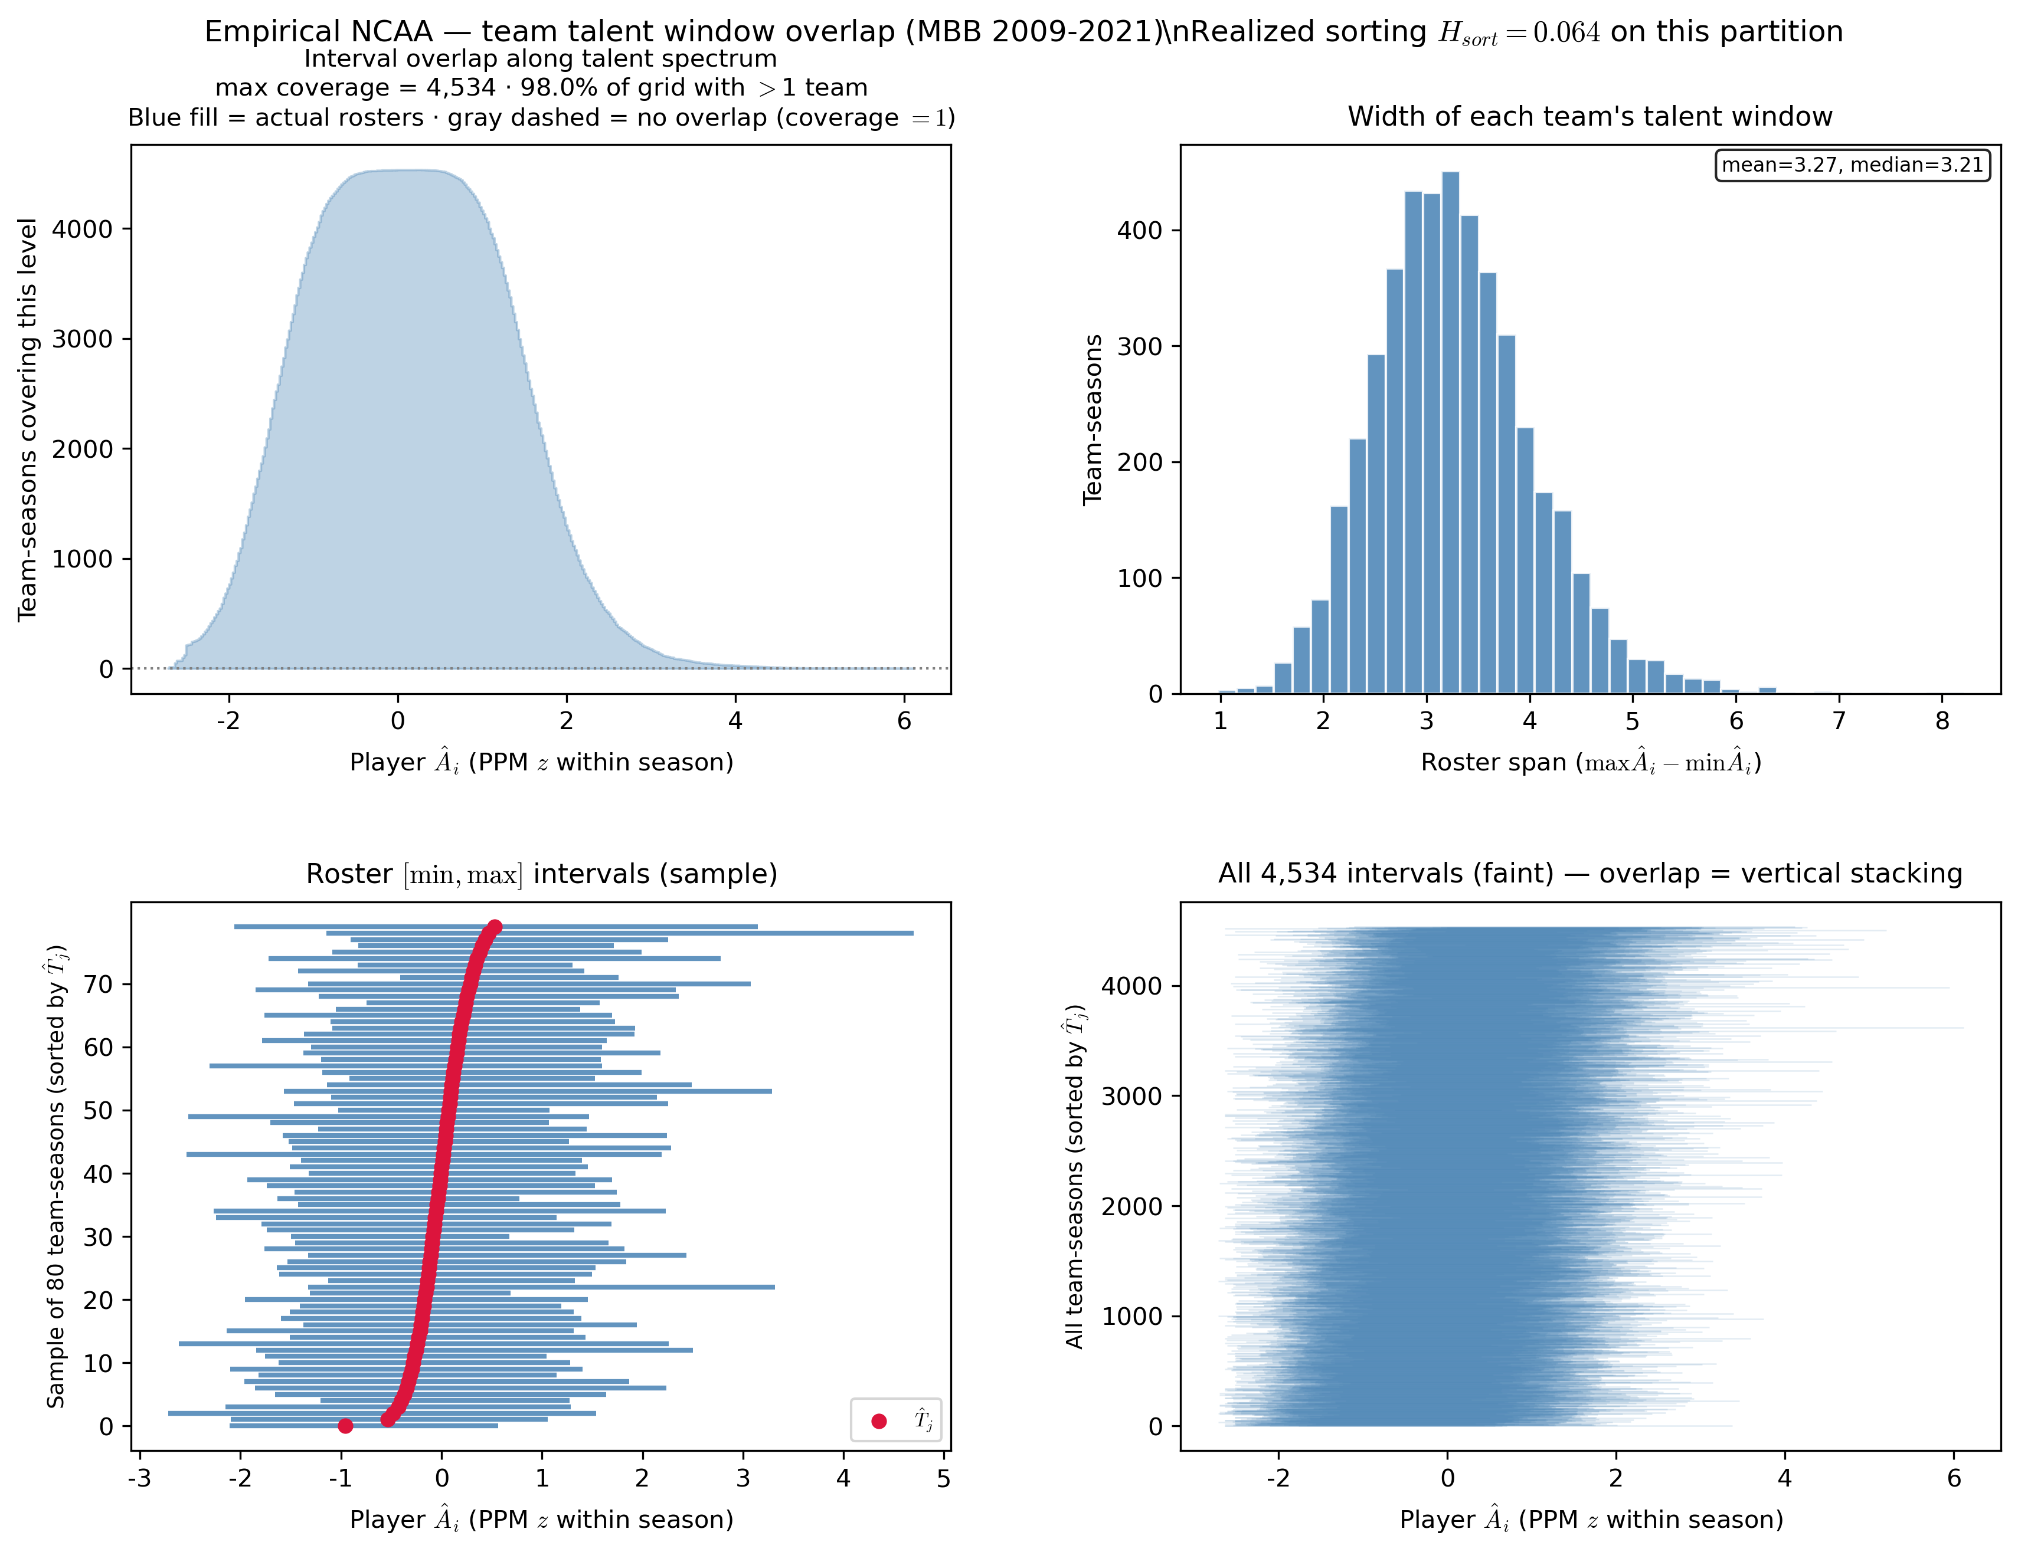
2.4 · Assortment / overlap?
Act II · Team interval overlap (panel 5)
3-Master_Plan/re_entry/HEROs_and_PASSes/sports_sandbox/reigning_hero/basic_data_plots/REIGNING_team_interval_overlap_mg10_min20_09_21.png
OK

Slide 16
— Act III —

Slide 17
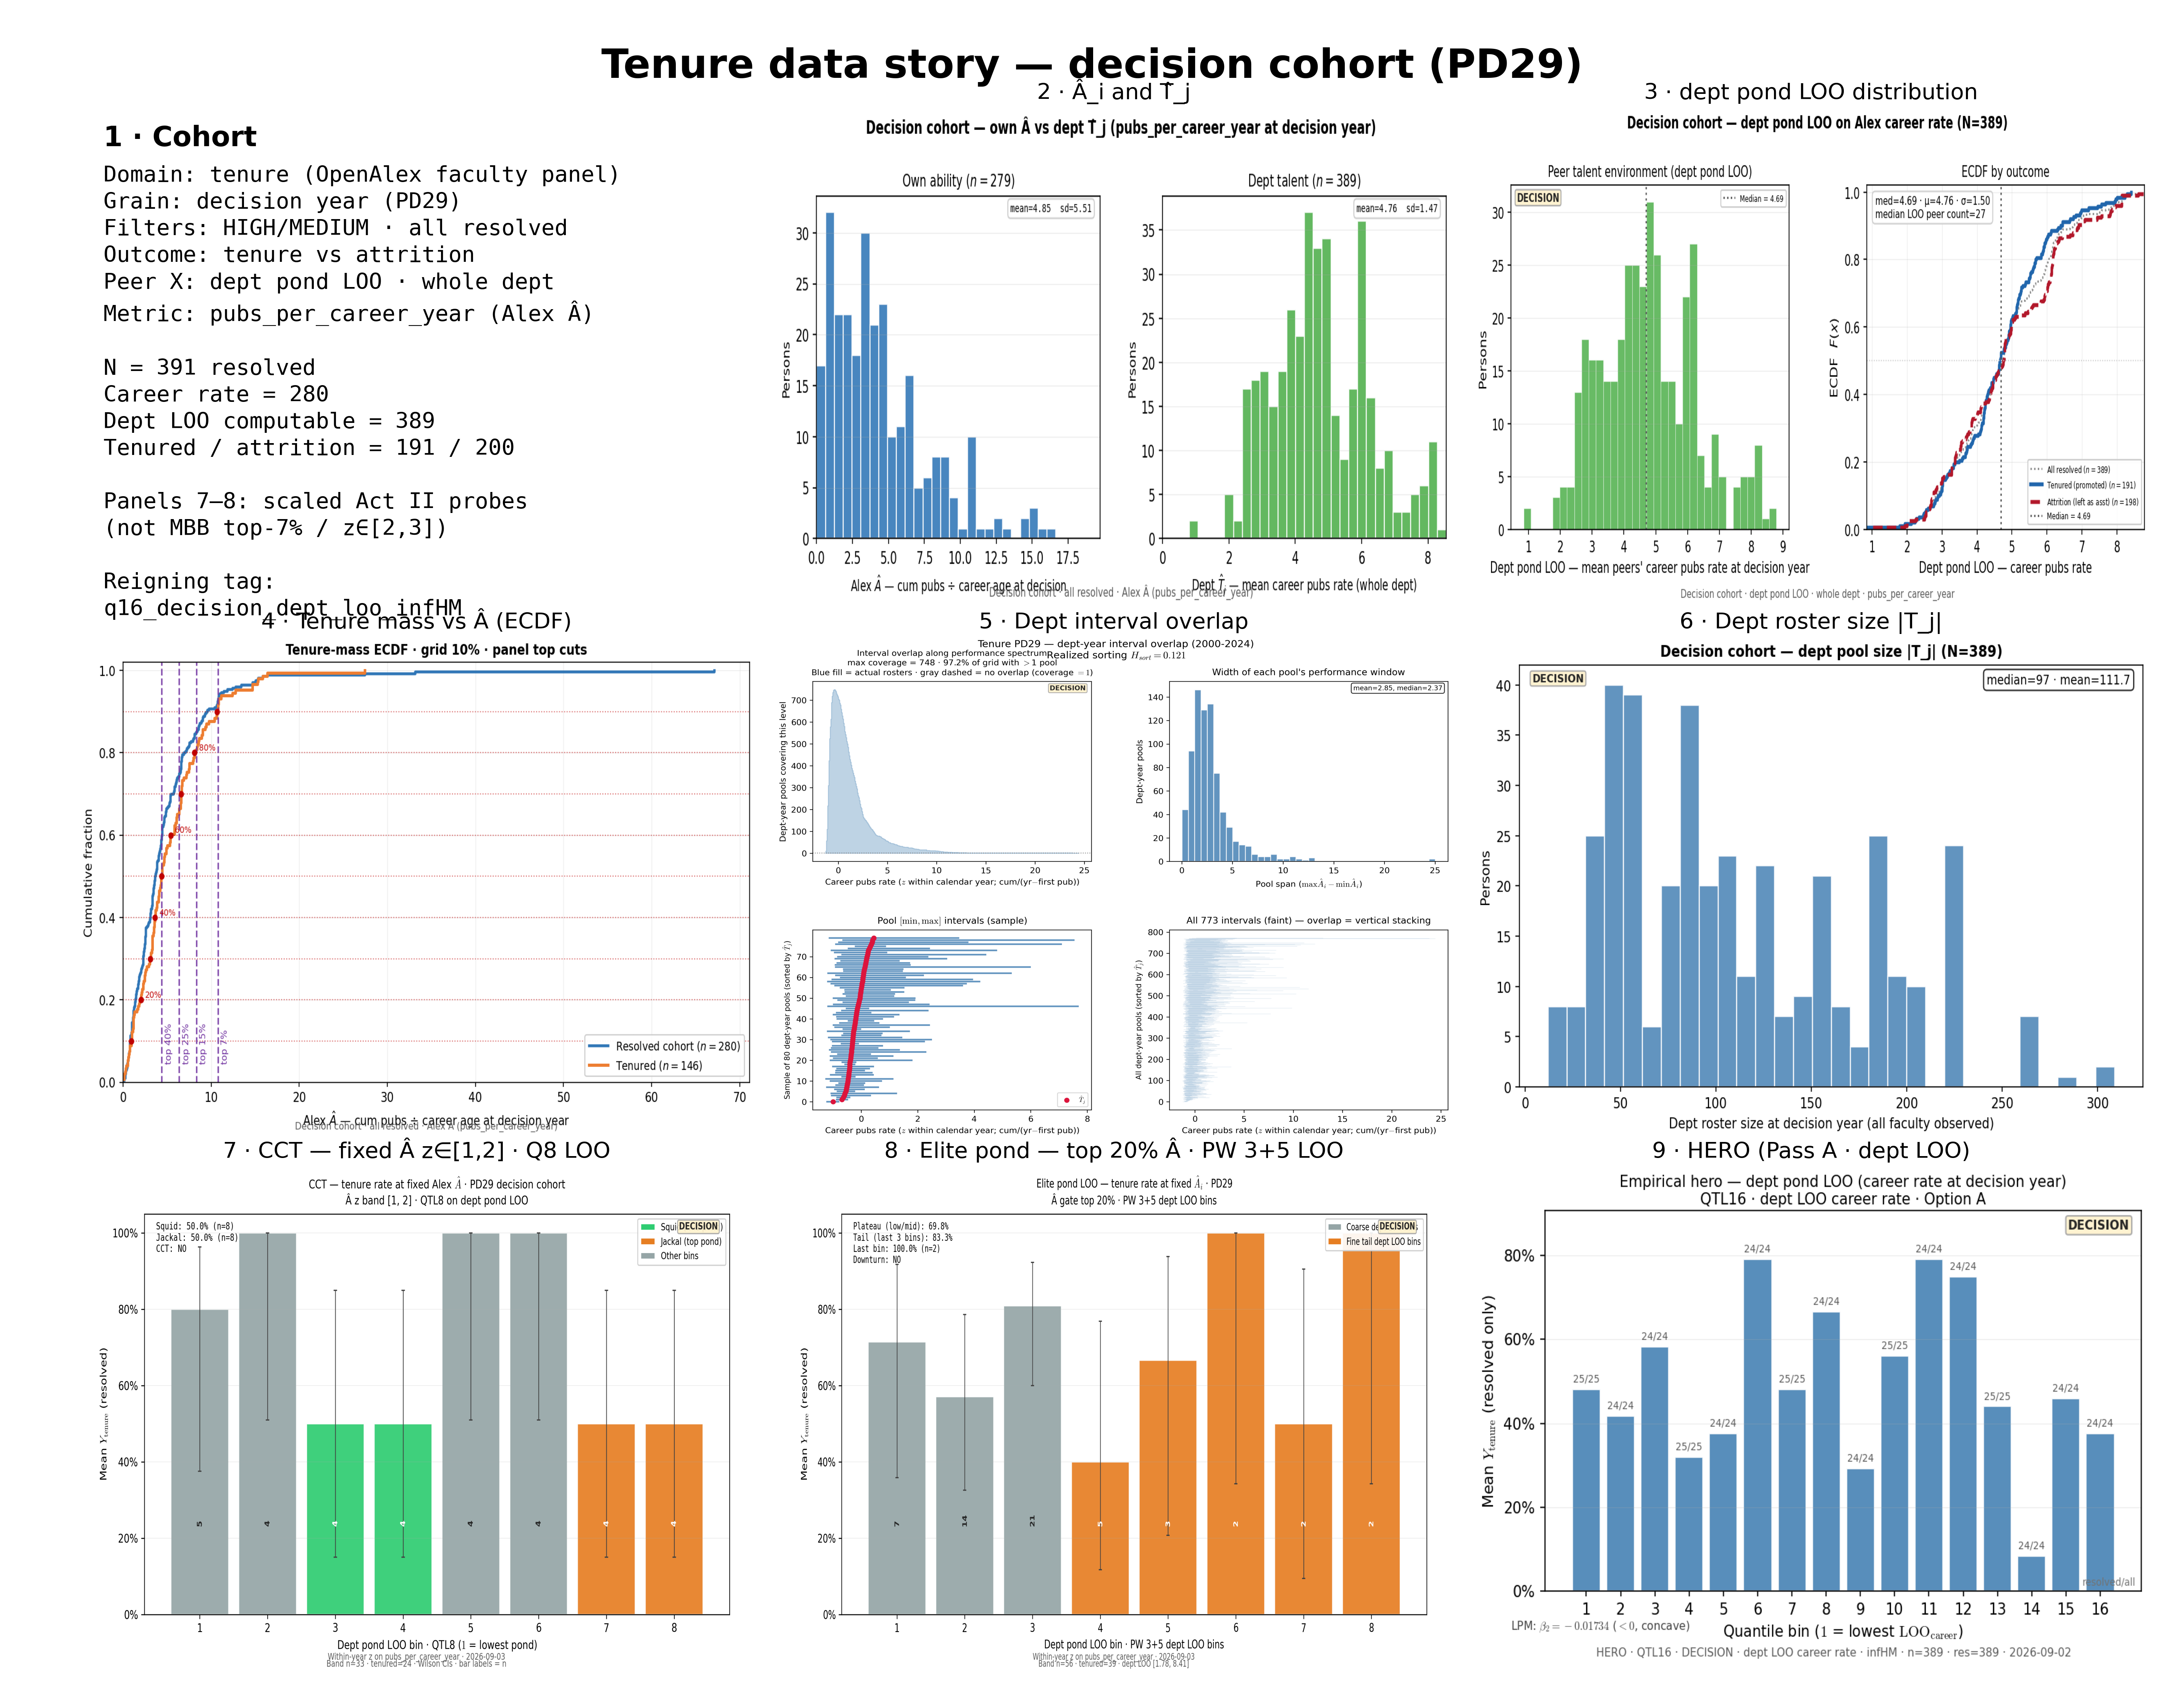
3.1 · Same skeleton, academia?
Act III · Tenure PD29 3×3 + panel 9 HERO
3-Master_Plan/re_entry/HEROs_and_PASSes/tenure_sandbox/data_story/TENURE_DATA_STORY_pd29_3x3.png
Panel 9 path below as standalone.
OK

Slide 18
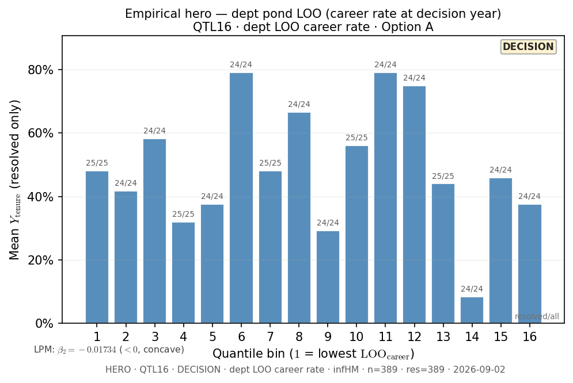
3.1b · Tenure HERO (panel 9 alone)
Act III · Dept LOO career rate Q16
3-Master_Plan/re_entry/HEROs_and_PASSes/tenure_sandbox/hero/HERO_tenure_q16_decision_dept_loo_infHM_slide.png
Same as panel 9 in 3×3.
OK

Slide 19
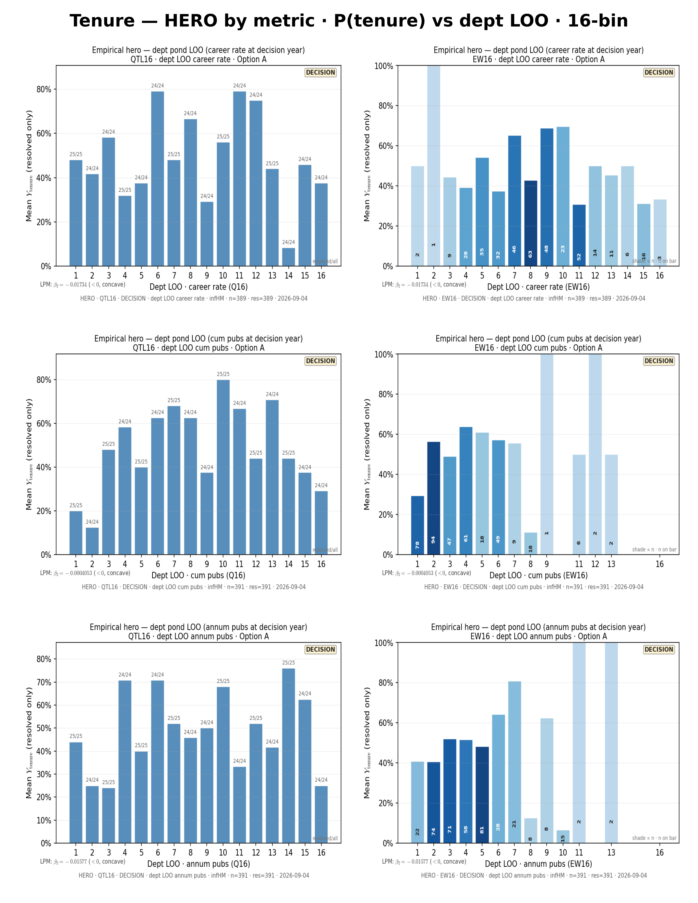
3.2 · Which performance metric?
Act III · Perf story p1
3-Master_Plan/re_entry/HEROs_and_PASSes/tenure_sandbox/data_story/TENURE_PERF_METRIC_STORY.png
OK

Slide 20
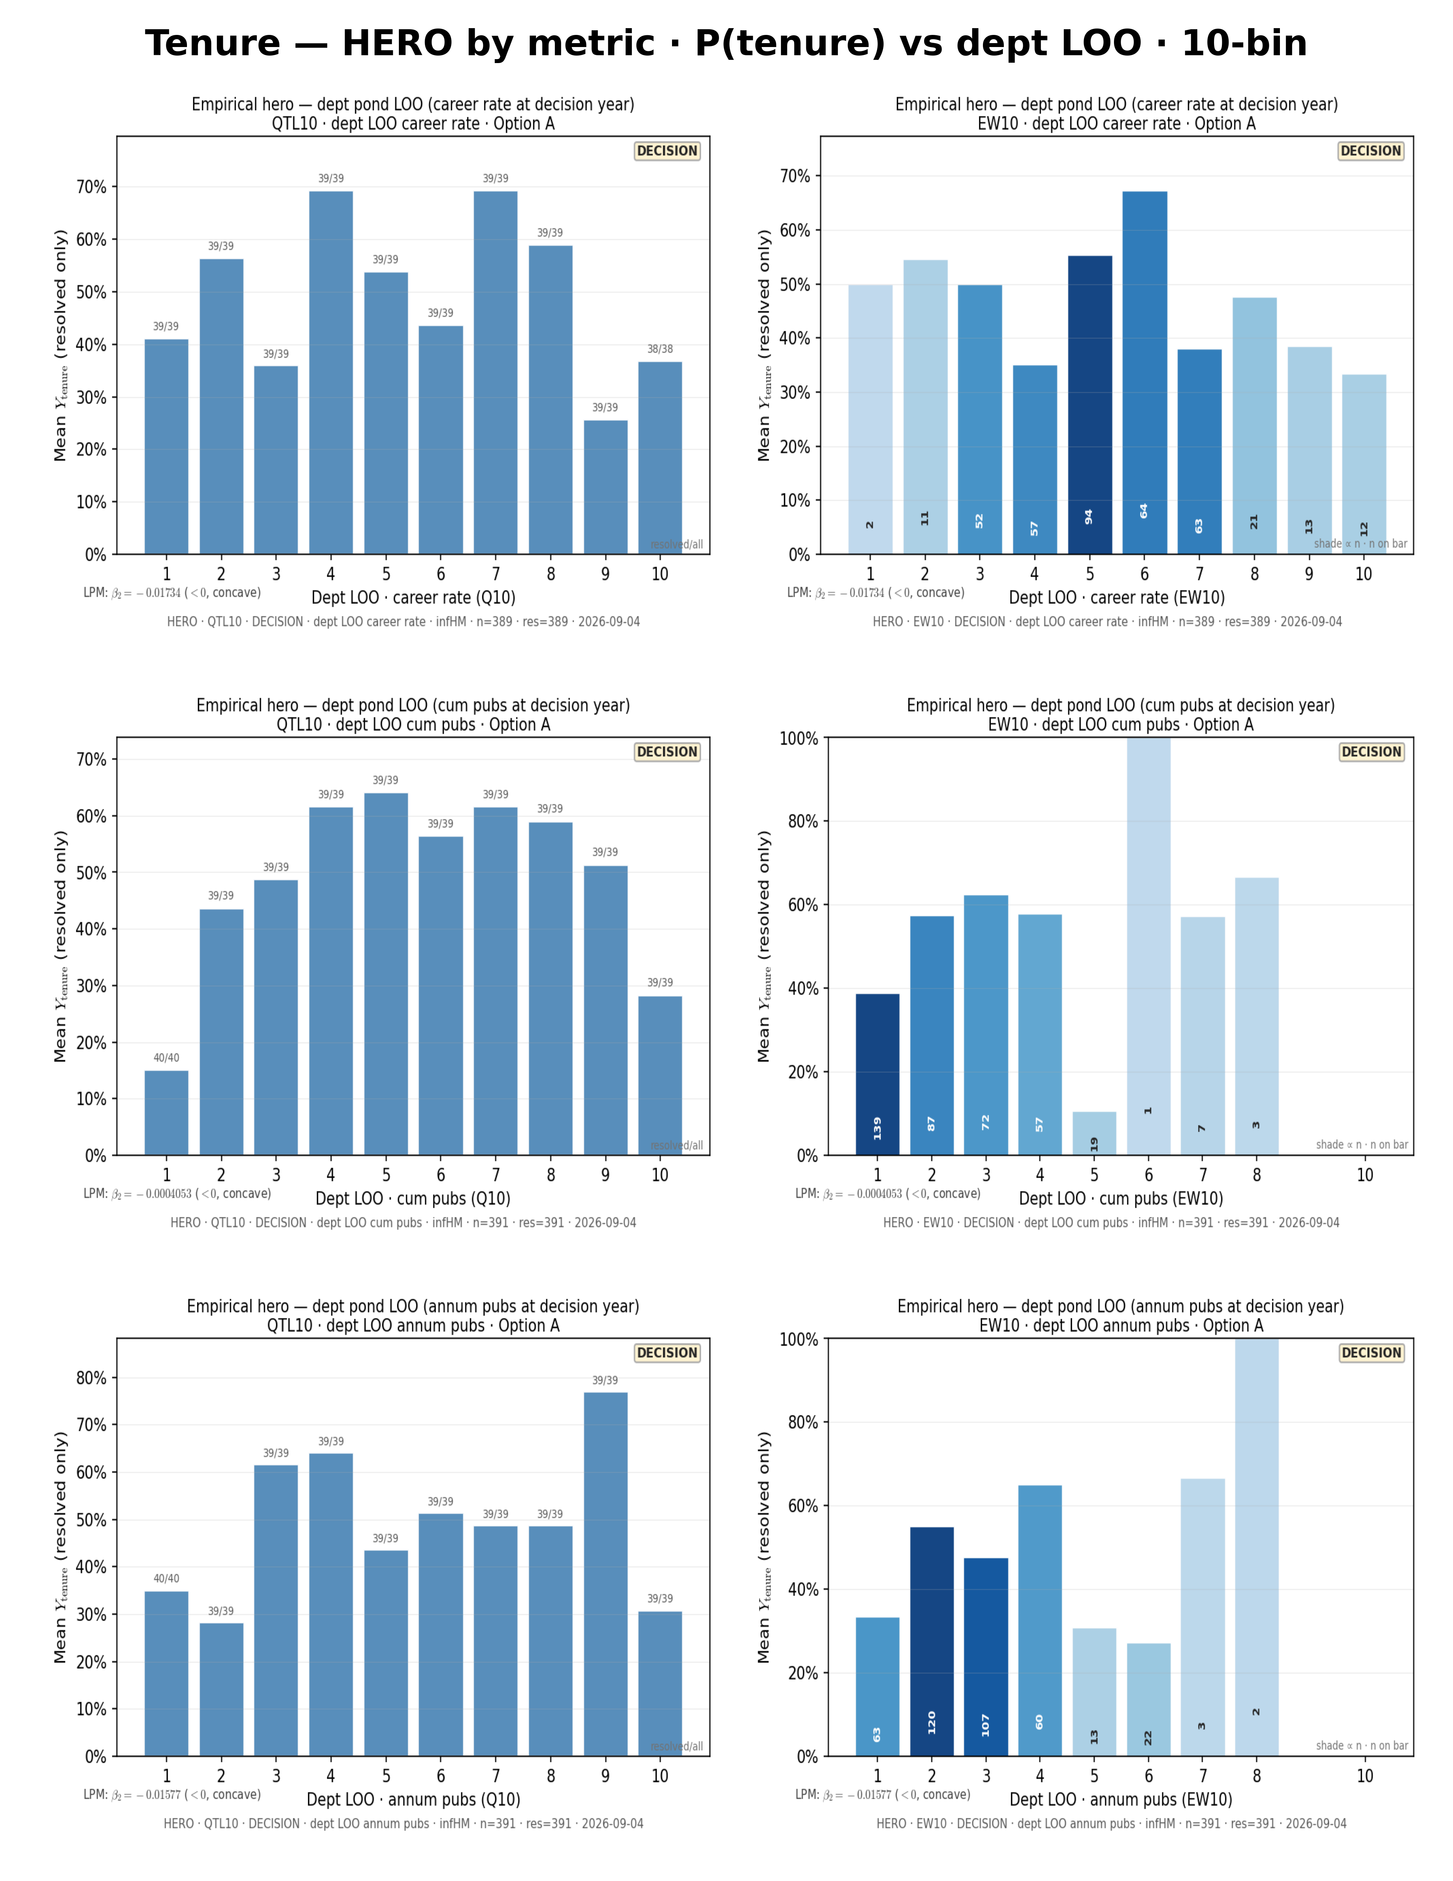
3.2b · Perf story p2
Act III · 10-bin sensitivity
3-Master_Plan/re_entry/HEROs_and_PASSes/tenure_sandbox/data_story/TENURE_PERF_METRIC_STORY_p2.png
OK

Slide 21
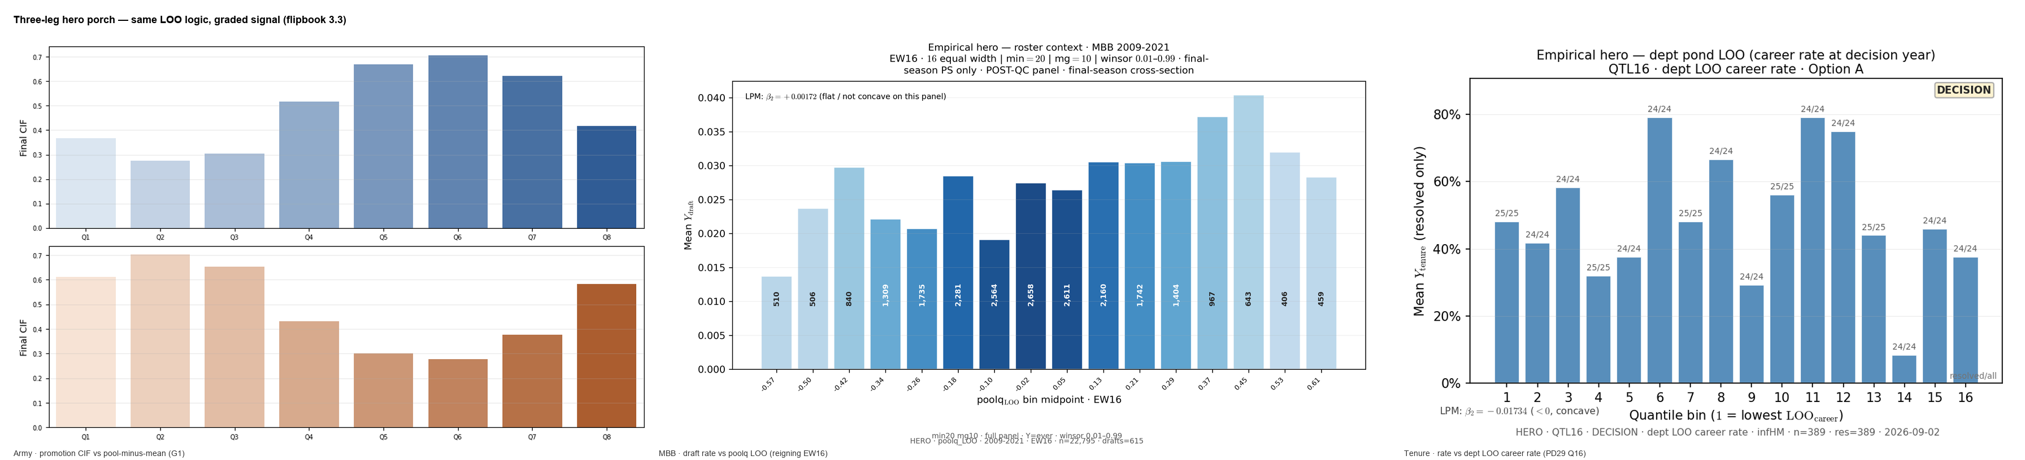
3.3 · Three-leg composite?
Act III · Army G1 + MBB + tenure heroes
3-Master_Plan/re_entry/HEROs_and_PASSes/composites/THREE_LEG_HERO_composite.png
Regen: scripts/build_three_leg_hero_composite.py
OK

Slide 22
— Act IV —

Slide 23
4.0 · Model in plain English
Act IV · Text intro before Model slide
Text-only slide — no figure file
Text slide — four-step pipeline overview.
TEXT

Slide 24
4.1 · Minimal generative story?
Act IV · Model one-slide (four steps)
PDF not embedded — open: 3-Master_Plan/re_entry/Model.pdf | Or: Model.pptx
3-Master_Plan/re_entry/Model.pdf
Also Model.pptx — Charles updated Sep 2026.
PDF

Slide 25
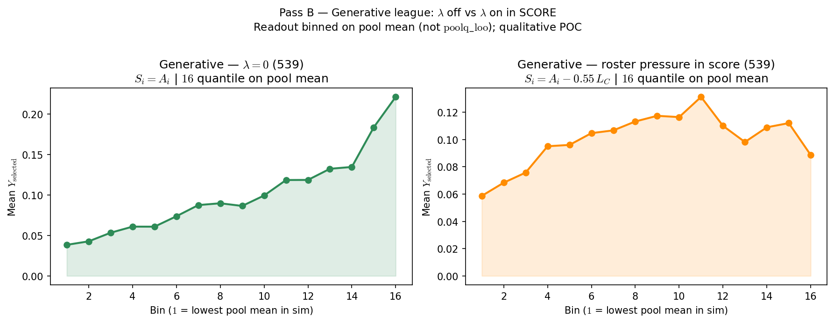
4.2 · λ knockout?
Act IV · Pass A generative sim (G2)
3-Master_Plan/re_entry/HEROs_and_PASSes/pass_b/PASS_B_generative_lambda_knockout_side_by_side.png
Repo folder pass_b/; doc 04 = Pass A.
OK

Slide 26
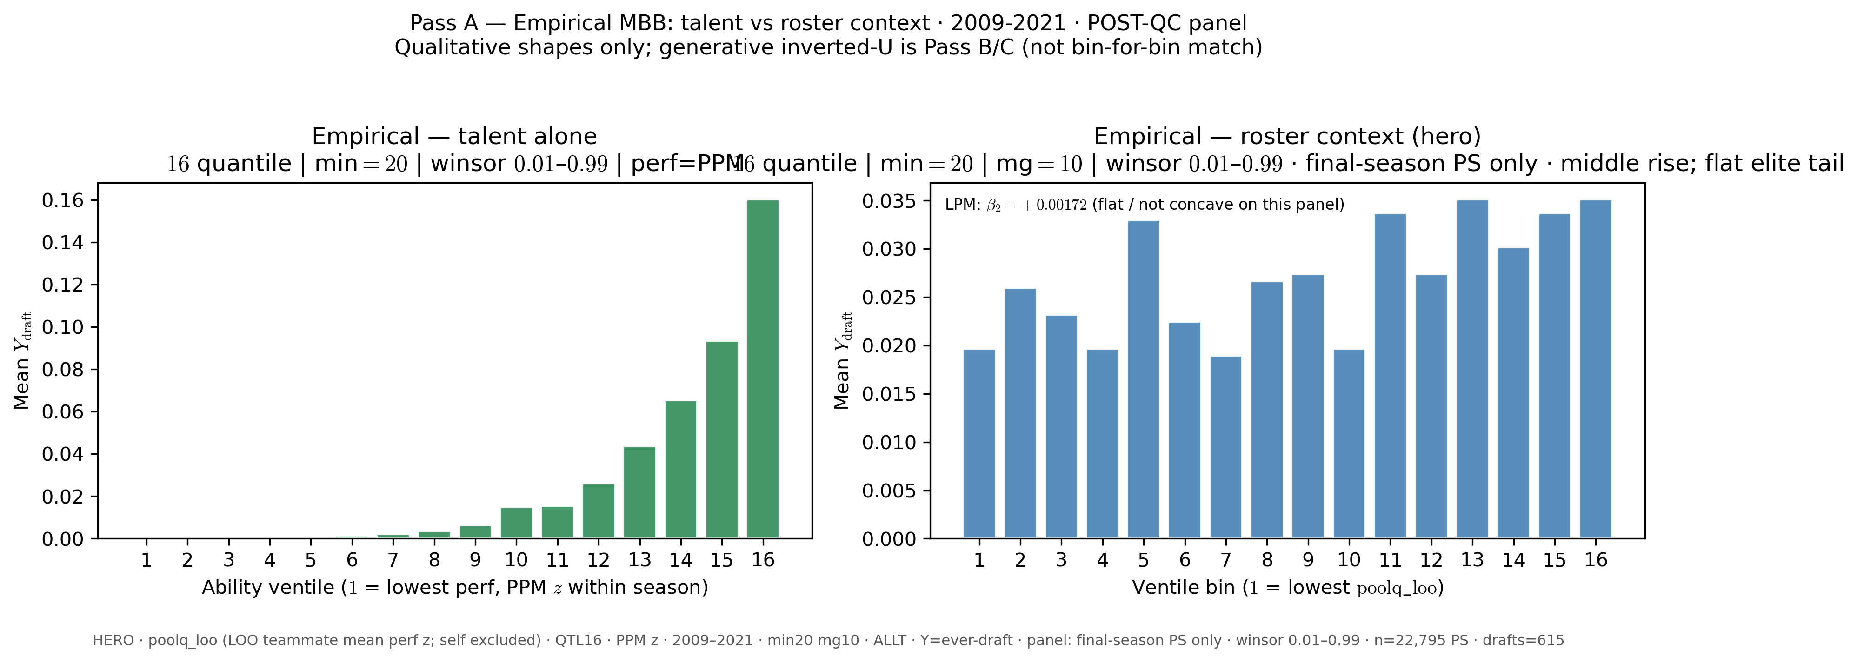
4.2b · Empirical talent vs LOO pair
Act IV · Pass A empirical (MBB)
3-Master_Plan/re_entry/HEROs_and_PASSes/pass_a/PASS_A_side_by_side_q16_allt_min20_mg10_9_21_last_ps.png
Inventory / appendix — same read as 2.2+2.3 on one slide.
OK

Slide 27
4.3 · Environment ≠ advancement?
Act IV · Binding table
Open document: 3-Master_Plan/BINDING_Selection_is_its_own_step.md
3-Master_Plan/BINDING_Selection_is_its_own_step.md
Same as slide 0.2.
TEXT

Slide 28
— Act V —

Slide 29
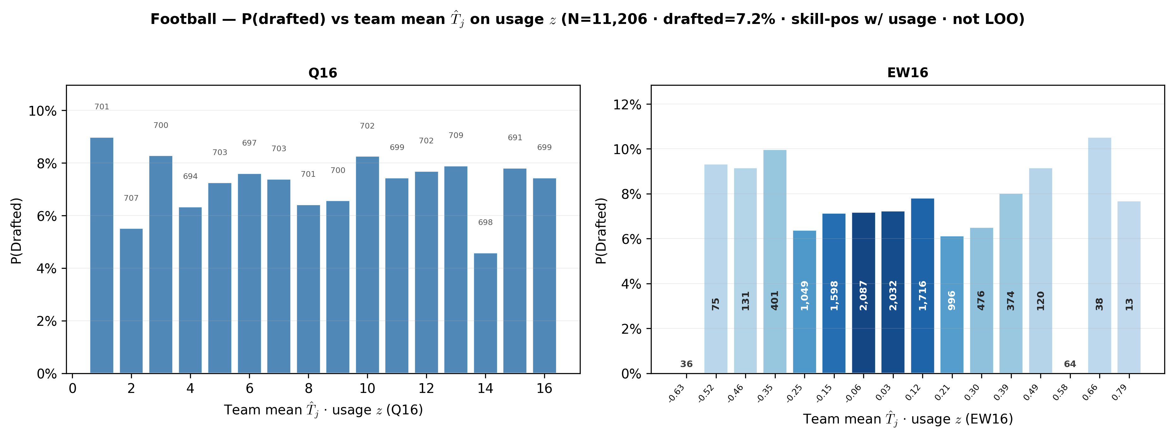
5.1 · Why LOO not team mean?
Act V · Usage T̂_j twin + usage LOO
3-Master_Plan/re_entry/HEROs_and_PASSes/football_sandbox/perf_story/FOOTBALL_usage_Tj_q16_ew16.png
Pair with usage LOO panel below.
OK

Slide 30
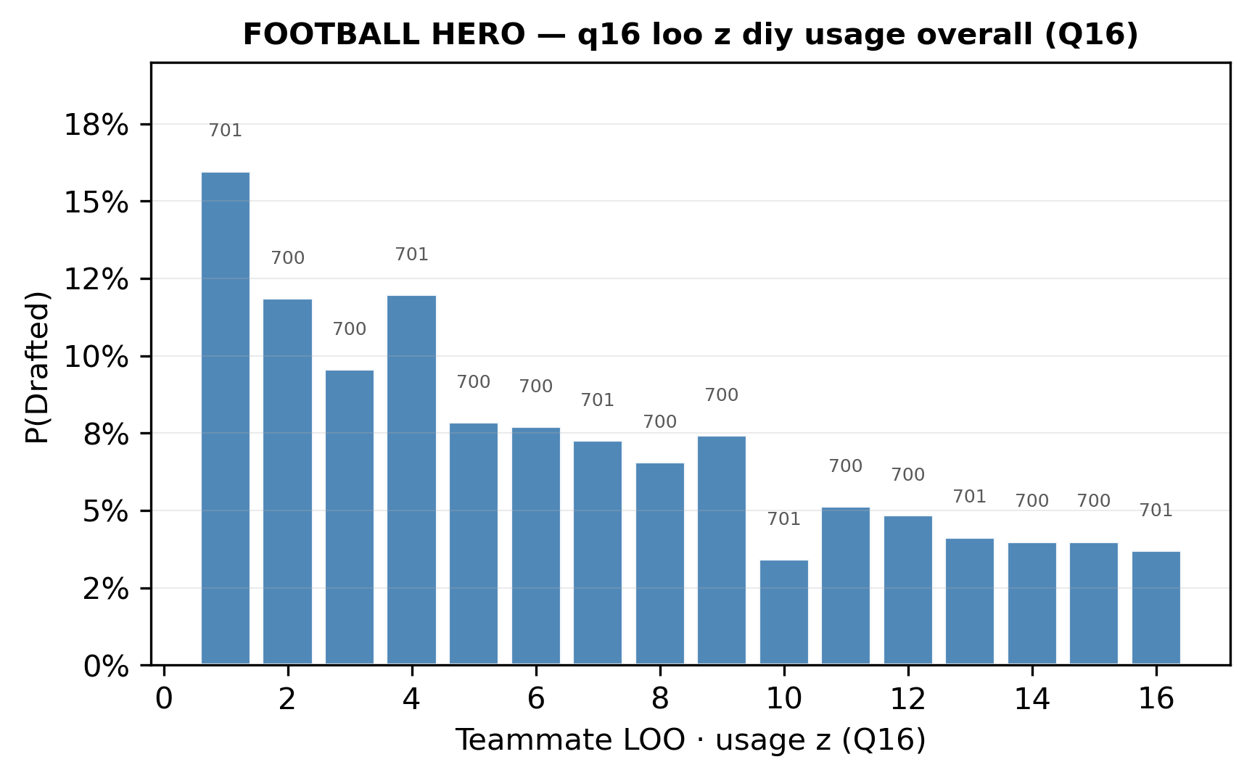
5.1b · Usage LOO panel
Act V · Perf story row 5
3-Master_Plan/re_entry/HEROs_and_PASSes/football_sandbox/perf_story/panels/HERO_football_perf_q16_loo_z_diy_usage_overall_slide.png
OK

Slide 31
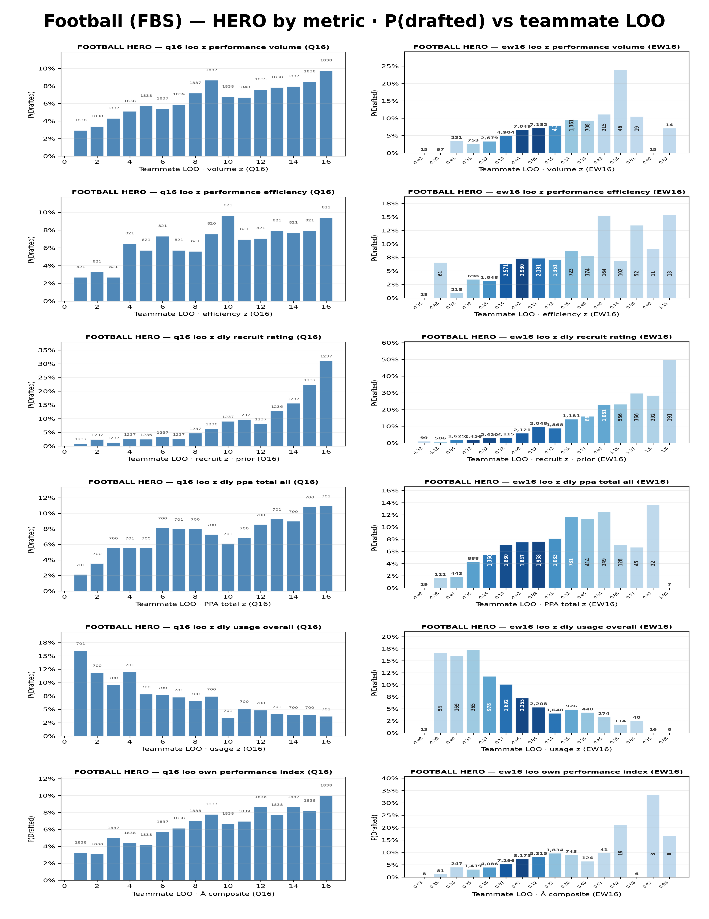
5.2 · Wrong metric, wrong story?
Act V · PPA LOO vs usage LOO
3-Master_Plan/re_entry/HEROs_and_PASSes/football_sandbox/data_story/FOOTBALL_PERF_METRIC_STORY.png
Full six-metric deck; row 4 vs 5 contrast.
OK

Slide 32
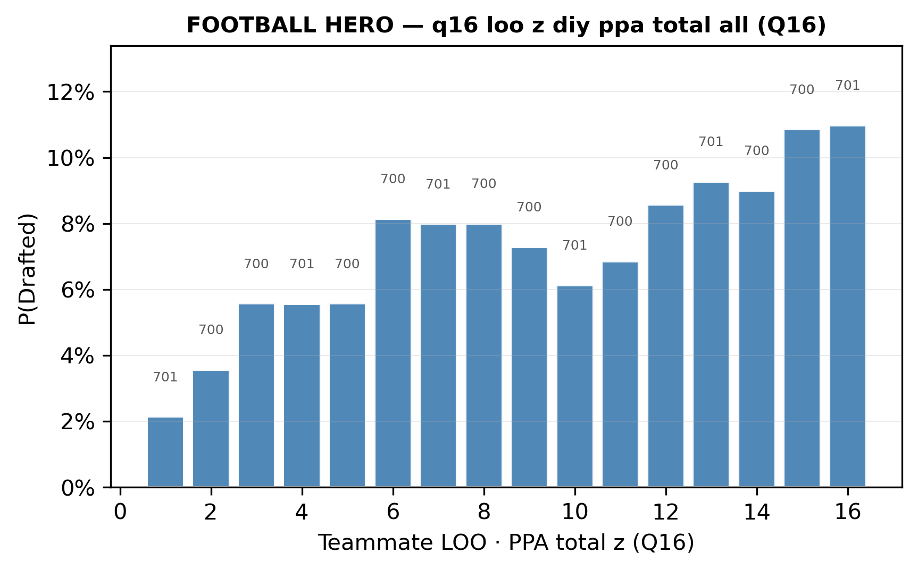
5.2b · PPA total LOO (row 4)
Act V · Talent-peer axis
3-Master_Plan/re_entry/HEROs_and_PASSes/football_sandbox/perf_story/panels/HERO_football_perf_q16_loo_z_diy_ppa_total_all_slide.png
OK

Slide 33
— Act VI —

Slide 34
6.1–6.3 · Limits & close
Act VI · Text / gap slides
Text-only slide — no figure file
No figures — see flipbook Act VI claims.
TEXT

