Slide 1
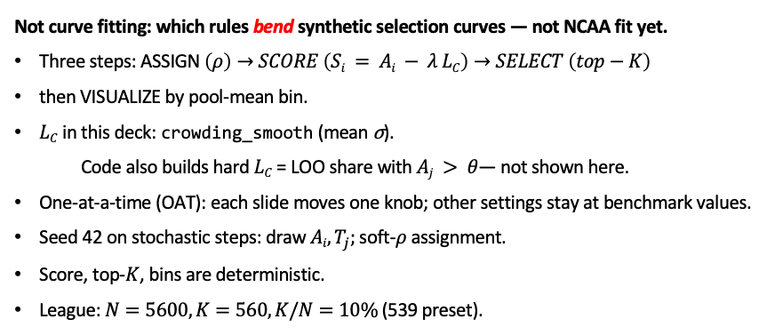
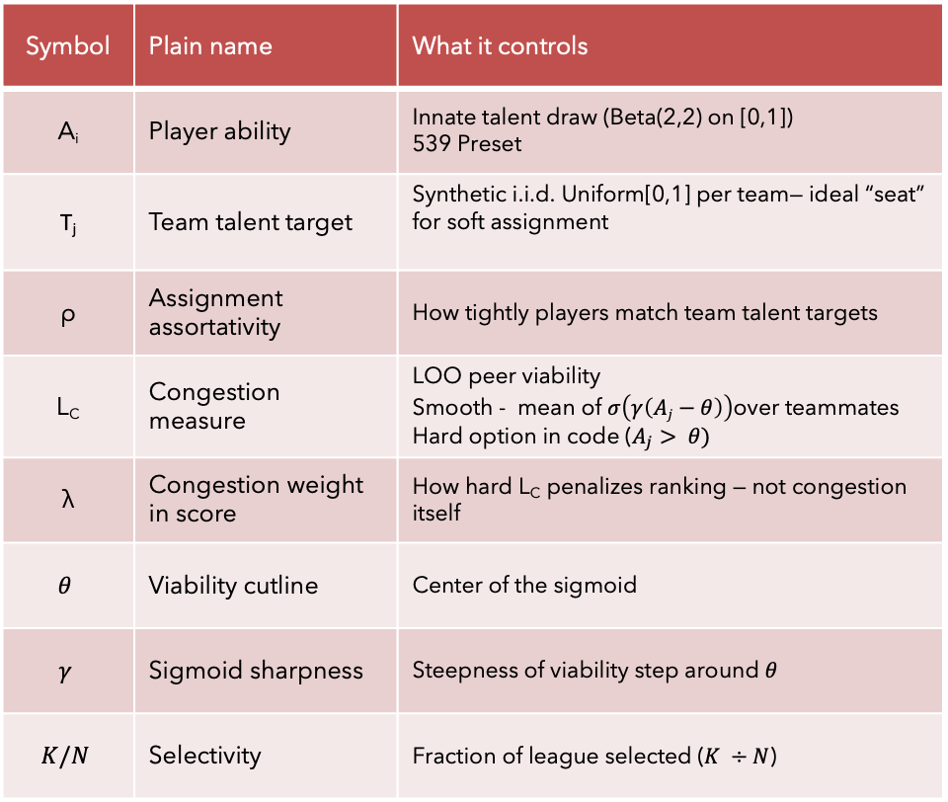
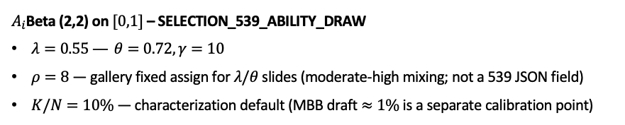
Phase B — Fake-league characterization (not curve fitting)
Knobs (mini glossary)
Not curve fitting: which rules bend synthetic selection curves — not NCAA fit yet.
Three steps: ASSIGN $\left(ρ\right)→SCORE \left(Si = Ai − λ LC\right)→SELECT \left(top−K\right)$
then VISUALIZE by pool-mean bin.
$LC$in this deck: crowding_smooth (mean σ).
Code also builds hard $LC$= LOO share with $Aj > θ$— not shown here.
One-at-a-time (OAT): each slide moves one knob; other settings stay at benchmark values.
Seed 42 on stochastic steps: draw $Ai, T_{j};$soft-$ρ$ assignment.
Score, top-$K$, bins are deterministic.
League:$N=5600, K=560, K/N=10\%$(539 preset).
Symbol | Plain name | What it controls
A_{i} | Player ability | Innate talent draw (Beta(2,2) on [0,1]) 539 Preset
T_{j} | Team talent target | Synthetic i.i.d. Uniform[0,1] per team— ideal “seat” for soft assignment
ρ | Assignment assortativity | How tightly players match team talent targets
L_{C} | Congestion measure | LOO peer viability Smooth - mean of $σ\left(γ\left(Aj−θ\right)\right)$over teammates Hard option in code ($A_{j}> θ)$
λ | Congestion weight in score | How hard L_{C} penalizes ranking — not congestion itself
$$θ$$ | Viability cutline | Center of the sigmoid
$$γ$$ | Sigmoid sharpness | Steepness of viability step around $θ$
$$K/N$$ | Selectivity | Fraction of league selected ($K ÷N$)
$A_{i}$Beta (2,2) on $[0,1]$– SELECTION_539_ABILITY_DRAW
$λ=0.55 — θ=0.72, γ=10$
$ρ=8$— gallery fixed assign for $λ\text{/}θ$ slides (moderate-high mixing; not a 539 JSON field)
$K/N=10\%$— characterization default (MBB draft $≈1\%$is a separate calibration point)
Real hero: draft rate vs poolq_loo (teammate quality, leave-one-out) — a bend at the top bins.
This deck: fraction selected vs pool mean in a fake league — same kind of question, different axis and league.
Benchmarks anchor to the Alex 539 playground track so sim slides stay comparable
We have not re-fit those numbers to NCAA data in Phase B.
Claim: Phase B maps which generative knobs move who gets selected — prerequisite before Phase C calibration to the hero.

