Slide 1
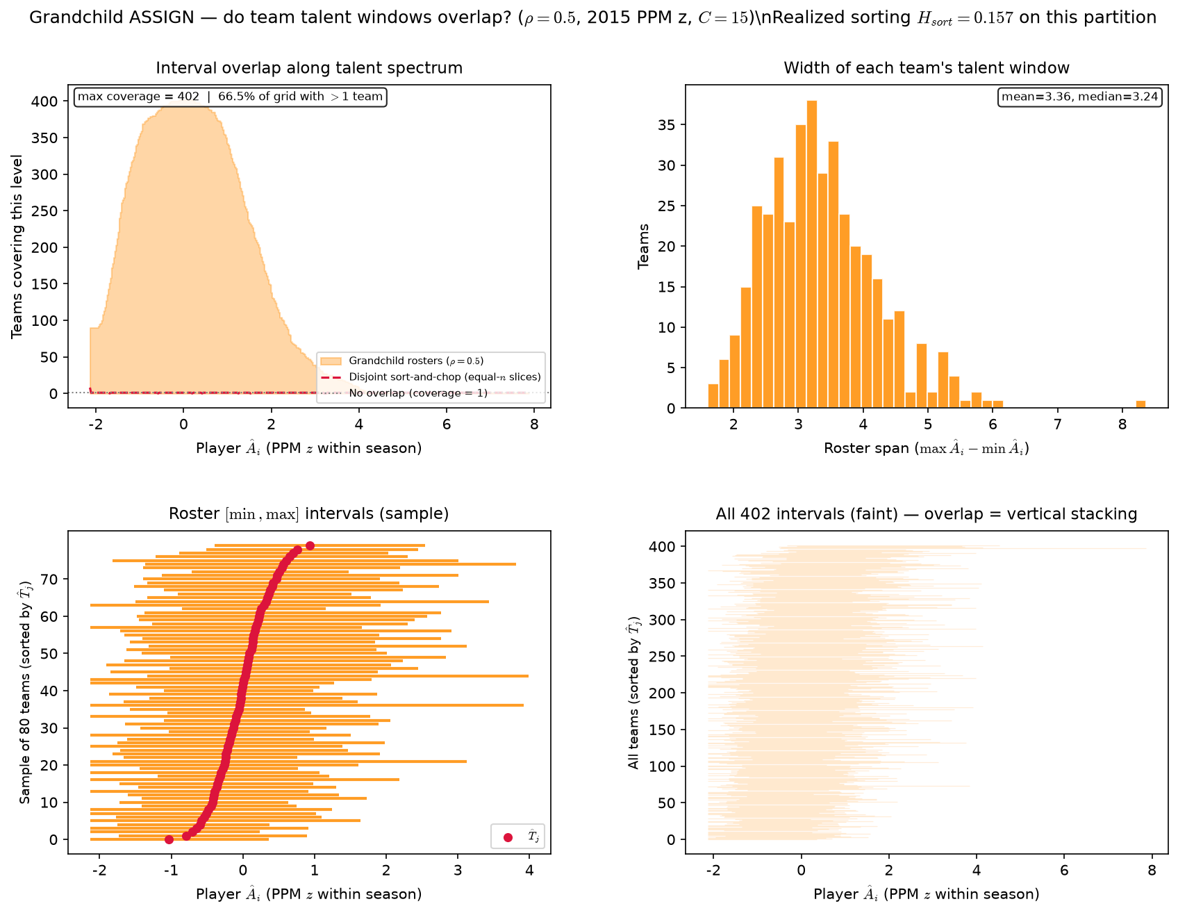
Grandchild sim — team \hat{A}_{i} interval overlap (\rho diagnostic)
2015 PPM z · Grandchild ASSIGN · N=6,030, J=402, C=15 · \rho=0.5 · 402 teams (530 CELL 8 analog) · H_{sort}=0.157
Each team: talent window [\min \hat{A}_{i}, \max \hat{A}_{i}] on PPM z.
Coverage = how many roster windows cover a point (530 CELL 8).
Grandchild ASSIGN: \rho=0.5, endogenous \mu_j — no T_{j^*}.
Red dashed: disjoint sort-and-chop on same player pool (537 B analog).
H_{sort} = 1 - \sum_i(\hat{A}_i - \hat{\mu}_{g(i)})^2 / \sum_i(\hat{A}_i - \bar{A})^2 — realized sorting on a fixed partition.
This partition: H_{sort} = 0.157 (0 = none, 1 = full team sorting).
Sim max coverage=402; sort-and-chop max=8.
66\% of grid points have >1 team covering.
Roster span: mean=3.36 z, median=3.24 z (402 teams).
HAND17 empirical ref: max coverage=6,305, span mean=2.98 z.
Centroid sd=0.396.
VECTOR lock: H_{sort} is realized sorting — not the generative homophily knob \rho.
Claim: Grandchild ASSIGN (endogenous centroids, no T_{j^*}) on 2015 PPM z — compare interval overlap and H_{sort} to HAND17 slide 3 empirical target.

