Slide 1
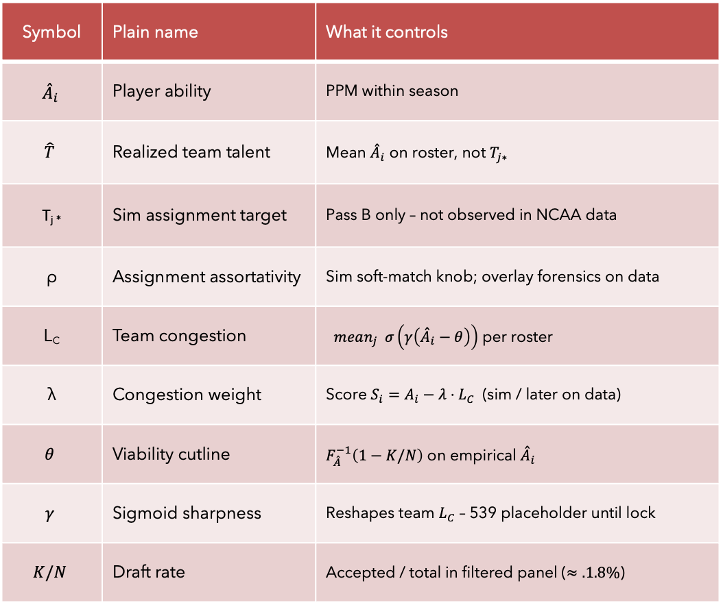

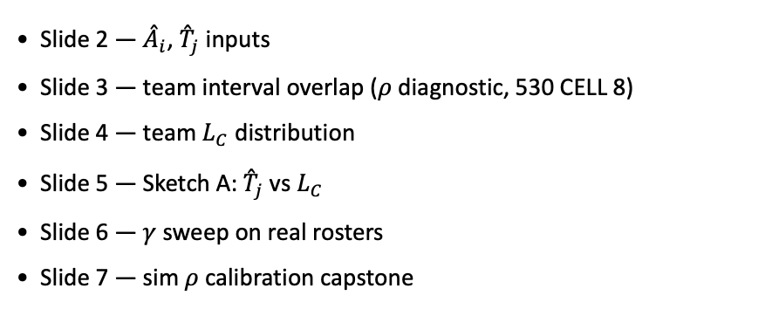
PD17 — Empirical MBB characterization
Knobs (mini glossary)
Symbol | Plain name | What it controls
$${\overset{ˆ}{A}}_{i}$$ | Player ability | PPM within season
$$\hat{T}$$ | Realized team talent | Mean ${\overset{ˆ}{A}}_{i}$ on roster, not $T_{j∗}$
T_{j *} | Sim assignment target | Pass B only – not observed in NCAA data
ρ | Assignment assortativity | Sim soft-match knob; overlay forensics on data
L_{C} | Team congestion | $mean_{j} σ\left(γ\left({\overset{ˆ}{A}}_{i}−θ\right)\right)$ per roster
λ | Congestion weight | Score $S_{i}=A_{i}−λ{⋅L}_{C}$ (sim / later on data)
$$θ$$ | Viability cutline | $F_{\overset{ˆ}{A}}^{−1}\left(1−K/N\right)$ on empirical ${\overset{ˆ}{A}}_{i}$
$$γ$$ | Sigmoid sharpness | Reshapes team $L_{C}$ – 539 placeholder until lock
$$K/N$$ | Draft rate | Accepted / total in filtered panel ($≈.1.8\%$)
Deck map (assign $→$score)
Slide 2 — ${\overset{ˆ}{A}}_{i}$, ${\overset{ˆ}{T}}_{j}$ inputs
Slide 3 — team interval overlap ($ρ$ diagnostic, 530 CELL 8)
Slide 4 — team $L_{C}$ distribution
Slide 5 — Sketch A: ${\overset{ˆ}{T}}_{j}$ vs $L_{C}$
Slide 6 — $γ$ sweep on real rosters
Slide 7 — sim $ρ$ calibration capstone
Claim (PD17): Map empirical properties of real rosters — prerequisite for pinning $ρ$ and $θ$ from data, then $γ$ and $λ$ without hero-curve matching.

Slide 2
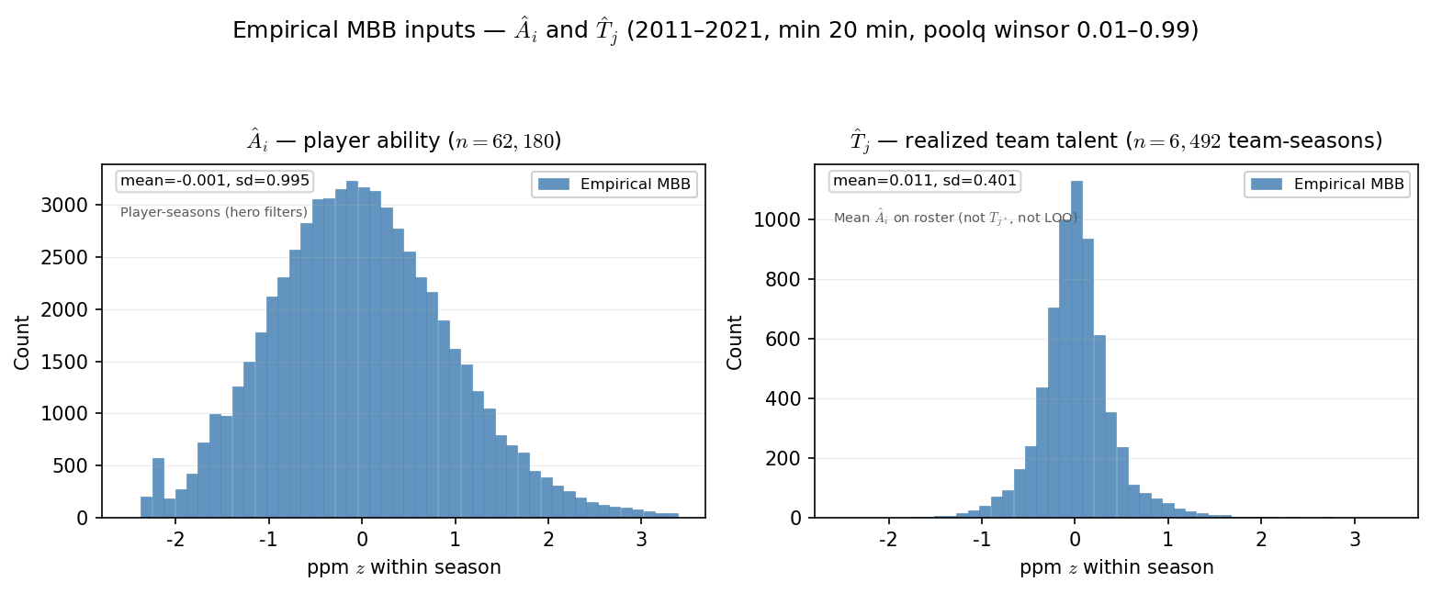

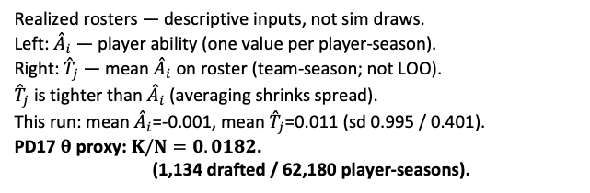
PD17 — Empirical MBB inputs: ${\overset{ˆ}{A}}_{i}$ and ${\overset{ˆ}{T}}_{j}$
MBB 2011-2021 · ppm z within season · min 20 min · poolq winsor 0.01–0.99
Realized rosters — descriptive inputs, not sim draws.
Left: ${\overset{ˆ}{A}}_{i}$ — player ability (one value per player-season).
Right: ${\overset{ˆ}{T}}_{j}$ — mean ${\overset{ˆ}{A}}_{i}$ on roster (team-season; not LOO).
${\overset{ˆ}{T}}_{j}$ is tighter than ${\overset{ˆ}{A}}_{i}$ (averaging shrinks spread).
This run: mean ${\overset{ˆ}{A}}_{i}$=-0.001, mean ${\overset{ˆ}{T}}_{j}$=0.011 (sd 0.995 / 0.401).
PD17 $θ$ proxy: $K/N=0.0182$.
(1,134 drafted / 62,180 player-seasons).
Claim (PD17): World-first inputs from the real MBB panel — ${\overset{ˆ}{A}}_{i}$ per player-season and ${\overset{ˆ}{T}}_{j}$ per team-season. Not $T_{j^{∗}}$(sim assignment targets).

Slide 3
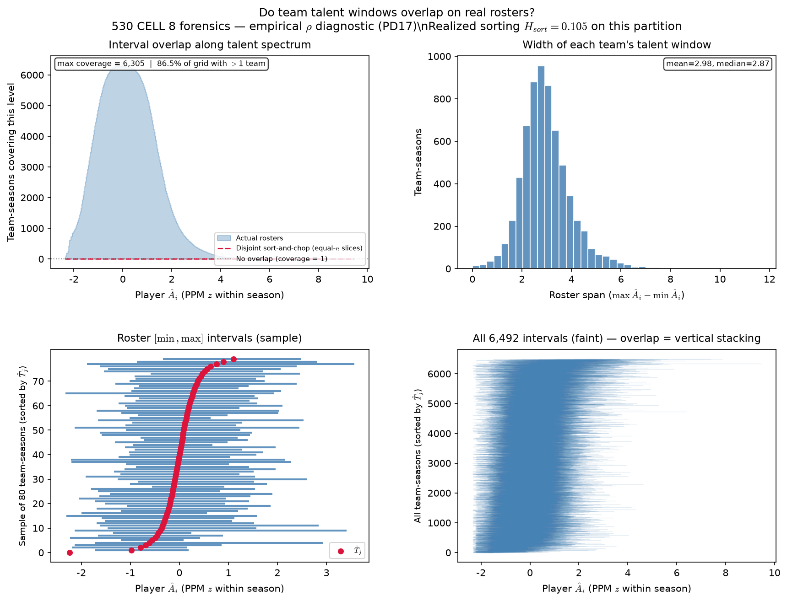
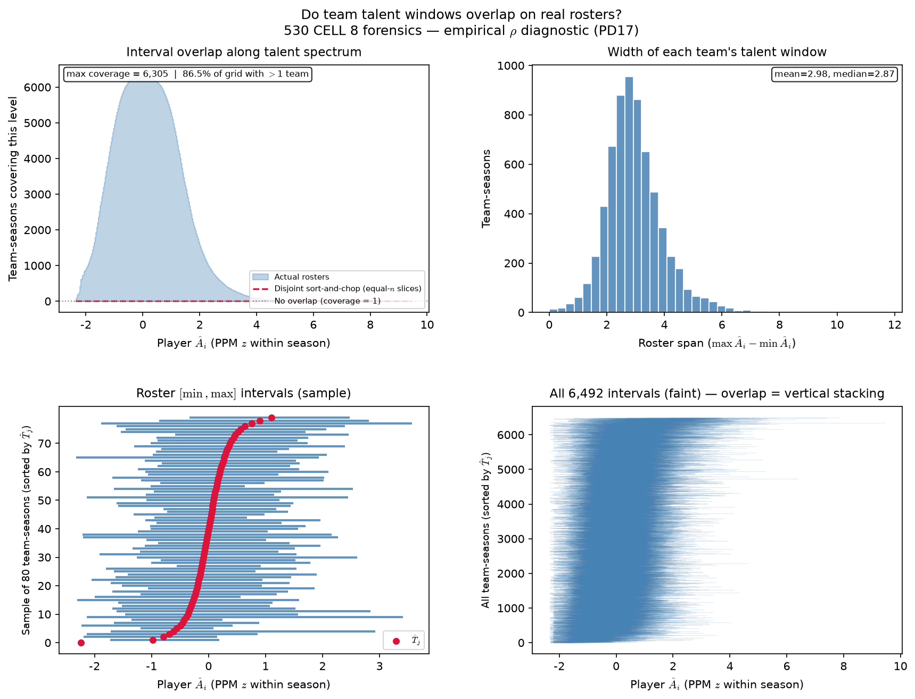

PD17 — Empirical team ${\overset{ˆ}{A}}_{i}$ interval overlap ($ρ$ diagnostic)
PD17 — Empirical team \hat{A}_{i} interval overlap (\rho diagnostic)
MBB 2011–2021 · PPM z · 6,492 team-seasons · H_{sort}=0.105
Each team-season: talent window [$\min{{\overset{ˆ}{A}}_{i}},\max{{\overset{ˆ}{A}}_{i}}$] on PPM z.
Coverage = how many windows cover a point on the spectrum (530 CELL 8).
Red dashed: disjoint sort-and-chop on same player-seasons (537 B analog).
Actual max coverage=6,305; sort-and-chop max=7.
$86\%$ of grid points have $>1$ team covering.
Roster span: mean=2.98 z, median=2.87 z (6,492 team-seasons).
Pairs with Phase B $ρ$ slide — sim $ρ$ dials overlap between these curves.
Each team-season: talent window [\min \hat{A}_{i}, \max \hat{A}_{i}] on PPM z.
Coverage = how many windows cover a point on the spectrum (530 CELL 8).
H_{sort} = 1 - \sum_i(\hat{A}_i - \hat{\mu}_{g(i)})^2 / \sum_i(\hat{A}_i - \bar{A})^2 — realized sorting on a fixed partition.
Empirical partition: H_{sort} = 0.105 (0 = none, 1 = full team sorting).
Max coverage=6,305; sort-and-chop max=7.
Roster span: mean=2.98 z (6,492 team-seasons).
VECTOR lock: H_{sort} is realized sorting — not the generative homophily knob \rho.
Claim (PD17): Real NCAA rosters leave massively overlapping team talent windows — compare H_{sort} on this partition to Grandchild sim (slide 4).
Claim (PD17): Real NCAA rosters leave massively overlapping team talent windows — the empirical target $ρ$ was meant to match in sim (530 CELL 8 / 538 Plot A).

Slide 4
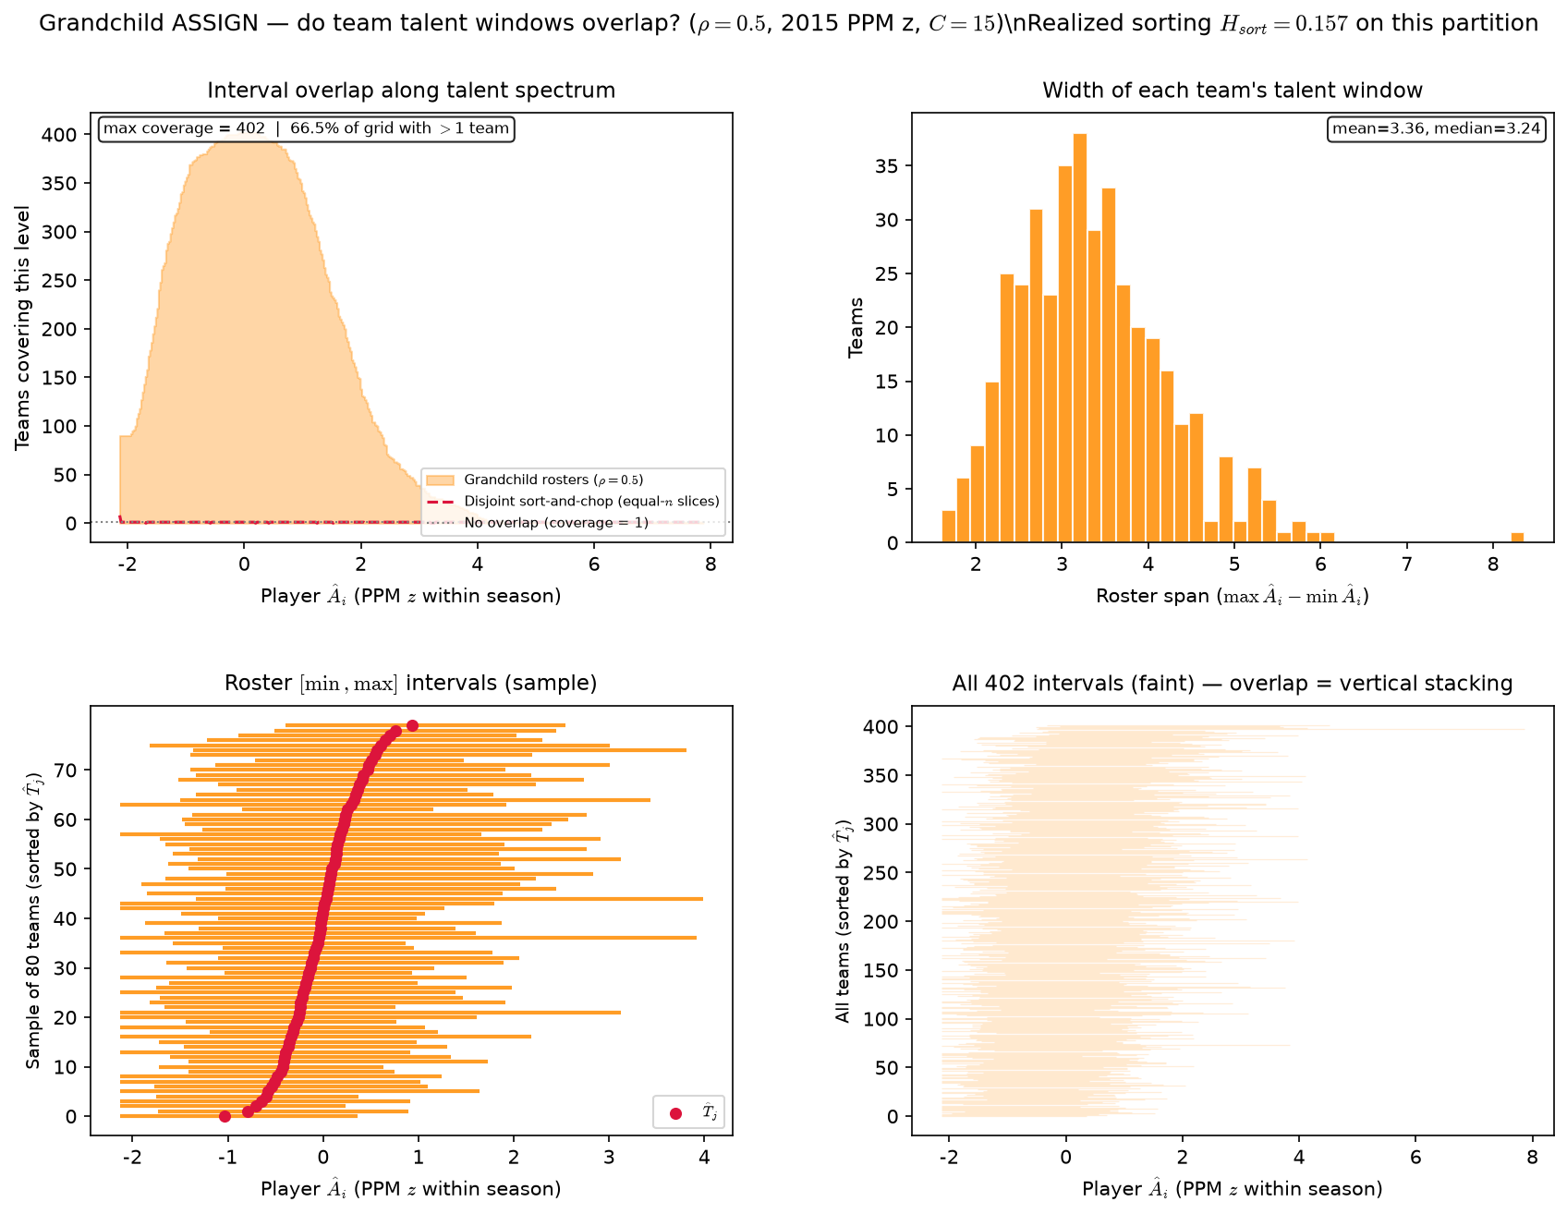

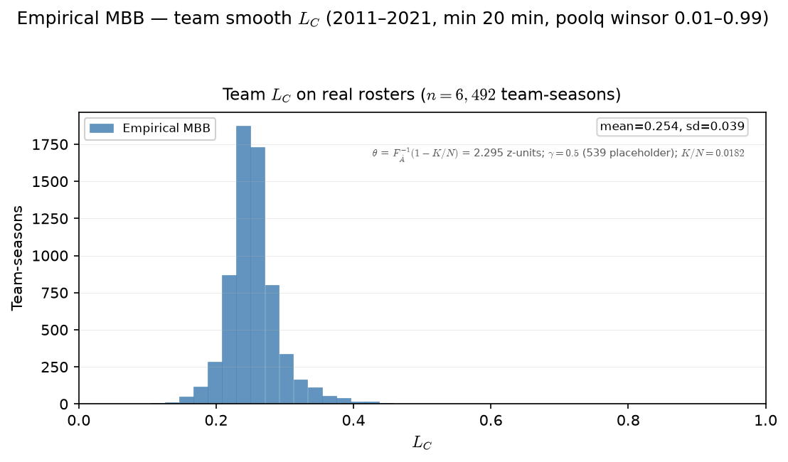
PD17 — Empirical team $L_{C}$ distribution
Given overlapping talent windows (prior slide), team $L_{C}$ summarizes peer viability on each roster.
Grandchild sim — team \hat{A}_{i} interval overlap (\rho diagnostic)
2015 PPM z · Grandchild ASSIGN · \rho=0.5 · H_{sort}=0.157 · 402 teams
MBB 2011-2021 · team smooth $L_{C}$ · PPM z within season · min 20 min · $θ=F_{\overset{ˆ}{A}}^{−1}\left(1−K/N\right)=2.295 \left(K/N=0.0182\right)$· $γ=0.5$ placeholder
Team $L_{C}=mean_{j} σ\left(γ\left({\overset{ˆ}{A}}_{j}−θ\right)\right)$ on each roster.
Same PD16 team-smooth definition — one value per team-season.
Not LOO; includes every roster member in the mean.
$γ=0.5$ (539 placeholder until PD17 $γ$ / $λ$ calibration).
This run: mean $L_{C}=0.254$, sd$=0.039$ ($6,492$ team-seasons).
$θ$ from draft rate: $K/N=0.0182⇒θ=2.295$ on ${\overset{ˆ}{A}}_{i}$.
Grandchild one-shot league: 2015 PPM z abilities, C=15, J=402.
ASSIGN: \rho=0.5, endogenous \mu_j — no T_{j^*} draw.
H_{sort} = 1 - \sum_i(\hat{A}_i - \hat{\mu}_{g(i)})^2 / \sum_i(\hat{A}_i - \bar{A})^2 — realized sorting on a fixed partition.
Grandchild partition: H_{sort} = 0.157 (0 = none, 1 = full team sorting).
Max coverage=402; sort-and-chop max=8.
Roster span: mean=3.36 z (402 teams).
VECTOR lock: H_{sort} is realized sorting — not the generative homophily knob \rho.
Claim: Grandchild ASSIGN (_x000D_ho-only, endogenous centroids) on 2015 PPM z — compare interval overlap and H_{sort} to empirical slide 3.
Claim (PD17): Real rosters carry a spread of team congestion $L_{C}$ — the descriptive input before we pin $ρ$ and $γ$ in sim.

Slide 5
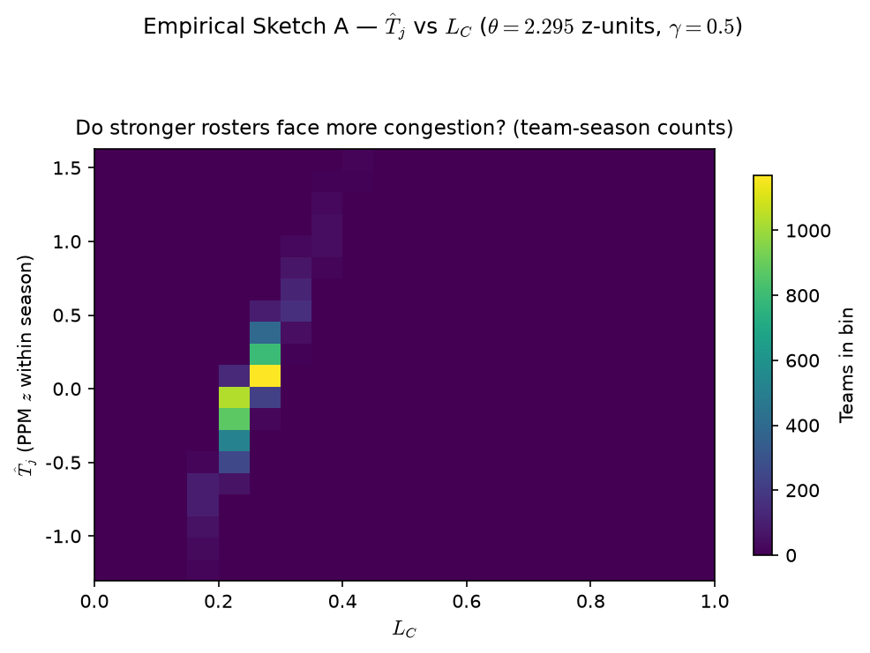

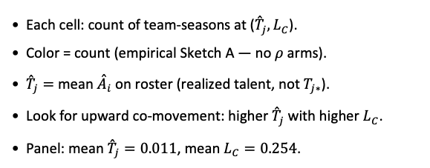
PD17 — Empirical Sketch A: ${\overset{ˆ}{T}}_{j}$ vs $L_{C}$
MBB 2011-2021 · team smooth $L_{C}$ · PPM z within season · min 20 min · $θ=F_{\overset{ˆ}{A}}^{−1}\left(1−K/N\right)=2.295. \left(K/N=0.0182\right)$ ·$γ=0.5$placeholder
Each cell: count of team-seasons at (${\overset{ˆ}{T}}_{j},L_{C}$).
Color = count (empirical Sketch A — no $ρ$ arms).
${\overset{ˆ}{T}}_{j}=$ mean ${\overset{ˆ}{A}}_{i}$ on roster (realized talent, not $T_{j∗}$).
Look for upward co-movement: higher ${\overset{ˆ}{T}}_{j}$ with higher $L_{C}$.
Panel: mean ${\overset{ˆ}{T}}_{j}=0.011$, mean $L_{C}=0.254$.
Claim (PD17): On actual team-seasons, stronger realized rosters (${\overset{ˆ}{T}}_{j}$) tend to co-occur with higher $L_{C}$ — empirical Sketch A.

Slide 6
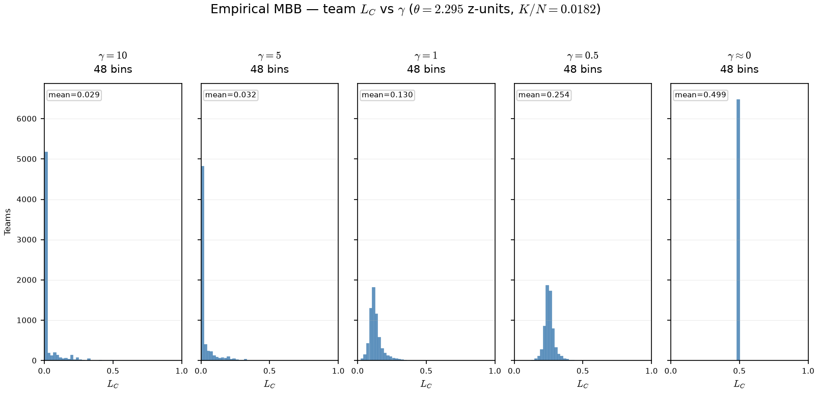

PD17 — Empirical $γ$ sweep: team $L_{C}$ on real rosters
MBB 2011-2021 · team smooth $L_{C}$ · PPM z · min 20 min · $θ=2.295$ z-units ($K/N=0.0182$) fixed across $γ$ arms
OAT on real panel: fixed $θ$ ($K/N$ cutline on PPM z); only $γ$ in $σ\left(γ\left(\overset{ˆ}{A}−θ\right)\right)$ changes.
Arms: $γ∈\left\{10,5,1,0.5,0.001\right\}$ — same team-seasons, same rosters.
At $γ=10$: mean $L_{C}=0.029, 84\%$ teams below $0.05$.
At $γ≈0$: mean $L_{C}=0.499$, max $L_{C}=0.500$ — spread opens on z-scale.
Claim (PD17): On real rosters, γ reshapes team $L_{C}$ — high γ compresses viability near 0 on the PPM-z scale; low γ spreads $L_{C}$ into the interior of [0,1].

Slide 7
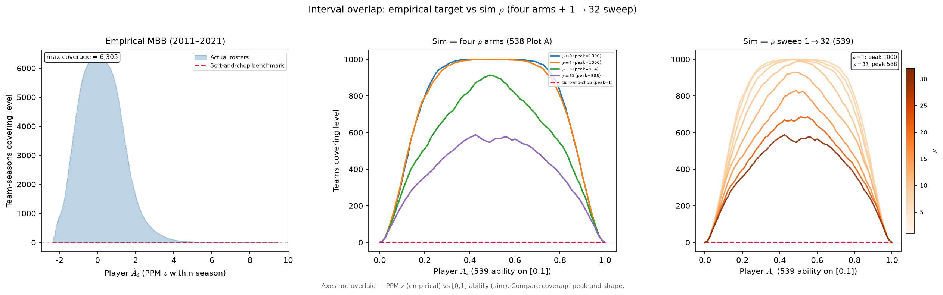
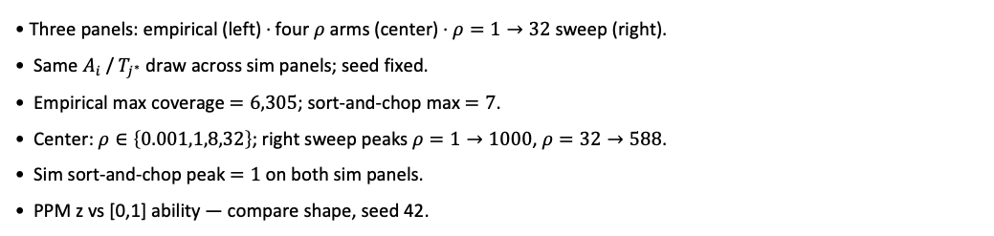
PD17 — Empirical vs sim interval overlap (\rho calibration target)
Assign block capstone · empirical MBB vs 539 sim · same coverage diagnostic
Three panels: empirical (left) · four $ρ$ arms (center) · $ρ=1→32$ sweep (right).
Same $A_{i}$ / $T_{j^{∗}}$ draw across sim panels; seed fixed.
Empirical max coverage $=6,305$; sort-and-chop max $=7$.
Center: $ρ∈\left\{0.001,1,8,32\right\}$; right sweep peaks $ρ=1→1000$, $ρ=32→588$.
Sim sort-and-chop peak $=1$ on both sim panels.
PPM z vs [0,1] ability — compare shape, seed 42.
Claim (PD17): Real rosters sit at high coverage peak — sim $ρ$ must be tuned so soft assign matches that overlap, not sort-and-chop.

