Slide 1
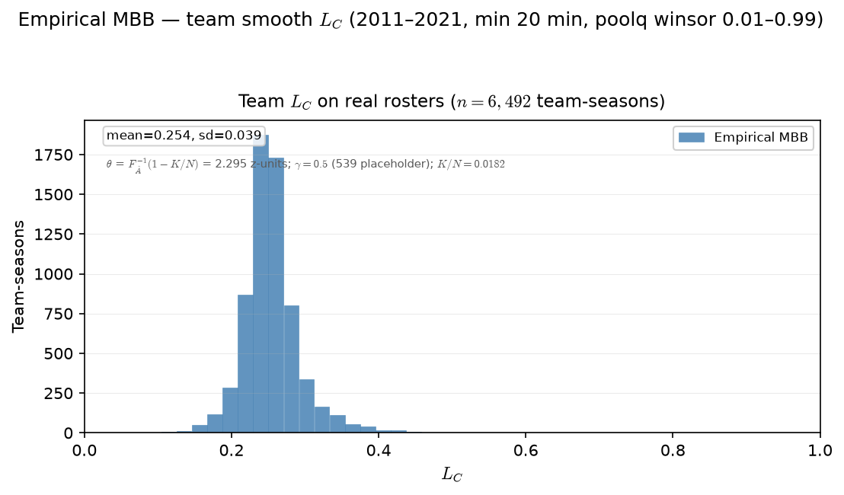

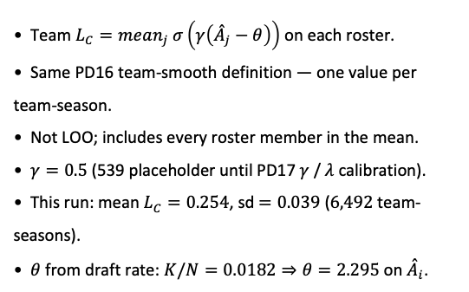
PD17 — Empirical team $L_{C}$ distribution
MBB 2011-2021 · team smooth $L_{C}$ · PPM z within season · min 20 min · $θ=F_{\overset{ˆ}{A}}^{−1}\left(1−K/N\right)=2.295 \left(K/N=0.0182\right)$· $γ=0.5$ placeholder
Team $L_{C}=mean_{j} σ\left(γ\left({\overset{ˆ}{A}}_{j}−θ\right)\right)$ on each roster.
Same PD16 team-smooth definition — one value per team-season.
Not LOO; includes every roster member in the mean.
$γ=0.5$ (539 placeholder until PD17 $γ$ / $λ$ calibration).
This run: mean $L_{C}=0.254$, sd$=0.039$ ($6,492$ team-seasons).
$θ$ from draft rate: $K/N=0.0182⇒θ=2.295$ on ${\overset{ˆ}{A}}_{i}$.
Claim (PD17): Real rosters carry a spread of team congestion $L_{C}$ — the descriptive input $ρ$ was meant to stratify in sim.

Slide 2
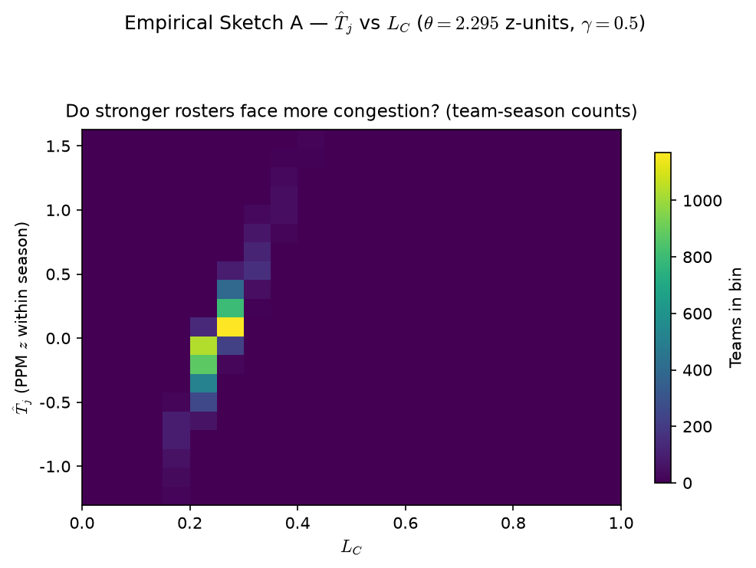

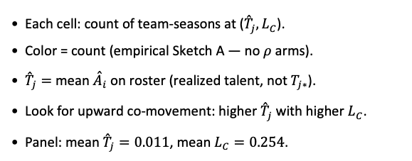
PD17 — Empirical Sketch A: ${\overset{ˆ}{T}}_{j}$ vs $L_{C}$
MBB 2011-2021 · team smooth $L_{C}$ · PPM z within season · min 20 min · $θ=F_{\overset{ˆ}{A}}^{−1}\left(1−K/N\right)=2.295. \left(K/N=0.0182\right)$ ·$γ=0.5$placeholder
Each cell: count of team-seasons at (${\overset{ˆ}{T}}_{j},L_{C}$).
Color = count (empirical Sketch A — no $ρ$ arms).
${\overset{ˆ}{T}}_{j}=$ mean ${\overset{ˆ}{A}}_{i}$ on roster (realized talent, not $T_{j∗}$).
Look for upward co-movement: higher ${\overset{ˆ}{T}}_{j}$ with higher $L_{C}$.
Panel: mean ${\overset{ˆ}{T}}_{j}=0.011$, mean $L_{C}=0.254$.
Claim (PD17): On actual team-seasons, stronger realized rosters (${\overset{ˆ}{T}}_{j}$) tend to co-occur with higher $L_{C}$ — empirical Sketch A.

