Slide 1
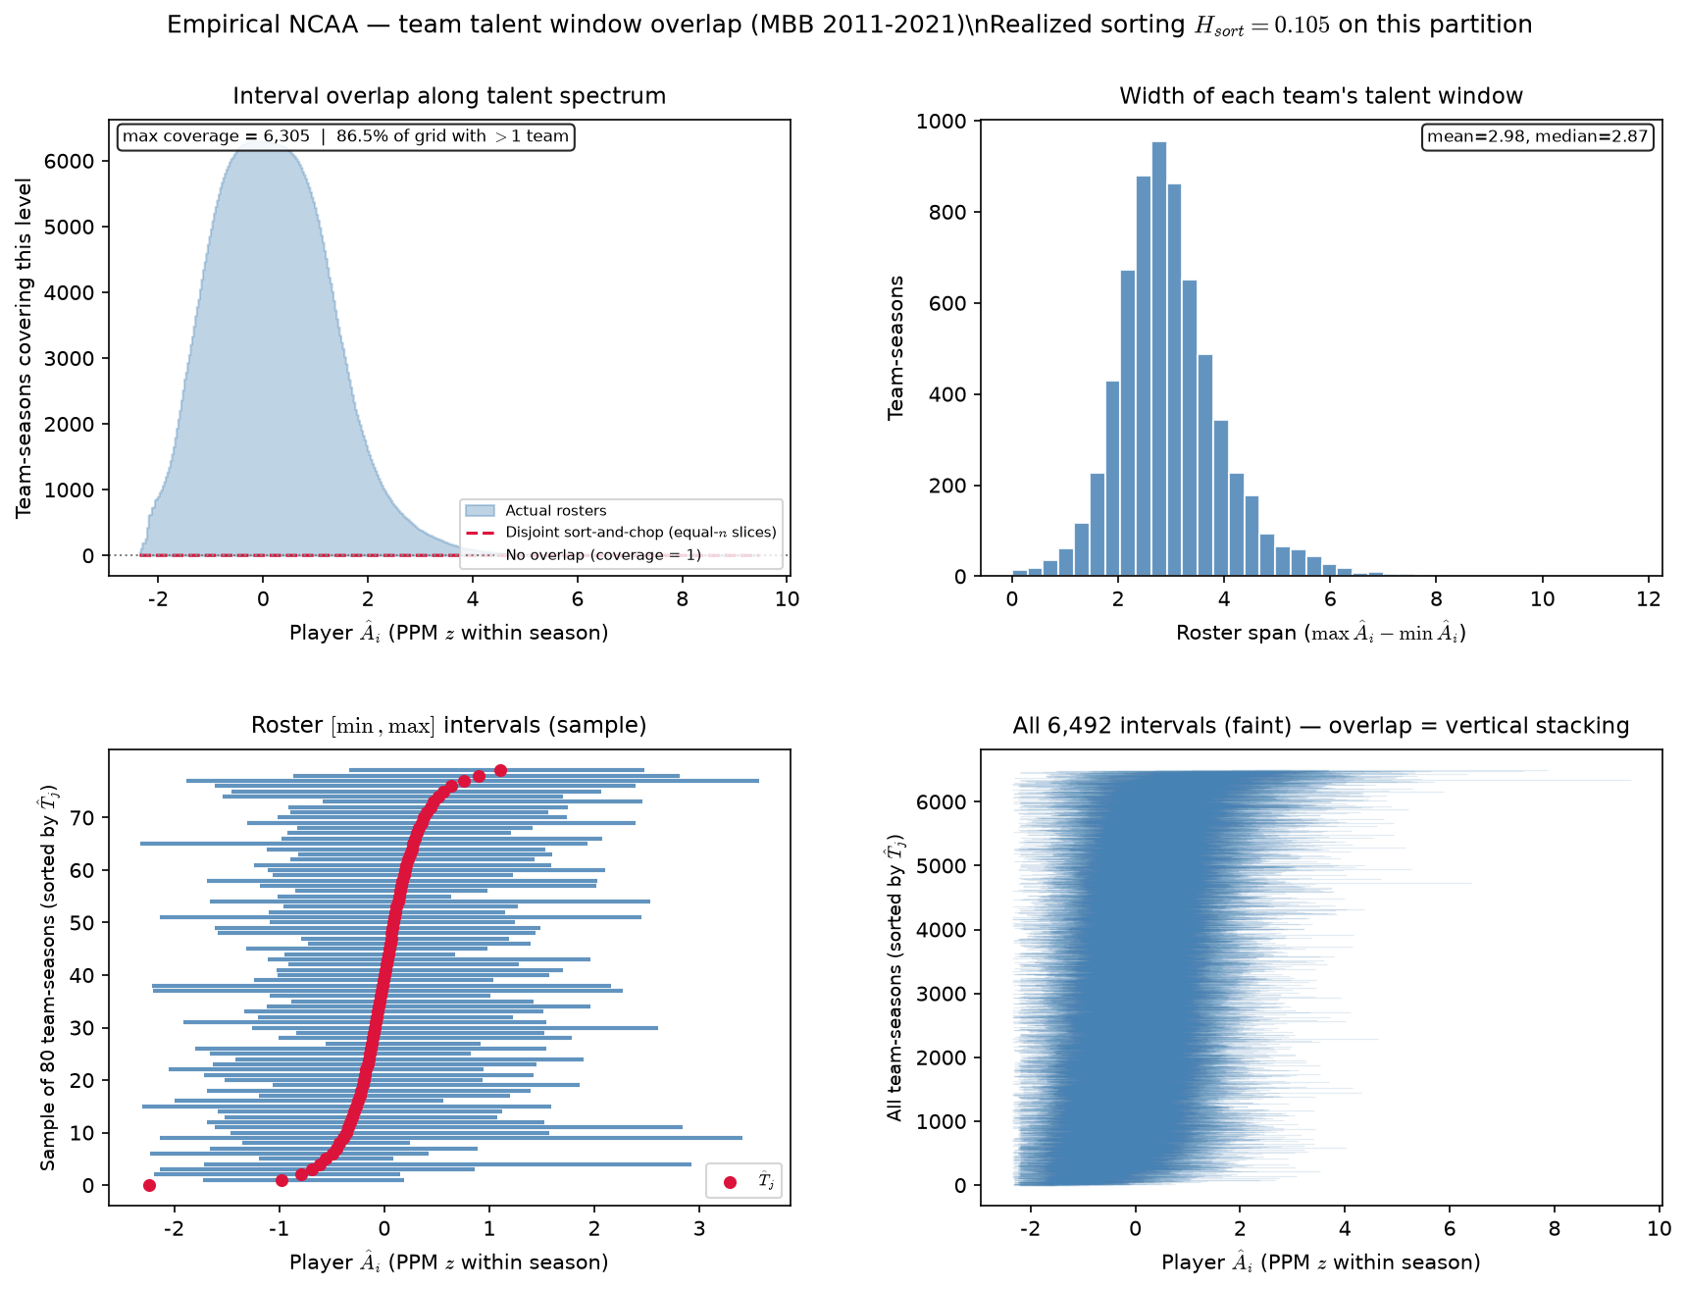
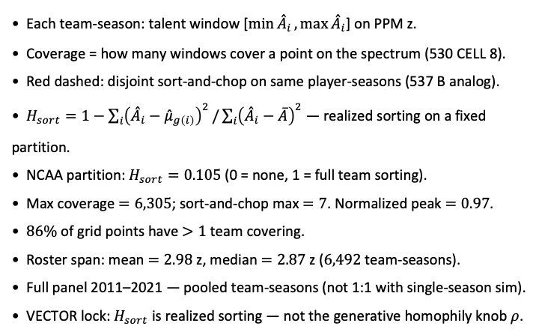
PD17 — Empirical team ${\overset{ˆ}{A}}_{i}$ interval overlap ($ρ$ diagnostic)
MBB 2011-2021 · PPM z within season · min 20 min · poolq winsor $0.01–0.99$ · $6,492$ team-seasons (530 CELL 8 port) · $H_{sort}=0.105$
Each team-season: talent window [$\min{{\overset{ˆ}{A}}_{i}},\max{{\overset{ˆ}{A}}_{i}}$] on PPM z.
Coverage = how many windows cover a point on the spectrum (530 CELL 8).
Red dashed: disjoint sort-and-chop on same player-seasons (537 B analog).
$H_{sort}=1−\sum_{i}{{\left({\overset{ˆ}{A}}_{i}−{\overset{ˆ}{μ}}_{g\left(i\right)}\right)}^{2}}/\sum_{i}{{\left({\overset{ˆ}{A}}_{i}−\overline{A}\right)}^{2}}$ — realized sorting on a fixed partition.
NCAA partition: $H_{sort}=0.105$ (0 = none, 1 = full team sorting).
Max coverage $=6,305$; sort-and-chop max $=7$. Normalized peak $=0.97$.
$86\%$ of grid points have $>1$ team covering.
Roster span: mean $=2.98$ z, median $=2.87$ z ($6,492$ team-seasons).
Full panel 2011–2021 — pooled team-seasons (not 1:1 with single-season sim).
VECTOR lock: $H_{sort}$ is realized sorting — not the generative homophily knob $ρ$.
Claim (PD17): Real NCAA rosters leave massively overlapping team talent windows — full 2011–2021 panel target for \rho characterization (530 CELL 8).

