Slide 1
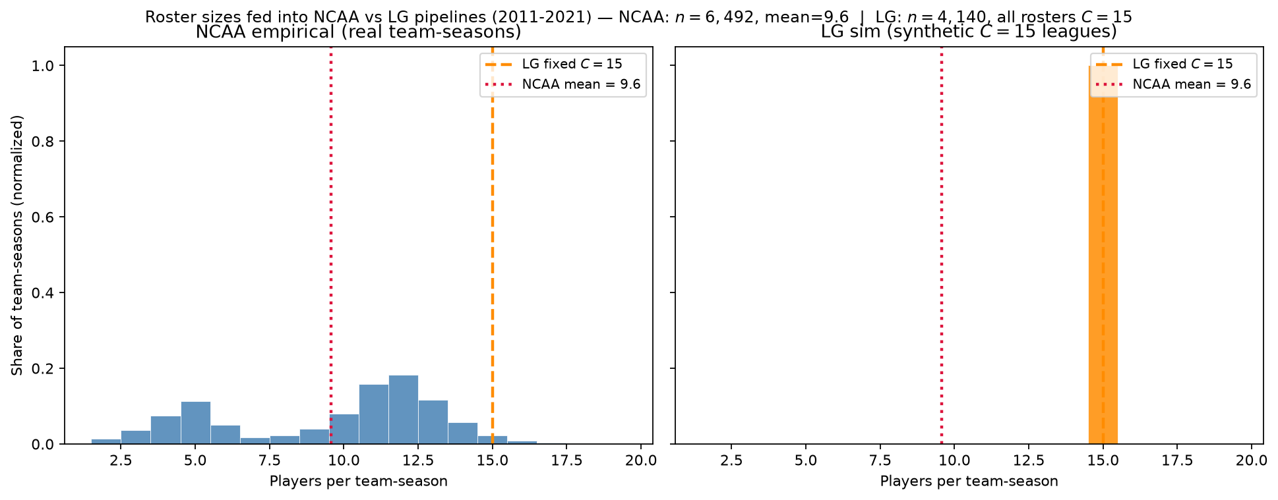
NCAA vs LG — roster sizes fed into the pipeline
MBB 2011-2021 · min 20 min · NCAA mean=9.6 vs LG $C=15$ · 6,492 vs 4,140 team-seasons
Players per team-season after \geq 20 ESPN box minutes (same panel as PD17 hero).
Left: NCAA real (team_id, season) units — $n=6,492$, mean=9.6, median=11.
Right: LG synthetic leagues — $n=4,140$, every roster $C=15$ (J = N/15 per season, stacked).
Red dotted: NCAA mean. Orange dashed: LG fixed capacity.
Only 2.3\% of NCAA team-seasons have exactly 15 qualifying players; LG always uses 15.
Same ~62k player-season ability pool; different team-unit structure fed to LOO / L_C.
Estimand: rotation-peer pools (not full roster sheets; not a minutes simulator).
Companion: grandchild_assign/GRANDCHILD_ncaa_roster_size_distribution_2011_2021.png
Claim (PD17 / LG): The minutes floor defines who counts as a roster peer — NCAA empirical team-units are thinner and variable; LG repacks the same ability pool into fixed C=15 synthetic leagues.

