Slide 1
Performance, Peers, and Advancement
A model of group composition, congestion, and selection

Slide 2




How does the group around you affect your chances of success?

Slide 3
How does the group around you affect your chances of success?
Individual performance and uncertain selection
NCAA evidence across peer environments
Congestion, roster pressure, and scarce opportunities
Group formation and experiments with sorting

Slide 4
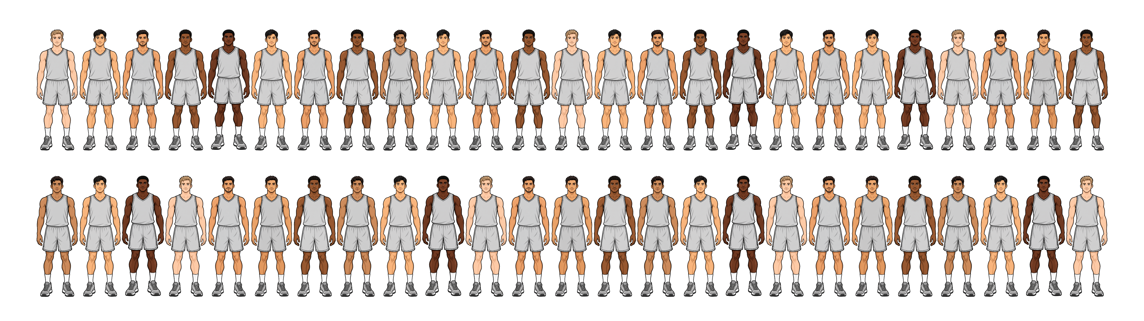
How does the group around you affect your chances of success?
Let’s use a visual example to make sense of our model.

Slide 5
How does the group around you affect your chances of success?
Let’s use a visual example to make sense of our model.
A small basketball league of $N=50$ players

Slide 6
Individual Performance Measure $A_{i}$
But are all individuals alike?

Slide 7
Individual Performance Measure $A_{i}$
But are all individuals alike?

Slide 8
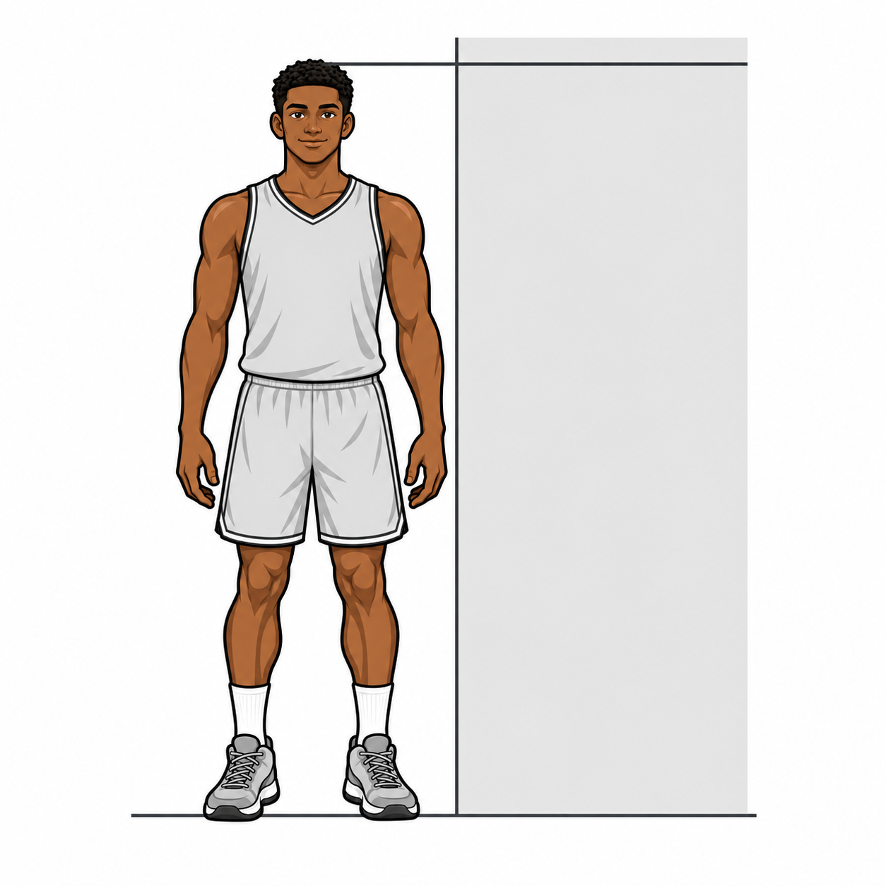


Individual Performance Measure $A_{i}$
But are all individuals alike?
Player $i$
Player $h$

Slide 9
Individual Performance Measure $A_{i}$
But are all individuals alike?
Player $i$
Player $h$

Slide 10
Individual Performance Measure $A_{i}$
But are all individuals alike?
$$A_{i}$$
$$A_{h}$$
Player $i$
Player $h$

Slide 11
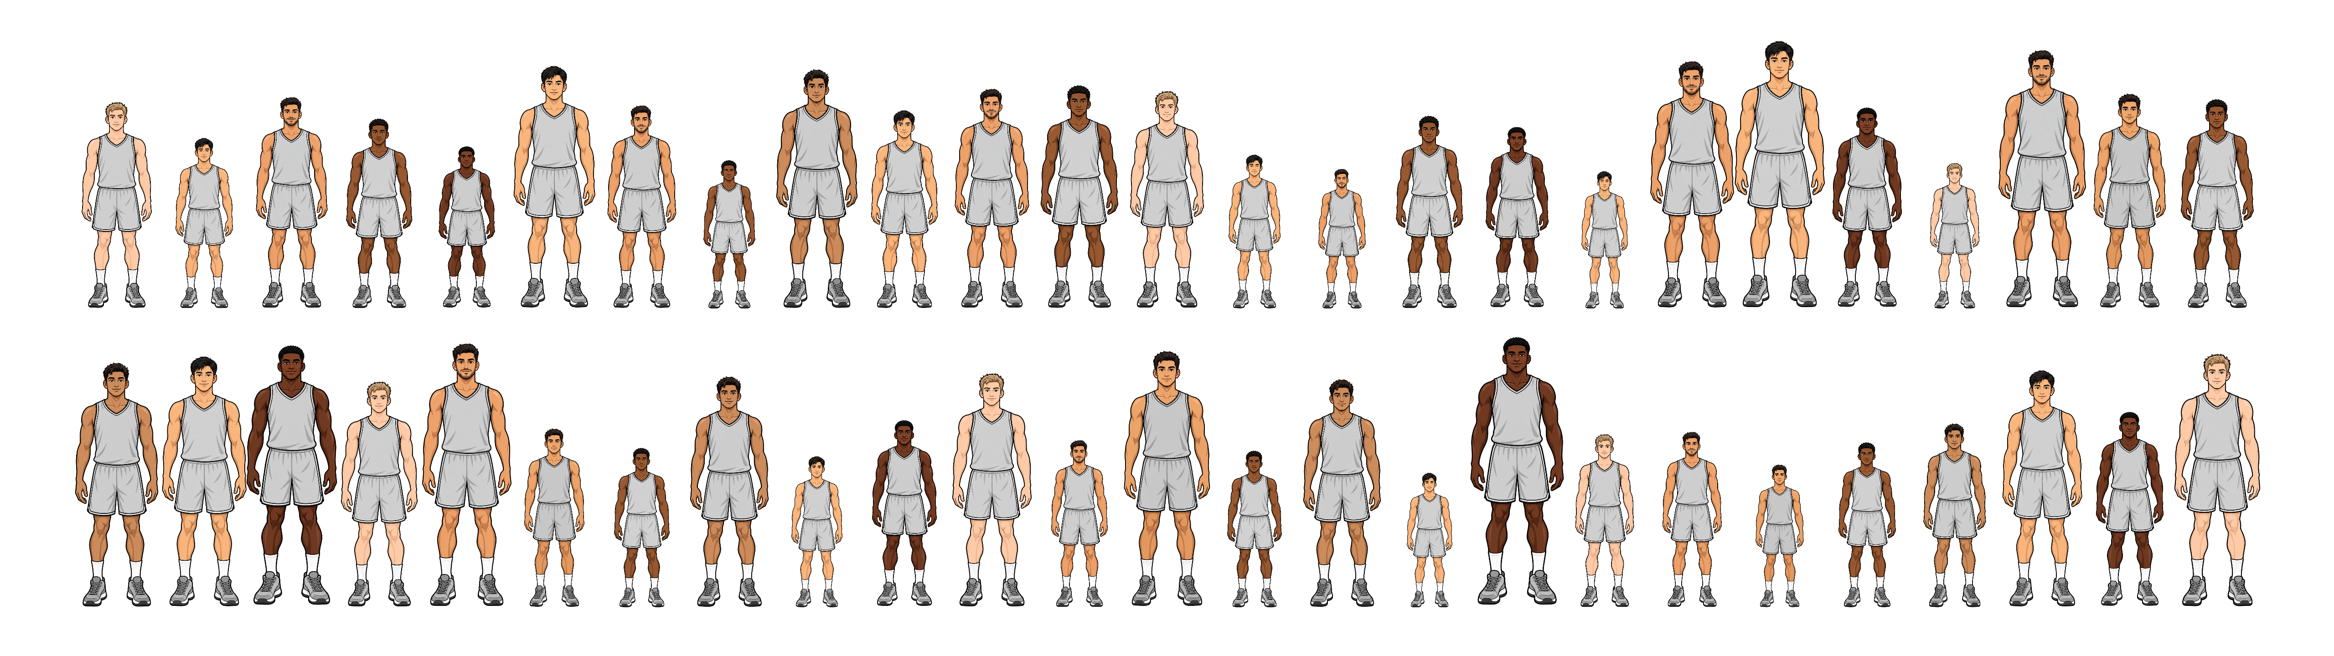
Individual Performance Measure $A_{i}$
We say the population mean is
$$\overline{A}=\frac{\sum_{i}{A_{i}}}{N}$$

Slide 12
First component of our model: SCORE
Each Player is assigned a score $S$

Slide 13
First component of our model: SCORE
Each Player is assigned a score $S$
The simplest method is just to use the individual performance metric.
Thus:
$S_{i}=A_{i}$, $S_{h}=A_{h}$
$$A_{i}$$
$$A_{h}$$
Player $i$
Player $h$

Slide 14
Second component of our model: SELECT
Each Player is considered for one of the $K$ advancement selections, $0<K<N$

Slide 15
Second component of our model: SELECT
Each Player is considered for one of the $K$ advancement selections, $0<K<N$
The proportion of $K$ slots available is the selection scarcity, $K/N$

Slide 16
Second component of our model: SELECT
Each Player is considered for one of the $K$ advancement selections, $0<K<N$
The proportion of $K$ slots available is the selection scarcity, $K/N$
Let’s say there are $K=10$ NBA Draft selections available for the league.
Here the selection scarcity $K/N=0.2$

Slide 17
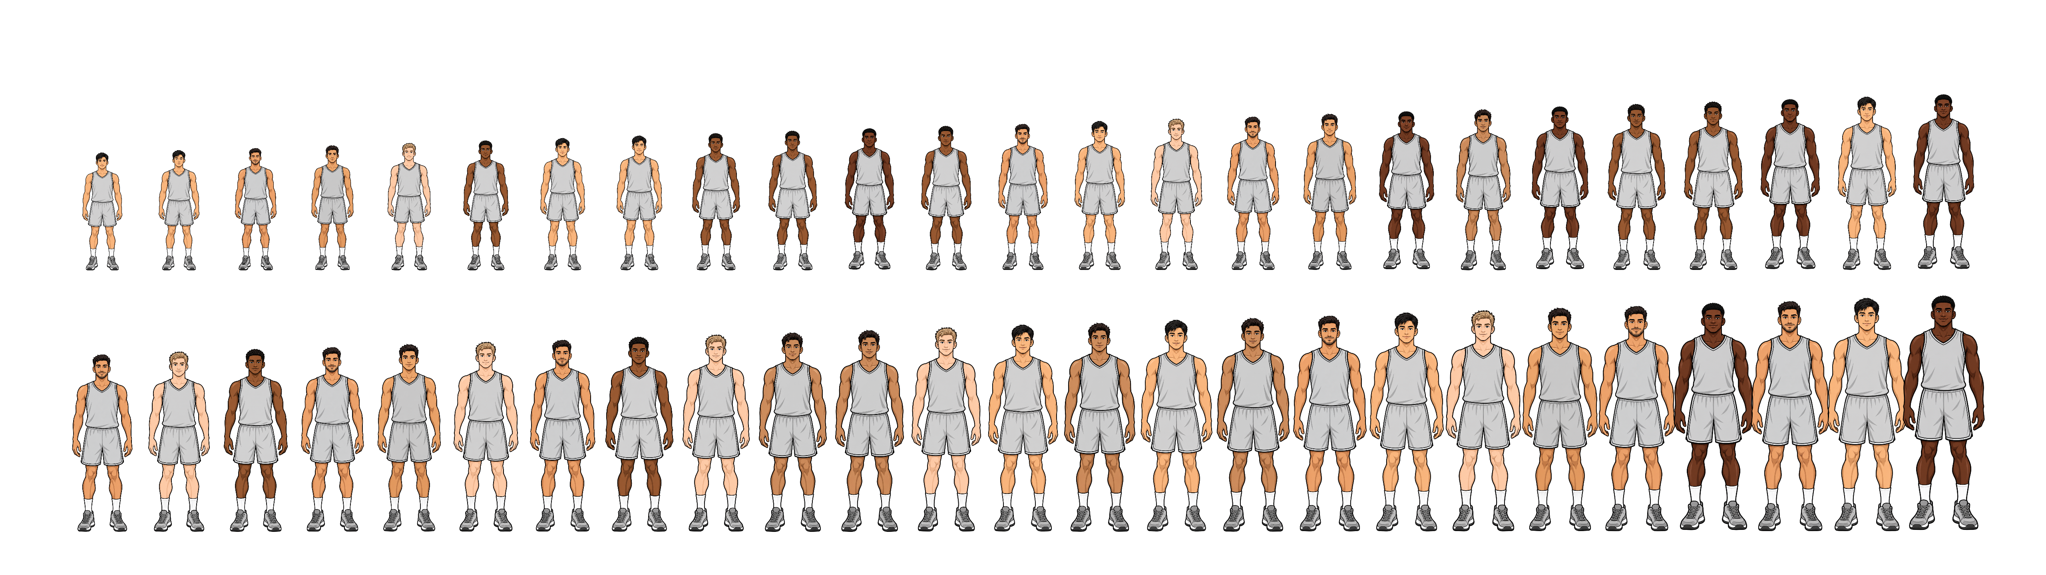
Second component of our model: SELECT
Each Player is considered for one of the $K$ advancement selections
The simplest method is just to sort the individuals by their score $S$

Slide 18
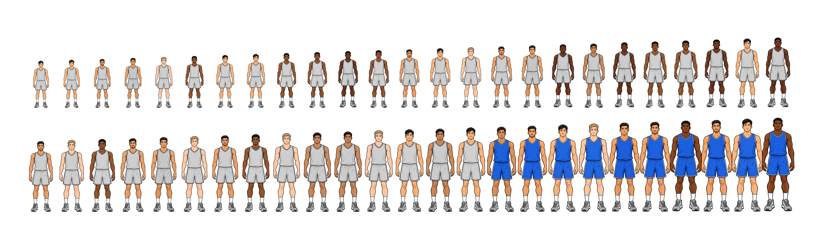
The Naïve Benchmark model
SCORE Player by performance metric, $S_{i}=A_{i}$
SELECT the top-$K$ players.

Slide 19
The Score and the Selection Rule
SCORE Player by performance metric, $S_{i}=A_{i}$
SELECT the top-$K$ players.
Write $S$ for the collection of all individual scores and let $W_{K}(S)$ denote the resulting set of winners.
If $Y_{i}=1$ when individual $i$ is selected and $Y_{i}=0$ otherwise, then
$$Y_{i}=1\left\{i∈ W_{K}\left(S\right)\right\}, \sum_{i∈ ℰ}{Y_{i}}=K.$$

Slide 20
Uncertainty in selection
In the real-world individuals are not perfectly selected

Slide 21
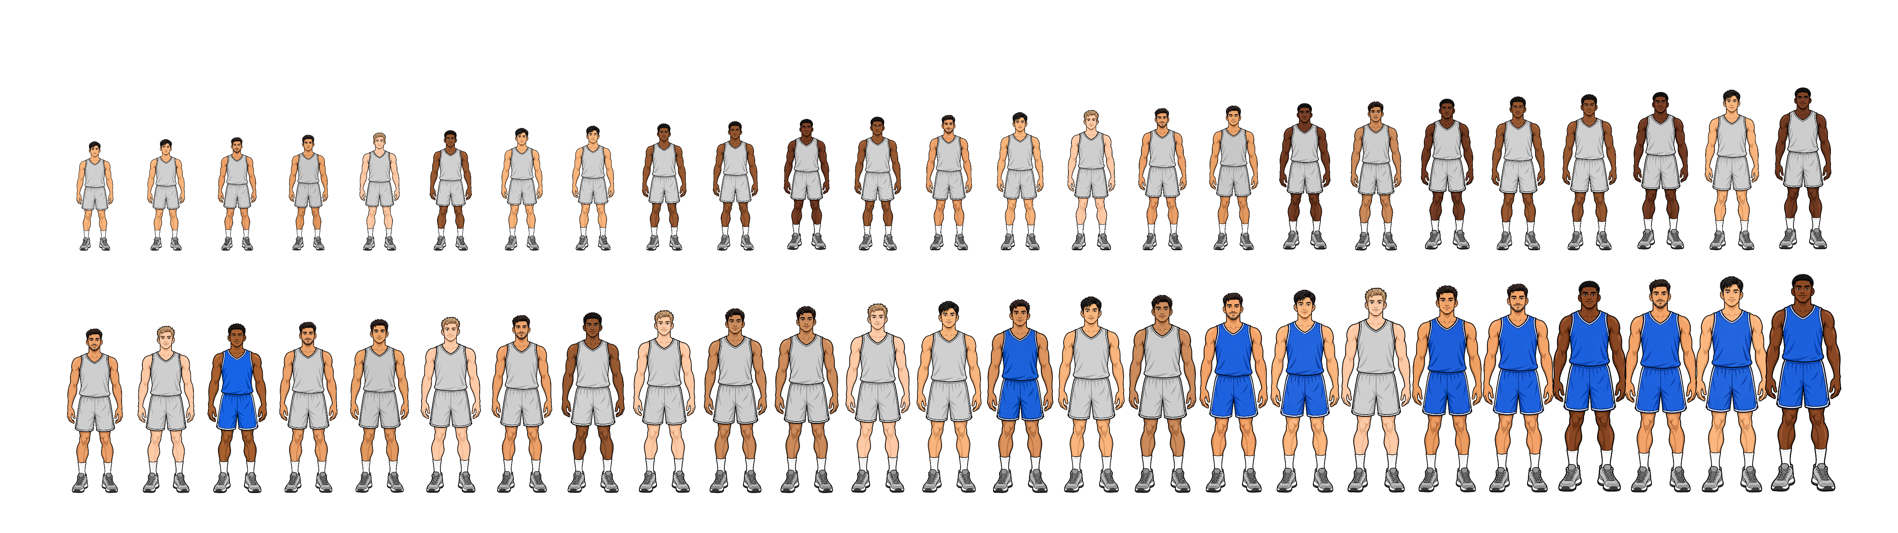
Uncertainty in selection
In the real-world individuals are not perfectly selected
Evaluators may observe incomplete records

Slide 22
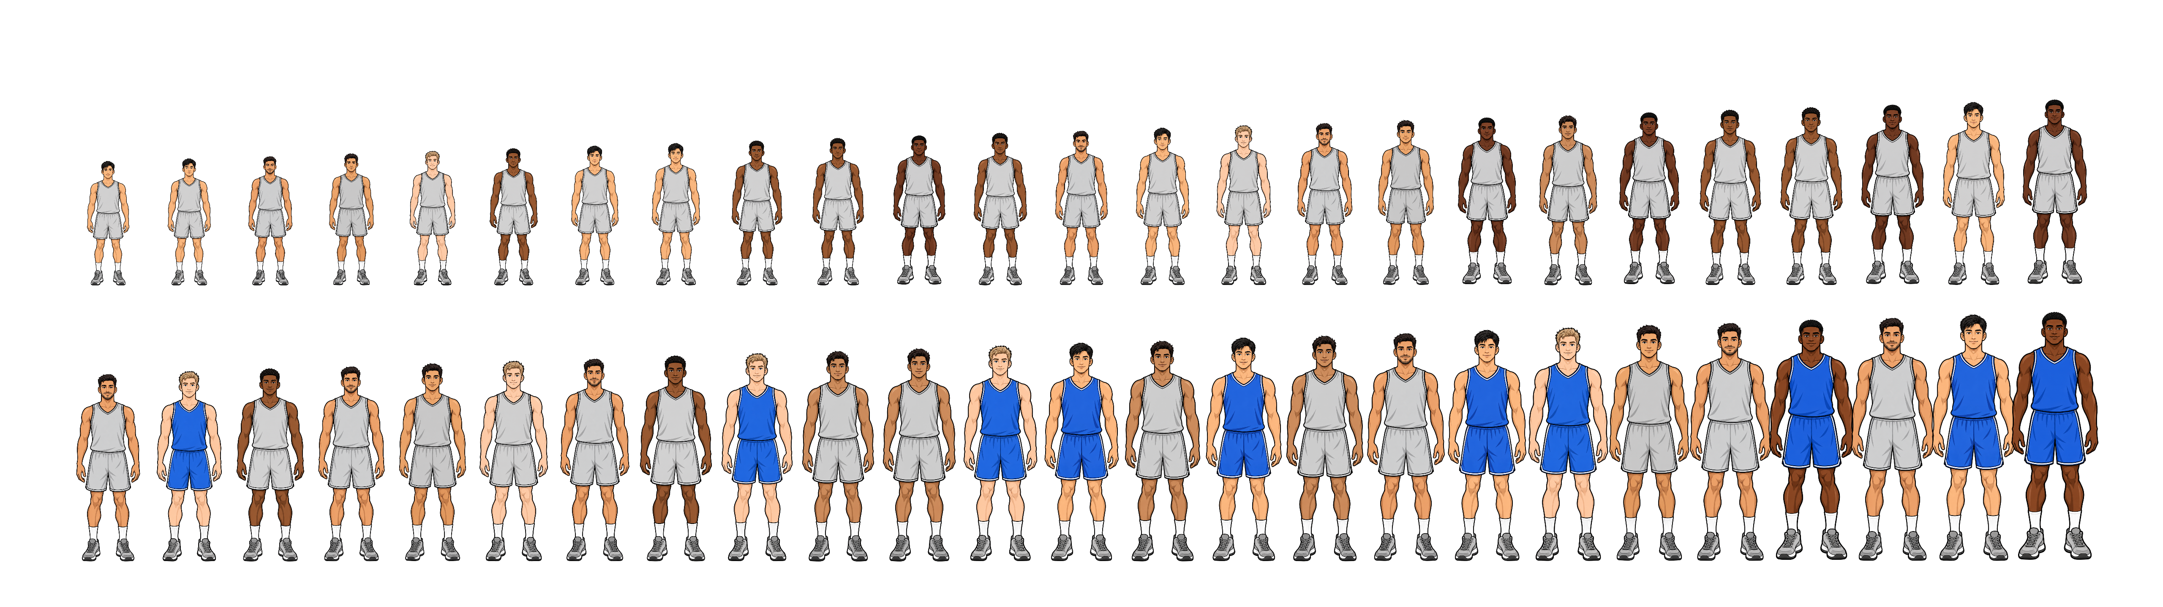
Uncertainty in selection
In the real-world individuals are not perfectly selected
Evaluators may observe incomplete records
Disagree about candidates

Slide 23
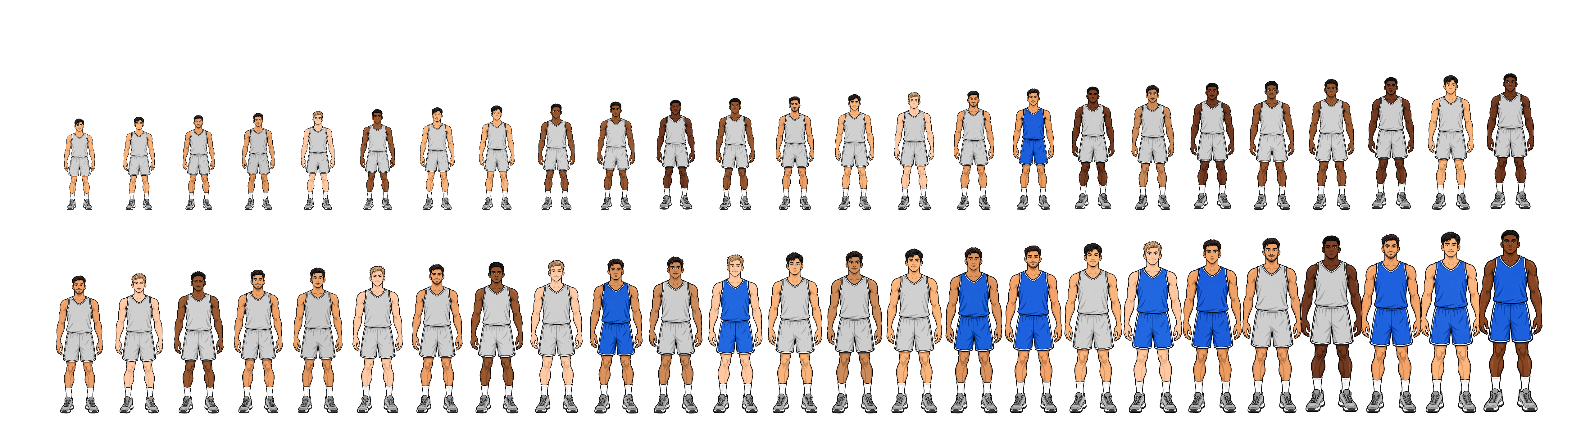
Uncertainty in selection
In the real-world individuals are not perfectly selected
Evaluators may observe incomplete records
Disagree about candidates
Or our performance metric ($A_{i}$) is a poor choice

Slide 24




Uncertainty in selection
We introduce a Player draw – simple example
$K=2$ draft picks
Assign weights to each player
Each player’s probability of being drawn is
His weight / total pool weight
Player $a$
Player $b$
Player $c$
Player $d$
$$w_{a}=4$$
$$w_{b}=1$$
$$w_{c}=3$$
$$w_{d}=2$$

Slide 25
Uncertainty in selection
We introduce a Player draw – simple example
$K=2$ draft picks
Assign weights to each player
Each player’s probability of being drawn is
His weight / total pool weight
Player $a$
Player $b$
Player $c$
Player $d$
$$w_{a}=4$$
$$w_{b}=1$$
$$w_{c}=3$$
$$w_{d}=2$$
So, the probability of Player $a$ being drawn is $\frac{4}{10}=0.40$

Slide 26

Uncertainty in selection
At the first draw, Player $c$ is selected
Player $a$
Player $b$
Player $c$
Player $d$
$$w_{a}=4$$
$$w_{b}=1$$
$$w_{c}=3$$
$$w_{d}=2$$

Slide 27
Uncertainty in selection
At the first draw, Player $c$ is selected
Player $c$ is removed from the pool
There is 1 draw left
Player $a$
Player $b$
Player $d$
$$w_{a}=4$$
$$w_{b}=1$$
$$w_{d}=2$$

Slide 28
Uncertainty in selection
At the first draw, Player $c$ is selected
Player $c$ is removed from the pool
There is 1 draw left
Player weights haven’t changed
Total pool weight has
Player $a$
Player $b$
Player $d$
$$w_{a}=4$$
$$w_{b}=1$$
$$w_{d}=2$$

Slide 29
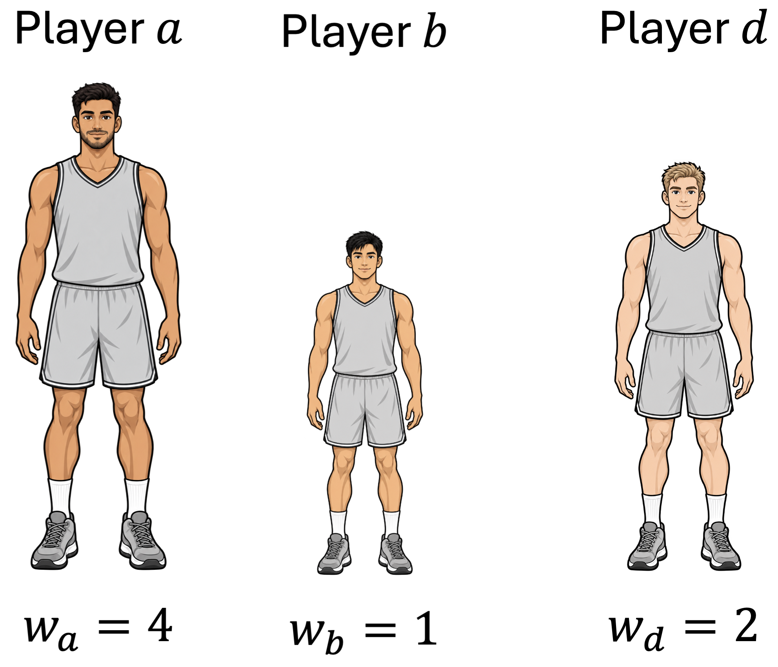
Uncertainty in selection
At the first draw, Player $c$ is selected
Player $c$ is removed from the pool
There is 1 draw left
Player weights haven’t changed
Total pool weight has
So, the probability of Player $a$ being drawn is now $\frac{4}{7}≈0.57$

Slide 30
Uncertainty in selection
How do we turn a Player’s score $S_{i}$ into a selection weight $w_{i}$ ?
Higher scores should receive greater weight, but we must specify how strongly a score advantage matters.
We control that relationship with a positive parameter called selection temperature, $t_{sel}$.

Slide 31
Uncertainty in selection
How do we turn a Player’s score $S_{i}$ into a selection weight $w_{i}$ ?
Higher scores should receive greater weight, but we must specify how strongly a score advantage matters.
We control that relationship with a positive parameter called selection temperature, $t_{sel}$.
$$w_{i}=e^{\left(\frac{S_{i}}{t_{sel}}\right)}, t_{sel}>0$$
These weights are called Gibbs weights

Slide 32
From weights to selection probabilities
At each draw, a candidate’s probability of selection is their Gibbs weight divided by the total Gibbs weight of the current eligible pool.
We define $R_{r}$ as the current eligible pool at draw $r$, and $I_{r}$ as the individual selected on the draw.
$$Pr\left(I_{r}=i |{ R}_{r}\right)=\frac{w_{i}}{\sum_{h∈R_{r}}{w_{h}}}=\frac{e^{S_{i}/t_{sel}}}{\sum_{h∈R_{r}}{e^{S_{h}/t_{sel}}}}$$
This is Plackett–Luce selection without replacement, using Gibbs weights.

Slide 33
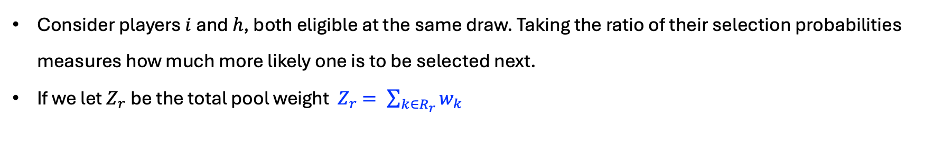
HOW MUCH does a score advantage matter?
Consider players $i$ and $h$, both eligible at the same draw. Taking the ratio of their selection probabilities measures how much more likely one is to be selected next.
If we let $Z_{r}$ be the total pool weight ${ Z}_{r} = \sum_{k∈R_{r}}{w_{k}}$

Slide 34
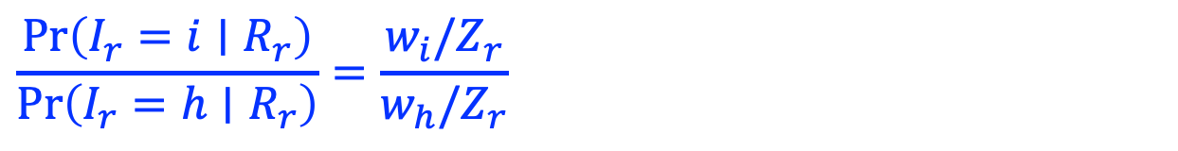
HOW MUCH does a score advantage matter?
Consider players $i$ and $h$, both eligible at the same draw. Taking the ratio of their selection probabilities measures how much more likely one is to be selected next.
If we let $Z_{r}$ be the total pool weight ${ Z}_{r} = \sum_{k∈R_{r}}{w_{k}}$
$$\frac{\operatorname{Pr}\left(I_{r}=i∣R_{r}\right)}{\operatorname{Pr}\left(I_{r}=h∣R_{r}\right)}=\frac{w_{i}/Z_{r}}{w_{h}/Z_{r}}$$

Slide 35
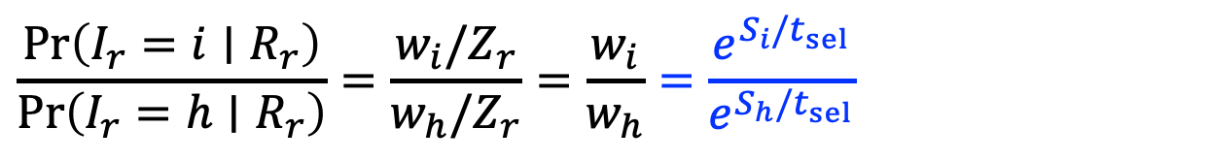
HOW MUCH does a score advantage matter?
Consider players $i$ and $h$, both eligible at the same draw. Taking the ratio of their selection probabilities measures how much more likely one is to be selected next.
If we let $Z_{r}$ be the total pool weight ${ Z}_{r} = \sum_{k∈R_{r}}{w_{k}}$
$$\frac{\operatorname{Pr}\left(I_{r}=i∣R_{r}\right)}{\operatorname{Pr}\left(I_{r}=h∣R_{r}\right)}=\frac{w_{i}/Z_{r}}{w_{h}/Z_{r}}=\frac{w_{i}}{w_{h}}=\frac{e^{S_{i}/t_{sel}}}{e^{S_{h}/t_{sel}}}$$

Slide 36
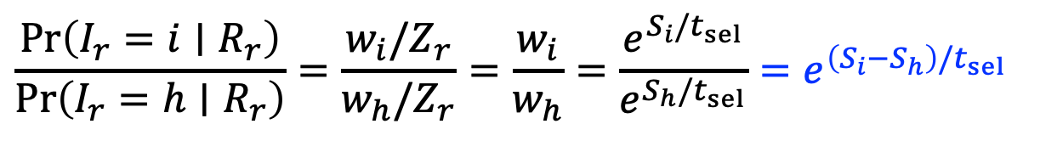
HOW MUCH does a score advantage matter?
Consider players $i$ and $h$, both eligible at the same draw. Taking the ratio of their selection probabilities measures how much more likely one is to be selected next.
If we let $Z_{r}$ be the total pool weight ${ Z}_{r} = \sum_{k∈R_{r}}{w_{k}}$
$$\frac{\operatorname{Pr}\left(I_{r}=i∣R_{r}\right)}{\operatorname{Pr}\left(I_{r}=h∣R_{r}\right)}=\frac{w_{i}/Z_{r}}{w_{h}/Z_{r}}=\frac{w_{i}}{w_{h}}=\frac{e^{S_{i}/t_{sel}}}{e^{S_{h}/t_{sel}}}=e^{\left(S_{i}−S_{h}\right)/t_{sel}}$$

Slide 37
HOW MUCH does a score advantage matter?
So, the advantage depends on the differences between their scores, measured relative to the selection temperature.
Candidate $i$ is therefore $e^{\left(S_{i}−S_{h}\right)/t_{sel}}$ times as likely as candidate $h$ to be selected next.

Slide 38
Lower temperature strengthens score advantages
When $S_{i}>S_{h}$, decreasing selection temperature makes player $i$ increasingly more likely than player $h$ to be selected next.
$$t_{sel}→0^{+} ⟹ e^{\left(S_{i}−S_{h}\right)/t_{sel}}→∞$$
$$A_{i}$$
$$A_{h}$$
Player $i$
Player $h$

Slide 39
Lower temperature strengthens score advantages
As temperature approaches zero, selection approaches the deterministic top-$K$ benchmark.
$$t_{sel}→0^{+} ⟹ e^{\left(S_{i}−S_{h}\right)/t_{sel}}→∞$$

Slide 40
Higher temperature weakens score advantages
As selection temperature increases, the same score difference gives player $i$ a smaller advantage over player $h$.
$$t_{sel}→∞ ⟹ e^{\left(S_{i}−S_{h}\right)/t_{sel}}→1$$
$$A_{i}$$
$$A_{h}$$
Player $i$
Player $h$

Slide 41
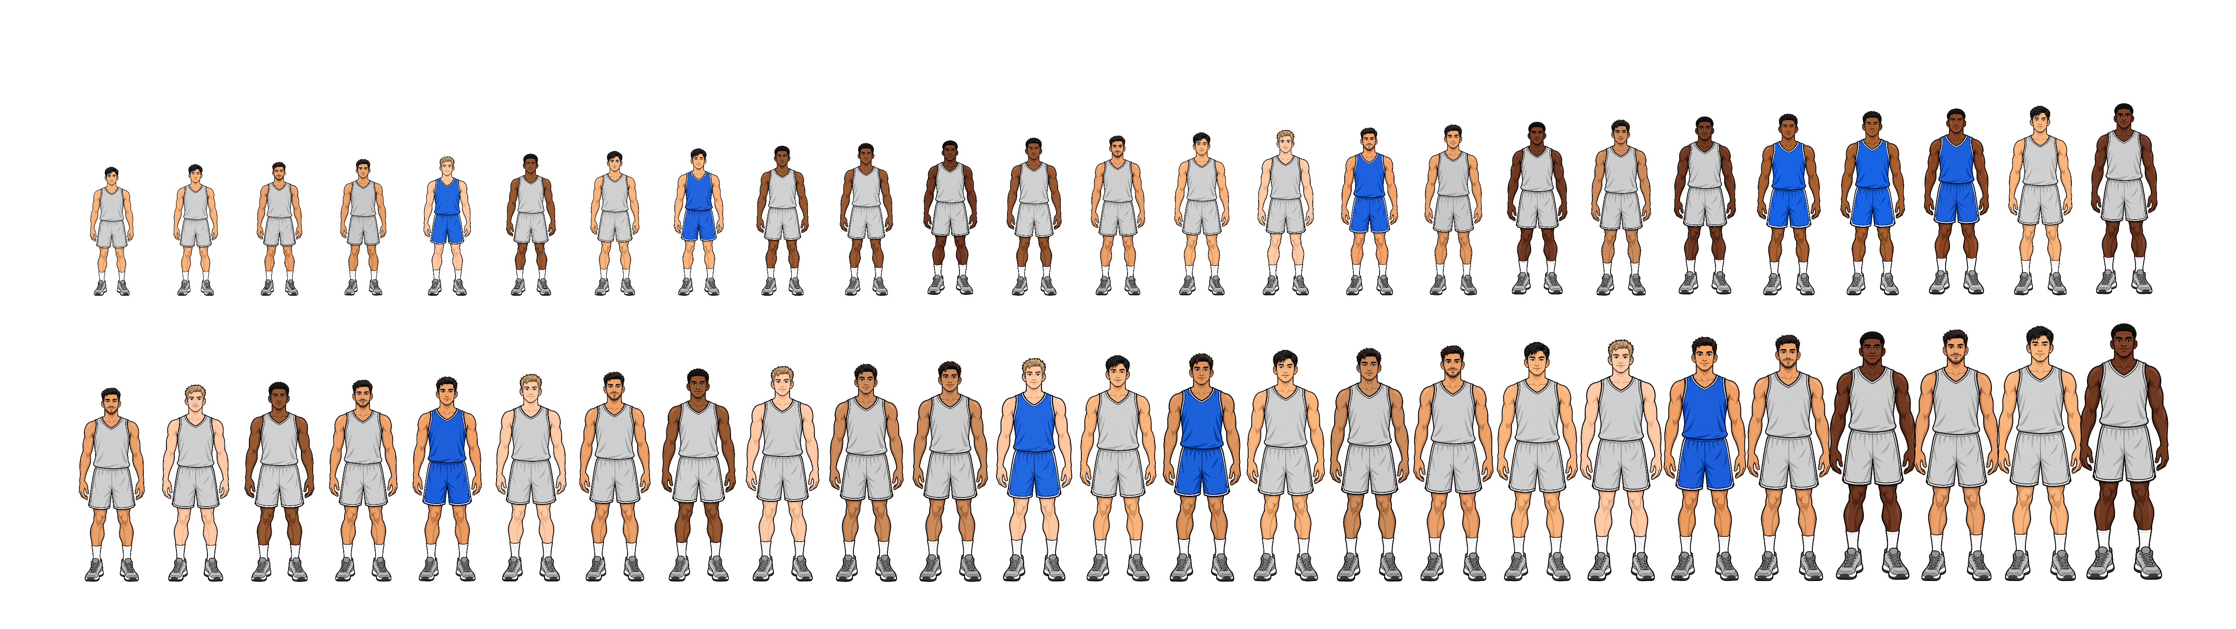
Higher temperature weakens score advantages
In the high-temperature limit, each draw becomes uniform among the eligible players. Each individual’s probability of receiving one of the $K$ places approaches $K/N$.
$$t_{sel}→∞ ⟹ e^{\left(S_{i}−S_{h}\right)/t_{sel}}→1$$
$$\operatorname{Pr}\left(Y_{i}=1\right)→\frac{K}{N}=\frac{10}{50}=0.2$$

Slide 42
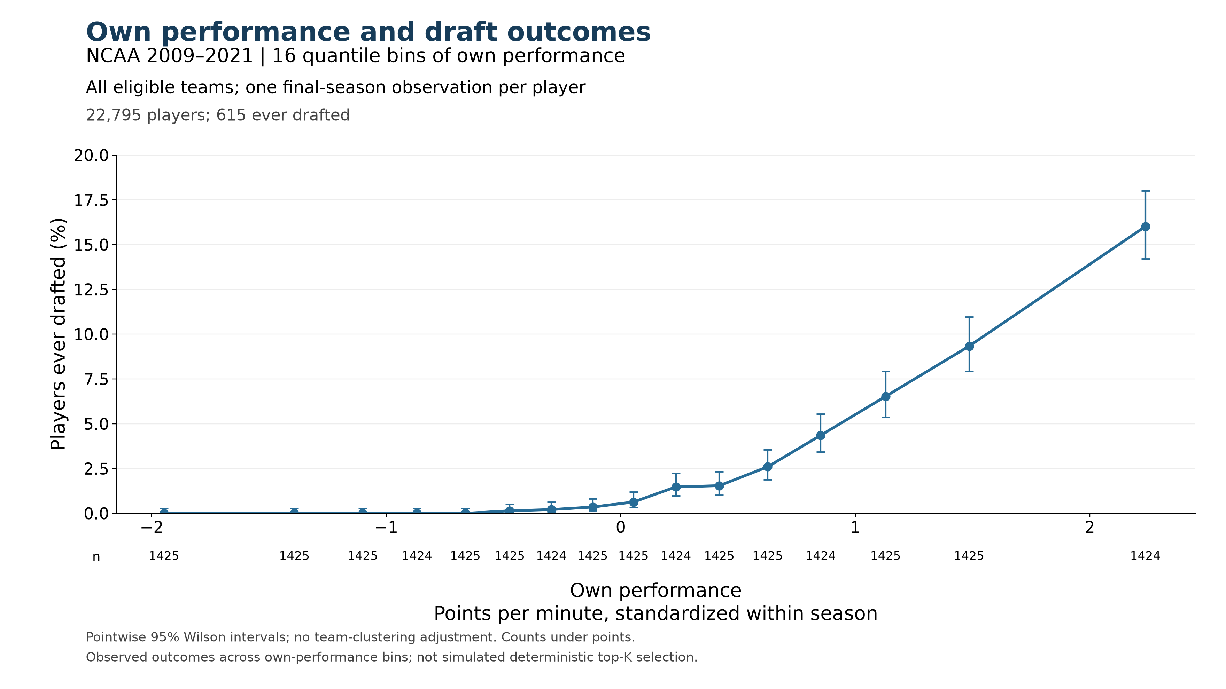
Higher individual performance is associated with higher draft rates
Empirical plot of Points Per Minute (PPM) vs probability of NBA draft
How does this relationship change when we consider the performance of a player’s teammates?

Slide 43
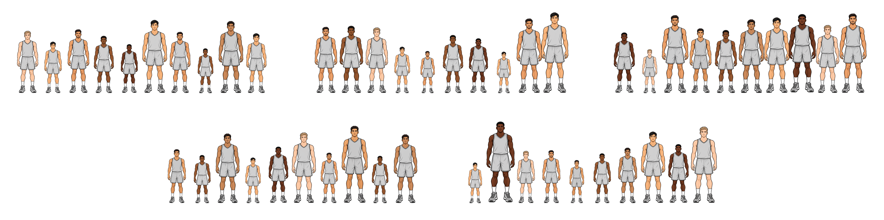
Individuals perform within groups
Strong peers can support development while also making it harder to stand out.
We model this competitive pressure, which we call congestion, while holding measured performance fixed.

Slide 44
Congestion changes the score entering selection
We introduce $C_{i}$ to represent the congestion faced by individual $i and$ $λ≥0$ to control the strength of its effect on their selection score.
$$S_{i}=A_{i}−λC_{i}$$
At the same measured performance, greater congestion produces a lower selection score when $λ>0$.
How should we measure Congestion?

Slide 45
A first congestion measure: mean group performance
A group’s average performance provides a simple starting point for describing its competitive environment.
Define $T_{j}$ as the mean performance of the $n_{j}$ members of group $j$, then
$$T_{j}=\frac{1}{n_{j}}\sum_{h:g\left(h\right)=j}{A_{h}}$$
In this specification, every member faces the same congestion: the group mean which includes their own performance.
$$C_{i}=C_{Q,i}=T_{g\left(i\right)}$$
$$T_{3}$$
Group $3$
$$T_{5}$$
Group $5$

Slide 46
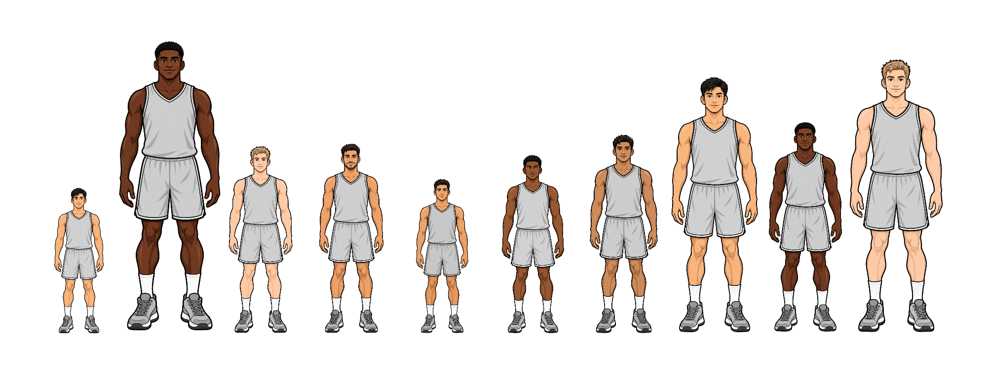
A second congestion measure: mean peer performance
The leave-one-out mean describes an individual’s peers by averaging the other group members’ performance, excluding their own.
$$C_{LOO,i}=\frac{1}{n_{g\left(i\right)}−1}\sum_{\begin{aligned}h:g\left(h\right)=g\left(i\right) \\ h≠i\end{aligned}}{A_{h}}$$
Unlike the full-group mean, this measure can differ between teammates.
Player $i$
$$C_{LOO,i}$$
Group $5$

Slide 47
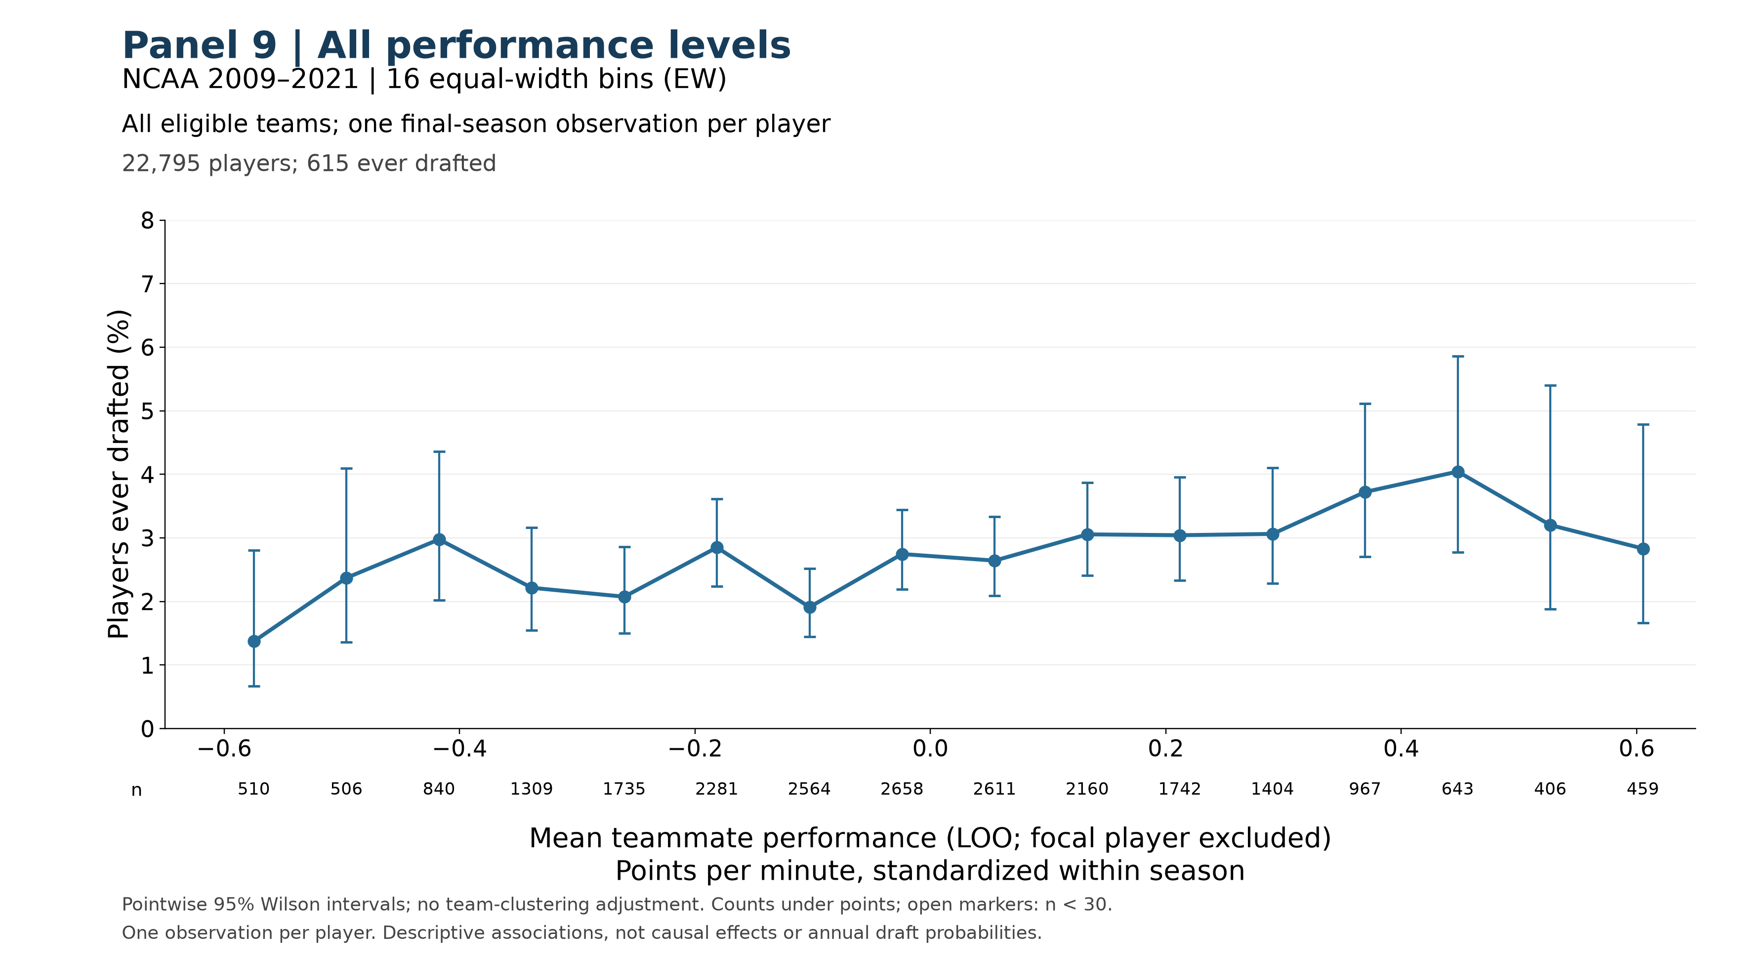
Draft outcomes across peer environments
Across all performance levels, the observed draft rate rises unevenly with teammate performance, then declines in the highest peer-performance bins.
47
$$θ$$

Slide 48
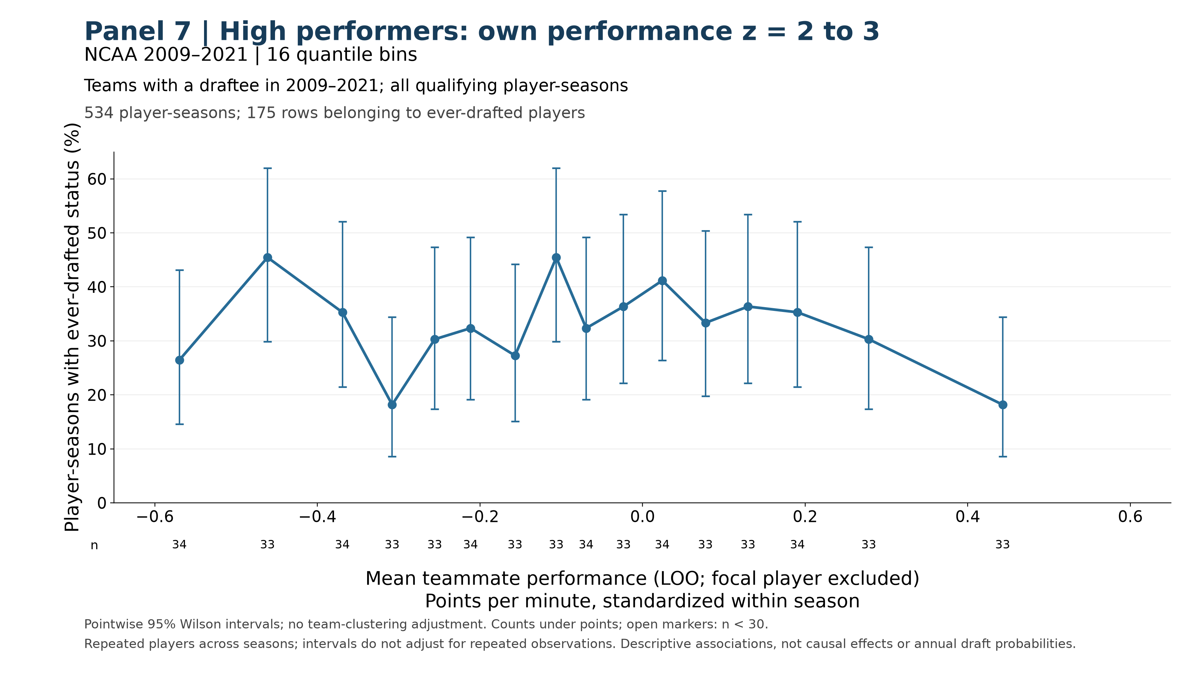
Comparing players within a high-performance band
Among players with own-performance z scores between 2 and 3, stronger teammates are not consistently associated with higher draft rates.
48
$$θ$$

Slide 49
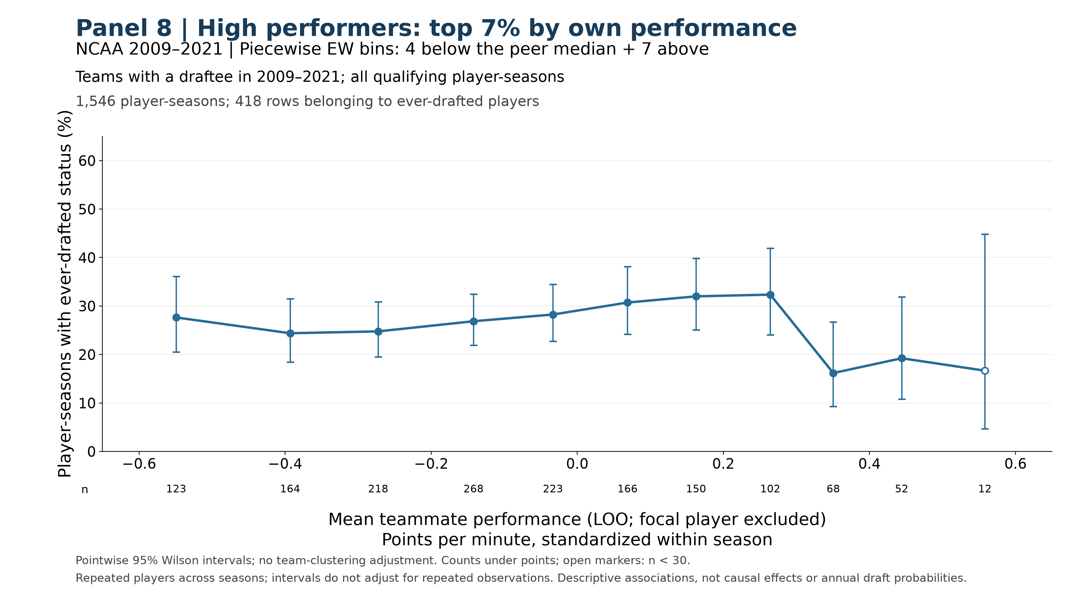
A downturn among the strongest peer environments.
Among the top 7% of performers, the observed draft rate falls in the highest peer-performance bins.
49
$$θ$$

Slide 50
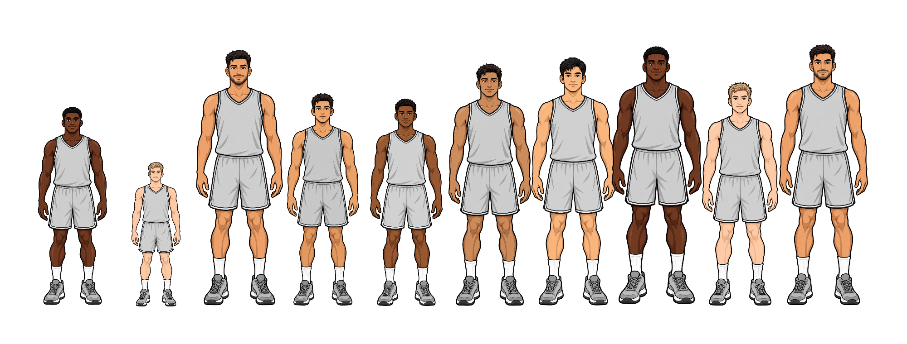
The same group average can conceal different competition
Two teams can have the same average performance but different numbers of credible competitors.
Our third congestion measure, roster pressure, accounts for how competitively relevant each member is.
Here $T_{3}=T_{5}$, but clearly the similar players $i$ and $h$ indicated on both teams face different competition.
$$A_{i} ≈{ A}_{h}$$
$$T_{5}$$
$$T_{3}$$
Group $5$
Group $3$

Slide 51
Which teammates count as credible competitors?
We introduce a common performance threshold $θ$ around which individuals become competitively relevant.
This global threshold determines how strongly someone contributes to roster pressure; it does not determine whether they are selected.
$$θ$$
Group $5$

Slide 52
Which teammates count as credible competitors?
We introduce a common performance threshold $θ$ around which individuals become competitively relevant.
This global threshold determines how strongly someone contributes to roster pressure; it does not determine whether they are selected.
$$θ$$
Group $5$

Slide 53


Which teammates count as credible competitors?
We introduce a common performance threshold $θ$ around which individuals become competitively relevant.
This global threshold determines how strongly someone contributes to roster pressure; it does not determine whether they are selected.
$$θ$$
$$θ$$
Group $5$
Group $5$

Slide 54

Which teammates count as credible competitors?
We introduce a common performance threshold $θ$ around which individuals become competitively relevant.
This global threshold determines how strongly someone contributes to roster pressure; it does not determine whether they are selected.
Should someone just below the line count entirely differently than someone just above it?
$$θ$$
Group $5$

Slide 55

Which teammates count as credible competitors?
We introduce a common performance threshold $θ$ around which individuals become competitively relevant.
This global threshold determines how strongly someone contributes to roster pressure; it does not determine whether they are selected.
Should someone just below the line count entirely differently than someone just above it?
$$θ$$

Slide 56

Which teammates count as credible competitors?
We introduce a common performance threshold $θ$ around which individuals become competitively relevant.
This global threshold determines how strongly someone contributes to roster pressure; it does not determine whether they are selected.
Should someone just below the line count entirely differently than someone just above it?
$$θ$$

Slide 57


Competitive relevance changes gradually around the threshold
Players just below and just above $θ$ have similar competitive relevance, rather than falling into entirely different categories.
We introduce the parameter $γ$ to control how sharply competitive relevance rises with performance: smaller $γ$ gives a more gradual transition; larger $γ$ gives a sharper transition.
Smaller $γ$
Larger $γ$
$$θ$$

Slide 58

Measuring competitive relevance
We assign each player a competitive relevance $v_{h}$ between zero and one using a sigmoid function.
$$v_{h}=σ\left(γ\left(A_{h}−θ\right)\right)=\frac{1}{1+e^{−γ\left(A_{h}−θ\right)}}, γ>0$$
At $A_{h}=θ$, competitive relevance equals ½. Higher performance gives greater relevance; $γ$ controls how sharply it increases.
Smaller $γ$
$$θ$$

Slide 59
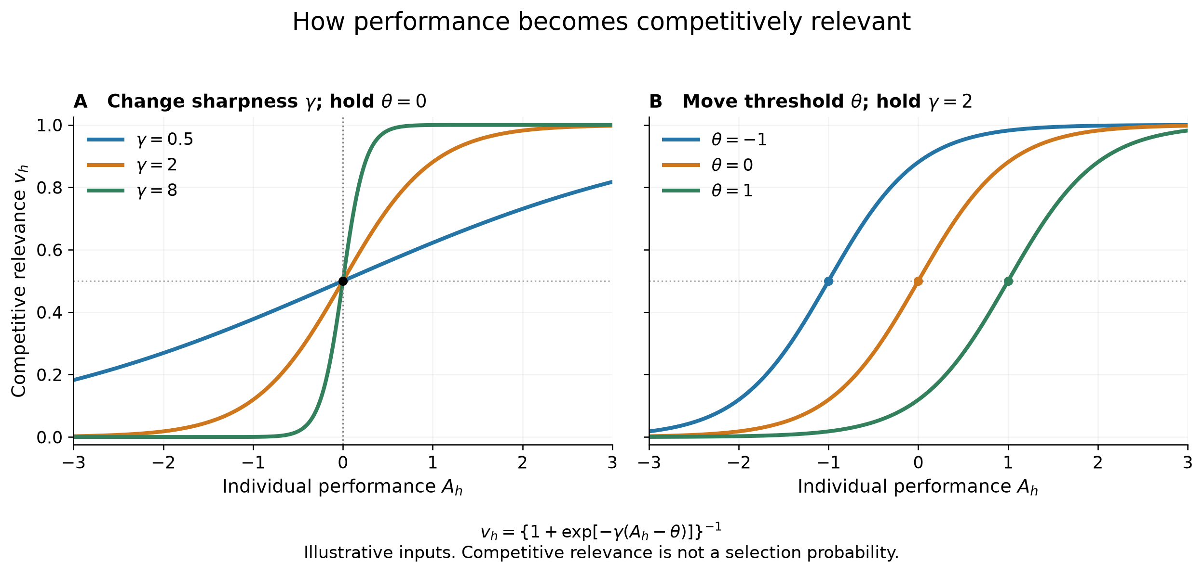
How threshold and sharpness shape competitive relevance
Threshold location and transition sharpness - Competitive relevance $v_{h}$ is plotted against individual performance $A_{h}$. Panel A holds $θ=0$ and compares $γ=0.5,2,$ and $8$. Panel B holds $γ=2$ and compares $θ=−1,0,$ and $1$. The marked points identify $A_{h}=θ$, where $v_{h}=1/2$. These illustrative curves describe competitive relevance, not selection probabilities.

Slide 60
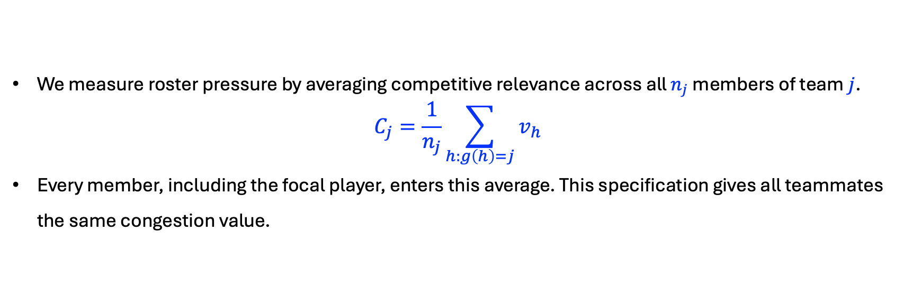
Roster Pressure means competitive concentration
We measure roster pressure by averaging competitive relevance across all $n_{j}$ members of team $j$.
$$C_{j}=\frac{1}{n_{j}}\sum_{h:g\left(h\right)=j}{v_{h}}$$
Every member, including the focal player, enters this average. This specification gives all teammates the same congestion value.
$$θ$$
Group $5$

Slide 61

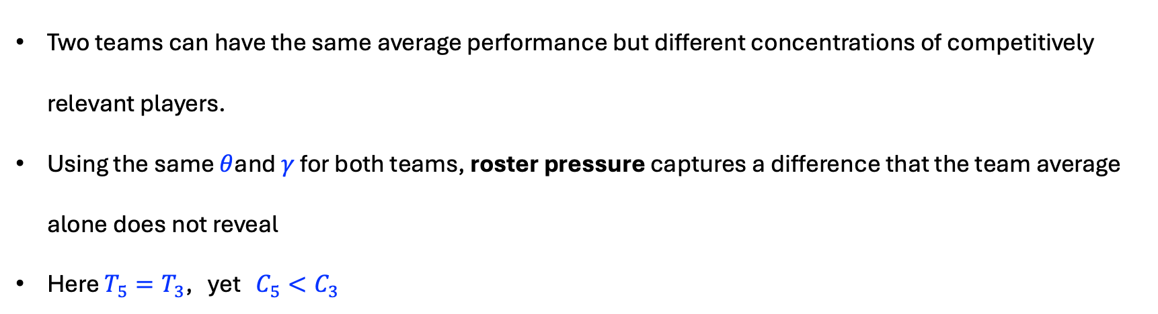
The same mean performance can produce different roster pressure
Two teams can have the same average performance but different concentrations of competitively relevant players.
Using the same $θ$and $γ$ for both teams, roster pressure captures a difference that the team average alone does not reveal
Here $T_{5}=T_{3}$, yet $C_{5}<C_{3}$
$$θ$$
$$T_{5}$$
$$T_{3}$$
Group $5$
Group $3$
61

Slide 62
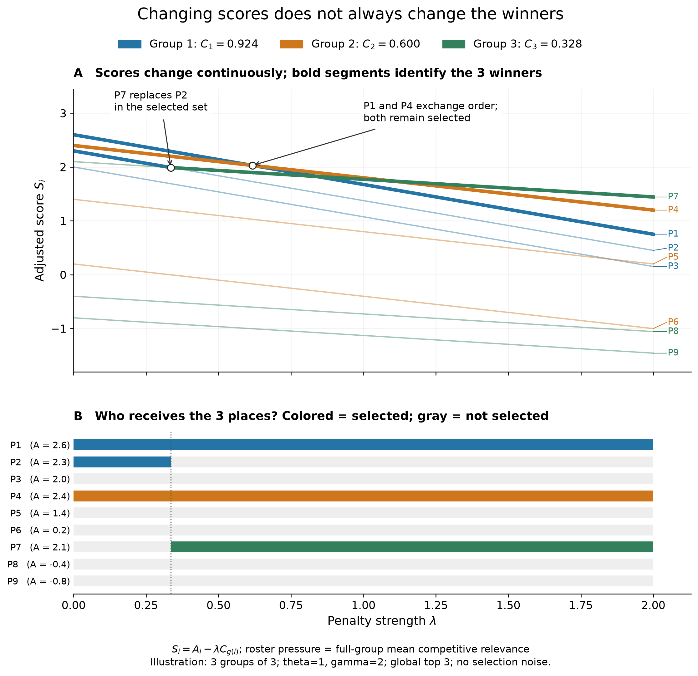
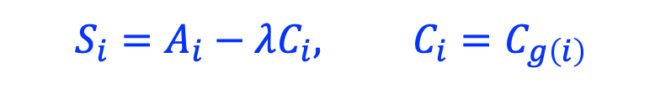
When does congestion change who is selected?
$$S_{i}=A_{i}−λC_{i}, C_{i}=C_{g\left(i\right)}$$
This illustration uses deterministic top-three selection, so the changes come entirely from congestion.

Slide 63
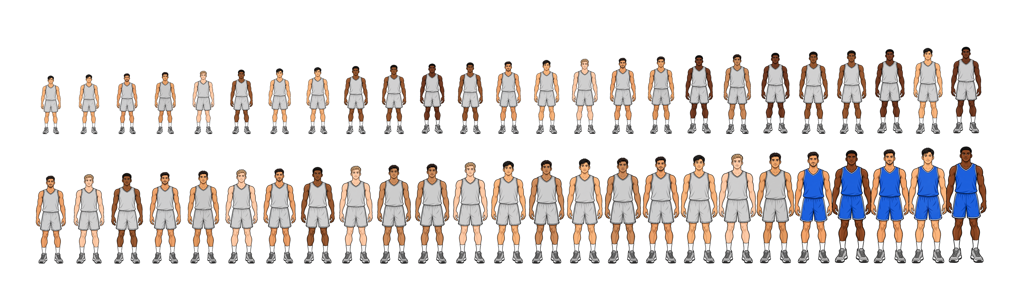


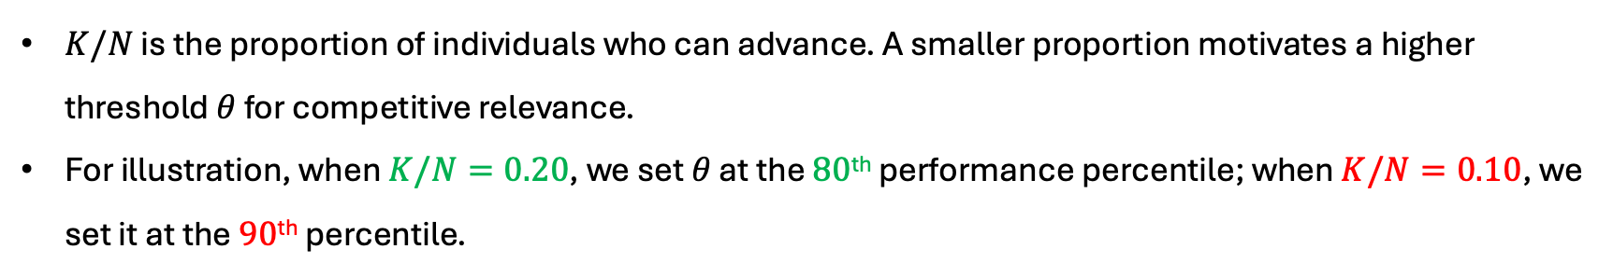
Scarcity informs the competitive threshold
$K/N$ is the proportion of individuals who can advance. A smaller proportion motivates a higher threshold $θ$ for competitive relevance.
For illustration, when $K/N=0.20$, we set $θ$ at the $80$^{th} performance percentile; when $K/N=0.10$, we set it at the $90$^{th} percentile.
$$θ$$
$$θ$$
63
$$θ$$

Slide 64
ASSIGN: varying how strongly similar performers group together
So how do players get assigned to teams in the real-world anyway?
Is it random?
Do we think it looks like this?
64

Slide 65
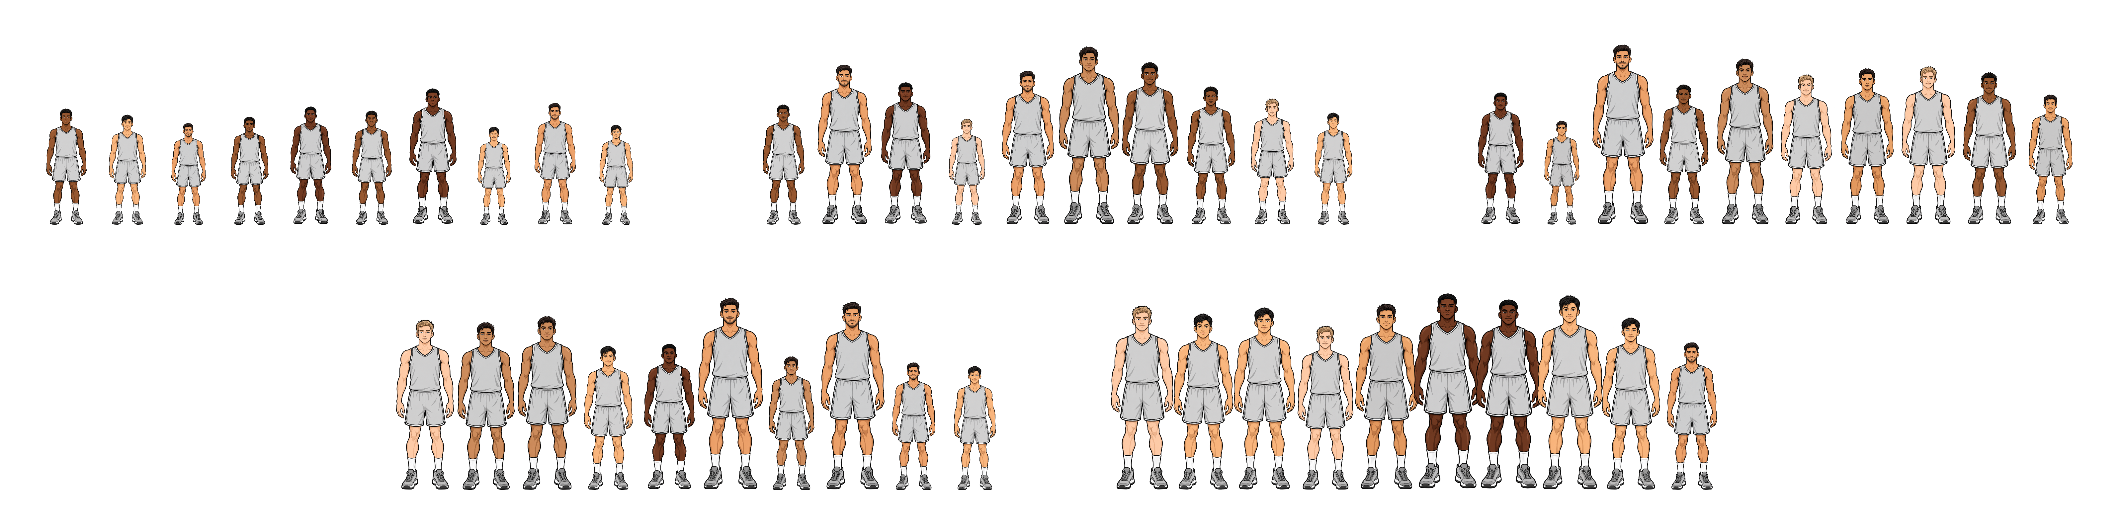
ASSIGN: varying how strongly similar performers group together
Or does it look more like this?
We investigate whether sorting, combined with congestion, can help explain the observed downturns.
65

Slide 66
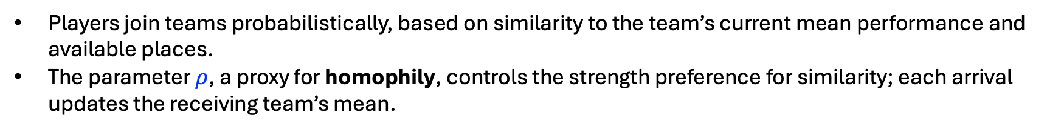
ASSIGN: varying how strongly similar performers group together
Players join teams probabilistically, based on similarity to the team’s current mean performance and available places.
The parameter $ρ$, a proxy for homophily, controls the strength preference for similarity; each arrival updates the receiving team’s mean.
66

Slide 67
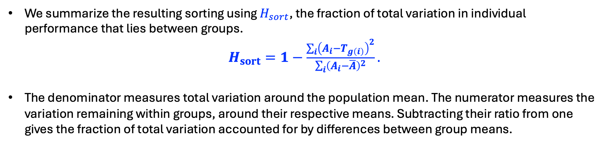
ASSIGN: varying how strongly similar performers group together
We summarize the resulting sorting using $H_{sort}$, the fraction of total variation in individual performance that lies between groups.
$H_{sort}=1−\frac{\sum_{i}{{\left(A_{i}−T_{g\left(i\right)}\right)}^{2}}}{\sum_{i}{{\left(A_{i}−\overline{A}\right)}^{2}}}.$
The denominator measures total variation around the population mean. The numerator measures the variation remaining within groups, around their respective means. Subtracting their ratio from one gives the fraction of total variation accounted for by differences between group means.
67

Slide 68
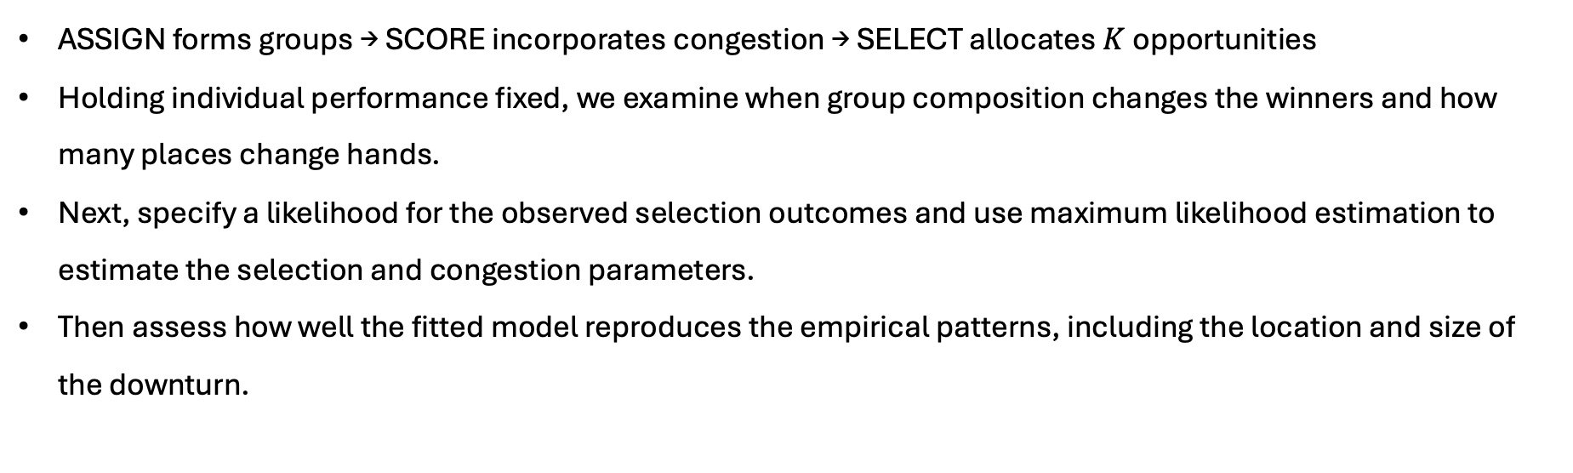
When does group composition change who advances?
ASSIGN forms groups → SCORE incorporates congestion → SELECT allocates $K$ opportunities
Holding individual performance fixed, we examine when group composition changes the winners and how many places change hands.
Next, specify a likelihood for the observed selection outcomes and use maximum likelihood estimation to estimate the selection and congestion parameters.
Then assess how well the fitted model reproduces the empirical patterns, including the location and size of the downturn.
68

Slide 69
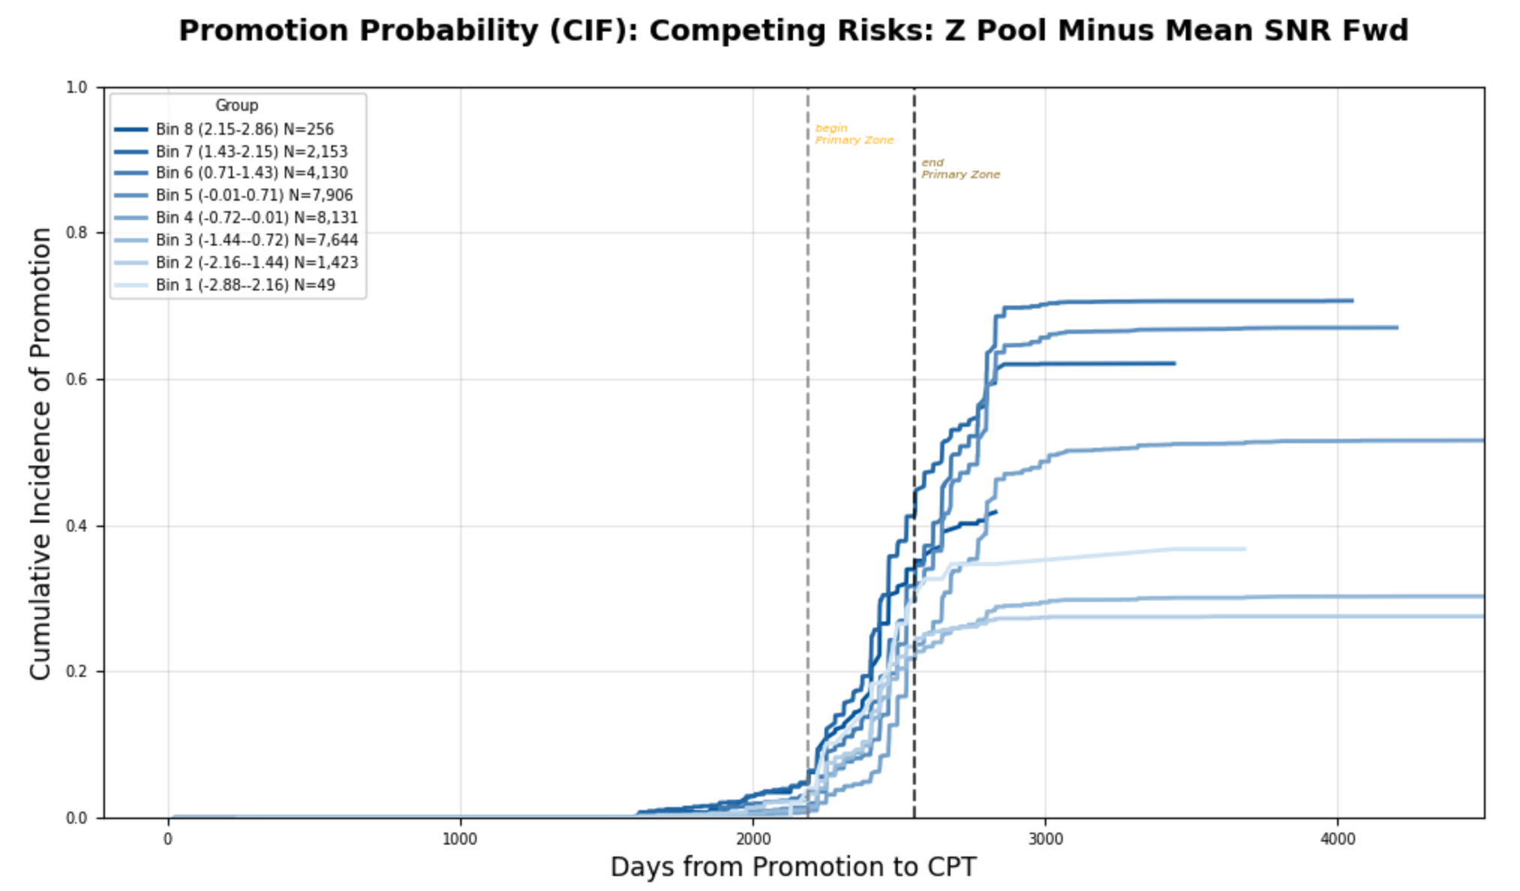
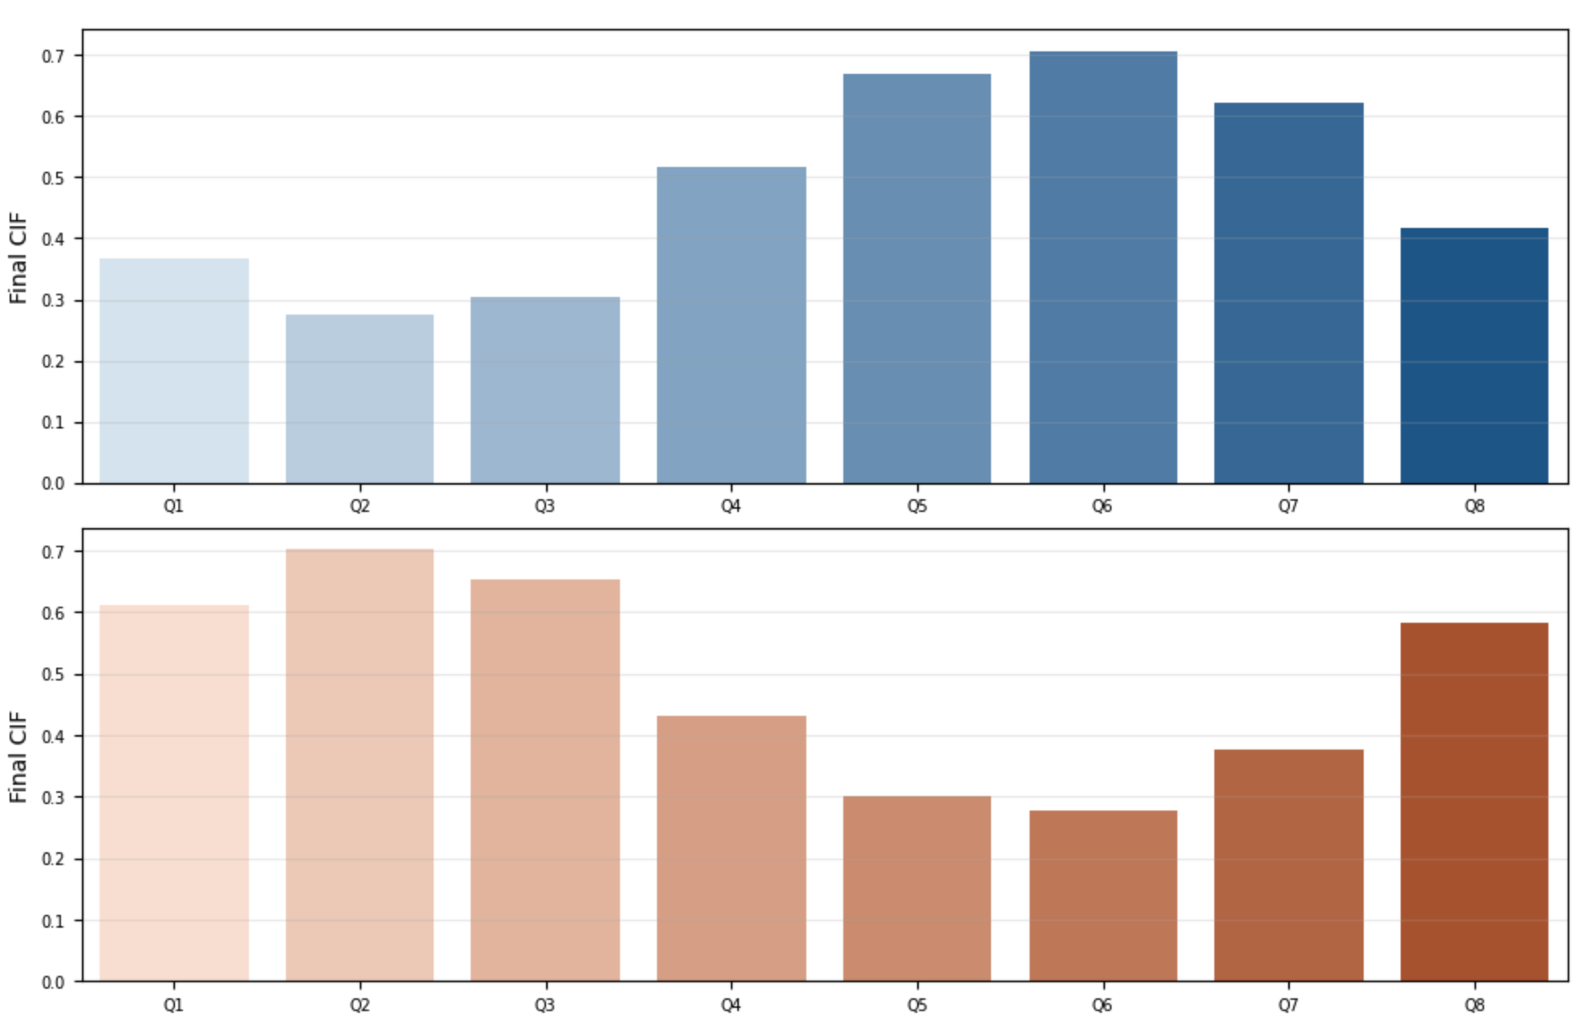
QUESTIONS?
69

