Slide 1
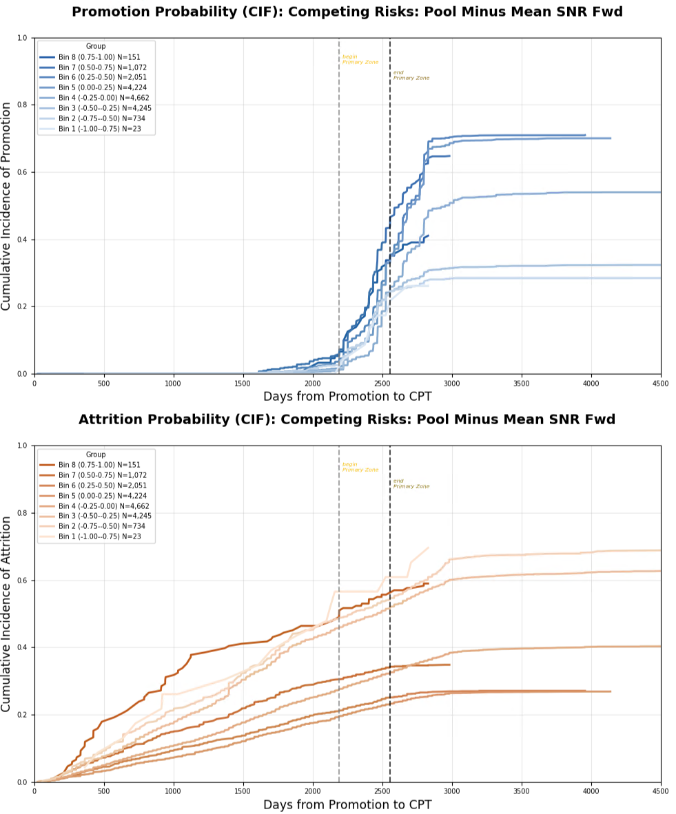
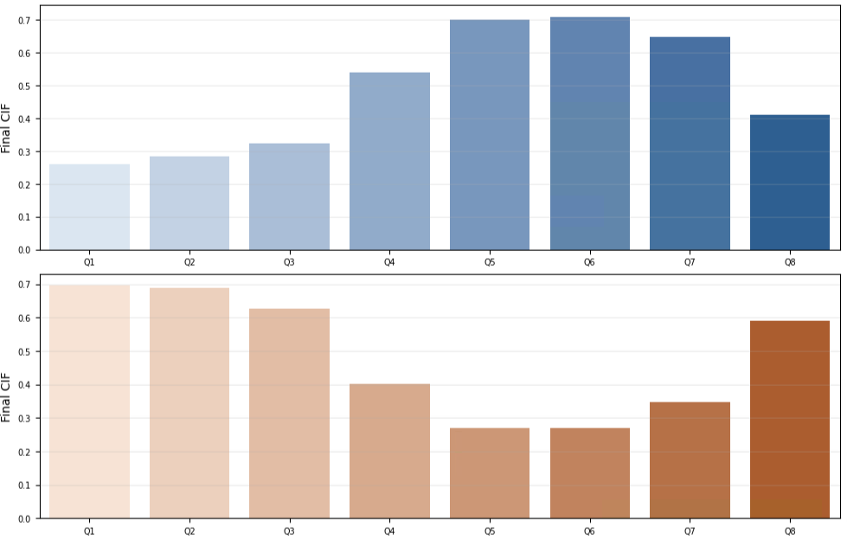
Original Army Talent Data

Slide 2
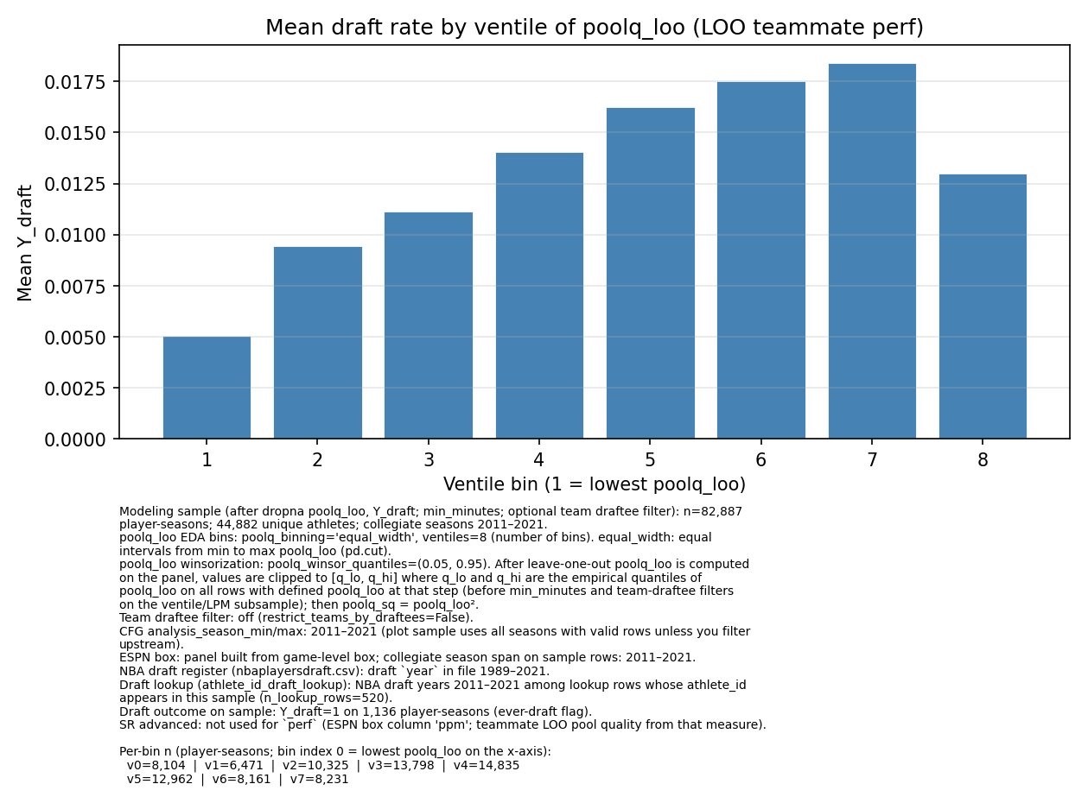
Comparison of Talent and Sports Domains
NCAA Basketball Player Draft Rate by Team Roster Pressure
NBA Draft Rate
Rate of Promotion/Early promotion to Major
by officer’s rating pool talent
Equal width bins of teammate PPM per season
Figure B
Cumulative Final Promotion Incidence
Equal width bins of rating pool Top Block Ratio
Figure A

Slide 3
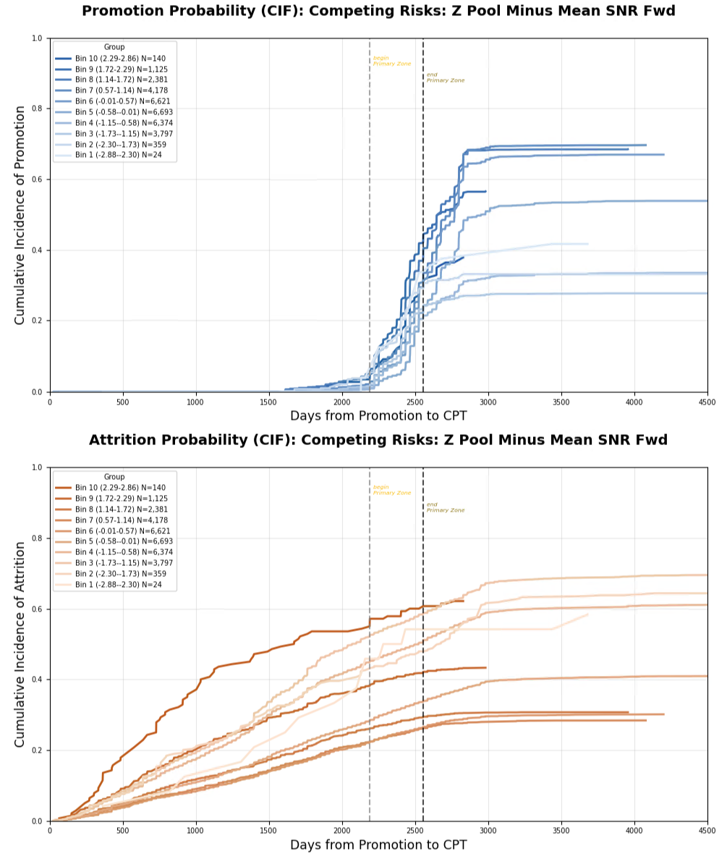
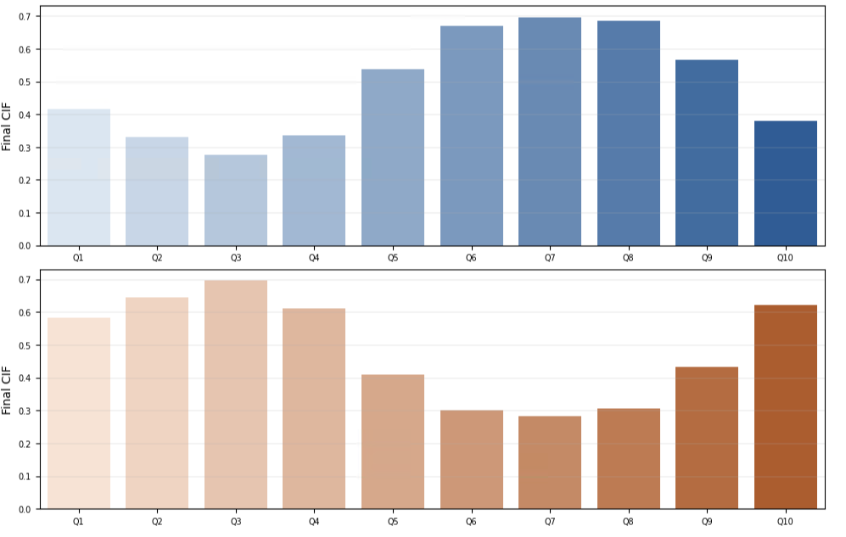
Full Own Performance Metric (OPM) Data (All Officers)

Slide 4
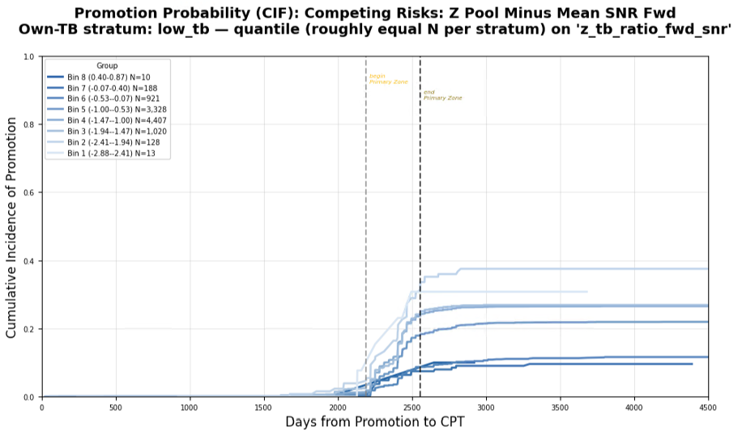
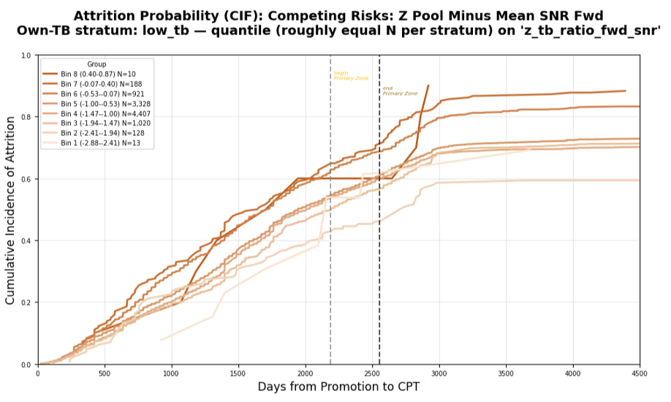
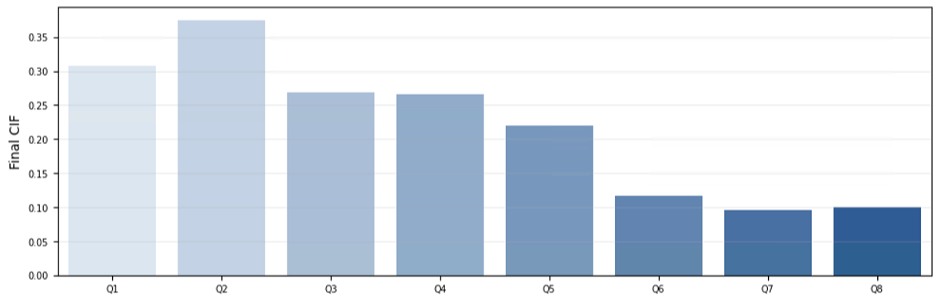
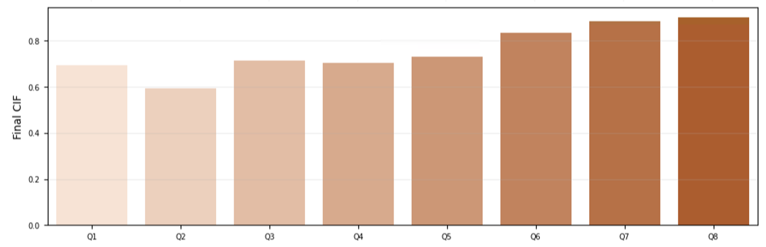
Lower Third OPM

Slide 5
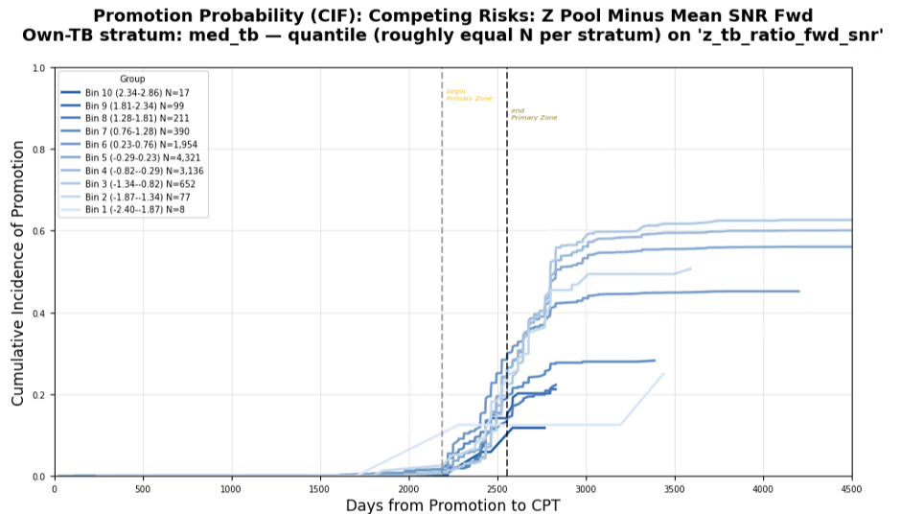
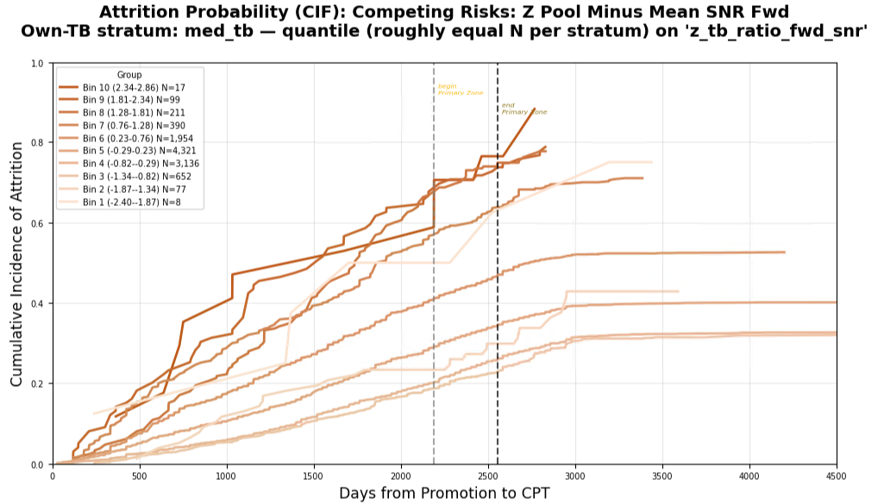
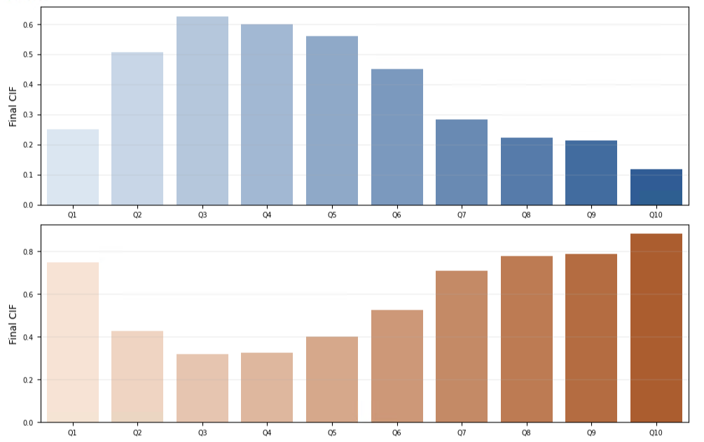
Middle Third OPM

Slide 6
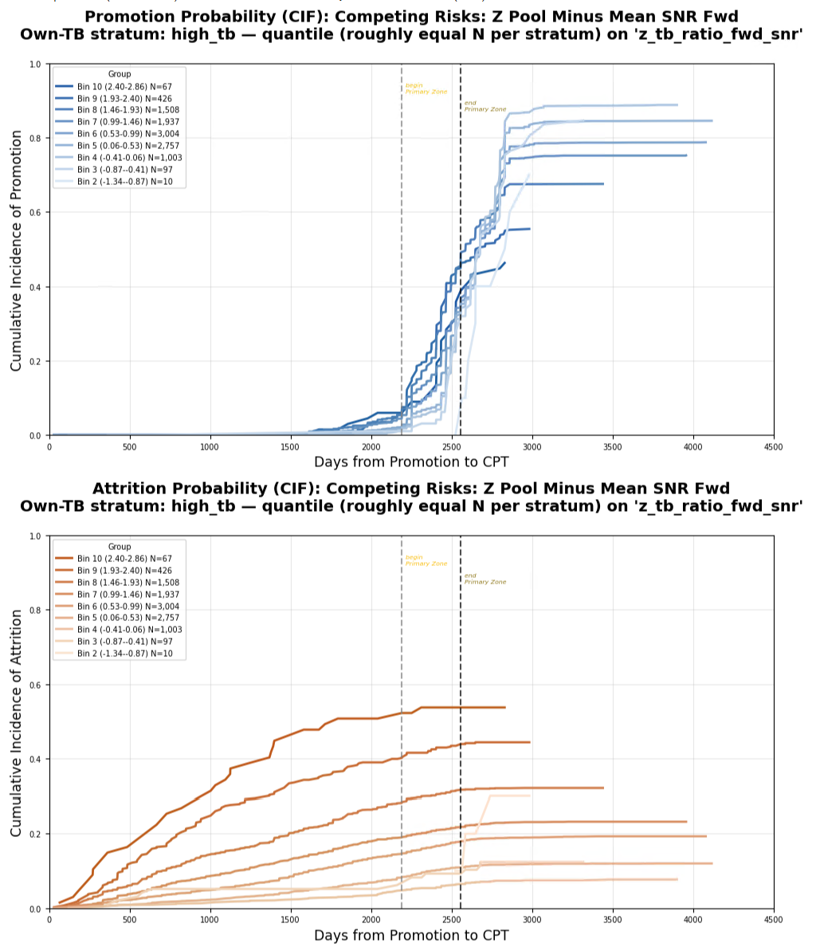
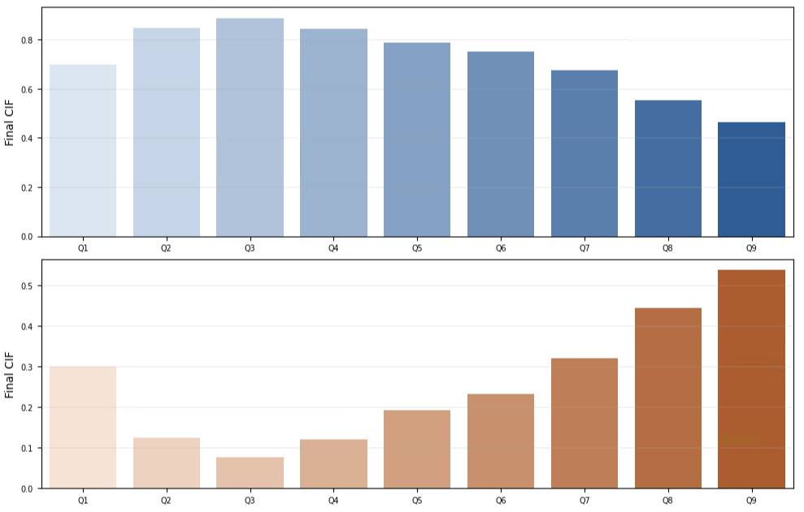
Upper Third OPM

Slide 7
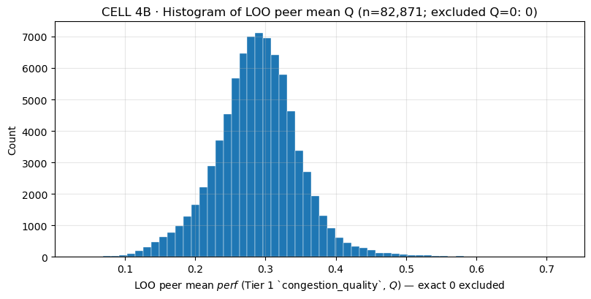
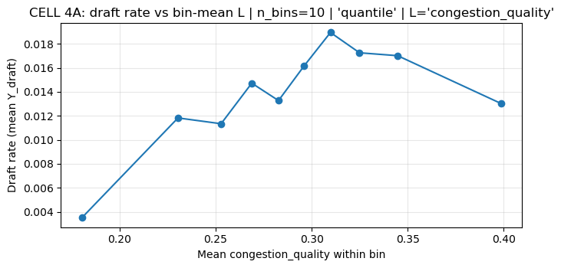
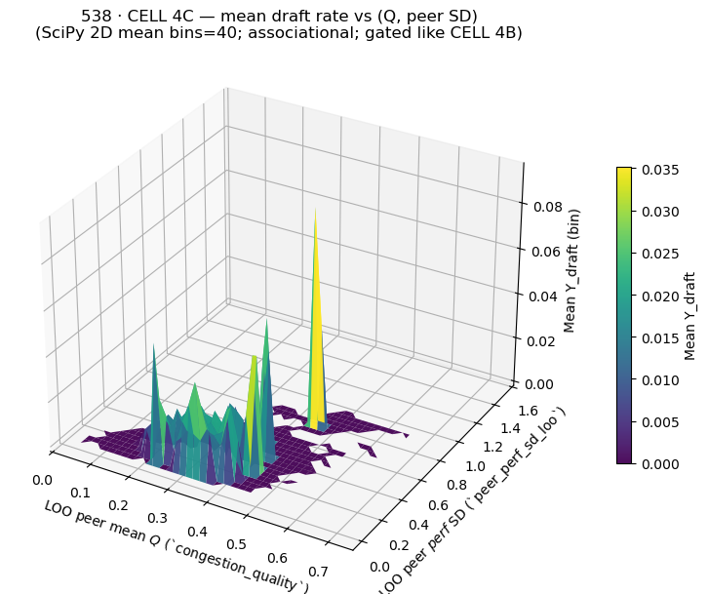
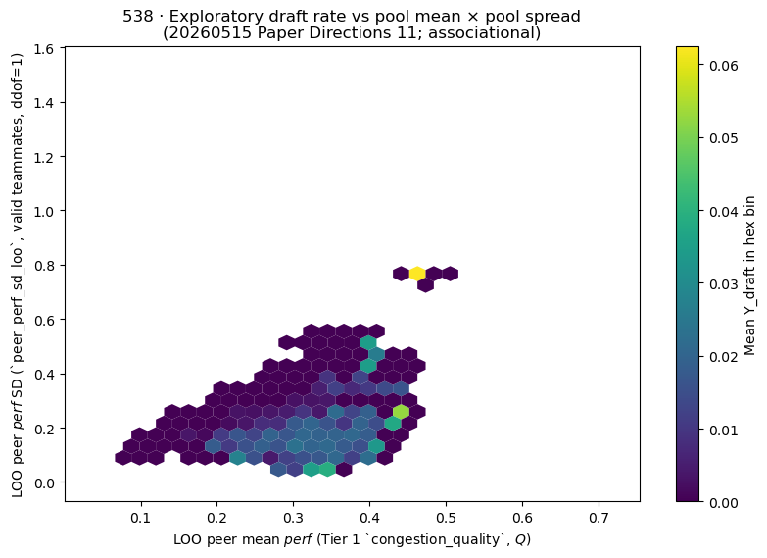
Exploratory Sports Data Analysis

Slide 8
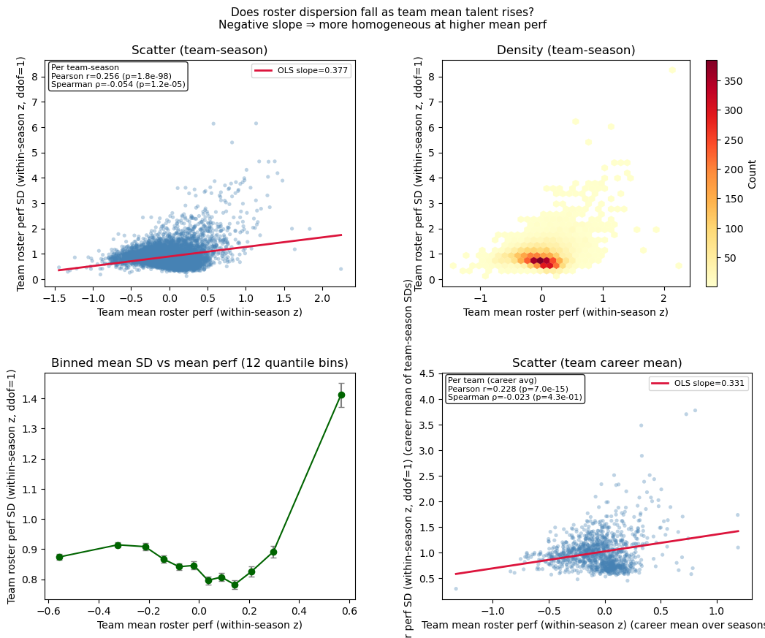
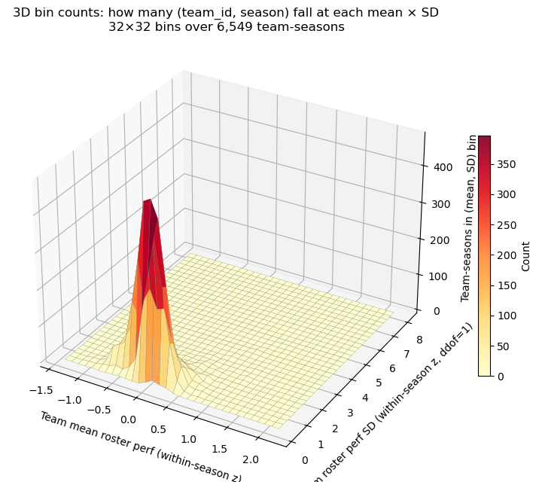
Empirical NCAA Data

Slide 9
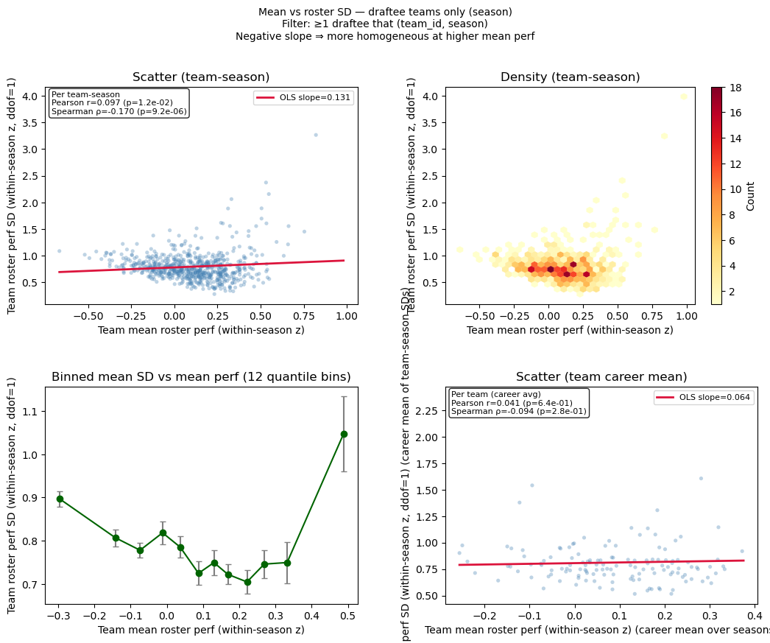
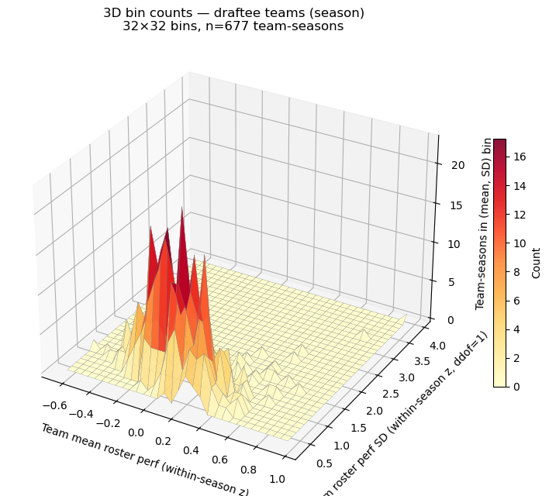
Empirical NCAA Data

Slide 10
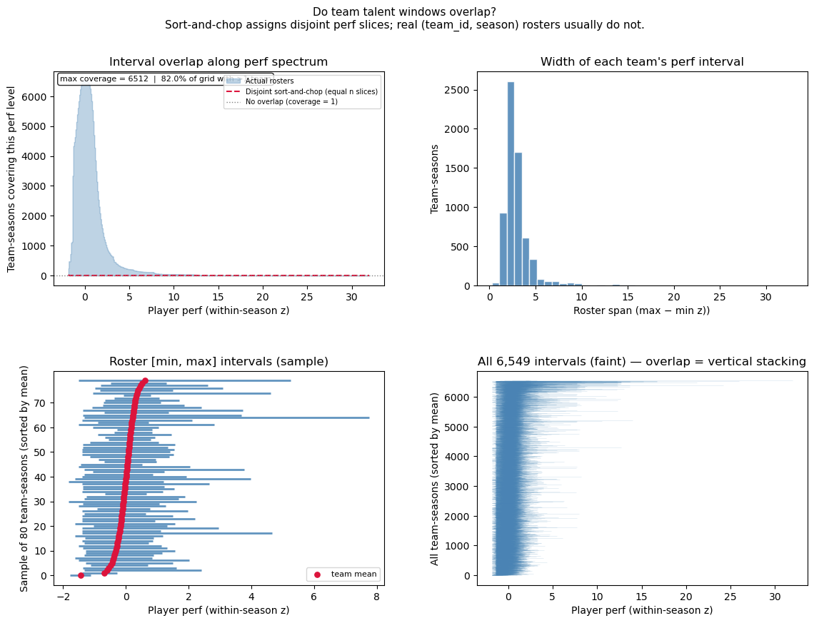
Empirical NCAA Data

Slide 11
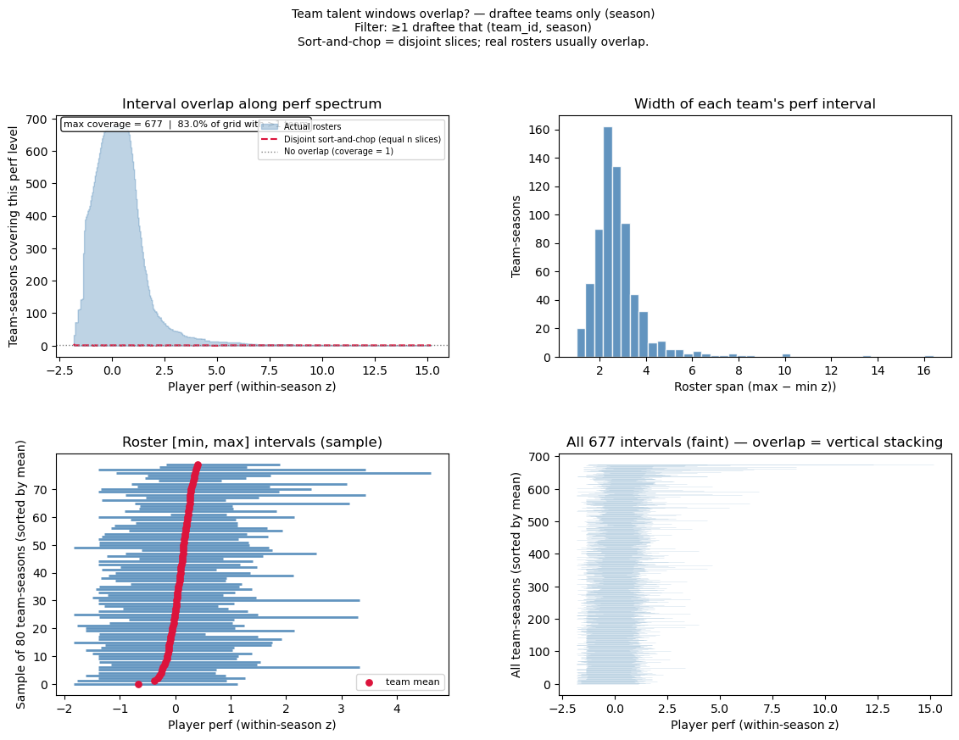
Empirical NCAA Data

Slide 12
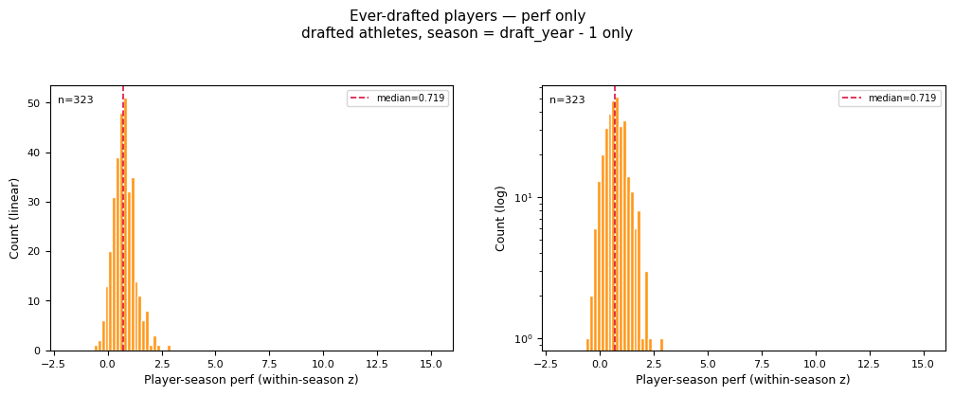
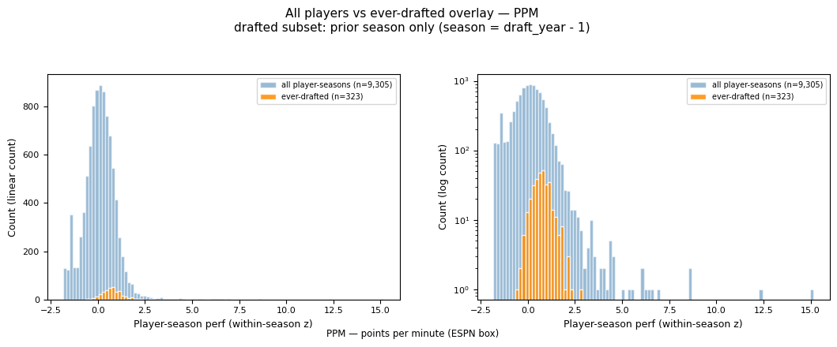
Empirical NCAA Data
=== Drafted-player perf quantiles (θ guide) ===
0.05 -0.047419
0.10 0.129225
0.15 0.254267
0.25 0.400061
0.50 0.719101
0.75 1.052542
0.90 1.362709
All-player p15=-0.6769 p25=-0.3791 (global viability benchmarks if θ is population-based)
Drafted-only p15=0.2543 p25=0.4001
PRIOR_DRAFT_SEASON_ONLY=True | drafted athletes=789 | rows in drafted hist=323

Slide 14
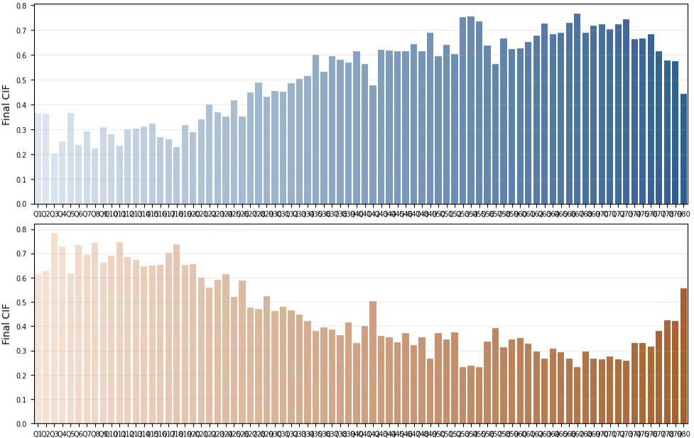
80 BINS, CA, QUANTILE

Slide 15
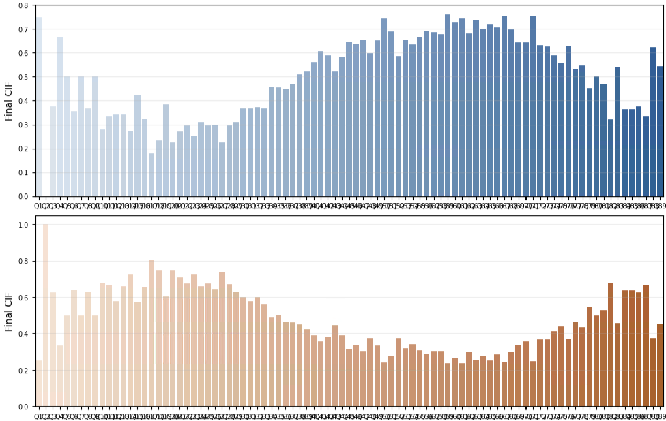
100 BINS, CA, EQUAL WIDTH

