Slide 1
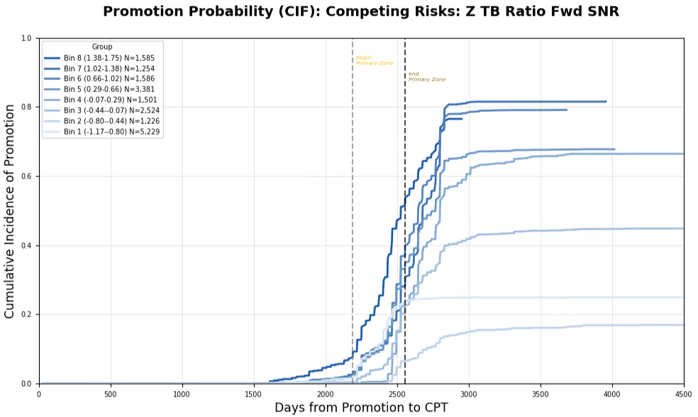
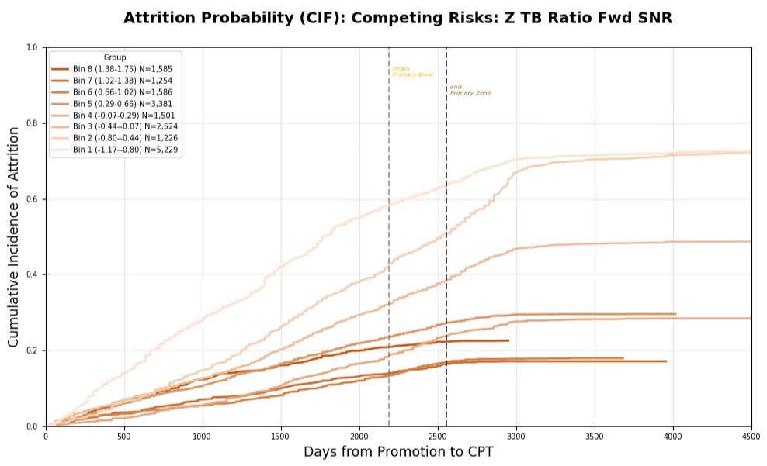
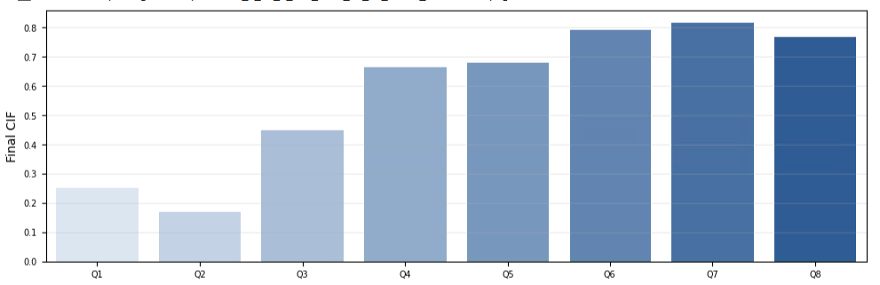
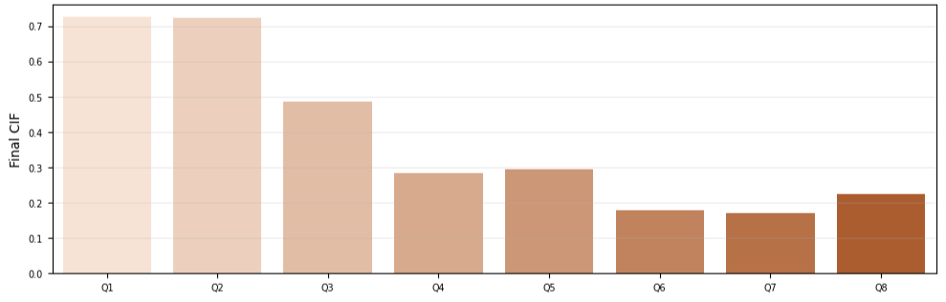
Figure 1

Slide 2
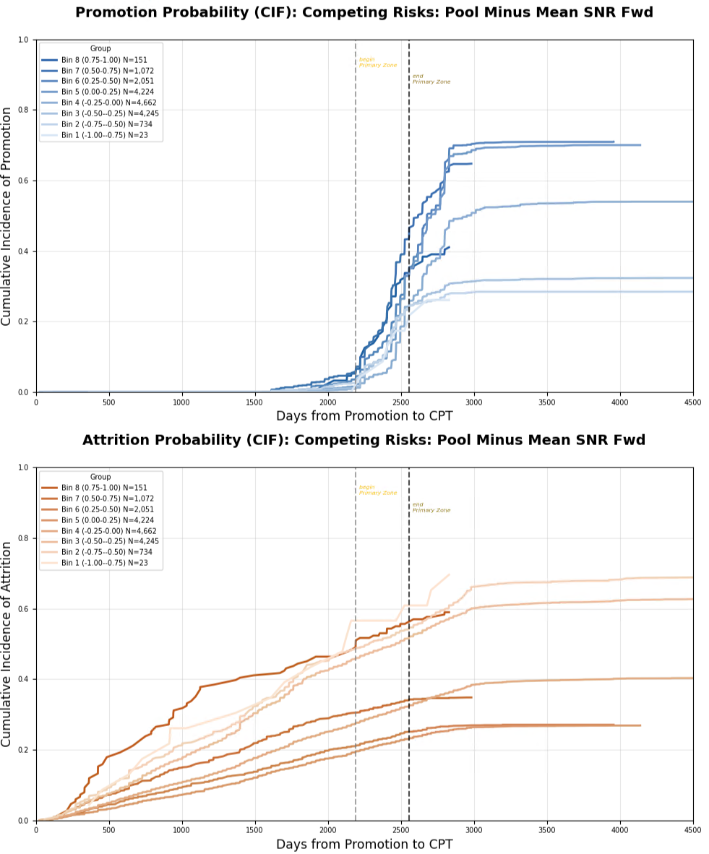
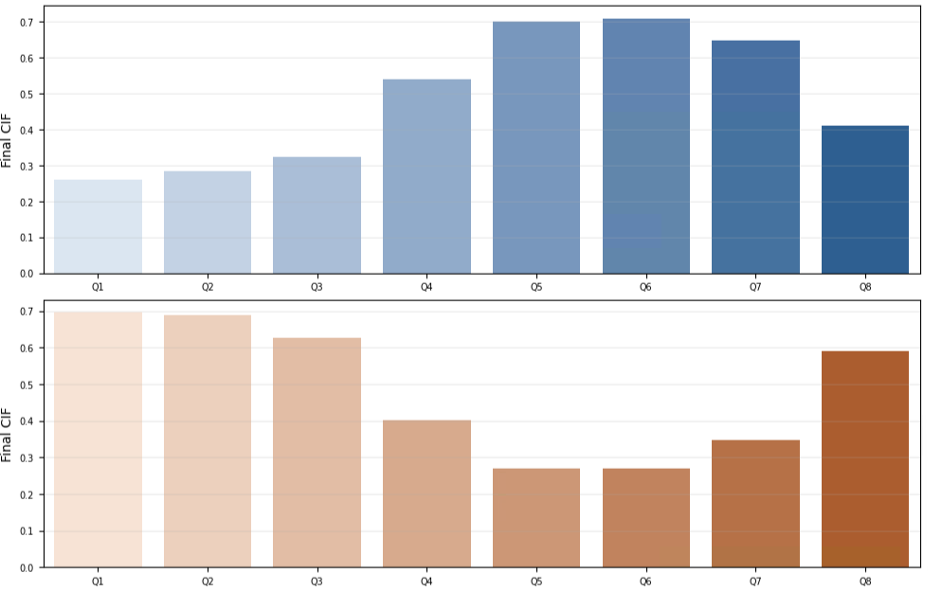
Figure 2

Slide 3
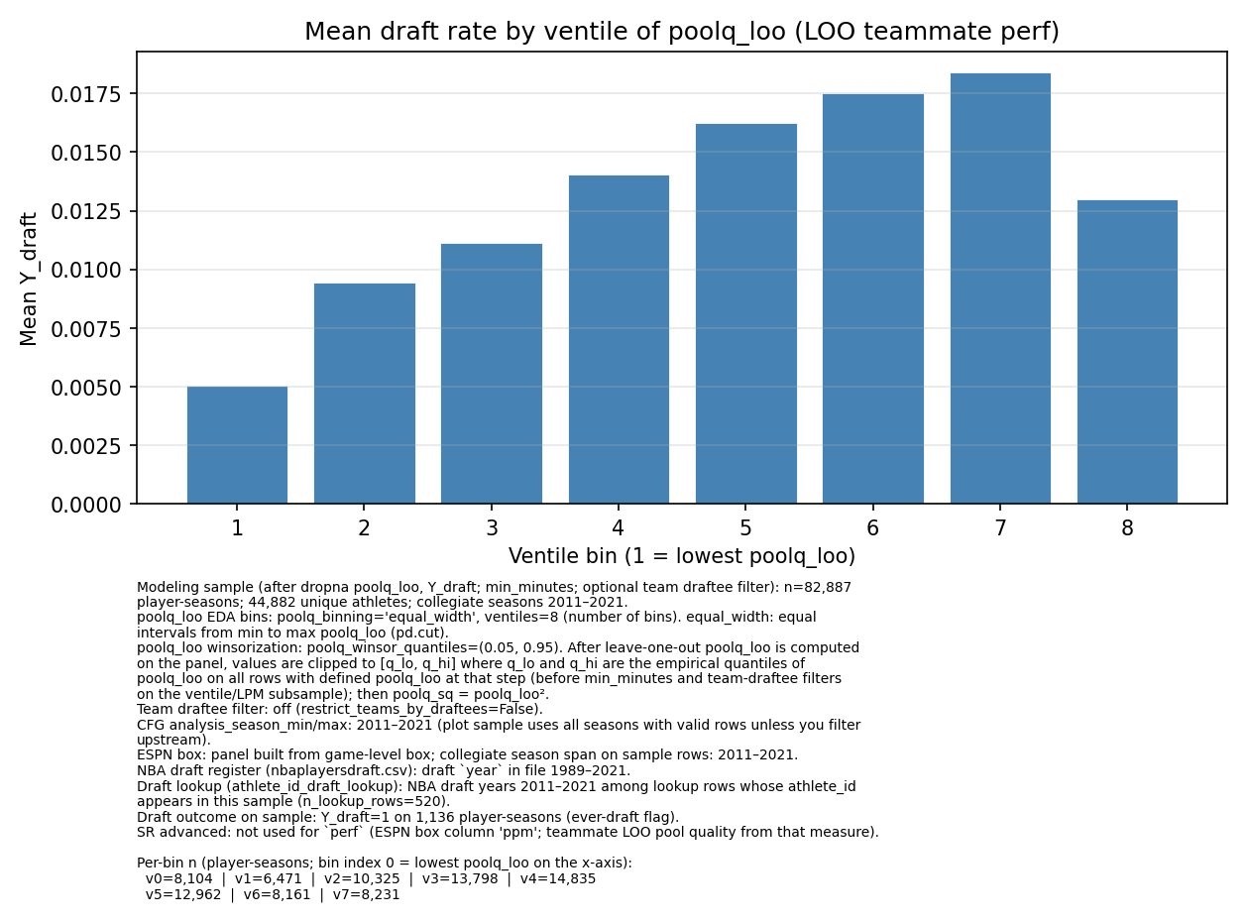
NCAA Basketball Player Draft Rate by Team Roster Pressure
NBA Draft Rate
Rate of Promotion/Early promotion to Major
by officer’s rating pool talent
Equal width bins of teammate PPM per season
Figure B
Cumulative Final Promotion Incidence
Equal width bins of rating pool Top Block Ratio
Figure A

Slide 4
Rate of Promotion/Early promotion to Major
by officer’s rating pool talent
Cumulative Final Promotion Incidence
Equal width bins of rating pool Top Block Ratio
Figure A

Slide 6
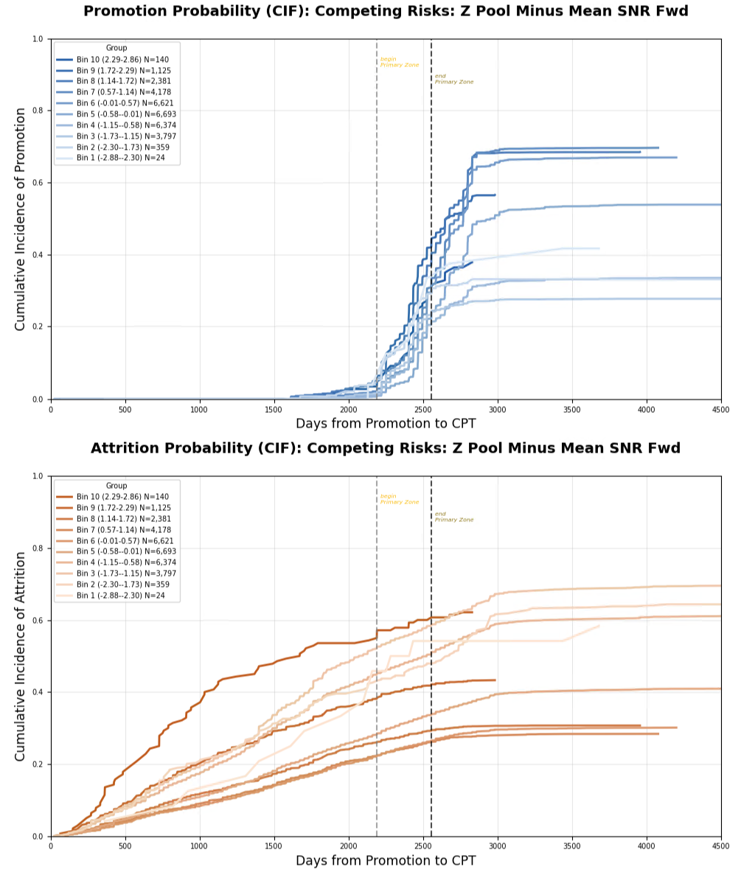
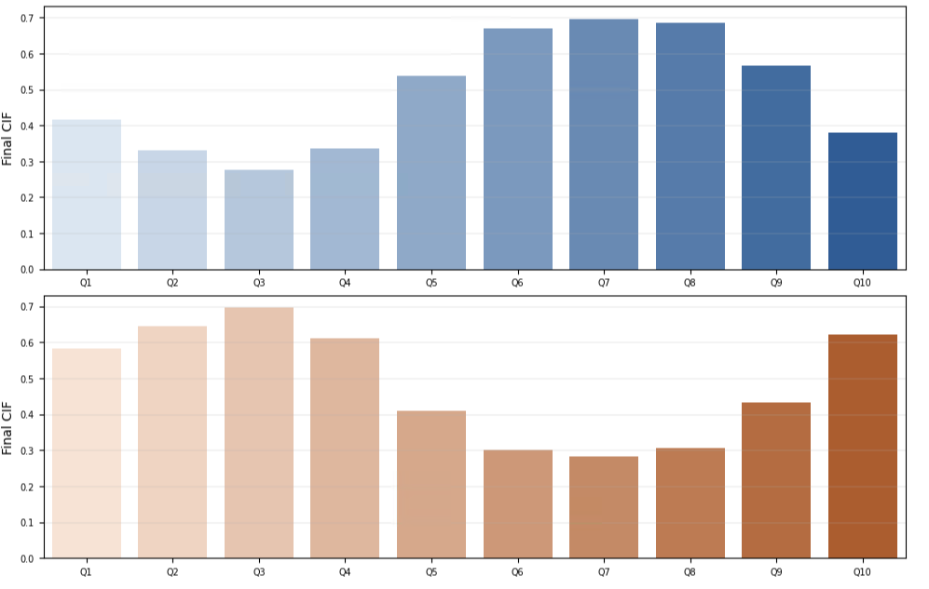
Full Own Performance Metric (OPM) Data (All Officers)

Slide 7
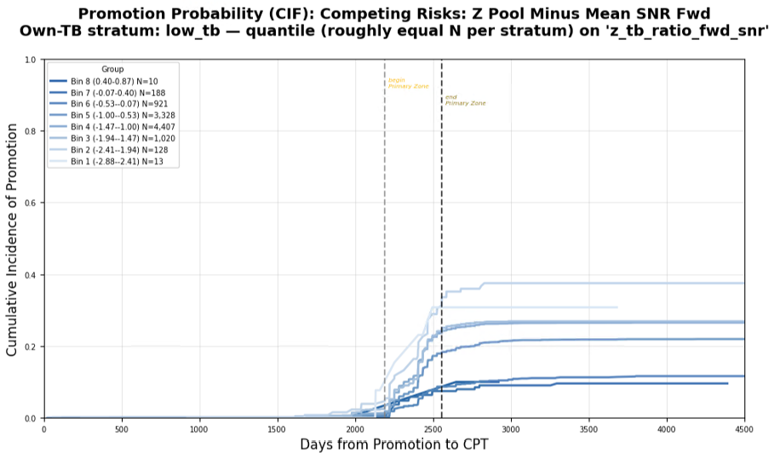
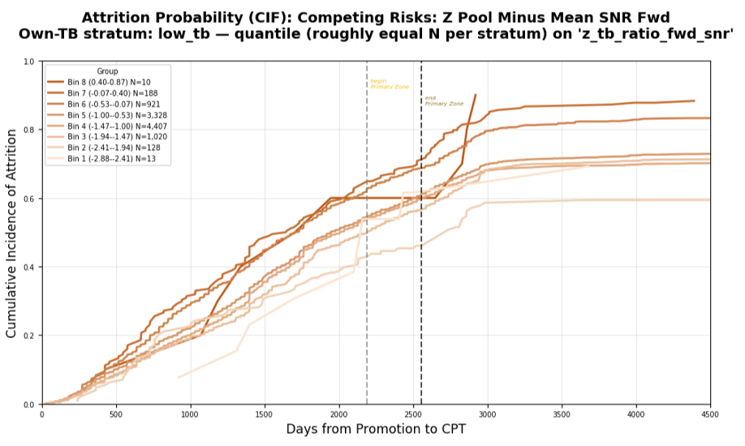
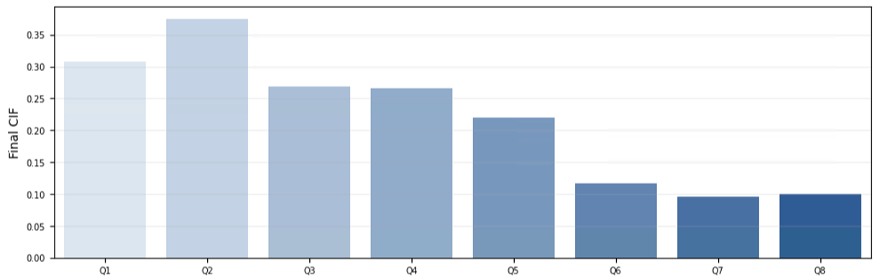
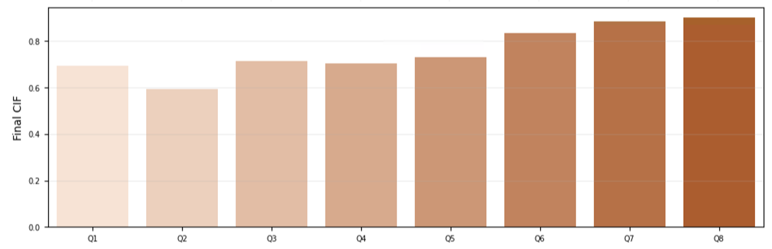
Lower Third OPM

Slide 8
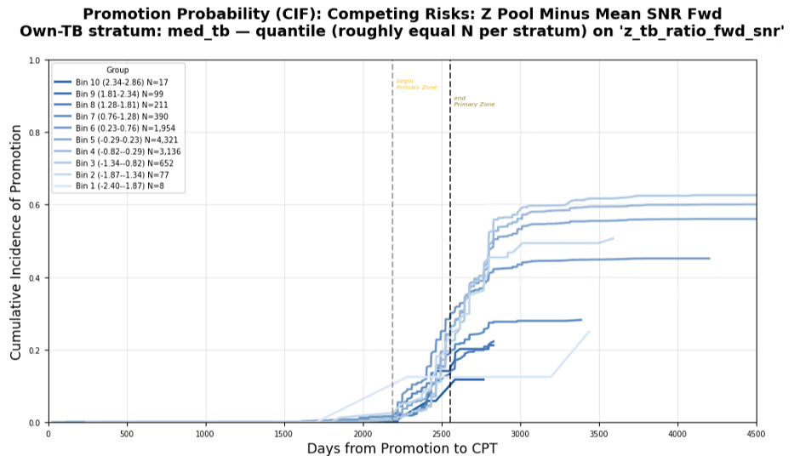
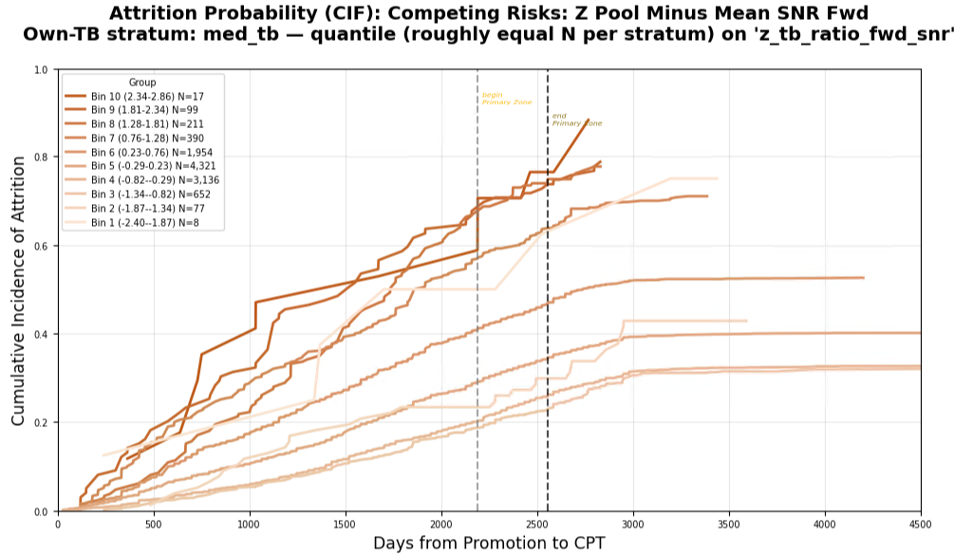
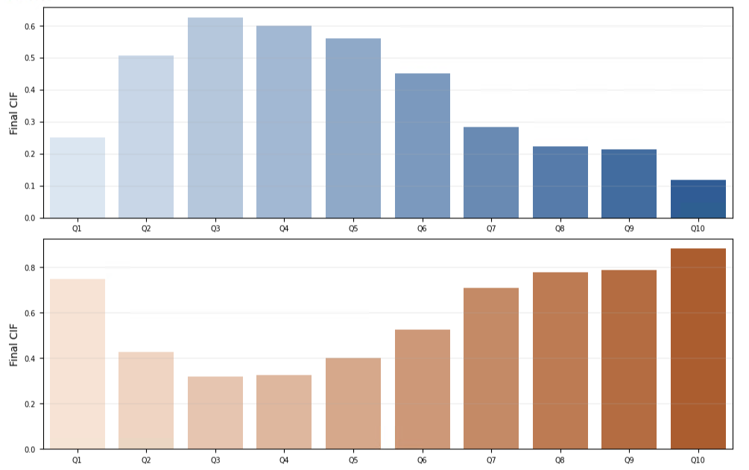
Middle Third OPM

Slide 9
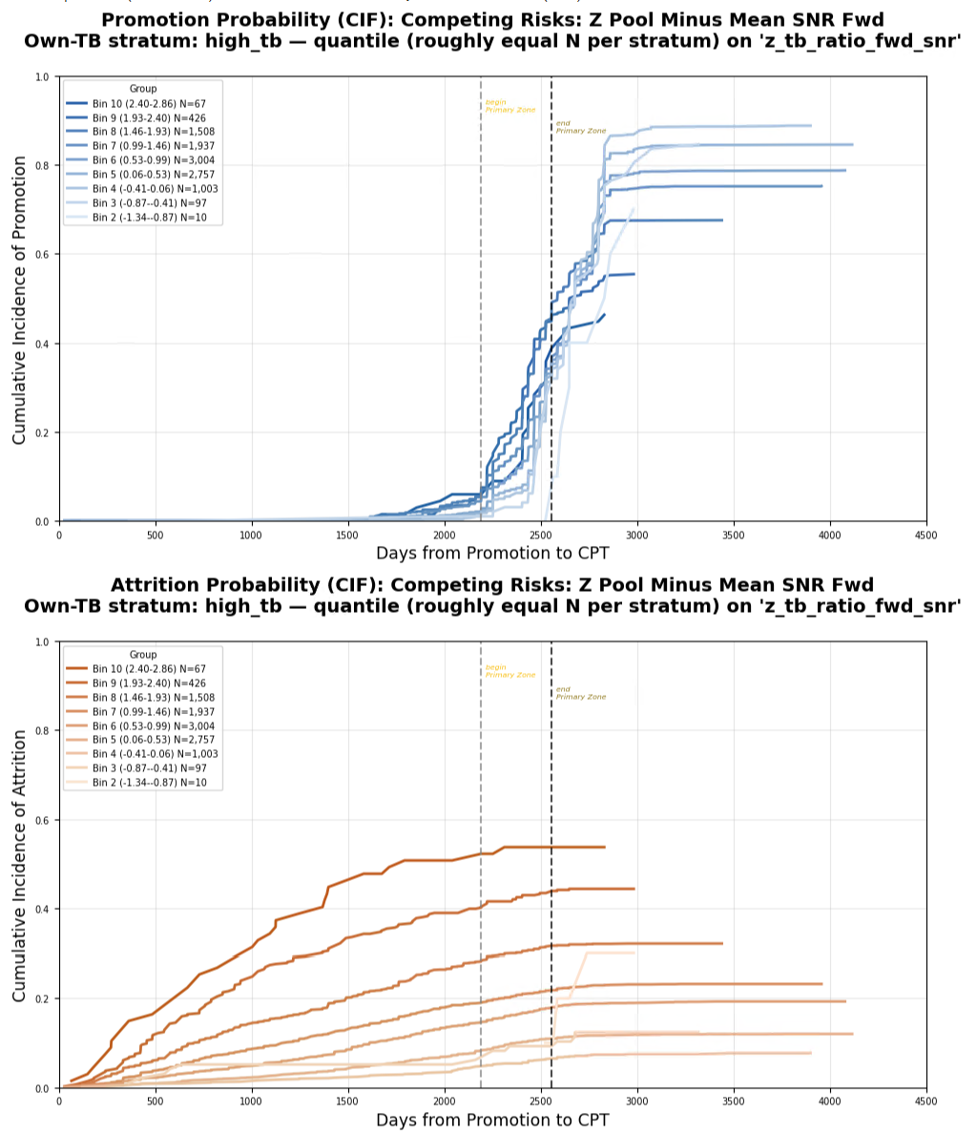
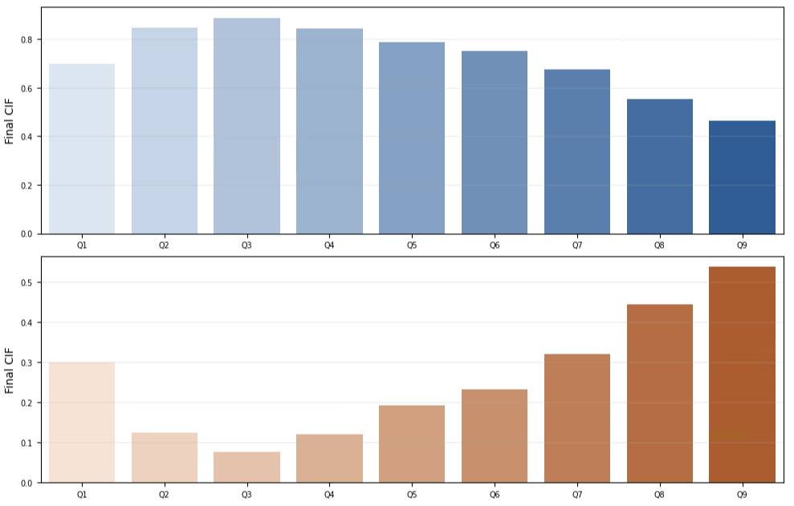
Upper Third OPM

Slide 10
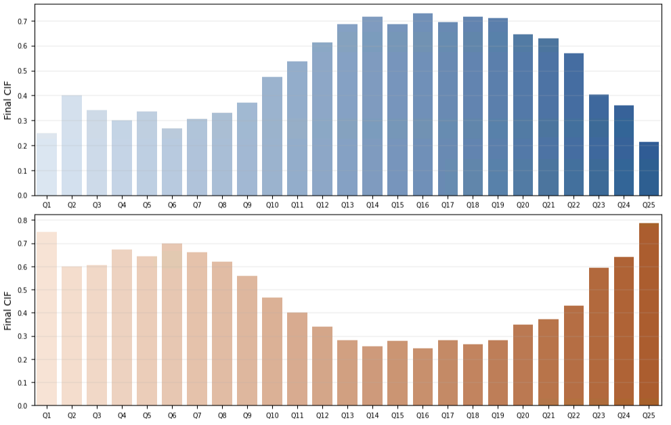
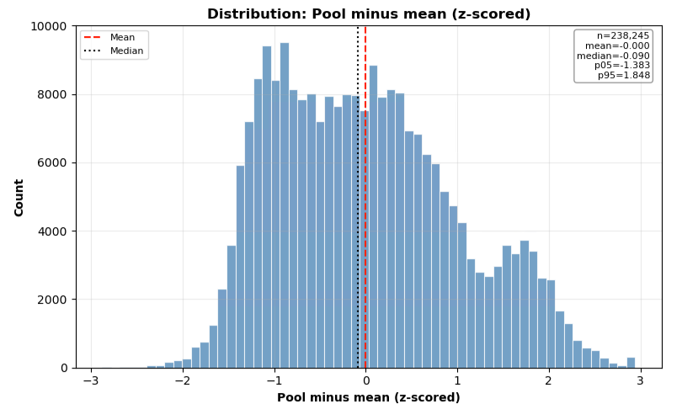
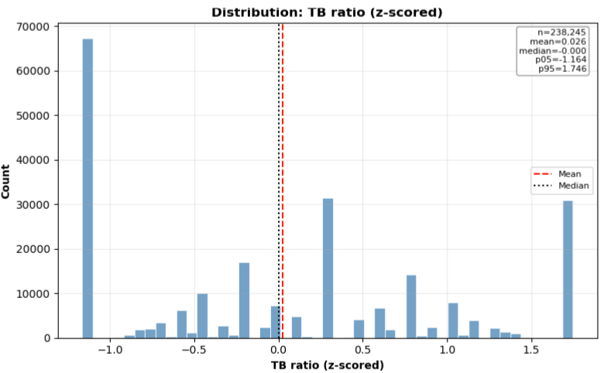
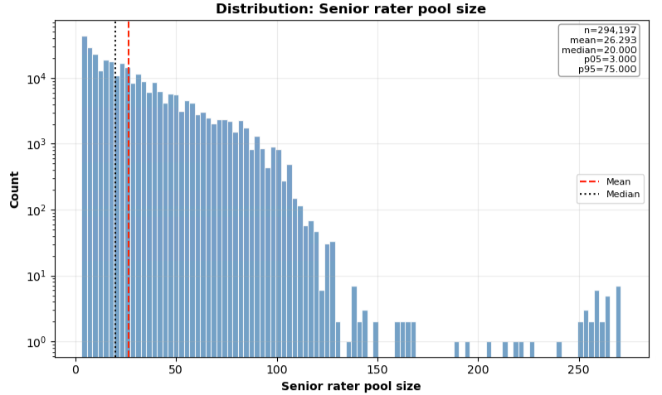
Supplementary Information

Slide 11
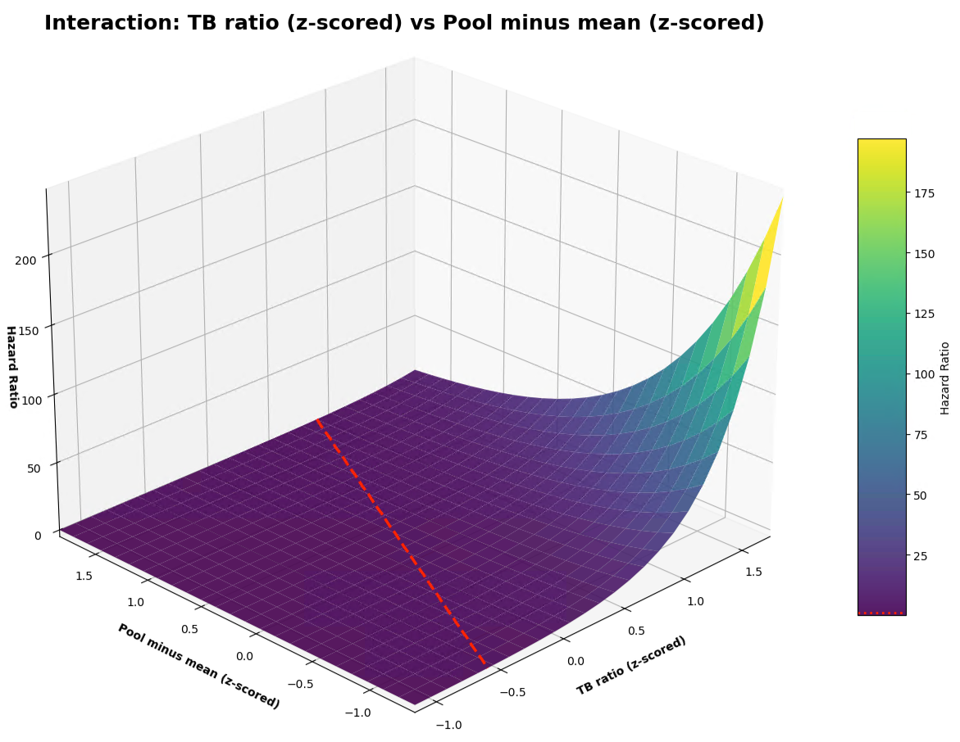
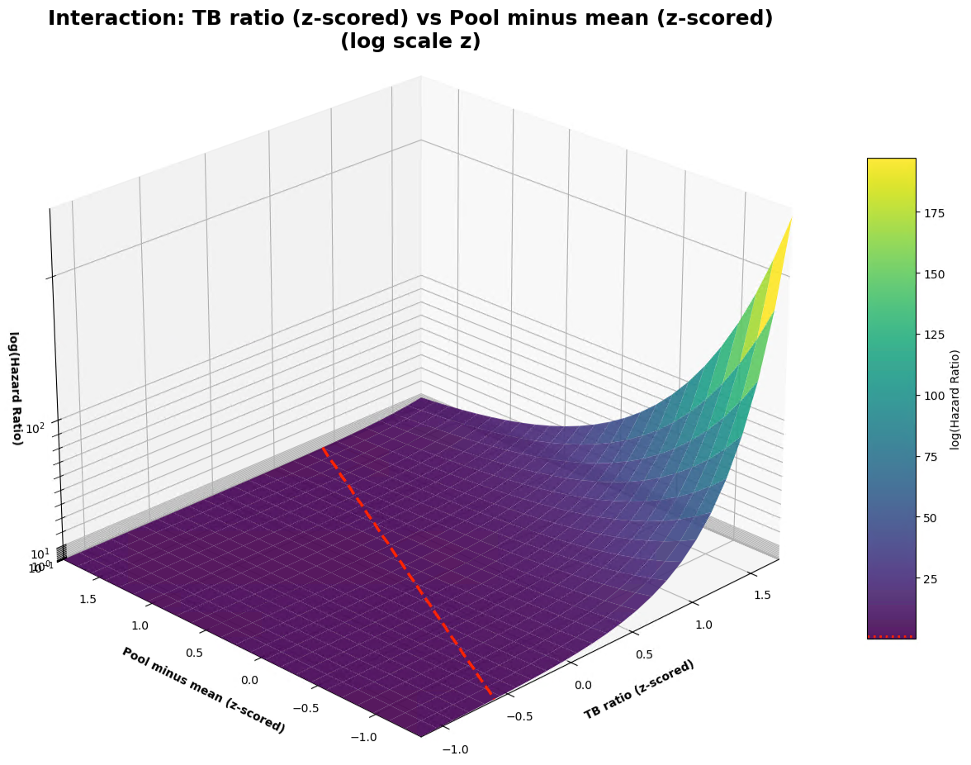
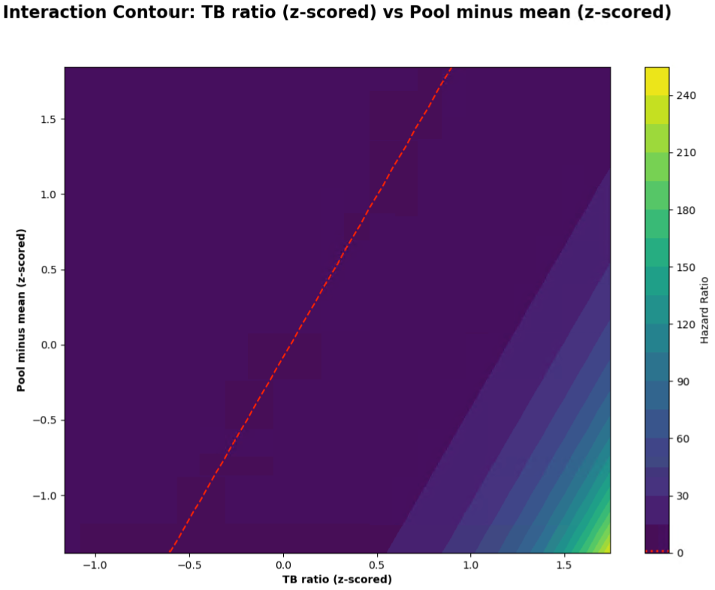
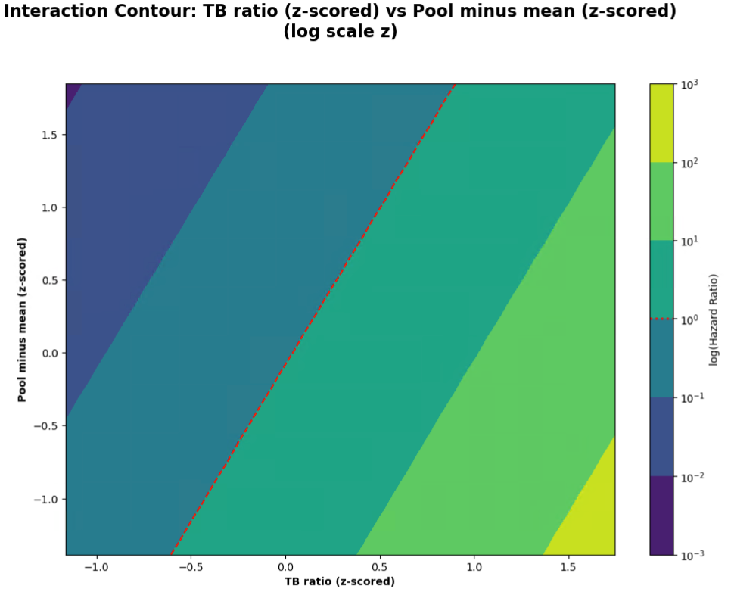
Supplementary Information

Slide 12
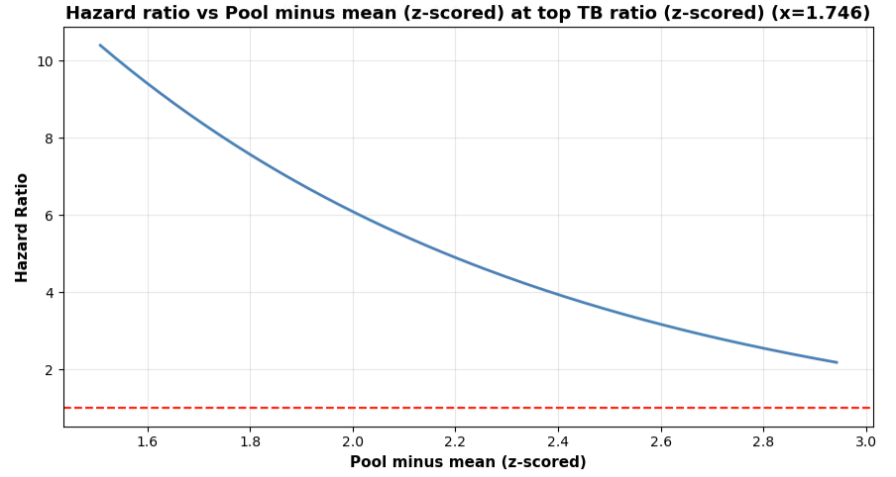
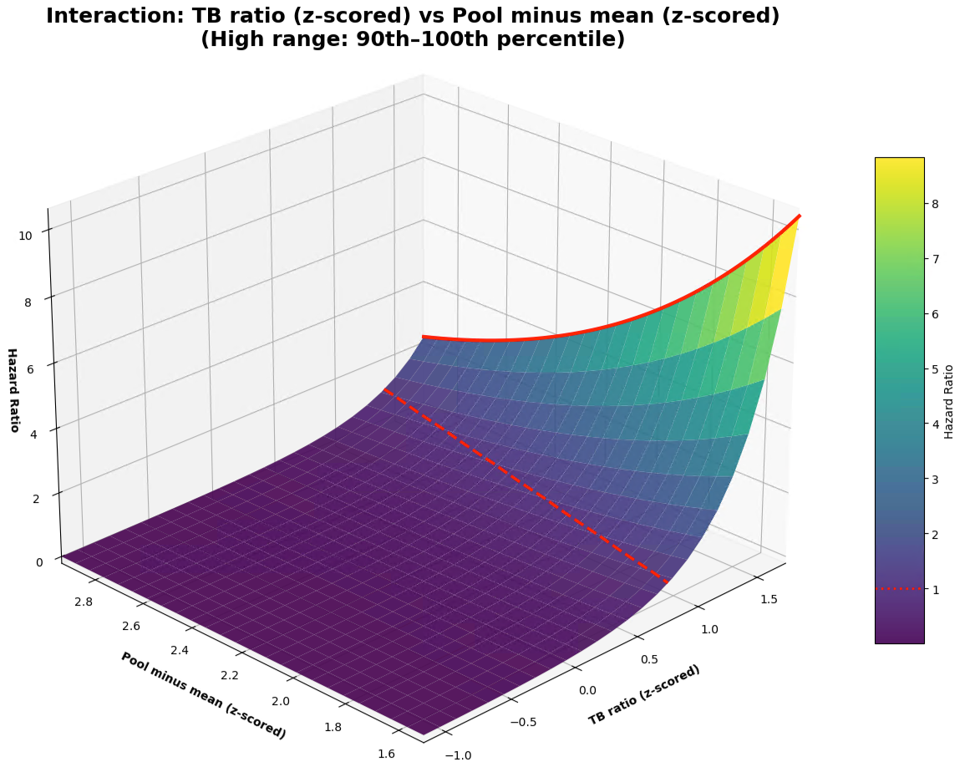
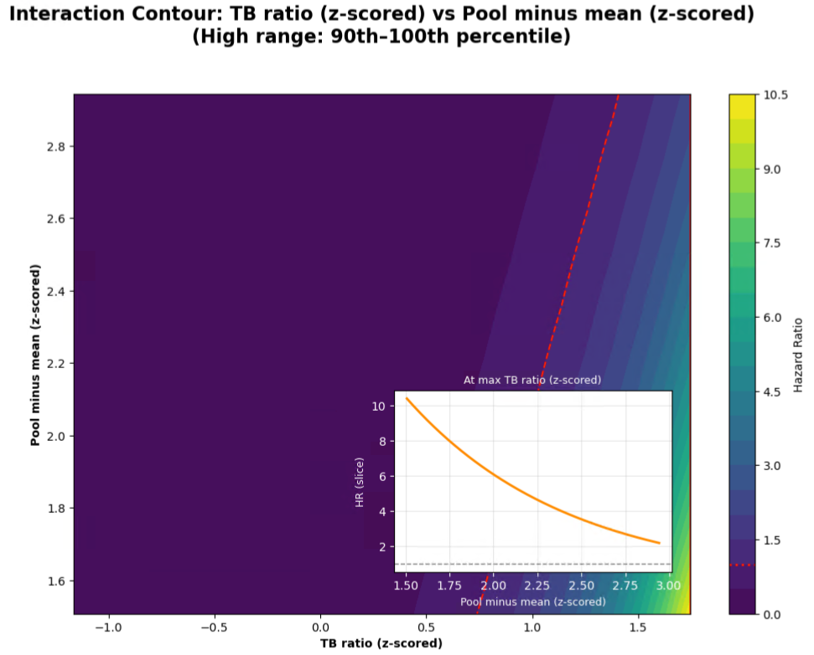
Supplementary Information

Slide 13
Supplementary Information

Slide 14
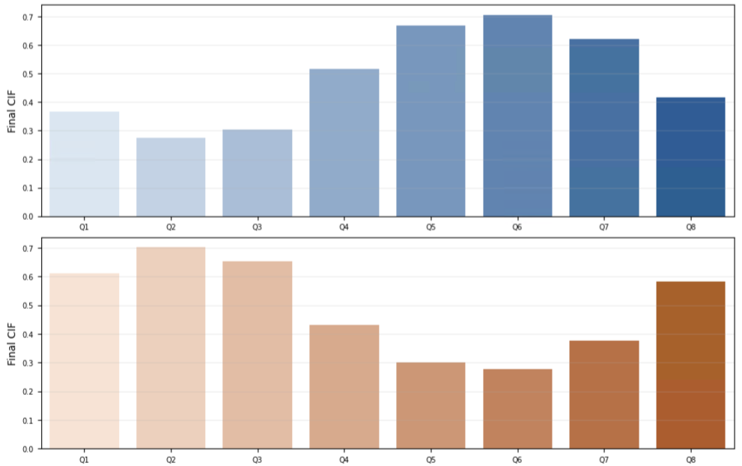
8 BINS, ALL BRANCHES, EQUAL WIDTH

Slide 15
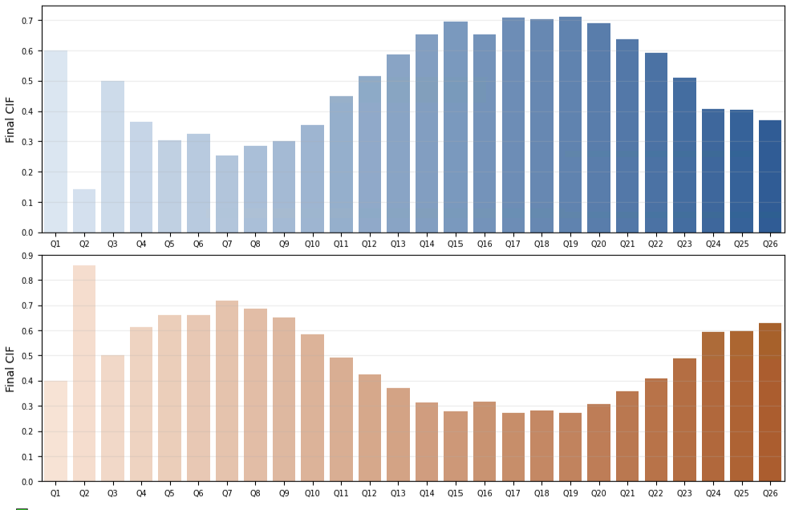
26 BINS, ALL BRANCHES, EQUAL WIDTH

Slide 16
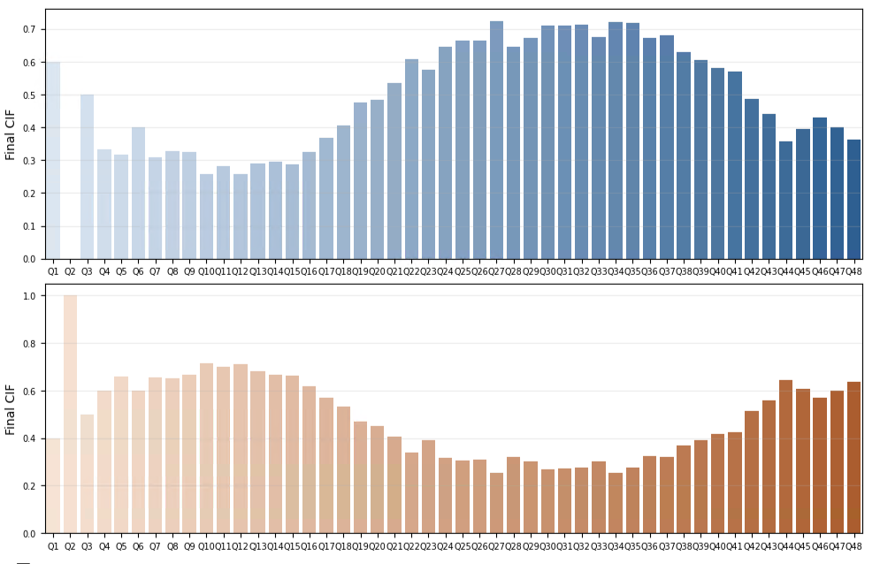
50 BINS, ALL BRANCHES, EQUAL WIDTH

Slide 17
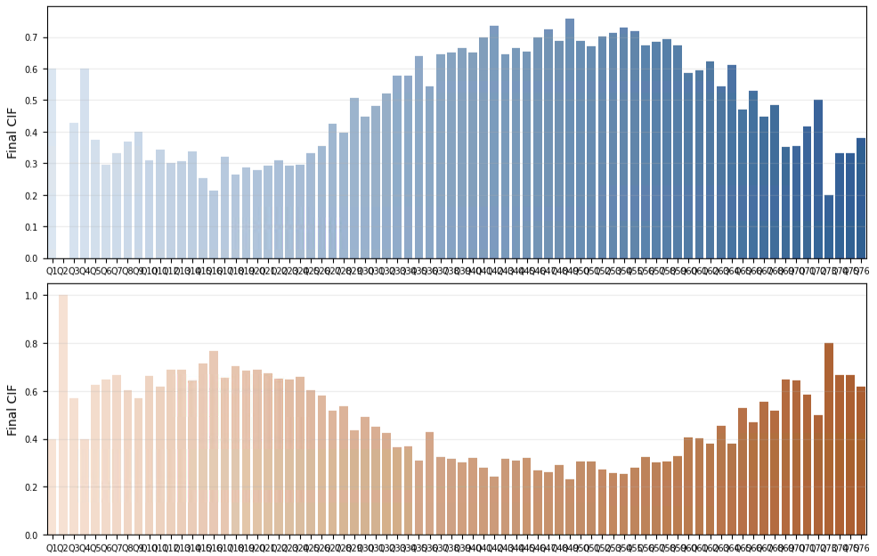
80 BINS, ALL BRANCHES, EQUAL WIDTH

Slide 18
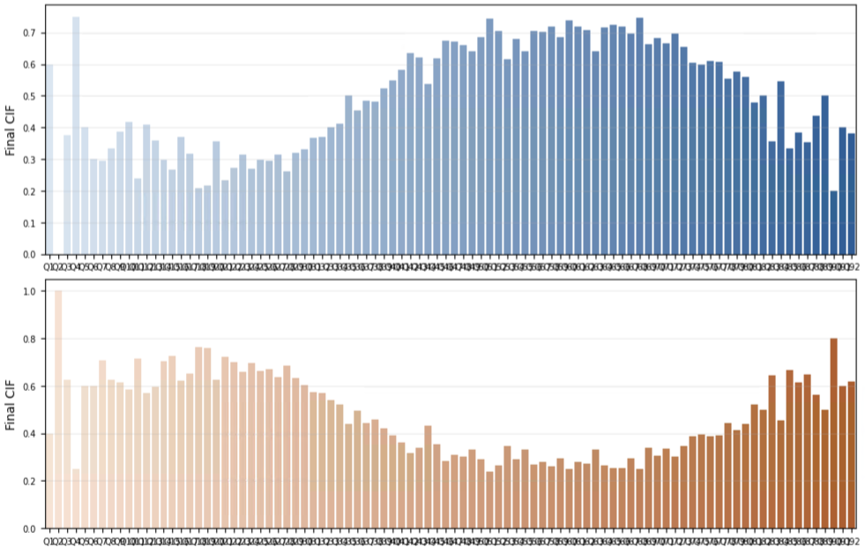
100 BINS, ALL BRANCHES, EQUAL WIDTH

Slide 19
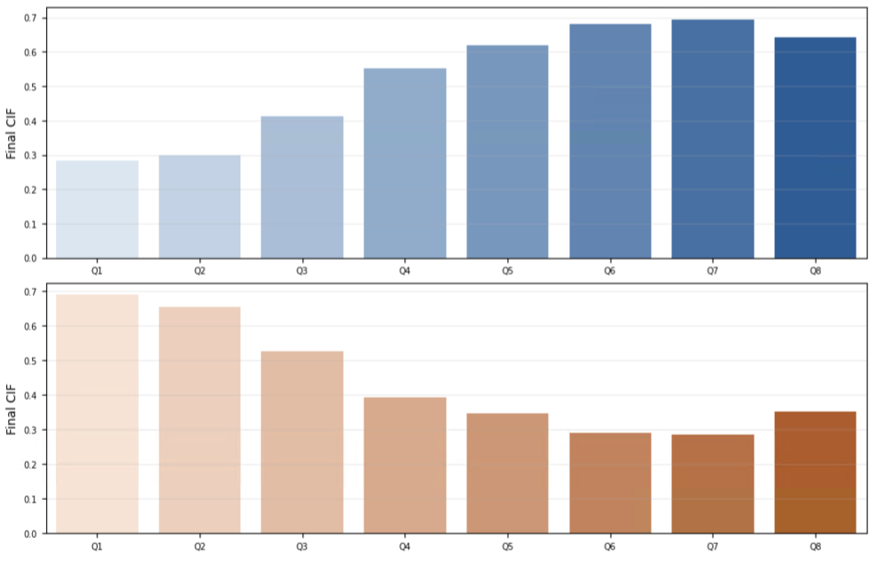
8 BINS, ALL BRANCHES, QUANTILE
8 bins all branches, QUANTILE

Slide 20
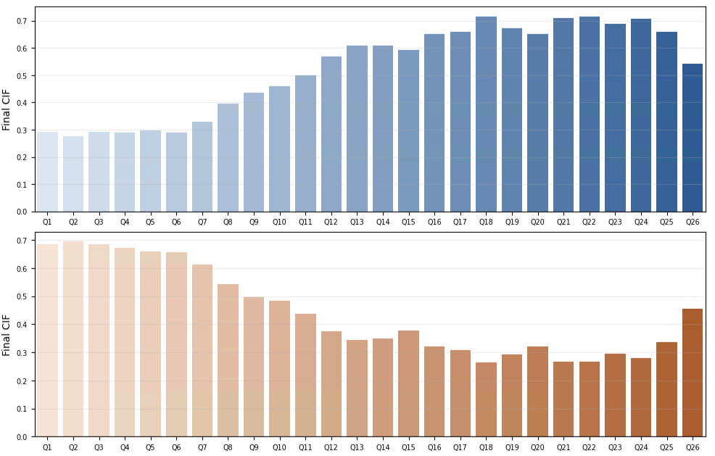
26 BINS, ALL BRANCHES, QUANTILE
26 bins all branches, QUANTILE

Slide 21
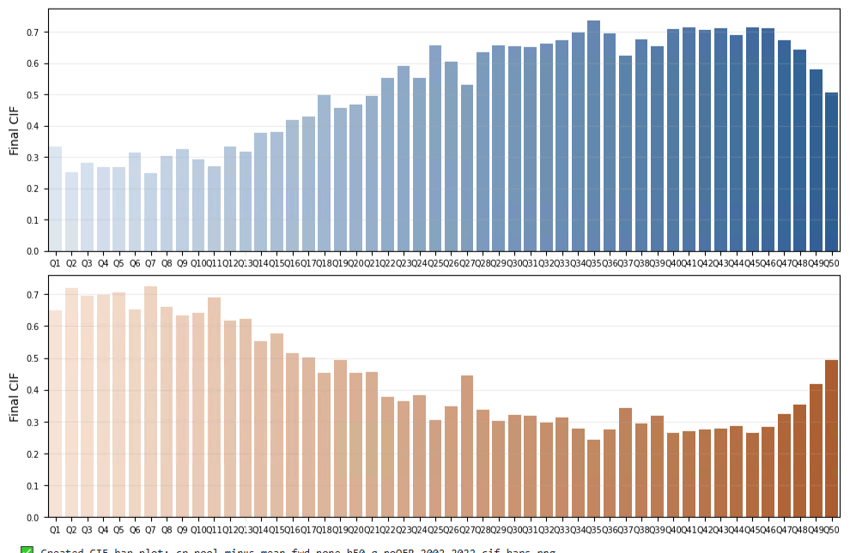
50 BINS, ALL BRANCHES, QUANTILE
50 bins all branches, QUANTILE

Slide 22
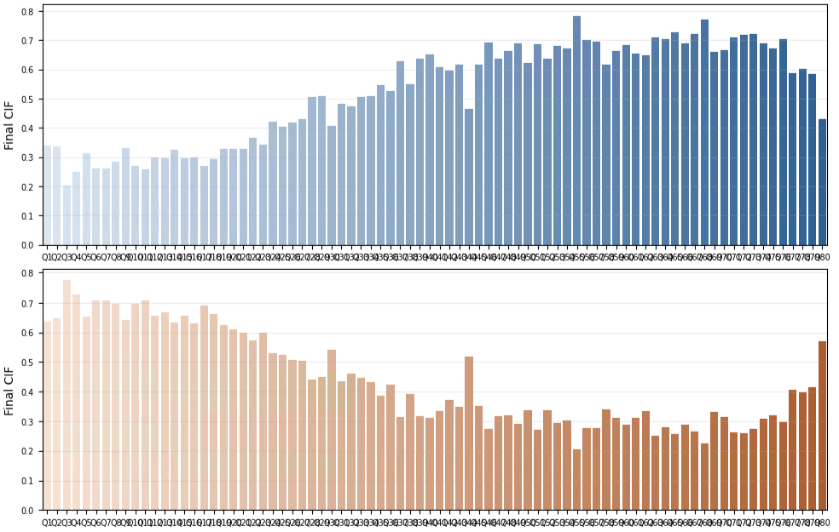
80 BINS, ALL BRANCHES, QUANTILE

Slide 23
100 BINS, ALL BRANCHES, QUANTILE

Slide 24
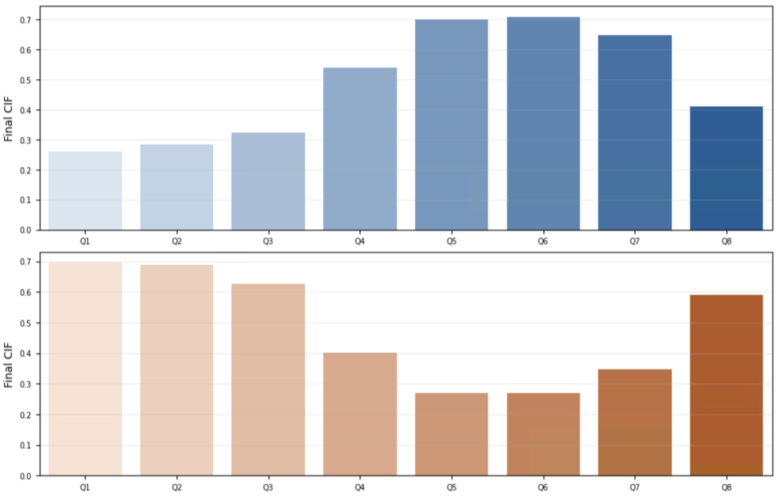
8 BINS, CS + CSS, EQUAL WIDTH

Slide 25
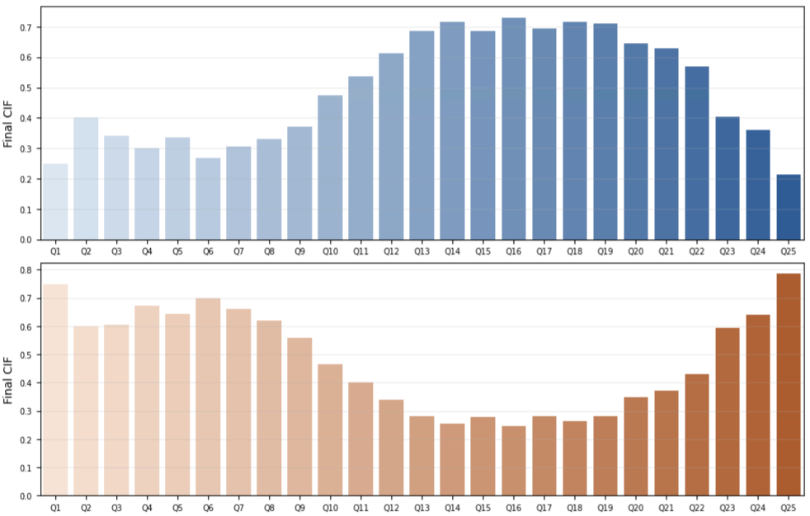
26 BINS, CS + CSS, EQUAL WIDTH

Slide 26
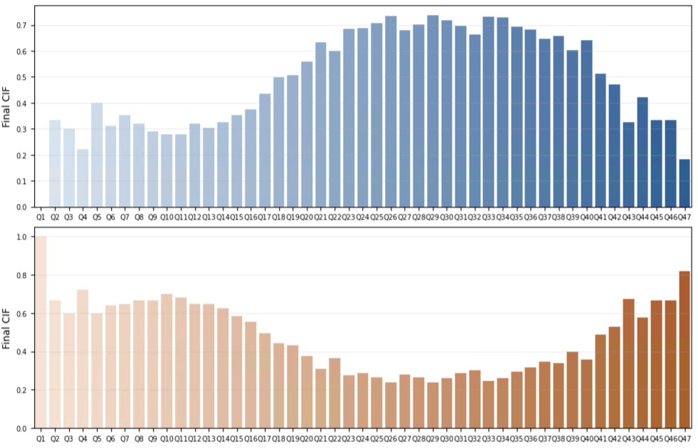
50 BINS, CS + CSS, EQUAL WIDTH

Slide 27
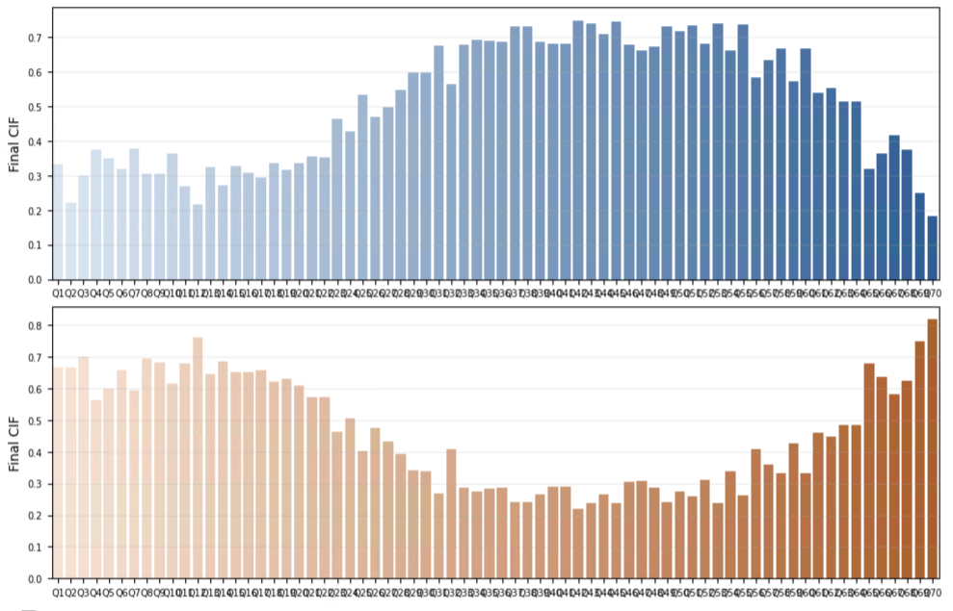
80 BINS, CS + CSS, EQUAL WIDTH

Slide 28
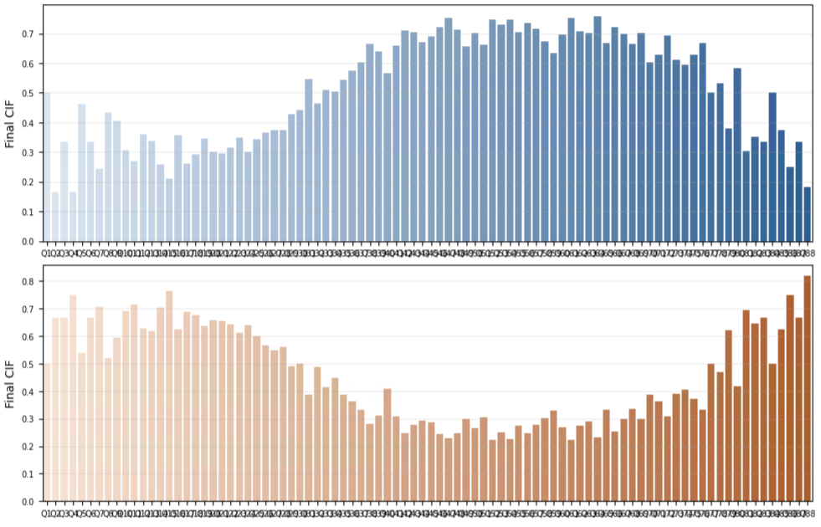
100 BINS, CS + CSS, EQUAL WIDTH

Slide 29
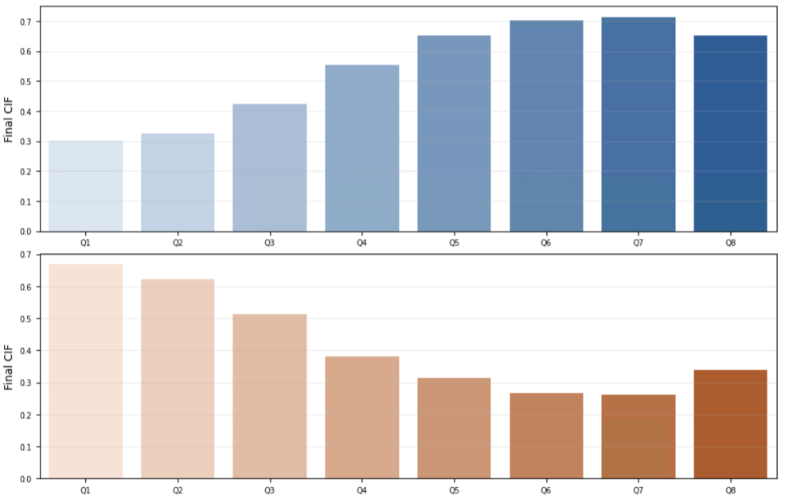
8 BINS, CS + CSS, QUANTILE

Slide 30
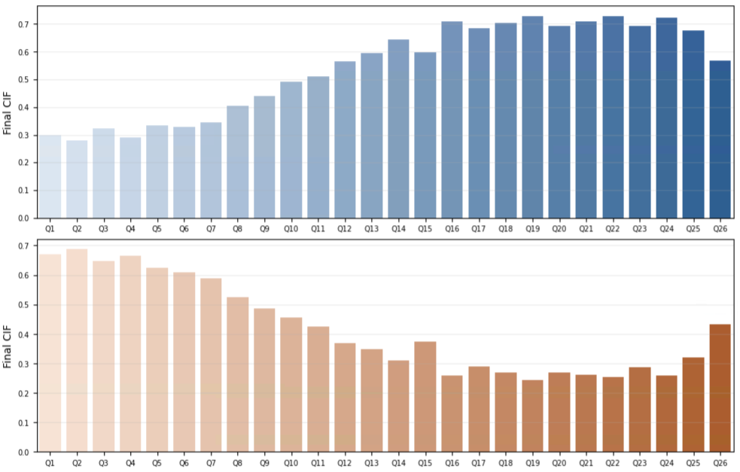
26 BINS, CS + CSS, QUANTILE

Slide 31
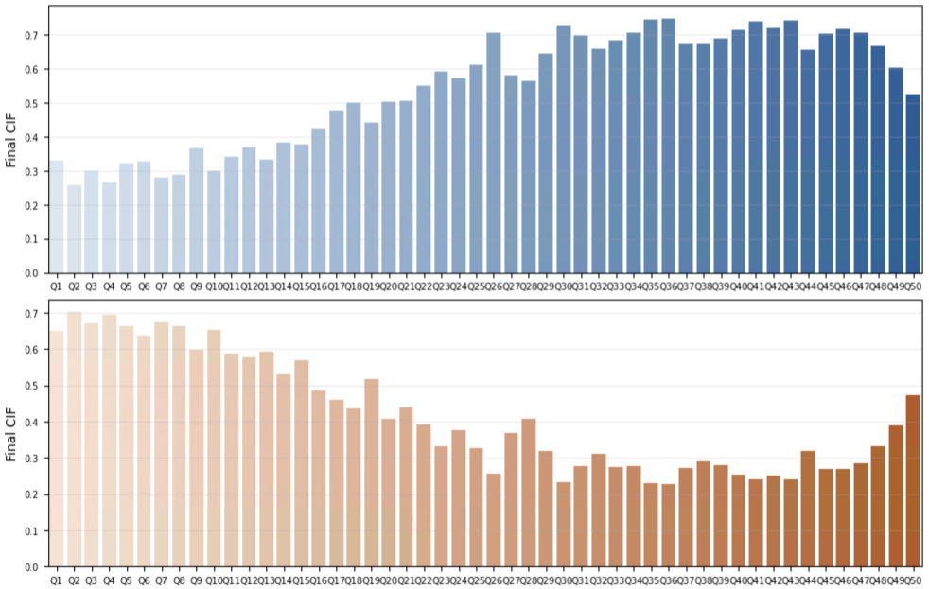
50 BINS, CS + CSS, QUANTILE

Slide 32

80 BINS, CS + CSS, QUANTILE

Slide 33
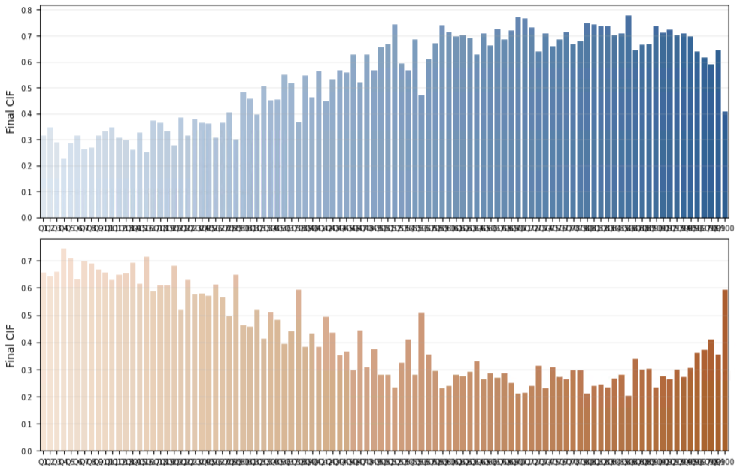
100 BINS, CS + CSS, QUANTILE

Slide 34
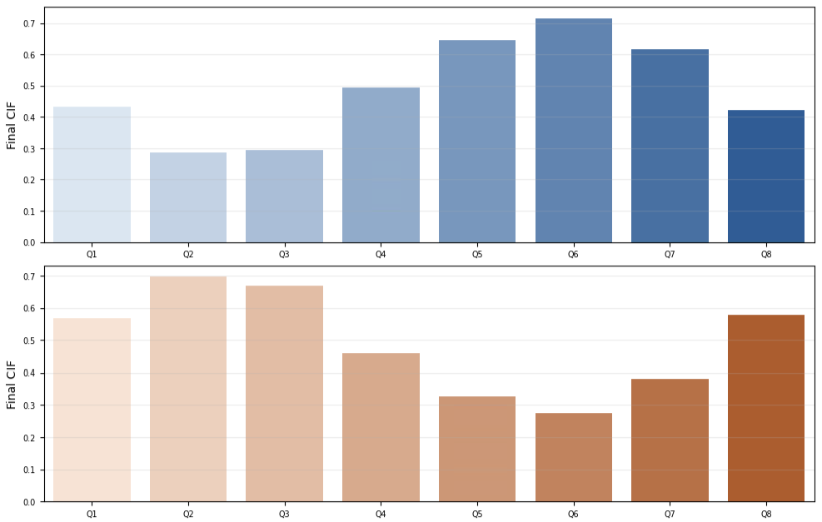
8 BINS, CA, EQUAL WIDTH

Slide 35
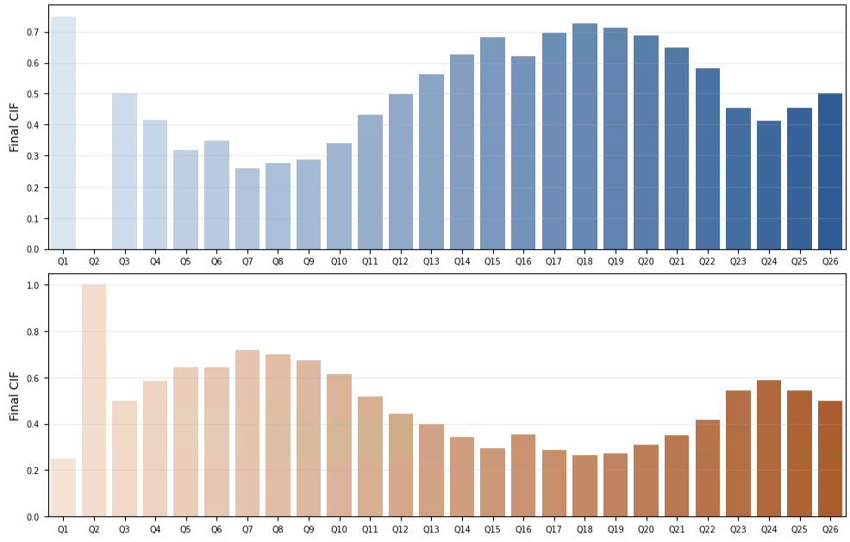
26 BINS, CA, EQUAL WIDTH

Slide 36
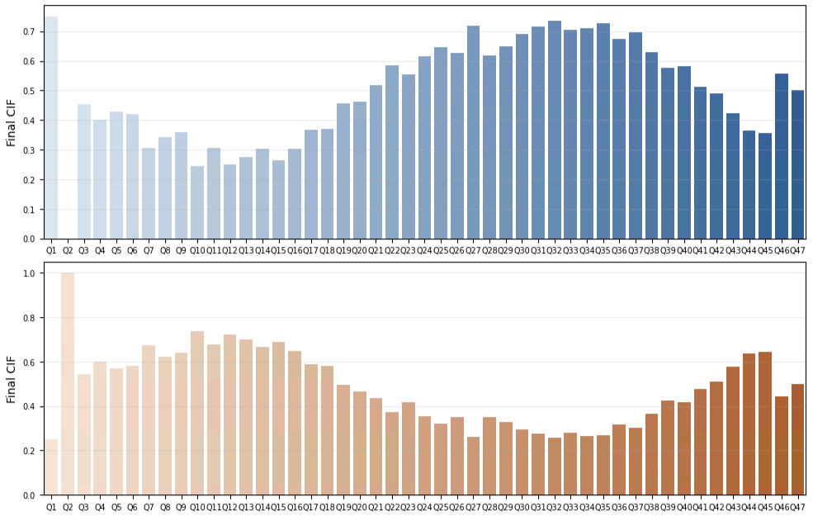
50 BINS, CA, EQUAL WIDTH

Slide 37

80 BINS, CA, EQUAL WIDTH

Slide 38

100 BINS, CA, EQUAL WIDTH

Slide 39

8 BINS, CA, QUANTILE

Slide 40

26 BINS, CA, QUANTILE

Slide 41

50 BINS, CA, QUANTILE

Slide 42

80 BINS, CA, QUANTILE

Slide 43

100 BINS, CA, QUANTILE

Slide 44

8 BINS, SF, EQUAL WIDTH

Slide 45

26 BINS, SF, EQUAL WIDTH

Slide 46

8 BINS, SF, QUANTILE

Slide 47

26 BINS, SF, QUANTILE

Slide 48

Supplementary Information
50 bins CA + CS + CSS, EQUAL WIDTH

Slide 49
Supplementary Information
50 bins CA + CS + CSS, QUANTILE

Slide 50
Supplementary Information
80 bins CA + CS + CSS, EQUAL WIDTH

Slide 51
Supplementary Information
80 bins CA + CS + CSS, QUANTILE

Slide 52
Supplementary Information
100 bins CA + CS + CSS, EQUAL WIDTH

Slide 53
Supplementary Information
100 bins CA + CS + CSS, QUANTILE

