Slide 1
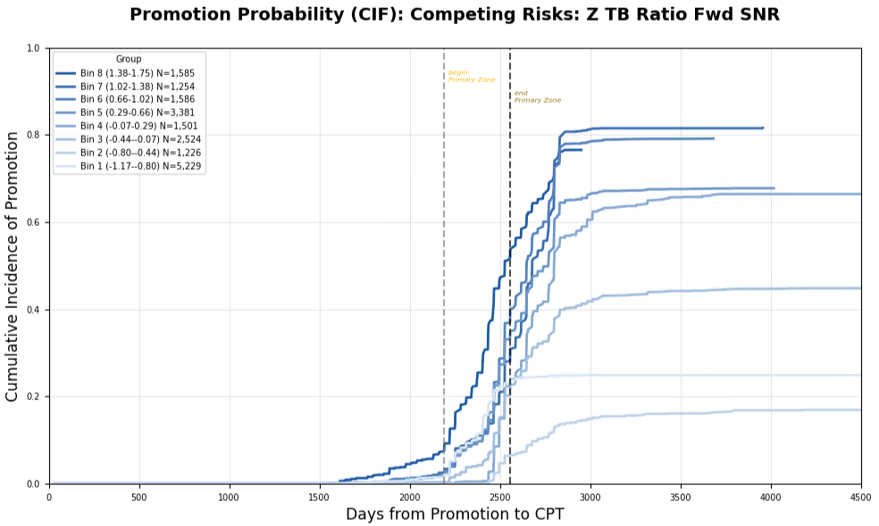
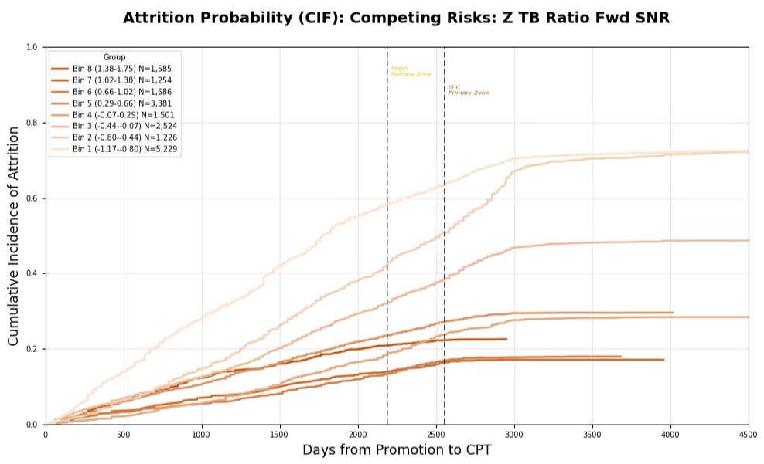
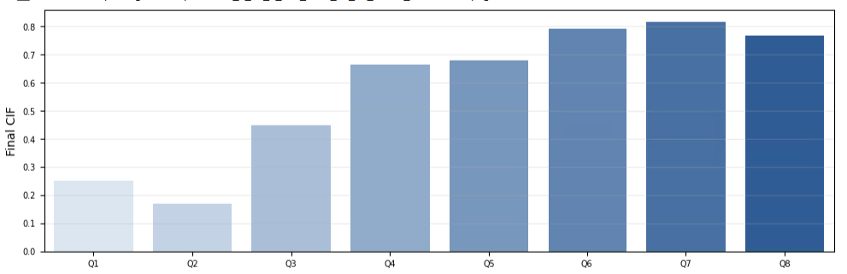
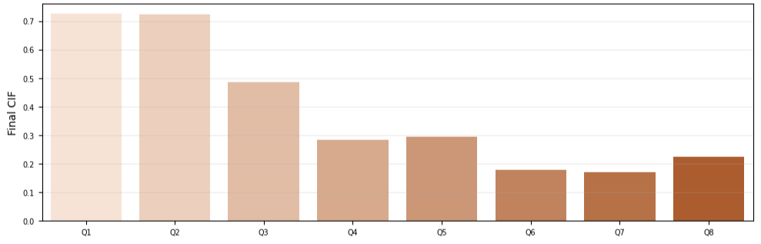
Figure 1

Slide 2
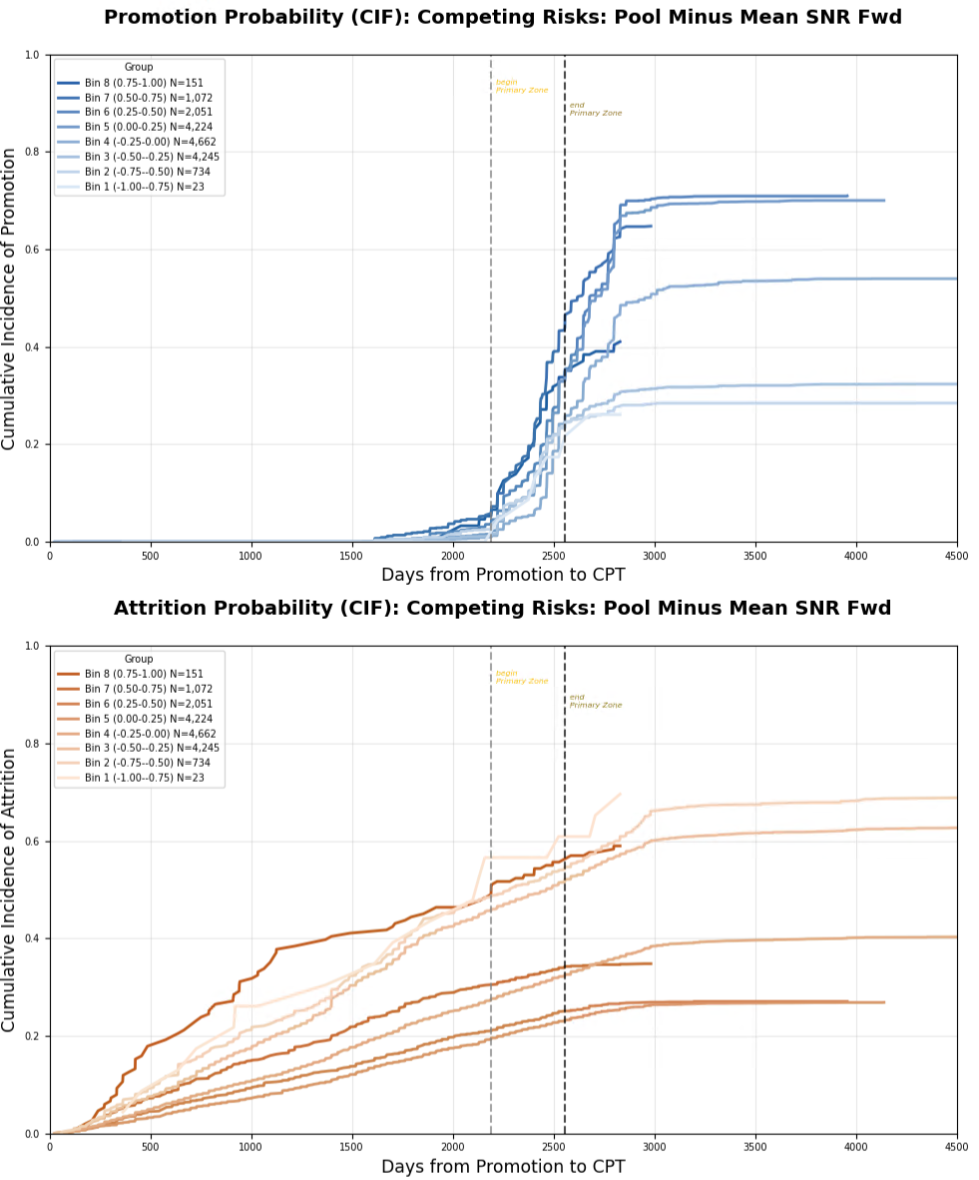
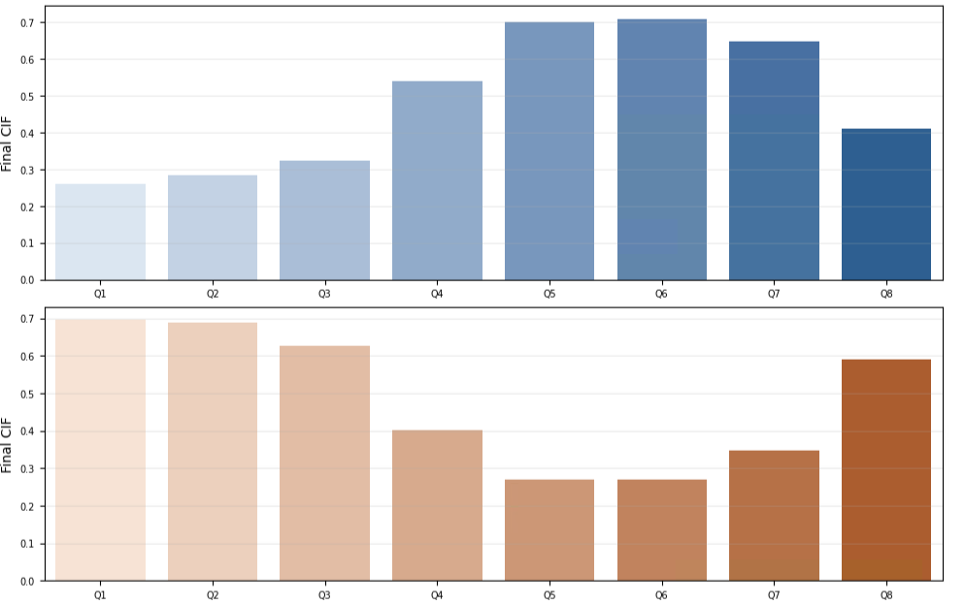
Figure 2

Slide 3
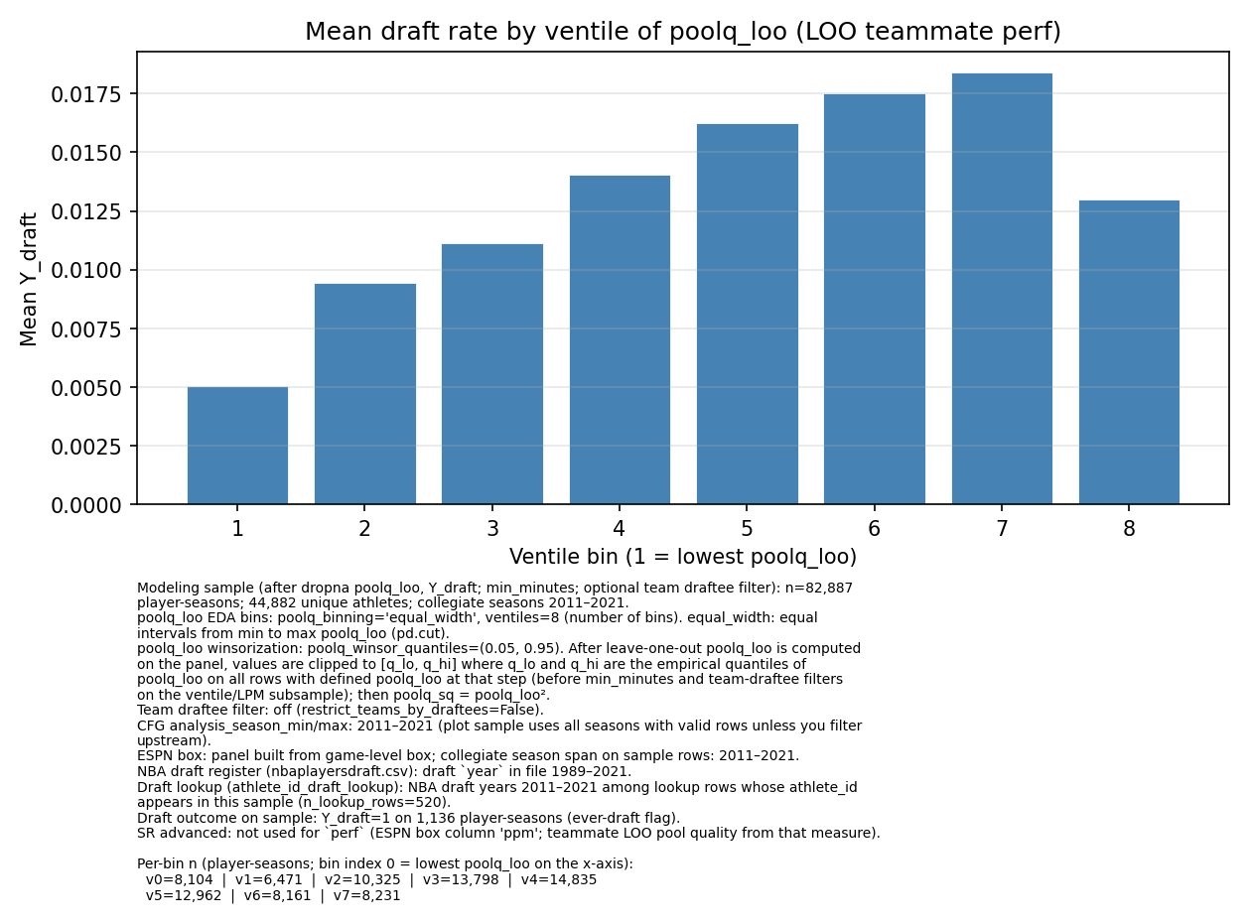
NCAA Basketball Player Draft Rate by Team Roster Pressure
NBA Draft Rate
Rate of Promotion/Early promotion to Major
by officer’s rating pool talent
Equal width bins of teammate PPM per season
Figure B
Cumulative Final Promotion Incidence
Equal width bins of rating pool Top Block Ratio
Figure A

Slide 4
Rate of Promotion/Early promotion to Major
by officer’s rating pool talent
Cumulative Final Promotion Incidence
Equal width bins of rating pool Top Block Ratio
Figure A

Slide 6
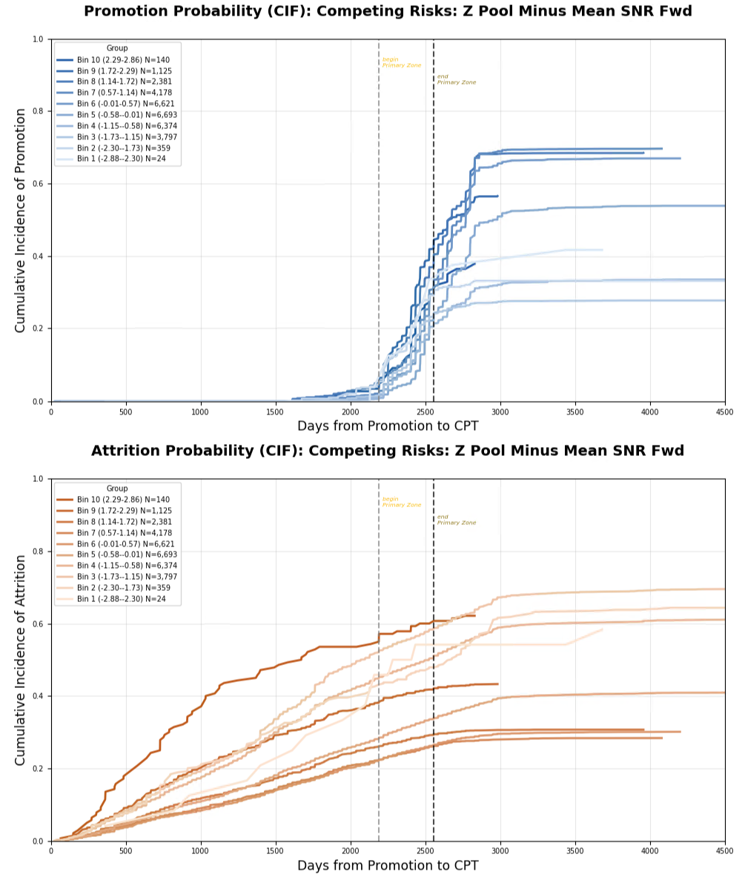
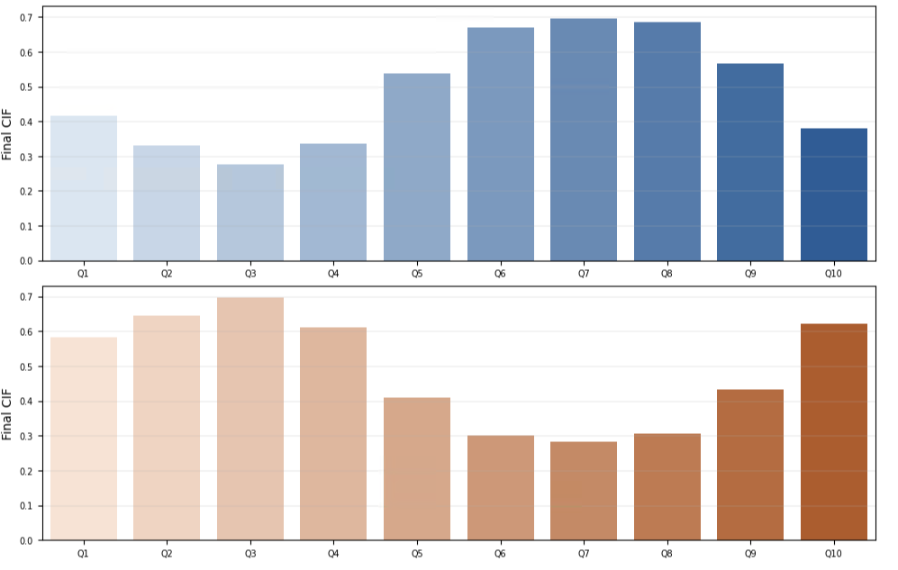
Full Own Performance Metric (OPM) Data (All Officers)

Slide 7
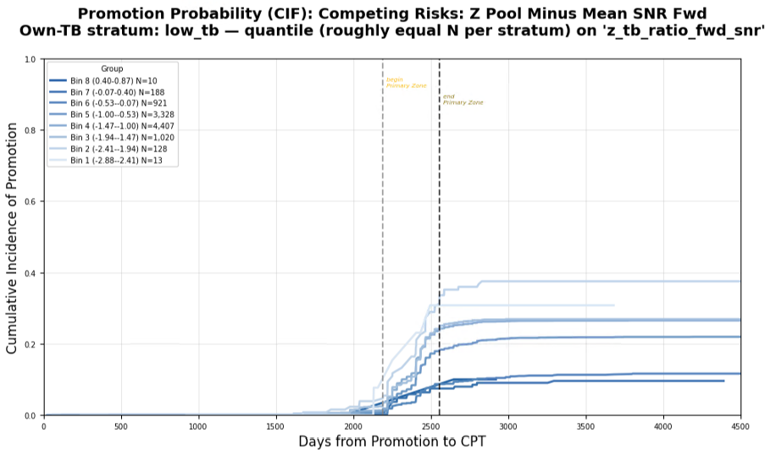
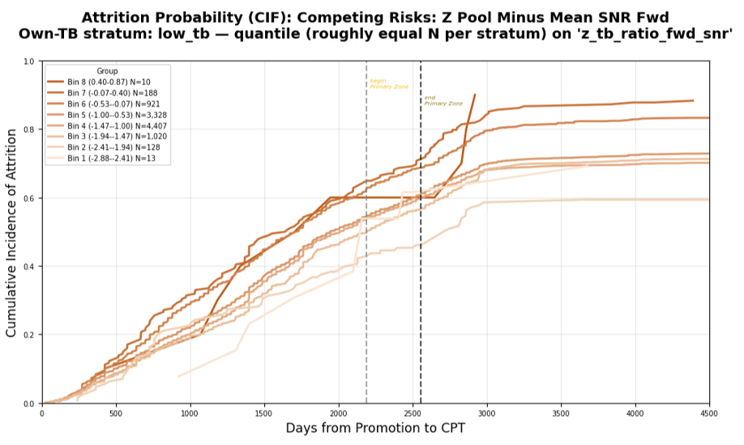
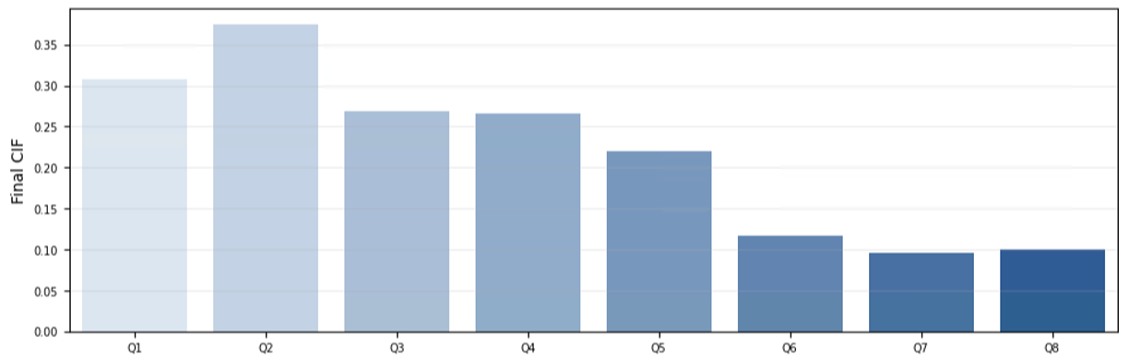
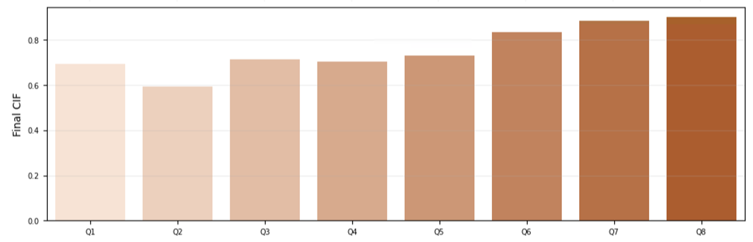
Lower Third OPM

Slide 8
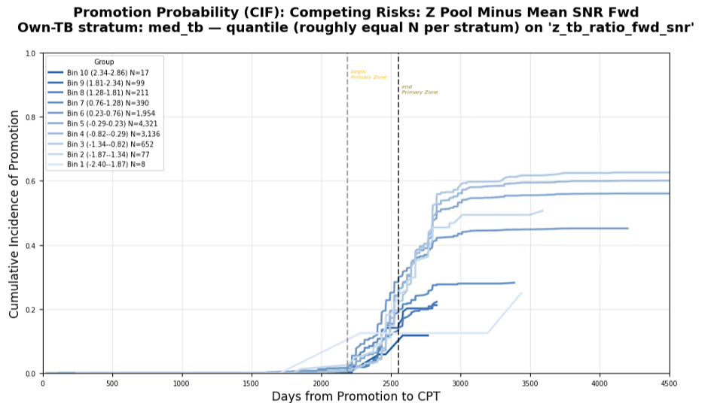
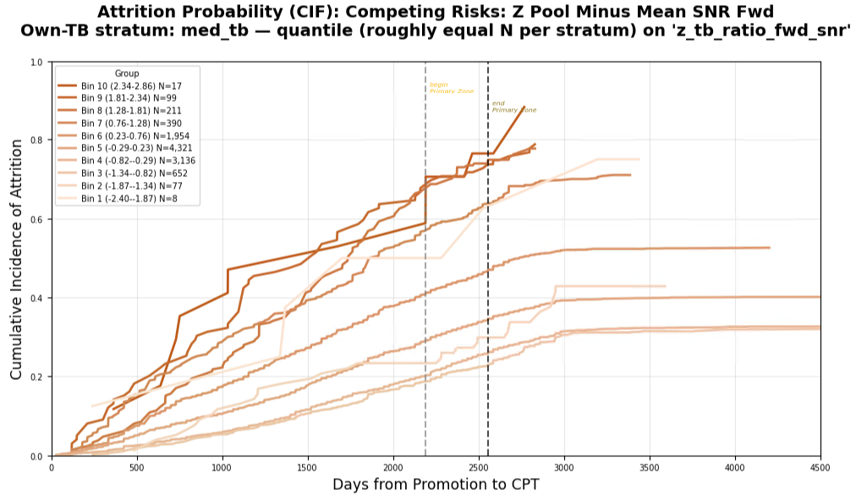
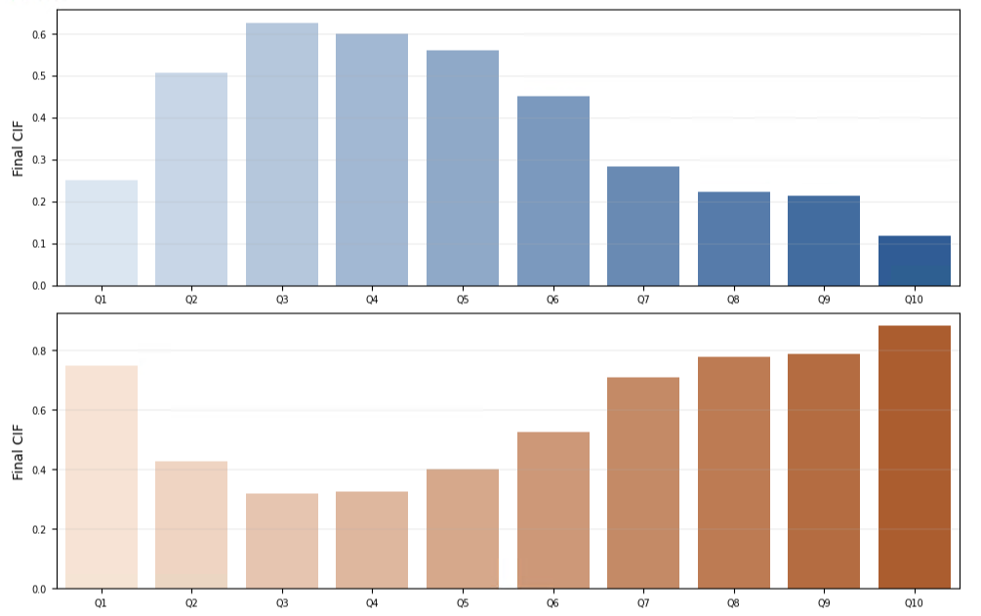
Middle Third OPM

Slide 9
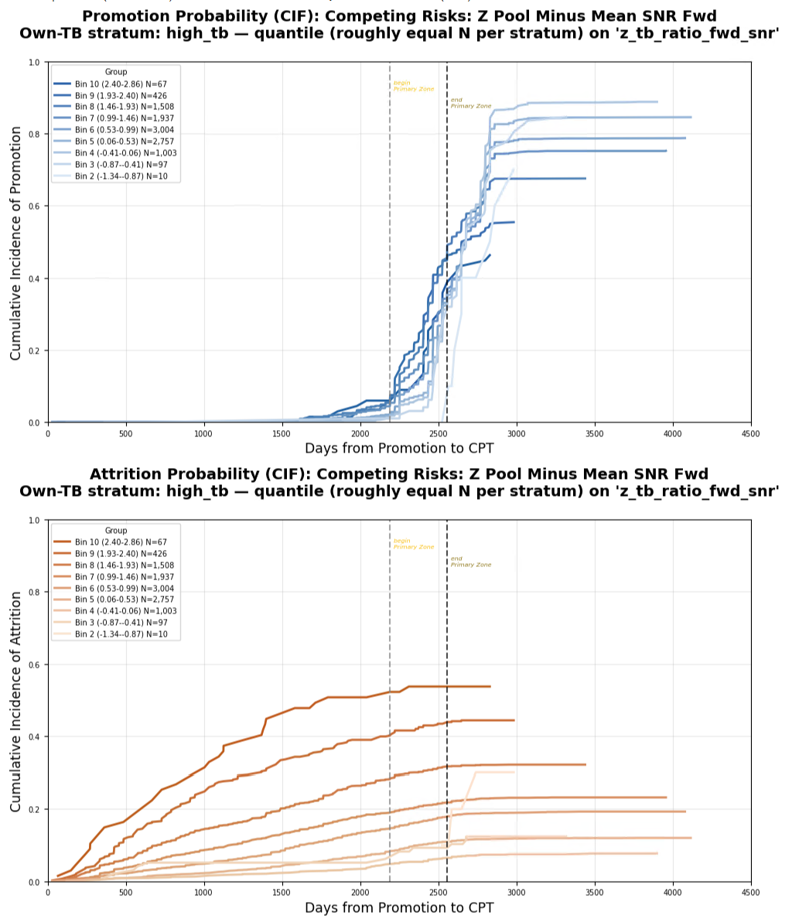
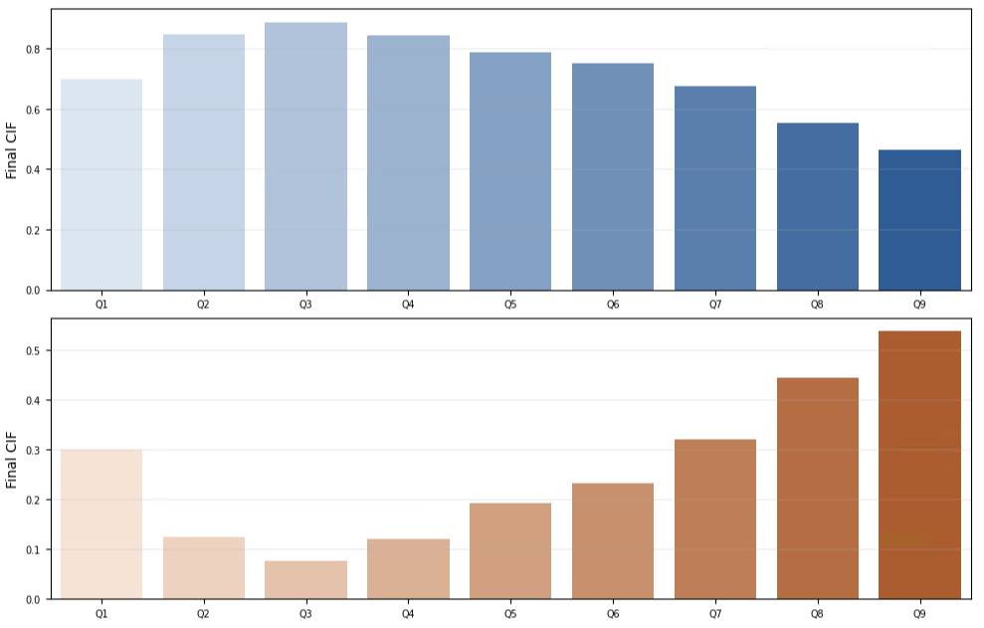
Upper Third OPM

Slide 10
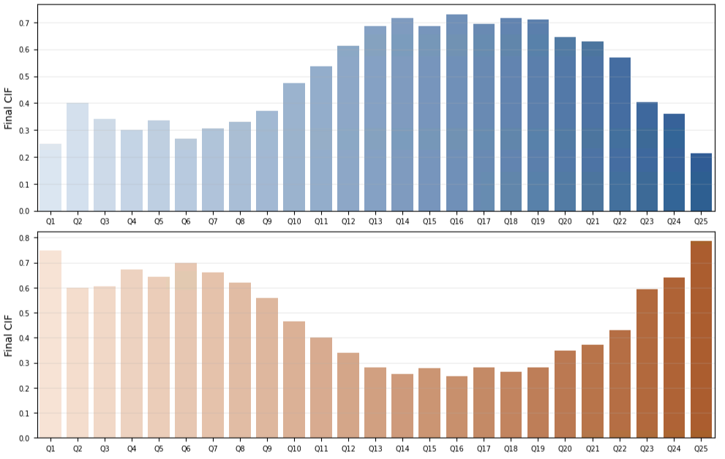
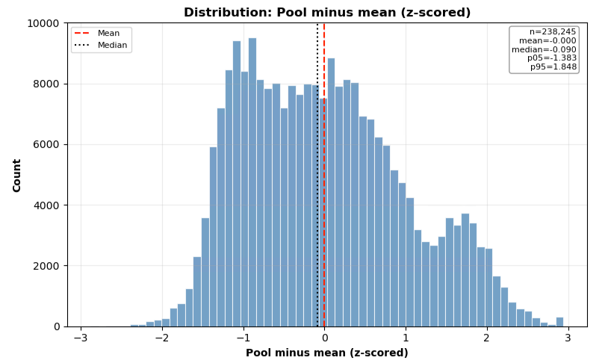
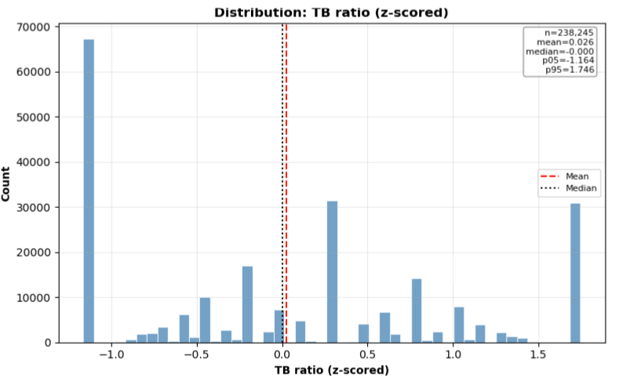
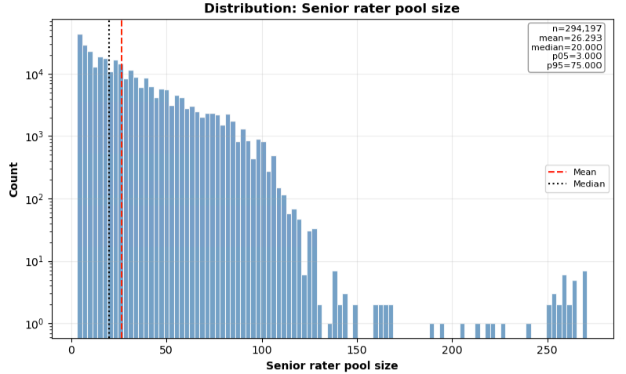
Supplementary Information

Slide 11
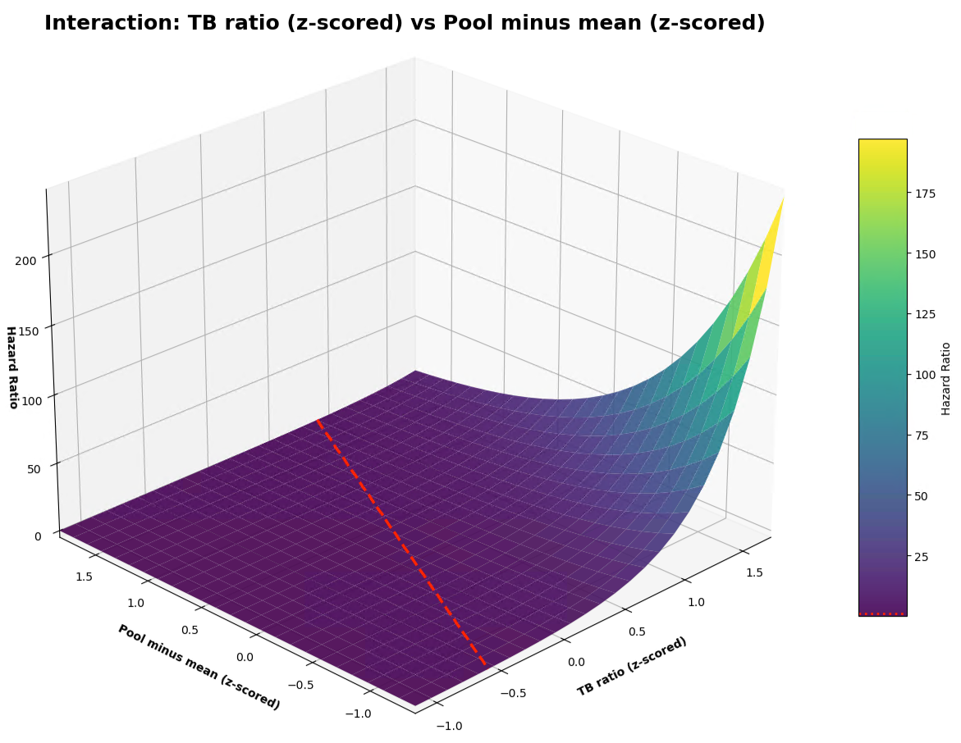
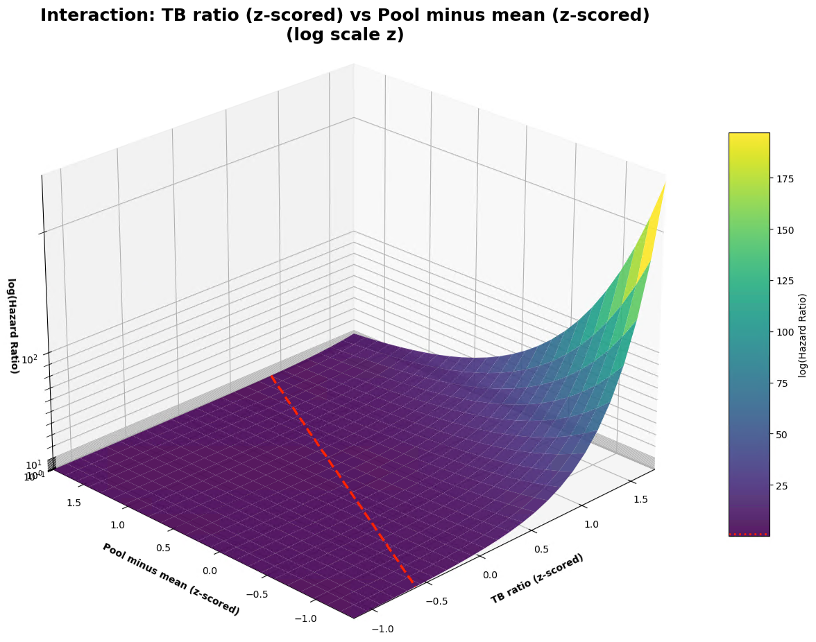
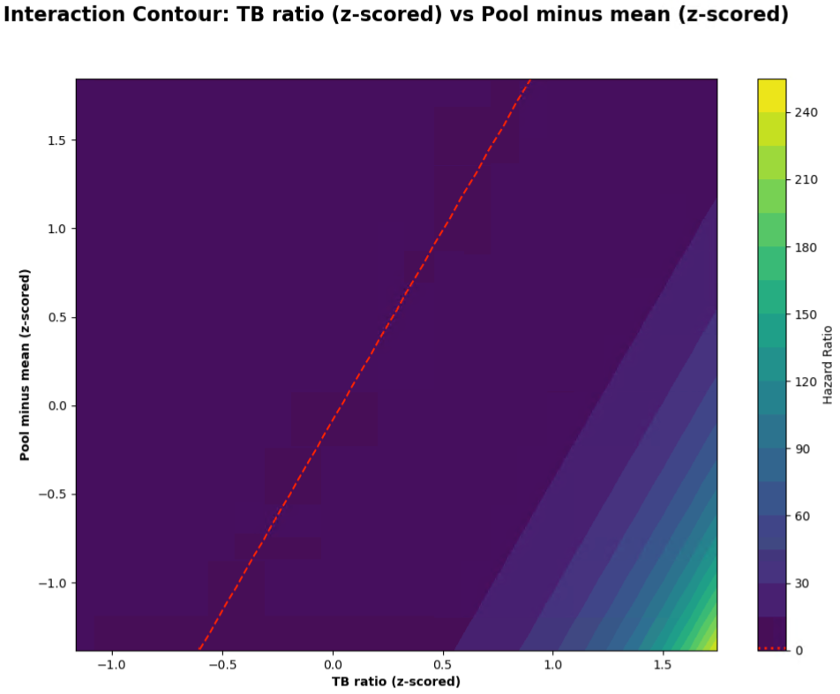
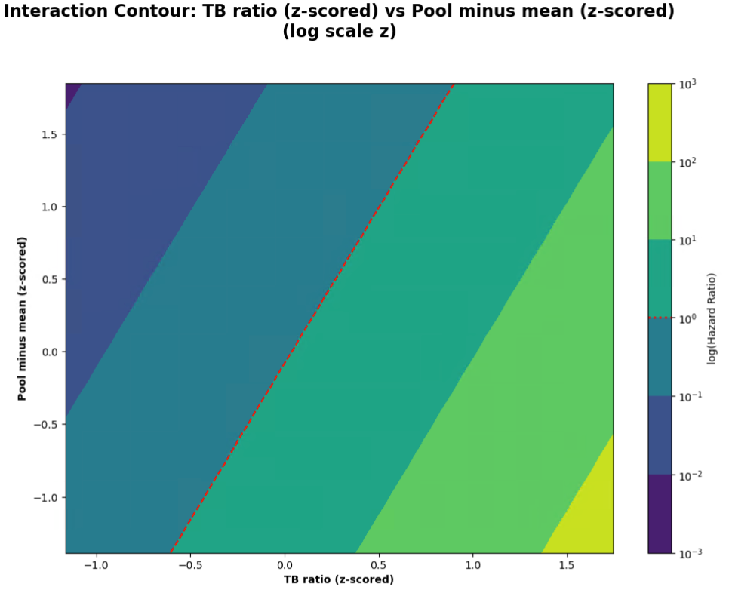
Supplementary Information

Slide 12
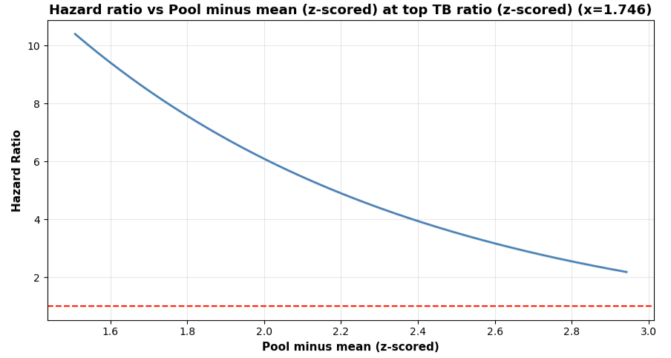
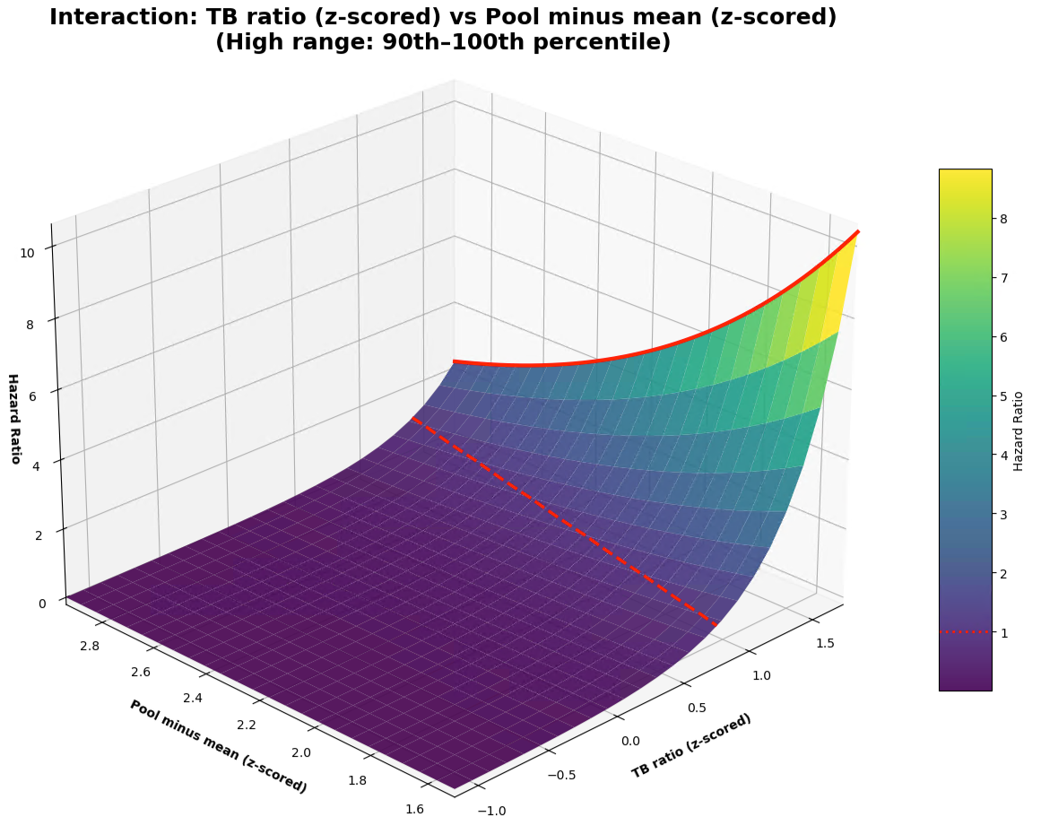
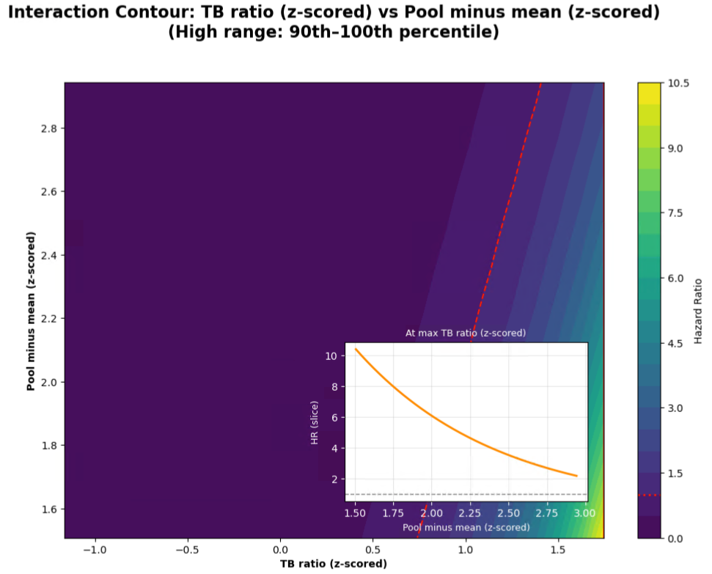
Supplementary Information

Slide 13
Supplementary Information

Slide 14
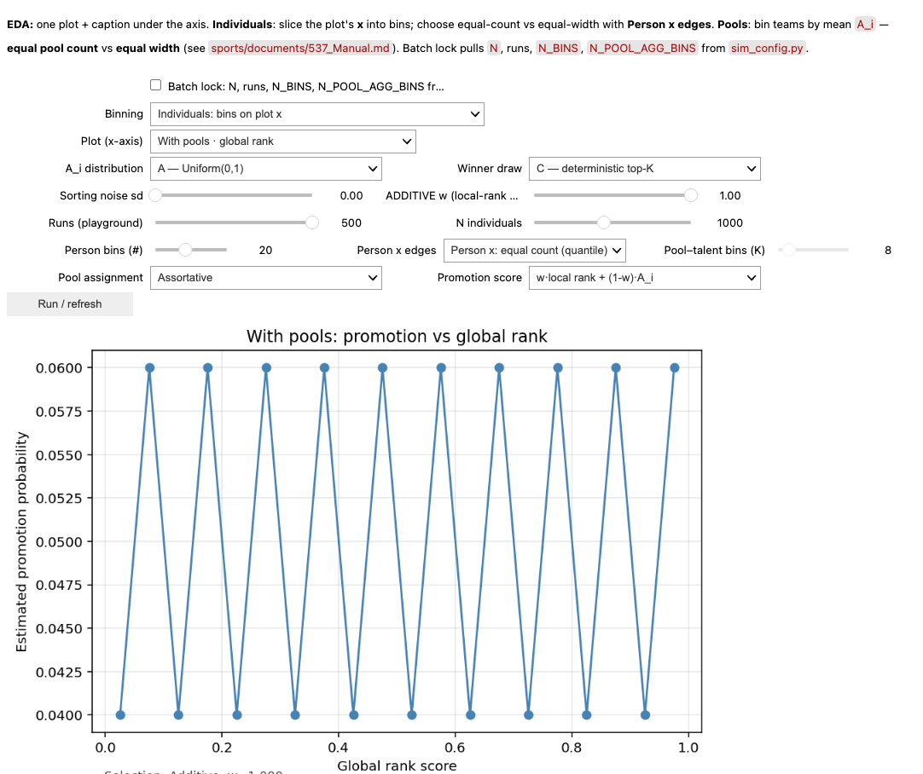
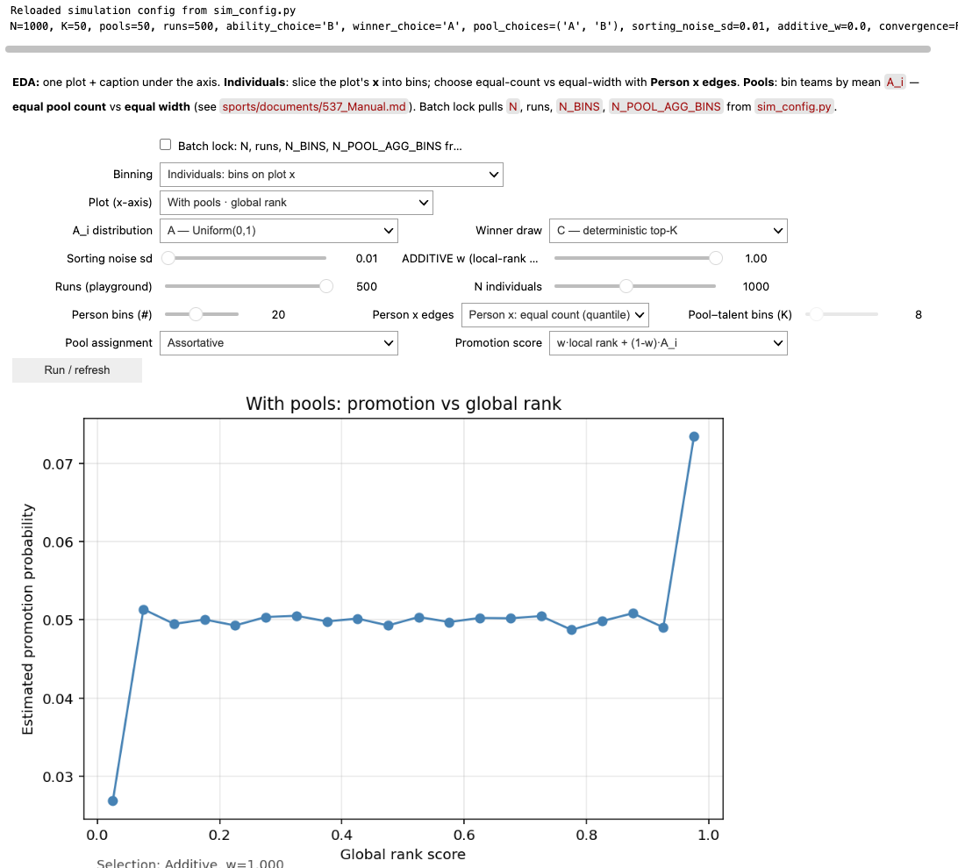
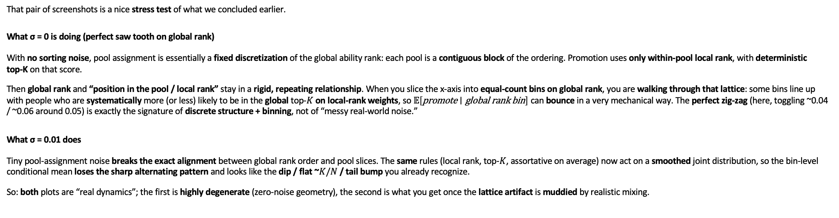
That pair of screenshots is a nice stress test of what we concluded earlier.
What σ = 0 is doing (perfect saw tooth on global rank)
With no sorting noise, pool assignment is essentially a fixed discretization of the global ability rank: each pool is a contiguous block of the ordering. Promotion uses only within-pool local rank, with deterministic top‑K on that score.
Then global rank and “position in the pool / local rank” stay in a rigid, repeating relationship. When you slice the x-axis into equal-count bins on global rank, you are walking through that lattice: some bins line up with people who are systematically more (or less) likely to be in the global top‑$K$ on local-rank weights, so $𝔼\left[\text{promote}∣\text{global} \text{rank} \text{bin}\right]$ can bounce in a very mechanical way. The perfect zig‑zag (here, toggling ~0.04 / ~0.06 around 0.05) is exactly the signature of discrete structure + binning, not of “messy real-world noise.”
What σ = 0.01 does
Tiny pool-assignment noise breaks the exact alignment between global rank order and pool slices. The same rules (local rank, top‑$K$, assortative on average) now act on a smoothed joint distribution, so the bin-level conditional mean loses the sharp alternating pattern and looks like the dip / flat ~$K/N$ / tail bump you already recognize.
So: both plots are “real dynamics”; the first is highly degenerate (zero-noise geometry), the second is what you get once the lattice artifact is muddied by realistic mixing.

Slide 15
