Slide 1
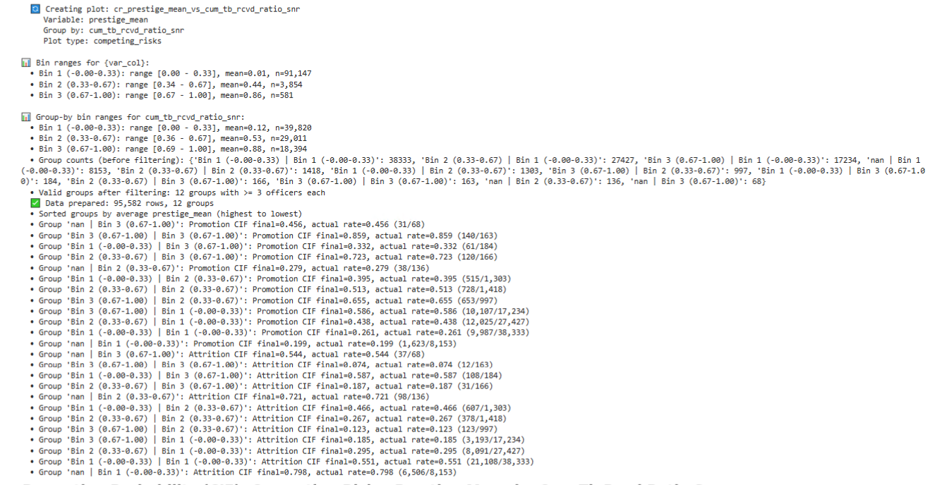

Slide 2
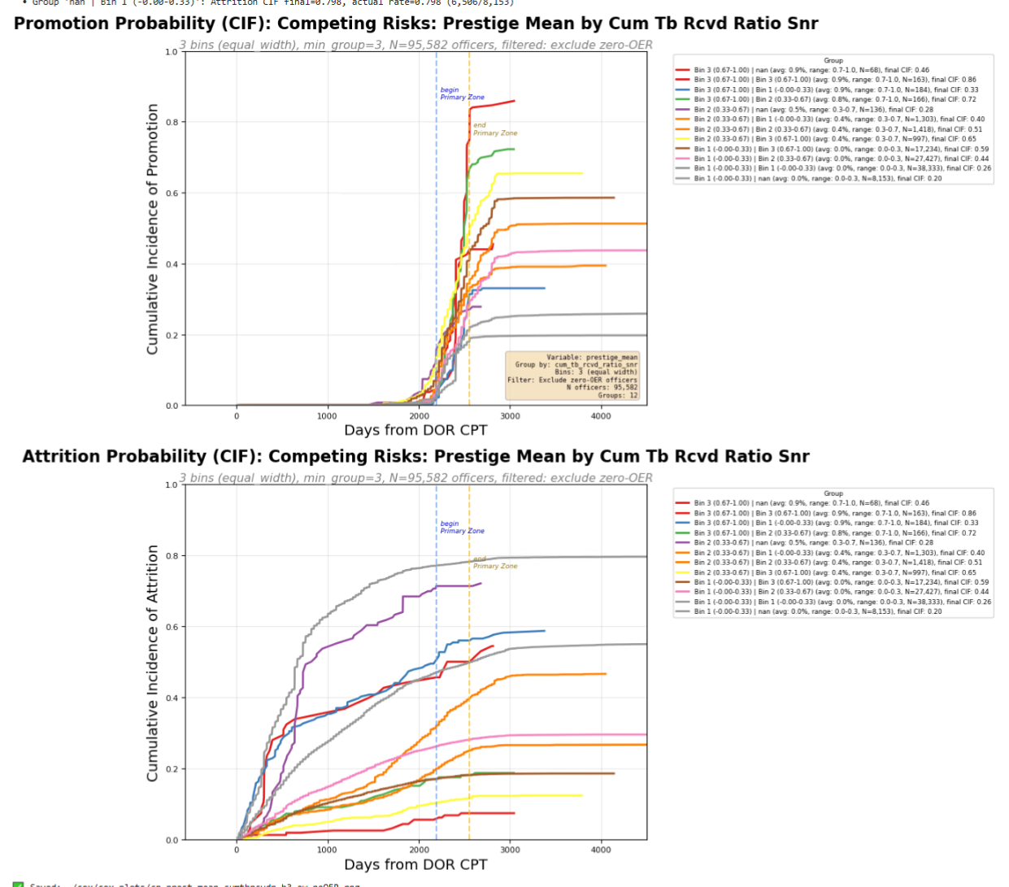

Slide 3
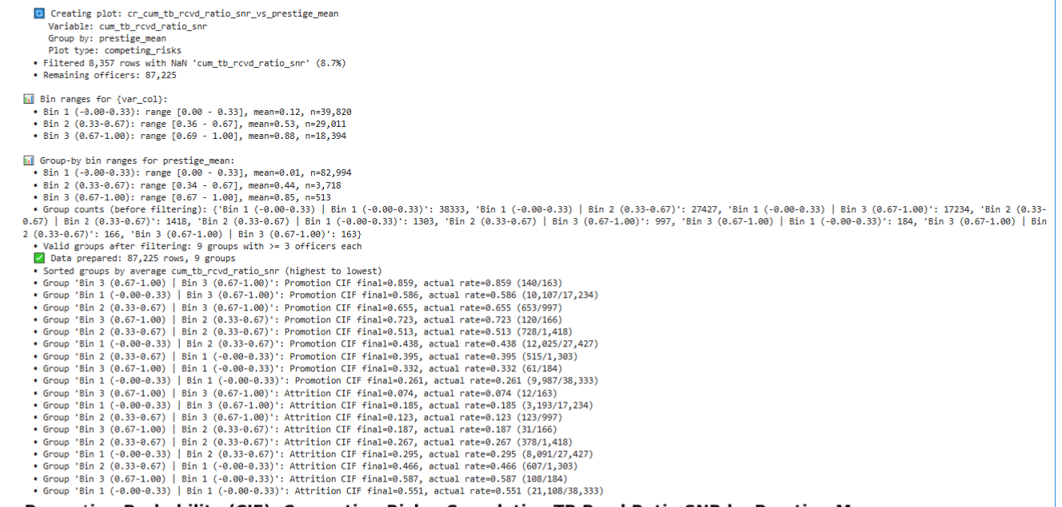

Slide 4
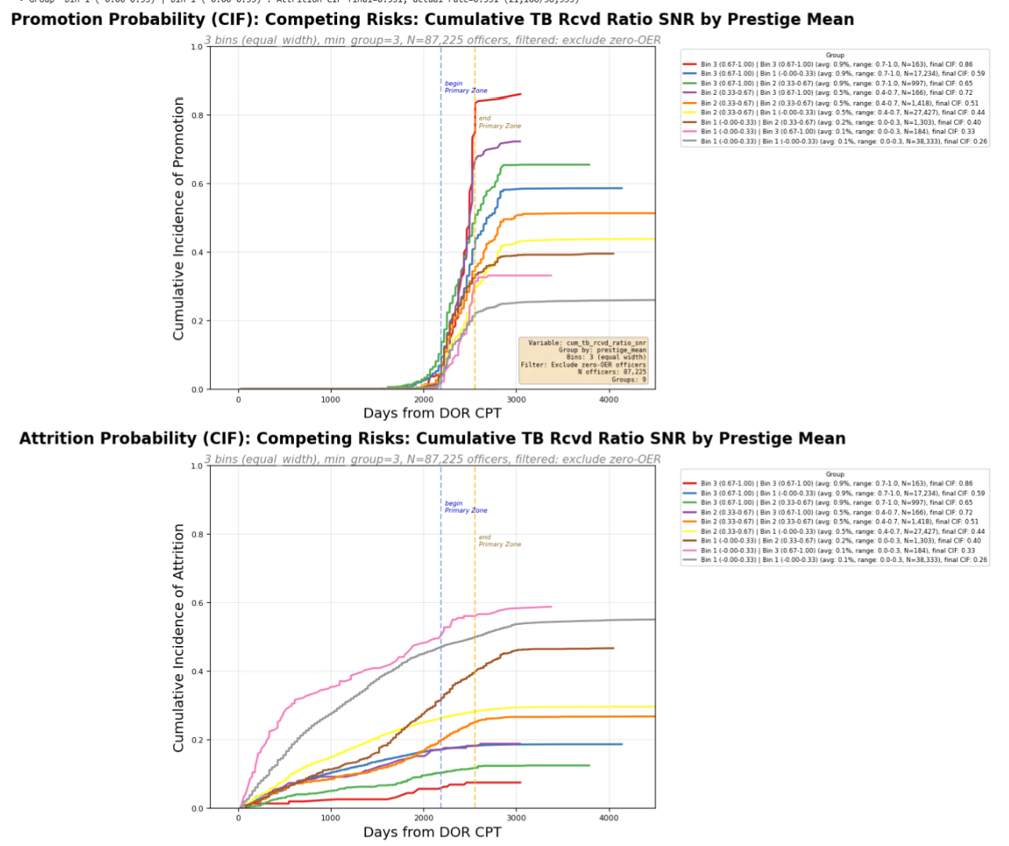

Slide 5
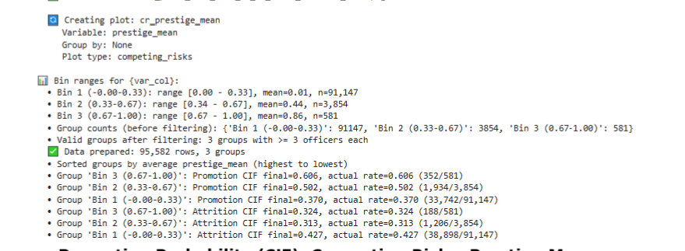

Slide 6
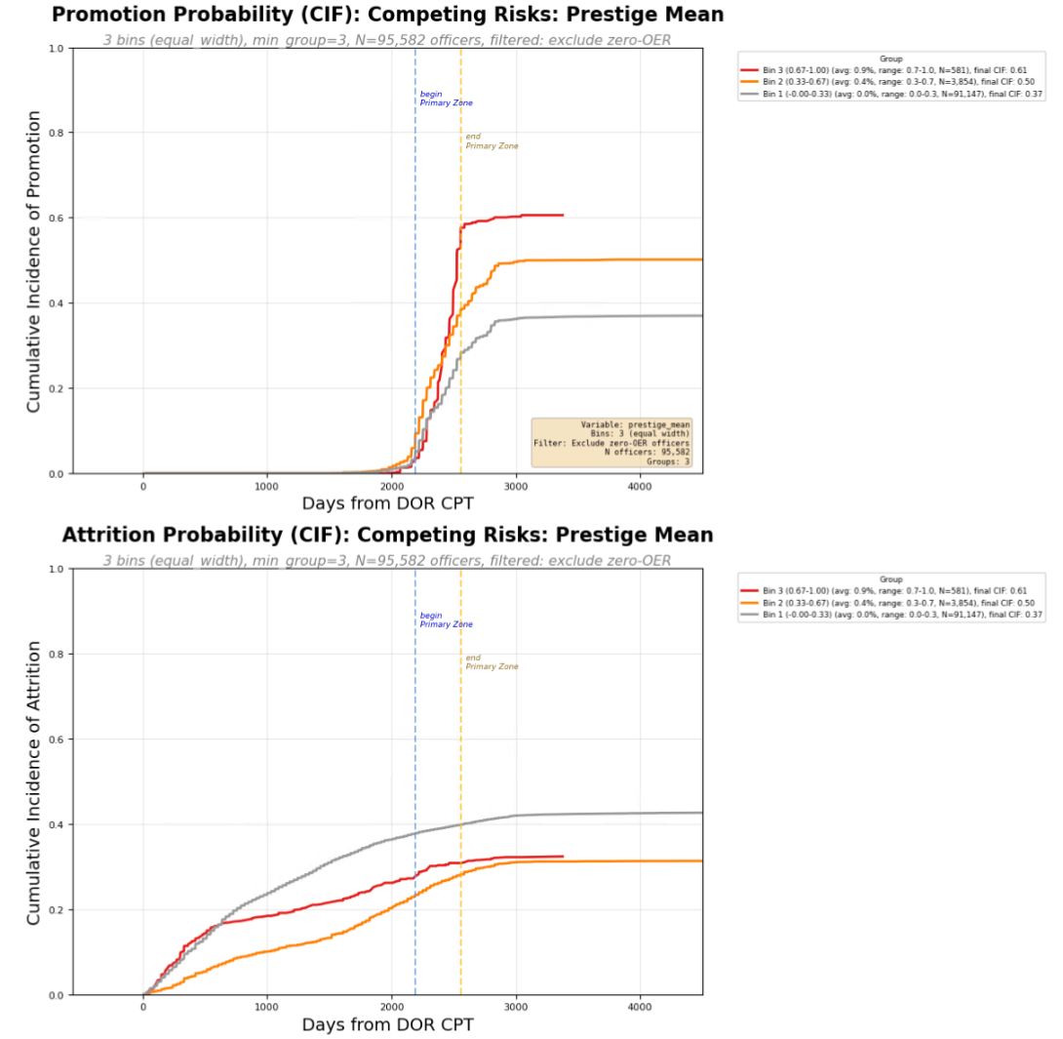

Slide 7
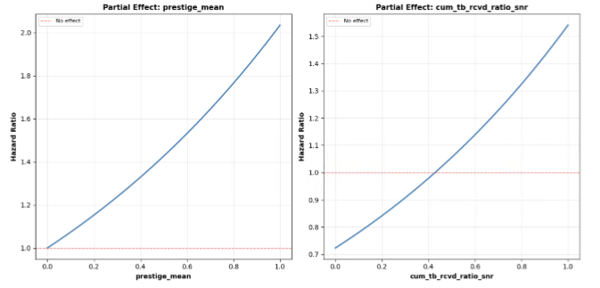
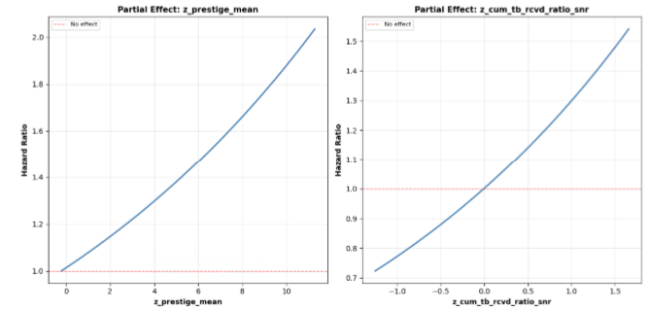

Slide 8
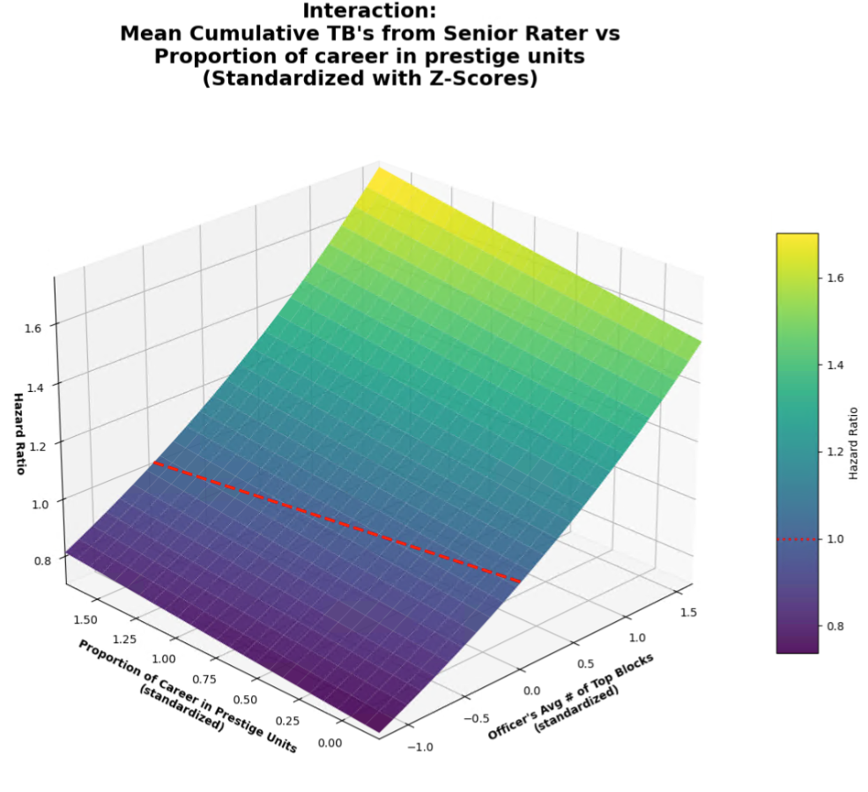

Slide 9
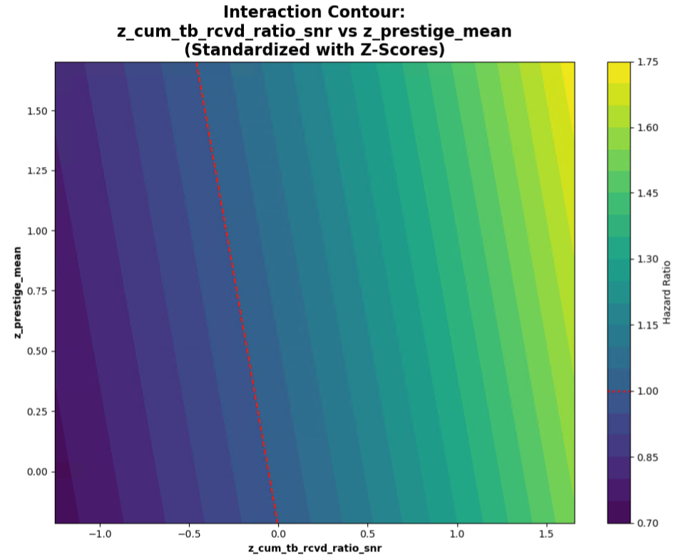

Slide 10


Slide 11
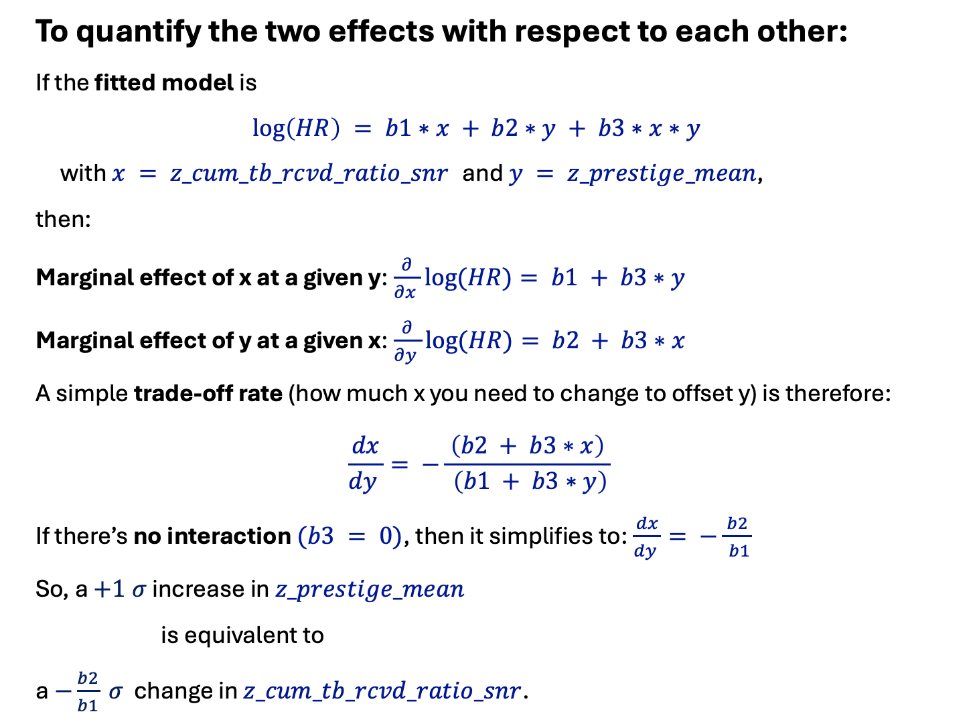
To quantify the two effects with respect to each other:
If the fitted model is
$$\log\left(HR\right) = b1∗x + b2∗y + b3∗x∗y$$
with $x = z_cum_tb_rcvd_ratio_snr$ and $y = z_prestige_mean$,
then:
Marginal effect of x at a given y:$\frac{∂}{∂x }log⁡(HR)= b1 + b3∗y$
Marginal effect of y at a given x:$\frac{∂}{∂y }log⁡(HR)= b2 + b3∗x$
A simple trade‑off rate (how much x you need to change to offset y) is therefore:
$$\frac{dx}{dy }= −\frac{ \left(b2 + b3∗x\right) }{ \left(b1 + b3∗y\right)}$$
If there’s no interaction $(b3 = 0)$, then it simplifies to:$\frac{dx}{dy }= −\frac{ b2 }{ b1}$
So, a $+1 σ$ increase in $z_prestige_mean$
is equivalent to
a $−\frac{b2}{b1} σ$ change in $z_cum_tb_rcvd_ratio_snr$.

Slide 12
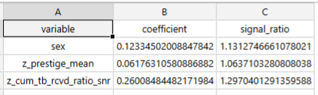
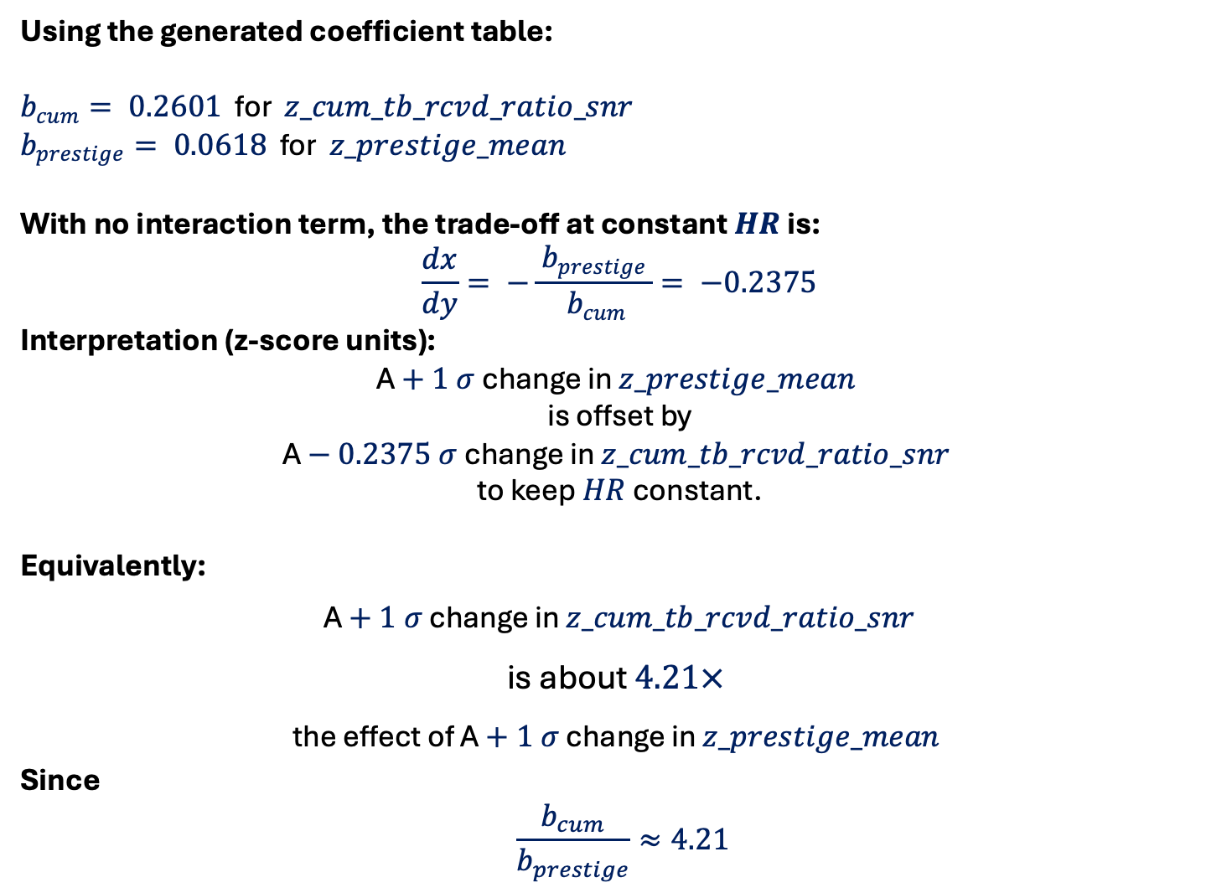
Using the generated coefficient table:
$b_{cum}= 0.2601$ for $z_cum_tb_rcvd_ratio_snr$
$b_{prestige}= 0.0618$ for $z_prestige_mean$
With no interaction term, the trade‑off at constant $HR$ is:
$$\frac{dx}{dy}= −\frac{ b_{prestige }}{ b_{cum}}= −0.2375$$
Interpretation (z‑score units):
A $+ 1 σ$ change in $z_prestige_mean$
is offset by
A $− 0.2375 σ$ change in $z_cum_tb_rcvd_ratio_snr$
to keep $HR$ constant.
Equivalently:
A $+ 1 σ$ change in $z_cum_tb_rcvd_ratio_snr$
is about $4.21×$
the effect of A $+ 1 σ$ change in $z_prestige_mean$
Since
$$\frac{b_{cum}}{b_{prestige}}≈4.21$$

Slide 13
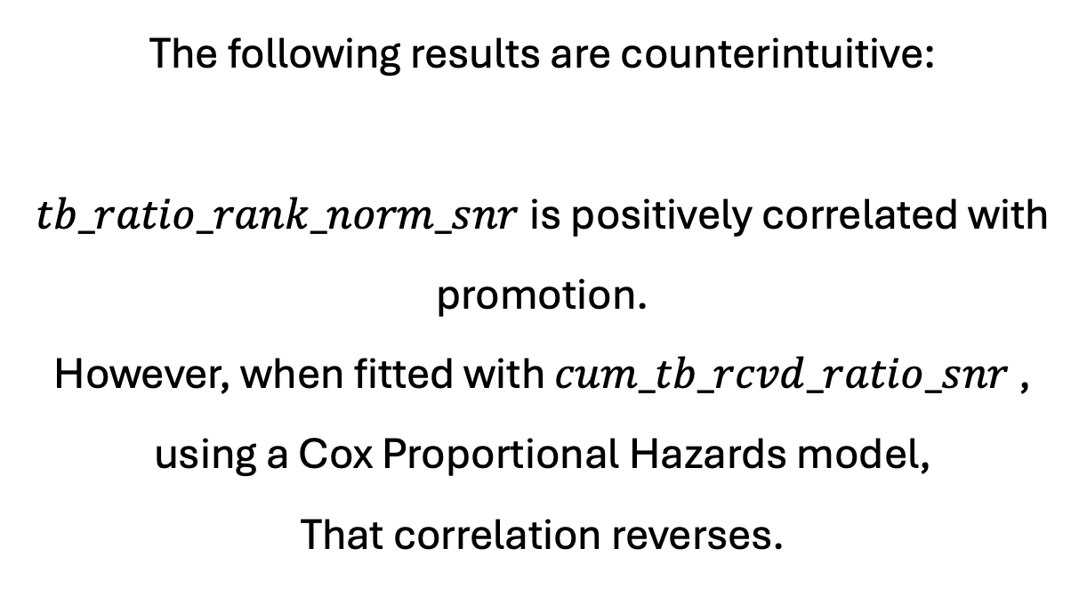
The following results are counterintuitive:
$tb_ratio_rank_norm_snr$is positively correlated with promotion.
However, when fitted with $cum_tb_rcvd_ratio_snr$ ,
using a Cox Proportional Hazards model,
That correlation reverses.

Slide 14
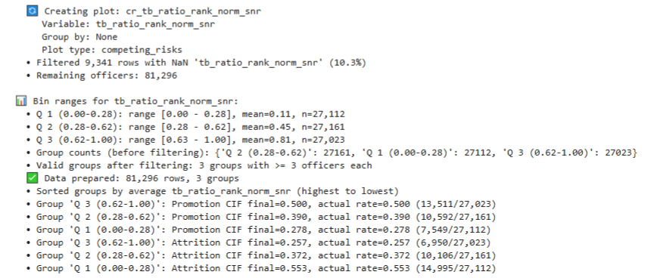

Slide 15
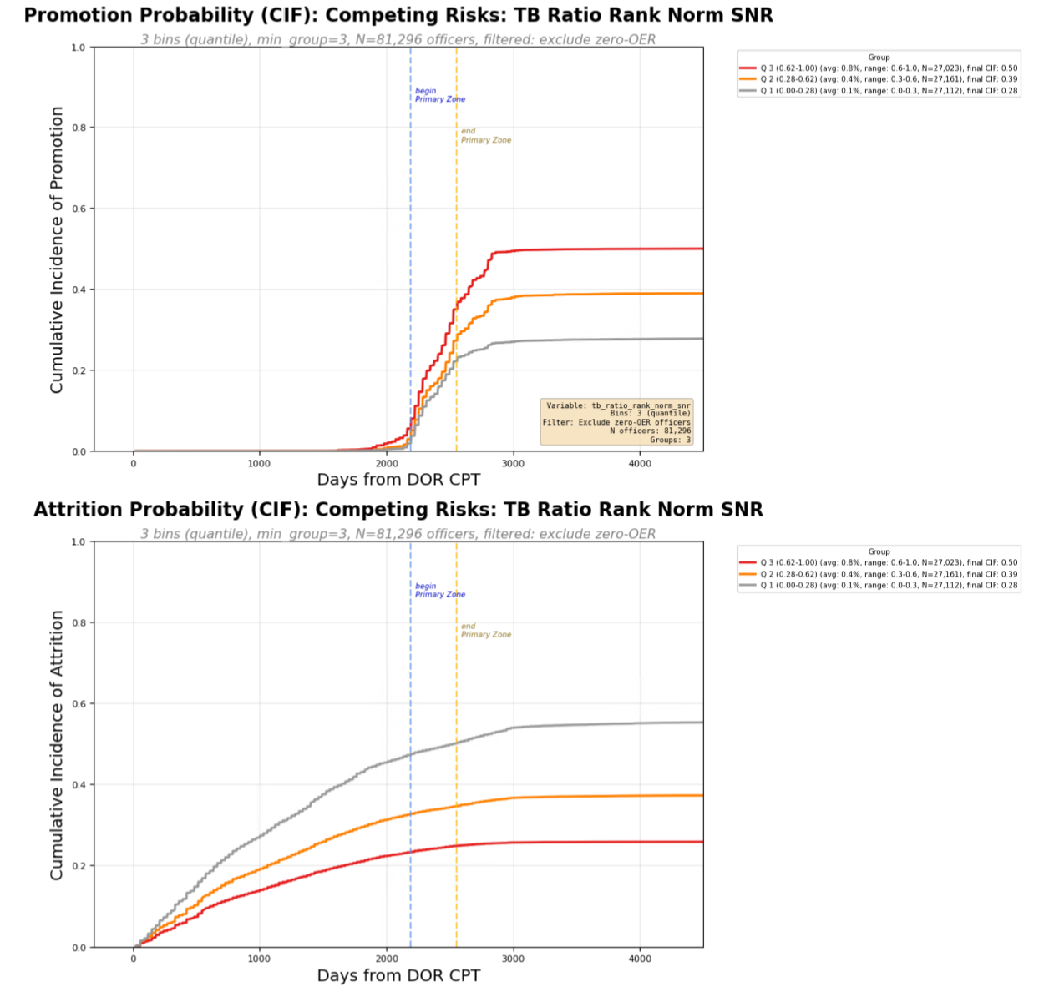

Slide 16
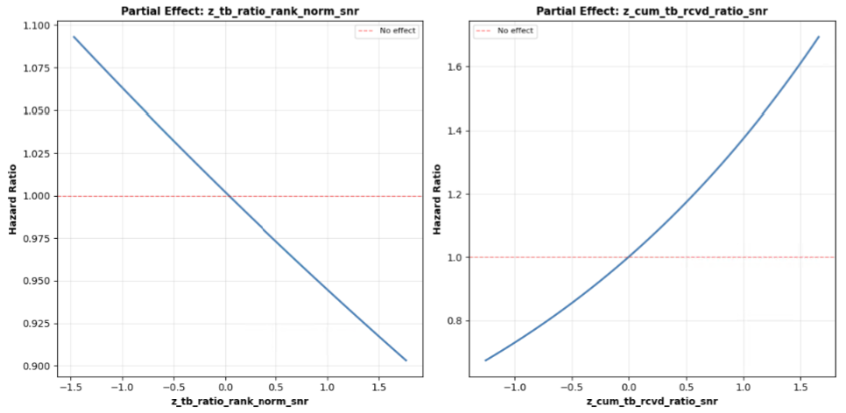

Slide 17
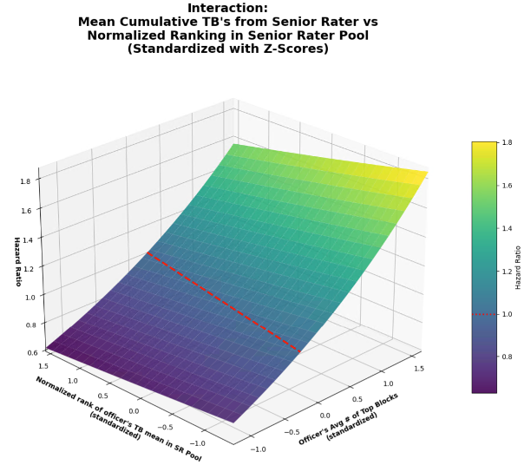

Slide 18
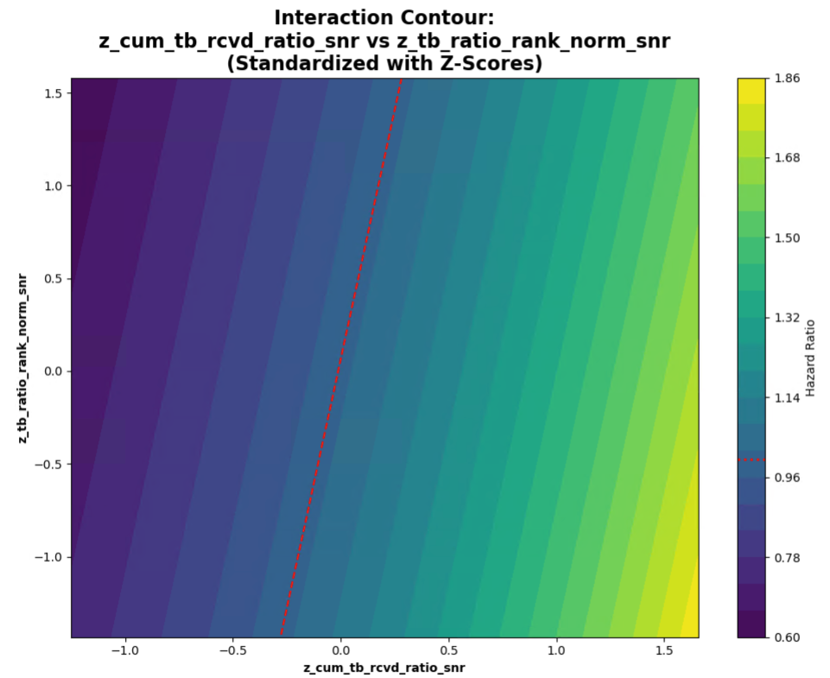

Slide 19
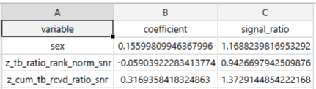

Slide 20
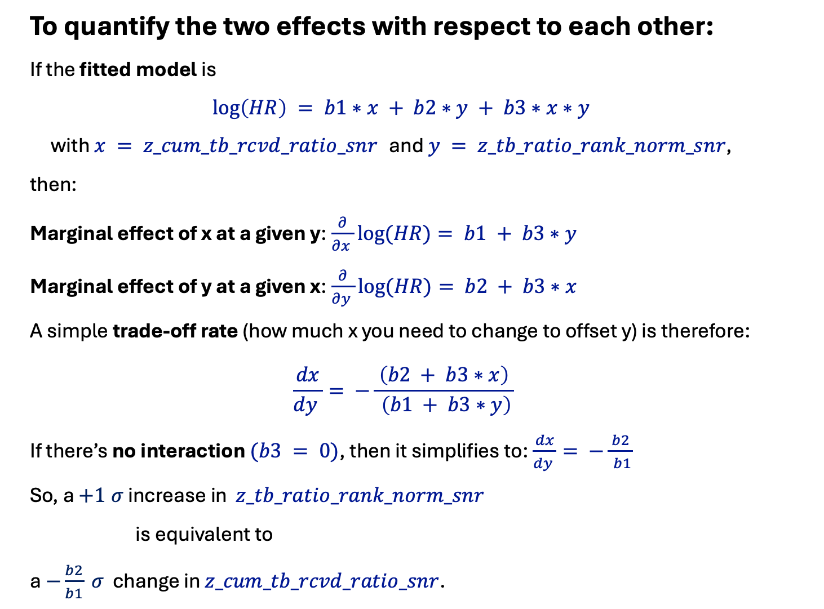
To quantify the two effects with respect to each other:
If the fitted model is
$$\log\left(HR\right) = b1∗x + b2∗y + b3∗x∗y$$
with $x = z_cum_tb_rcvd_ratio_snr$ and $y = z_tb_ratio_rank_norm_snr$,
then:
Marginal effect of x at a given y:$\frac{∂}{∂x }log⁡(HR)= b1 + b3∗y$
Marginal effect of y at a given x:$\frac{∂}{∂y }log⁡(HR)= b2 + b3∗x$
A simple trade‑off rate (how much x you need to change to offset y) is therefore:
$$\frac{dx}{dy }= −\frac{ \left(b2 + b3∗x\right) }{ \left(b1 + b3∗y\right)}$$
If there’s no interaction $(b3 = 0)$, then it simplifies to:$\frac{dx}{dy }= −\frac{ b2 }{ b1}$
So, a $+1 σ$ increase in $z_tb_ratio_rank_norm_snr$
is equivalent to
a $−\frac{b2}{b1} σ$ change in $z_cum_tb_rcvd_ratio_snr$.

Slide 21
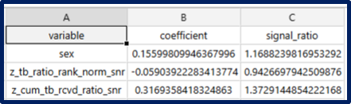
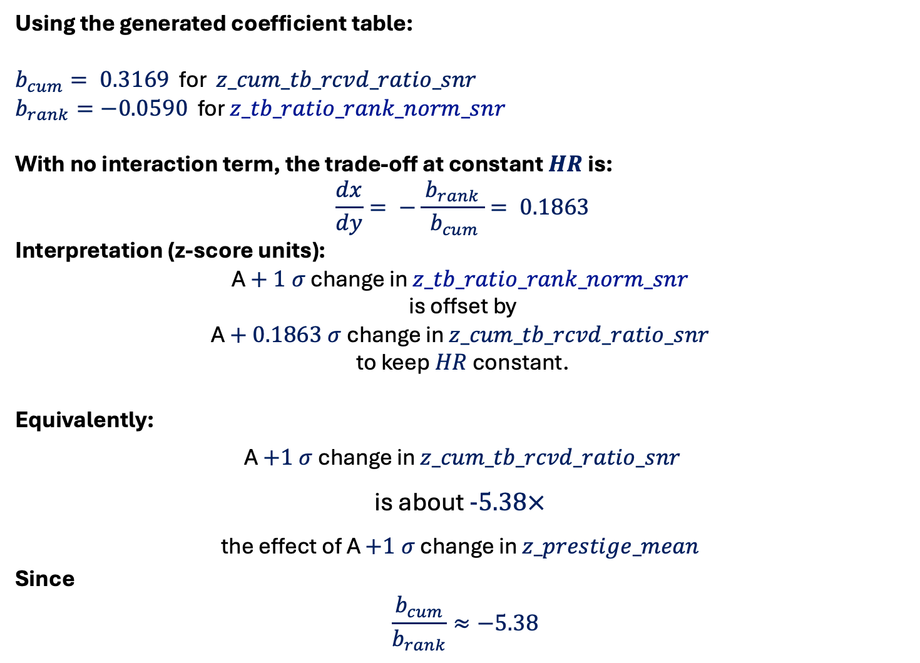
Using the generated coefficient table:
$b_{cum}= 0.3169$ for $z_cum_tb_rcvd_ratio_snr$
$b_{rank}=−0.0590$ for $z_tb_ratio_rank_norm_snr$
With no interaction term, the trade‑off at constant $HR$ is:
$$\frac{dx}{dy}= −\frac{ b_{rank }}{ b_{cum}}= 0.1863$$
Interpretation (z‑score units):
A $+ 1 σ$ change in $z_tb_ratio_rank_norm_snr$
is offset by
A $+ 0.1863 σ$ change in $z_cum_tb_rcvd_ratio_snr$
to keep $HR$ constant.
Equivalently:
A $+1 σ$ change in $z_cum_tb_rcvd_ratio_snr$
is about $−5.38×$
the effect of A $+1 σ$ change in $z_prestige_mean$
Since
$$\frac{b_{cum}}{b_{rank}}≈−5.38$$

Slide 22
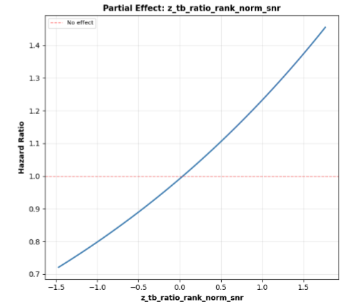

Slide 23
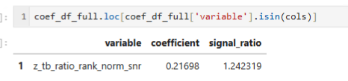
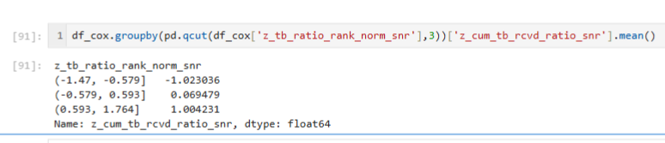
coef_df_full.loc[coef_df_full['variable'].isin(cols)]
df_cox.groupby(pd.qcut(df_cox['z_tb_ratio_rank_norm_snr'], 3))['z_cum_tb_rcvd_ratio_snr'].mean()

Slide 24
Thanks — those results line up perfectly with the collinearity story:
Step 4 (coefficients):
z_tb_ratio_rank_norm_snr has positive coefficient (0.21698) and HR ≈ 1.24, so once the absolute ratio is removed, it behaves as you expected.
Step 5 (pool‑strength check):
The mean z_cum_tb_rcvd_ratio_snr rises across rank‑norm bins:
low rank bin: −1.02
mid bin: 0.07
high rank bin: 1.00
So higher rank in pool is strongly tied to higher absolute performance — exactly the shared signal that was being split between the two variables.
If you want to keep both variables in the model but avoid the sign flip, we can try:
removing one of them,
replacing rank with pool mean‑adjusted residuals, or
adding an interaction term and interpreting jointly.

Slide 25
New Approach RUN 1

Slide 26
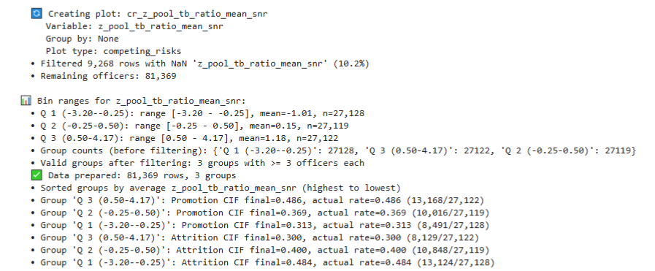

Slide 27
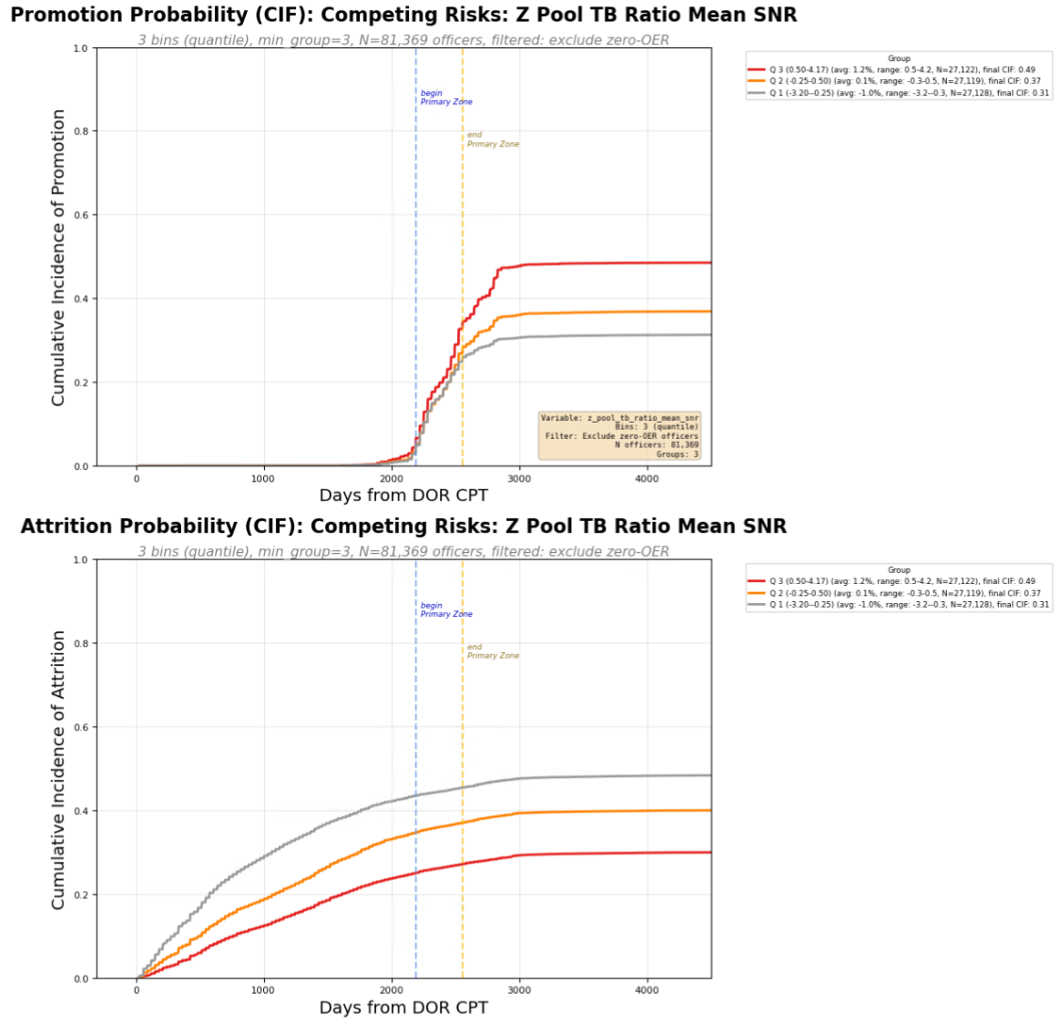

Slide 28
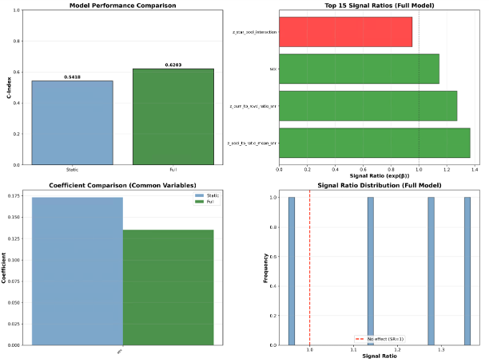

Slide 29
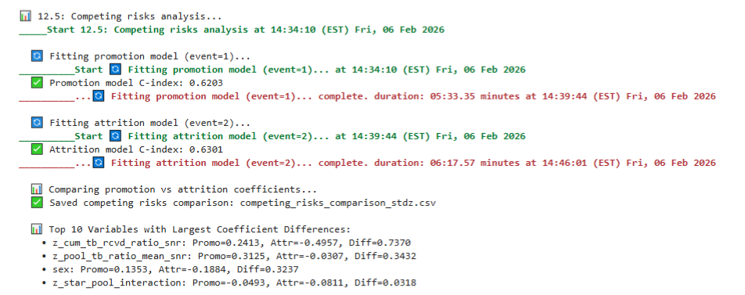

Slide 30
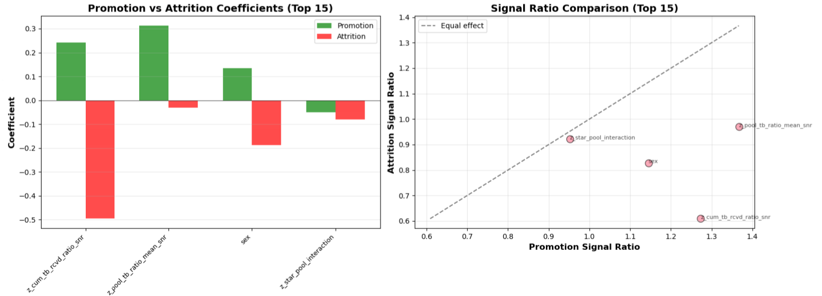

Slide 31
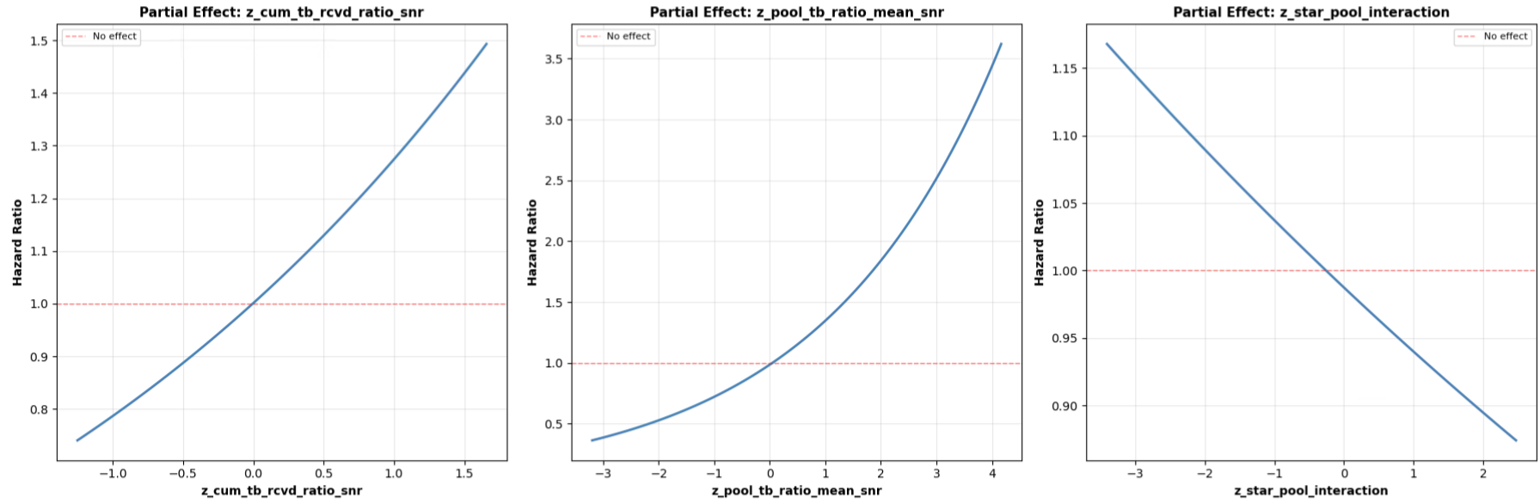

Slide 32
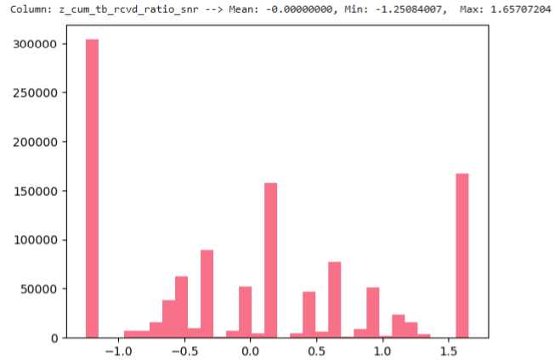
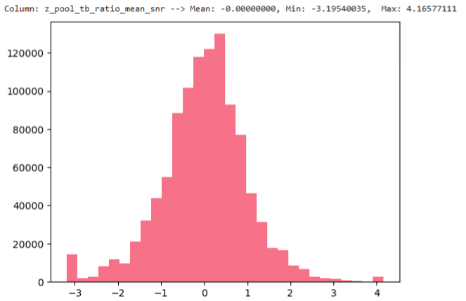
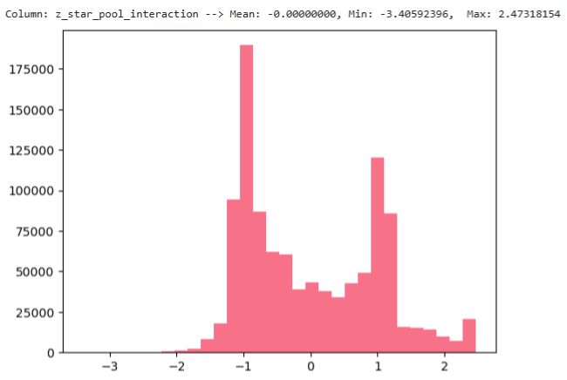

Slide 33
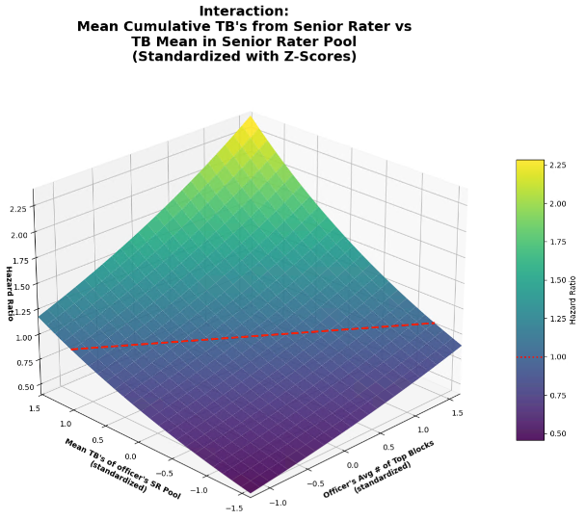

Slide 34
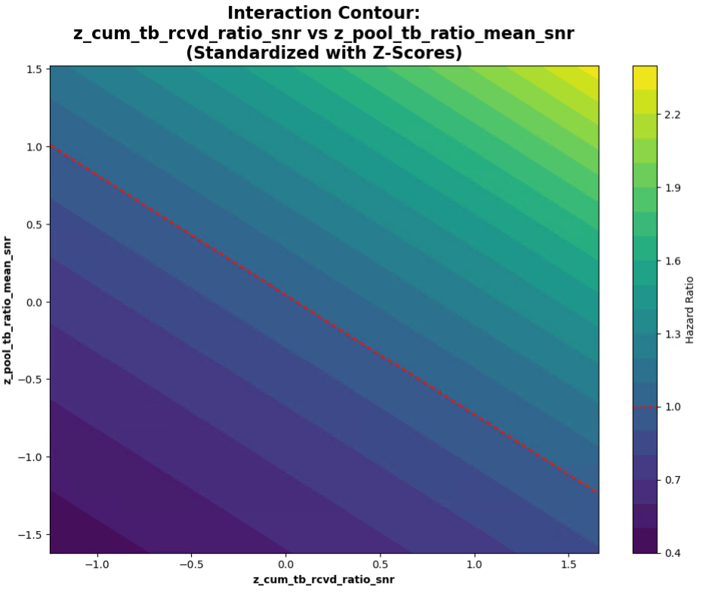

Slide 35
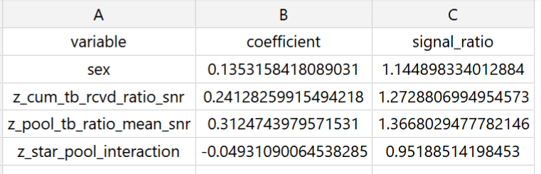

Slide 36

To quantify the two effects with respect to each other:
If the fitted model is
$$\log\left(HR\right) = b1∗x + b2∗y + b3∗x∗y$$
with $x = z_cum_tb_rcvd_ratio_snr$ and $y = z_pool_tb_ratio_mean_snr$,
then:
Marginal effect of x at a given y:$\frac{∂}{∂x }log⁡(HR)= b1 + b3∗y$
Marginal effect of y at a given x:$\frac{∂}{∂y }log⁡(HR)= b2 + b3∗x$
A simple trade‑off rate (how much x you need to change to offset y) is therefore:
$$\frac{dx}{dy }= −\frac{ \left(b2 + b3∗x\right) }{ \left(b1 + b3∗y\right)}$$
If there’s no interaction $(b3 = 0)$, then it simplifies to:$\frac{dx}{dy }= −\frac{ b2 }{ b1}$
So, a $+1 σ$ increase in $z_pool_tb_ratio_mean_snr$,
is equivalent to
a $−\frac{b2}{b1} σ$ change in $z_cum_tb_rcvd_ratio_snr$.

Slide 37
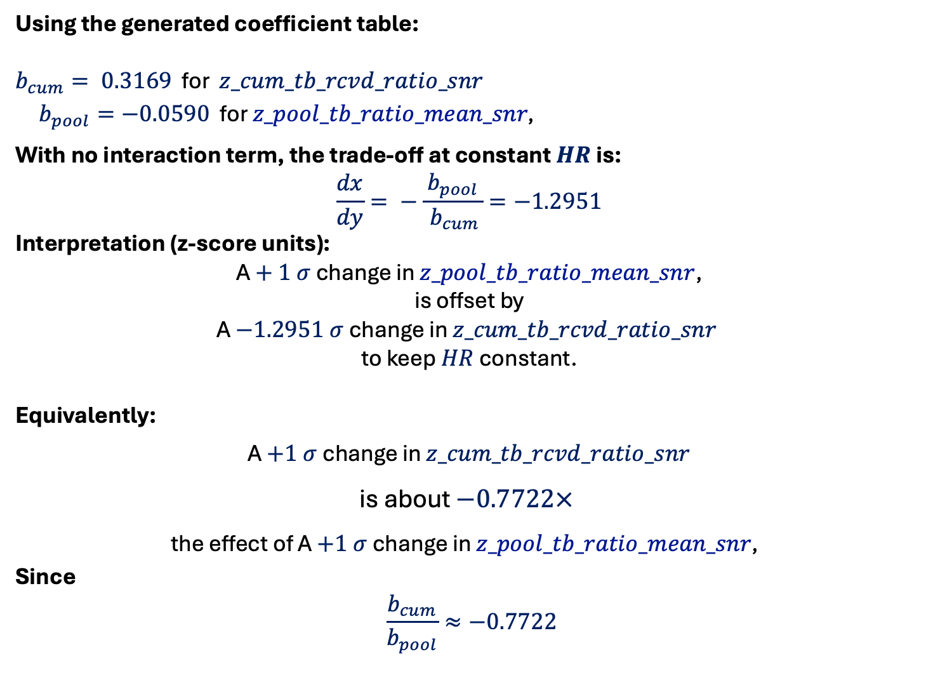
Using the generated coefficient table:
$b_{cum}= 0.3169$ for $z_cum_tb_rcvd_ratio_snr$
$b_{pool}=−0.0590$ for $z_pool_tb_ratio_mean_snr\text{, }$
With no interaction term, the trade‑off at constant $HR$ is:
$$\frac{dx}{dy}= −\frac{ b_{pool }}{ b_{cum}}=−1.2951$$
Interpretation (z‑score units):
A $+ 1 σ$ change in $z_pool_tb_ratio_mean_snr$,
is offset by
A $−1.2951 σ$ change in $z_cum_tb_rcvd_ratio_snr$
to keep $HR$ constant.
Equivalently:
A $+1 σ$ change in $z_cum_tb_rcvd_ratio_snr$
is about $−0.7722×$
the effect of A $+1 σ$ change in $z_pool_tb_ratio_mean_snr\text{, }$
Since
$$\frac{b_{cum}}{b_{pool}}≈−0.7722$$

Slide 38
New Approach RUN 2

Slide 39
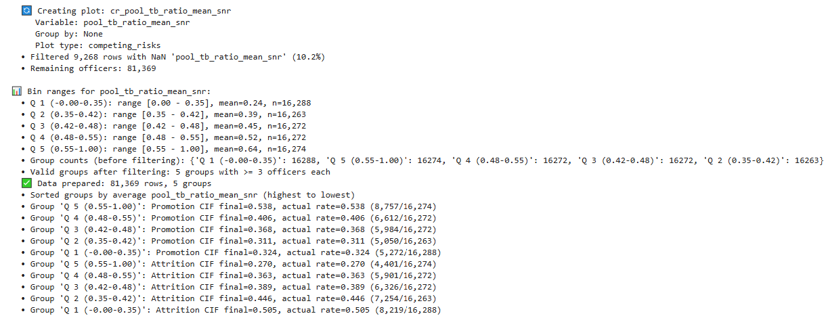

Slide 40
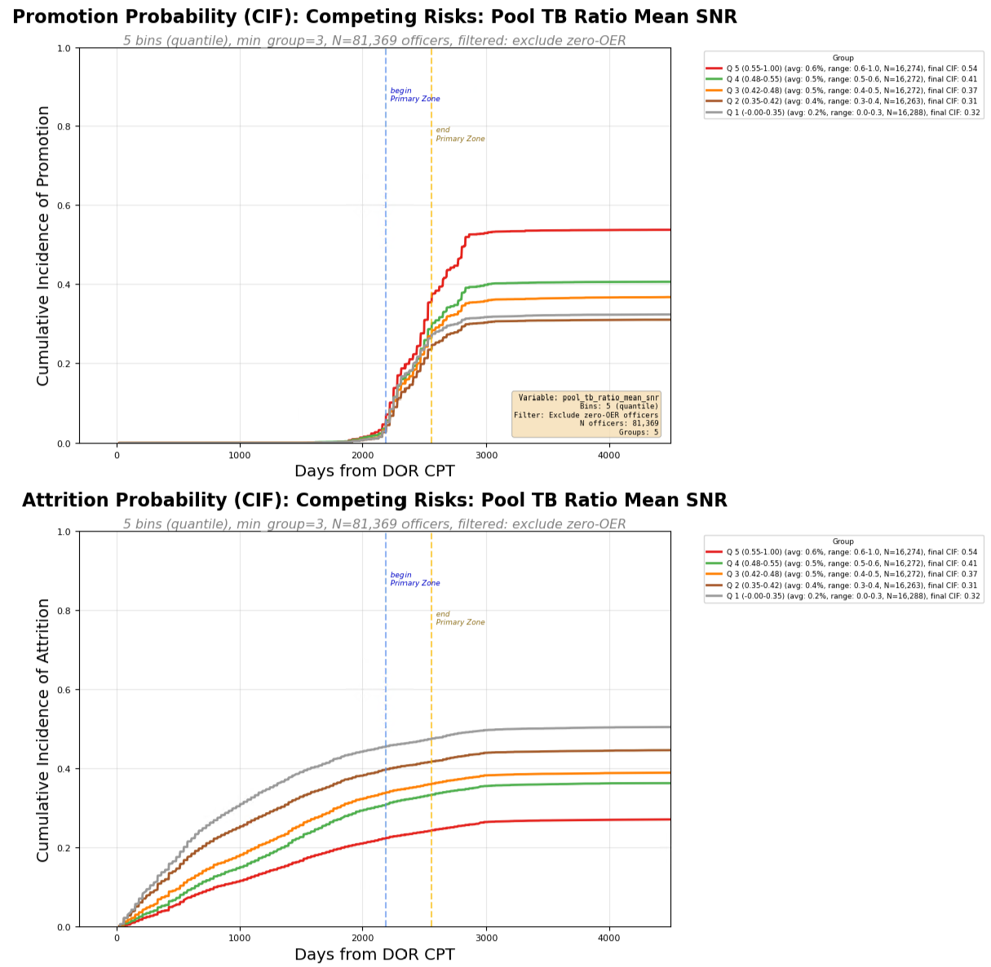

Slide 41
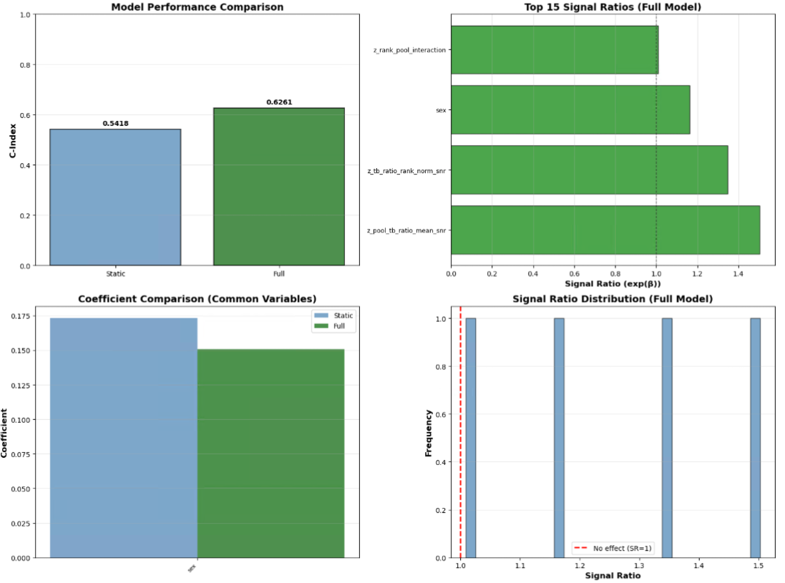

Slide 42
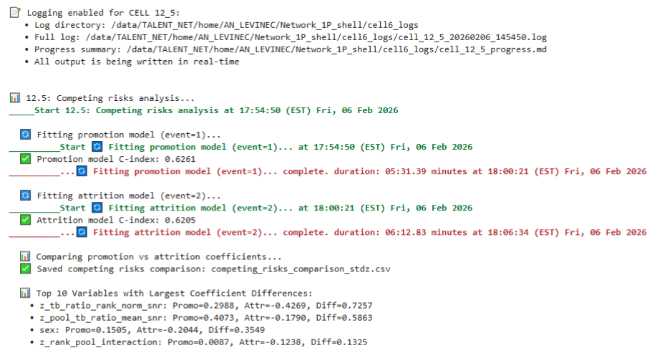

Slide 43
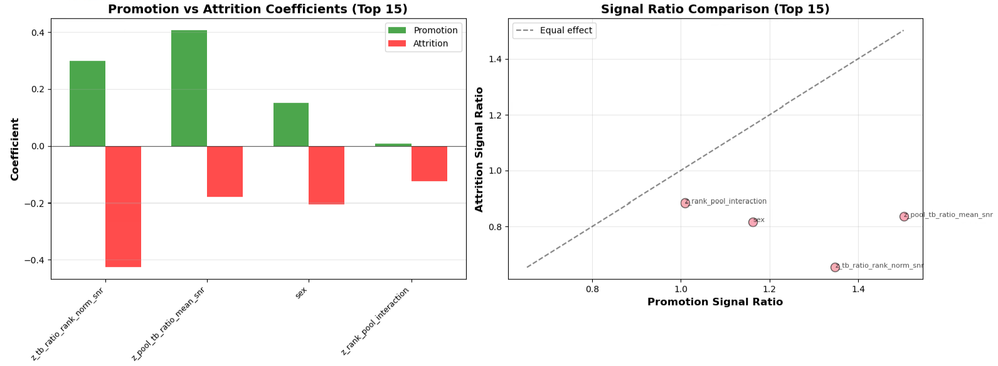

Slide 44
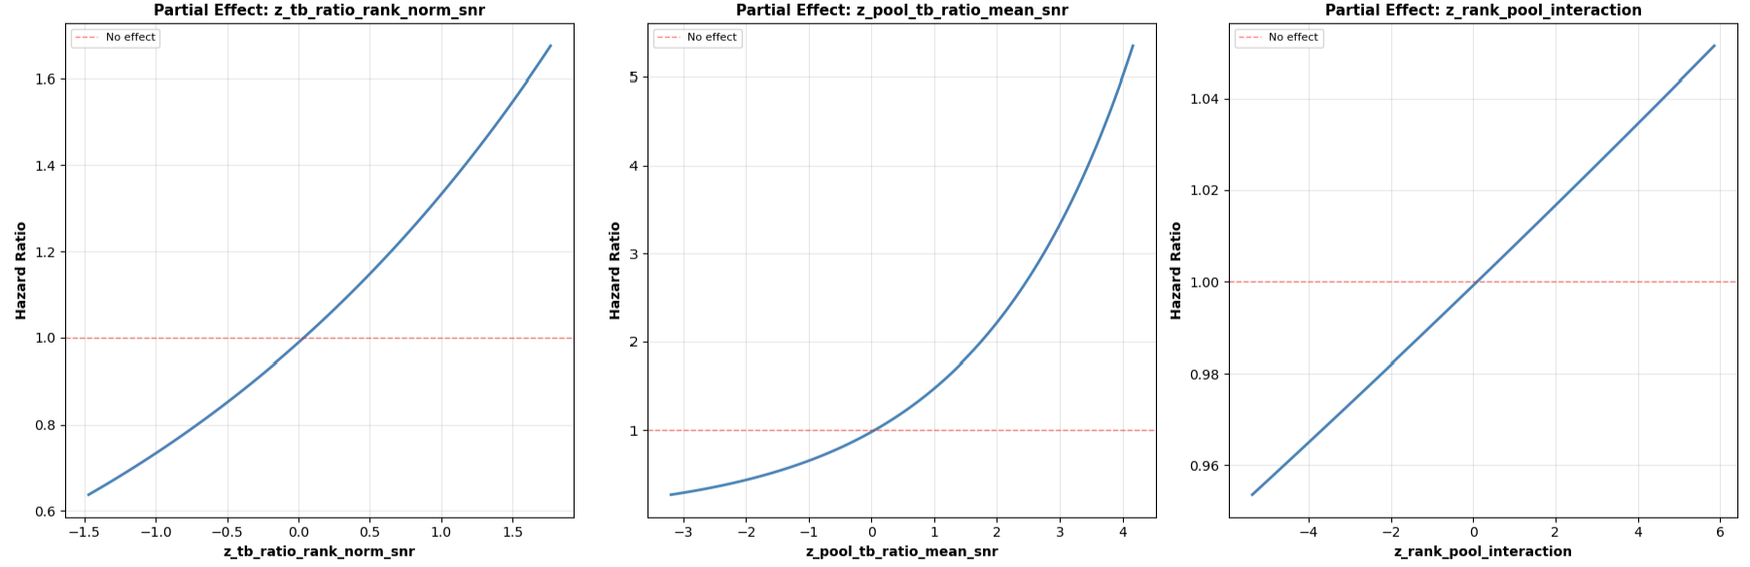

Slide 45
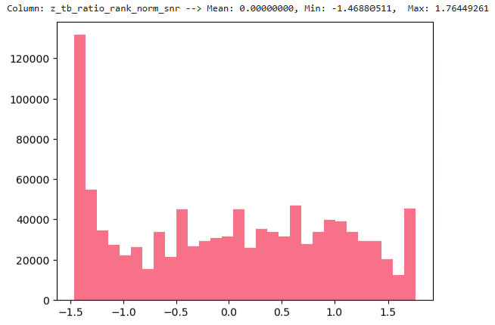
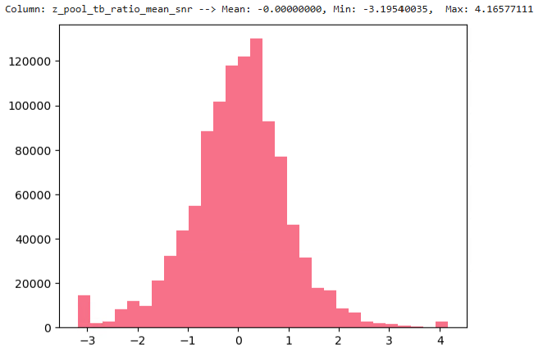
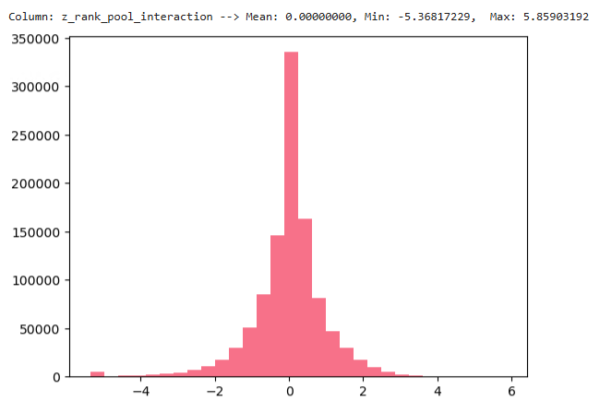

Slide 46
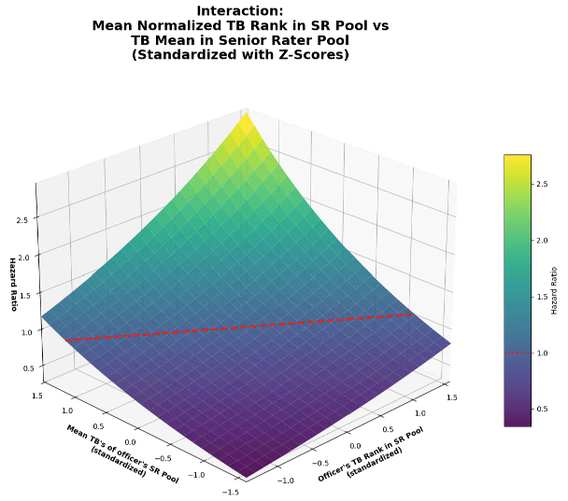

Slide 47
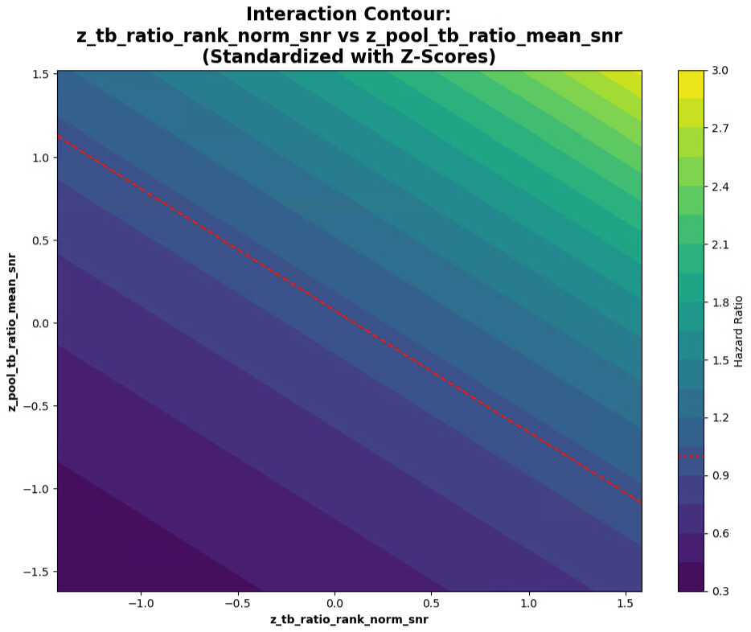

Slide 48



Slide 49
To quantify the two effects with respect to each other:
If the fitted model is
$$\log\left(HR\right) = b1∗x + b2∗y + b3∗x∗y$$
with $x = z_cum_tb_rcvd_ratio_snr$ and $y = z_tb_ratio_rank_norm_snr$,
then:
Marginal effect of x at a given y:$\frac{∂}{∂x }log⁡(HR)= b1 + b3∗y$
Marginal effect of y at a given x:$\frac{∂}{∂y }log⁡(HR)= b2 + b3∗x$
A simple trade‑off rate (how much x you need to change to offset y) is therefore:
$$\frac{dx}{dy }= −\frac{ \left(b2 + b3∗x\right) }{ \left(b1 + b3∗y\right)}$$
If there’s no interaction $(b3 = 0)$, then it simplifies to:$\frac{dx}{dy }= −\frac{ b2 }{ b1}$
So, a $+1 σ$ increase in $z_tb_ratio_rank_norm_snr$
is equivalent to
a $−\frac{b2}{b1} σ$ change in $z_cum_tb_rcvd_ratio_snr$.

Slide 50
Using the generated coefficient table:
$b_{cum}= 0.3169$ for $z_cum_tb_rcvd_ratio_snr$
$b_{rank}=−0.0590$ for $z_tb_ratio_rank_norm_snr$
With no interaction term, the trade‑off at constant $HR$ is:
$$\frac{dx}{dy}= −\frac{ b_{rank }}{ b_{cum}}= 0.1863$$
Interpretation (z‑score units):
A $+ 1 σ$ change in $z_tb_ratio_rank_norm_snr$
is offset by
A $+ 0.1863 σ$ change in $z_cum_tb_rcvd_ratio_snr$
to keep $HR$ constant.
Equivalently:
A $+1 σ$ change in $z_cum_tb_rcvd_ratio_snr$
is about $−5.38×$
the effect of A $+1 σ$ change in $z_prestige_mean$
Since
$$\frac{b_{cum}}{b_{rank}}≈−5.38$$

