Slide 1
Officer’s Timeline
using ‘backward paint’ method
2019-08-19
Eval thru date
“40”
2020-08-19
Eval thru date
“50”
Eval Credit = “40”
Eval Credit = “50”
2019
2020
Q2
Q3
Q4
Q1
Q2
Q3
Q4
Q1
JAN
FEB
MAR
APR
MAY
JUN
JUL
AUG
SEP
OCT
NOV
DEC
JAN
FEB
MAR
APR
MAY
JUN
JUL
AUG
SEP
OCT
NOV
DEC
JAN
FEB
2019-12-31
Last Snapshot
2020-02-03
Promo to MAJ
2016-10-01
Promo to CAPTAIN
1187 days
From CPT
1221 days
From CPT
Officer’s Survival Record Entry

Slide 2
Officer’s Timeline
using ‘forward signal’ method
Past Eval
2018-08-19
Eval thru date
“50”
2019-08-19
Eval thru date
“40”
2020-08-19
Eval thru date
“50”
Eval Credit = “50”
Eval Credit = “40”
Eval Credit = “50”
2019
2020
Q2
Q3
Q4
Q1
Q2
Q3
Q4
Q1
JAN
FEB
MAR
APR
MAY
JUN
JUL
AUG
SEP
OCT
NOV
DEC
JAN
FEB
MAR
APR
MAY
JUN
JUL
AUG
SEP
OCT
NOV
DEC
JAN
FEB
2019-12-31
Last Snapshot
2020-02-03
Promo to MAJ
2016-10-01
Promo to CAPTAIN
1187 days
From CPT
1221 days
From CPT
Officer’s Survival Record Entry

Slide 3
RUN 1
Individual TB Ratio
vs
Senior Rater Pool Mean
z_tb_ratio_1wd_snr
z_pool_minus_mean_snr_fwd
z_star_pool_interaction
RUN 1

Slide 4
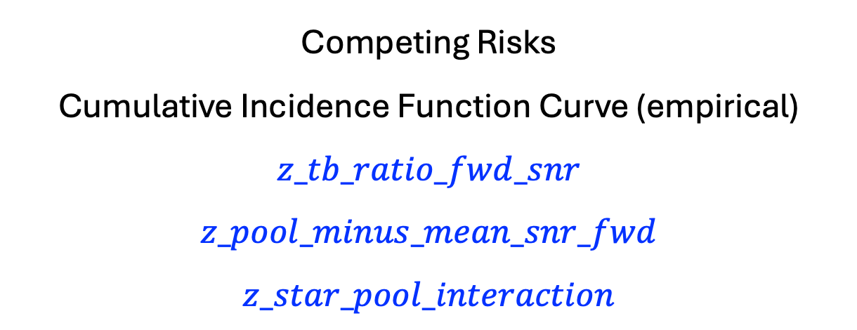
Competing Risks
Cumulative Incidence Function Curve (empirical)
$$z_tb_ratio_fwd_snr$$
$$z_pool_minus_mean_snr_fwd$$
$$z_star_pool_interaction$$
RUN 1

Slide 5
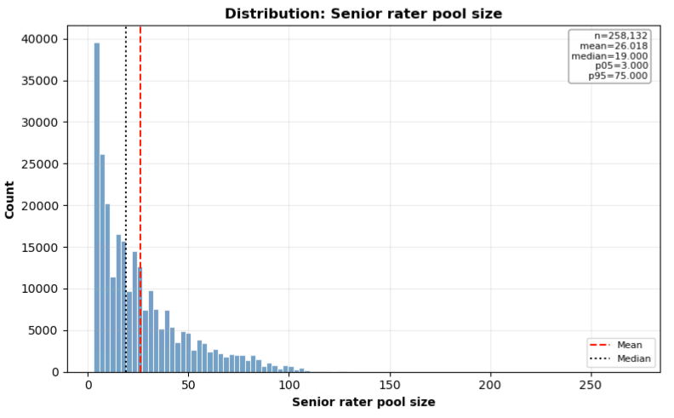
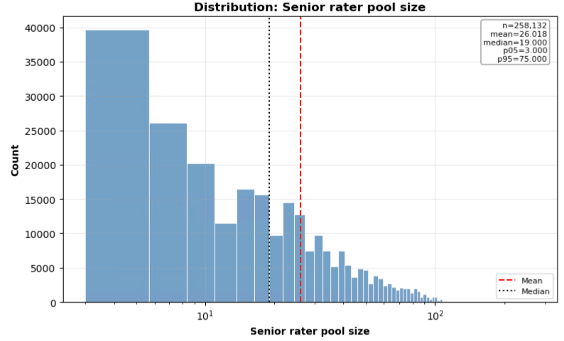
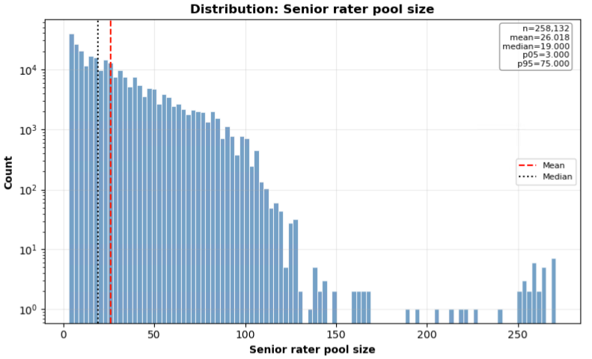
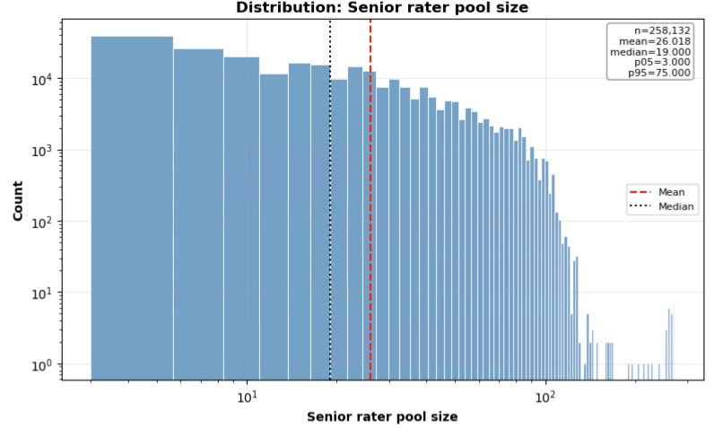
Senior Rater Pool
RUN 1

Slide 6
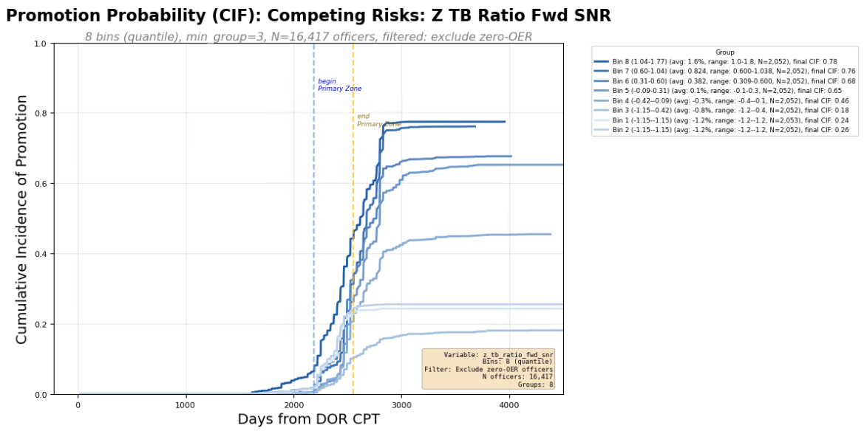
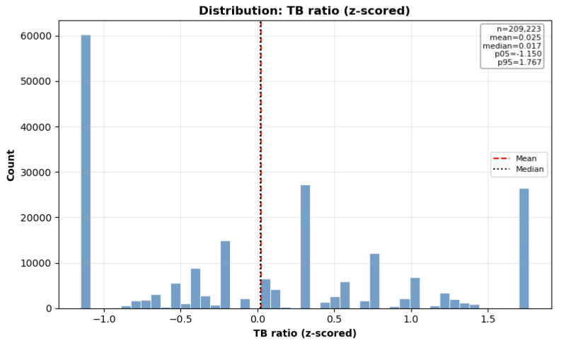
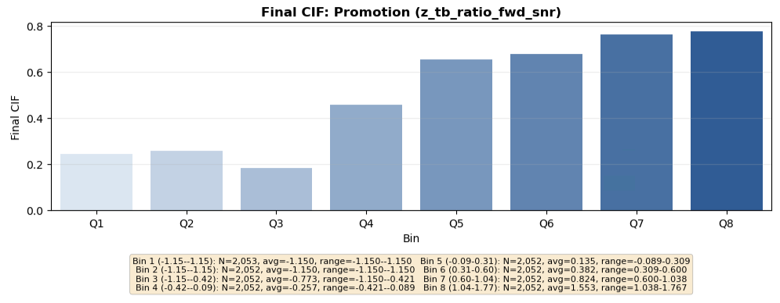
Individual Metrics
RUN 1

Slide 7
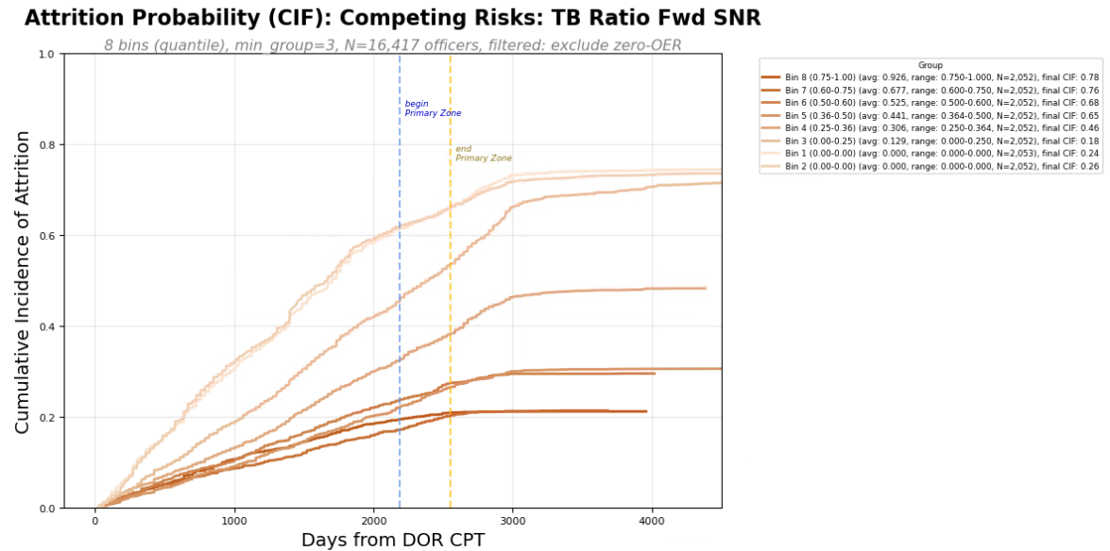
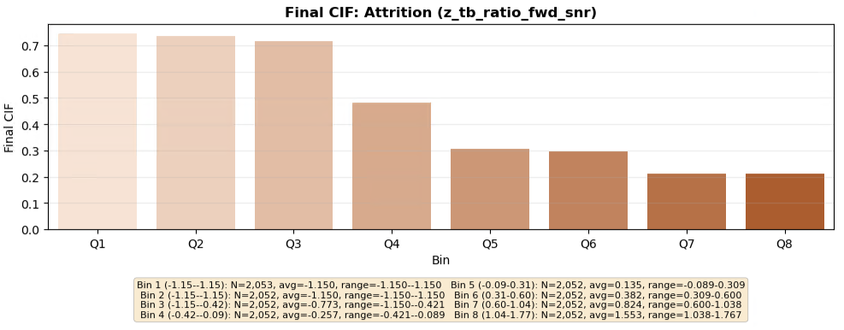
Individual Metrics
RUN 1

Slide 8
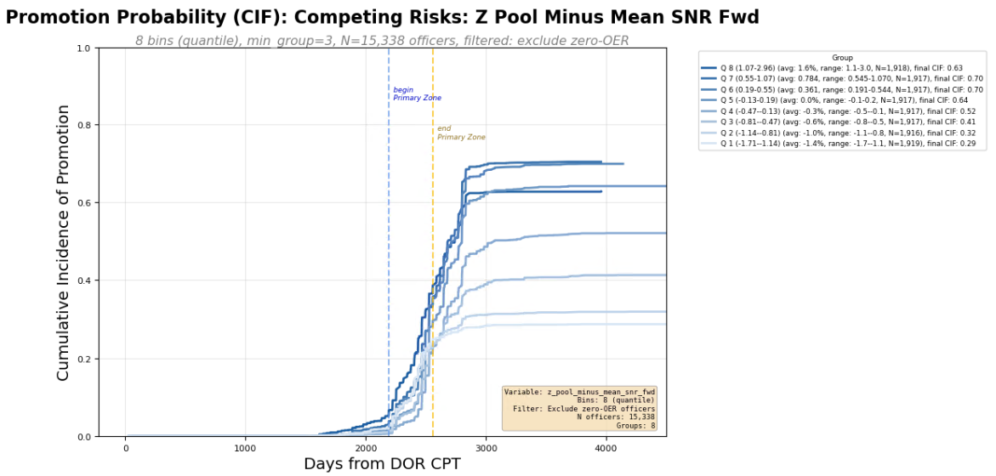
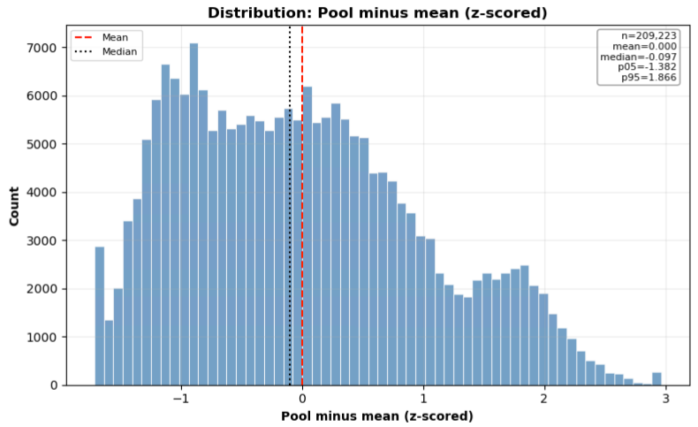
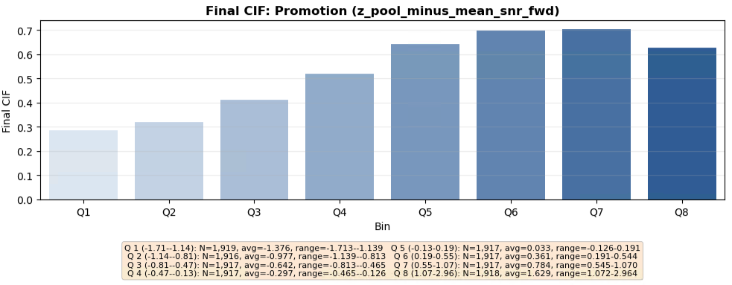
Pool Metrics
RUN 1

Slide 9
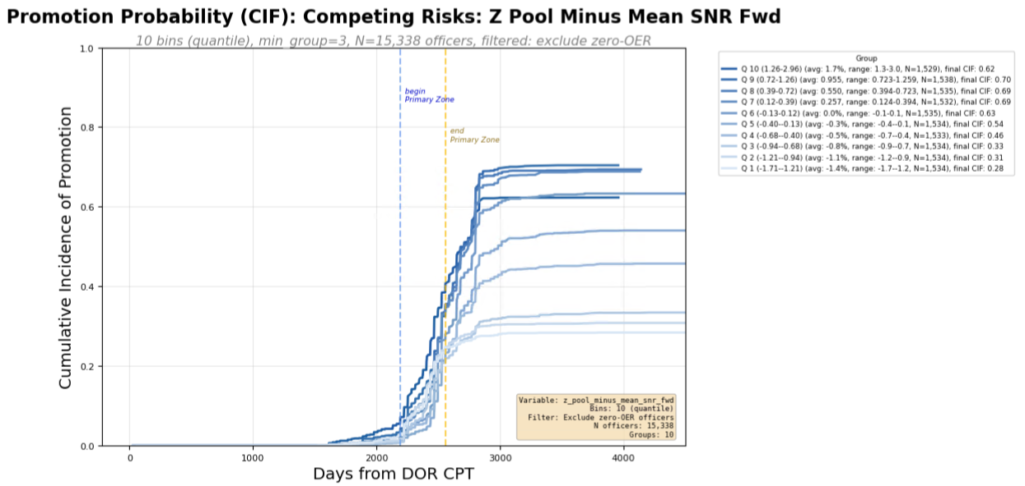
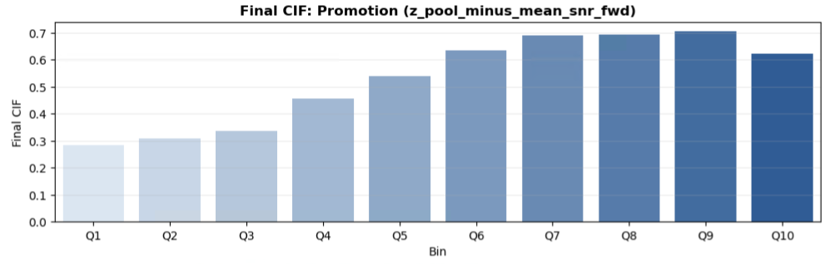
Pool Metrics
10 Bins
RUN 1

Slide 10
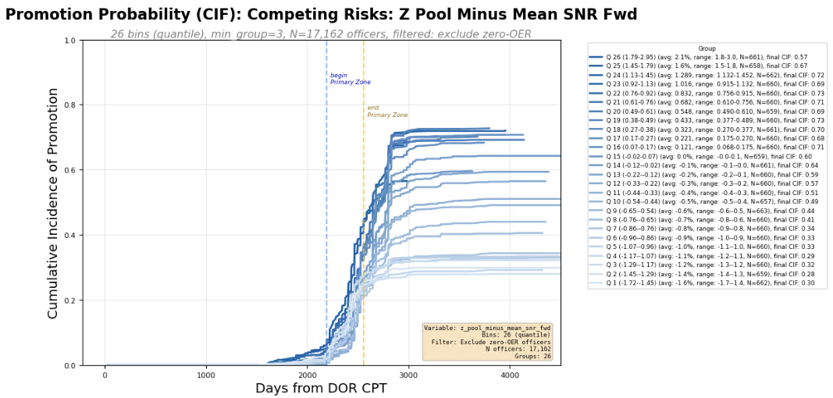
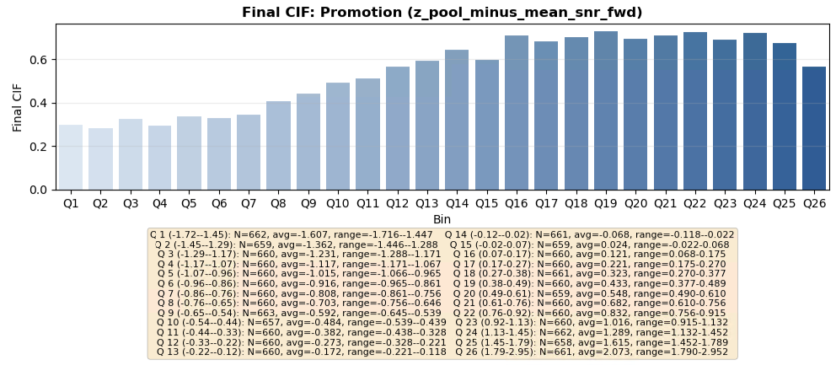
Pool Metrics
26 Bins
RUN 1

Slide 11
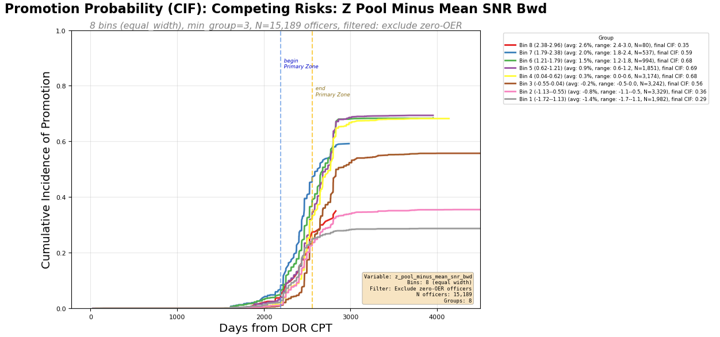
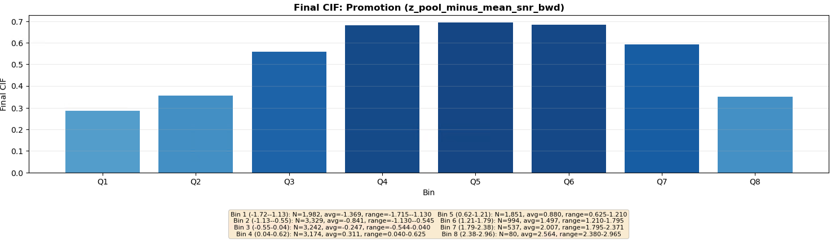
Pool Metrics
True Quantile
RUN 1

Slide 12
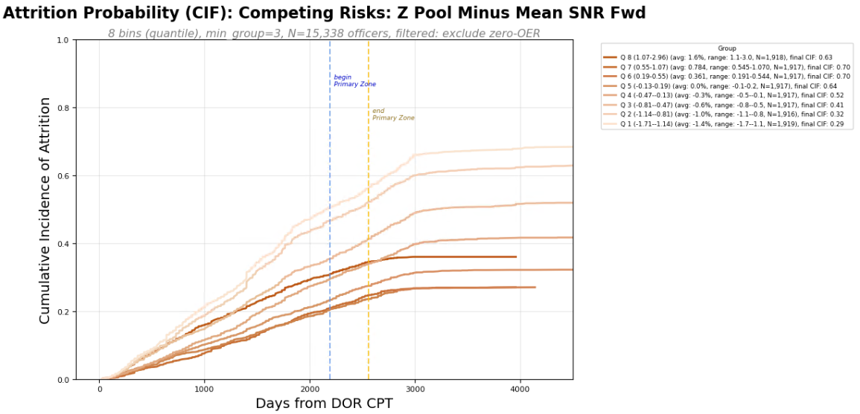
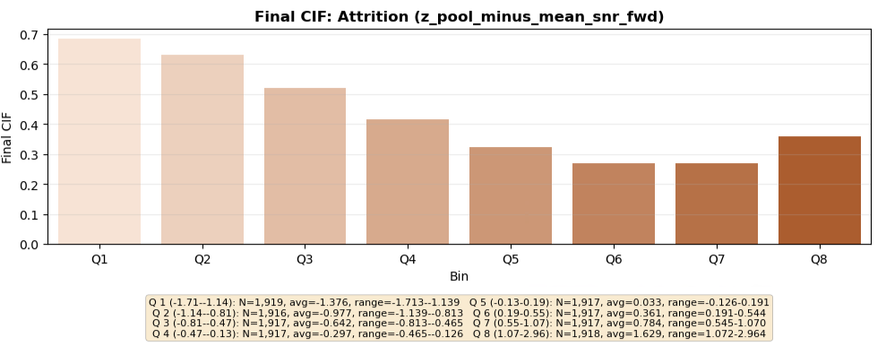
Pool Metrics
RUN 1

Slide 13
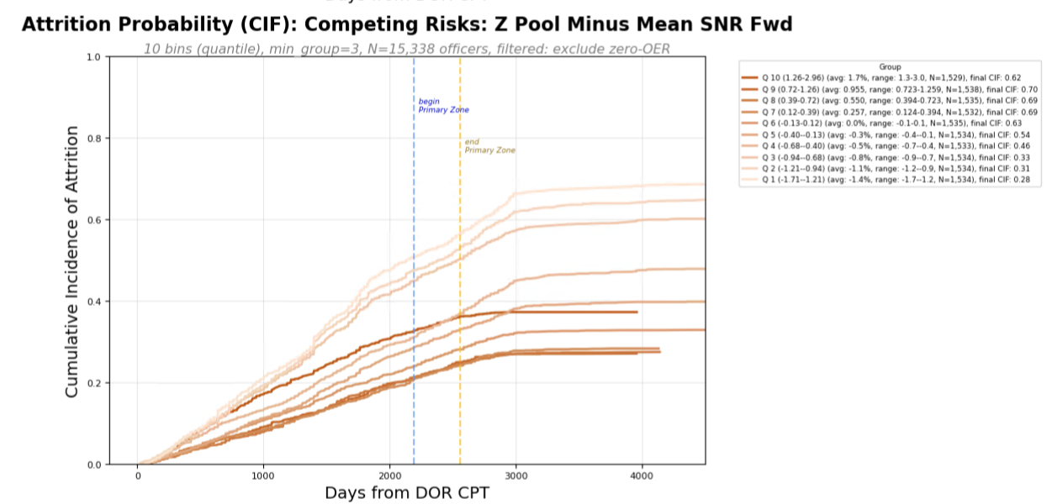
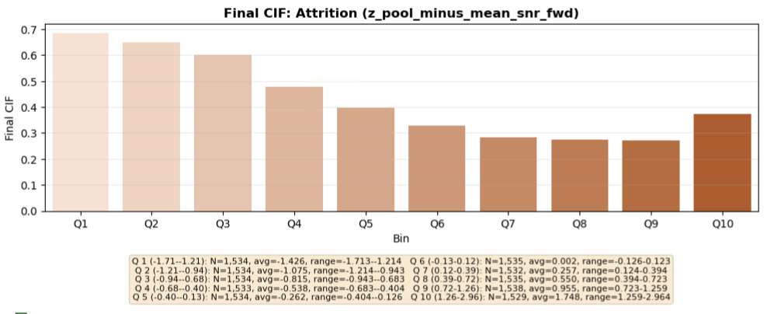
Pool Metrics
10 Bins
RUN 1

Slide 14
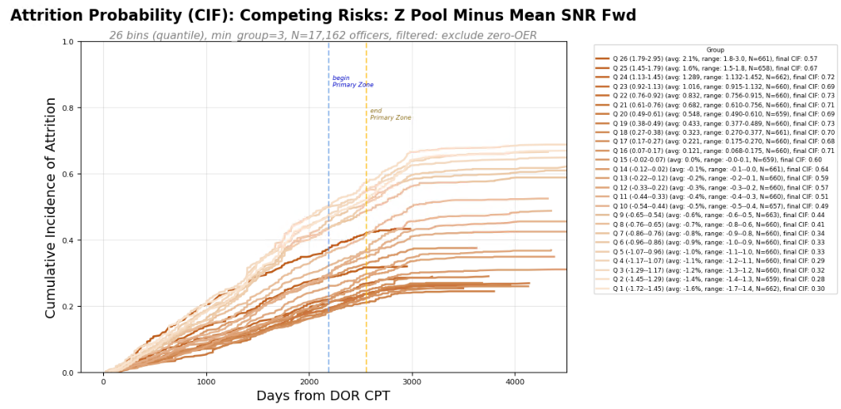
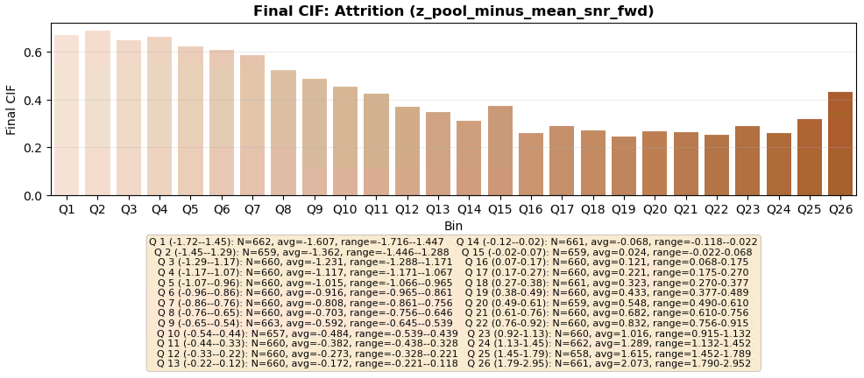
Pool Metrics
26 Bins
RUN 1

Slide 15
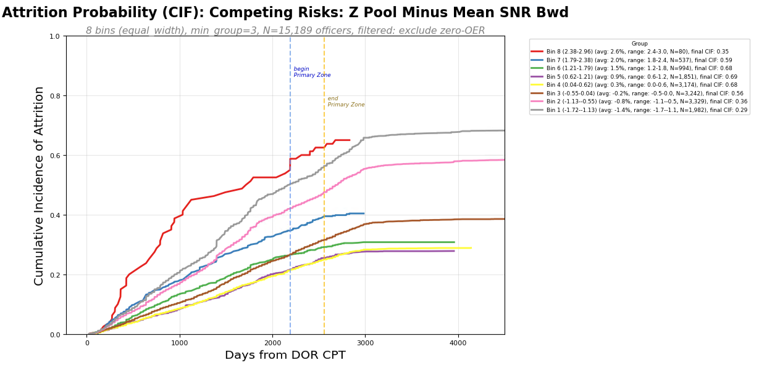
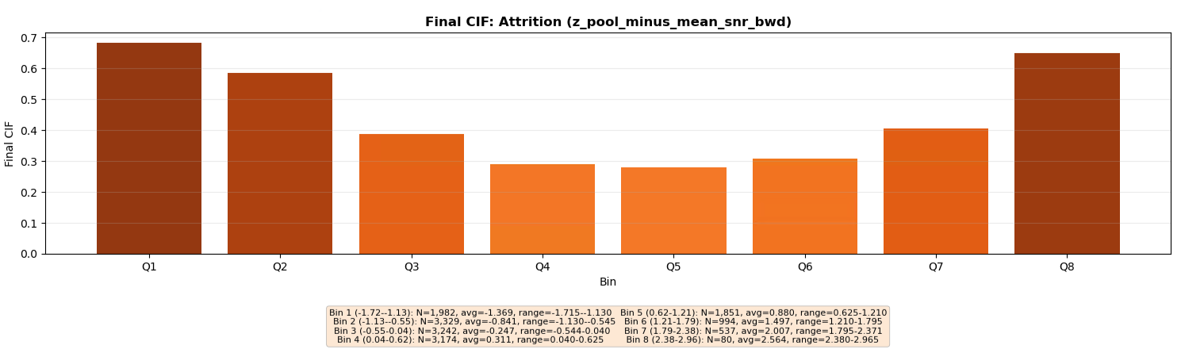
Pool Metrics
True Quantile
RUN 1

Slide 16
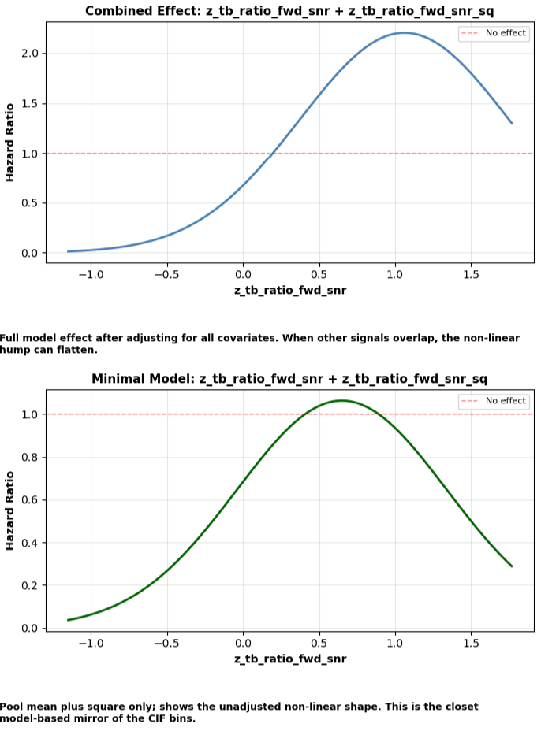
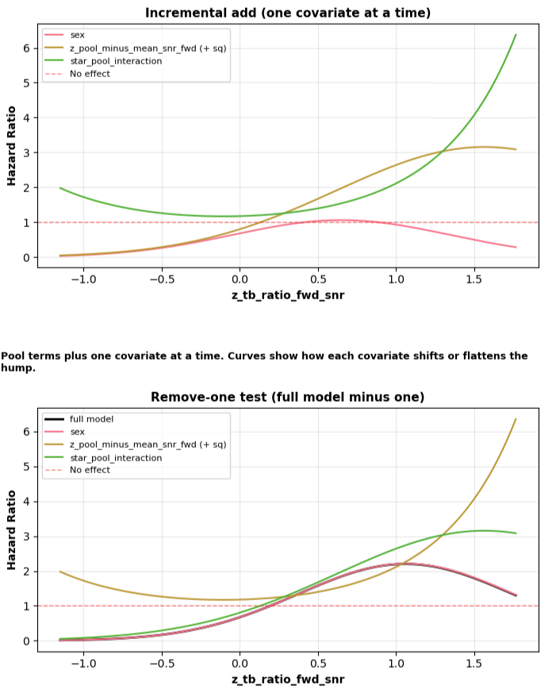
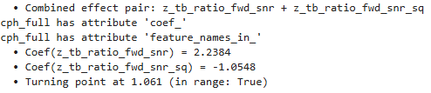
RUN 1

Slide 17
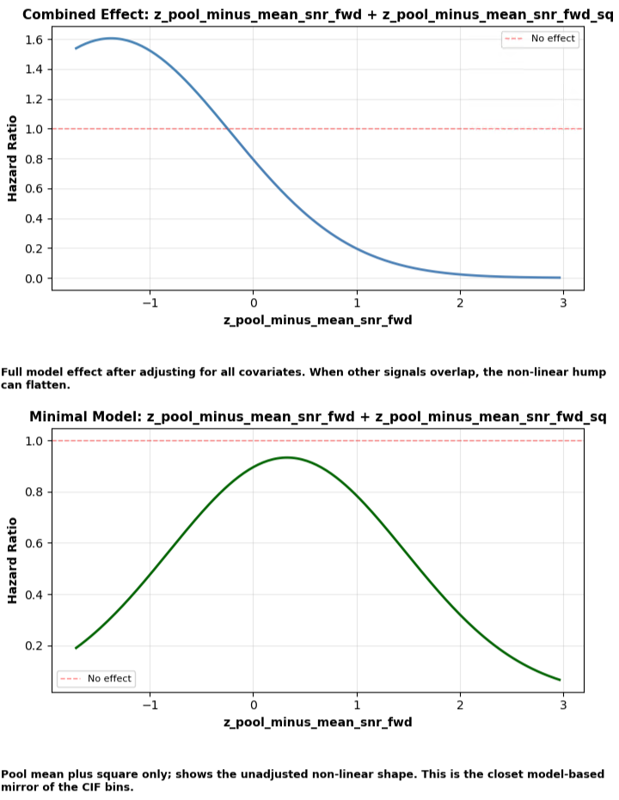
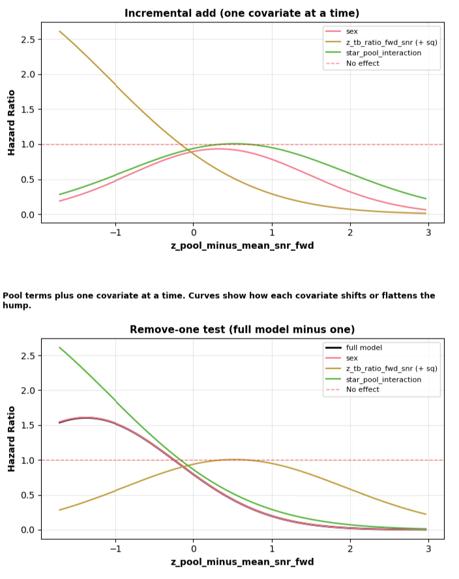

RUN 1

Slide 18
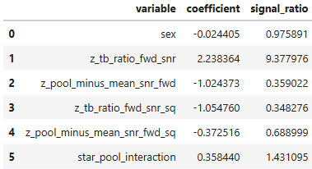

RUN 1

Slide 19
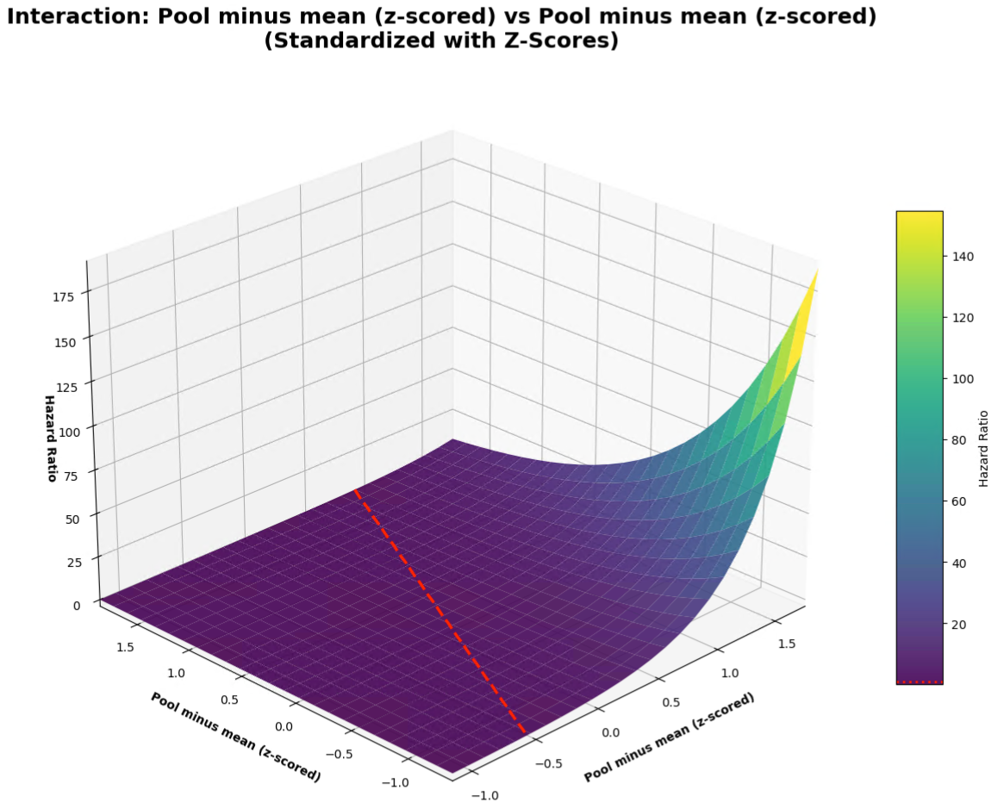
RUN 1

Slide 20
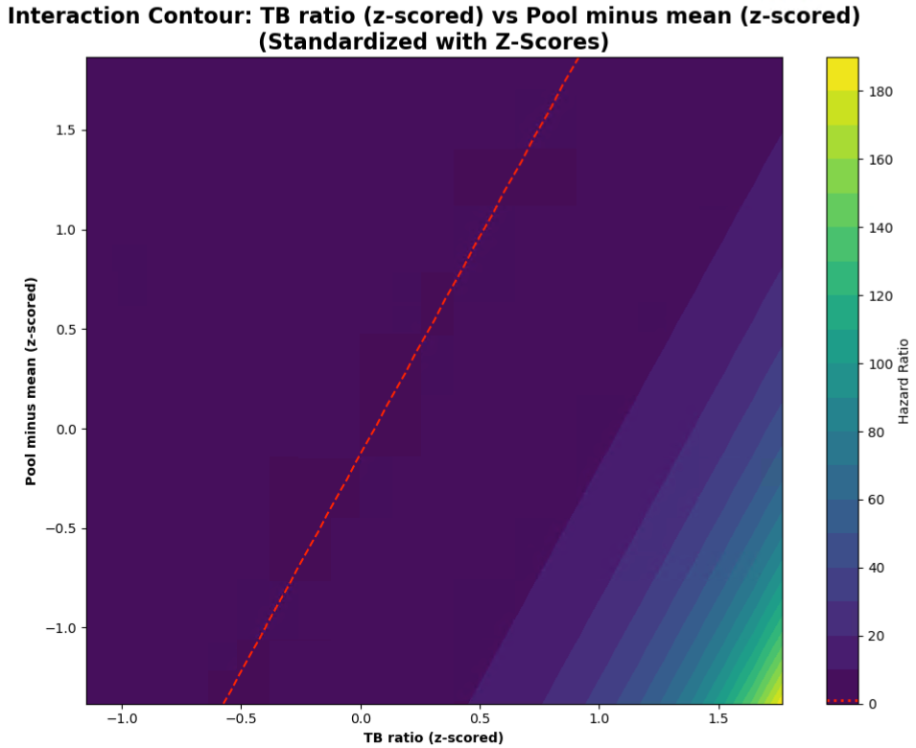
RUN 1

Slide 21
RUN 3
Individual TB Ratio
vs
Senior Rater Pool Rank
z_tb_ratio_bwd_snr
z_pool_tb_ratio_rank_pct_snr_bwd
z_standing_pool_interaction

Slide 22
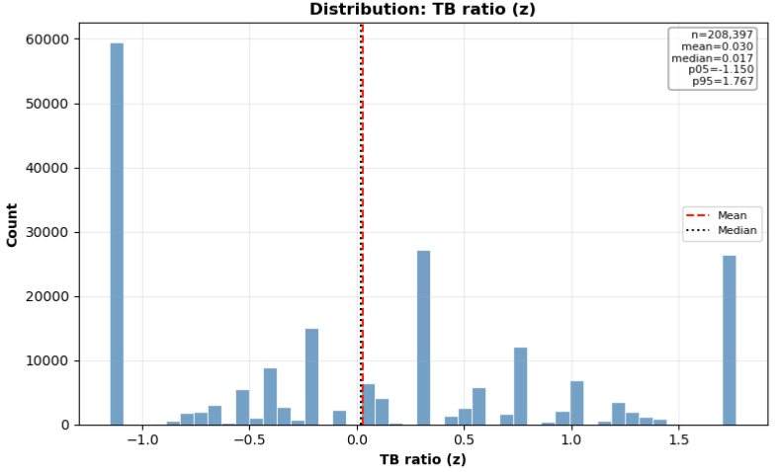
Individual Metrics
RUN 3

Slide 23
Individual Metrics
RUN 3

Slide 24
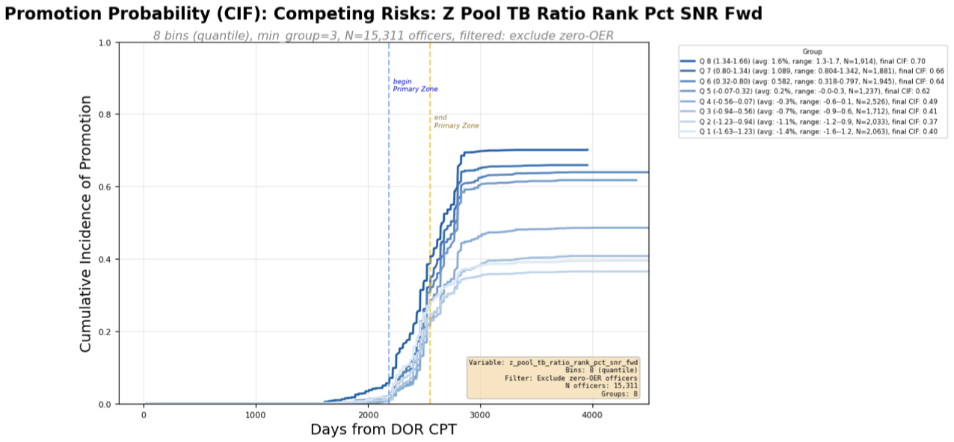
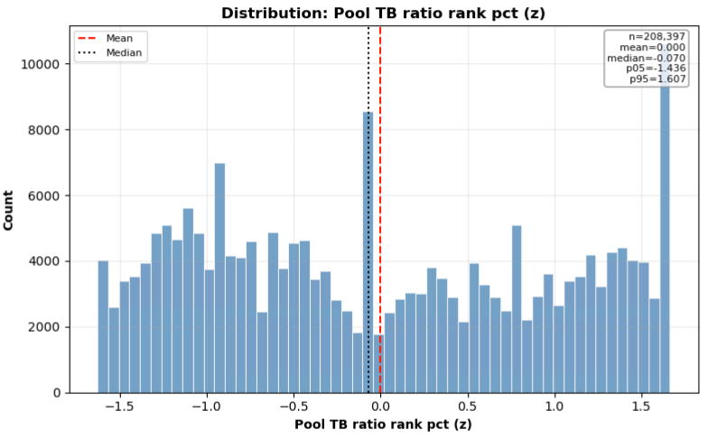
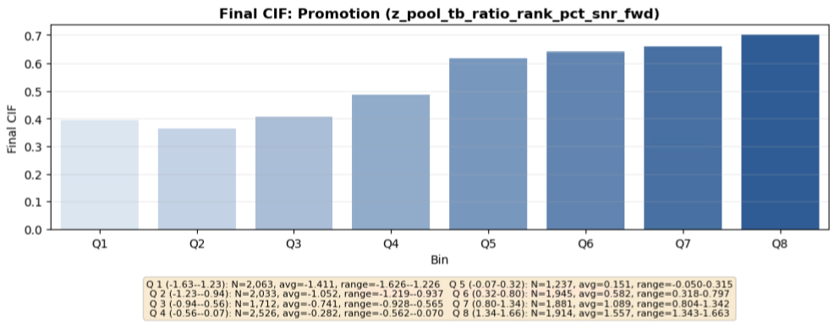
Pool Metrics
RUN 3

Slide 25
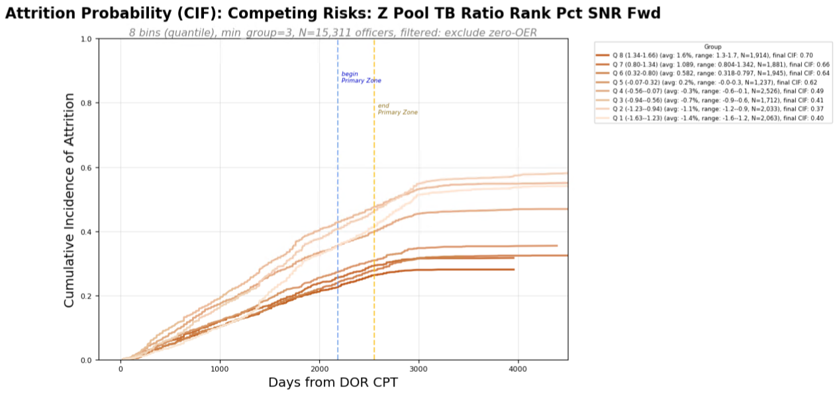
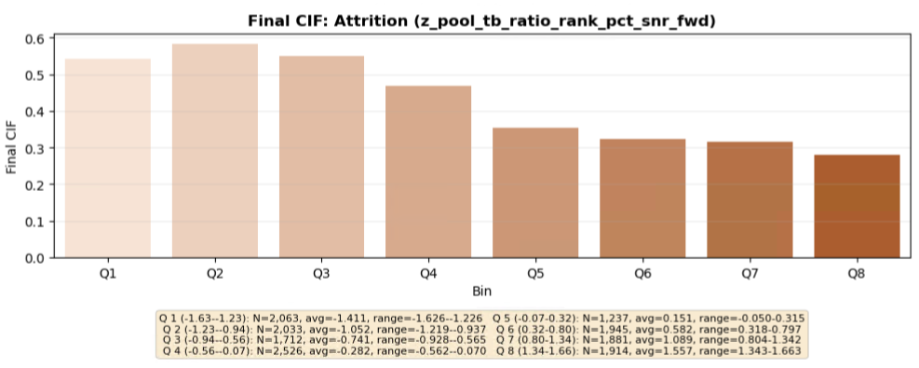
Pool Metrics
RUN 3

Slide 26
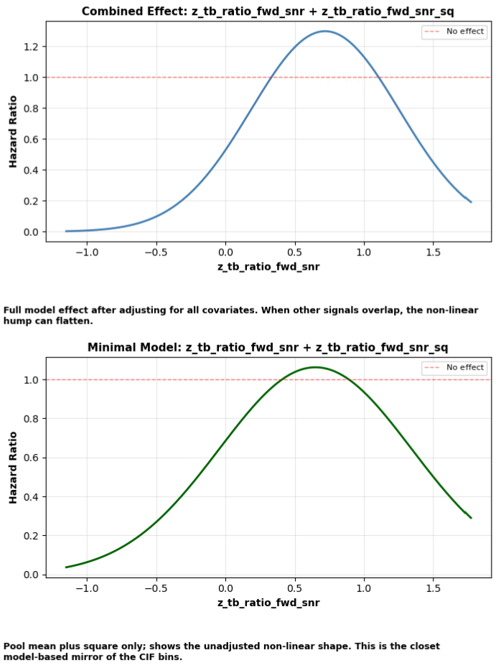
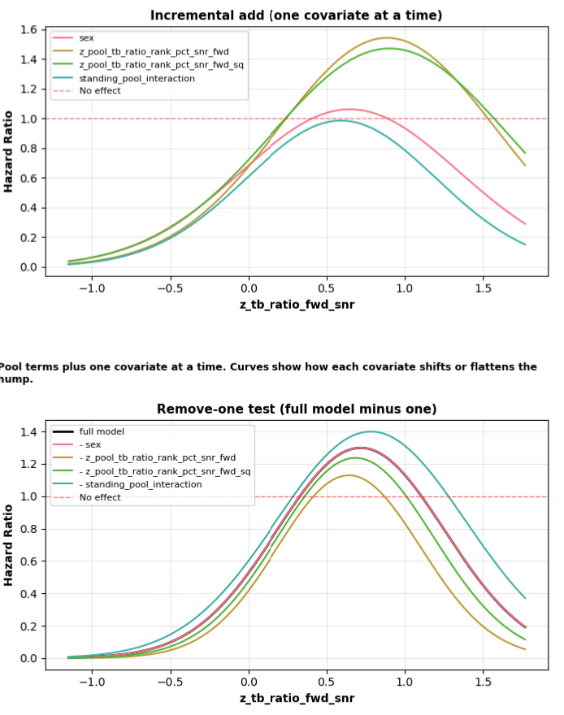

RUN 3

Slide 27
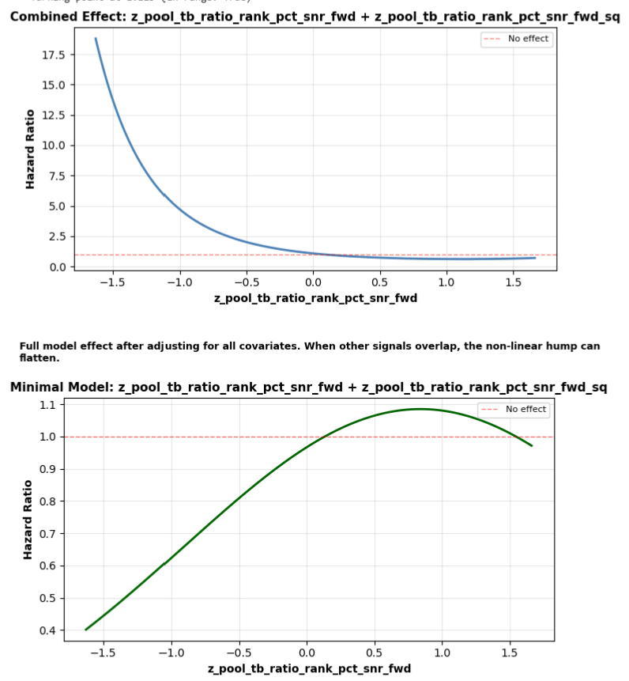
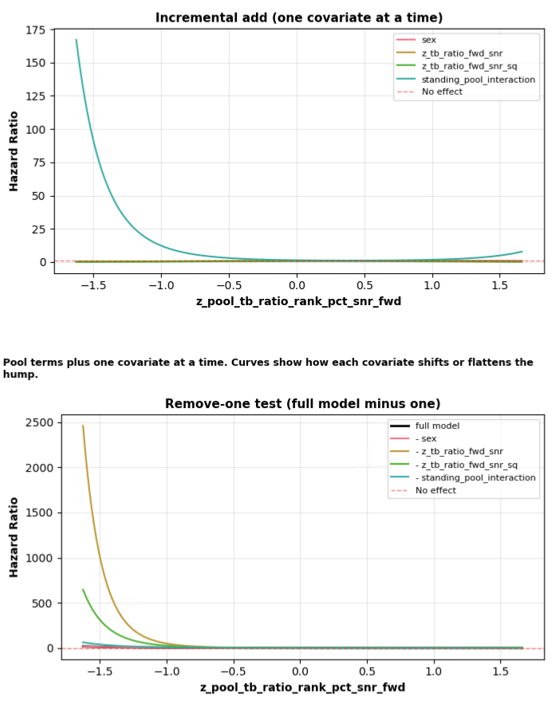

RUN 3

Slide 28
RUN 3

Slide 29
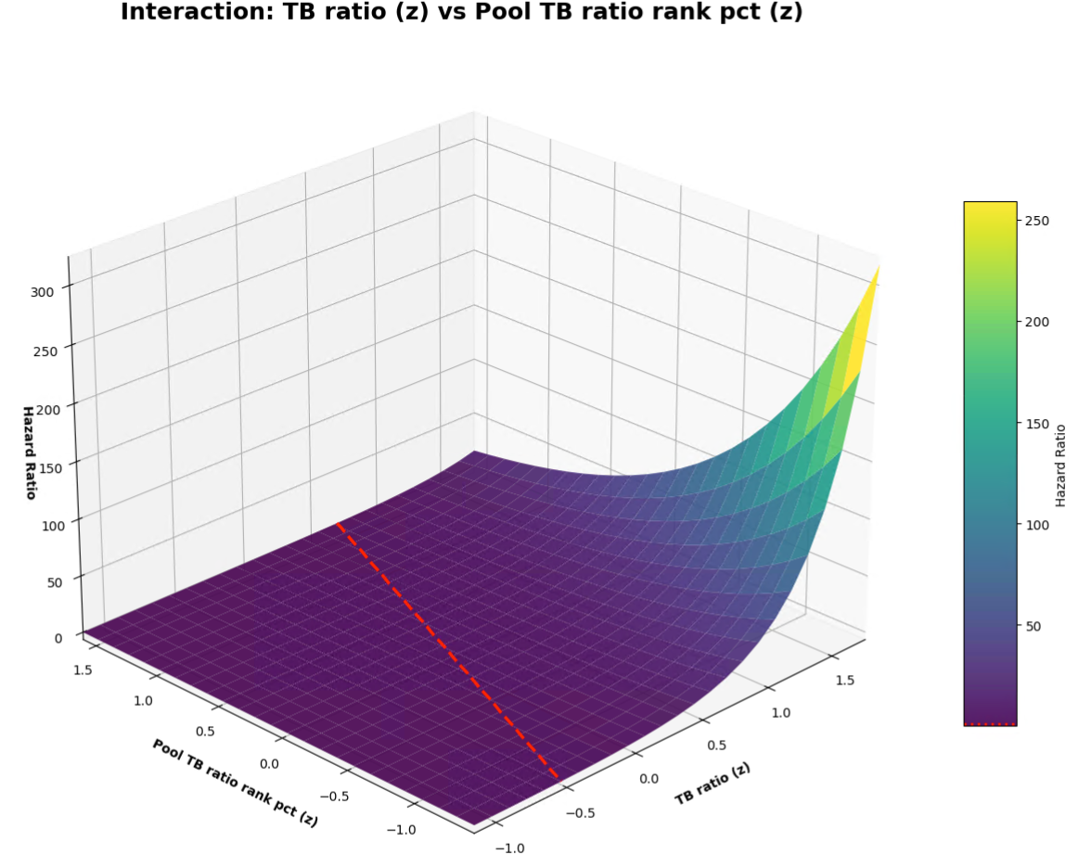
RUN 3

Slide 30
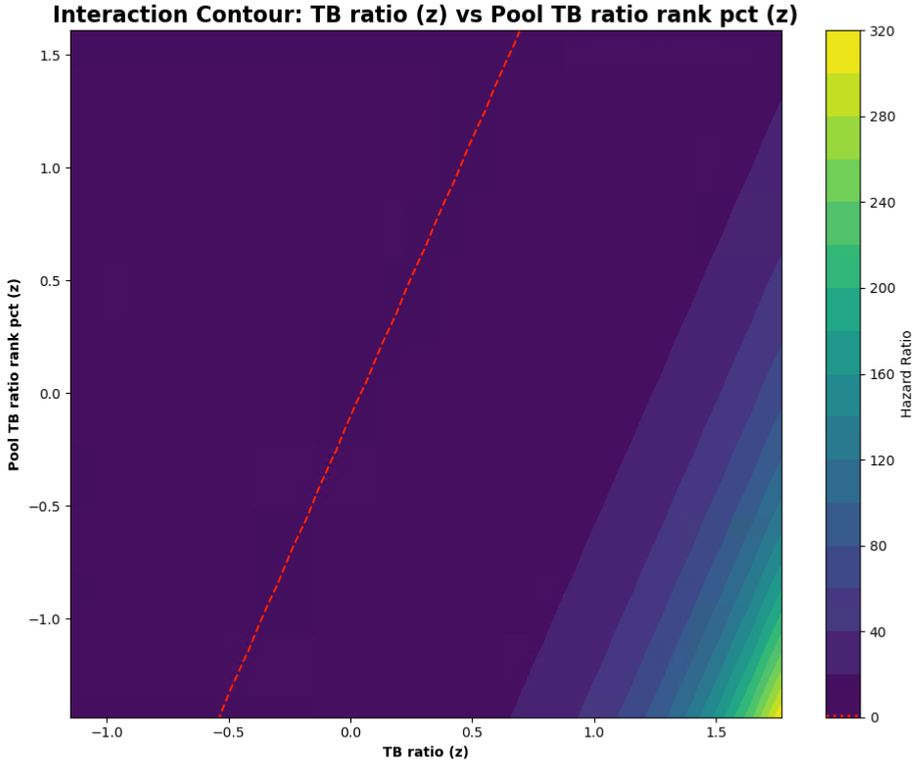
RUN 3

