Slide 1
RUN 1
Individual TB Ratio
vs
Senior Rater Pool Mean
z_tb_ratio_bwd_snr
z_pool_minus_mean_snr_bwd
z_star_pool_interaction

Slide 2
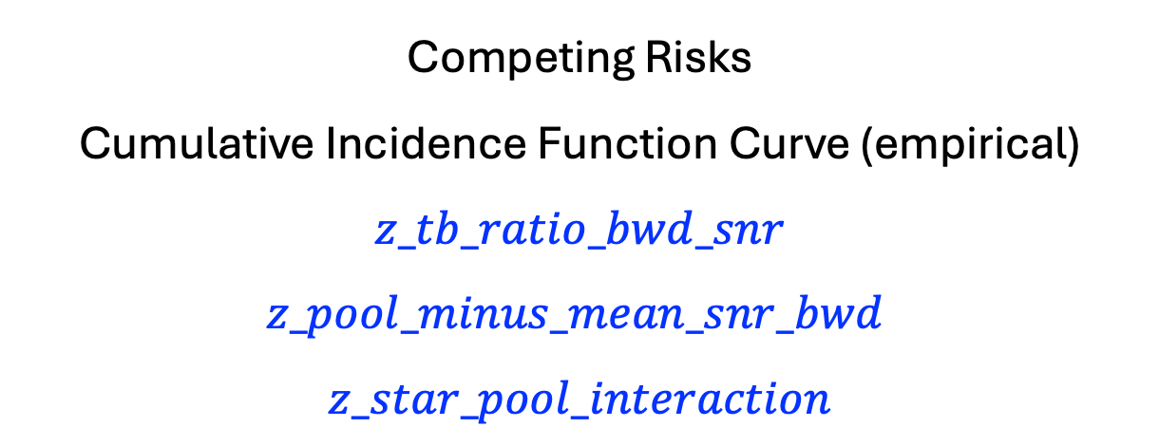
Competing Risks
Cumulative Incidence Function Curve (empirical)
$$z_pool_minus_mean_snr_bwd z_tb_ratio_bwd_snr$$
$$z_star_pool_interaction$$

Slide 3
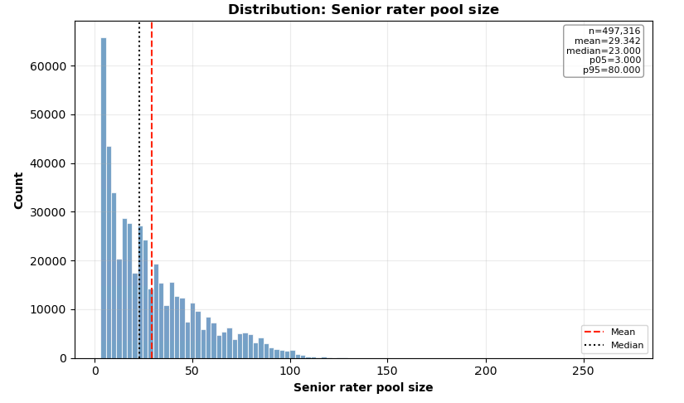
Senior Rater Pool

Slide 4
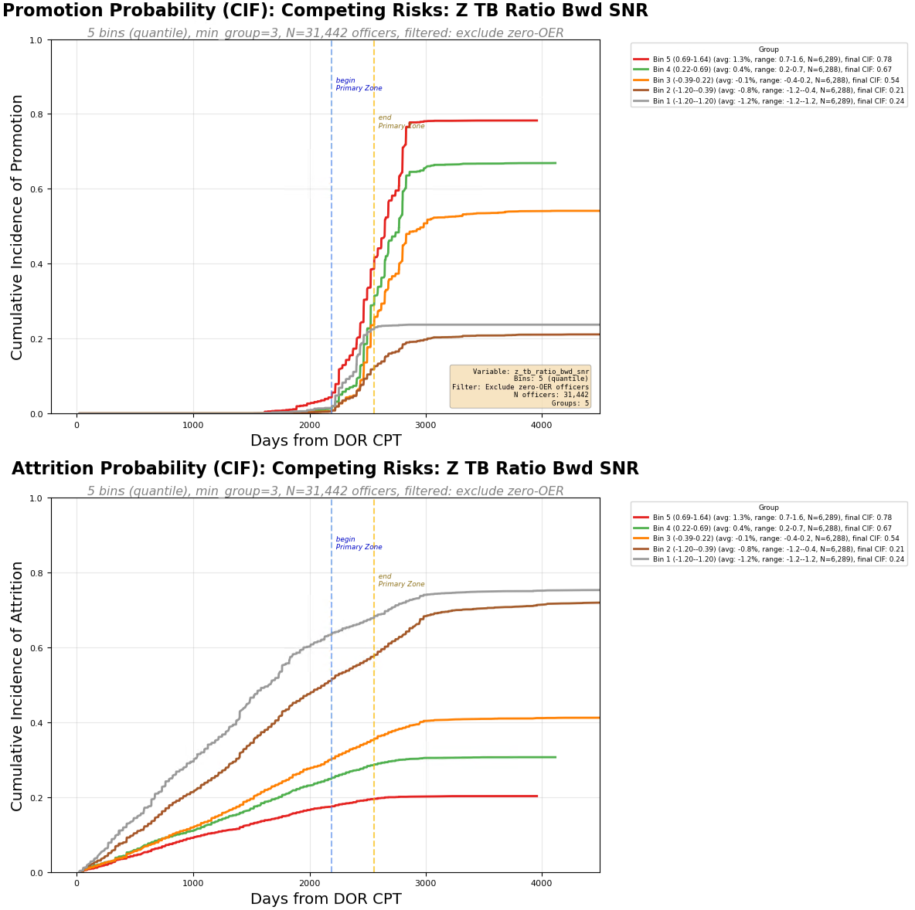
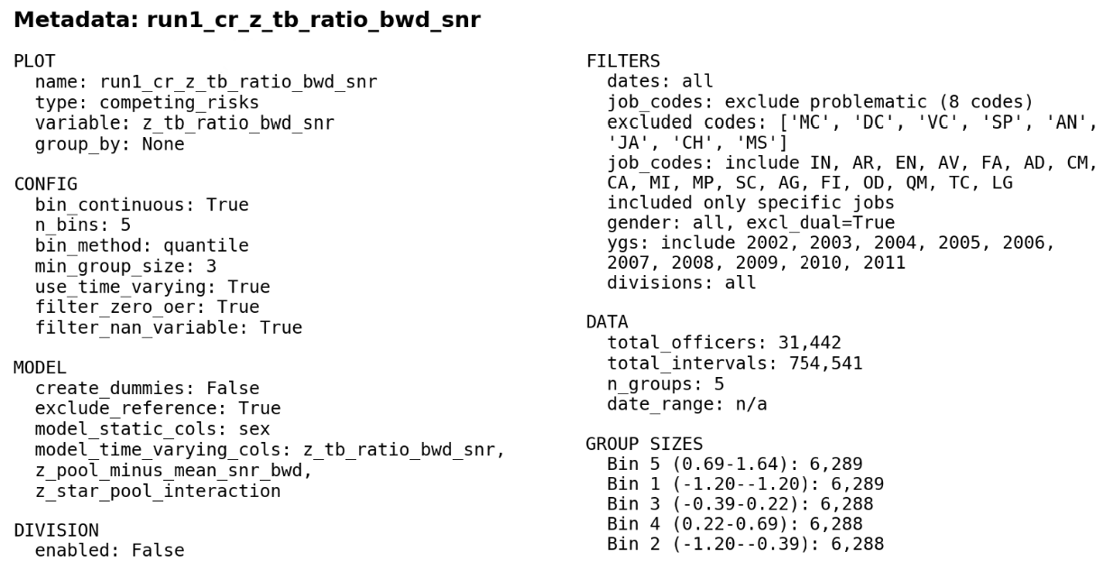
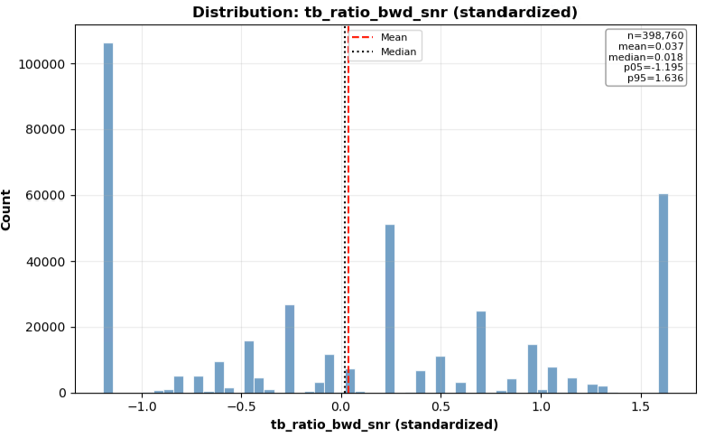

Slide 5
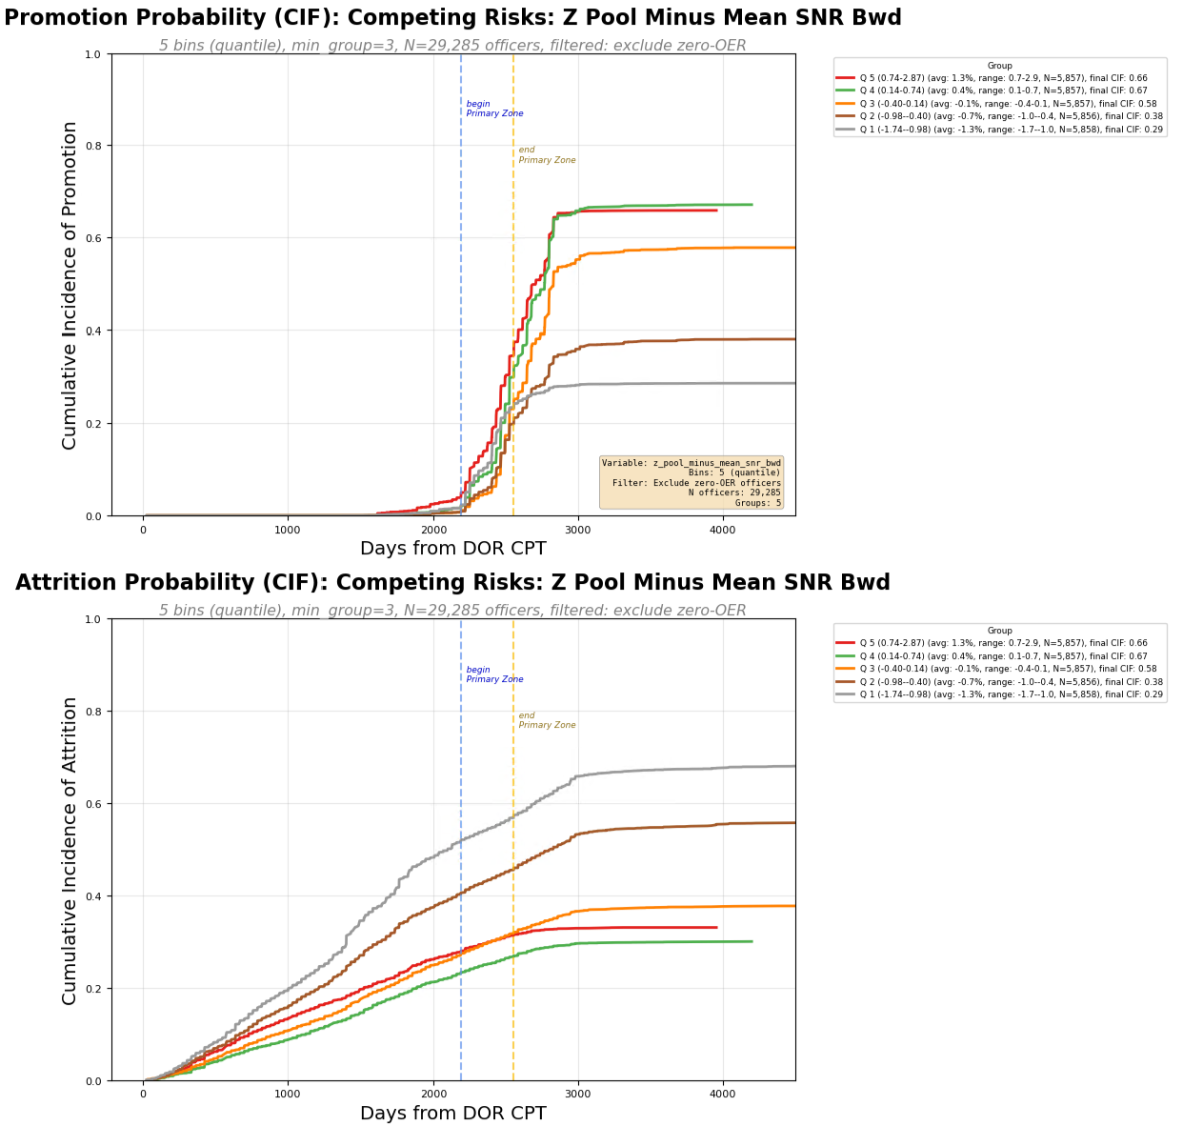
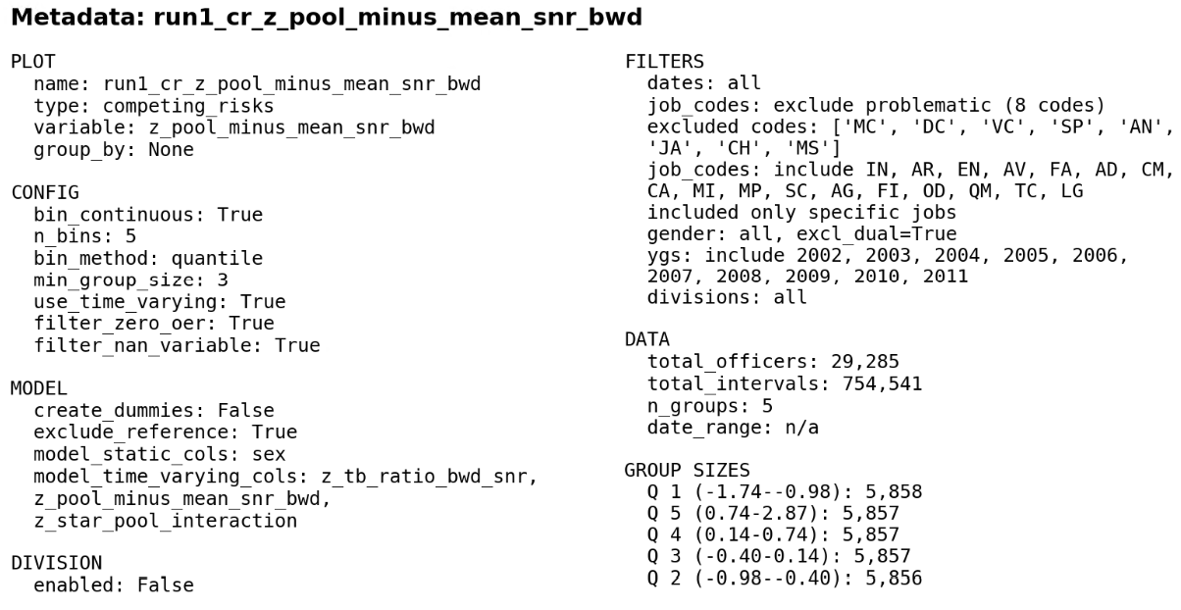
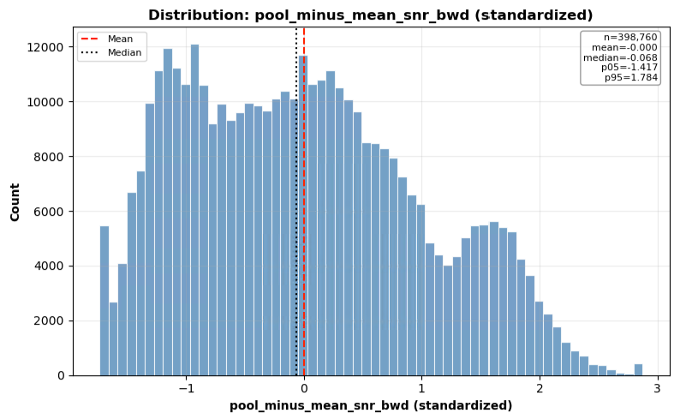

Slide 6
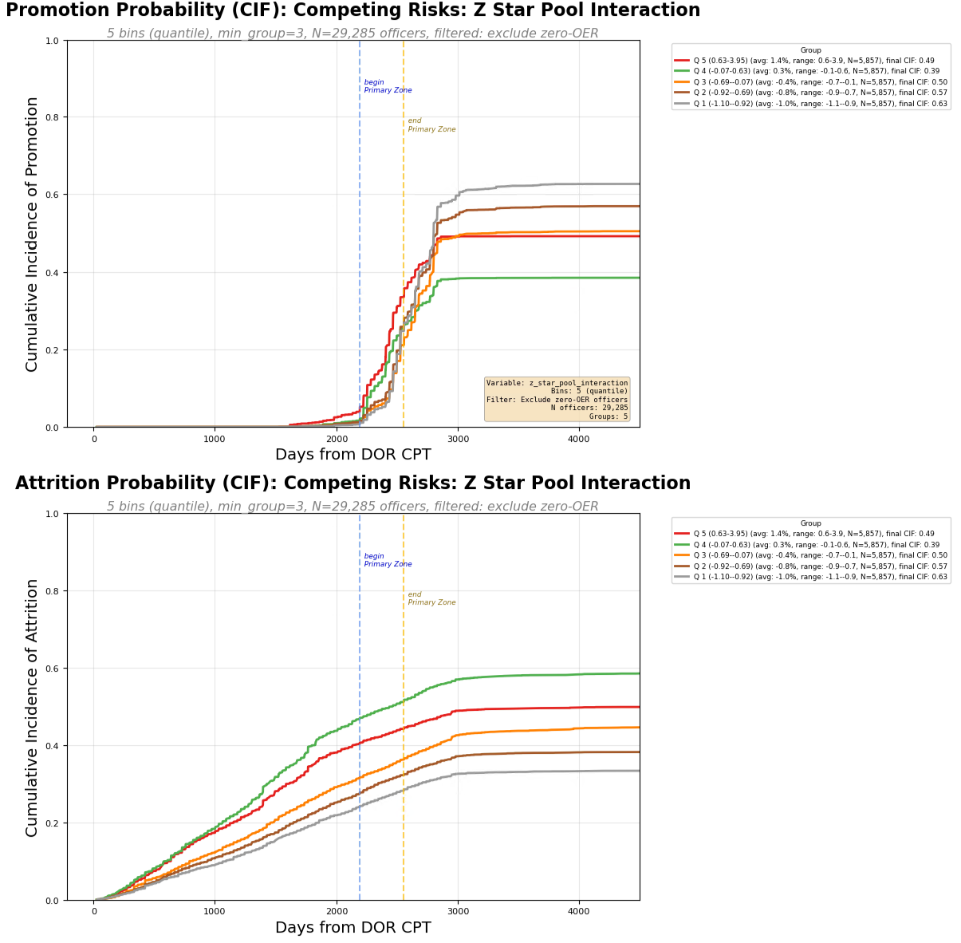
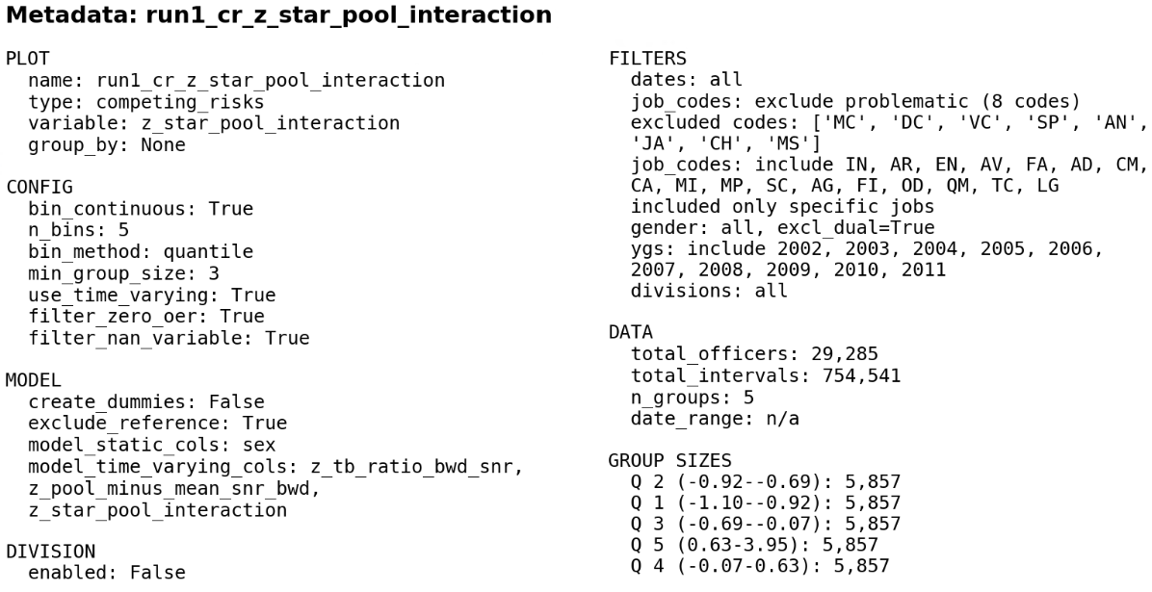

Slide 7
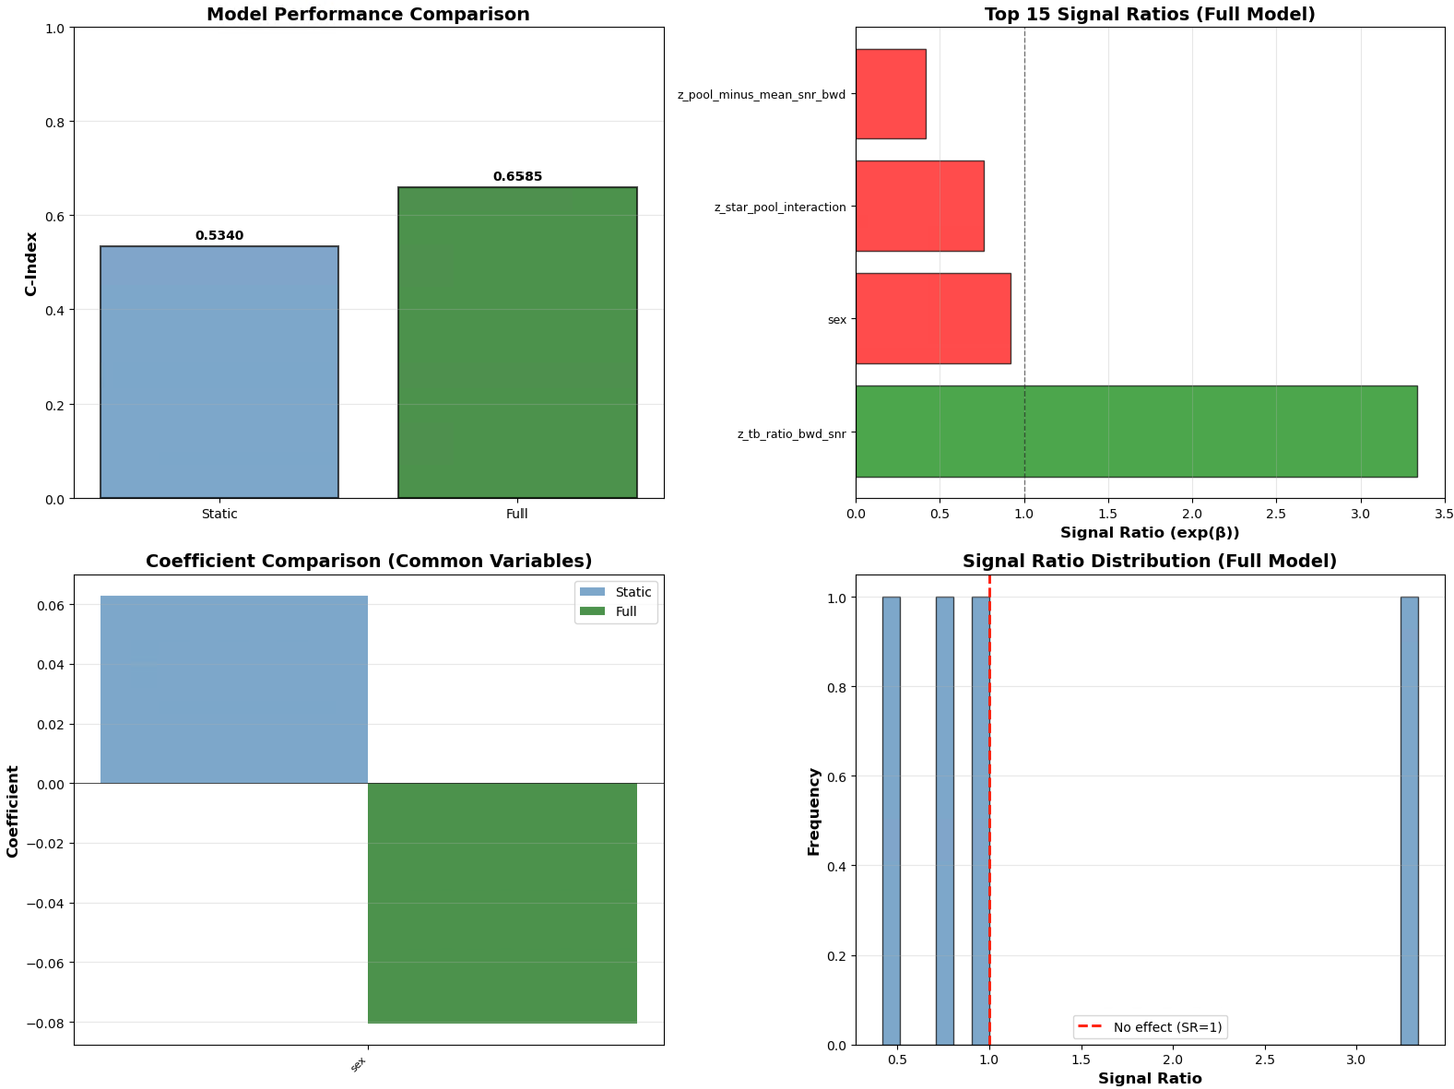

Slide 8
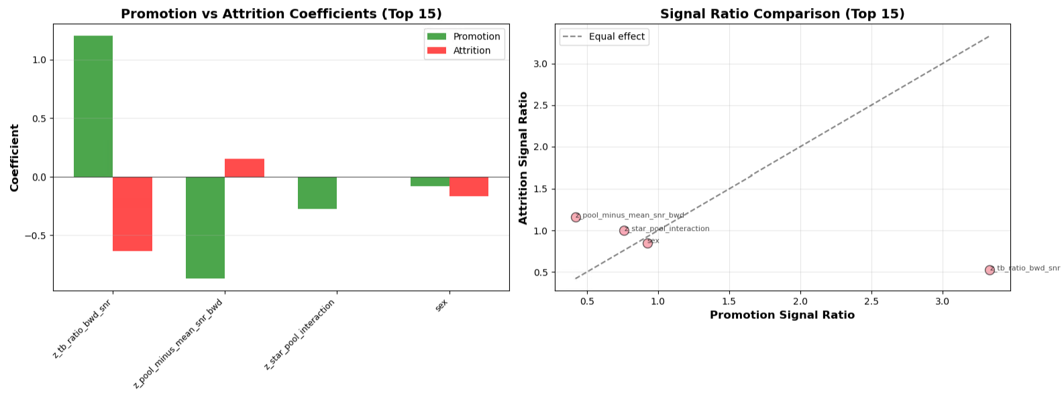

Slide 9
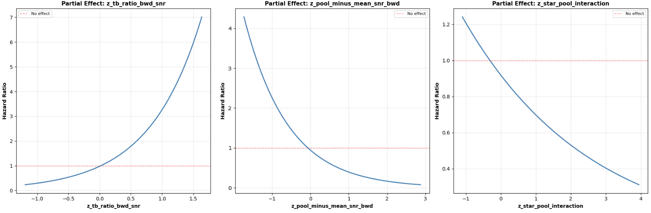

Slide 10
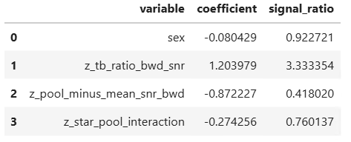


Slide 11
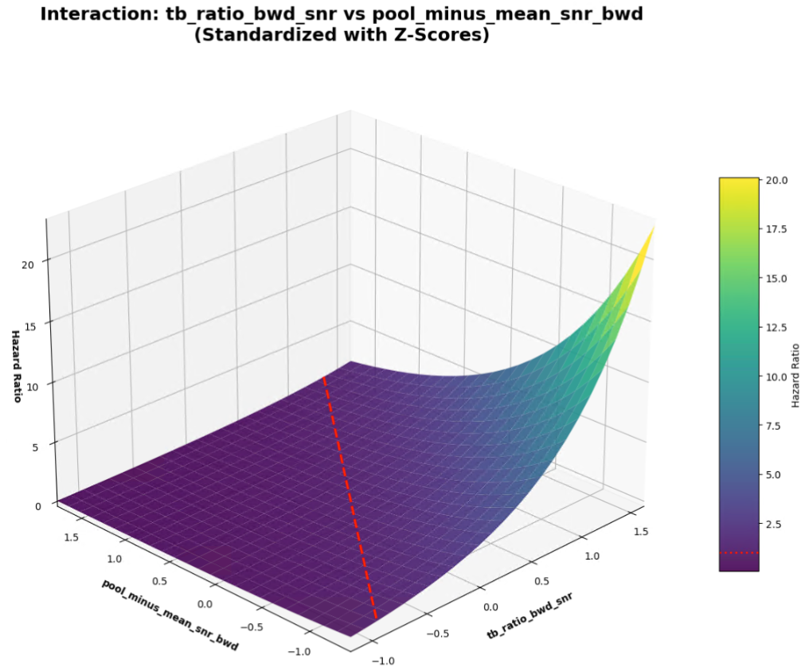

Slide 12
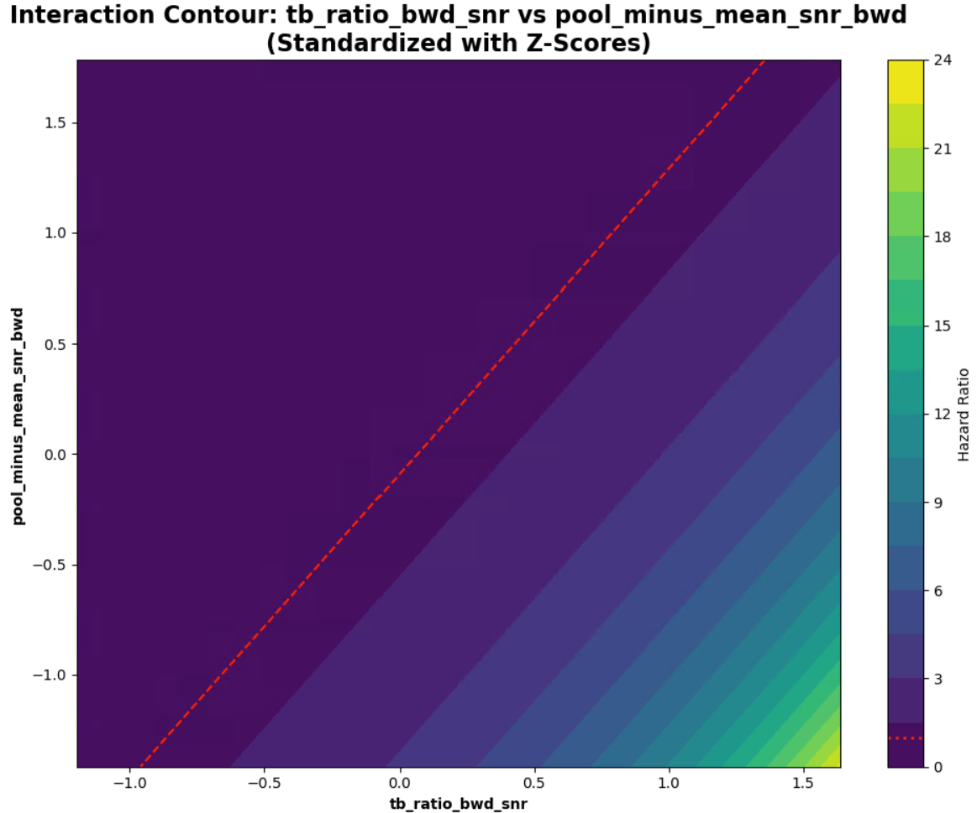

Slide 13
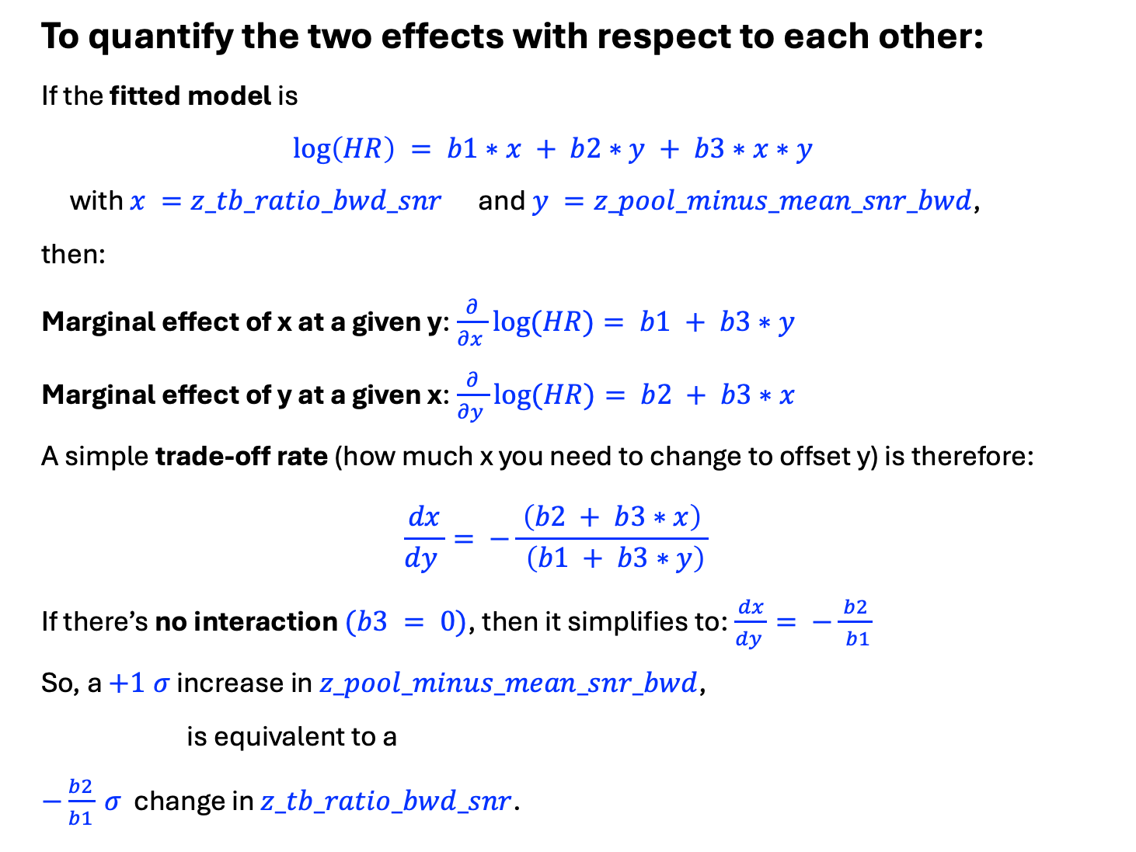
To quantify the two effects with respect to each other:
If the fitted model is
$$\log\left(HR\right) = b1∗x + b2∗y + b3∗x∗y$$
with $x =z_tb_ratio_bwd_snr$ and $y =z_pool_minus_mean_snr_bwd$,
then:
Marginal effect of x at a given y:$\frac{∂}{∂x }log⁡(HR)= b1 + b3∗y$
Marginal effect of y at a given x:$\frac{∂}{∂y }log⁡(HR)= b2 + b3∗x$
A simple trade‑off rate (how much x you need to change to offset y) is therefore:
$$\frac{dx}{dy }= −\frac{ \left(b2 + b3∗x\right) }{ \left(b1 + b3∗y\right)}$$
If there’s no interaction $(b3 = 0)$, then it simplifies to:$\frac{dx}{dy }= −\frac{ b2 }{ b1}$
So, a $+1 σ$ increase in $z_pool_minus_mean_snr_bwd$,
is equivalent to a
$−\frac{b2}{b1} σ$ change in $z_tb_ratio_bwd_snr$.

Slide 14
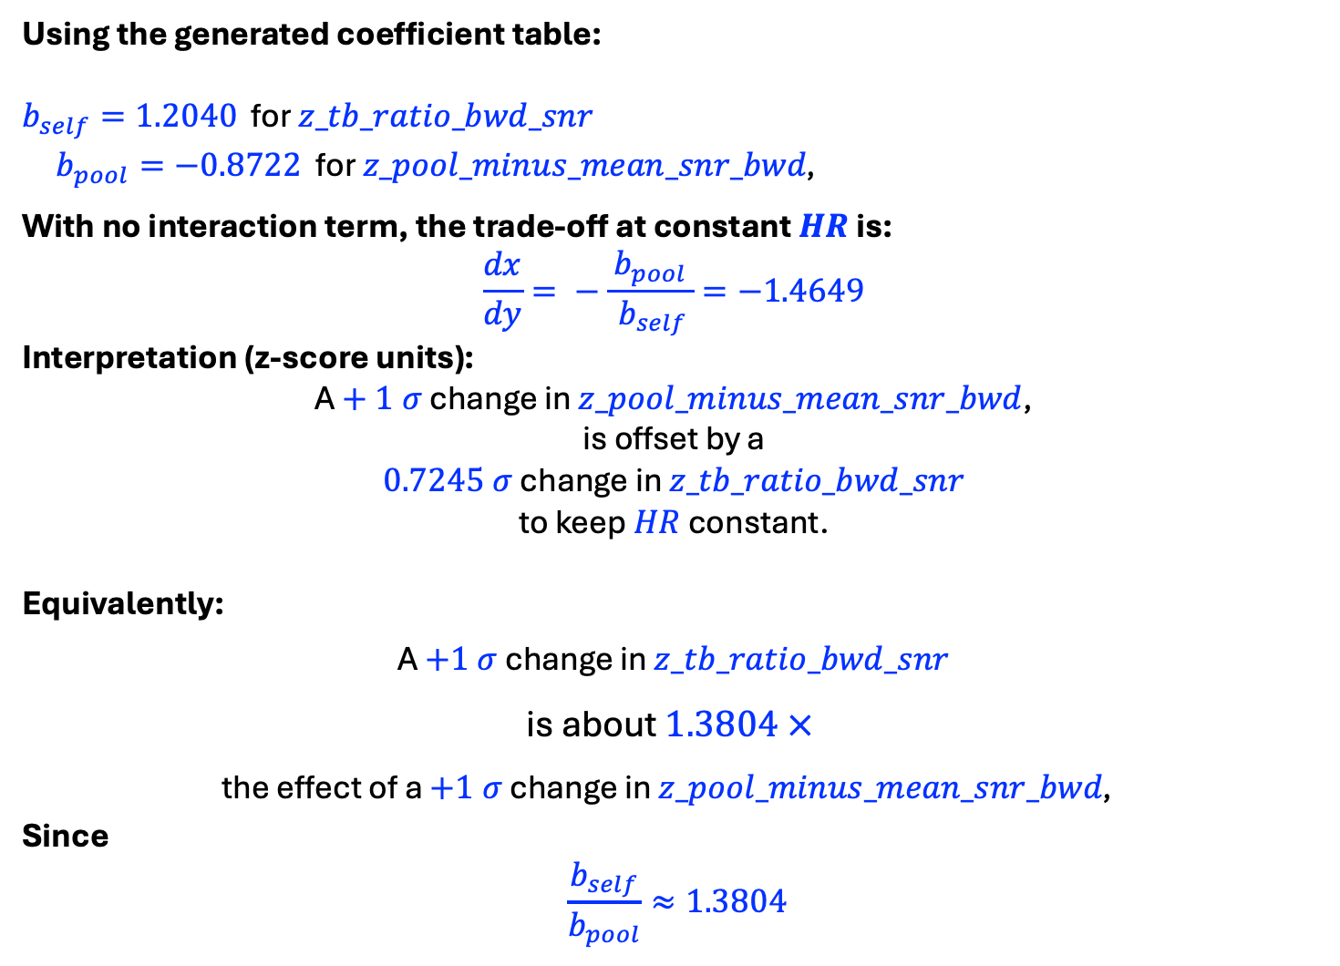
Using the generated coefficient table:
$b_{self}=1.2040$ for $z_tb_ratio_bwd_snr$
$b_{pool}=−0.8722$ for $z_pool_minus_mean_snr_bwd\text{, }$
With no interaction term, the trade‑off at constant $HR$ is:
$$\frac{dx}{dy}= −\frac{ b_{pool }}{ b_{self}}=−1.4649$$
Interpretation (z‑score units):
A $+ 1 σ$ change in $z_pool_minus_mean_snr_bwd$,
is offset by a
$0.7245 σ$ change in $z_tb_ratio_bwd_snr$
to keep $HR$ constant.
Equivalently:
A $+1 σ$ change in $z_tb_ratio_bwd_snr$
is about $1.3804 ×$
the effect of a $+1 σ$ change in $z_pool_minus_mean_snr_bwd\text{, }$
Since
$$\frac{b_{self}}{b_{pool}}≈1.3804$$

Slide 15
RUN 2
Senior Rater Pool Mean
vs
Senior Rater Pool Rank
z_pool_minus_mean_snr_bwd
z_pool_tb_ratio_rank_pct_snr_bwd
z_rank_pool_interaction

Slide 16
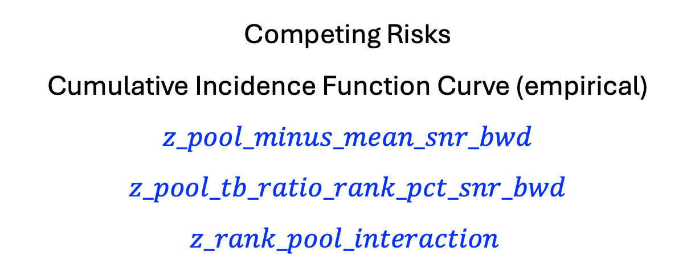
Competing Risks
Cumulative Incidence Function Curve (empirical)
$$z_pool_minus_mean_snr_bwd$$
$$z_pool_tb_ratio_rank_pct_snr_bwd$$
$$z_rank_pool_interaction$$

Slide 17

Senior Rater Pool

Slide 18
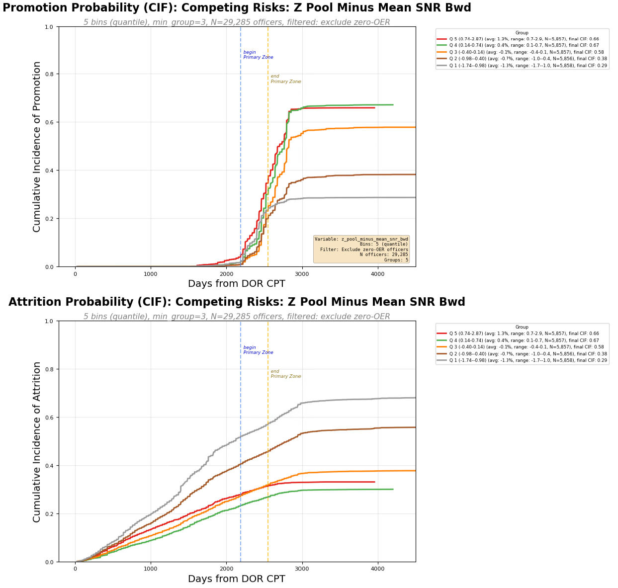
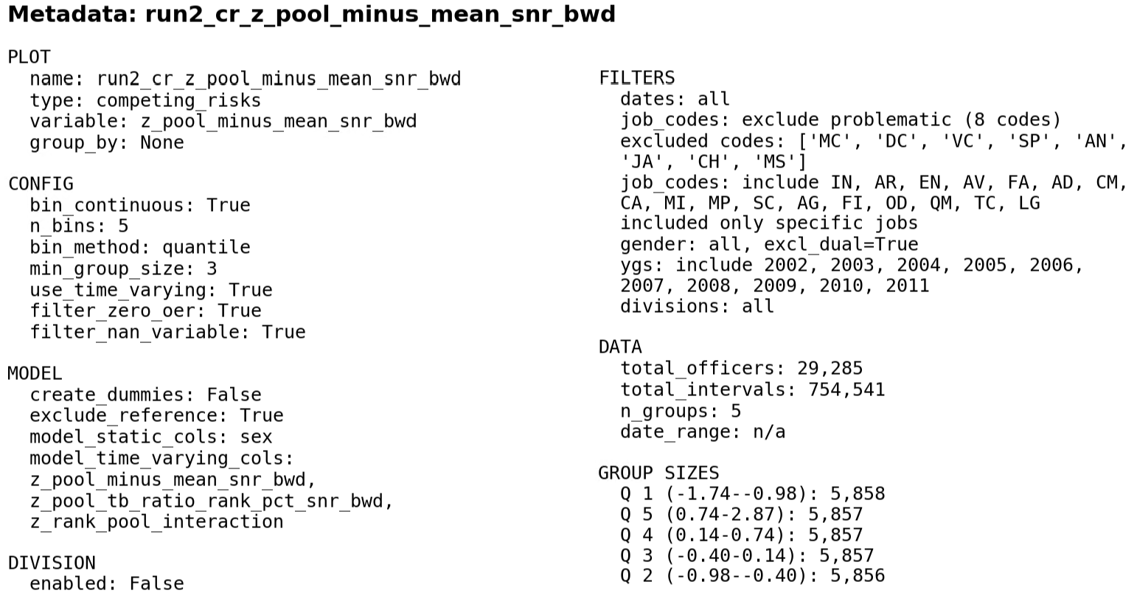
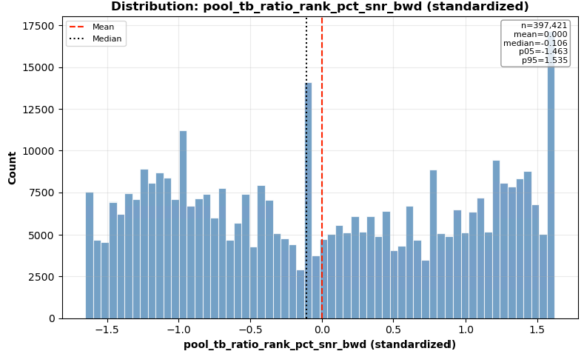

Slide 19
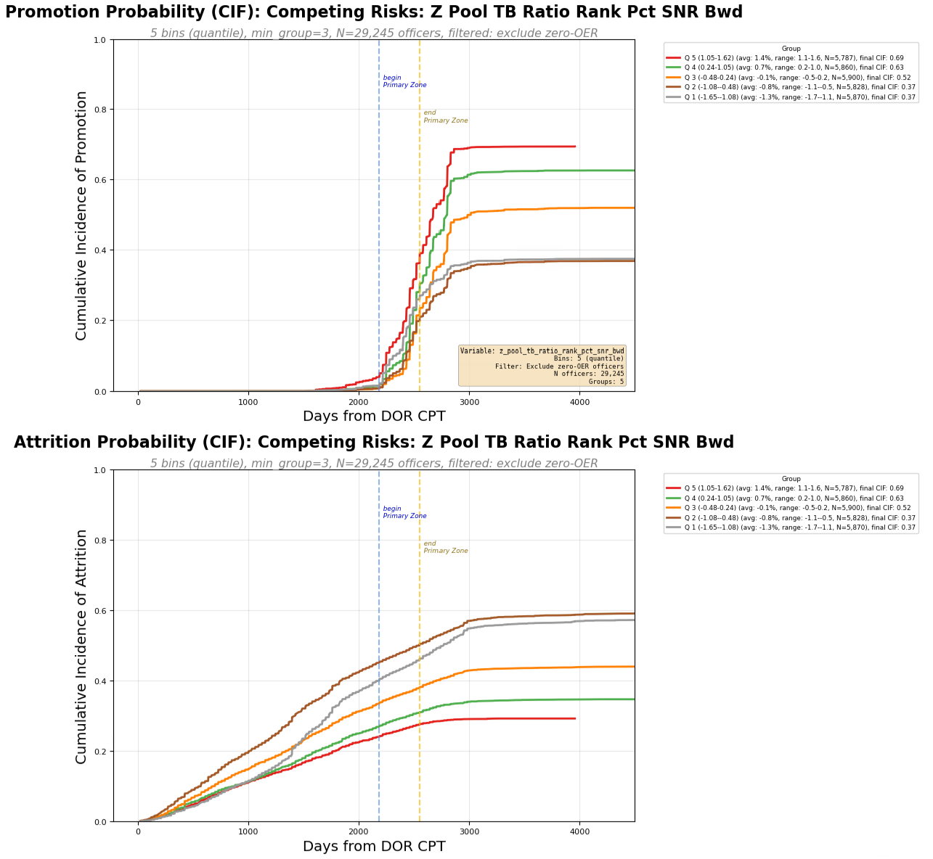
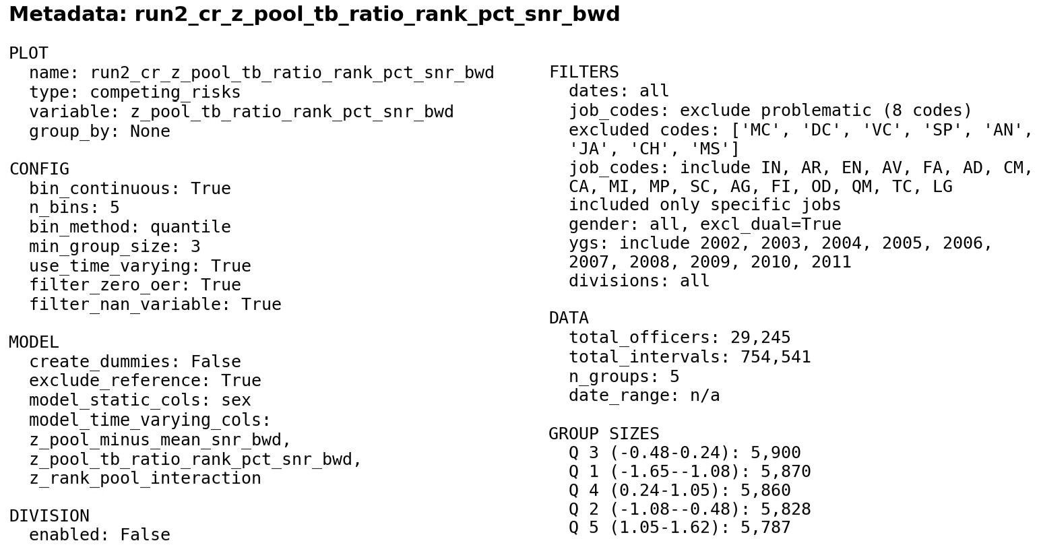
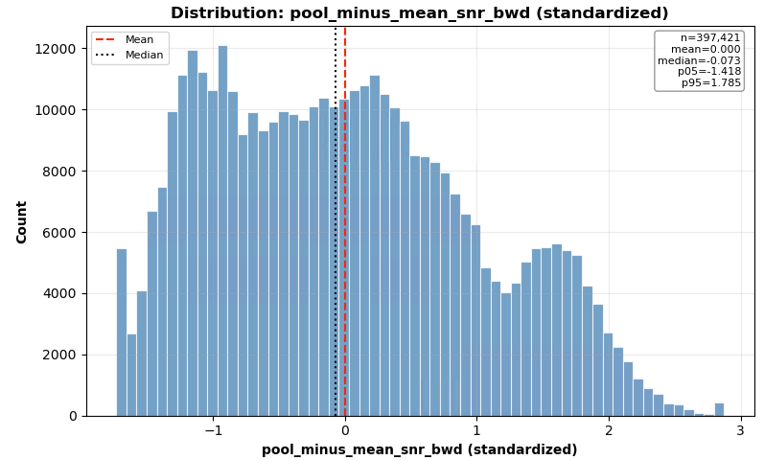

Slide 20

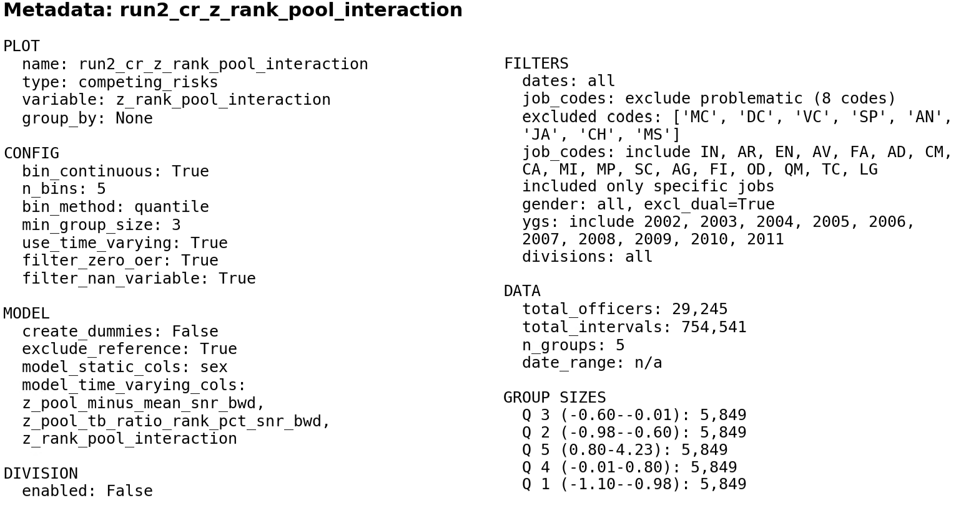

Slide 21
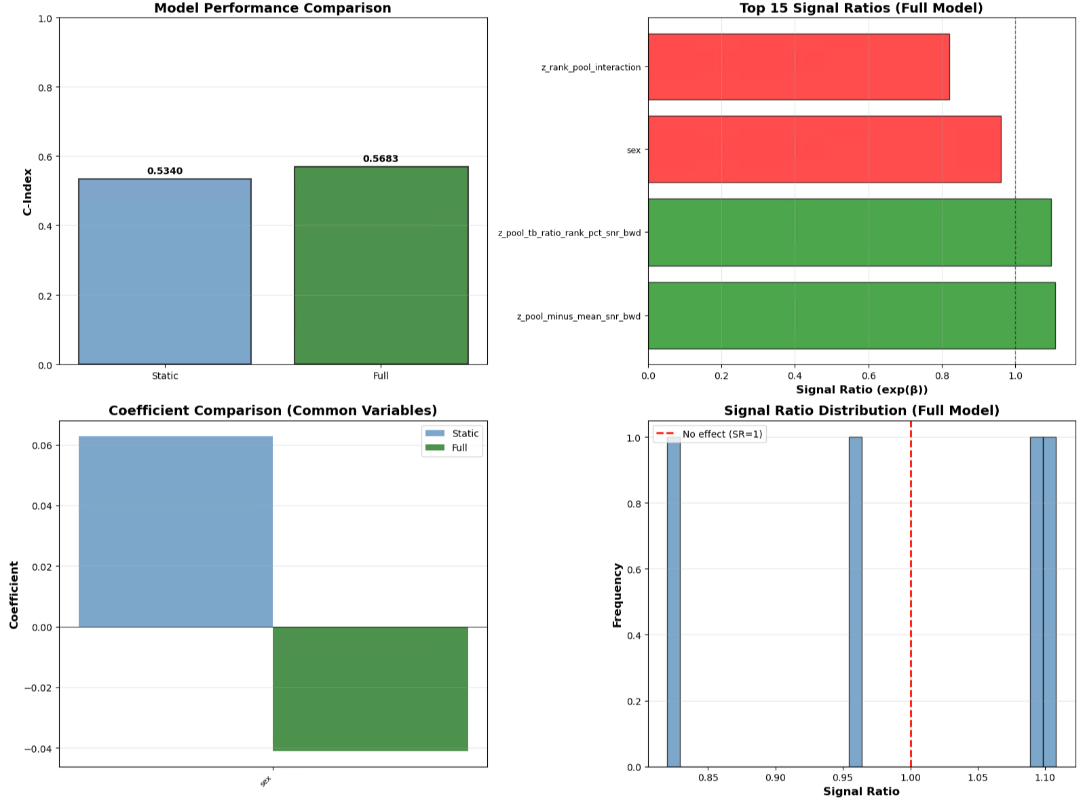

Slide 22
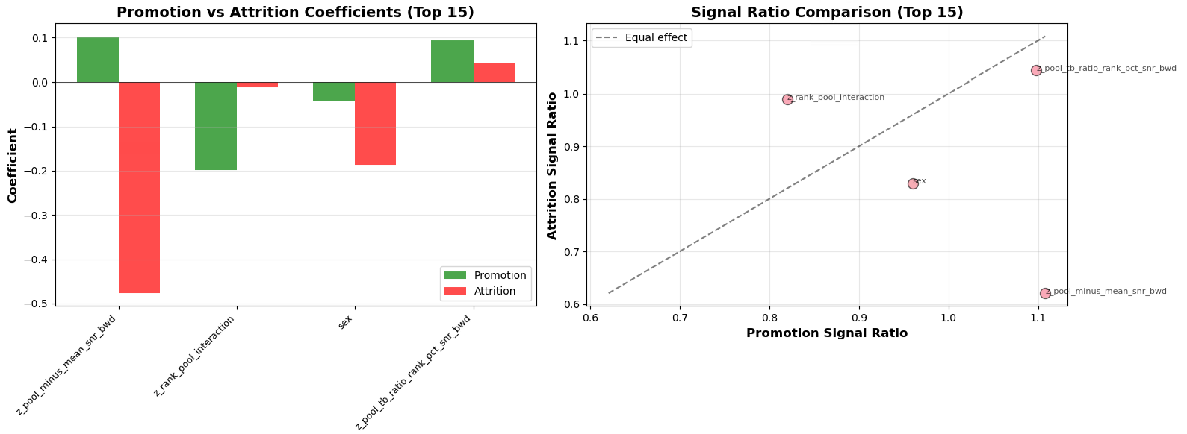

Slide 23
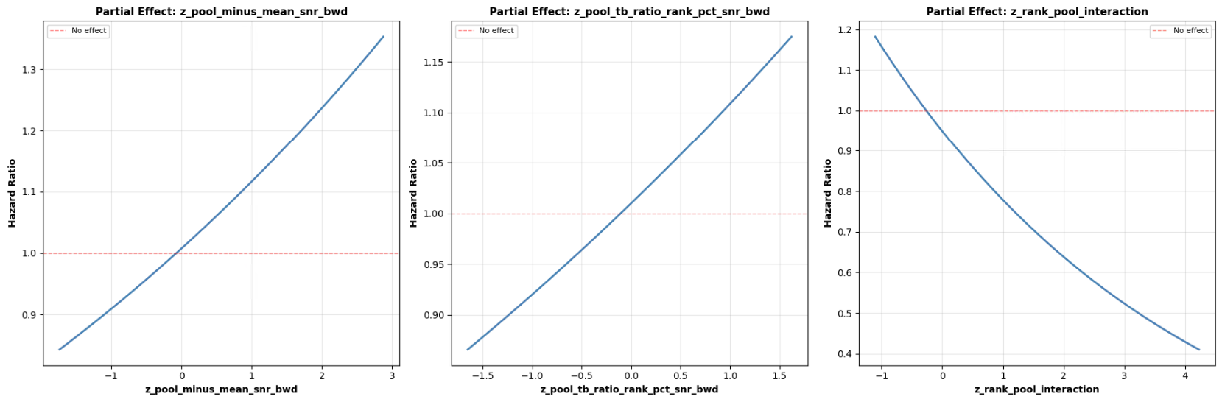

Slide 24
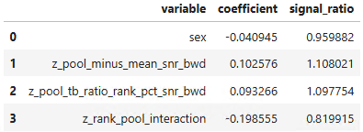


Slide 25
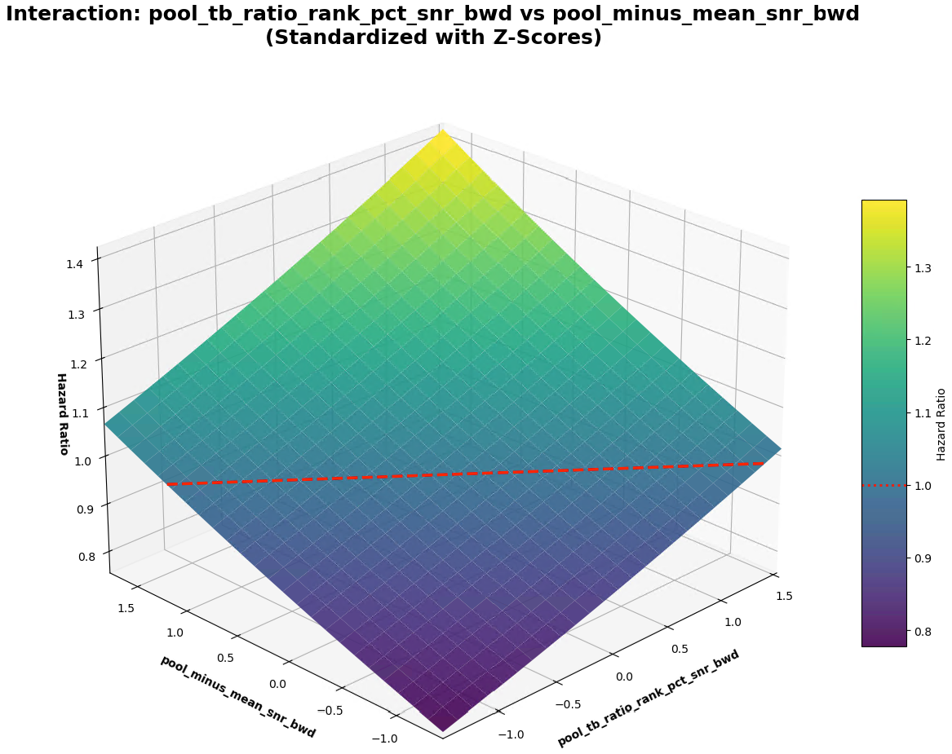

Slide 26
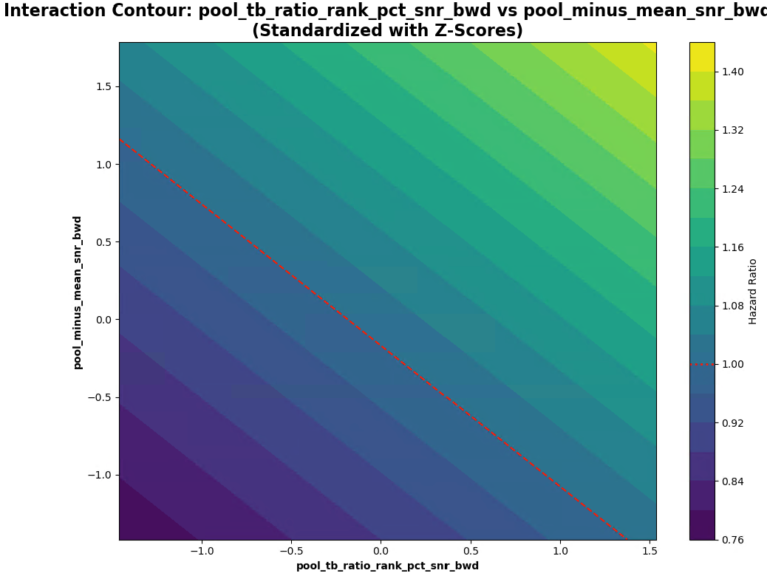

Slide 27
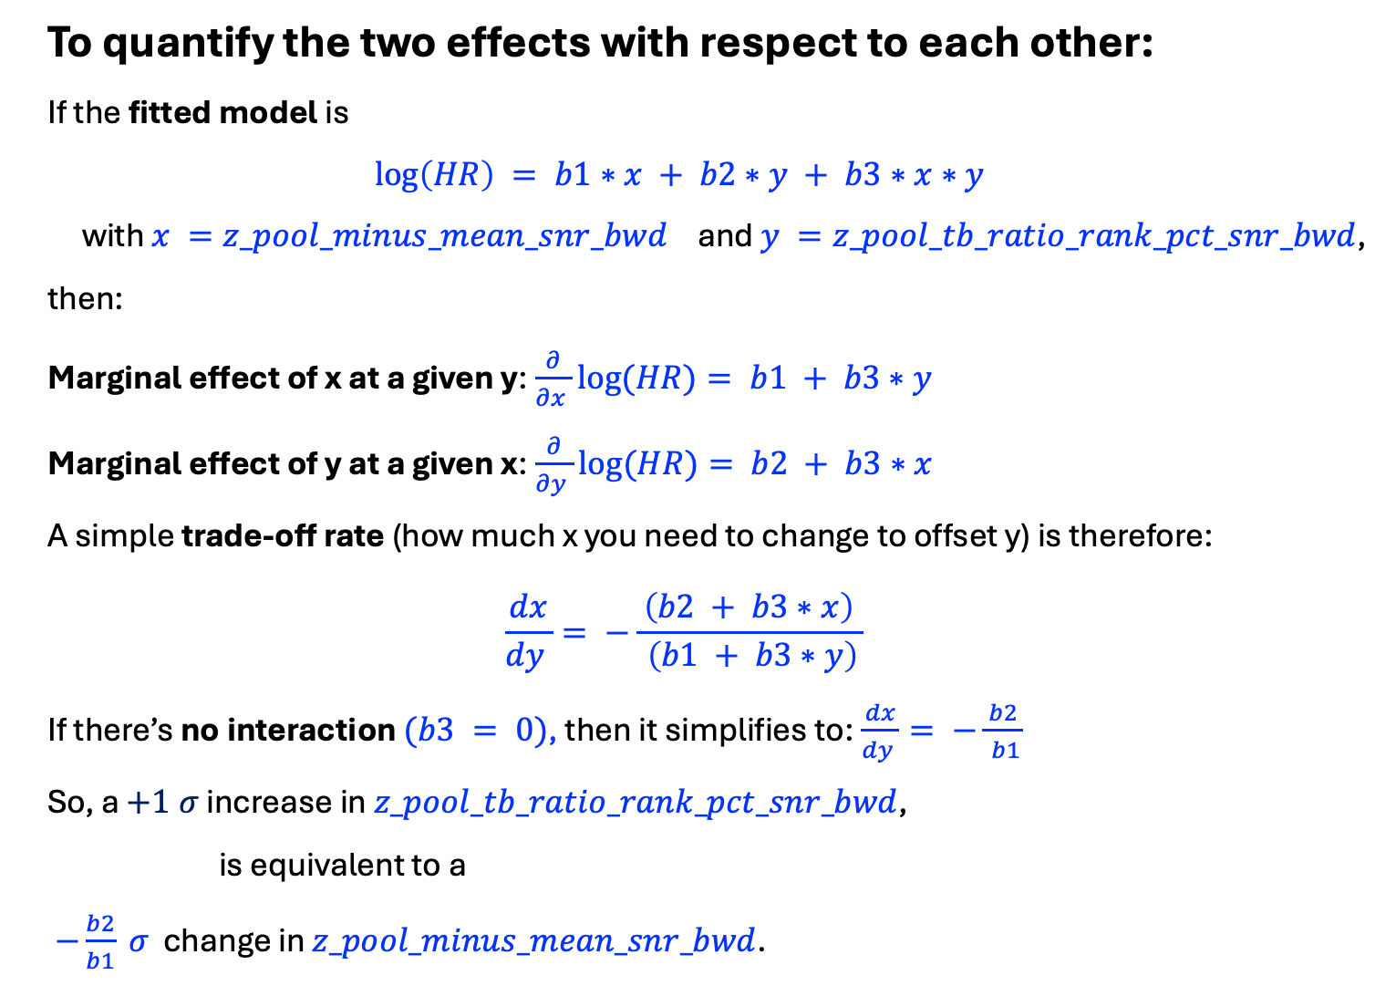
To quantify the two effects with respect to each other:
If the fitted model is
$$\log\left(HR\right) = b1∗x + b2∗y + b3∗x∗y$$
with $x =z_pool_minus_mean_snr_bwd$ and $y =z_pool_tb_ratio_rank_pct_snr_bwd$,
then:
Marginal effect of x at a given y:$\frac{∂}{∂x }log⁡(HR)= b1 + b3∗y$
Marginal effect of y at a given x:$\frac{∂}{∂y }log⁡(HR)= b2 + b3∗x$
A simple trade‑off rate (how much x you need to change to offset y) is therefore:
$$\frac{dx}{dy }= −\frac{ \left(b2 + b3∗x\right) }{ \left(b1 + b3∗y\right)}$$
If there’s no interaction $(b3 = 0)$, then it simplifies to:$\frac{dx}{dy }= −\frac{ b2 }{ b1}$
So, a $+1 σ$ increase in $z_pool_tb_ratio_rank_pct_snr_bwd$,
is equivalent to a
$−\frac{b2}{b1} σ$ change in $z_pool_minus_mean_snr_bwd$.

Slide 28
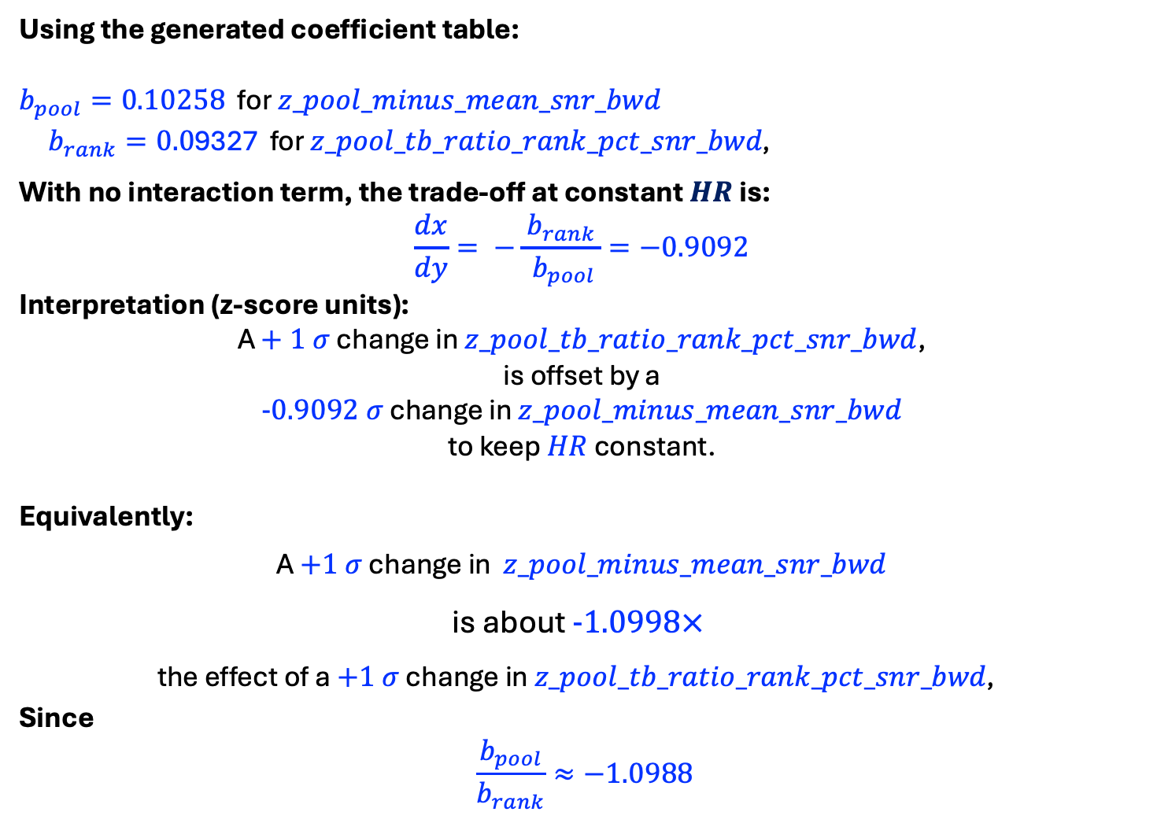
Using the generated coefficient table:
$b_{pool}=0.10258$ for $z_pool_minus_mean_snr_bwd$
$b_{rank}=0.0$9327 for $z_pool_tb_ratio_rank_pct_snr_bwd\text{, }$
With no interaction term, the trade‑off at constant $HR$ is:
$$\frac{dx}{dy}= −\frac{ b_{rank }}{ b_{pool}}=−0.9092$$
Interpretation (z‑score units):
A $+ 1 σ$ change in $z_pool_tb_ratio_rank_pct_snr_bwd$,
is offset by a
$-0.9092 σ$ change in $z_pool_minus_mean_snr_bwd$
to keep $HR$ constant.
Equivalently:
A $+1 σ$ change in $z_pool_minus_mean_snr_bwd$
is about $-1.0998×$
the effect of a $+1 σ$ change in $z_pool_tb_ratio_rank_pct_snr_bwd\text{, }$
Since
$$\frac{b_{pool}}{b_{rank}}≈−1.0988$$

Slide 29
RUN 3
Individual TB Ratio
vs
Senior Rater Pool Rank
z_tb_ratio_bwd_snr
z_pool_tb_ratio_rank_pct_snr_bwd
z_standing_pool_interaction

Slide 30
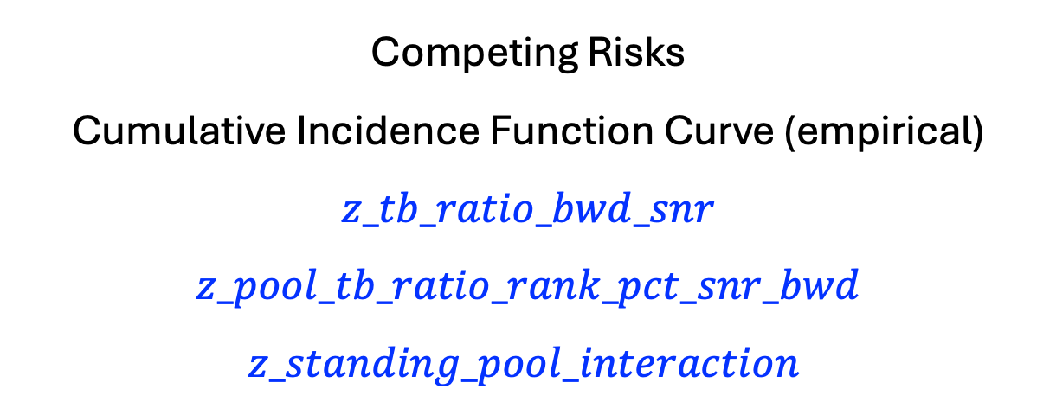
Competing Risks
Cumulative Incidence Function Curve (empirical)
$$z_tb_ratio_bwd_snr$$
$$z_pool_tb_ratio_rank_pct_snr_bwd$$
$$z_standing_pool_interaction$$

Slide 31

Senior Rater Pool

Slide 32
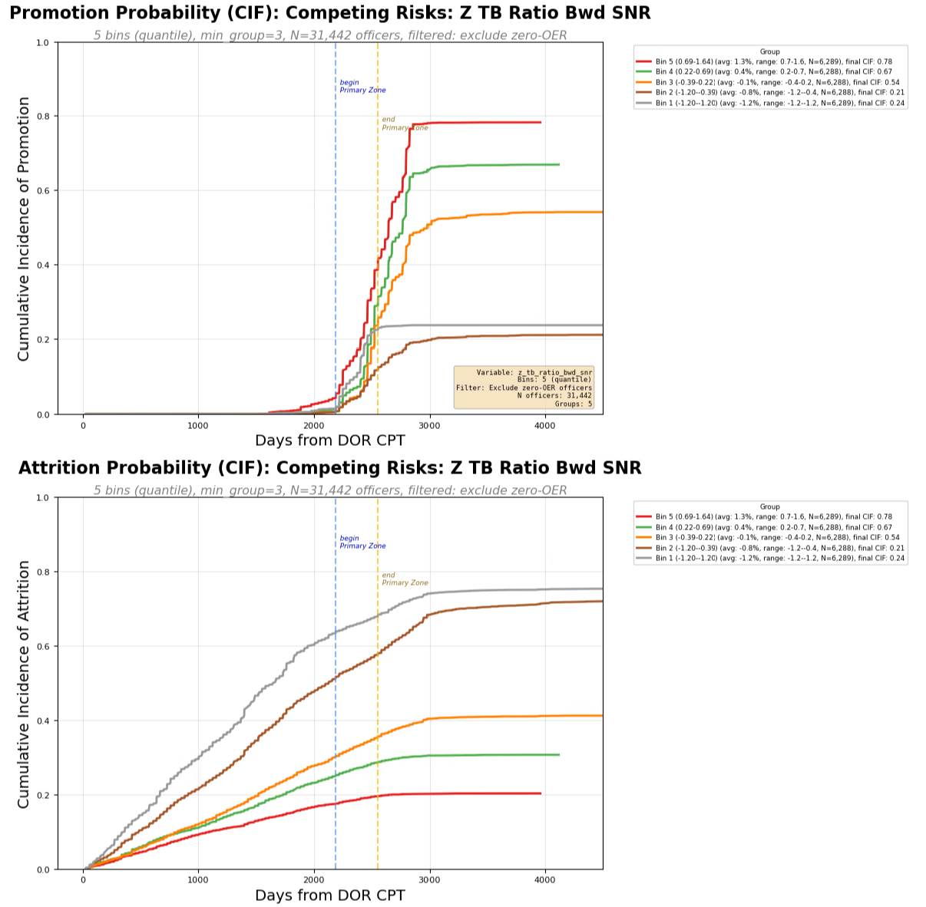
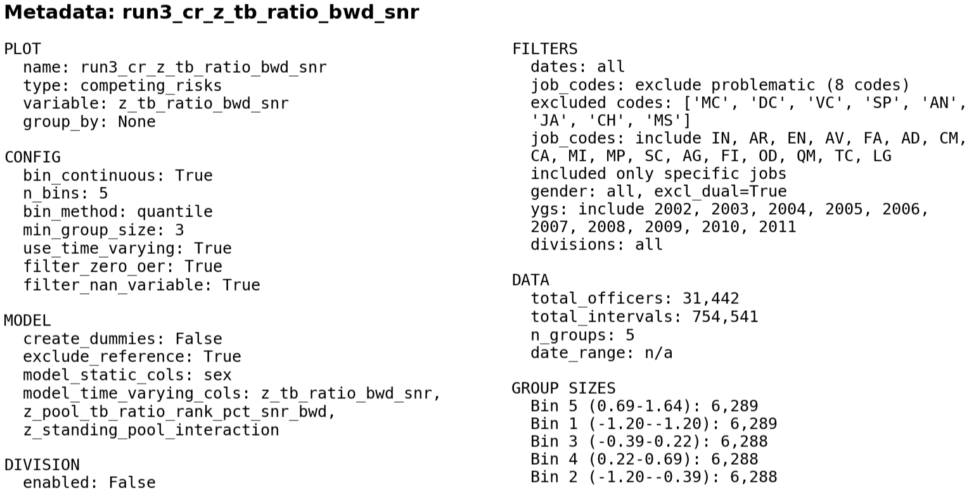
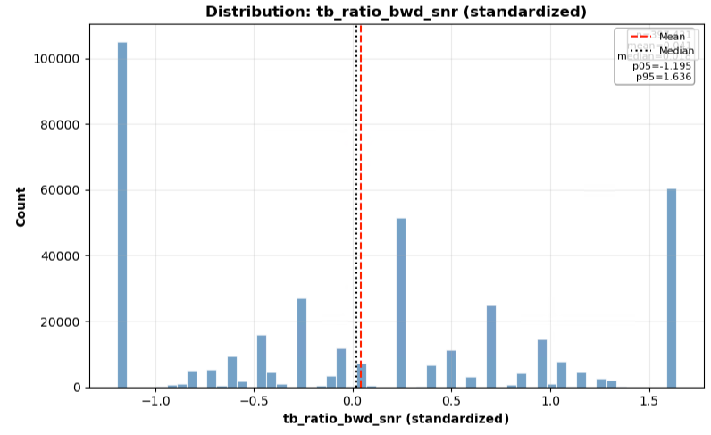

Slide 33

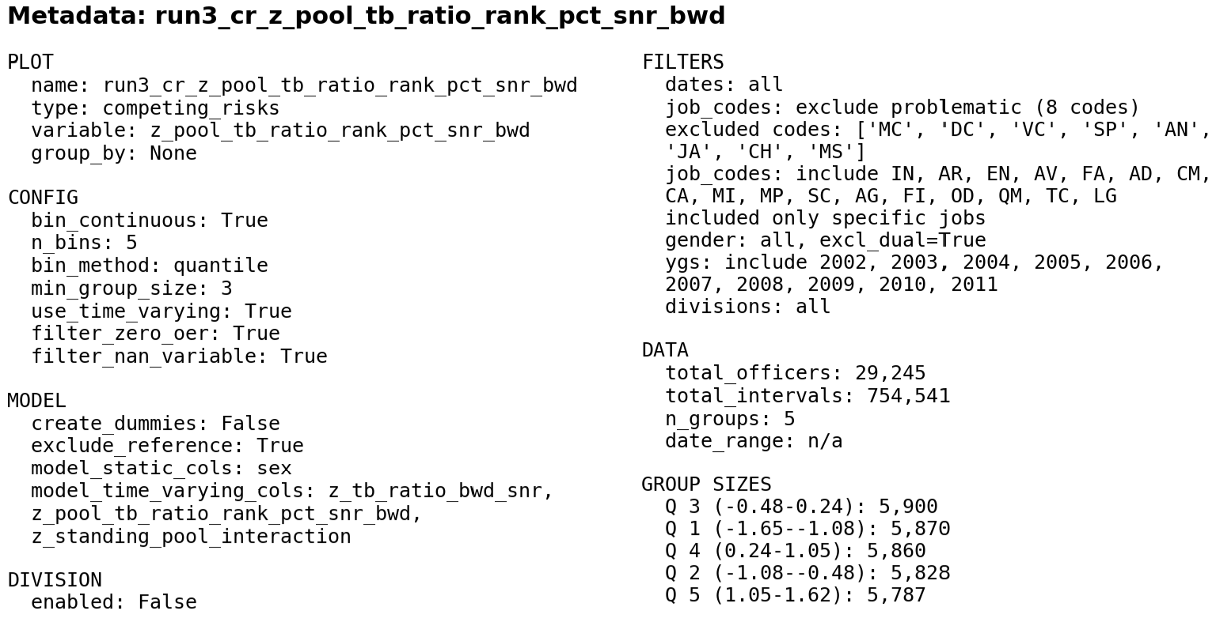
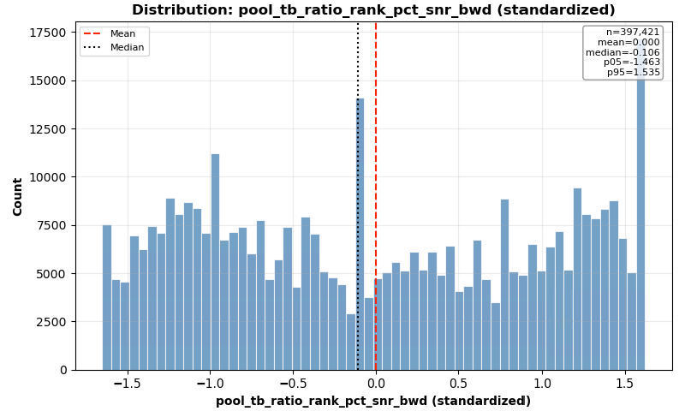

Slide 34
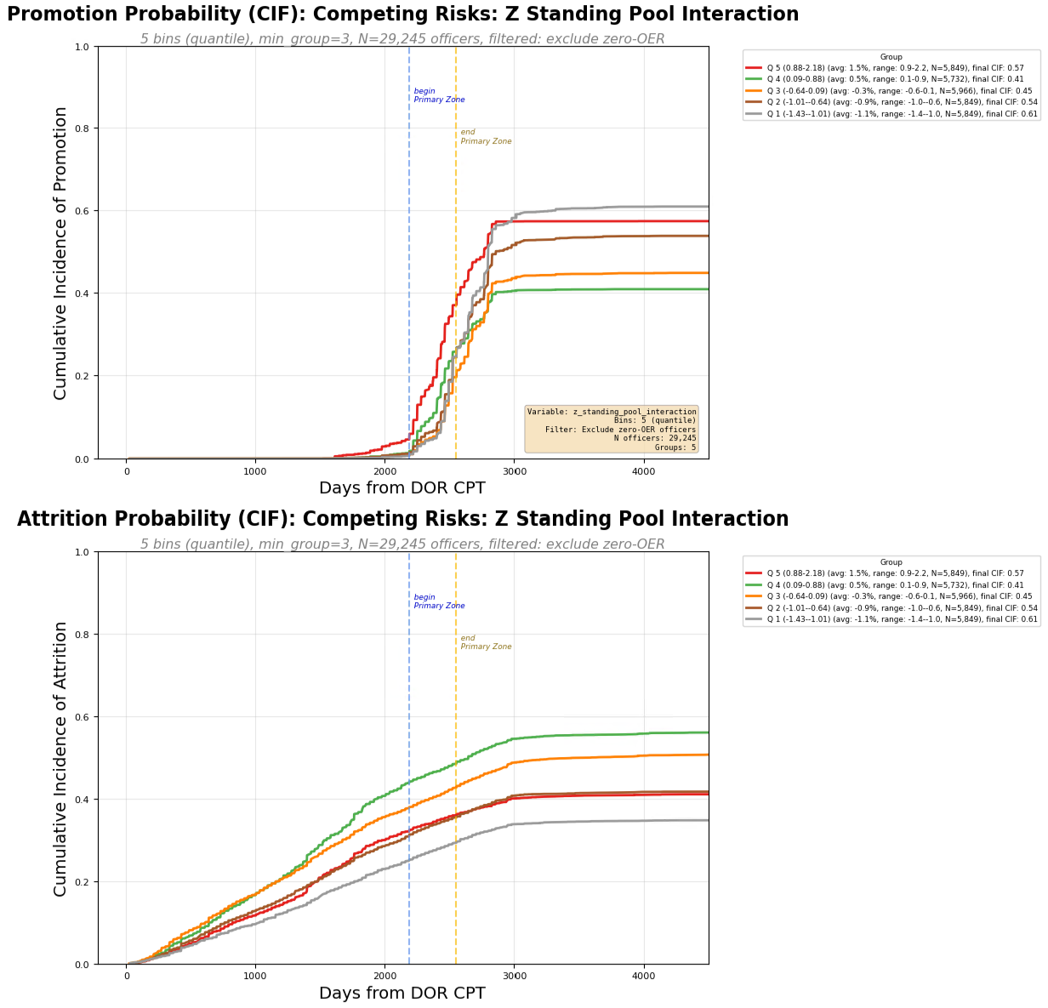
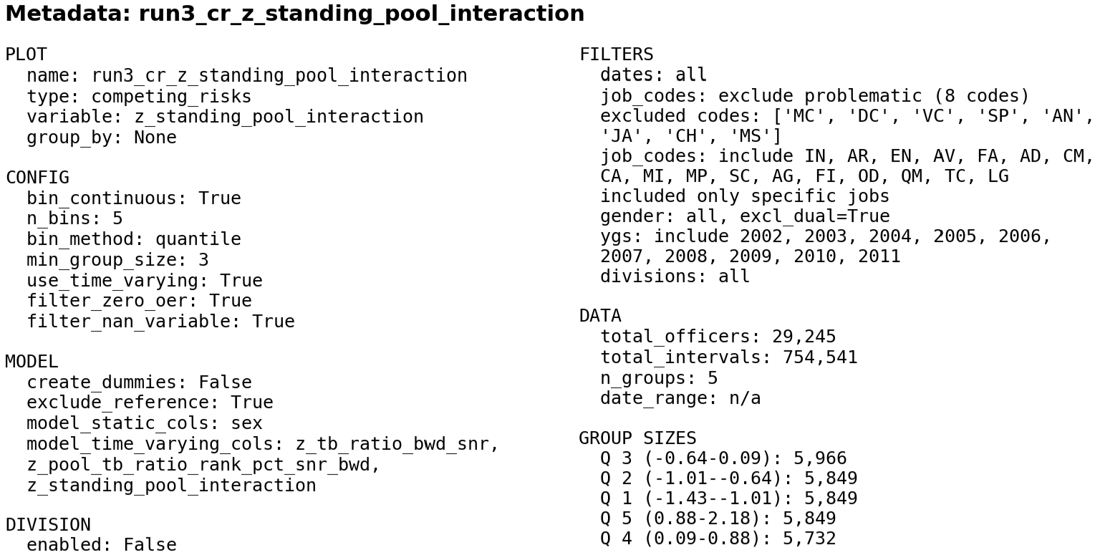

Slide 35
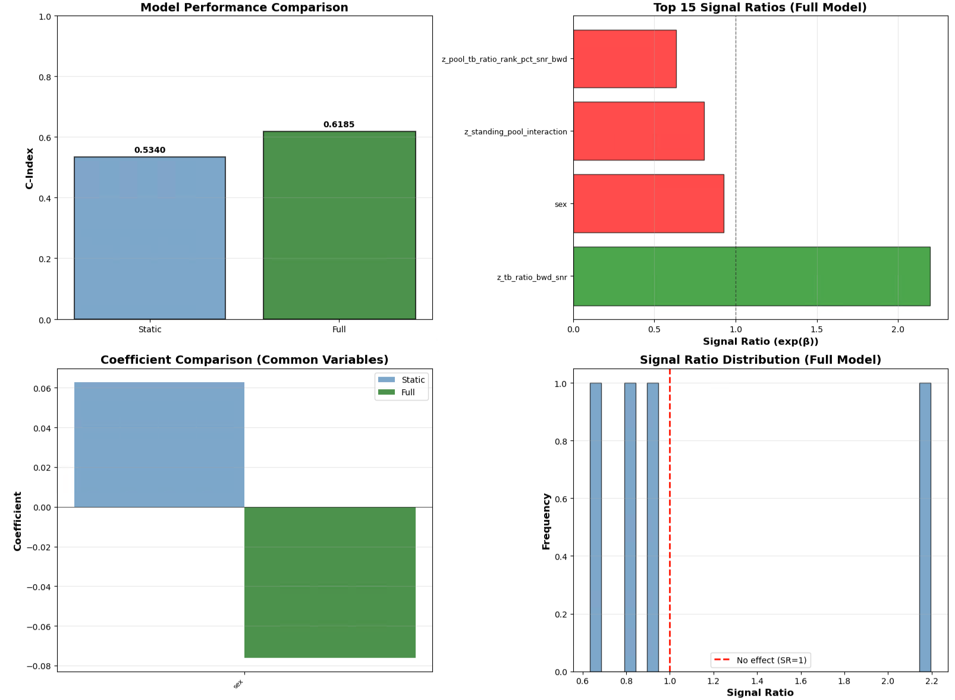

Slide 36
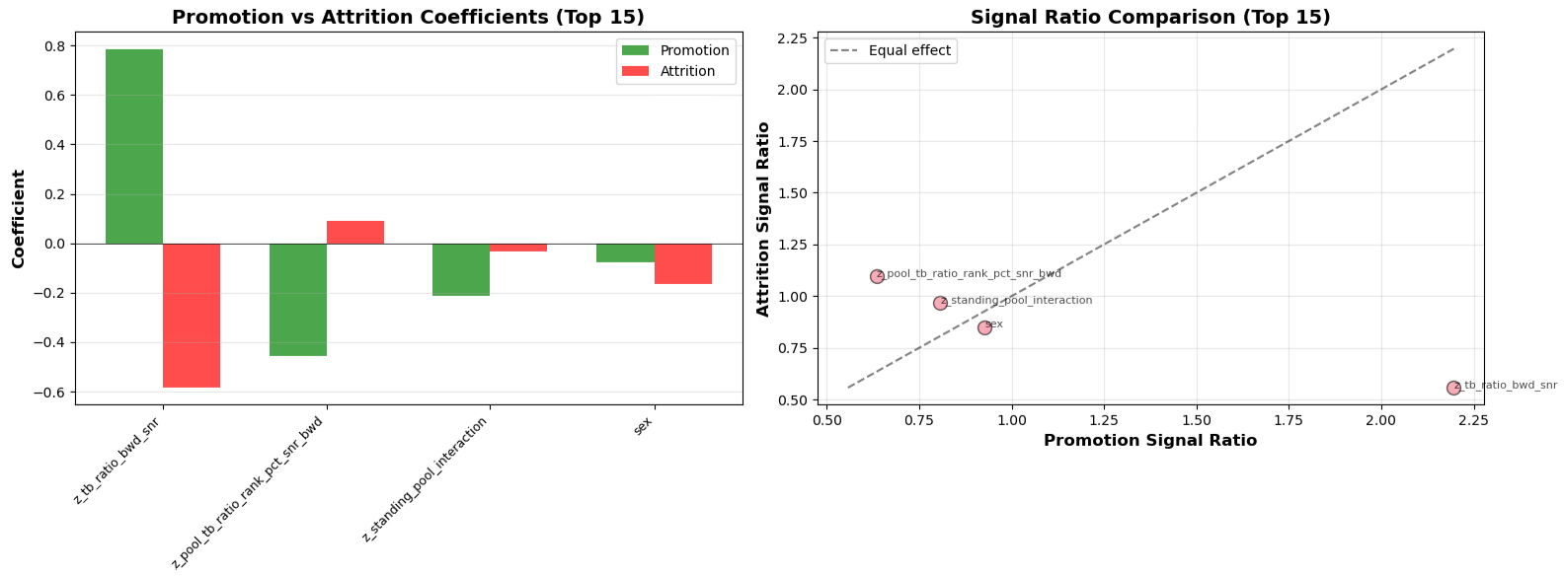

Slide 37
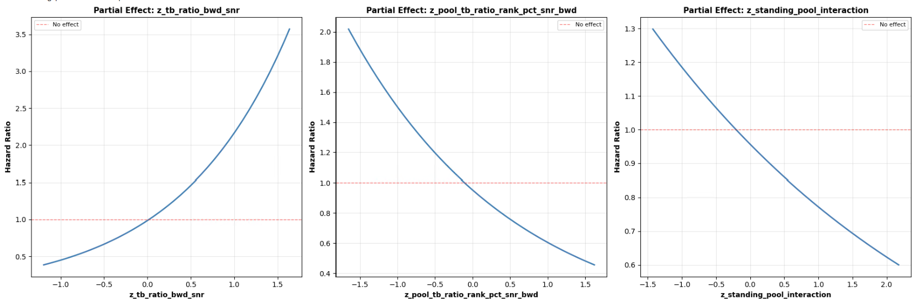

Slide 38
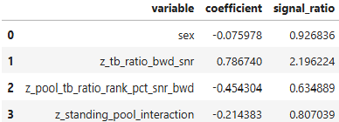


Slide 39
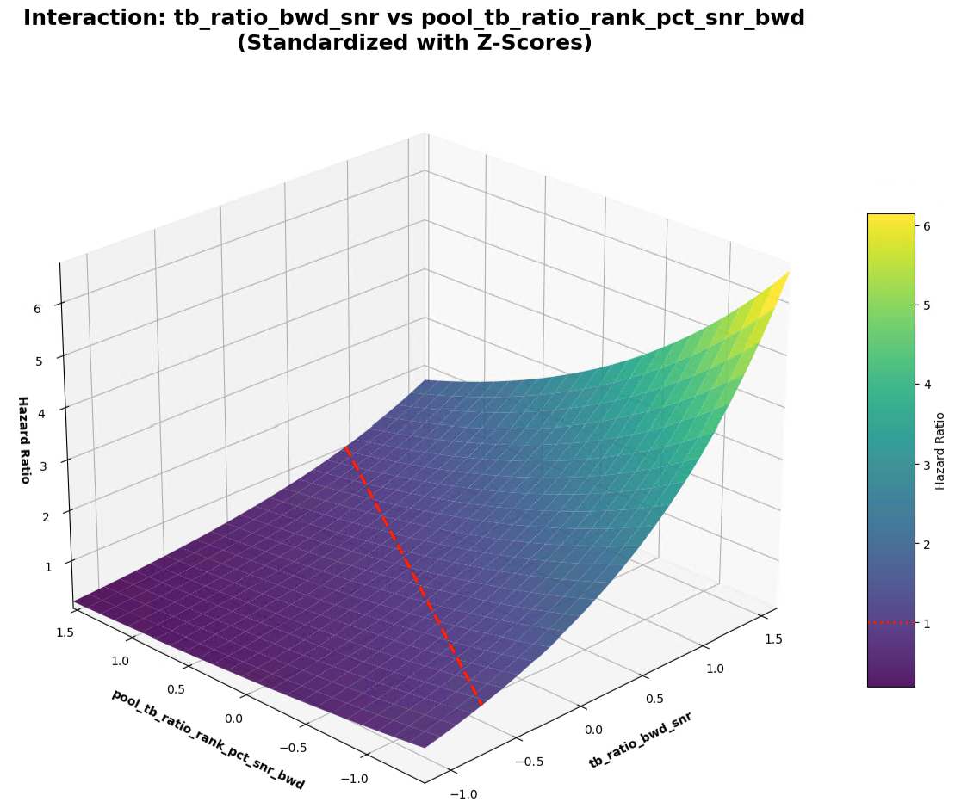

Slide 40
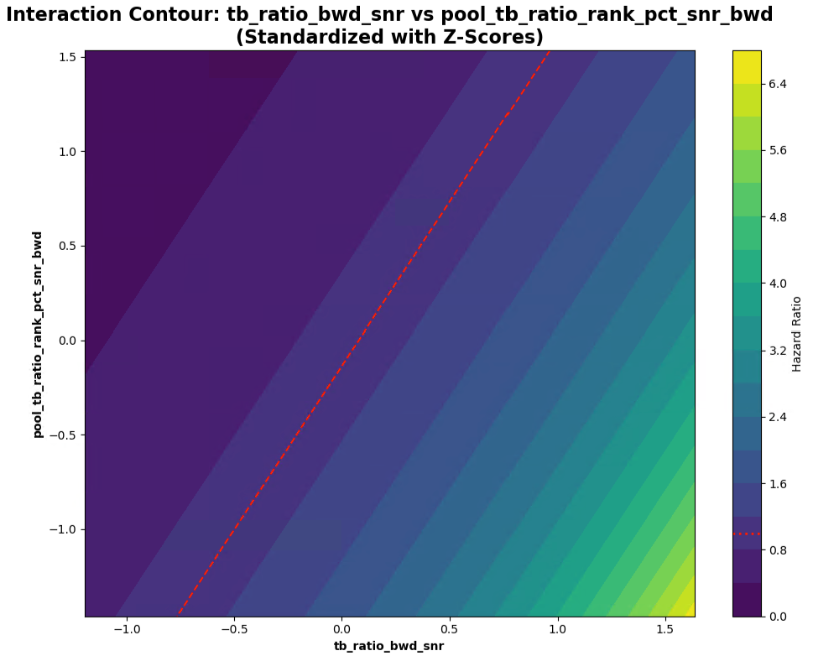

Slide 41
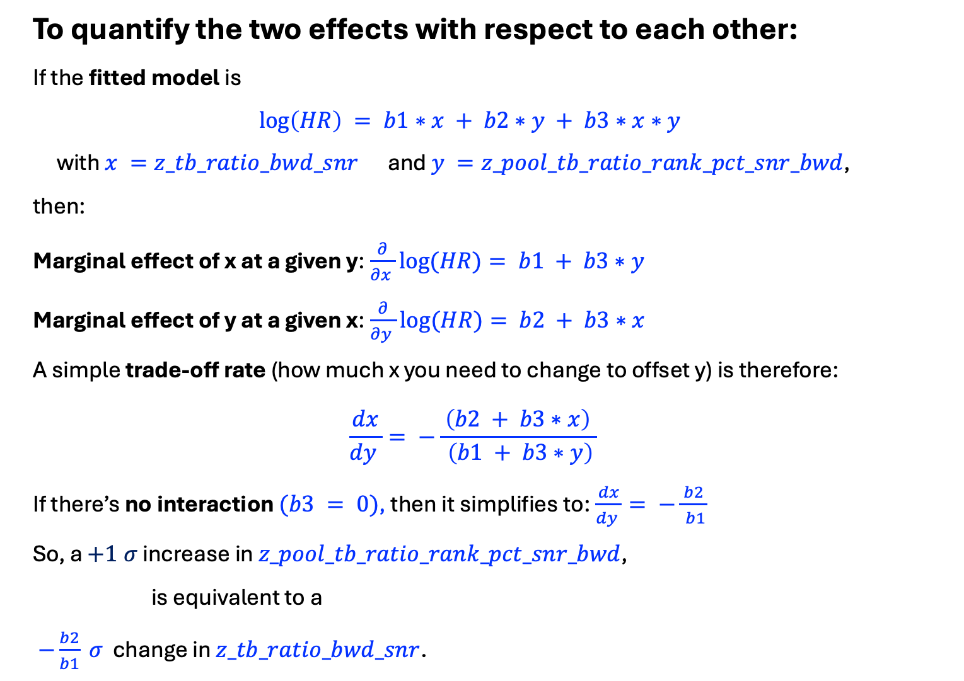
To quantify the two effects with respect to each other:
If the fitted model is
$$\log\left(HR\right) = b1∗x + b2∗y + b3∗x∗y$$
with $x =z_tb_ratio_bwd_snr$ and $y =z_pool_tb_ratio_rank_pct_snr_bwd$,
then:
Marginal effect of x at a given y:$\frac{∂}{∂x }log⁡(HR)= b1 + b3∗y$
Marginal effect of y at a given x:$\frac{∂}{∂y }log⁡(HR)= b2 + b3∗x$
A simple trade‑off rate (how much x you need to change to offset y) is therefore:
$$\frac{dx}{dy }= −\frac{ \left(b2 + b3∗x\right) }{ \left(b1 + b3∗y\right)}$$
If there’s no interaction $(b3 = 0)$, then it simplifies to:$\frac{dx}{dy }= −\frac{ b2 }{ b1}$
So, a $+1 σ$ increase in $z_pool_tb_ratio_rank_pct_snr_bwd$,
is equivalent to a
$−\frac{b2}{b1} σ$ change in $z_tb_ratio_bwd_snr$.

Slide 42
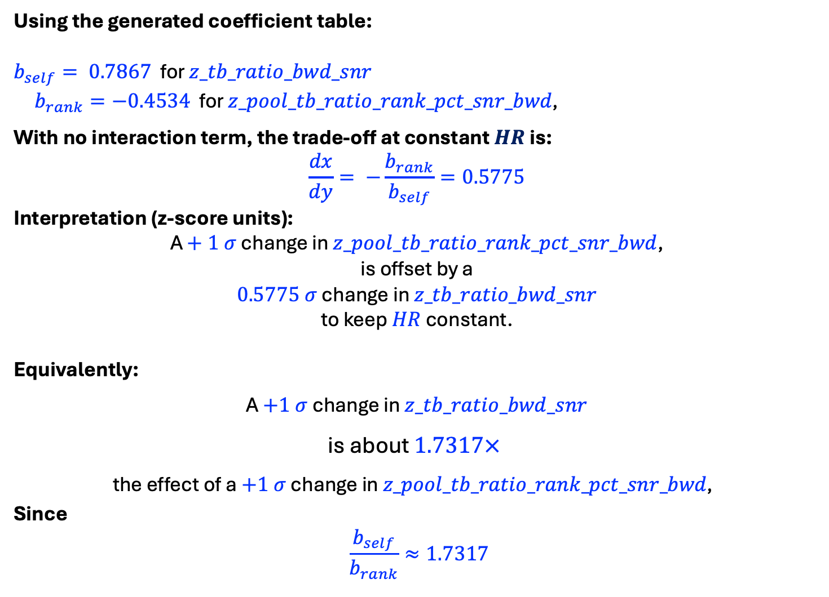
Using the generated coefficient table:
$b_{self}= 0.7867$ for $z_tb_ratio_bwd_snr$
$b_{rank}=−0.4534$ for $z_pool_tb_ratio_rank_pct_snr_bwd\text{, }$
With no interaction term, the trade‑off at constant $HR$ is:
$$\frac{dx}{dy}= −\frac{b_{rank}}{b_{self}}=0.5775$$
Interpretation (z‑score units):
A $+ 1 σ$ change in $z_pool_tb_ratio_rank_pct_snr_bwd$,
is offset by a
$0.5775 σ$ change in $z_tb_ratio_bwd_snr$
to keep $HR$ constant.
Equivalently:
A $+1 σ$ change in $z_tb_ratio_bwd_snr$
is about $1.7317×$
the effect of a $+1 σ$ change in $z_pool_tb_ratio_rank_pct_snr_bwd\text{, }$
Since
$$\frac{b_{self}}{b_{rank}}≈1.7317$$

